Slide 1


Introduction to the New
Electronic Claims Processing of
Long Term Care Services
Revised 9/26/16

Slide 2
History and Objectives
Historically, all Long Term Care (LTC) claims for Medicaid participants who reside in LTC residential supportive living and institutional settings have been generated by the Department using recipient and provider information entered into the Department’s eligibility and LTC databases.
With the implementation of this new billing process, the Department will require providers to electronically submit claims for LTC residential services for payment consideration. This will result in claims needing fewer adjustments and will meet the uniform billing standards set forth in the Health Insurance Portability and Accountability Act (HIPAA).
Our goal in this introductory presentation is to provide some general guidelines on:
Who must submit these electronic LTC claims
When the new billing process is effective
What type of claim format to use to submit the claim
Where to get information
Where to submit claims for payment consideration
How to prepare
General billing information

Slide 3
Who must submit these electronic LTC claims?
All LTC providers who currently have their claims generated by the Department’s “Pre-Payment” Report (HFS 3402) process will be required to submit claims for services electronically.
Supportive Living Program (SLP) Participating Facilities
Nursing Facilities (NF)
Nursing Facilities Eligible to be Licensed as Specialized Mental Health Rehabilitation Facilities (SMHRF)
Intermediate Care Facilities for Individuals with Intellectual Disabilities (ICF/IID)
These providers can submit claims themselves or they may partner with a billing agent to submit claims.

Slide 4
When is the new billing process effective?
The new electronic LTC billing process well be effective beginning with claims for October 1, 2016 services.
The Department will continue to generate claims for all service periods prior to October 1, 2016 until it has been determined that all timely filing requirements for services prior to October 1, 2016 have been exhausted.

Slide 5
Claims for services provided prior to
October 1, 2016
No change to the current process of claims for service periods prior to October 1, 2016 will be made.
The Department will continue to create claims via the current pre-payment report process for service periods prior to October 1, 2016.
All changes in recipient information must continue to be submitted electronically through an Electronic Data Interchange (EDI) system as outlined in the 89 Ill. Adm. Code 140.20 and 140.513 for these services, which includes:
  Admissions
  Discharges
  TPL coverage
  Income changes and patient credit updates
  Temporary leaves of absences (Bed Reserves)
  Medicare coverage
The current adjustment processes will continue to adjust claims for changes made to recipient and provider information that affect the payment amount of original or previously adjusted claims.

Slide 6
Claims for service beginning
October 1, 2016
Providers will follow the UB04 and 837I implementation guidelines to submit claims electronically for all LTC services beginning October 1, 2016.
No paper claims will be accepted for LTC services.
Providers will be required to submit an “inpatient” claim, with the exception of Supportive Living Program (SLP) facilities, who will be required to submit “outpatient” claims.
All providers must continue to submit changes in recipient information electronically through an Electronic Data Interchange (EDI) system as outlined in the 89 Ill. Adm. Code 140.20 and 140.513, which includes:
  Admissions
  Discharges
  Third Party Liability (TPL) coverage
  Income changes and patient credit updates
Notes:
The LTC admit information on system will continue to serve as a approval of LTC services by the caseworker. Claims submitted for services periods not covered by an admit in system will be rejected back to submitter.
The reporting of a recipient discharge allows for other services and or providers to bill.
The reporting of TPL coverage is still required to identify that a recipient has additional payer for services.
The reporting of income changes are still required to update the patient credit amount in system, which will continue to be the data source used to determine the Medicaid payment amount of claim.

Slide 7
Changes in Reporting Recipient Information Beginning October 1, 2016
Temporary leaves of absences (Bed Reserves) will be reported on the submitted claim so they will no longer need to be reported through the LTC links of an EDI system.
Medicare coverage will be received as a “crossover” claim and therefore also will no longer be required to be submitted through the LTC links of an EDI system.
TPL coverage will still be required to be submitted through the LTC links of an EDI system but the reporting of payment from a Third Party Liability (TPL) will now be reported as a reduction to the submitted claim. This will reduce or eliminate the need to submit the TPL payment transmittal form (HFS 3461) and payment separately.
Adjustment of claims for corrections to reported covered days must be initiated by the provider. Adjustments for retroactive changes in a recipient’s patient credit amount or a provider’s daily rate will be automatically generated by the Department.
Notes:
Claims submitted to Medicare will crossover to Medicaid through a fiscal intermediary. To assure proper pricing of Medicare crossover claims, LTC providers should submit LTC claims for a single calendar month of service to Medicare for dually eligible recipients when possible.
Providers may refer to the “Source Code” field found in the TPL section of the MEDI eligibility verification for a recipient’s three-digit TPL code. If the recipient has Hospital Insurance Benefits (HIB) or Qualified Medicare Beneficiary (QMB), the submitted claim must reflect Medicare as the primary payer even if the benefit has been exhausted. If the recipient has a TPL such as Blue Cross Blue Shield or any other commercial payer and TPL is not reported on the submitted claim, the claim will not be rejected. If the claim is Medicaid only or has a TPL other than Medicare, use Value Code 80 for the covered days and Value Code 81 for non-covered days. Covered days must equal the covered accommodation days on the claim.

Slide 8
What type of format must LTC providers use to submit claims?
The Department will accept claims in an American National Standard (ANS) X12 837I Health Care Claim (5010) file format or as a direct data entered (DDE) claim.

Slide 9
Where to get information?
The new LTC billing process has been designed utilizing the guidelines set forth by the Washington Publishing Company 837 Institutional Implementation Guidelines for the Health Insurance Portability and Accountability Act (HIPAA), version 005010X223 and the National Uniform Billing Committee’s (NUBC) data specifications, UB-04.
Providers may find it helpful to refer to the following websites for the Washington Publishing Company and the NUBC to become a subscriber.
  http://www.wpc-edi.com/reference
  http://www.nubc.org/subscriber/index.dhtml
The Department is unable to recommend a specific company or product related to X12 software. However, the information related to X12 software or companies who may be available for providers to partner with are numerous.
Notes:
May try to search using “X12” or “837I”.

Slide 10
More Information Sources
The Department will continue to publish informational notices to provide information about the new LTC billing process. Links available through the HFS website also contain provider handbooks related to claim submittal and answers to frequently asked questions (FAQs). HFS will continue to post information related to upcoming webinars and training sessions.
As all notices from the Department are only published on the HFS website, we strongly suggest providers register to receive all notices through the HFS Medical Electronic Data Interchange (MEDI).
  http://www.myhfs.illinois.gov
The Handbook for Electronic Processing (Chapter 300 Companion Guide) contains supplemental information to the X12 (5010) Implementation Guide. This handbook contains the unique data elements required by HFS related to the claim submitter, the claim receiver, the billing provider and payer information.
The MEDI IEC link contains claim submission overview information, help manuals, data element information as well as tutorials on claim submittal.
Notes:
HFS updates information often so it is important to check for latest versions online.

Slide 11
Where to submit claims for payment consideration?
Providers will be able to submit claims for consideration through the HFS Internet Electronic Claim (IEC) system that is accessible through the Medical Electronic Data Interchange (MEDI) system.
The IEC link allows authorized providers/payees to submit Institutional Claim (837I) transactions as an X12 file or as a DDE claim. Registered users are only allowed access to providers and functions for which they are an authorized user.
To gain access to the IEC links, providers must complete the payee information during registration. For help registering please contact:
The MEDI HelpDesk at (800) 366-8768, option 1, then option 3
  Effective May 12, use option 1, then option 2.
Bureau of Long Term Care at (217) 782-0557

Slide 12
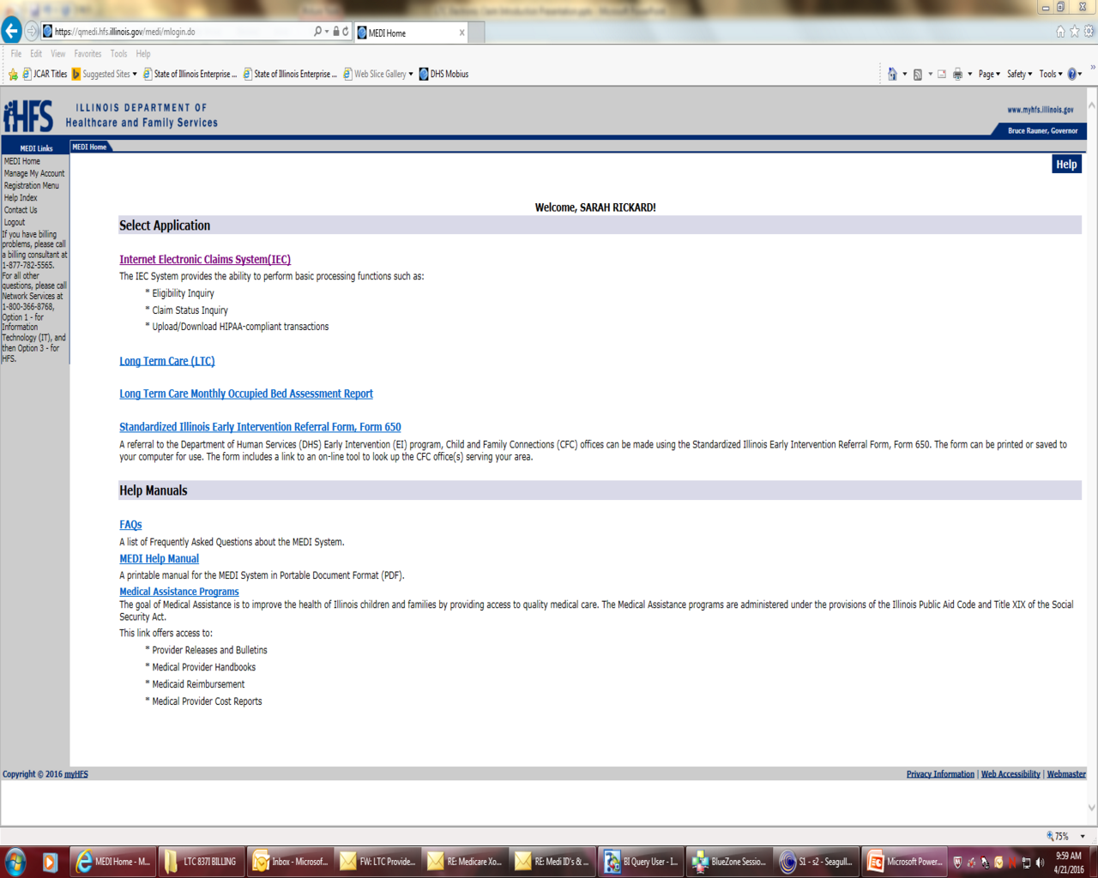
MEDI HOME PAGE

Slide 13
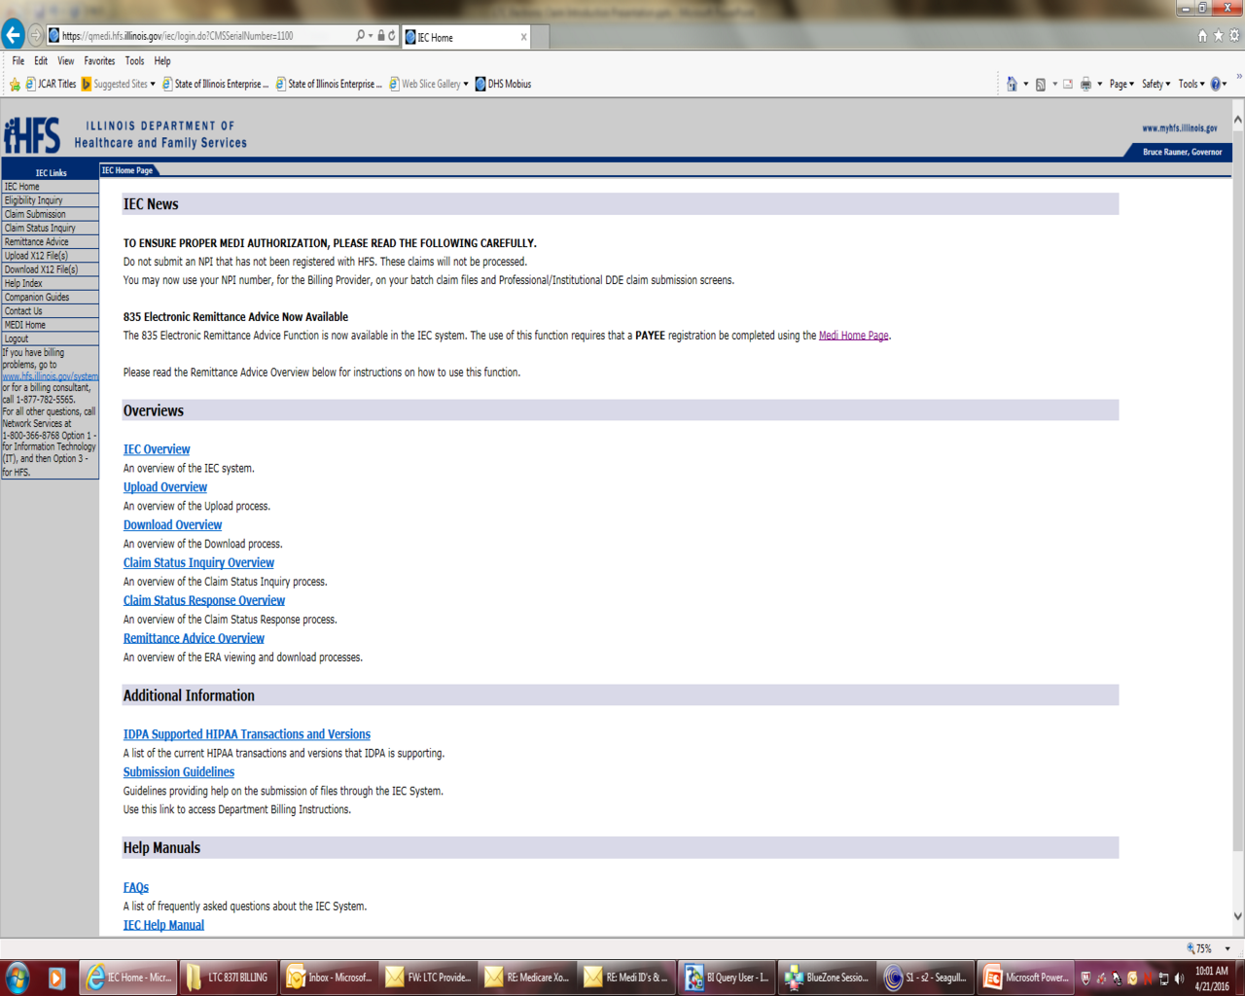
IEC HOME PAGE
Take advantage of the information in the overviews and manuals.

Slide 14
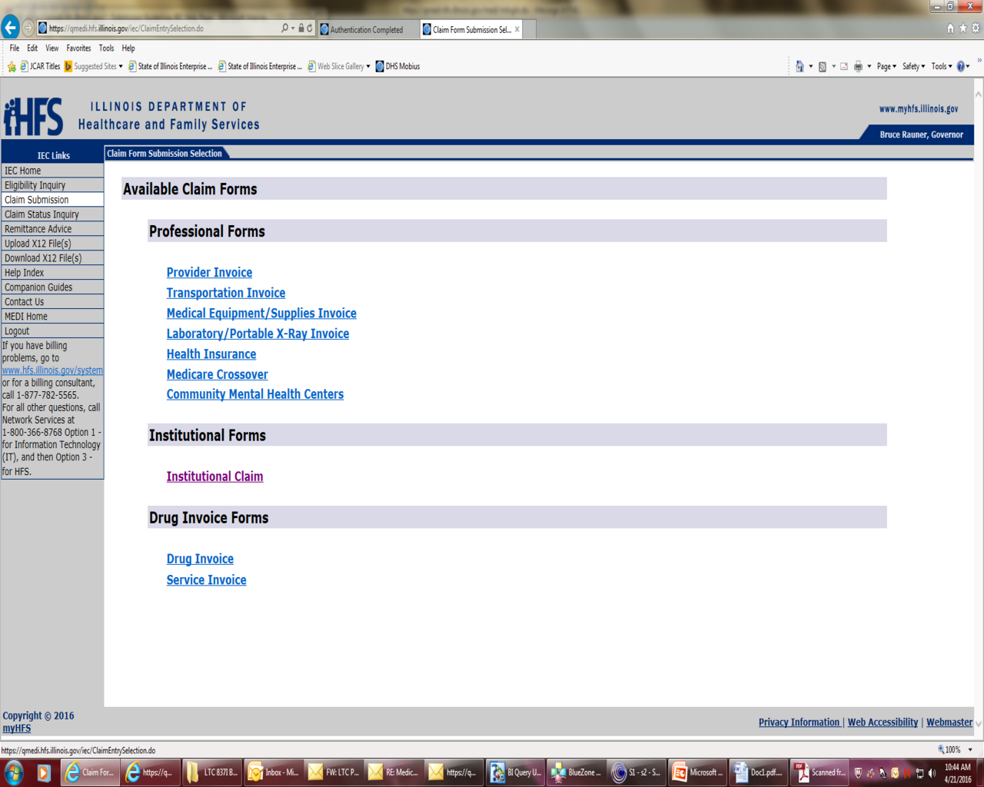
Where to Directly Enter a Claim
Notes:
Links in the upper left

Slide 15
How to prepare?
Provider Enrollment:
The new billing process requires 837I claims to be submitted with a National Provider Identification (NPI) registered on the National Plan and Provider Enumeration System (NPPES). The NPI used to submit claims must also be the NPI used when enrolling as an Illinois Medicaid provider in the IMPACT system.
The registered NPI used to enroll must be unique for each twelve (12) digit provider identification number (PIN) assigned to each enrolled Medicaid provider.
If the NPI used to submit a claim is not a registered NPI in the NPPES system, or cannot be cross walked to a unique HFS PIN, the claim will be rejected.

Slide 16
More Preparations
MEDI Registration:
Register Payee information in the MEDI system to gain access to the IEC links for claim submittal. The MEDI IEC link contains claim submission overview information, help manuals, data element information as well as tutorials on claim submittal.
Implementation Guides:
Providers are urged to obtain access to the Implementation Guides related to the American National Standard (ANS) X12 837I Health Care Claim (005010X223) transactions and the National Uniform Billing Committee’s (NUBC) data specification Manual, UB-04.

Slide 17
How ready are you?
Analyze Claim Submittal Path:
Your organization should research the information related to electronic X12 837I transactions and determine how you will submit an electronic LTC claim prior to the implementation of this new billing system. Things to consider:
Will you send claim files or enter claim information in the IEC DDE?
If you choose to submit a claim file you must determine if you have the ability to build the claim file with your current software or will you need to obtain software.
If you choose to partner with a billing agent or clearinghouse to submit claims on your behalf you should seek a billing agent or clearinghouse that will meet your needs.
Notes:
Note: The chosen Billing Agents must be associated to your facility when enrolling in IMPACT.
http://www.illinois.gov/hfs/impact/pages/faqs.aspx

Slide 18
More Information to Come
Follow HFS Progress:
Providers should be sure to check the HFS website to get provider notices related to the new LTC electronic claim submission process. The HFS website will also include:
Copy of this webinar
A schedule of upcoming webinars and training sessions
Answers to frequently asked questions (FAQs)
Links to Provider Handbooks
Webinar schedule:
May 4, 2016
Topic: Direct data entry (DDE) and file uploading.
May 18, 2016
Topic: Billing Requirements

Slide 19
General Billing Information Continued
Requirements for timely claims submittal will continue to be enforced.
Electronic claims submitted for LTC services must be for a single month of service.
Service months must be submitted in sequence for ICF/IID providers only.
Medicaid Room and Board services provided by a LTC provider will be reported as Revenue Codes on the claim.
Third Party Liability (TPL) payments submitted on a LTC claim will be allowed as a reduction from the payable amount when reported in the “other payer loop”.
The monthly patient credit amount will be applied to the fee-for-service LTC or Hospice claims on a first come first serve basis.
The amount of patient credit applied will continue to be based on the amount of patient credit entered into the LTC patient credit segments by the Department of Human Services (DHS) caseworker.
Notes:
For payment consideration, an LTC claim either as an initial or resubmitted claim following prior rejection, must be received by the Department no later than 180 days after the date of service or no later than 180 days after the date of completion of the admission transaction. For payment consideration, the Department must receive claims after disposition by Medicare or its fiscal intermediary no later than 24 months after the date of service.
Claims that are submitted for more than one calendar month will be rejected.
Prior claim information related to temporary absences and Medicare coverage will be reviewed for proper pricing of current claim.
In order to identify appropriate reimbursement rates, HFS will require specific Taxonomy code, Type of Bill and Value Codes. Recipients with Medicare Part A coverage must be billed to Medicare for any covered service prior to billing Medicaid.
Claims submitted to Medicare will crossover to Medicaid through a fiscal intermediary. To assure proper pricing of Medicare crossover claims, LTC providers should submit LTC claims for a single calendar month of service to Medicare for dually eligible recipients when possible.
Providers may refer to the “Source Code” field found in the TPL section of the MEDI eligibility verification for a recipient’s three-digit TPL code. If the recipient has Hospital Insurance Benefits (HIB) or Qualified Medicare Beneficiary (QMB), the submitted claim must reflect Medicare as the primary payer even if the benefit has been exhausted. If the recipient has a TPL such as Blue Cross Blue Shield or any other commercial payer and TPL is not reported on the submitted claim, the claim will not be rejected. If the claim is Medicaid only or has a TPL other than Medicare, use Value Code 80 for the covered days and Value Code 81 for non-covered days. Covered days must equal the covered accommodation days on the claim.
Providers will continue to submit income changes and review patient credit amounts electronically through the EDI LTC links.
Patient credit amounts should be reported as a Value Code 23 – Recurring Monthly Income.

Slide 20
General Billing Information Continued
Temporary leaves of absences or bed reserves must be reported on the submitted claim as a Revenue Code. Leave of absence days will be identified from the claim, using ‘Leave of Absence’ Revenue Codes with Occurrence Span Code 74.
  ‘Non-Covered Days’ and a Value Code of 81 must be used even though some leave of absence days may be priced as payable. Pricing of bed hold days will be based on provider and bed hold type coverage rules.
  The Occurrence Date Span of non-covered days reported with Occurrence Span Code 74, ‘Non-Covered Days’, associated with ‘Leave of Absence’ Revenue Codes must match the number of non-covered days listed with Value Code 81. HFS will accept the following Leave of Absence Revenue Codes:
    0182 (Patient Convenience)
    0183 (Therapeutic Leave)
    0185 (Hospitalization)
NOTE: The number of days listed with Value Code 81 (non-covered days) plus the number of days listed with Value Code 80 (covered days) must add up to the total number of days calculated based on the reported ‘Statement’ dates for each claim.
Notes:
Example:
Claims statement date is for 10/01/16 – 10/31/16
Occurrence Span Code 74 “non covered” = 10/05/16 – 10/06/16
Revenue code 0182 is reported, monetary amount = $200.00, DA = 2
Revenue code 0110 is reported, monetary amount = $2900.00, DA = 29
Value code 80 “covered days” should be = 29
Value code 81 “non covered” should be = 2

Slide 21
General Billing Information Continued
Exceptional Care coverage (i.e., ventilator care) requirements and processes will not change. Provider must request and the exceptional care status must be approved for each recipient prior to provider submitting claim for reimbursement of exceptional care service.
Adjustments for provider rate and patient credit changes will be processed through an automatic adjustment process initiated by HFS.
Only prior paid claims with incorrect coding will require a void/rebill initiated by the provider.
Upon implementation of the new billing process, the system will not have the capability to electronically accept a void of prior paid claim.
Beginning with October 2016 services providers must request the incorrect paid claim to be voided by submitting an HFS 2249 Adjustment (Hospital) form to the Bureau of Long Term Care.
Notes:
Once a recipient has been approved for Exceptional care coverage, the provider may submit claims for payment of exceptional care services by reporting Revenue Codes 019X. Claims submitted with exceptional care Revenue Codes for a recipient without approval being entered will be rejected.
Providers should continue to address adjustments to the patient credit amounts by assuring all residents income changes have been reported timely through the EDI vendor or MEDI LTC income change links. For questions regarding the status of submitted or completed income changes contact the appropriate DHS LTC Unit.
After the void transaction has been completed, providers may submit a new claim for the service period with a Type of Bill Frequency Code 1-4, as applicable. Providers will be notified of completed void transactions via the remittance advice. Providers are also encouraged to review “Claim Status” through the IEC links.

Slide 22
CATEGORY OF SERVICE CROSSWALK
The next slides are related to the Category of Service (COS) Crosswalk that was attached to the April 19, 2016 Provider Notice.
To get to the “legacy” COS that providers see on remittance advices and for the Department to price the claim correctly providers must bill using the appropriate Taxonomy, Bill Type and Revenue Code combinations. The crosswalk gives the acceptable combinations for each provider type.
There are other code values that further define pricing but the COS crosswalk and the following slides provide a basic overview of the claim coding.

Slide 23
Supportive Living Program
(Provider Type 028)
TAXONOMY | TAXONOMY DESCRIPTION | BILL TYPE FL 04 | BILL TYPE DESCRIPTION | LEGACY COS | LEGACY COS DESCRIPTION | REVENUE CODE FL 42 | REVENUE CODE DESCRIPTION
311500000X | ALZHEIMER/DEMENTIA CENTER | 089X | SPECIAL FACILITY - OTHER | 86 | LTC SLF Dementia Care | 0240 | ALL INCLUSIVE ANCILLARY/GENERAL
311500000X | ALZHEIMER/DEMENTIA CENTER | 089X | SPECIAL FACILITY - OTHER | 86 | LTC SLF Dementia Care | 0182 0183 | PATIENT CONVENIENCE THERAPEUTIC LEAVE
311500000X | ALZHEIMER/DEMENTIA CENTER | 089X | SPECIAL FACILITY - OTHER | 86 | LTC SLF Dementia Care | 0185 | HOSPITALIZATION
310400000X | ASSISTED LIVING FACILITY | 089X | SPECIAL FACILITY - OTHER | 87 | LTC - Supportive Living Facility (Waivers) | 0240 | ALL INCLUSIVE ANCILLARY/GENERAL
310400000X | ASSISTED LIVING FACILITY | 089X | SPECIAL FACILITY - OTHER | 87 | LTC - Supportive Living Facility (Waivers) | 0182 0183 | PATIENT CONVENIENCE THERAPEUTIC LEAVE
310400000X | ASSISTED LIVING FACILITY | 089X | SPECIAL FACILITY - OTHER | 87 | LTC - Supportive Living Facility (Waivers) | 0185 | HOSPITALIZATION

Slide 24
Intermediate Care Facilities for Individuals with Intellectual Disabilities (ICF/IID) (Provider Type 029)
TAXONOMY | TAXONOMY DESCRIPTION | BILL TYPE FL 04 | BILL TYPE DESCRIPTION | LEGACY COS | LEGACY COS DESCRIPTION | REVENUE CODE FL 42 | REVENUE CODE DESCRIPTION
315P00000X | ICF MENTALY RETARDED | 065X 066X | INTERMEDIATE CARE - LEVEL I INTERMEDIATE CARE - LEVEL II | 73 | LTC--ICF/MR | 0110 – 0160 * | GENERAL ROOM & BOARD VALUES
315P00000X | ICF MENTALY RETARDED | 065X 066X | INTERMEDIATE CARE - LEVEL I INTERMEDIATE CARE - LEVEL II | 73 | LTC--ICF/MR | 0182 0183 | PATIENT CONVENIENCE THERAPEUTIC LEAVE
315P00000X | ICF MENTALY RETARDED | 065X 066X | INTERMEDIATE CARE - LEVEL I INTERMEDIATE CARE - LEVEL II | 73 | LTC--ICF/MR | 0185 | HOSPITALIZATION
315P00000X | ICF MENTALY RETARDED | 065X 066X | INTERMEDIATE CARE - LEVEL I INTERMEDIATE CARE - LEVEL II | 38 | Exceptional Care | 0190 | SUBACUTE CARE - GENERAL CLASSIFICATION
3140N1450X | NURSING CARE, PEDIATRIC | 065X 066X | INTERMEDIATE CARE - LEVEL I INTERMEDIATE CARE - LEVEL II | 74 | LTC--ICF/MR skilled pediatric | 0110 – 0160 * | GENERAL ROOM & BOARD VALUES
3140N1450X | NURSING CARE, PEDIATRIC | 065X 066X | INTERMEDIATE CARE - LEVEL I INTERMEDIATE CARE - LEVEL II | 74 | LTC--ICF/MR skilled pediatric | 0182 0183 | PATIENT CONVENIENCE THERAPEUTIC LEAVE
3140N1450X | NURSING CARE, PEDIATRIC | 065X 066X | INTERMEDIATE CARE - LEVEL I INTERMEDIATE CARE - LEVEL II | 74 | LTC--ICF/MR skilled pediatric | 0185 | HOSPITALIZATION
320600000X | RESIDENTIAL TREATMENT FACILITY, MENTAL RETARDATION AND/OR DEVELOPMENTAL DISABILITIES | 065X 066X | INTERMEDIATE CARE - LEVEL I INTERMEDIATE CARE - LEVEL II | 76 | LTC - Specialized Living Center - Intermediate MR | 0110 – 0160 * | GENERAL ROOM & BOARD VALUES
Notes:
* Except for Revenue Codes 0115, 0125, 0135, 0145 or 0155

Slide 25
Nursing Facilities Eligible to be Licensed as Specialized Mental Health Rehabilitation Facilities (SMHRF) (Provider Type 038)
TAXONOMY | TAXONOMY DESCRIPTION | BILL TYPE FL 04 | BILL TYPE DESCRIPTION | LEGACY COS | LEGACY COS DESCRIPTION | REVENUE CODE FL 42 | REVENUE CODE DESCRIPTION
310500000X | INTERMEDIATE CARE FACILITY, MENTAL ILLNESS | 065X 066X | INTERMEDIATE CARE - LEVEL I INTERMEDIATE CARE - LEVEL II | 71 | LTC - Intermediate | 0110 -0160 * | GENERAL ROOM & BOARD VALUES
310500000X | INTERMEDIATE CARE FACILITY, MENTAL ILLNESS | 065X 066X | INTERMEDIATE CARE - LEVEL I INTERMEDIATE CARE - LEVEL II | 71 | LTC - Intermediate | 0182 0183 | PATIENT CONVENIENCE THERAPEUTIC LEAVE
310500000X | INTERMEDIATE CARE FACILITY, MENTAL ILLNESS | 065X 066X | INTERMEDIATE CARE - LEVEL I INTERMEDIATE CARE - LEVEL II | 71 | LTC - Intermediate | 0185 | HOSPITALIZATION
Notes:
* Except for Revenue Codes 0115, 0125, 0135, 0145 or 0155

Slide 26
Nursing Facilities (NF) Skilled (Provider Type 033)
TAXONOMY | TAXONOMY DESCRIPTION | BILL TYPE FL 04 | BILL TYPE DESCRIPTION | LEGACY COS | LEGACY COS DESCRIPTION | REVENUE CODE FL 42 | REVENUE CODE DESCRIPTION
314000000X | SKILLED NURSING FACILITY | 021X 022X | SKILLED NURSING INPATIENT (INCLUDING MEDICARE PART A) Skilled Nursing Facilities - (Inpatient Part B) | 70 | LTC - Skilled | 0110 -0160 * | GENERAL ROOM & BOARD VALUES
314000000X | SKILLED NURSING FACILITY | 021X 022X | SKILLED NURSING INPATIENT (INCLUDING MEDICARE PART A) Skilled Nursing Facilities - (Inpatient Part B) | 70 | LTC - Skilled | 0182 0183 | PATIENT CONVENIENCE THERAPEUTIC LEAVE
314000000X | SKILLED NURSING FACILITY | 021X 022X | SKILLED NURSING INPATIENT (INCLUDING MEDICARE PART A) Skilled Nursing Facilities - (Inpatient Part B) | 70 | LTC - Skilled | 0185 | HOSPITALIZATION
314000000X | SKILLED NURSING FACILITY | 065X 066X | INTERMEDIATE CARE - LEVEL I INTERMEDIATE CARE - LEVEL II | 71 | LTC - Intermediate | 0110 -0160 * | GENERAL ROOM & BOARD VALUES
314000000X | SKILLED NURSING FACILITY | 065X 066X | INTERMEDIATE CARE - LEVEL I INTERMEDIATE CARE - LEVEL II | 71 | LTC - Intermediate | 0182 0183 | PATIENT CONVENIENCE THERAPEUTIC LEAVE
314000000X | SKILLED NURSING FACILITY | 065X 066X | INTERMEDIATE CARE - LEVEL I INTERMEDIATE CARE - LEVEL II | 71 | LTC - Intermediate | 0185 | HOSPITALIZATION
314000000X | SKILLED NURSING FACILITY | 021X | SKILLED NURSING INPATIENT (INCLUDING MEDICARE PART A) | 65 | LTC Full Medicare Coverage | 0110 -0160 * | GENERAL ROOM & BOARD VALUES
314000000X | SKILLED NURSING FACILITY | 021X | SKILLED NURSING INPATIENT (INCLUDING MEDICARE PART A) | 72 | LTC--NF skilled -Co-Ins(partial Medicare coverage) | 0110 -0160 * | GENERAL ROOM & BOARD VALUES
Notes:
Note : Claims submitted for a Medicare covered recipient must include an Occurrence Code showing Medicare coverage end date to obtain Medicaid payment.
Occurrence Codes:
A2 – EFFECTIVE DATE OF MEDICAID
A3 - BENEFITS EXHAUSTED
22 - DATE ACTIVE CARE ENDED
25 – DATES BENEFIT TERMINATED BY PRIMARY PAYER
* Except for Revenue Codes 0115, 0125, 0135, 0145 or 0155

Slide 27
Nursing Facilities (NF) Skilled – Exceptional Care
(Provider Type 033)
TAXONOMY | TAXONOMY DESCRIPTION | BILL TYPE FL 04 | BILL TYPE DESCRIPTION | LEGACY COS | LEGACY COS DESCRIPTION | REVENUE CODE FL 42 | REVENUE CODE DESCRIPTION
314000000X | SKILLED NURSING FACILITY | 021X 022X | SKILLED NURSING INPATIENT (INCLUDING MEDICARE PART A) Skilled Nursing Facilities - (Inpatient Part B) | 38 | Exceptional Care - TBI LEVEL I | 0191 | SUBACUTE CARE - LEVEL I
314000000X | SKILLED NURSING FACILITY | 021X 022X | SKILLED NURSING INPATIENT (INCLUDING MEDICARE PART A) Skilled Nursing Facilities - (Inpatient Part B) | 38 | Exceptional Care - TBI LEVEL II | 0192 | SUBACUTE CARE - LEVEL II
314000000X | SKILLED NURSING FACILITY | 021X 022X | SKILLED NURSING INPATIENT (INCLUDING MEDICARE PART A) Skilled Nursing Facilities - (Inpatient Part B) | 38 | Exceptional Care - TBI LEVEL III | 0193 | SUBACUTE CARE - LEVEL III
314000000X | SKILLED NURSING FACILITY | 021X 022X | SKILLED NURSING INPATIENT (INCLUDING MEDICARE PART A) Skilled Nursing Facilities - (Inpatient Part B) | 38 | Exceptional Care - VENT | 0194 | SUBACUTE CARE - LEVEL IV
Notes:
Exceptional Care coverage must be requested and approved.
If claim is submitted with EC revenue codes and approval is not on system, the claim will reject.
Approval can be seen by doing a LTC Inquiry in the LTC link on MEDI.

Slide 28
Nursing Facilities (NF) Intermediate
(Provider Type 033)
TAXONOMY | TAXONOMY DESCRIPTION | BILL TYPE FL 04 | BILL TYPE DESCRIPTION | LEGACY COS | LEGACY COS DESCRIPTION | REVENUE CODE FL 42 | REVENUE CODE DESCRIPTION
313M00000X | NURSING FACILITY / INTERMEDIATE CARE FACILITY | 065X 066X | INTERMEDIATE CARE - LEVEL I INTERMEDIATE CARE - LEVEL II | 71 | LTC - Intermediate | 0110 -0160 * | GENERAL ROOM & BOARD VALUES
313M00000X | NURSING FACILITY / INTERMEDIATE CARE FACILITY | 065X 066X | INTERMEDIATE CARE - LEVEL I INTERMEDIATE CARE - LEVEL II | 71 | LTC - Intermediate | 0182 0183 | PATIENT CONVENIENCE THERAPEUTIC LEAVE
313M00000X | NURSING FACILITY / INTERMEDIATE CARE FACILITY | 065X 066X | INTERMEDIATE CARE - LEVEL I INTERMEDIATE CARE - LEVEL II | 71 | LTC - Intermediate | 0185 | HOSPITALIZATION
Notes:
* Except for Revenue Codes 0115, 0125, 0135, 0145 or 0155

Slide 29
Nursing Facilities (NF) General Acute Care Hospital (LTC wing) - Skilled
(Provider Type 033)
TAXONOMY | TAXONOMY DESCRIPTION | BILL TYPE FL 04 | BILL TYPE DESCRIPTION | LEGACY COS | LEGACY COS DESCRIPTION | REVENUE CODE FL 42 | REVENUE CODE DESCRIPTION
282N00000X | GENERAL ACUTE CARE HOSPITAL (LTC wing) | 021X 022X | SKILLED NURSING INPATIENT (INCLUDING MEDICARE PART A) Skilled Nursing Facilities - (Inpatient Part B) | 70 | LTC - Skilled | 0110 -0160 * | GENERAL ROOM & BOARD VALUES
282N00000X | GENERAL ACUTE CARE HOSPITAL (LTC wing) | 021X 022X | SKILLED NURSING INPATIENT (INCLUDING MEDICARE PART A) Skilled Nursing Facilities - (Inpatient Part B) | 70 | LTC - Skilled | 0182 0183 | PATIENT CONVENIENCE THERAPEUTIC LEAVE
282N00000X | GENERAL ACUTE CARE HOSPITAL (LTC wing) | 021X 022X | SKILLED NURSING INPATIENT (INCLUDING MEDICARE PART A) Skilled Nursing Facilities - (Inpatient Part B) | 70 | LTC - Skilled | 0185 | HOSPITALIZATION
282N00000X | GENERAL ACUTE CARE HOSPITAL (LTC wing) | 021X | ESKILLED NURSING INPATIENT (INCLUDING MEDICARE PART A) | 65 | LTC Full Medicare Coverage | 0110 -0160 * | GENERAL ROOM & BOARD VALUES
282N00000X | GENERAL ACUTE CARE HOSPITAL (LTC wing) | 021X | SKILLED NURSING INPATIENT (INCLUDING MEDICARE PART A) | 72 | LTC--NF skilled -Co-Ins(partial Medicare coverage) | 0110 -0160 * | GENERAL ROOM & BOARD VALUES
Notes:
Note : Claims submitted for a Medicare covered recipient must include an Occurrence Code showing Medicare coverage end date to obtain Medicaid payment.
Occurrence Codes:
A2 – EFFECTIVE DATE OF MEDICAID
A3 - BENEFITS EXHAUSTED
22 - DATE ACTIVE CARE ENDED
25 – DATE BENEFITS TERMINATED BY PRIMARY PAYER
* Except for Revenue Codes 0115, 0125, 0135, 0145 or 0155
We removed Bill type 11X HOSPITAL INPATIENT (INCLUDING MEDICARE PART A)

Slide 30
Nursing Facilities (NF) General Acute Care Hospital (LTC wing) - Intermediate
(Provider Type 033)
TAXONOMY | TAXONOMY DESCRIPTION | BILL TYPE FL 04 | BILL TYPE DESCRIPTION | LEGACY COS | LEGACY COS DESCRIPTION | REVENUE CODE FL 42 | REVENUE CODE DESCRIPTION
282N00000X | GENERAL ACUTE CARE HOSPITAL (LTC wing) | 065X 066X | INTERMEDIATE CARE - LEVEL I INTERMEDIATE CARE - LEVEL II | 71 | LTC - Intermediate | 0110 -0160 * | GENERAL ROOM & BOARD VALUES
282N00000X | GENERAL ACUTE CARE HOSPITAL (LTC wing) | 065X 066X | INTERMEDIATE CARE - LEVEL I INTERMEDIATE CARE - LEVEL II | 71 | LTC - Intermediate | 0182 0183 | PATIENT CONVENIENCE THERAPEUTIC LEAVE
282N00000X | GENERAL ACUTE CARE HOSPITAL (LTC wing) | 065X 066X | INTERMEDIATE CARE - LEVEL I INTERMEDIATE CARE - LEVEL II | 71 | LTC - Intermediate | 0185 | HOSPITALIZATION
Notes:
* Except for Revenue Codes 0115, 0125, 0135, 0145 or 0155

Slide 31
Nursing Facilities (NF) General Acute Care Hospital (LTC wing) – Exceptional Care
(Provider Type 033)
TAXONOMY | TAXONOMY DESCRIPTION | BILL TYPE FL 04 | BILL TYPE DESCRIPTION | LEGACY COS | LEGACY COS DESCRIPTION | REVENUE CODE FL 42 | REVENUE CODE DESCRIPTION
282N00000X | GENERAL ACUTE CARE HOSPITAL (LTC wing) | 021X 022X | SKILLED NURSING INPATIENT (INCLUDING MEDICARE PART A) Skilled Nursing Facilities - (Inpatient Part B) | 38 | Exceptional Care - TBI LEVEL I | 0191 | SUBACUTE CARE - LEVEL I
282N00000X | GENERAL ACUTE CARE HOSPITAL (LTC wing) | 021X 022X | SKILLED NURSING INPATIENT (INCLUDING MEDICARE PART A) Skilled Nursing Facilities - (Inpatient Part B) | 38 | Exceptional Care - TBI LEVEL II | 0192 | SUBACUTE CARE - LEVEL II
282N00000X | GENERAL ACUTE CARE HOSPITAL (LTC wing) | 021X 022X | SKILLED NURSING INPATIENT (INCLUDING MEDICARE PART A) Skilled Nursing Facilities - (Inpatient Part B) | 38 | Exceptional Care - TBI LEVEL III | 0193 | SUBACUTE CARE - LEVEL III
282N00000X | GENERAL ACUTE CARE HOSPITAL (LTC wing) | 021X 022X | SKILLED NURSING INPATIENT (INCLUDING MEDICARE PART A) Skilled Nursing Facilities - (Inpatient Part B) | 38 | Exceptional Care - VENT | 0194 | SUBACUTE CARE - LEVEL IV
Notes:
Exceptional Care coverage must be requested and approved.
If claim is submitted with EC revenue codes and approval is not on system claim will reject.
Approval can be seen by doing a LTC Inquiry in the LTC link on MEDI.

Slide 32
We want to hear from you.
Questions regarding the new electronic billing for Long Term Care services should be submitted to the Bureau of Long Term Care at HFS.LTC@illinois.gov with the Subject line: Monthly Billing Process.
Your questions and answers will be posted in a Frequently Asked Questions document that will be routinely updated and will be accessible on the HFS Home Page Medical Providers.
The website will also provide information regarding future trainings, webinars, and additional ongoing support.

