Slide 1
Medi Training
Training on Eligibility Look-Up and Sexual Assault Survivor Registration Site (ERSASS)

Slide 2


Slide 3
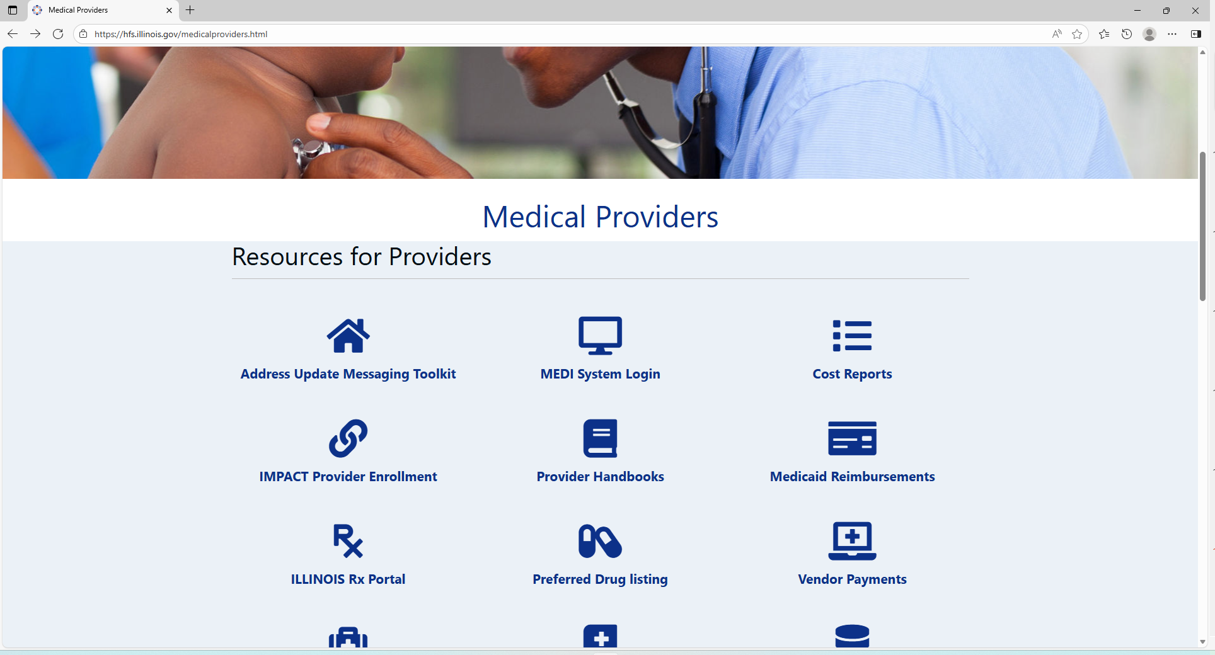

Slide 4
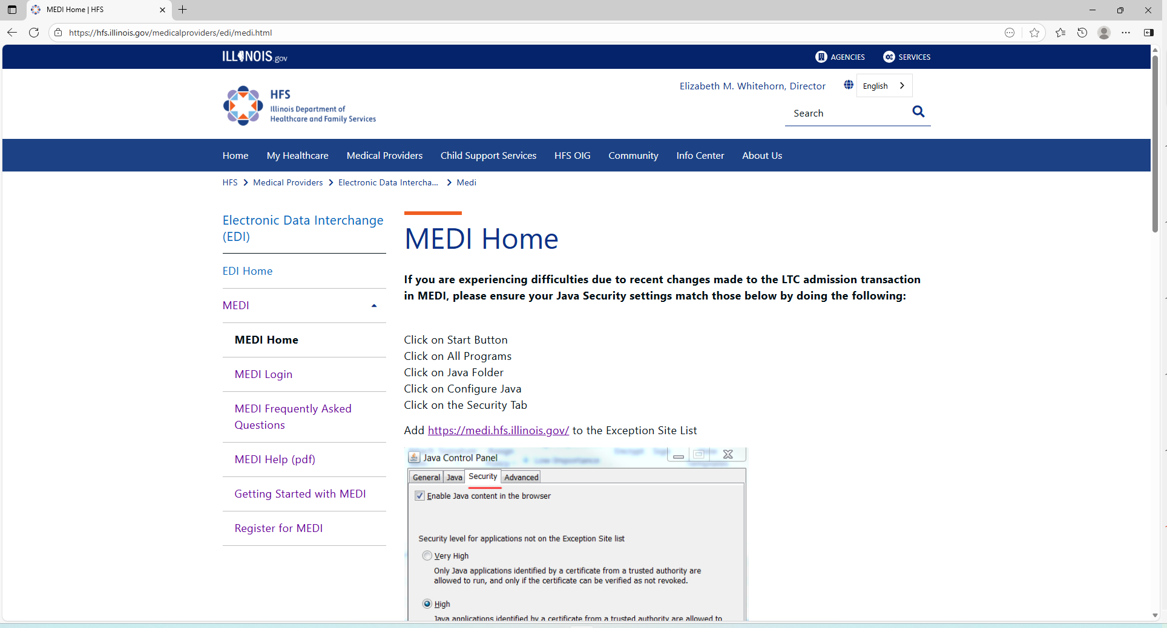

Slide 5
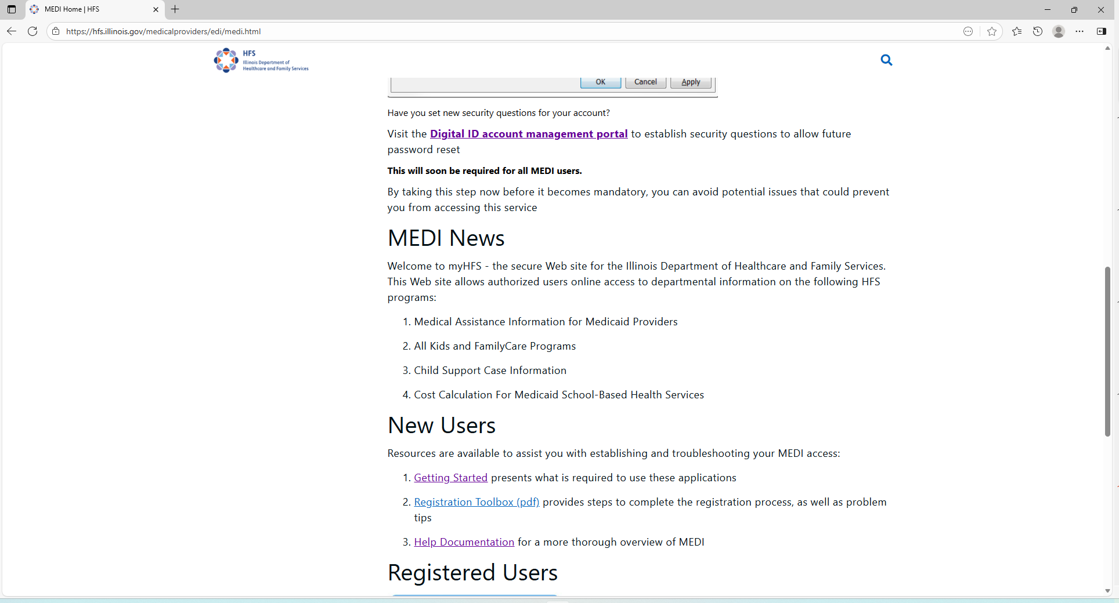

Slide 6
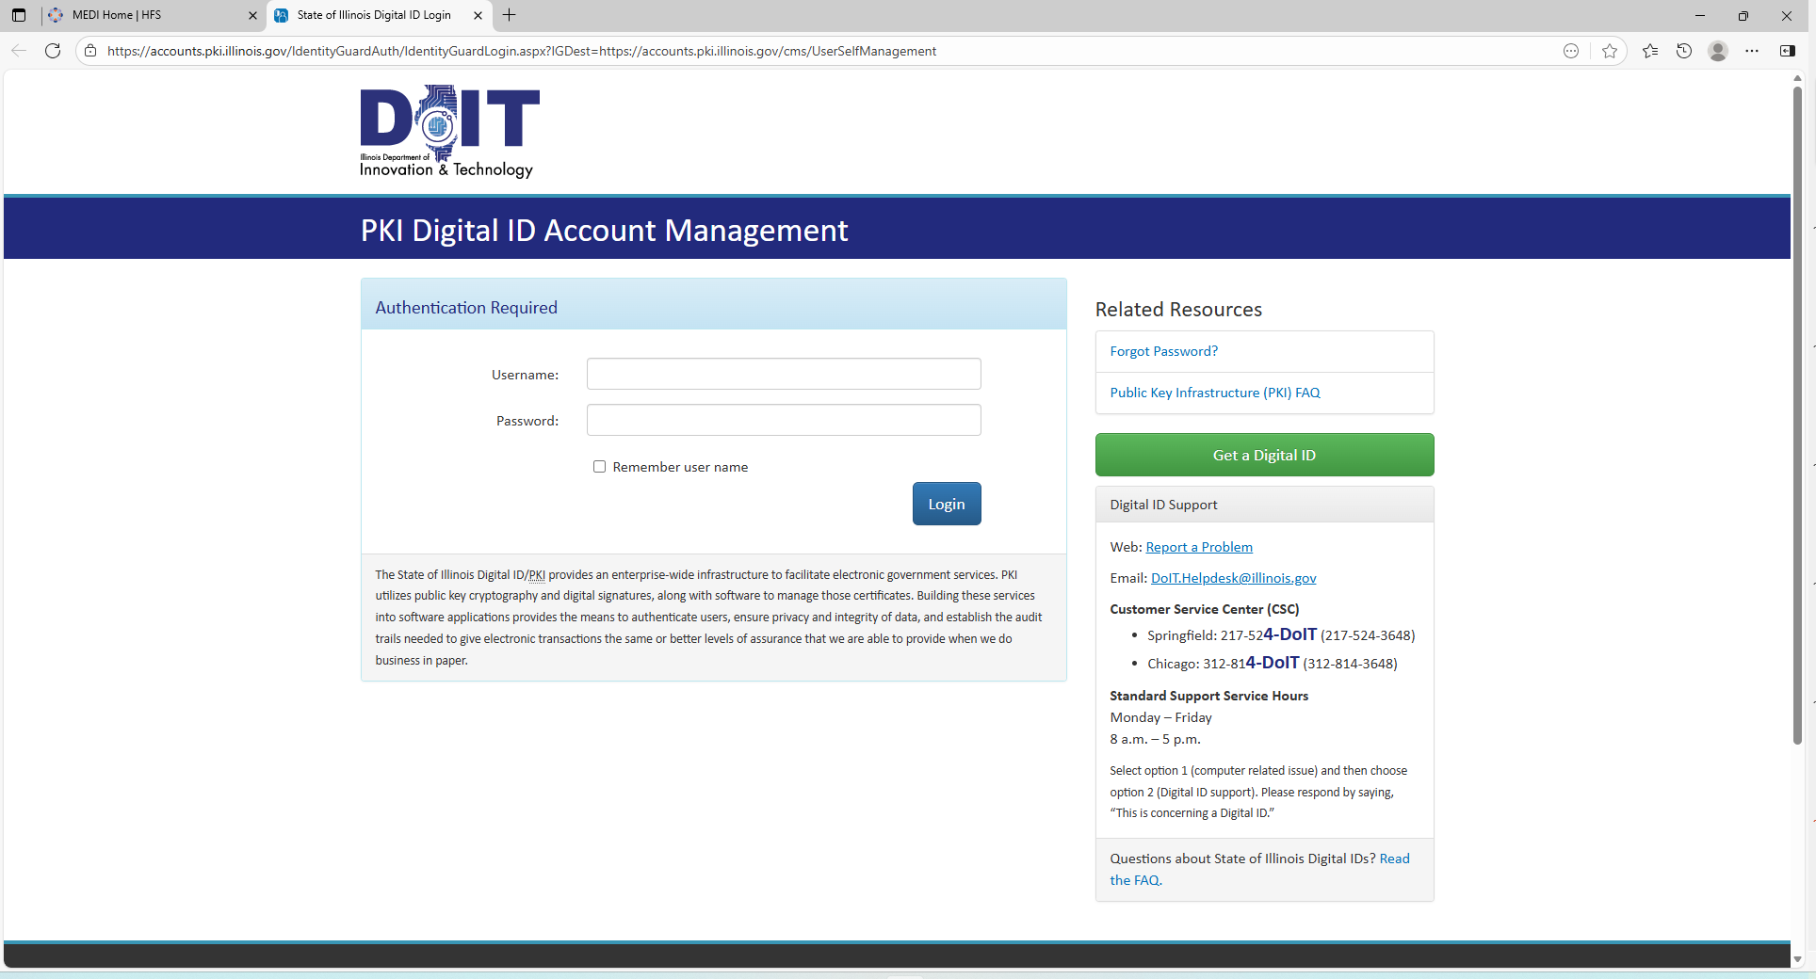

Slide 7
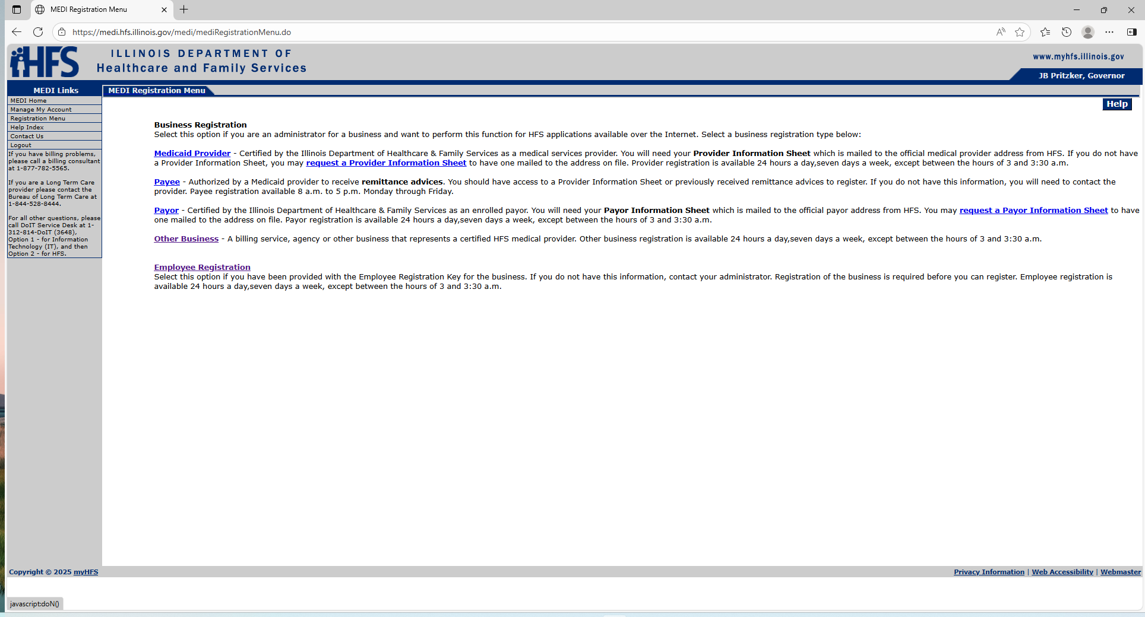

Slide 9
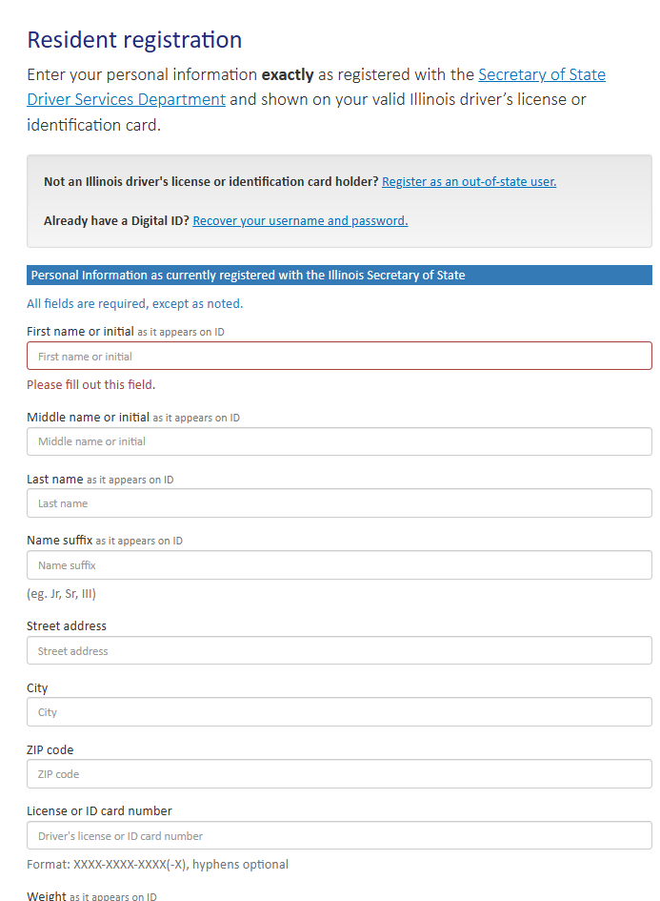

Slide 10
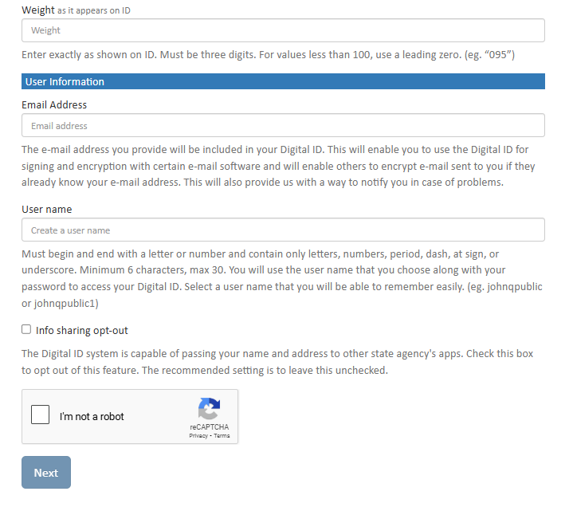

Slide 11
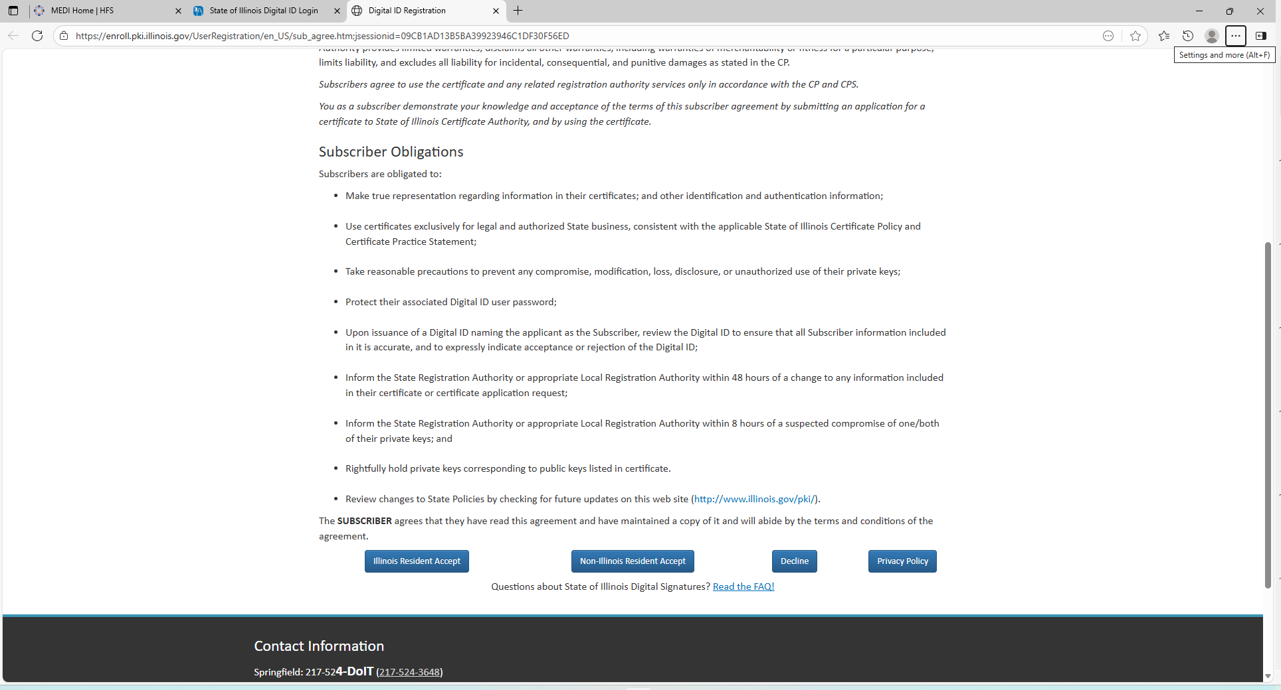

Slide 12
Enter your username and password

Slide 13
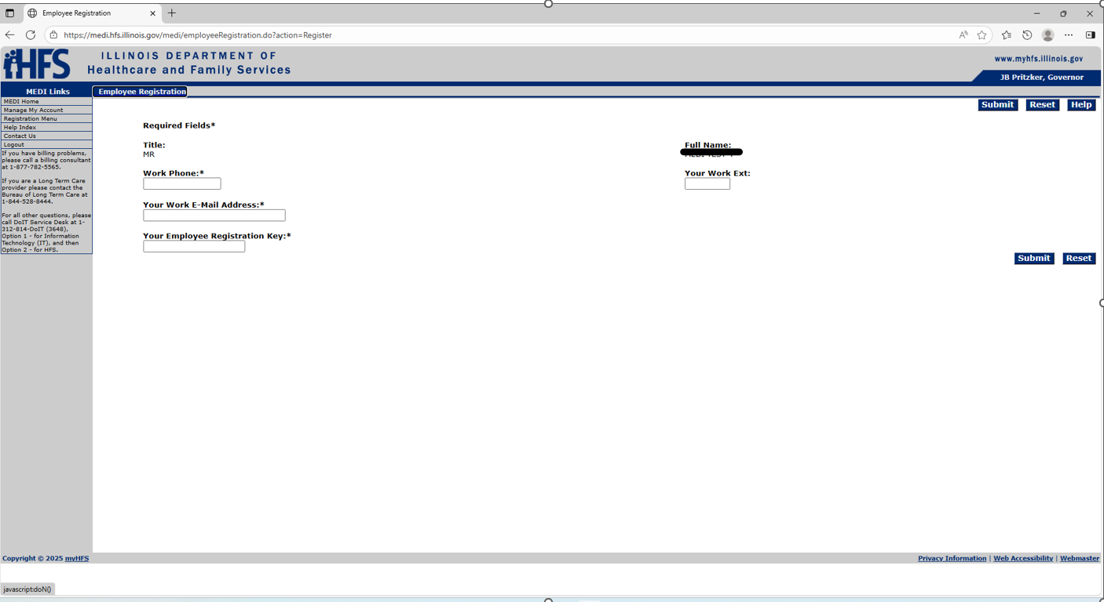

Slide 17
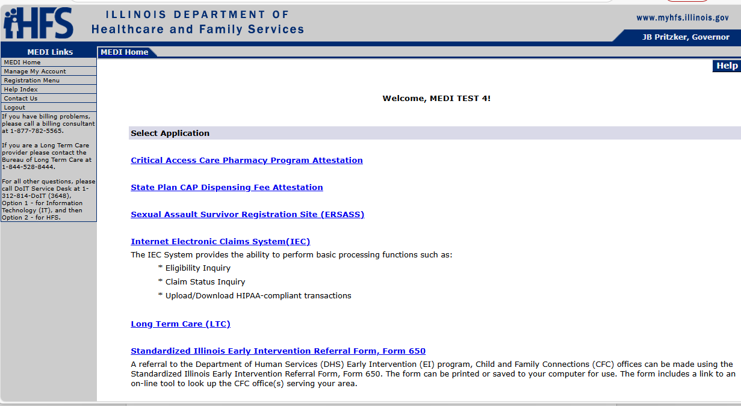

Slide 18
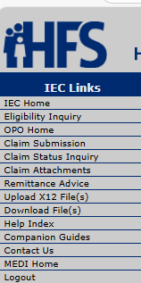


Slide 20
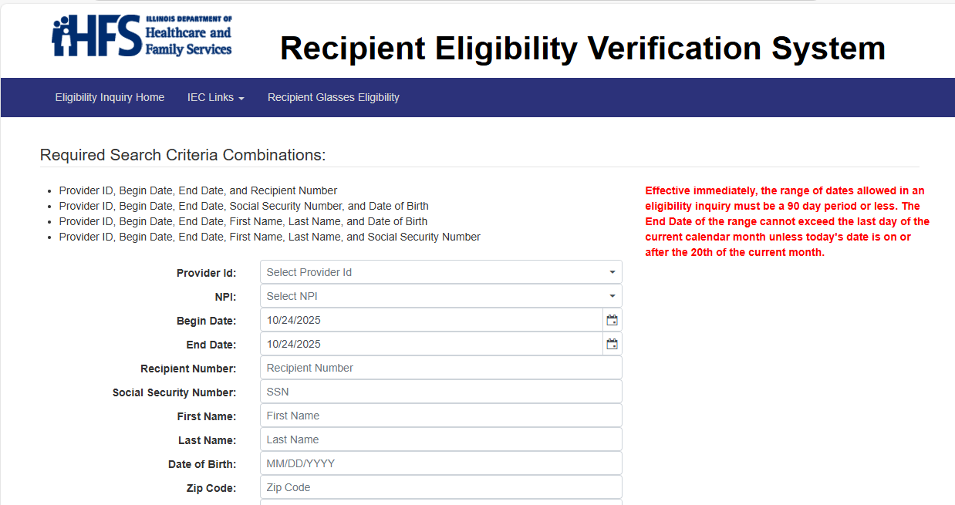

Slide 22
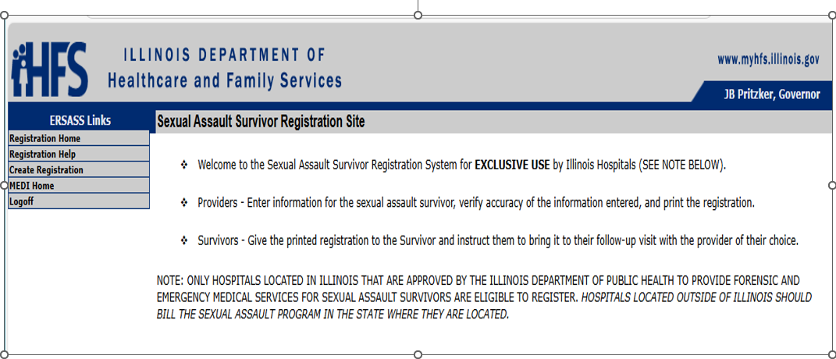

Slide 23


Slide 24
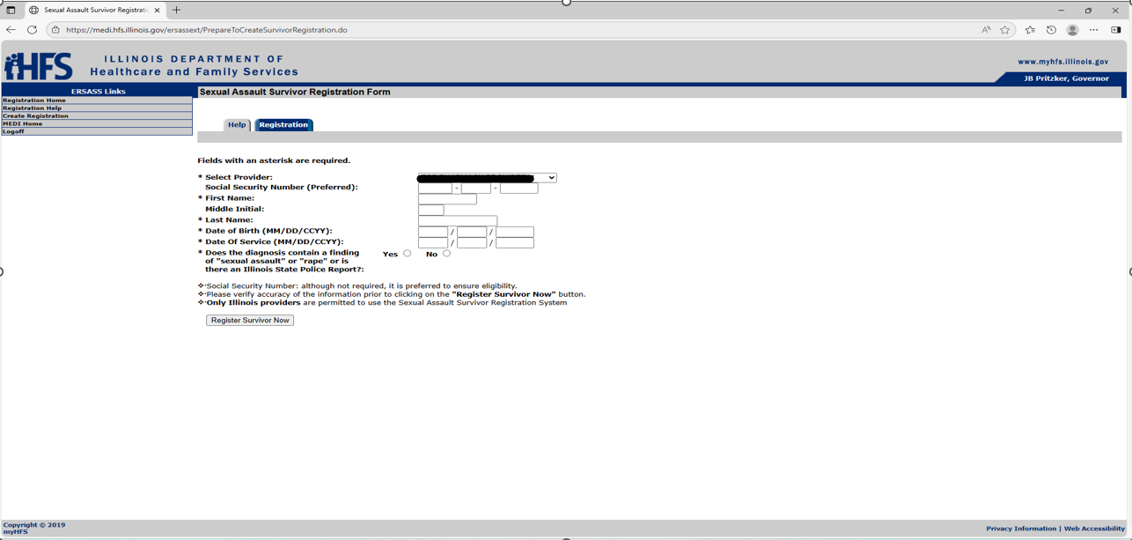

Slide 25
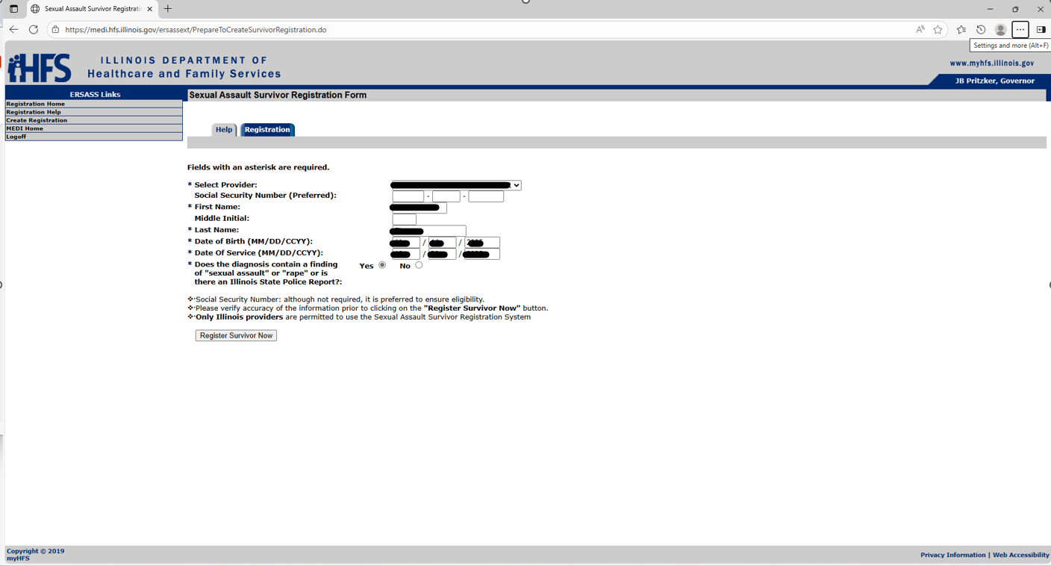

Slide 26
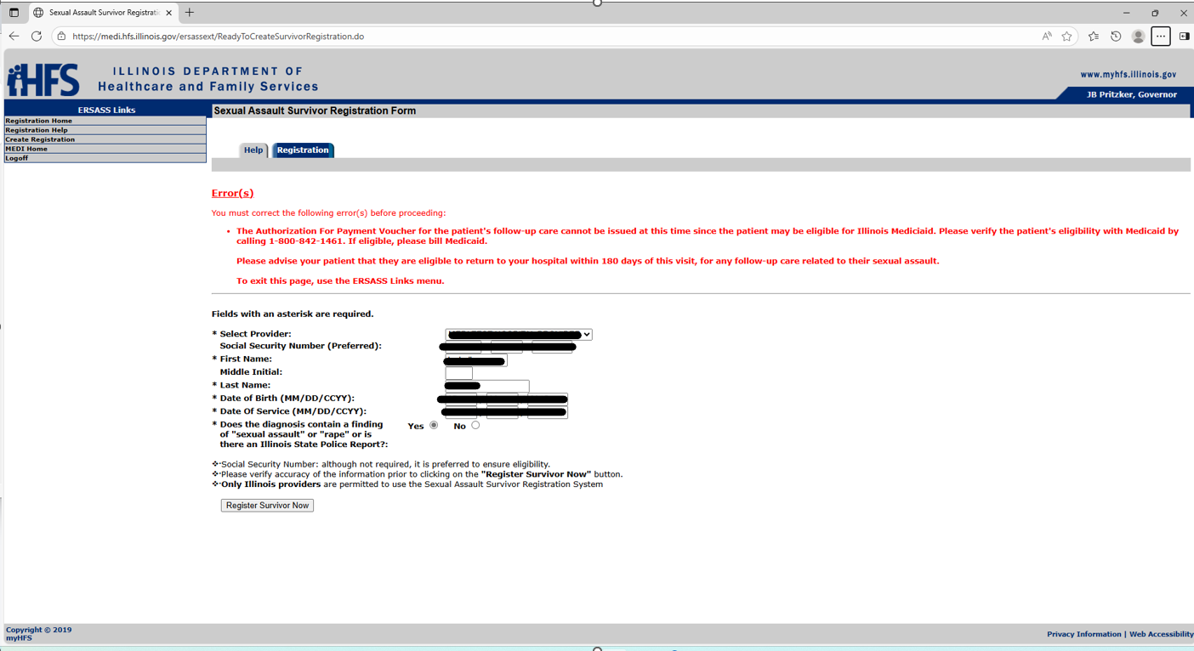

Slide 27
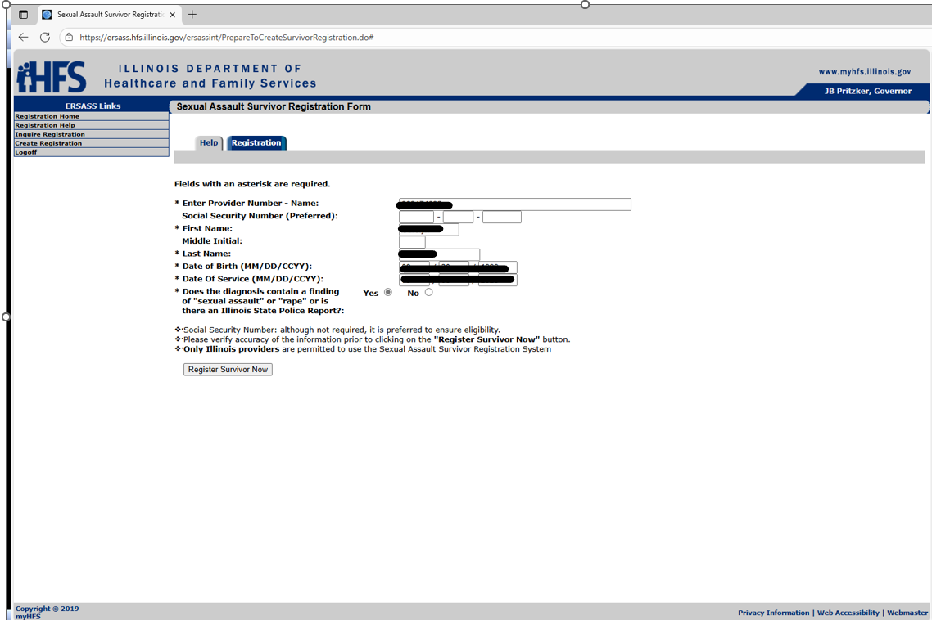

Slide 28
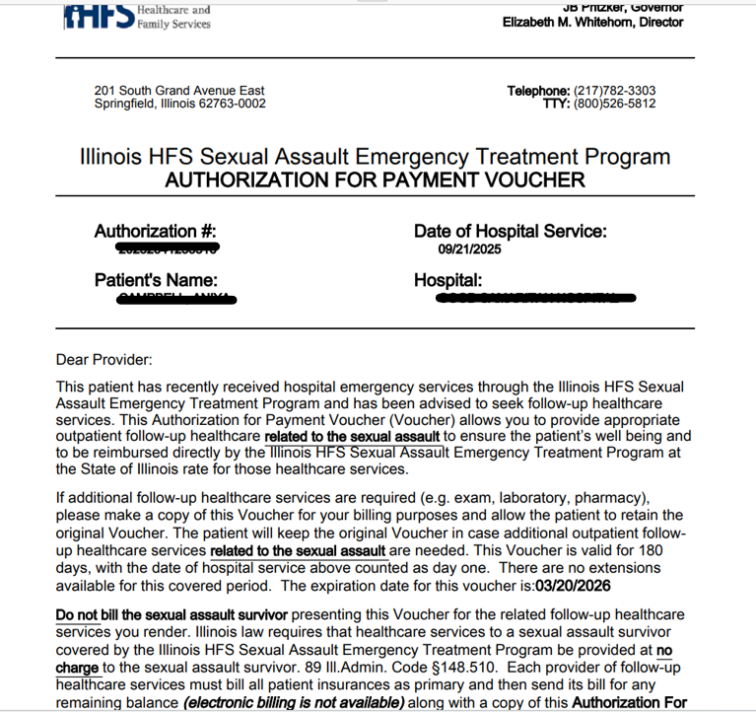

Slide 29
RESOURCES
CLAIM SUMITTAL - HFS.SAClaims@illinois.gov
QUESTIONS – HFS.ISAETP@illinois.gov
MEDI - https://medi.hfs.illinois.gov/

