Slide 1

Provider Resolution Portal Overview
February 2021

Slide 2

Background Landscape
HFS recognizes the importance of providers having a mechanism for reporting and resolving issues encountered with an individual Medicaid MCO when these issues cannot be resolved using existing processes designated by the MCO.
Effective February 28, 2020, HFS implemented a new dispute resolution process for submitting, monitoring, and resolving disputes.
  Required by Public Act 101-0209 (SB1321) and Rule 89 Ill. Adm. Code Section 140
  Note: The new Provider Portal is designed specifically for issues enrolled providers have with Illinois Medicaid MCOs under the managed care programs. Provider complaints regarding the resolution of Medicaid fee-for-service issues should continue to be directed to HFS at 877-782-5565.​

Slide 3
New Provider Resolution Portal
All providers are required to submit unresolved disputes with an MCO to HFS via the secure web-based Provider Resolution portal.
The link to the Provider Complaint Resolution Portal may be found on HFS’ Care Coordination webpage or accessed directly from the HFS Managed Care Provider Resolution Webpage.
Tickets that are submitted in the portal will be processed under the provider dispute resolution process and applicable timeframes.

Slide 4
Provider Disputes Requirements
Providers must first use the MCO internal dispute/appeals process to attempt to resolve a complaint. This means providers must first follow and exhaust ALL processes provided by MCOs to resolve a dispute, including peer-to-peer before submitting a complaint through the portal. Providers and MCOs are expected to actively communicate on the status of a dispute during the dispute resolution process and prior to submitting a ticket into the resolution portal.
Disputes submitted to the MCO internal dispute resolution process may be submitted to the new HFS Complaint Resolution Portal:
  No sooner than 30 calendar days after submitting to the MCO's internal process; and,
  No later than 60 calendar days after submitting to the MCO’s internal process.
If it is determined that a complaint was submitted sooner than 30 calendar days or later than 60 calendar days after submitting the dispute to the MCO’s internal process, the complaint will be immediately closed.

Slide 5
Provider Resolution Portal: Complaint Types
The Provider Resolution Portal can be used for various disputes between providers and MCOs that cannot be resolved using the existing MCOs internal process.
Portal Complaint Types:
  Claims/Payment
  Communications
  Contracting
  Coverage/Service Denials
  Eligibility
  Prior Authorizations
  Provider Enrollment
  Roster
  System Issue
  Other

Slide 6
Summary of New Features for Claims Disputes
All MCOs are required to assign the provider a tracking number for each complaint submitted through the MCO internal dispute process
  Providers must enter this MCO-assigned tracking number in the HFS Provider Resolution portal when completing the complaint ticket.
  If providers did not receive a tracking number from their MCO for disputes submitted to the MCOs internal dispute process, providers must contact the MCO to receive a tracking number.
When a MCO requests additional information, the provider must provide the additional information within 5 business days or demonstrate that this information was already provided to the MCO.
  Incomplete responses or lack of response will cause the complaint to be closed.
MCOs must respond to the provider with a response to the complaint and when applicable, a plan to address the complaint; the plan must include a time period in which the complaint will be resolved. The MCO will also include the name and contact information of a provider service representative for follow-up.
Only one (1) 30-day extension is possible in extenuating circumstances to either the provider or the MCO, but not both (as approved by HFS).
If complaints cannot be resolved, a provider can request HFS review. HFS will make a final decision. The HFS decision on all disputes shall be final.

Slide 7
Standard Complaint Template
Providers must use the new standard Complaints/Claims-Issue template when submitting two (2) or more of the same or similar complaints with the same MCO:
  Providers are limited to a maximum of 100 similar complaints/claims on a template.
  For 2 or more same or similar complaints via the Claim-Issue template, the tracking number should be assigned to the template (not individual complaint). Providers shall include the tracking number(s) provided by the MCO for each claim included on the template.
  Complaints that are submitted for multiple complaints, and do not include a completed complaint template, will be closed.
Providers should not mix complaints/claims from different MCOs or different providers/facilities.
  Separate complaints/claims should be filed, with separate templates for each unique provider/facility (by Medicaid Tax ID and location address).

Slide 8

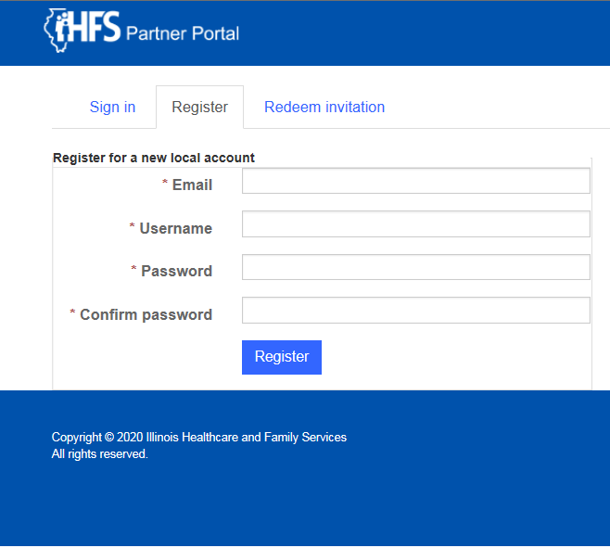
Provider Registration
Portal registration instructions with screenshots
1. Click “sign in” to begin the registration process.
Screenshot of new Provider Portal
Providers or designated billing staff must first register with the portal in order to access and submit disputes.
Registration will occur through the HFS Managed Care Provider Resolution Webpage at the following link
  Click login from the webpage to access the portal
  Complete steps 1-3 in the illustration
Fill out all fields completely on the registration form. Missing information will cause delays in the registration process.
It may take up to 48 hours for your registration to be confirmed.
Submit questions about registration on the portal to: HFS.PortalInquiries@Illinois.gov
2. Click “register”
3. Enter your email, choose a username and password, and click register.

Slide 9
Provider Portal Timeline

Slide 10
Provider Portal Timeline Overview
Provider
Works with MCO to resolve issues. Follow MCO’s internal dispute process to submit a dispute with the MCO
Disagree with MCO determination and files dispute in the HFS Provider resolution portal within 30-60 calendar days
Review MCO response. If accepted, ticket will be closed after 5 business days. If provider disagrees with resolution, the provider may request HFS review within 30 calendar days
Complaint resolved
MCO
Issue written response/proposal to resolve the disputed complaint ticket within 30 calendar days¹
Provides Provider with a MCO tracking number for disputed claim and makes a determination on dispute
HFS/Portal Staff
Submit complete complaint to MCO within 10 business days. If complaint is not complete, the ticket will be closed.
Make final determination within 30 calendar days
Complaint resolved
1. If the MCO requires additional information from the provider, the MCO must request the additional information from the provider within five (5) business days of receiving the complaint ticket When additional information is requested from the provider by the MCO within the timeframes described above, the provider has five (5) business days to provide the additional information or demonstrate that it was already provided to the MCO.
NOTE: In extenuating circumstances, the MCO or the provider may request, through the provider complaint portal, HFS to authorize a single thirty (30) calendar day extension for either the MCO or Provider, but not both.

Slide 11
Portal Timeline
Complaint Submission Process
Disputes already submitted to the MCO internal dispute resolution process may be submitted to the HFS Provider Resolution Portal:
  No sooner than thirty (30) calendar days* after submitting to the MCO's internal process and no later than sixty (60) calendar days after submitting the dispute to the MCO’s internal process.
The provider’s submission to the portal must include the date the disputed claim(s) was filed with the MCO’s internal provider dispute resolution process and the corresponding MCO provided tracking number.
The Portal staff shall review and if the submission is complete, present the complaint to the appropriate MCO within 10 business days of receipt via the Resolution Portal.
*Note: The MCO 30 calendar day resolution period begins the day that the MCO receives the dispute from the provider and the tracking number is assigned.

Slide 12
Portal Timeline
MCO Written Response/Proposal
MCOs have thirty 30 calendar days to issue its written response/proposal to resolve the disputed complaint tickets.
If the MCO requires additional information, the MCO must request the additional information from the provider within five (5) business days of receiving the complaint ticket.
When the MCO requests additional information from the provider, the provider has five (5) business days to provide the additional information or demonstrate that it was already provided to the MCO. If the provider does not respond, or the response is incomplete, the ticket will be closed.
Note: At HFS’s discretion, sanctions may be applied to MCOs if a response is not submitted within 30 calendar days.

Slide 13
Portal Timeline
MCO Written Response/Proposal
4. During the resolution process, and in extenuating circumstances, the MCO or the provider may request, in the provider complaint portal, HFS to authorize a single thirty (30) calendar day extension for either the MCO or Provider, but not both.
    An extension request must be made no later than seven (7) calendar days prior to the end of the initial thirty (30) calendar day period. Approval of the extension is at the discretion of HFS.
    Only one (1) extension is possible in extenuating circumstances to either the provider or the MCO, but not both (as approved by HFS).
    An approved extension adds thirty (30) calendar days to the initial thirty (30) calendar day period, for a total of sixty (60) calendar days within which the MCO must develop a written response/proposal to resolve the complaint ticket.

Slide 14
Portal Timeline
Provider Response
If the provider accepts the MCO written response/proposal or does not contest the response within 5 business days, the ticket will be closed.
If the provider disagrees with the MCO's written response/proposal, the provider has thirty (30) calendar days to request HFS review of the dispute.
If HFS review is requested, both the MCO and the provider shall deliver all relevant information to HFS within 30-calendar days, including contact information for knowledgeable personnel.

Slide 15
Portal Timeline
HFS Decision
When HFS review has been requested by a provider, HFS shall provide a written decision within 30 calendar days that reflects and is consistent with:
  applicable contract terms
  written HFS policies and procedures
  state and federal law and regulations
The decision of HFS is final.
Note: Disputes between MCOs and providers presented to HFS for resolution are not contested cases, and do not confer any right to an administrative hearing.

Slide 16
Questions
Questions regarding the Provider Resolution process may be directed to the Department’s Bureau of Managed Care and Portal staff at:
HFS.PortalInquiries@illinois.gov

