Slide 1
Illinois Provider Portal
Prescriber Webinar
Notes:
Script:
Welcome to the Illinois Provider Portal Prescriber webinar. In today’s webinar, you will learn how to define and explain the purpose and benefits of the Provider Portal, enroll, login, and change your password in the Provider Portal, and how to navigate the Provider Portal and perform Prescriber functions.

Slide 2
What is the Provider Portal?
Secure, Web-based Portal for Prescribers to:
  View Participant’s Eligibility
  View Participant’s Profile
    Approved Prior Authorizations
    Medication Profile (Illinois Medicaid)
  View Illinois Medicaid's Formulary
    View Preferred Drug List (PDL)
    Preferred/Non-Preferred Status, Including Potential Alternatives
    Four Prescription Policy Inclusion/Exclusion
  Submit Prior Authorization (PA) Requests Electronically
    Upload Supporting Documents
    View Real-Time Status of Prior Authorization Requests
Note: The Illinois Provider Portal is compliant with federal and state accessibility requirements, including
the Illinois Technology Accessibility Act (ITAA) and the Americans with Disabilities Act (ADA).

Slide 3
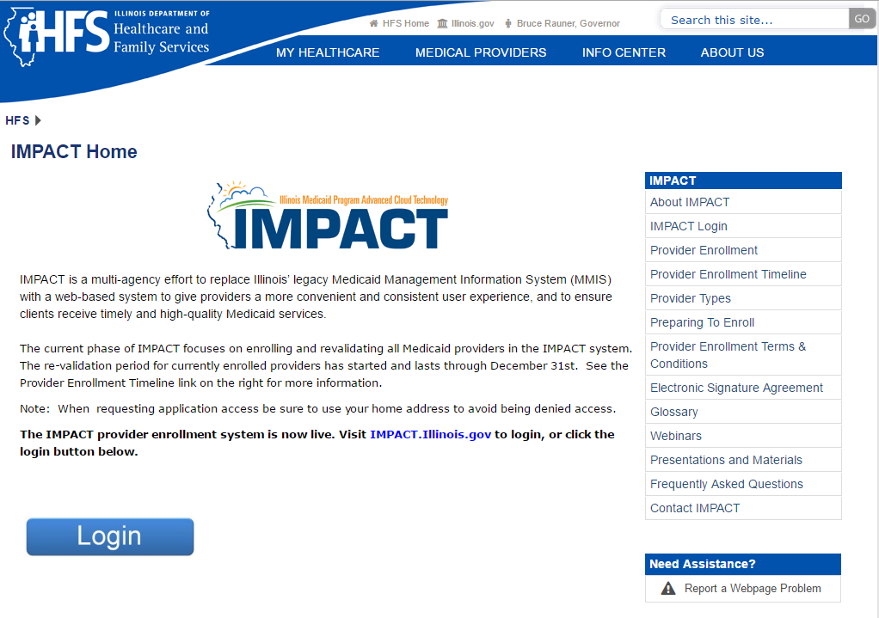
Registration
All providers currently registered with IMPACT will receive an email with enrollment instructions.
If you have not registered for IMPACT, you need to do so.
Note: Access to the Illinois Provider Portal is limited to authorized pharmacists and prescribers.
IMPACT Home: http://www.illinois.gov/hfs/impact/Pages/default.aspx

Slide 4
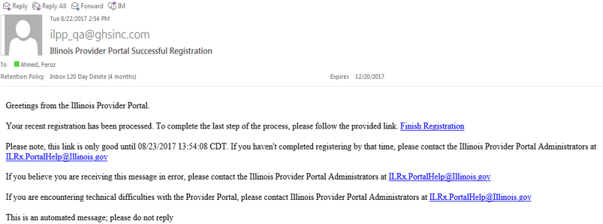

Registration
Once your registration for the new system has been processed, you will receive an email to Finish Registration. This will take approximately ten (10) days.
Note: Office Workers must be registered in IMPACT and be associated with a Prescriber. After the initial registration for the primary user, all other users will receive an email when their administrator grants them access to the Provider Portal.

Slide 5
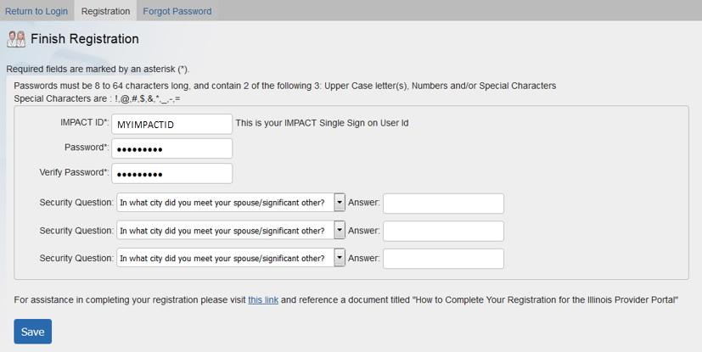
Registration – Finish Registration
After clicking the Finish Registration link in the email, you will be directed to the Finish Registration screen. Enter the required information: IMPACT ID; New Password; Verify Password; Select a Security Question (drop down box); Enter Answer to security question; and Click Submit.
Note¹: Security question Answers are not case sensitive.
Note²: Total number of Security Questions may vary. You cannot select duplicate Security Questions.

Slide 6
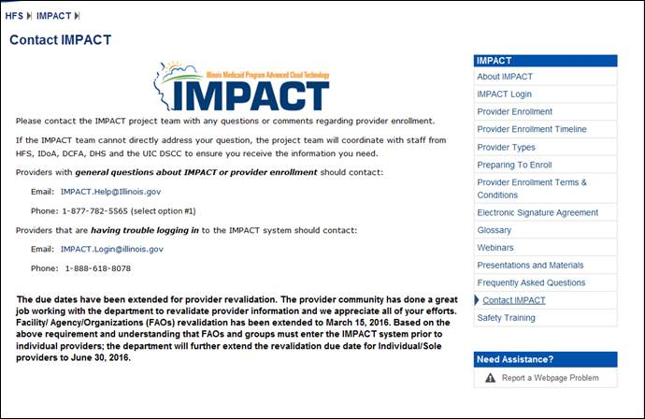
Registration
General Questions: Providers with general questions about IMPACT or provider enrollment should contact:
Email: IMPACT.help@Illinois.gov
Phone: 1–877–782 -5655 (select option #1)
Login Issues: Providers that are having trouble logging in to the IMPACT system should contact:
Email: IMPACT.Login@Illinois.gov
Phone: 1-888-618-8078
Please contact the IMPACT project team with any questions or comments regarding provider enrollment. If the IMPACT team cannot directly address your question, the project team will coordinate with staff from HFS, IDoA, DCFA and the UIC DSCC to ensure you receive the information you need.

Slide 7
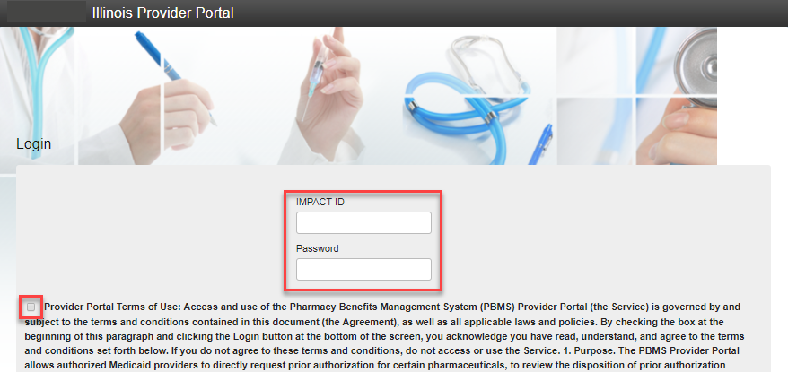
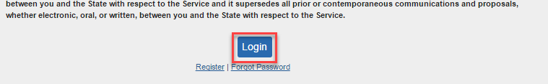
Logging In
To Login to the Illinois Provider Portal, go to:
https://ilrxportal.illinois.gov
From the Login screen, enter your IMPACT ID and Password. Read the Terms and Condition, and click to add a checkmark to accept the terms.
Scroll to the bottom of the page and click the Login button.
Note: The application is set to lock out after five failed login attempts. If this happens, please contact HFS - Email: ILRx.PortalHelp@Illinois.gov

Slide 8

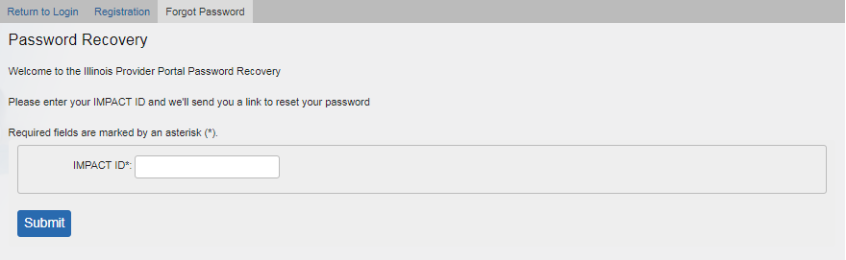
Forgot Password
If you forgot your password, select the Forgot Password hyperlink from the Login screen (bottom of page). Enter your IMPACT ID and click Submit. You will receive an email with a hyperlink to reset the password.

Slide 9
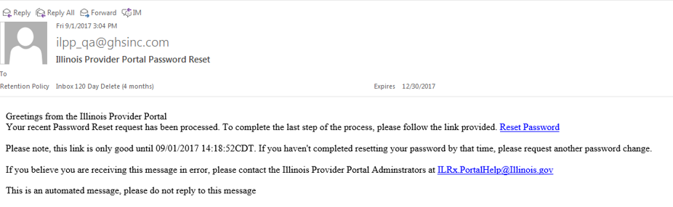
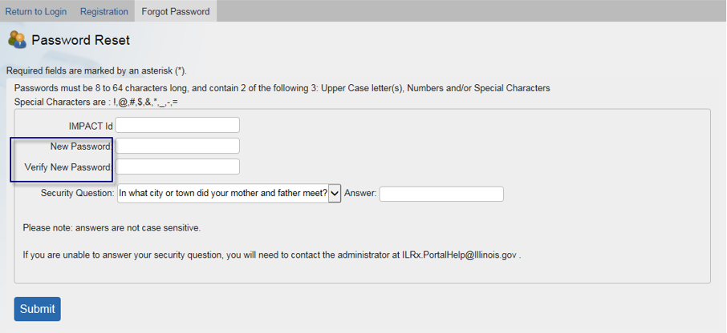
Password Reset
Click the Reset Password link in the email to continue.
Note: The reset hyperlink is valid for only 15 minutes.
Enter the required information:
IMPACT ID
New Password
Verify Password
Select a Security Question
(drop down box)
Enter Security Question Answer
Click Submit
Note: Security Question answers are not case sensitive.

Slide 10
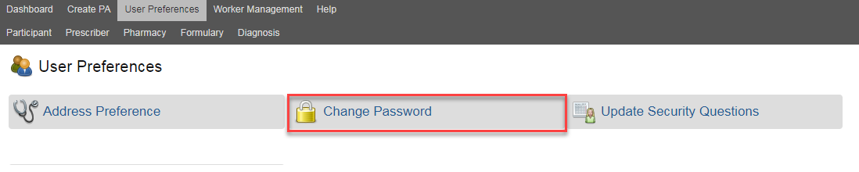
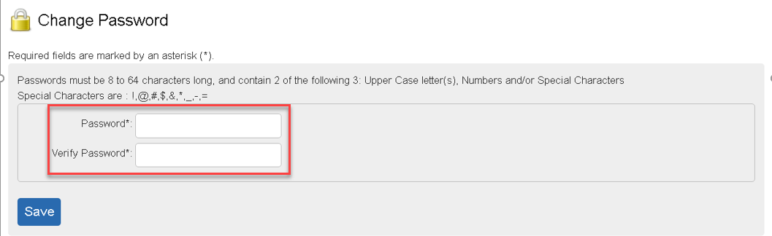
Change Password
You can reset your password by clicking on the menu item titled User Preferences.
Under User Preferences, click Change Password. Enter your new Password, verify Password (e.g., enter new Password again), and click Save.

Slide 11

Dashboard – Menu Bar
Once logged into the Illinois Provider Portal, you will see the Dashboard screen. At the top of the Dashboard screen you will find access to the following menu items:
Dashboard | Participant
Create PA | Prescriber
User Preferences Worker Management Help | Formulary Diagnosis

Slide 12
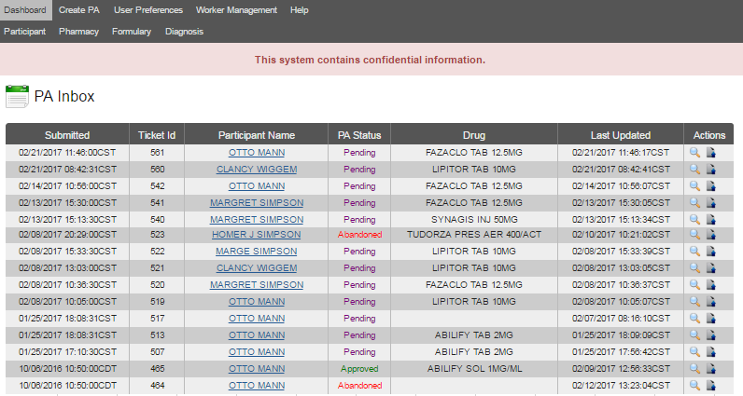
Dashboard
Ability to View Status of All PAs Submitted in Last 45 Days
Includes Faxed or Electronic
Status – Pending, Approved, Denied, Deferred and Abandoned
Unique Ticket ID for Every PA Request
Use for Correspondence/Follow-Up on Request
Notes:
The Dashboard is the landing page upon logging in to the Illinois Provider Portal. You will have the ability to see the status of all Prior Authorizations (PAs) submitted in the last 45 days. This includes all PAs faxed or submitted via the Illinois Provider Portal.
Every PA request will receive a unique Ticket ID number. Only those PAs that have been approved will receive an actual PA number (PA Statuses – Inprocess, Approved, Deferred, Denied, Abandoned, etc). Using the Ticket ID is a very useful way to correspond back and forth for any request.

Slide 13

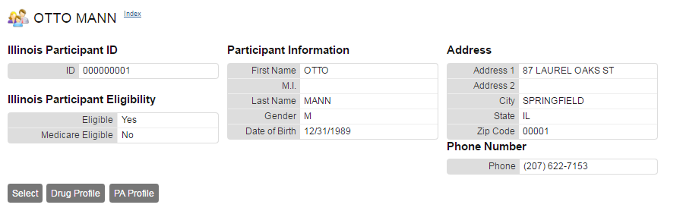
Dashboard - Participant Name
Participant’s Name hyperlink, allows you to view the participant’s profile, which includes:
Demographics | Third Party Liability (TPL)
Eligibility (Medicaid/Medicare) | Claim History (Drug Profile Hyperlink)
Provider Restrictions | Approved PA History (PA Profile Hyperlink)
Managed Care Organization (MCO)
Note: You can also retrieve a participant’s information by clicking on the Participant menu option. You can search by Illinois Medicaid ID number, Social Security Number (SSN), or a combination of last name, first name, and date of birth (DOB).
Notes:
Clicking the Participant Name hyperlink takes you to the participant’s profile, which includes:
Demographic Information, Eligibility (Medicaid/Medicare), Provider Restrictions, Managed Care Organization (MCO)
From this screen you can view the participant’s demographic information, including Medicaid and Medicare eligibility, Provider Restrictions, Manage Care Organization (MCO) and Third Party Liability (TPL) Information. Additionally, you can view the participant’s claim history
Script:
Kerri – HFS wants you to show Participants with Provider Restrictions, MCO, and TPL.
The following Sample Participants have additional eligibility information:
ID: 000000003 (Marge Simpson) – MCO
ID: 000000007 (Selma Bouvier – Provider Restrictions
ID: 000000009 (Moe Szyslak - TPL

Slide 14

Dashboard - View PA Details
Clicking the View (magnifying glass) hyperlink takes you to the PA Details screen.
Note: Prescribers are notified by fax when a PA request is approved, denied, deferred, or abandoned. The system uses the fax number associated with your account in IMPACT. Make sure your fax number is correct so you receive notifications in a timely manner.

Slide 15
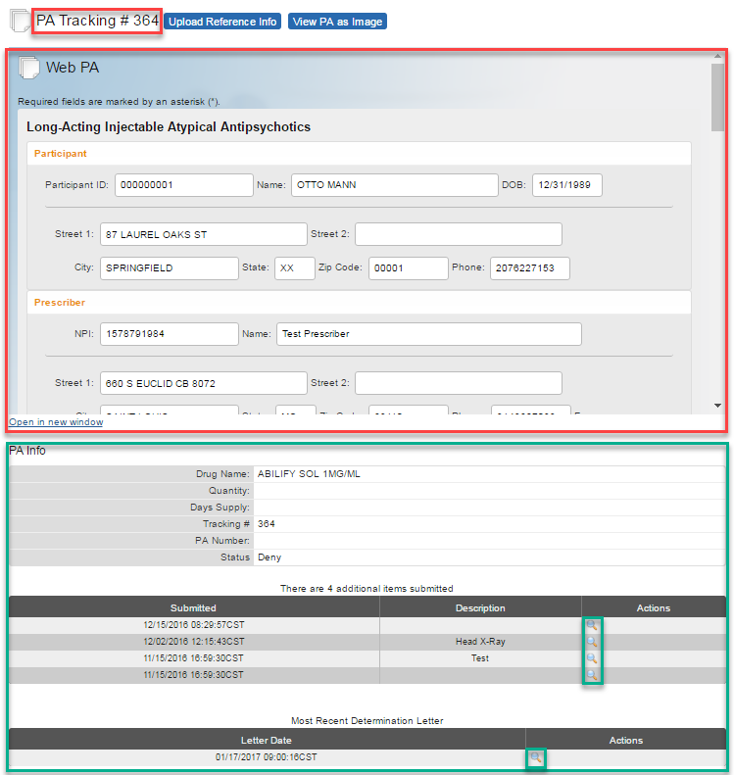
Dashboard - View PA Details Screen
The PA Details screen provides the PA Tracking number and an image of the PA submitted (Web PA).
Note: To view the entire PA, click the View PA as Image button or Open in new window hyperlink.
You can also view PA Info, documents that have been submitted (uploaded) and review the Most Recent Determination Letter Sent.

Slide 16
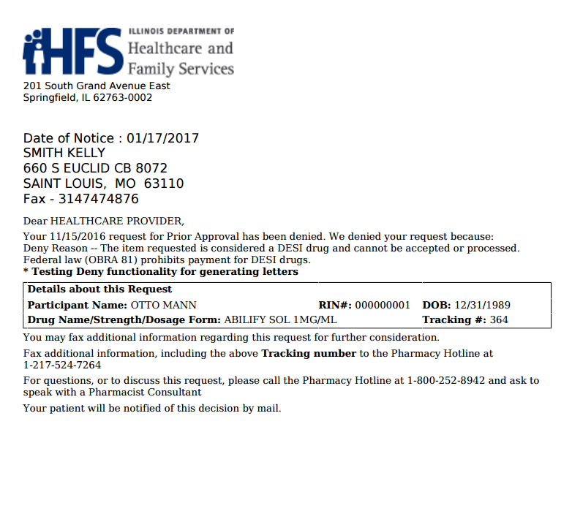
Dashboard – Determination Letter
Clicking the View (magnifying glass) hyperlink opens the most recent determination letter.
Prescribers are notified by fax when a PA request is pending, approved, denied, deferred, or abandoned. The system uses the fax number associated with your account in IMPACT.
Make sure your fax number is correct so you receive notifications in a timely manner.

Slide 17
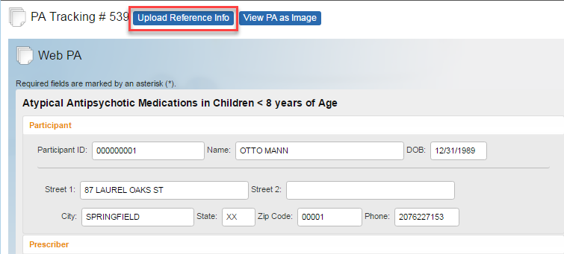
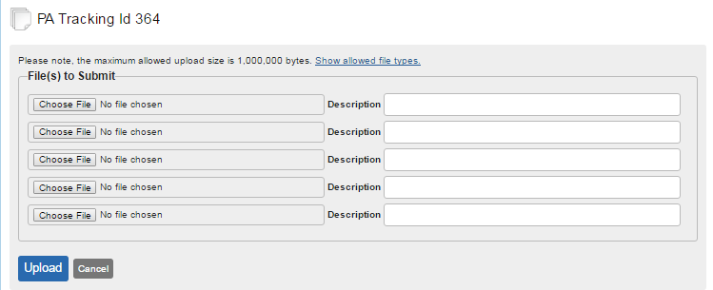
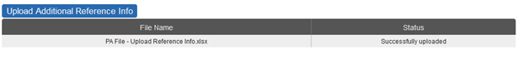
Dashboard
Upload Reference Info
Once the PA has been created, you can upload reference information to support the PA request (i.e., lab results, chart notes, or other documentation requested from the Dashboard).
Step 1. Identify the PA request and click the magnifying glass or upload reference info action button.
Step 2. Click the Upload Reference Info button.
Note: This step skipped if selecting upload reference info action button from Dashboard.
Step 3. Select the ref info from your files, and click the Upload button.
Confirmation: After the reference information has been uploaded, a message regarding the status appears on the screen.
Note: Files size cannot exceed 1 MB.

Slide 18
Prior Authorization Workflow
Request PA via Provider Portal
HFS Adjudicates/ Determines PA
Response Letter Mailed to Participants/Faxed to Prescribers
Status of PAs and Determination Letter Available on Dashboard
Approved PA Available for Claim Adjudication

Slide 19
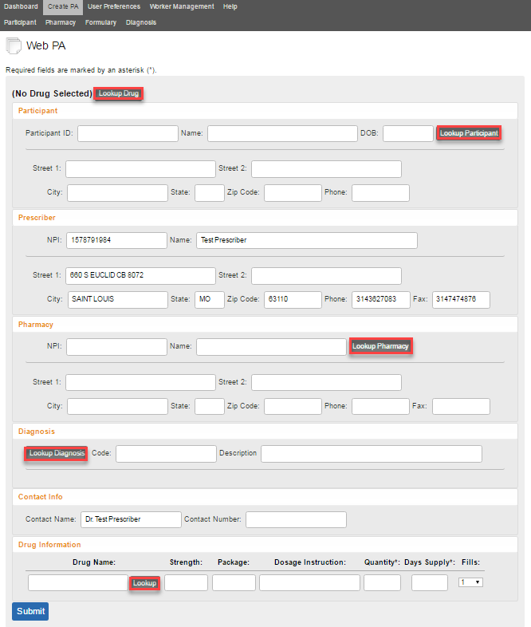
Creating a New PA (Create PA)
Step 1. Getting Started, P. 1
Click on the Create PA tab to begin a new prior authorization request.
Use the Lookup toggle buttons to search for:
  Lookup Drug
  Lookup Participant
  Lookup Pharmacy (Optional)
  Lookup Diagnosis
The Prescriber section of the PA form will be auto-populated.
Note: Throughout PA form, blank fields can not be typed in where a Lookup toggle button is present.

Slide 20
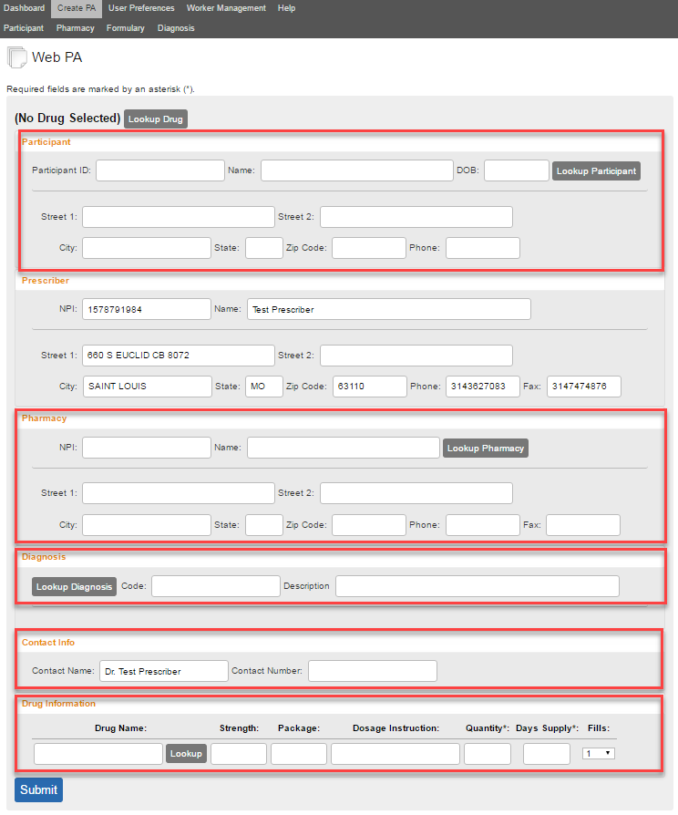
Creating a New PA (Create PA)
Step 1. Getting Started, P. 2
Required Fields
Required fields include Drug, Participant, Prescriber, Pharmacy (optional if prescriber is completing; required from pharmacy); Contact Info (Contact Name and Contact Number); and Quantity/Days Supply (not – fill # is defaulted).
Most required fields on a PA form have an asterisk (*) next to them (not all fields though are marked – such as Contact Info and Contact Number).
If a required field is not completed, upon submitting a PA, you will receive an error. Fields containing an error will have a hyperlink that will direct you to the field that needs to be completed (Example provided in Step 2. Drug Info Populated in PA slide).

Slide 21
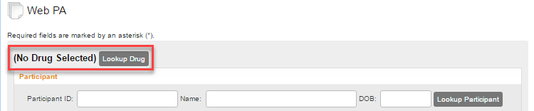
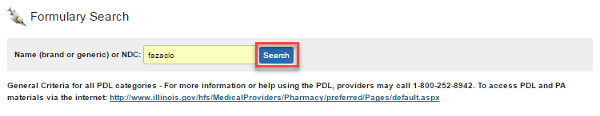
Creating a New PA
Step 2. Lookup Drug
Click the Lookup Drug toggle button to get to the Formulary Search screen.
Enter the National Drug Code (NDC) number or at least the first three characters of a brand name or generic drug and click the Search button.

Slide 22
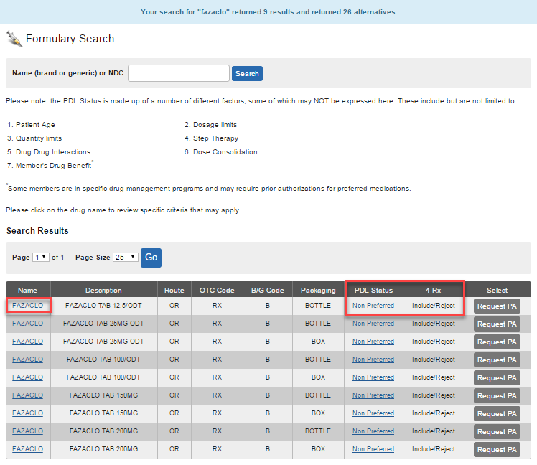
Creating a New PA
Step 2. Formulary Search Results, p.1
Two lists display. The top list contains drugs that meet the entered search criteria and outlines the drugs by Name, Description, Route (of Administration), Over-The-Counter (OTC) Code, Brand/Generic (BG) Code, Packaging type, Preferred Drug List (PDL) Status, 4 RX (Prescription) and the option to Request PA.
*PDL Status identifies whether the drug is Preferred/Non-Preferred, including those preferred requiring a PA.
*4 RX will identify whether the drug is included (reject or not reject) or excluded from the 4 RX Policy.
Click on the drug name to display the clinical criteria about the drug.

Slide 23
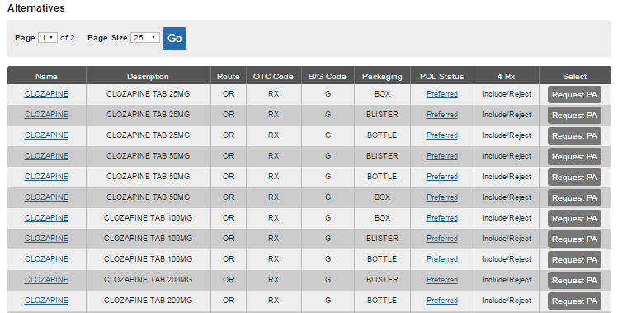
Creating a New PA
Step 2. Formulary Search Results, p.2
The lower list displays other formulary drug alternatives.

Slide 24
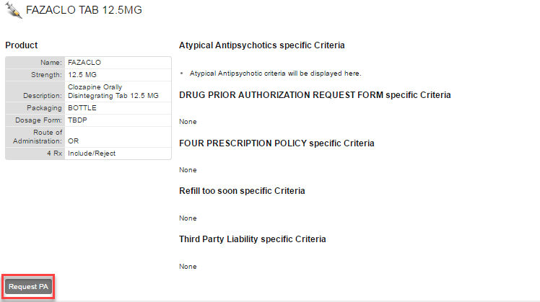
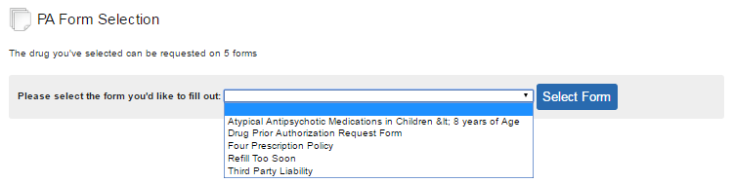
Creating a New PA
Step 2. Select Drug/Request PA
Select Drug: From either the Formulary Search or Drug Information screen, you can select the drug by clicking on the Request PA button.
Select PA Form: Based on the drug and type of request, you may have multiple forms to choose from (see PA Form Selection). From the drop-down box, choose the appropriate PA and click the Select Form button.

Slide 25
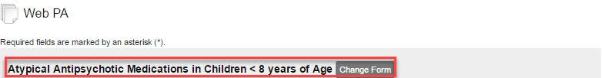
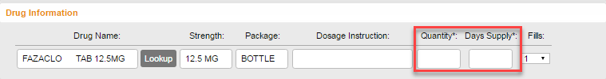

Creating a New PA
Step 2. Drug Info Populated in PA
Once the appropriate drug and PA form have been selected, the Drug Name, Strength, and Package fields are auto populated in the PA request.
Required Fields
Quantity
Days Supply
Note: Entering Dosage Instructions is optional.
Error: If Quantity or Days Supply is not populated, upon submitting the PA, you will receive an error. Fields containing an error will have a hyperlink that will direct you to the field that needs to be completed.

Slide 26
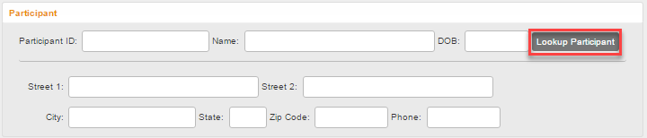
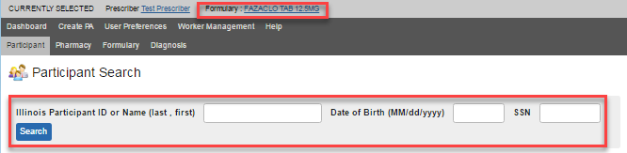
Creating a New PA
Step 3. Lookup Participant
Click the Lookup Participant in the Web PA form (Required Field).
Your search criteria needs to be specific enough that only the one participant you are looking for appears in the search results. You can search by Illinois Participant ID number, Social Security Number (SSN), or a combination of last name, first name, and date of birth (DOB).
Note: As you choose the participant, pharmacy, and diagnosis, you will can see the Currently Selected above the menu bar.

Slide 27
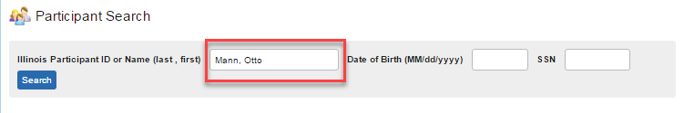
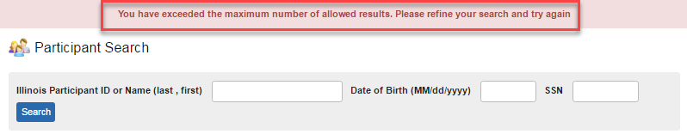
Creating a New PA
Step 3. Lookup Participant - Error
If you put in only the participant’s, you will receive an error message (see below).
The Illinois Provider Portal will display a maximum of one participant record
in response to a Participant Search.

Slide 28
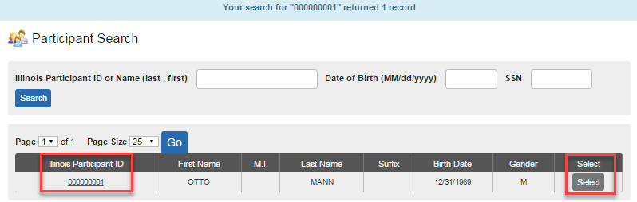
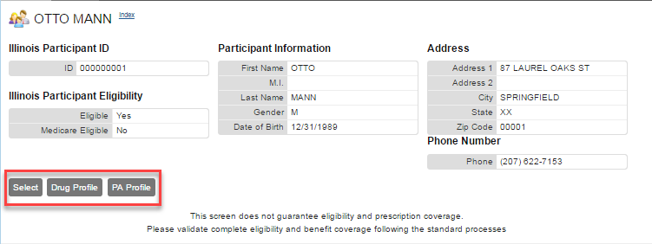
Creating a New PA
Step 3. Participant – Search Results
Clicking the Illinois Participant ID hyperlink or the Select button to go to the participant’s profile.

Slide 29

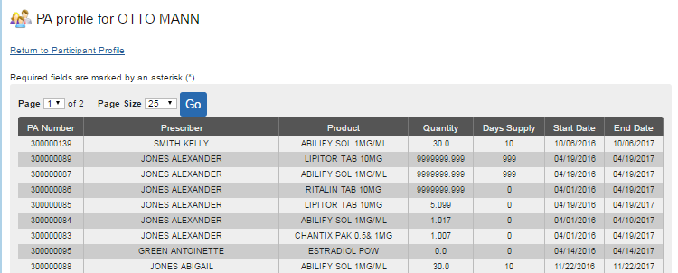
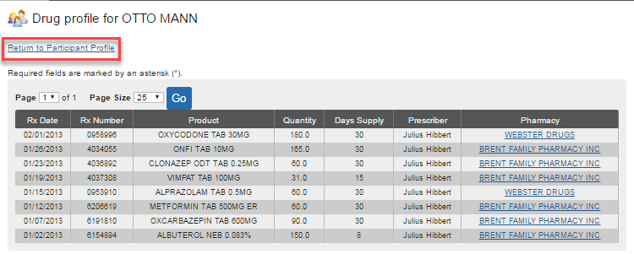
Creating a New PA
Step 3. Participant – Profiles
Click on the PA Profile to view the participant’s prior authorization history.
Click on the Drug Profile to view the participant’s RX history.
Click the Return to Participant Profile to return to the participant profile screen.
Click Select to populate the participant’s information into the PA form.

Slide 30
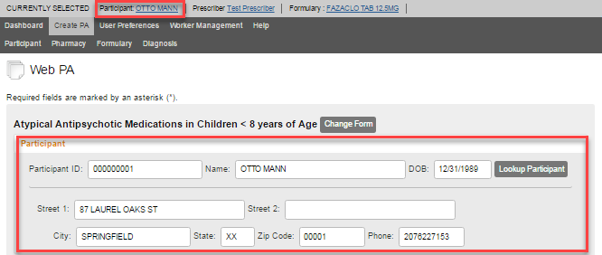

Creating a New PA
Step 3. Participant – Selected
Once the participant is selected, their information populates in the PA form. Note: To deselect a participant, click the Clear button on the Participant Profile screen. *The Clear function is a common feature for Participant, Pharmacy, Formulary, and Diagnosis.

Slide 31
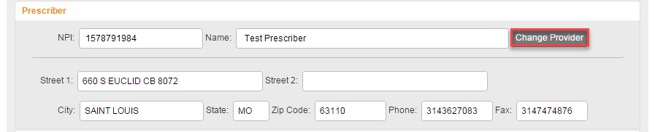
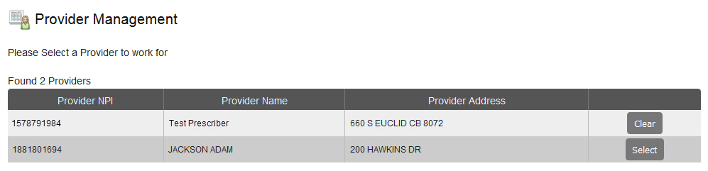
Creating a New PA
Step 4. Change Provider
As the Prescriber, your information should auto-populate into the PA form fields.
If your staff works for more than one physician (Office Manager/Office Worker) they can click the Change Provider button to select the correct location in Provider Management

Slide 32
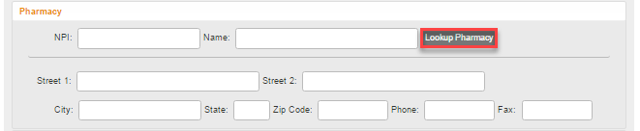
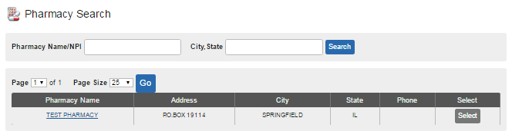
Creating a New PA
Step 5. Lookup Pharmacy
Click the Lookup Pharmacy button in the Web PA form (Not Required).
To locate a pharmacy, enter: The National Provider Identifier (NPI) number, or at least
the first three characters of a pharmacy name, or a City and State combination. Click the
Search button. Depending on the search criteria, a single pharmacy or a list of
pharmacies will display, with addresses and phone numbers, will display.

Slide 33
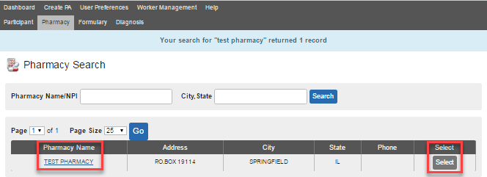
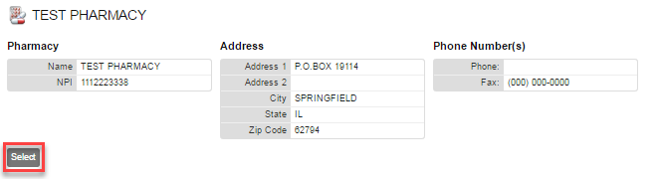
Creating a New PA
Step 5. Pharmacy – Search Results
Clicking the Pharmacy Name hyperlink or the Select button to go to the pharmacy’s profile.
Clicking the Select button to select the pharmacy.

Slide 34
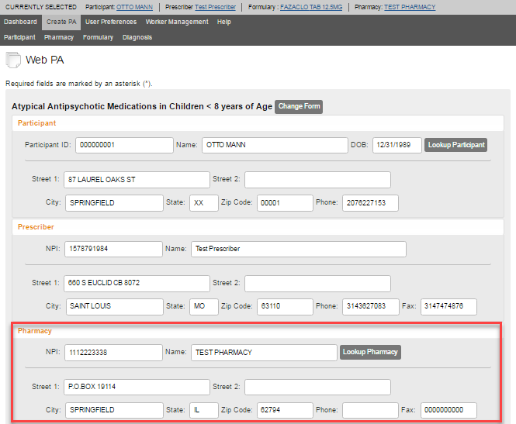
Creating a New PA
Step 5. Pharmacy – Selected
Once the Pharmacy is selected, their information populates in the
PA form and above the menu bar.

Slide 35

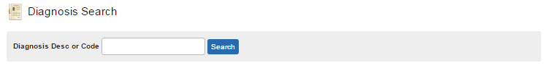
Creating a New PA
Step 6. Lookup Diagnosis
Click the Lookup Diagnosis in the Web PA form (Not Required).
Enter the ICD-10 code, ICD-9 code (if the date of service is prior to October 1, 2015), or at least three characters of a diagnosis description and click the Search button. The results list displays, containing the ICD-10 or ICD-9 code, a diagnosis description,
and an option to select the Diagnosis to appear on the PA form.

Slide 36
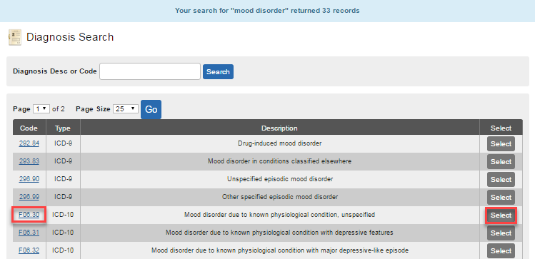
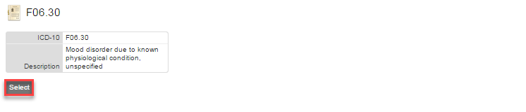
Creating a New PA
Step 6. Diagnosis – Search Results
Clicking the Code hyperlink or the Select button to go to view Diagnosis information.
Clicking the Select button to select the
Diagnosis code.

Slide 37
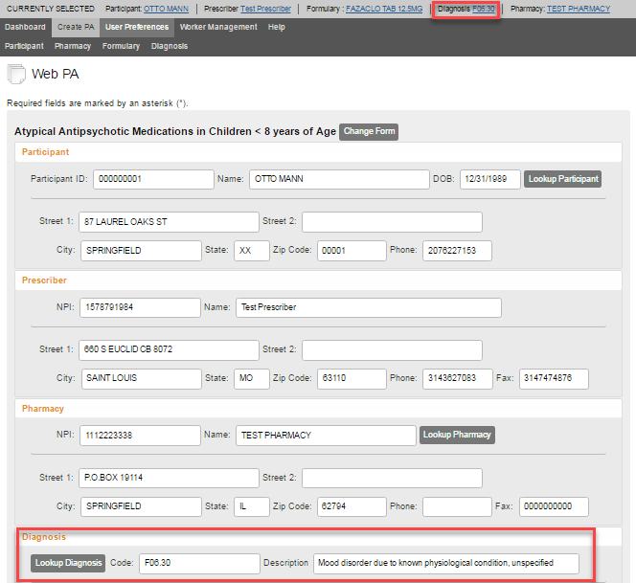
Creating a New PA
Step 6. Diagnosis – Selected
Once the Diagnosis code is selected, the information populates in the PA form
and displays at the top of the screen.

Slide 38

Creating a New PA
Step 7. Contact Information
While not marked with an asterisks (*), you must verify that you Contact Name and Contact Number are entered (Required). If one or the other is missing, you will receive an error message upon submitting.

Slide 39


Creating a New PA
Step 8. Drug Information
If you did not use the Lookup Drug button at the start of the Create PA process, click the
Lookup button to find drug information (previously covered in Creating a New PA - Step 1).
To complete the Drug Information section, enter the Quantity and Days Supply (Required)

Slide 40
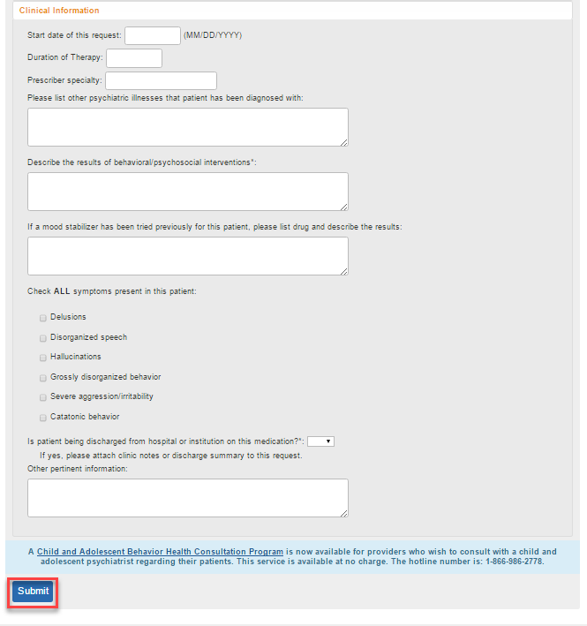

Creating a New PA
Step 9. Clinical Information
Depending on which PA form is in use, the lower section requires various types of information. You may be required to provide clinical information (medical necessity) to justify the PA request. These are text fields where you can type in related information that will assist the clinical pharmacist in making a determination on the PA. Note: Based on the form chosen (i.e., General PA Form), the override selection is optional.
Once the PA form has been completed, click the Submit button. If there were no errors, you will receive a notification that it has been submitted.

Slide 41
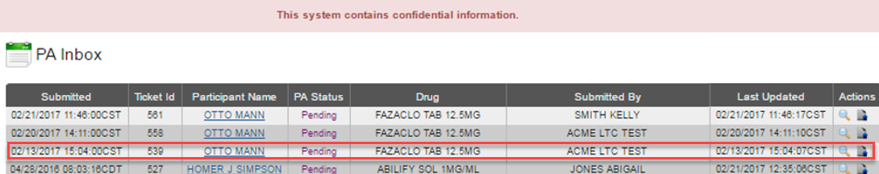
Creating a New PA
Step 10. Submitted PA - Dashboard
Your PA will be submitted to the HFS prior authorization team to adjudicate and determine your PA request. Within a few minutes of submitting the PA form, the status of the PA request will appear on your Dashboard. You can refresh the page to monitor the status or log out/log back in to check on your request.
Status Types:
Pending: PA request is in process.
Approved: A request has been approved, PA number assigned.
Denied: PA request has been denied.
Deferred: PA request is waiting on additional information from the provider before determination.
Abandoned: Deferred PAs that receive no additional information from the provider are closed after 20 days.

Slide 42
Dashboard
Upload Reference Info
Once the PA has been created, you can upload reference information to support the PA request (i.e., lab results, chart notes, or other documentation requested from the Dashboard).
Step 1. Identify the PA request and click the magnifying glass or upload reference info action button.
Step 2. Click the Upload Reference Info button.
Note: This step skipped if selecting upload reference info action button from Dashboard.
Step 3. Select the ref info from your files, and click the Upload button.
Confirmation: After the reference information has been uploaded, a message regarding the status appears on the screen.
Note: Files size cannot exceed 1 MB.

Slide 43

Dashboard
Upload Reference Info, MIME Types
The main file types allowed are listed below:
Microsoft Excel Files (.xsl, .xslx)
Microsoft Word (.doc, .docx)
Rich Text format (.rtf, .rtfx)
Text files, such as from notepad (.txt)
Graphics files such as the following:
  Bitmaps (.bmp)
  .Jpeg
  .Pjpeg
  .Tiff, .x-tiff
  .png
Internet Explorer files (.html)
Adobe Acrobat files (.pdf)
Open Office formats (.xml)

Slide 44

User Preferences
The User Preferences tab enables you to:
Address Preference: Prescribers often practice in multiple locations. The Address Preference option gives prescribers the option to select a specific location to be used as the default location. The selected location auto-populates the PA form.
Change Password: The Change Password button on the User Preferences screen provides the ability to change the login password. Changes take effect immediately.
Update Security Questions: The Update Security Questions button on the User Preferences screen provides the ability to edit unique identifiers to confirm your identity as the account owner and prevent others from compromising your account.

Slide 45

Address Preference
Prescribers often practice in multiple locations. The Address Preference option gives prescribers the option to select a specific location to be used as the default location. The selected location auto-populates the PA form.

Slide 46

Change Password
The Change Password button on the User Preferences screen provides the ability to change the login password. Changes take effect immediately.

Slide 47


Update Security Questions
The Update Security Questions button on the User Preferences screen provides the ability to edit unique identifiers to confirm your identity as the account owner and prevent others from compromising your account.
Examples of Security Questions

Slide 48

Worker Management
The Worker Management tab gives prescribers a way to grant permission to office workers to submit PA requests on their behalf.
Click the User button to change the user from Office Worker to Office Manager.
Click the Change User icon to move the user from Office Manager to Office Worker.
Click the red “X” to delete the office worker.
Note: Once you have removed an Office Worker from all associated providers, he or she no longer has access to the Illinois Provider Portal.

Slide 49
Provider Management –
Office Manager/Worker Tool
The Provider Management button gives Office Workers who are associated with multiple prescribers the option to enter PA requests for each prescriber.
Note: Each worker must be enrolled in IMPACT and associated with each prescriber.

Slide 50

Help
The Help tab contains information about the Illinois Provider Portal and provides you with a hyperlink to the User Guide, User Tutorials, and important contact information.

Slide 51

Conclusion
You have completed the Provider Portal webinar.

