Slide 1
PUBLIC EDUCATION SUBCOMMITTEE (PUB ED)
DECEMBER 15, 2022
VIRTUAL WebEx Meeting
10AM – 12PM

Slide 3
Public Education Subcommittee Charter
The Public Education Subcommittee is established to advise the Medicaid Advisory Committee concerning materials and methods for informing individuals about health benefits available under the Department of Healthcare and Family Service's medical programs.
The subcommittee, comprised of a diverse group of stakeholders, will:
This sub-committee shall:
Review and provide advice on brochures, pamphlets and other written materials prepared by the department;
Review and provide advice on HFS website content directed towards Medicaid beneficiaries and the general public;
Review projects designed to inform the general public about medical programs;
Serve as conduit for informing the Medicaid Advisory Committee and the department concerning gaps in public understanding of the medical programs;
Propose additional means of communicating information about medical programs;
Review and provide advice on program eligibility changes, customer service delivery, and eligibility processing systems, and
Make necessary recommendations to the Medicaid Advisory Committee
Presenter: Kathy Chan, Chair of Public Education Subcommittee

Slide 4
Attend all regularly scheduled meetings; when this is not possible, secure prior approval from Chair to send a non-voting substitute.
Bring healthcare and social determinants of health knowledge and subject matter expertise to bear on the work of the subcommittee in support of Illinois’ Medicaid Program.
Drive meeting agendas and work products
Expectations of Subcommittee Members

Slide 5
House Keeping
Facilitator: Melishia Bansa, Special Assistant to the Director of HFS
Meeting basics
Please note, this meeting is being recorded.
To ensure accurate records, please type name, organization, and email address into the chat.
If possible, members are asked to attend meetings with their camera’s turned on, however, if you call in & need materials, please email veronica.archundia@illinois.gov and Margaret.dunne@illinois.gov with a copy to Melisha.Bansa@Illinois.gov as soon as safely possible.
Mute audio except when speaking.
Please note that HFS staff may mute participants to minimize disruptive noise or feedback.
Patience, please – many subcommittee members and staff are new to MAC proceedings.
HFS is committed to hosting meetings that are accessible and ADA compliant. Closed captioning will be provided. Please email veronica.archundia@illinois.gov and Margaret.dunne@illinois.gov with a copy to Melisha.Bansa@Illinois.gov in advance to report any requests or accommodations you may require or use the chat to alert us of challenges during a meeting.
Minutes of the prior meeting will be circulated to subcommittee members in advance of each session. Once approved, they will be posted to the website.
Presenter: Melishia Bansa, Special Assistant to Director of HFS

Slide 6
Agenda
Call to order
Roll call of Subcommittee Members
Introduction of HFS staff
Review and Approval of Meeting Minutes from October 20, 2022
Required Training for Appointees
2023 Public Education Subcommittee Meeting Schedule
Presenter: Kathy Chan, Chair of Public Education Subcommittee

Slide 7
Agenda
VII. State Updates:
Medical Programs Update
DHS Update
HealthChoice Illinois Update
Eligibility Update:
Family Planning Program
Applications, Redeterminations & Reports
VIII. End of Public Health Emergency Communications
& Key Messaging
IX. Public Comments

Slide 8
Agenda
X. Additional Business: Old & New
XI. HFS Announcements
XII. Public Comments
XIII. Adjournment

Slide 9
V. Required Training for Appointees

Slide 10
V. Required Training for Appointees
A. All appointees must complete the following trainings on OneNet:
Diversity, Equity, and Inclusion Training
HIPPA and Privacy Training
Security Awareness Training
Harassment and Discrimination Prevention Training
Ethics Training
You can access the training at the following link:
http:onenet.Illinois.gov/mytraining
Please see attached memo for additional details. Please complete the training through OneNet later than December 16, 2022.
Presenter: Kiran Mehta, Assistant General Counsel

Slide 11
VI. 2023 Public Education Subcommittee Meeting Schedule

Slide 12
VI. 2023 Pub Ed Meeting Dates
Wednesdays
Time: 10:00 a.m. – 12:00 p.m.
February 22,
April 26,
June 21,
August 23,
October 25,
December 13
Presenter: Kathy Chan, Chair of Public Education Subcommittee

Slide 13
VII. State Updates

Slide 14
VII. A. Medical Programs

Slide 15
VII. A. Medical Programs
Update:
Certified Community Behavioral Health Clinic – Planning Grant Application
Healthcare Transformation
Statewide Transition Plan (HCBS Services)
Money Follows the Person – Planning Grant Status
Presenter: Kelly Cunningham, Medicaid Administrator

Slide 16
VII.B. DHS Update

Slide 17
VII. B. DHS Update
Presenter: Leslie Cully, Associate Director, IDHS Division of Family & Community Services

Slide 18
VII.C. HealthChoice Illinois Update

Slide 19
VII. C. HealthChoice Illinois
Health Choice Update:
MMAI transition plan submitted to CMS on 10/01/2022.
Awaiting feedback from CMS.
Presenter: Robert Mendonsa, Care Coordination Rate & Finance Administrator

Slide 20
VII.D. Eligibility Update

Slide 21
D.2. Family Planning
Update:
Family Planning: Go Live - November 30, 2022
Number of individuals enrolled to date = 294
Ways to enroll in Family Planning
Customer already has Medicaid – Call caseworker
Customer does not have Medicaid – Apply via ABE
Public Facing Website – Updates coming soon
Presenter: Laura Phelan, Policy Director

Slide 22
a. Metrics
Type | Total | Notes
New Application | 5,073 | Total reflects statewide applications Older than 45 days
Redetermination | 6,662 | On hand Form A that is being returned, but are not required SNAP Redetermination that has a Medical Redetermination attached to it
Presenter: Sergio Obregón, Division of Medical Eligibility

Slide 23
b. Health Benefits for Immigrants
Immigrant Seniors (65+)
14,698 enrolled $261,200,522 in claims
Immigrant Adults 55-64
10,687 enrolled $73,485,345 in claims
Immigrant Adults 42-54
15,693 enrolled $52,686,208 in claims
Complete reports by county can be viewed on the HFS Public Education Subcommittee website at : Reports | HFS (illinois.gov)
Presenter: Sergio Obregón, Division of Medical Eligibility

Slide 24
c. Other Eligibility Updates
Anticipated Public Health Emergency End Date: April 11, 2023
First Redeterminations Sent | 05/31/2023
First Redeterminations Due | 07/01/2023
First Cancellations to occur | 07/31/2023
Presenter: Sergio Obregón, Division of Medical Eligibility

Slide 25
c. Other Eligibility Updates
All Kids Landing Page - Healthcare for Kids | HFS (illinois.gov)
Updated to reflect CHIP to Medicaid transition
Collective Efforts for PHE Unwinding: Ambassadors of Health
HFS Application Agents | HFS (illinois.gov)
Navigators
In Person Counselors
Presenter: Sergio Obregón, Division of Medical Eligibility

Slide 26
VIII. End of Public Health Emergency Communications and Key Messaging

Slide 27
VIII. End of the Public Health Emergency Communications
& Key Messaging
Phase 1: (NOW) Address updates
Phase 1.5: (@ 60-Day Notice) Prepare transition to Phase 2
Phase 2: (PHE End) Connect to Coverage - renew/transition
Seeking your feedback to the messaging. Please respond to the survey you received.
Presenter: Evan Fazio, Communications Director

Slide 28
TBC: Key Messaging for Phase 2
Step One: Update your address – If you use Medicaid, you need to keep your address current. Update your contact at medicaid.illinois.gov or report a change through your Manage My Case at abe.Illinois.gov. You can also call 877-805-5312. For TTY, call 877-204-1012.
Step Two: Check your mail – Check your mail for a letter about your Medicaid coverage. It will tell you if you need to complete a renewal to see if you still qualify for Medicaid.

Slide 29
TBC: Key Messaging for Phase 2
Step Three: Complete your renewal – If you need to, complete and submit your renewal before the due date to avoid losing your Medicaid coverage. There are three options: 1) submit through your Manage My Case at abe.illinois.gov, or 2) mail/fax in your form according to the letter; or 3) call the DHS Customer Call Center at 1-800-843-6154 (coming soon). Even if you think you are not eligible, submit the renewal. You will need a Medicaid denial to buy a plan on the Marketplace.
Step Four: Connect to coverage – If you still qualify for Medicaid, be sure to make an appointment with your primary care provider for a check-up and any immunizations. Contact your managed care organization with any questions or help making an appointment. If you are no longer eligible for Medicaid, ask your job if they offer health insurance or visit Healthcare.gov to get your own Marketplace health plan. Financial help is available on the Marketplace!

Slide 30
Messaging Channels
= Updates
HFS
MCOs and Partners
In Development
Social (organic)
News Media
ABE Texts/Emails
TV/Radio PSAs
Website
IVRs
Partners to include: Members of this subcommittee, providers, CBOs, state and local governments, assisters, etc.
Social: Organic + paid
IVRs
Emails
Texts
Phone Calls
Events
In-person locations
1:1 conversations
Salesforce Marketing Cloud
Email
Text
Social Media (Paid)
Paid media (digital, broadcast, out of home)

Slide 31
Paid Media Campaign
Statewide
Omnichannel
Spread over full year

Slide 32
IX. ILOGIN

Slide 33
IX. ILOGIN Update
Will use latest security tools to improve protection of private information, will make account recovery easier, will be used across multiple state platforms
Already deployed:
HFS IMPACT
IDPH – Contact tracing
IDES
More systems in 2023
Will be deployed for:
ABE Apply for Benefits
ABE Manage My Case
ABE Provider Portal
IES External Worker Portal
Expected deployment March/April 2023
Communications through multiple sources; ABE page, FAQs, Webinars
Presenter: Margaret Dunne, Program Analyst

Slide 34
What you Can do to Prepare
Customers and Providers will be required to use an email as their User ID instead of a self-chosen ID. This will help users to get into their account when they have forgotten passwords and prevent the need for creating new accounts.
What if I don't have an email address?
There are several email providers who offer free email accounts. Please note that these providers are not partners with the State of Illinois, and email messages are not stored in State of Illinois systems.
Gmail: https://www.google.com/gmail/about
Yahoo Mail: https://login.yahoo.com/account/create
Microsoft Live Hotmail: https://outlook.live.com/owa

Slide 35
X. Public Comments

Slide 36
X. Public Comments
Presenter: Melishia Bansa, Special Assistant to Director of HFS

Slide 37
XI. Additional Business: Old & New

Slide 38
XII. Announcements

Slide 39
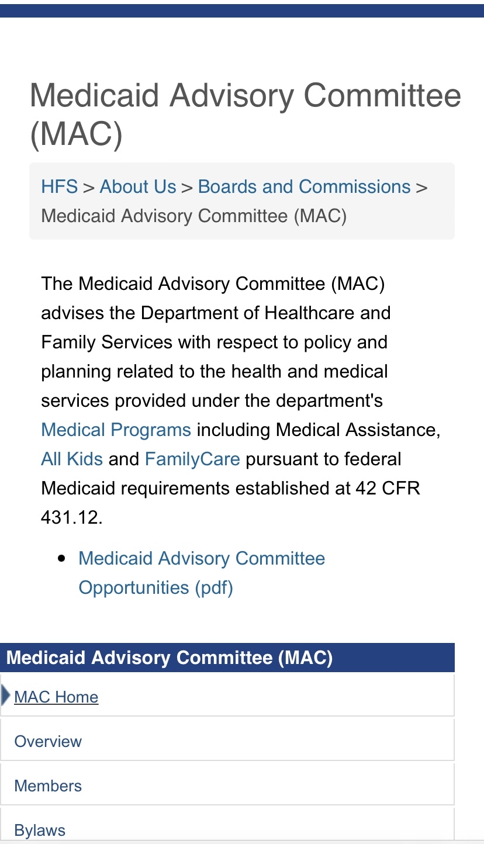
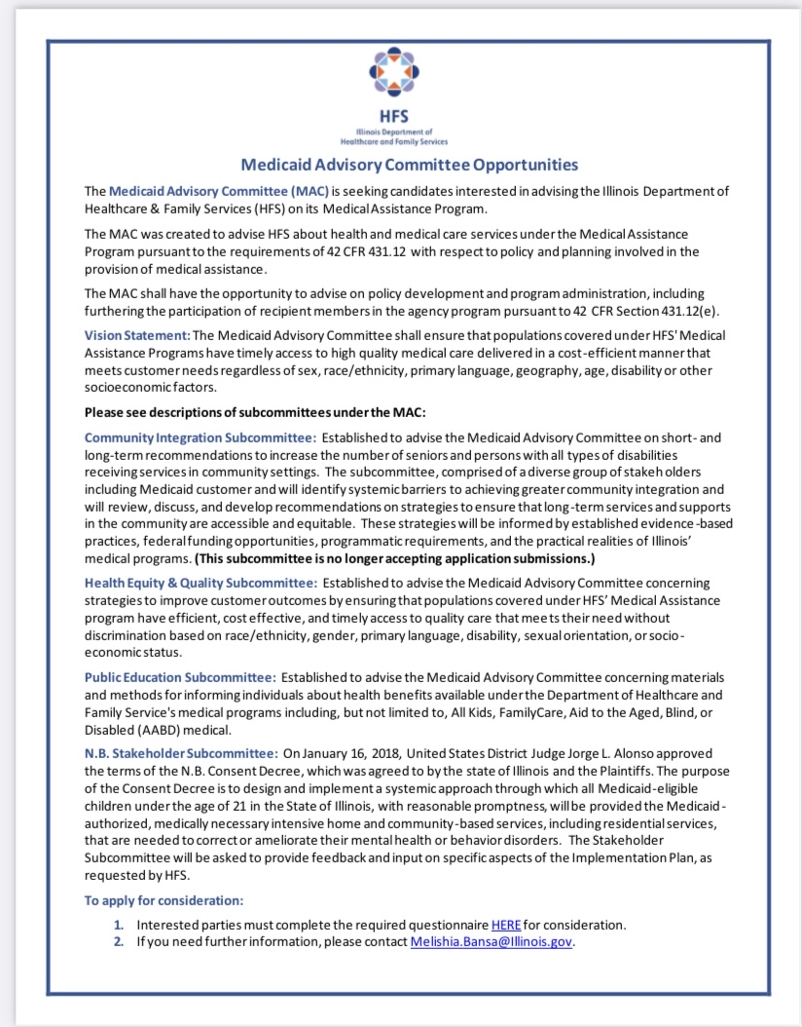
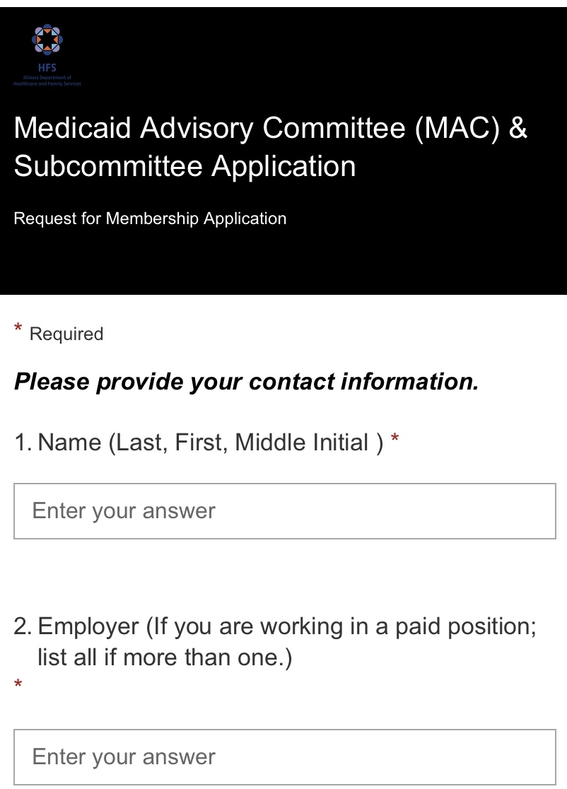
A. New MAC and Subcommittee Membership Questionnaire
Step 1
Step 2
Step 3
Presenter: Melishia Bansa, Special Assistant to Director of HFS

Slide 40
B. Resources
To receive email notifications regarding public meeting notices, sign up for our MAC and Subcommittee Listserv:
Medicaid Advisory Committee (MAC) | HFS (illinois.gov)
MAC and Subcommittees E-mail Notification Request | HFS (illinois.gov)
Presenter: Melishia Bansa, Special Assistant to Director of HFS

Slide 41
B. Resources
The Illinois Department of Healthcare and Family Services (HFS) utilizes a range of social media accounts to better reach our customers and stakeholders. We encourage you to follow us on Facebook, Twitter, and LinkedIn for important news, announcements and alerts. And please spread the word to your own followers.
Together, let's keep those we serve well informed, educated and
empowered!
Presenter: Melishia Bansa, Special Assistant to Director of HFS

Slide 42
XIII. Adjournment

