Slide 1
Electronic Claims Submission of
Long Term Care Service Claims as
Direct Data Entry and Uploaded File
Revised: 03/17/20

Slide 2
Overview and Objectives of This Presentation:
To provide some general navigational instructions for the HFS Internet Electronic Claim (IEC) system.
To give examples of how to enter a claim as a direct data entry (DDE).
To give information on how to submit a claim file.

Slide 3
Where to go to enter a claim or to submit a claim file
Providers will be able to submit claims for consideration through the HFS Internet Electronic Claim (IEC) system that is accessible through the Medical Electronic Data Interchange (MEDI) system.
The IEC link allows authorized providers/payees to submit Institutional Claim (837I) transactions as an X12 file or as a DDE claim. Registered users are only allowed access to providers and functions for which they are an authorized user.
To gain access to the IEC links, providers must complete the payee information during registration. For help registering please contact:
The MEDI Help Desk at (312) 814-3648, option 1, then option 2
Bureau of Long Term Care at (217) 782-0545

Slide 4
HFS Website Medical Providers Link

Slide 5
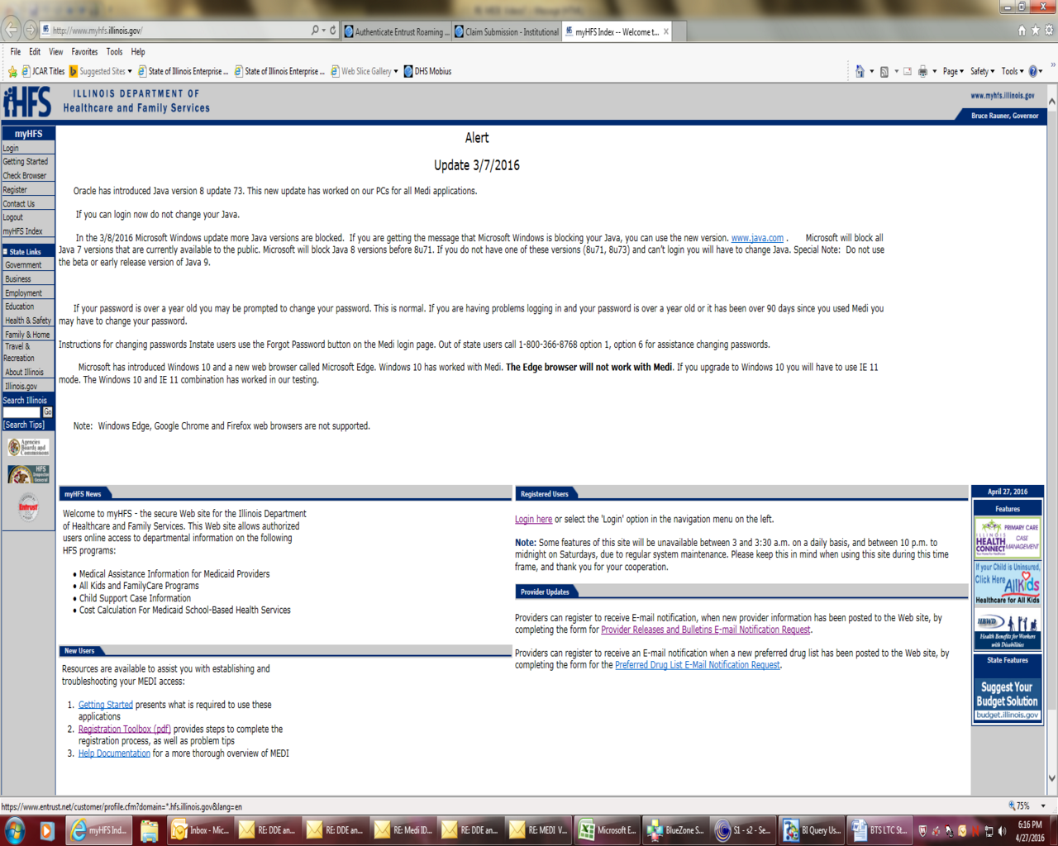
MyHFS – MEDI System Login Link

Slide 6
New Users Getting Started Link

Slide 7
MEDI HOME PAGE

Slide 8
IEC HOME PAGE
Take advantage of the information in the overviews and manuals.

Slide 9
Where to Directly Enter a Claim
Notes:
Links in the upper left

Slide 10
Patient/Subscriber

Slide 11
Subscriber Help Screen Information Data field definitions can be obtained by using the help button located in the upper right corner of any tab of the DDE . The definition includes the UB-04 reference information. Note: that references to the UB-04 are for coding information only, as no paper LTC claims will be accepted.
Field Name | Definition | Validation Rules
Recipient ID Number (RIN) | Indicates the Medicaid ID number for the individual receiving medical service. Use no punctuation or spaces. Do not use the Case Identification Number. UB-04 Reference: FL 60 (A-C) Insured’s Unique Identifier. | Required. Must be numeric and exactly nine digits.
First Name | The first name of the recipient. UB-04 Reference: FL 58 (A-C) Insured’s Name | Required
Middle Name | The middle name of the recipient. UB-04 Reference: FL 58 (A-C) Insured’s Name | N/A
Last Name | The last name of the recipient. UB-04 Reference: FL 58 (A-C) Insured’s Name | Required
Information related to Subscriber is also located in the Subscriber Name and Address Loop 2010BA in the 837I Implementation Guide.

Slide 12
X12 Claim Breakdown
Subscriber Detail
Subscriber Detail Loop 2000B
HL*2*1*22*0~
SBR*U*18*******MC~
Subscriber Name Loop 2010BA
NM1*IL*1*LAST NAME*FIRST NAME*MIDDLE***MI*MEDICAID RIN~
Subscriber Address Loop 2010BA
N3*SUBSCRIBER STREET ADDRESS~
N4*CITY*IL*ZIPCODE+4~
DMG*D8*RECIPIENT DATE OF BIRTH*M~
Notes:
Red = Static Data
Green = Assigned by Submitter
Black = Chosen Code Value or Date

Slide 13
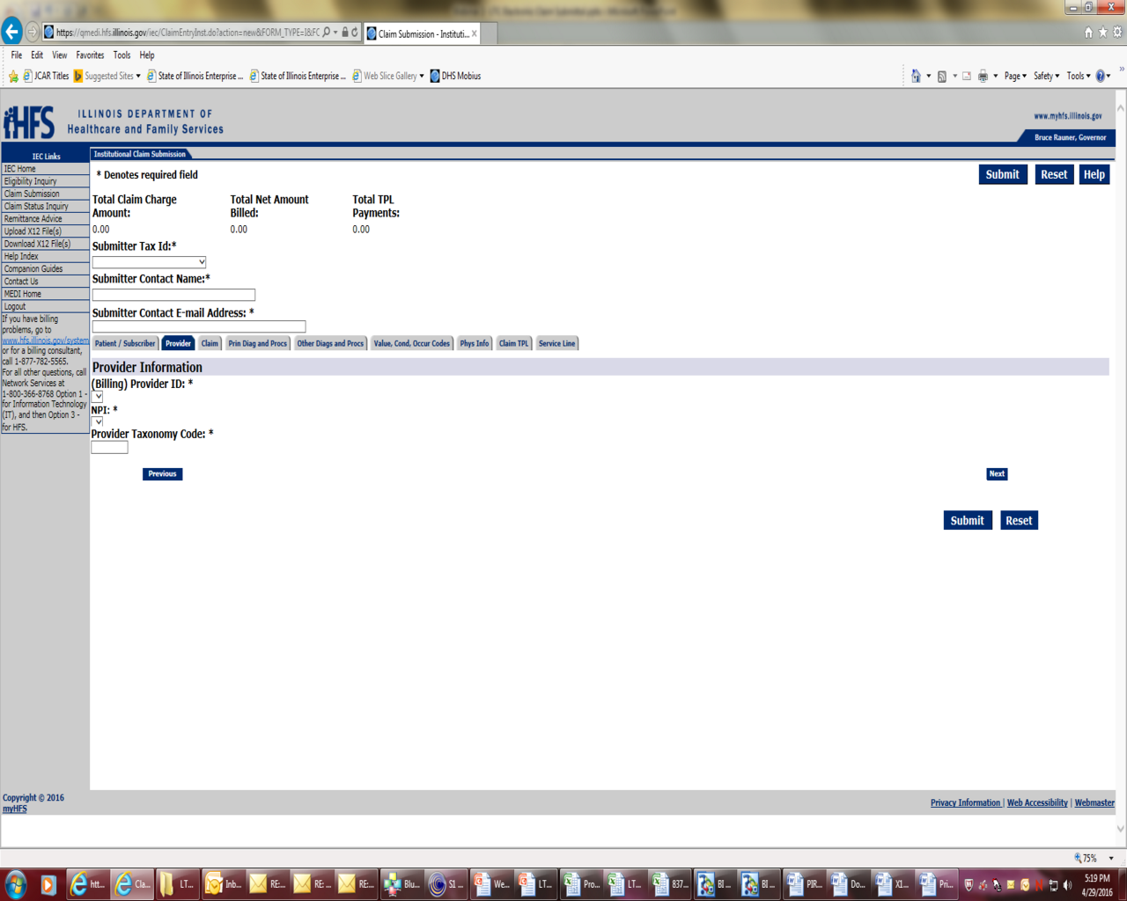
Provider
A list of providers, for which the logged in user is registered to submit transactions, will appear in a drop down box.

Slide 14
Provider Help Screen Information
Field Name | Definition | Validation Rules | Field Type
Billing Provider | The Billing Provider Name and HFS Billing Provider Number UB-04 Reference: FL 50 Payer Name and FL 57 Other (Billing) Provider Identifier. | Required | Dropdown Box
Billing Provider NPI | Billing Provider NPI UB-04 Reference: FL 56 National Provider Identifier – Billing Provider | Required | Dropdown Box
Provider Taxonomy Code | The Taxonomy code of the Provider. UB-04 Reference: FL 81 Code-Code Field | Required. Should be 10 bytes. | Text Box
Information related to Billing Provider is also located in the Billing Provider Loops 2000A & 2010AA of the 837I Implementation Guide.

Slide 15
X12 Claim Breakdown
Billing Provider Detail
Billing Provider Loop 2000A-Billing Provider Hierarchical Level
HL*1**20*1~
PRV*BI*PXC*~TAXONOMY CODE~
Billing Provider Name Loop 2010AA
NM1*85*2*BILLING PROVIDER NAME*****XX*BILLING PROVIDER’S NPI~
N3*BILLING PROVIDER STREET ADDRESS~
N4*CITY*IL*ZIPCODE+4~
REF*EI*BILLING PROVIDER ID NUMBER~

Slide 16
LTC Accepted Taxonomy Codes
PROVIDER TYPE | PROVIDER TYPE CODE | TAXONOMY | TAXONOMY DESCRIPTION
Supportive Living Program | 028 | 311500000X 310400000X | ALZHEIMER/DEMENTIA CENTER ASSISTED LIVING FACILITY
Intermediate Care Facility for the Intellectually Disabled (IID) | 029 | 315P00000X 3140N1450X 320600000X | ICF MENTALLY RETARDED NURSING CARE, PEDIATRIC RESIDENTIAL TREATMENT FACILITY, MENTAL RETARDATION AND/OR DEVELOPMENTAL DISABILITIES
Nursing Facilities (NF) | 033 | 314000000X 313M00000X282N00000X | Skilled Nursing Facility Nursing Facility/Intermediate Care Facility General Acute Care Hospital (LTC Wing)
Specialized Mental Health Rehabilitation Facility (SMRHF) | 038 | 310500000X | Intermediate Care Facility, Mental Illness

Slide 17
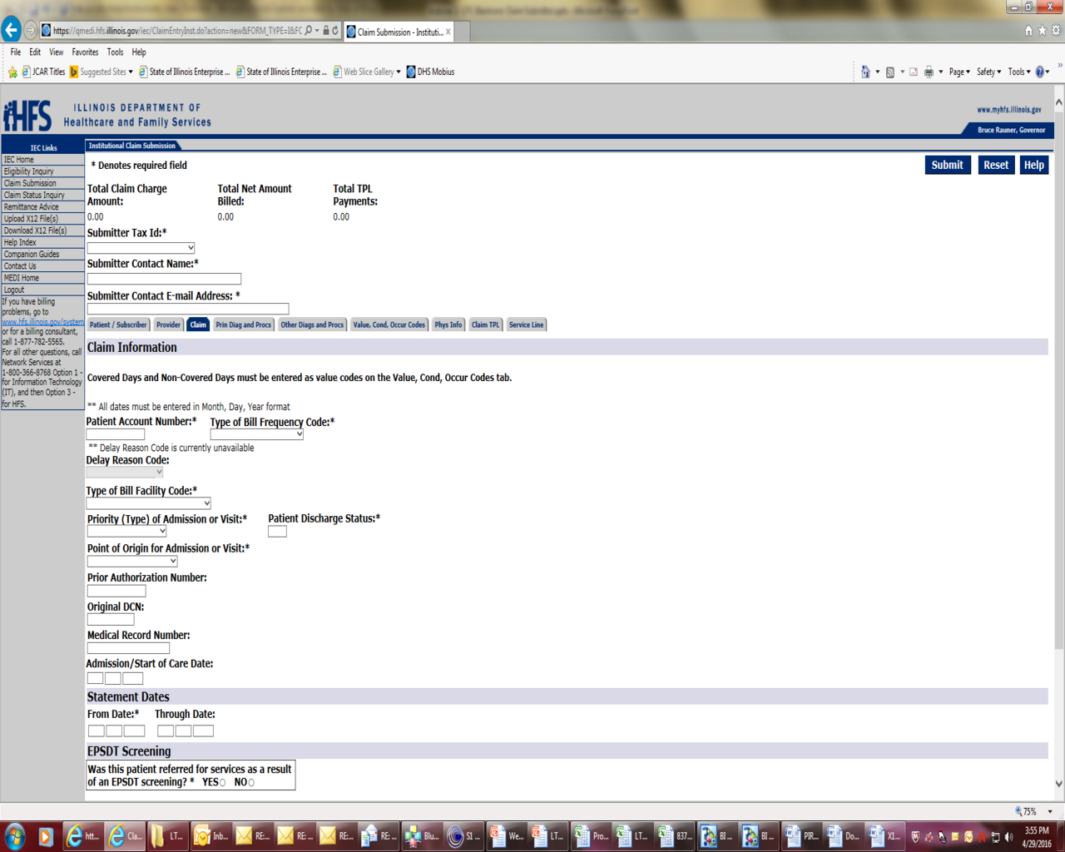
Claim Information

Slide 18
Claim Help Screen Information
Field Name | Definition | Validation Rules | Field Type
Patient Account Number | Indicates the claim submitter's identifier. Also known as Patient Control Number. UB-04 Reference: FL 03a Patient Control Number | Required | Text Box
Type of Bill Frequency Code | Code specifying the frequency of the claim. Do not include the leading zero on electronic claims. Excluding the leading zero, this is the third position of the UB-04 Type of Bill. UB-04 Reference: FL 04 Type of Bill | Required | Dropdown Box
Type of Bill Facility Code | Code identifying the type of facility where services were performed. Do not include the leading zero on electronic claims. Excluding the leading zero, this is the first and second positions of the UB-04 Type of Bill. UB-04 Reference: FL 04 Type of Bill | Required | Dropdown Box
Was this an EPSDT Service | If Yes, answer additional questions | Required | Radio Button
Claim Information is also located in Loop 2300 of the 837I Implementation Guide.

Slide 19
LTC Allowed Claim Codes
Bill Type Facility Code
21 | Skilled Nursing (including Medicare Part A)
22 | Skilled Nursing Facilities (including Medicare Part B)
65 | Intermediate Care – Nursing Facility or SMHRF
66 | Intermediate Care – Institution for Intellectual Disabilities
79 | Developmental Training
86 | State Operated Facility
89 | Supportive Living
Type of Bill Frequency Codes
1 | Admit through Discharge Claim
2 | Interim-First Claim
3 | Interim – Continuing Claim
4 | Interim –Last Claim
5 | Late Charge (s) Only
Bill Type Facility Codes listed above are the only codes LTC providers should use to bill for LTC services.
Type of Bill Frequency Codes 7 & 8 will not be available for LTC provider use at time of implementation.

Slide 20
Principle Diagnoses & Procedure
Notes:
Other Diagnoses and Procedure tab is not required for LTC providers.

Slide 21
Principle Diagnoses & Procedure Help Screen Information
Field Name | Definition | Validation Rules | Field Type
Principal Diagnosis | Code indicating a code from a specific industry code list. UB-04 Reference: FL 67 Principal Diagnosis Code and Present on Admission Indicator | Required | Text Box
POA Indicator | POA Indicator for above Diagnosis UB-04 Reference: FL 67 Principal Diagnosis Code and Present on Admission Indicator | Required | Text Box
Claim Information related to Health Care Code Information (HI) is also located in Loop 2300 of the 837I Implementation Guide.
Notes:
ABK = Principal Diagnosis (ICD-10)
ABJ = Admitting Diagnosis (ICD-10)
Only valid ICD-10 Diagnoses Codes will be accepted.
We do not anticipate LTC providers to give procedure codes on claim but if they are given they must be valid ICD-10 procedure codes.

Slide 22
Value, Condition and Occurrence Code Tab
Notes:
BI = Occurrence Span Code *NOTE* Leave of Absent Dates are all reported as a non covered Occurrence Span Code “74” , even if days may be payable.
BH = Occurrence Code *NOTE* A2 – Effective Date of Medicaid, A3 – Benefits Exhausted, 22 - Date Active Treatment Ended, 25 – Benefits Terminated by Primary Payer, 50 – Assessment Date.
Occurrence Span Code 74, ‘Non-Covered Days’ and a Value Code of 81, ‘Non-covered Days’ even though some bed hold days may be priced as payable. The pricing of bed hold days will be based on provider and bed hold type coverage rules.
The Date Span of non-covered Leave of Absence days will also be required to be reported with Occurrence Span Code 74, ‘Non-Covered Days.’

Slide 23
Occurrence Code Help Screen Information
Field Name | Definition | Validation Rules | Field Type
Occurrence Span Code | Code indicating a code from a specific industry code list. UB-04 Reference: FL 35-36, Occurrence Span Code and Dates | N/A | Text Box
Occurrence From/To Date | Indicates the Occurrence Span Code associated with from and through dates. UB-04 Reference: FL 35-36Occurrence Span Code and Dates | N/A | Text Box
Occurrence Code | Code indicating a code from a specific industry code list. UB-04 Reference: FL 31-34Occurrence Codes and Dates | N/A | Text Box
Occurrence Date | Occurrence Date. UB-04 Reference: FL 31-34 Occurrence Codes and Dates | N/A | Text Box
Claim Information related to Health Care Code Information (HI) is also located in Loop 2300 of the 837I Implementation Guide.

Slide 24
Value, Condition and Occurrence Code Tab cont.
Notes:
BE = Value Code *NOTE* 80- Covered Days, 81 Non Covered Days, 82 Co Insurance Day
BG = Condition Code
* There are more Heath Care Codes. Listed here are only those on this example claim.
The total number of days associated with ‘Leave of Absence’ Revenue Codes must match the number of non-covered days listed with a Value Code 81.
The number of days listed with Value Code 81 (non-covered days) plus the number of days listed with Value Code 80 (covered days) must add up to the total number of days calculated based on the reported ‘Statement’ dates for each claim.

Slide 25
Value and Condition Code Help Screen Information
Field Name | Definition | Validation Rules | Field Type
Value Code | Code indicating a code from a specific industry code list. UB-04 Reference: FL 39 (a-d) - 41 (a-d) Value Codes and Amounts | N/A | Text Box
Associated Amount | Indicates the value code associated amount. UB-04 Reference: FL 39 (a-d) – 41 (a-d) | N/A | Text Box
Condition Codes | Code indicating a code from a specific industry code list. UB-04 Reference: FL 18 through 28 Condition Codes | N/A | Text Box
Claim Information related to Health Care Code Information (HI) is also located in Loop 2300 of the 837I Implementation Guide.

Slide 26
X12 Claim Breakdown
Claim Information
Claim Information Loop 2300
CLM*PATIENT CONTROL NUMBER*TOTAL CLAIM CHARGE AMOUNT***BILL TYPE:A:BILL FREQUENCY **A*Y*Y~
DTP*434*RD8*STATMENT FROM-STATEMENT TO DATE~
DTP*435*D8*ADMISSION DATE~
CL1*2*4*30~
HI*ABK:L02213~
HI*ABJ:L02213~
HI*ABF:A4902~
HI*BI:74:RD8:20161218-20161218~
HI*BH:22:D8:20161226*BH:50:D8:20161220~
HI*BE:80:::13*BE:81:::1*BE:82:::13~
HI*BG:57~
Health Care Code Information (HI) claim lines is where the Diagnosis, Procedure, Occurrence, Value, Condition and Treatment information is reported. The code value in HI01-1 defines the code submitted.

Slide 27
Code Guidelines for Health Care Code Information (HI) Claim Lines
ABK = Principal Diagnosis (ICD-10)
ABJ = Admitting Diagnosis (ICD-10)
ABF = Other Diagnosis
BI = Occurrence Span
74 Non-Covered Days (Leave of Absence Dates)
BH = Occurrence Code
A2 – Effective Date of Medicaid
A3 – Benefits Exhausted
22 - Date Active Treatment Ended
25 – Date Benefits Terminated by Primary Payer
50 – Assessment Date
BE = Value Code
80- Covered Days
81 - Non Covered Days
82 - Co Insurance Days
23 – Recurring Monthly Income (Patient Credit Amount)
24- Medicaid Rate Code (Developmental Training Agency Code)
BG = Condition Code
Leave of Absence Dates must be reported as a non covered Occurrence Span Code “74” with the date span.
The pricing of bed hold days will be based on coverage rules for provider type.
The total number of days associated with ‘Leave of Absence’ Revenue Codes must also match the number of non-covered days listed with a Value Code 81.
The number of days listed with Value Code 81 (non-covered days) plus the number of days listed with Value Code 80 (covered days) must add up to the total number of days calculated based on the reported ‘Statement’ dates for each claim.
* There are more Heath Care Codes. Listed here are only those used in the example claim.

Slide 28
Physician Information

Slide 29
Physician Help Screen Information
Field Name | Definition | Validation Rules | Field Type
Attending Physician First Name | Indicates the Attending Physician First Name. UB-04 Reference: FL 76, Attending Provider Name and Identifiers | N/A | Text Box
Attending Physician Middle Name | Indicates the attending physician middle name UB-04 Reference: FL 76 Attending Provider Name and Identifiers | N/A | Text Box
Attending Physician Last Name | Indicates the Attending Physician Last Name. UB-04 Reference: FL 76, Attending Provider Name and Identifiers | N/A | Text Box
Attending Physician NPI | Indicates attending Physician NPI UB-04 Reference: FL 76 Attending Provider Name and Identifiers | N/A | Text Box
Attending Physician Information is also located in Loop 2310A of the 837I Implementation Guide.

Slide 30
X12 Claim Breakdown
Attending Provider Name Loop 2310A
NM1*71*1*LAST NAME*M*FIRST NAME **MD*XX*ATTENDING PHYSICIAN’S NPI~
PRV*AT*PXC*PHYSICIAN’S TAXONOMY CODE~
The Attending Physician is required when submitting a claim for LTC services.

Slide 31
Claim TPL

Slide 32
Claim TPL Help Screen Information
Field Name | Definition | Validation Rules | Field Type
First Name | Indicates the Other Insured First Name. UB-04 Reference: FL 58 (A-C) Insured’s Name | Required when Claim TPL is entered | Text Box
Middle Name | Indicates the Other Insured Middle Name. UB-04 Reference: FL 58 (A-C) Insured’s Name | N/A | Text Box
Last Name | Indicates Other Insured Last Name. UB-04 Reference: FL 58 (A-C) Insured’s Name | Required when Claim TPL is entered | Text Box
ID | Indicates Other Insured Identifier. UB-04 Reference: FL 60 (A-C) [Insured’s Unique Identifier | Required when Claim TPL is entered | Text Box
Claim Filing Code | Code indicating type of claim | N/A | Dropdown Box
Other Payer Name | Indicates Other Payer Name. UB-04 Reference: FL 50 (A-C) Payer Name | Required when Claim TPL is entered | Text Box
Other Payer Identifier | Indicates Other Payer Identifier | Required when Claim TPL is entered | Text Box
TPL Code | Indicates Other Payer Secondary Identifier. Must be the three digit TPL Code assigned by HFS to other payers. UB-04 Reference: FL 51 (A-C) Health Plan Identification Number. | Required when Claim TPL is entered | Text Box
TPL Status Code | Indicates Other Payer Secondary Identifier. Enter the two digit TPL Status Code assigned by HFS. UB-04 Reference: FL 51 (A-C) Health Plan Identification Number | Required when Claim TPL is entered | Dropdown Box

Slide 33
Claim TPL Help Screen Information Cont.
Field Name | Definition | Validation Rules | Field Type
Payer Paid Amount/TPL Amount | Indicates Other Payer Paid Amount. UB-04 Reference: FL 54 (A-C) Prior Payments - Payers | Required when Claim TPL is entered | Text Box
Deductible Amount | Indicates Deductible Amount UB-04 Reference: FL 39-41 Value Codes and Amounts Note: (For 837I reported in Loop 2320, CAS segment, Claim Adjustment Group Code “Patient Responsibility” (PR) with the appropriate Reason Code.) | N/A | Text Box
Coinsurance Amount | Indicates Coinsurance Amount UB-04 Reference: FL 39-41 Value Codes and Amounts Note: (For 837I reported in Loop 2320, CAS segment, Claim Adjustment Group Code “Patient Responsibility” (PR) with the appropriate Reason Code.) | N/A | Text Box
Copayment | Indicates Copayment Amount UB-04 Reference: FL 39-41 Value Codes and Amounts Note: (For 837I reported in Loop 2320, CAS segment, Claim Adjustment Group Code “Patient Responsibility” (PR) with the appropriate Reason Code.) | N/A | Text Box
Adjudication or Payment Date | Indicates Adjudication or Payment Date | Required when Claim TPL is entered | Text Box

Slide 34
TPL Information is also located in Loops 2320
Other Subscriber Information, 2330 Other Subscriber Name and 2330B Other Payer Name of the 837I Implementation Guide.
For HFS a secondary identification number (REF02 of the 2330 Loop) is always required when loop 2320 is used.
The REF02 must be the 3-digit TPL Code followed by the 2- digit Status Code assigned by HFS to other payers. For example:
REF*2U*90901~
TPL Code “909” = Medicare Part A
Status Code “01” = TPL Adjudicated – total payment shown
Prior payment amounts should be reported as claim level adjustments in loop 2320. Do not send any line level adjustment segments in loop 2430.

Slide 35
TPL Status Codes:
01 – TPL Adjudicated – total payment shown: TPL Status Code 01 is to be entered when payment has been received from the patient’s third party resource. The amount of payment received must be entered in the TPL amount box.
02 – TPL Adjudicated – patient not covered: TPL Status Code 02 is to be entered when the provider is advised by the third party resource that the patient was not insured at the time services were provided.
03 – TPL Adjudicated – services not covered: TPL Status Code 03 is to be entered when the provider is advised by the third party resource that services provided are not covered.
05 – Patient not covered: TPL Status Code 05 is to be entered when a patient informs the provider that the third party resource identified on the MediPlan Card is not in force.
06 – Services not covered: TPL Status Code 06 is to be entered when the provider determines that the identified resource is not applicable to the service provided.
07 – Third Party Adjudication Pending: TPL Status Code 07 may be entered when a claim has been submitted to the third party, thirty (30) days have elapsed since the third party was billed, and reasonable follow-up efforts to obtain payment have failed.
08 – Estimated Payment: TPL Status Code 08 may be entered if the provider has billed the third party, contact was made with the third party, and payment is forthcoming but not yet received. The provider must indicate the amount of the payment estimated by the third party. The provider is responsible for any adjustment, if required, after the actual receipt of the payment from the third party.
10 – Deductible Not Met: TPL Status Code 10 is to be entered when the provider has been informed by the third party resource that non-payment of the service was because the deductible was not met.
99 – Zero or Negative Payment: TPL Status Code 99 identifies a zero or negative payment by Medicare on a crossover claim.

Slide 36
TPL Guidelines
Third Party Liability (TPL) payments will be allowed as a reduction from payable charges submitted on the LTC claim as “Other Payer”.
Providers may refer to the “Source Code” field found in the TPL section of the MEDI eligibility verification for a recipient’s three-digit TPL code.
If the recipient has Hospital Insurance Benefits (HIB) or is a Qualified Medicare Beneficiary (QMB), the submitted claim must reflect Medicare as the primary payer; or if there is no applicable benefit, the claim must contain an occurrence code identifying the date the benefit exhausted/ended or date Medicaid became the primary payer. Medicaid only claims using intermediate care Bill Type 65X do not need the additional occurrence code.
If the recipient has a TPL such as Blue Cross Blue Shield or any other commercial payer and TPL is not reported on the submitted claim, the claim will not be rejected. HFS will continue to seek collection of non reported TPL payments through the current collection process.
If the claim is Medicaid only or has a TPL other than Medicare, use Value Code 80 for the covered days and Value Code 81 for non-covered days.

Slide 37
X12 Claim Breakdown
Other Subscriber Information Loop 2320
SBR*P*18*******16~
CAS*CO*45*3703.15**253*154.36~
CAS*PR*2*1102.5~
AMT*D*7563.62~
OI***Y***Y~
The Claim Adjustment Reason Code required in CAS02 must be an adjustment code published in Washington Publishing Company website.
WPC Claim Adjustment Reason Code List
Other Subscriber Name Loop 2330A
NM1*IL*1*LAST NAME *FIRST NAME****MI*MEDICAID RIN~
N3*SUBSCRIBER STREET ADDRESS~
N4*CITY*IL*ZIPCODE+4~
Other Payer Name Loop 2320B
NM1*PR*2*TPL NAME*****PI*TPL CODE ~
DTP*573*D8*ADJUDICATION OR PAYMENT DATE~
REF*2U*TPL CODE01~
REF*F8*OTHER PAYER’S CLAIM CONTROL NUMBER~
REF*T4*Y~
Notes:
When using the Other Subscriber and Payer loops on claim it is important to make sure that your claim is balanced.

Slide 38
Service Line
More than one service line can be added by clicking on the “save service line” button. Service lines can also be edited or removed prior to submission of claim.

Slide 39
Service Line Help Screen Information
Field Name | Definition | Validation Rules | Field Type
Revenue Code | Indicates the Revenue Code UB-04 Reference: FL 42 Revenue Codes | Required when Service Line is entered | Text Box
Unit Code | A code describing the units in which a value is being expressed. | Required | Dropdown Box
Unit Count | The Quantity, Units or Minutes as described by the Unit Code. UB-04 Reference: FL 46 Service Units | Required | Text Box
Line Item Charge Amount | Indicates the amount charged for the service line. UB-04 Reference: FL 47 Total Charges | Required. Amounts that are whole numbers (dollars only with no cents) can be entered with or without the decimal places. For example, $50 can be entered as 50 or 50.00. The dollar sign is not needed and is not valid. | Text Box
Service From Date | The starting date for the claim service period. UB-04 Reference: FL 45 Service Date | Required. The Service From Date Month must be numeric and must be on or before the current date. The month can be entered as M or MM (May be entered as 5 or 05). | Text Box
Service Line Information is also located in Loop 2400 of the 837I Implementation Guide.

Slide 40
X12 Claim Breakdown
Service Line Number Loop 2400
LX*1~
SV2*0022*HP:RUG SCORE*0*DA*14~
REF*6R*1510310190010010MCA~
LX*2~
SV2*0120**3900*DA*13~
REF*6R*1510310190010020MCA~
LX*3~
SV2*0182**1203.44*DA*1~
REF*6R*1510310190010030MCA~
LX*4~
SV2*0270**20*UN*1~
REF*6R*1510310190010040MCA~
LX*5~
SV2*0300**1183.67*UN*1~
REF*6R*1510310190010050MCA~
*Most revenue codes can be sent on a LTC claim but only a few will be priced.

Slide 41
Revenue Codes for Pricing By LTC Provider Type
Provider Type | Revenue Code | Revenue Description
Supportive Living Program (028) | 0240 0182 0183 0185 | All Inclusive Ancillary/General Patient Convenience (Therapeutic) Therapeutic Leave Hospitalization
Intermediate Care Facilities for Individuals with Intellectual Disabilities (ICF/IID) (029) | 0110 - 0160 0182 0183 0185 0190 - 0193 | General Room & Board Values Patient Convenience (Therapeutic) Therapeutic Leave Hospitalization Subacute Care
Intermediate Care Facilities for Individuals with Intellectual Disabilities (ICF/IID) (029) *Claims for Developmental Training Services must be billed separately from residential claim. | 0942 | Education and Training (Dev. Training)
Nursing Facility (033) | 0110 - 0160 0182 0183 0185 0191 0192 0193 0194 | General Room & Board Values Patient Convenience (Therapeutic) Therapeutic Leave Hospitalization Subacute Care – Level I – TBI Level I Subacute Care – Level II – TBI Level II Subacute Care – Level III – TBI Level III Subacute Care – Level IV – Ventilator
Nursing Facility (033) *Claims for Developmental Training Services must be billed separately from residential claim. | 0942 | Education and Training (Dev. Training)
Nursing Facilities Eligible to be Licensed as Specialized Mental Health Rehabilitation Facilities (SMHRF) (038) | 0110 - 0160 0182 0183 0185 | General Room & Board Values Patient Convenience (Therapeutic) Therapeutic Leave Hospitalization

Slide 42
Medical Provider Manuals: Chapter 300 is Illinois’ Companion Guide to the HIPAA 5010 Implementation Guide.
The 837I Standard Companion Guide gives claim coding clarifications and the EDI Control link gives information specific to file submission.

Slide 43
Submitted Claim Example
Notes:
This slide and the following 3 slides are an example of result screen form a submitted claim.

Slide 44
Submitted Claim Example Cont.

Slide 45
Submitted Claim Example Cont.

Slide 46
Submitted Claim Example Cont.

Slide 47
Claim File Upload
To upload an X12 claim file provider should select the “Upload X12 file” link on the left.

Slide 48
Upload File Home Page
Help button on the upper right provides important information about Submission Guidelines, which are also provided on the next slide.

Slide 49
Help Screen - Submission Guidelines
1. Any file to be uploaded needs to have a .txt or .dat file extension.
2. Data being uploaded must be in X12 format.
3. To send a file to HFS, use the Upload function.
4. To receive a file from HFS, use the Download function.
5. If the submitter is not authorized, an 824 acknowledgement will be generated and will be available on the Download page within 24 hours.
6. If an uploaded file is not compliant, a 997 or 824 acknowledgement will be generated and will be available on the Download page.
7. In order to successfully submit an X12 transmission to HFS, the sender and receiver ID must be populated correctly in the ISA (Interchange Control Header) segment of the transmission.
To find the sender ID associated with a given entity, access the MEDI system. Once you have successfully entered MEDI, click on the 'Manage My Account' link from the left side menu bar. This will open the Manage MEDI Account page. Select the Business Association that you would like to submit transactions for, and click the 'Display' button. This will open up a page that displays more detailed information about the Business Association. Under the heading 'HIPAA - IEC System' there is information about the values you will need to use to populate the ISA segment in any X12 transmissions you would like to send to HFS. Values for both inbound and outbound transmissions are included.

Slide 50
How do I upload documents?
1. Click on the Upload File(s) link from the IEC menu bar on the left hand side of the page.
2. You are required to choose which Entity you are submitting for through the "Entity" drop down box. This box displays only those Entities for which the IEC user is authorized to submit a transaction.
3. Once you have selected an Entity, you will be able to select files to upload using the "Browse" and "Add File" buttons. Clicking the "Browse" button will produce a "pop-up" window that will display the entire file directory structure on your workstation.
4. Then select which file you want to upload, click "Open", and you will see the file that was selected displayed in the text box next to the "Browse" button. Click on the "Add File" button. You will see the selected file in the "Files to be Uploaded" display box.
5. You can also delete any files displayed in the "Files to be Uploaded" display area. To do this, click the check box next to the unwanted file(s) and click on the "Remove File(s)" button located next to the "Add File" button.
6. After selecting files, click on the "Upload Files" button to begin the upload process.
7. Once the upload is completed, notification that your files were submitted successfully will be displayed on the Upload Confirmation page. Confirmation for those files submitted will include: Date, Time, Status, IEC Audit Number and File Name(s). You can repeat the process to upload additional files by clicking on the "Upload More File(s)" button located at the bottom of the confirmation page. In addition to the immediate notification, an X12 997 will be available within a 5-minute period and any negative X12 824 will be made available within a 24-hour period.

Slide 51
File Transaction Set Header and Trailer
File must contain both a Transaction Set Header and a Trailer.
The Transaction set Header contains information related to the submitter and indicates the beginning of the transaction set.
The Transaction set Trailer signifies the end of the transaction set and includes the segment count.
Transaction Set Header and Trailer information is also located in the 837I Implementation Guide .

Slide 52
X12 Claim Breakdown
HEADER
Transaction Set Header
ST*837*0010*005010X223A2~
BHT*0019*00*ORGINATOR APPLICATION IDENTIFIER*20160222*083756*CH~
Header Loop 1000A - Submitter
NM1*41*2*SUBMITTER NAME*****46*SUBMITTERS TAX ID NUMBER~
PER*IC*CONTACT NAME*TE*2177822222*EM*ACMECORP@GMAIL.ORG* ~
Header Loop 1000B-Receiver
NM1*40*2*ILLINOIS MEDICAID*****46*37-1320188~
---------------------------------------------------------------------------
Transaction Set Trailer
SE*66*0010~
Notes:
BHT03 Reference Identification/Originator Application Transaction Identifier is the number assigned by the originator to identify the transaction within the originator’s business application system.

Slide 53
Claims submitted for payment by Medicaid will indicate Illinois Medicaid as the Payer in Loop 2010BB
Payer Name Loop 2010BB
NM1*PR*2*ILLINOIS MEDICAID*****PI*37-1320188~
N3*201 S. GRAND AVENUE, E.~
N4*SPRINGFIELD*IL*62763~
Note: Payer Identification number for Illinois Medicaid is 37-1320188

Slide 54
Electronic Data Interchange (EDI)
The link below is to the EDI Control (packaging/Enveloping of transmissions). Information regarding Interchange Control Header and Financial Group Header are provided in this link.
EDI CONTROL PACKAGING/ENVELOPING OF TRANSMISSIONS

Slide 55
X12 Claim Breakdown
Interchange Control Header
ISA*00* *00* *ZZ*INTERCHANGE SENDER ID*ZZ*37-1320188INT*161225*
1635**00501*000525985*0*T*~
Interchange Control Trailer
IEA*1*000525985~
Interchange Sender ID, ISA06 is assigned by HFS during the MEDI registration process.
Interchange Control Number, ISA13 must be the same as the Group Control Number (IEA02).

Slide 56
Please continue to submit your questions.
Questions regarding the new electronic billing for Long Term Care services should be submitted to the Bureau of Long Term Care at HFS.LTC@illinois.gov with the Subject line: Monthly Billing Process.
Your questions and answers will be posted in a Frequently Asked Questions document that will be routinely updated and will be accessible on the HFS LTC Dirct Billing Page.
The website will also provide information regarding future trainings, webinars, and additional ongoing support.

