Slide 1
PHE Unwinding:
The End of the Continuous Coverage Period/Start of Redeterminations
April 18, 2023

Slide 3



Agenda
Medical Eligibility:
End of Continuous Coverage
Resuming Medical Redeterminations
Special Populations
Communication Strategy
Presenter: Kathy Chan, Chair of Public Education Subcommittee
Partner Agency Outreach Efforts:
    Partnering with MCOs and Providers
    Manage My Case

Slide 4


Background
12

Slide 5

COVID-19 Public Health Emergency
The declaration of the Public Health Emergency (PHE) provided states with authority to implement numerous flexibilities that impact almost all aspects of Illinois Medicaid operations.
The Families First Coronavirus Response Act (FFCRA) legislation offered states enhanced federal match in exchange for meeting a Maintenance of Effort (MOE) requirement.
  The ‘continuous coverage' or 'continuous enrollment’ condition was part of the Maintenance of Effort.

Slide 6
Consolidated Appropriations Act, 2023 (CCA)
Signed by President Biden on December 29, 2022
Amends the FFCRA to delink the Medicaid Continuous Enrollment Requirement from
the end of the COVID PHE.
  Other Medicaid flexibilities remain tied to the end of the PHE.
Phases out the enhanced federal match rate authorized by the FFCRA.
Impact on Continuous Enrollment
Continuous Enrollment no longer tied to PHE end date.
Medicaid continuous enrollment condition will end March 31, 2023.
  Redeterminations will begin for Illinois medical customers on 04/01/2023.
  First group of redetermination letters will be mailed on 05/01/2023.
  First date Medicaid customers could lose coverage is 07/01/2023.

Slide 7
PHE Eligibility Flexibilities
PHE Flexibilities will continue through the unwinding to help eligible customers get and stay covered, including:
Accepting attestation for income, incurred medical expenses, and insured status, but if possible, include “proof” with redetermination, especially of income – to avoid VCL.
Delay action on changes affecting eligibility until redetermination
Presumptive eligibility for MAGI adults at initial application
Increase Presumptive Eligibility (PE) for children and MAGI adults to up to two times in a calendar year.
Notes:
Partial list – other things like telehealth, pre-authorizations, etc. will be shared via a Provider Notice

Slide 8
Restarting Redeterminations

Slide 9
HFS Goals
Minimize the number of eligible customers who lose coverage
Provide all customers with access to multiple customer-centered redetermination completion and submission opportunities
Ensure all Medicaid eligible customers continue to connect with their healthcare providers

Slide 10
How to Find Renewal Dates
ABE.Illinois.gov
  Manage My Case
  Benefit Details Tab
Medi System for Providers
Customer’s Managed Care Organization (MCO), if enrolled
Coming Soon: Automated Voice Response (AVR) Phoneline

Slide 11
Providers Using MEDI: Individual or Batch Inquiries
Entities registered and authorized in MEDI for the Internet Electronic Claims (IEC) and the Recipient Eligibility Verification (REVS) web applications can check recipient eligibility using multiple methods:
A single inquiry can be done in real time using the REVS Direct Date Entry (DDE) web application.
Batch inquiries using the HIPAA 270/271 transactions can be done using the IEC web application.
Entities that have joined the Electronic Data Exchange (EDX) program can check eligibility in real time and batch modes using the CAQHCORE Safe Harbor web service. They can also check eligibility using FTPS in a batch mode. The HIPAA 270/271 eligibility transactions are used in both options.
If you wish to join the EDX program, you should email HFS.EDITradingPartner@illinois.gov and request a Trading Partner Agreement and an Application for the EDX program.
.

Slide 12
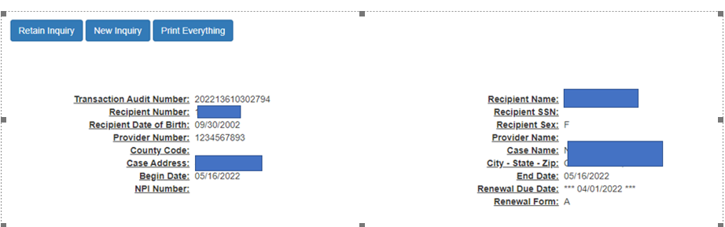
Medi Screen for Medical Providers
Renewal Form indicator is not updated until 1 month before the renewal date. If older than that, do NOT use.

Slide 13
Redeterminations: Form A and Form B
Form A | Form B
IES currently renews 30-40% of medical customers each month automatically. This is done through electronic verification of income and other factors This process does not require customer action unless information has changed. Process is known as Ex Parte or Form A process. | All Medicaid customers whose eligibility information cannot be electronically verified. Pre-populated with information from case record Customer reviews and updates with current information. Update information and attach proof of income for last 30 days (if don’t have proof, submit anyway).
SNAP beneficiaries receiving medical benefits are also renewed when they go through the SNAP redetermination process. | Customers that cannot be redetermined through electronic means or through the receipt of another program like SNAP, enter the Form B process.

Slide 14
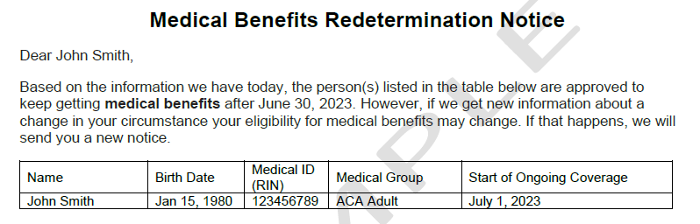
Examples: Form A

Slide 15
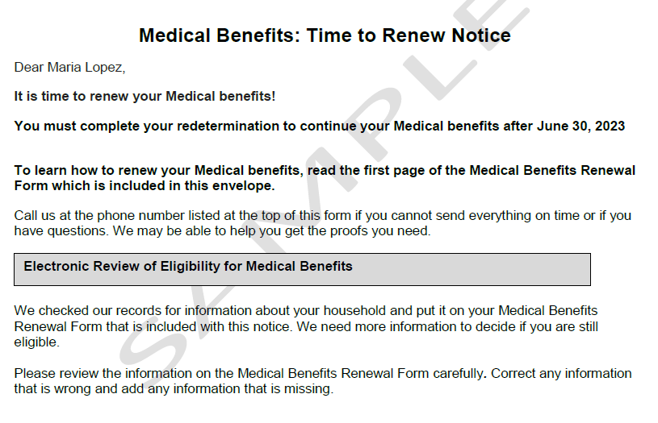
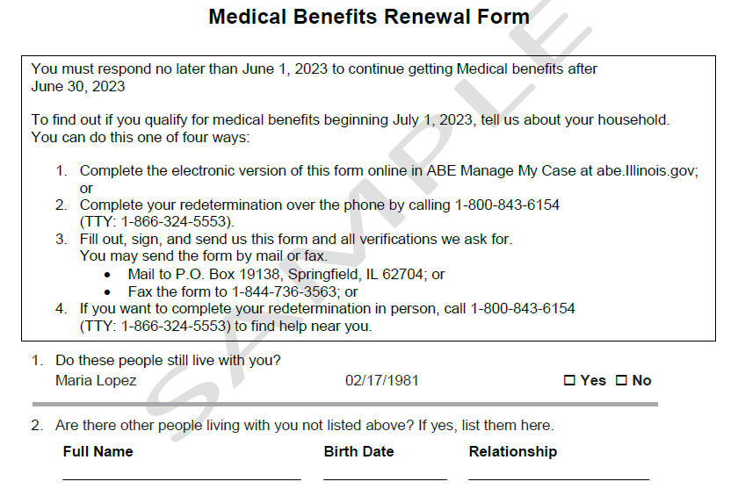
Example: Form B

Slide 16
Redetermination Process Examples*
End of Certification Period | Form B Mailed | Rede Due Date on Notice | Cut-off Date: Rede case closure | No “B”, no coverage | 90 day reinstatement period
06/30/2023 | 05/01/2023 | 06/01/2023 | 06/15/2023 | 07/01/2023 | 09/30/2023
07/31/2023 | 06/01/2023 | 07/01/2023 | 07/17/2023 | 08/01/2023 | 10/31/2023
08/31/2023 | 07/01/2023 | 08/01/2023 | 08/15/2023 | 09/01/2023 | 11/30/2023
*Rede due dates will be spread over a 12-month period: 6/01/23 – 5/01/24

Slide 17
4 Ways To Complete redeterminations
Online through ABE.Illinois.gov Must have Manage My Case (MMC) If rede is due – Renew button and electronic version of redetermination questions will appear in MMC. | By Phone: Call the DHS Call Center 1-800-843-6154/ 1-866-324-5553 TTY prompts to select TBD
Return the Renewal Notice by mail or fax to: Central Scanning Office (not local office). Return envelope is included in mailing P.O. Box 19138 Springfield, IL 62763 or Fax: 1-844-736-3563 | Return the form in person to Department of Human Services (DHS) office on Notice. Click here for list of Family Community Resource Centers
For free help completing and submitting the form refer members to a Certified Application Assistant

Slide 18
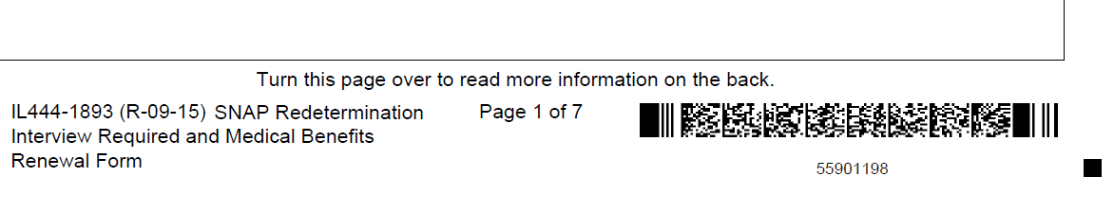
More on Rede Forms
Each REDE form has a barcode that identifies: 1) the case; and 2) the form.
When the paper form is returned to Central Scanning, it is electronically scanned into IES and the case is automatically updated to show the redetermination form was received.
As long as IES shows the renewal is submitted by the due date, the case will stay open. Any future action will depend on eligibility when processed.
EXAMPLE of barcode at bottom of notice

Slide 19
Special Populations and Transitions During the Unwinding

Slide 20
ACA to AABD Transitions
Type | Total | Notes
ACA Adults to AABD | Approx. 55,000 | Individuals that turned 65 and/or started receiving Medicare during PHE HFS transitioned customers in IES the week of 02/20/23 Placed in AABD or AABD Met Spenddown Customers notices were generated the week of 02/20/23 Customer will stay in this status until redetermination in one year (from Transition)

Slide 21
2023 Increases in Income and Resource Standards https://www.dhs.state.il.us/page.aspx?item=21741
 | 1 Person | 2 People | Notes
Income: AABD Medical | $ 1,215 | $ 1,643 | FPL update – effective 1/1/23
Income: Medicare Savings Program | See policy |  | FPL update effective 1/1/23
Resources: AABD medical | $17,500 | $17,500 | State Decision, effective with restart of resource test on 5/12/23
Resources: Medicare Savings Program (MSP = QMB, SLIB & Q1) | $ 9,090 | $15,160 | Federally set, effective with restart of resource test 5/12/23
For pending applications, the new standards will apply for any budget month beginning with January 2023.
Those in spenddown with income below 2023 FPL became AABD (no spenddown) after 3/2023 mass change in IES.

Slide 22

Medicaid to Marketplace: Getting Help to Enroll
Visit GetCoveredIllinois.gov and go to the “Get Free Help” button
Enter your zip code and find a Certified Application Counselor(CAC) near you.
CACs, will not recommend a specific plan for you but they will answer any questions you have regarding the different plans available.
CACs can also help with Medicaid renewals
Get Covered Illinois is an ACA partnership between Illinois and the federal Marketplace.
getcovered.illinois.gov

Slide 23
Communications Strategy

Slide 24
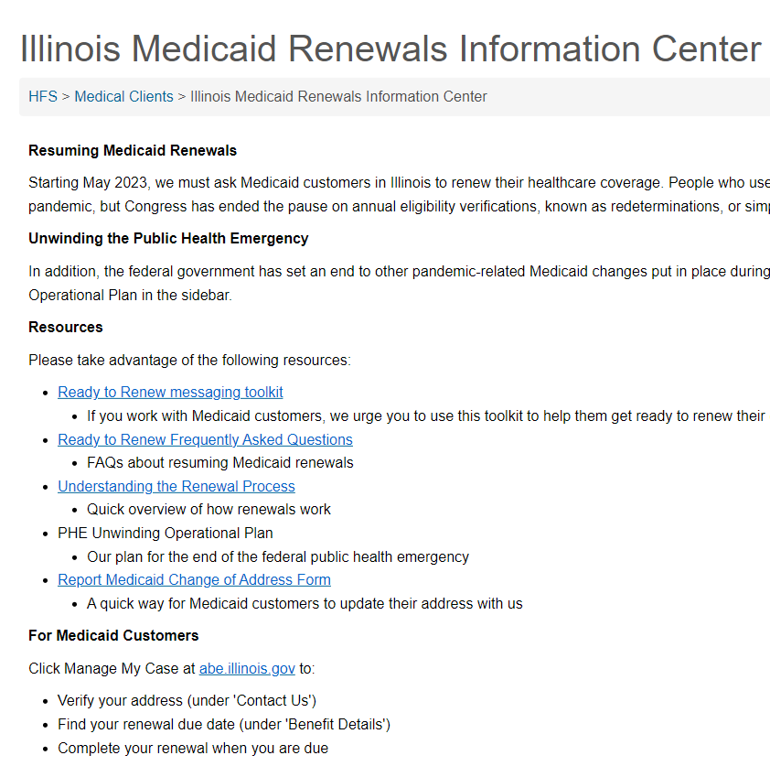
Unwinding Communication: Phase 2, Ready to Renew!
Illinois Medicaid
Renewals
Information Center:
Medicaid.Illinois.gov

Slide 25
MCO Text Messaging
Text Deployment Date/Timing | Message Copy
75 days before REDE due date | IMPORTANT: IL Medicaid, SNAP or Cash customers IDHS/HFS needs your current address. Manage your Case http://dhs.illinois.gov/?item=138311
60 days before REDE due date | Your IL Medicaid renewal will mail in 30 days. Click Manage My Case at abe.illinois.gov to verify your address and set up your account so you can renew online.
37 days before REDE due date | Your IL Medicaid renewal notice will mail in 7 days. Click Manage My Case at abe.illinois.gov to link your case to your online account so you can renew online.
25 Days before REDE due date, renewal button now visible to customers in ABE MMC | Your IL Medicaid renewal is ready online! You must renew within 30 days to keep your benefits. Visit abe.illinois.gov today and click Manage My Case to begin.
3 days post-cutoff and not received | Your IL Medicaid benefits end 01/01/0000. Redetermination not submitted. Need Medicaid? Click Manage My Case at abe.illinois.gov, submit redetermination ASAP.
After closure due to nonresponse | Your IL Medicaid ended. You may be eligible for reinstatement! Go to abe.illinois.gov, click renew button, complete the questions, and submit redetermination.
After closure due to ineligibility | Your IL Medicaid ended. You are no longer eligible. Visit getcovered.illinois.gov, medicare.gov or your job, ask about special enrollment period for coverage.

Slide 26
HFS/DHS Text Messaging
Text Deployment Date/Timing | Message Copy
2 weeks before ​REDE Due Proactive Notification | IDHS/HFS Reminder; Redetermination due <First day of REDE Due Date Month> Manage your benefits http://dhs.illinois.gov/?item=138311
​1 week before REDE due REDE due notification | IDHS/HFS Reminder: Redetermination due <First Day of REDE Due Date Month> Manage your benefits http://dhs.illinois.gov/?item=138311
3rd day of month after Rede Due: Past-due notification | IDHS/HFS Reminder: Redetermination overdue. Submit by <Cutoff Date> to keep getting benefits. Manage your benefits http://dhs.illinois.gov/?item=138311

Slide 27
HFS/DHS Automatic Text Messaging
SMS (Short Message Service) | MMS (Multimedia Message Service)
Get ready to renew your Medicaid! Find your due date & verify your mailing address at abe.illinois.gov (click Manage My Case) or 1-800-843-6154. Txt STOP=stop | Get ready to renew your Medicaid! Illinois is checking to see if you are still eligible for Medicaid. You need to verify your mailing address and know your due date to make sure you get your renewal letter. Click Manage My Case today at abe.illinois.gov or call 1-800-843-6154. STOP = unsubscribe.

Slide 28

Paid Media Campaign
Statewide
Targeted
Omnichannel
Yearlong
Multilingual

Slide 29


Partner Agency Outreach Efforts

Slide 30
Helping Our Customers Retain Coverage
Partnering with MCOs and Providers
Manage My Case

Slide 31
Partnering with Medicaid MCOs: Communication
Managed Care plans are developing robust outreach initiatives including:
  Text Messaging Campaigns
  Emails and mailings to members
  Phone banking and customer engagement
    Example: If a customer contacts their MCO and is known to have a renewal due, the MCO will offer to transfer the caller to the DHS Helpline to complete the redetermination over the phone.
  Redetermination events – are you interested in participating?
  Redetermination awareness campaigns
Improved data sharing between HFS and MCOs to target customers

Slide 32
Providers: Help our Customers Retain Coverage
Encourage medical customers to learn about their redetermination date
When speaking or working with someone – try to tell them when their redetermination is due
Refer to Get Covered Illinois Navigators for help with Medicaid and Marketplace forms
Explain the timeline of when redeterminations are mailed vs. their due date.
  Redes are mailed 30 days before their renewal due date and 60 days before the end of their certification period (which is the last day of coverage if don’t renew).
Continue to encourage medical customers to update their contact information through: 1) MMC, 2) by calling 877-805-5312 or 3) submitting online form
Assist customers with setting up Manage My Case (MMC) accounts – via phone, zoom, facetime, or in person. Are there volunteers who can be trained to help?

Slide 33
The 3 Cs of Manage My Case (MMC)
Create | Check | Change
Create a Login Link Accounts | Check your renewal date Review your case Information Check for notices from HFS and DHS Check upcoming appointments and reschedule | Submit your renewal Change your address Change of Income Add household members to your case Report Expenses Upload documents
MMC is one of the easiest way for consumers to submit redeterminations!
MMC allows customers to make fewer visits to their local DHS office, stay informed on the status of their benefits, and manage their case information.
We urge all agencies with customer contact and resources available to assist customers in setting up MMC accounts.
Notes:
MyChart!

Slide 34
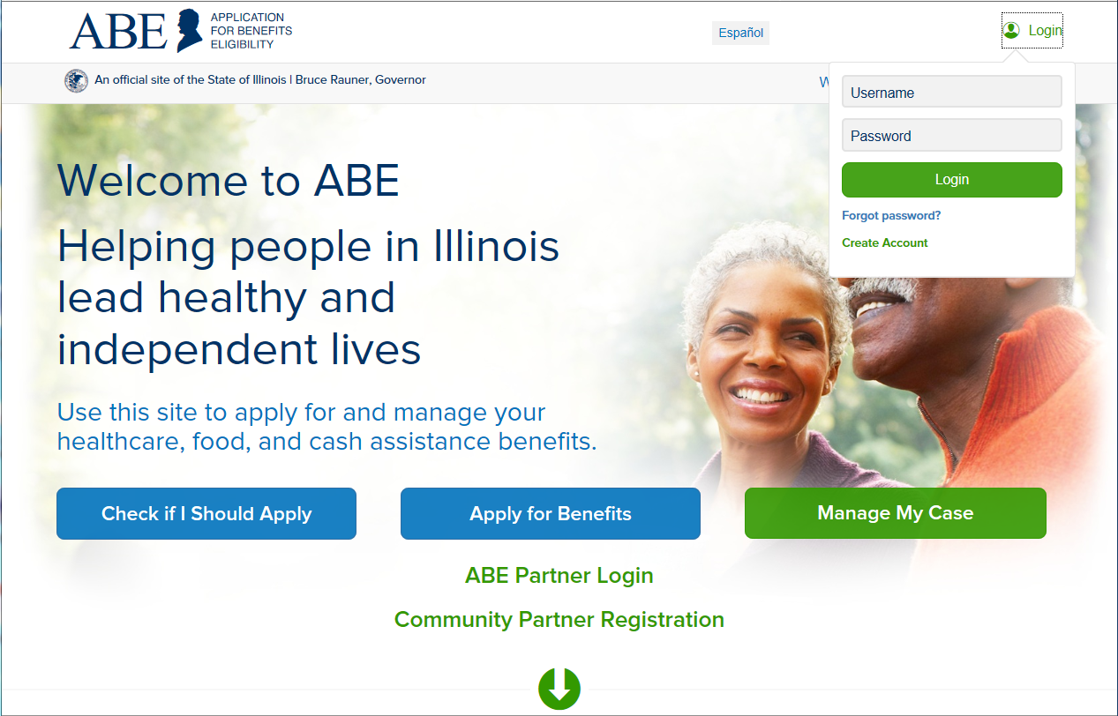
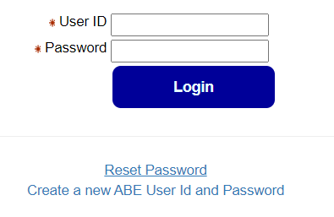
MMC Create
Most customers can use Manage My Case in ABE.
If the customer created an ABE Profile to apply for benefits, they will use that login information.
New to ABE: Create an ABE User ID and password to access Manage My Case.

Slide 35
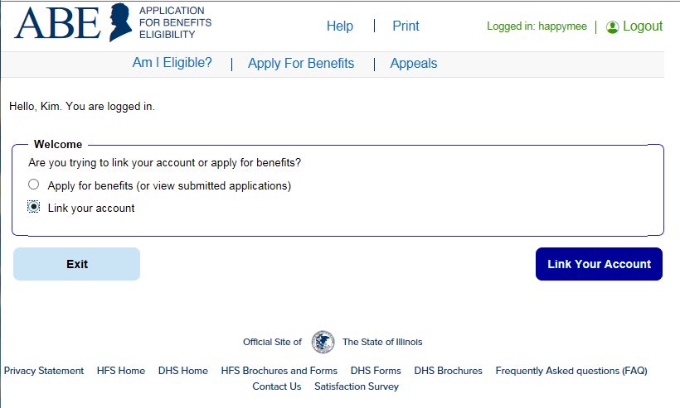
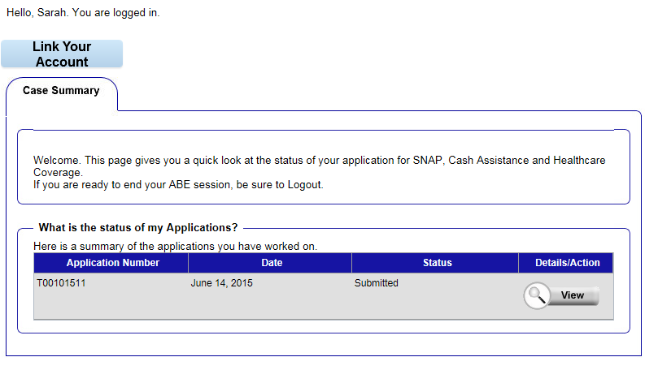
Linking an Account
Submitted Application via ABE
  Status of application seen on Case Summary page
Logging in to link a new account
Presenter: Margaret Dunne, Division of Medical Eligibility

Slide 36
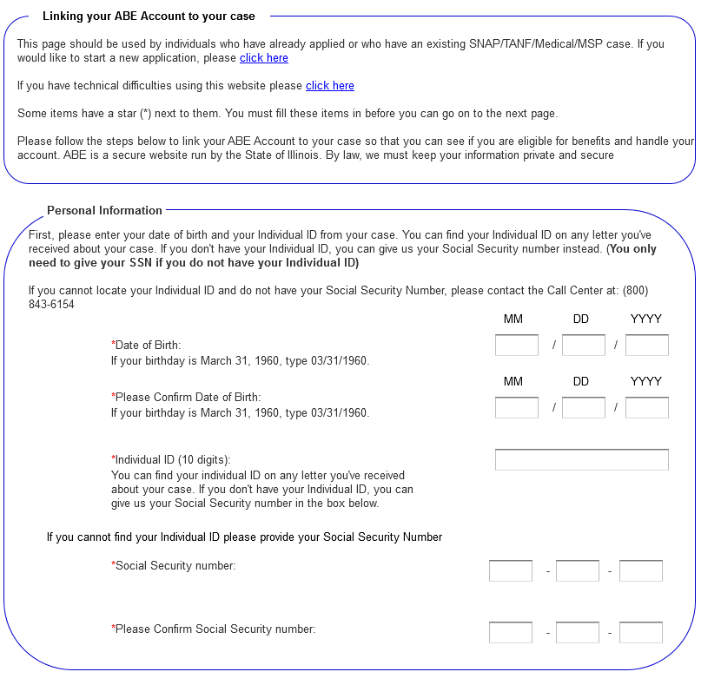

Linking ABE Account to Case Information
Customer enters Date of Birth and Individual ID or Social Security Number. ​
The Individual ID is a 10-digit number listed in the top right corner of the Notice of Decision Letter.
This is not the same as the Recipient Identification Number (RIN).
After linking, the customer may be asked to perform ID Proofing.

Slide 37
Identity Verification (ID Proofing)
If ID proofing was not completed while submitting the application, ID Proofing must be completed before using MMC.
ID Proofing is required only once.
Three (3) ID Proofing services will be available. They will be offered to the customer in the following order.
  Secretary of State (SoS) – Verifies a SoIL Driver’s License or State ID information. (available in March 2023)
  Experian – Randomly generated questions only the customer would know based on previous addresses, tax data or ownership details.
  Manual ID Proofing – Paper form process with DHS/HFS.

Slide 38
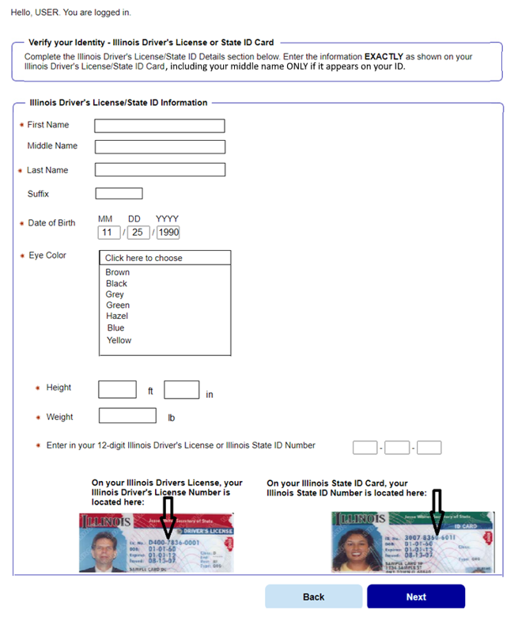
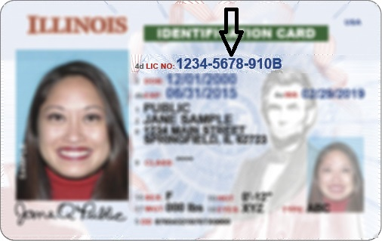
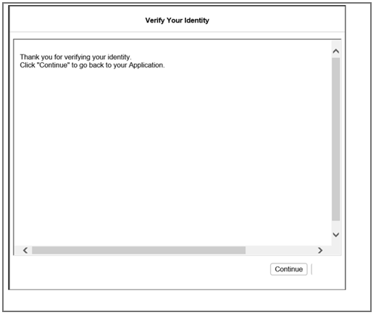
Matching Information
The user will be asked to enter multiple fields EXACTLY as they appear on their ID, including the License or ID Number.
  If successful, customers will get a Thank you message and click Next to navigate to MMC Landing page.
If unsuccessful, clicking next will navigate to Experian ID Proofing

Slide 39
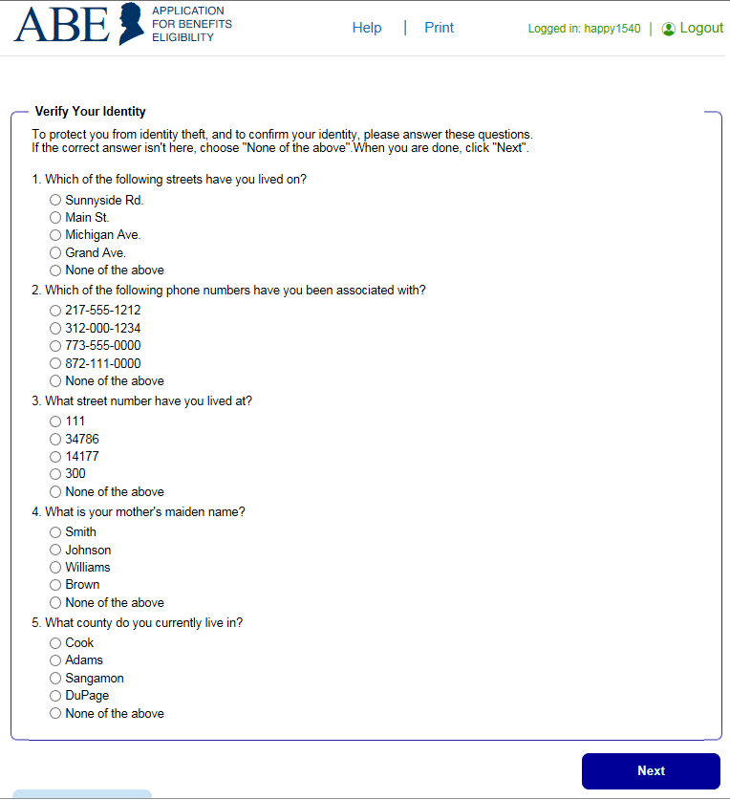
Experian ID Proofing Screens:
Experian ID Proofing will be used when:
Customer does not have IL Driver’s License or ID
Identity Verification fails through SOS
Multiple-choice questions will display that only the customer would know the answer to, thus “proving” the customer identity.
If successful, the Next button will take customer to MMC Landing page
If unsuccessful, the Next button will give further instructions

Slide 40
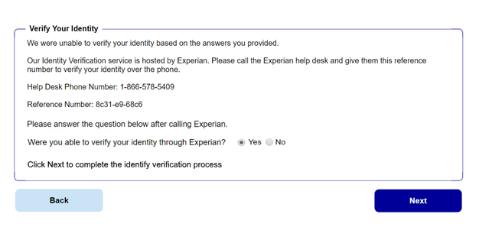
Experian ID Proofing - Verification
  If the customer is NOT able to answer the questions correctly or if the service does not have enough information to offer questions, the customer will be asked to contact the Experian Help Desk with a reference number for additional questions to answer.
After calling Experian help desk answer the question, “Were you able to verify your identity through Experian?”
If successful, the customer will select “yes” that they were able to verify identity through Experian – and then click [Next].
If unsuccessful, the customer will click “no” and will need to use the Manual ID Proofing process.
Note: The customer will be unable to access MMC until their identity has been verified manually.

Slide 41
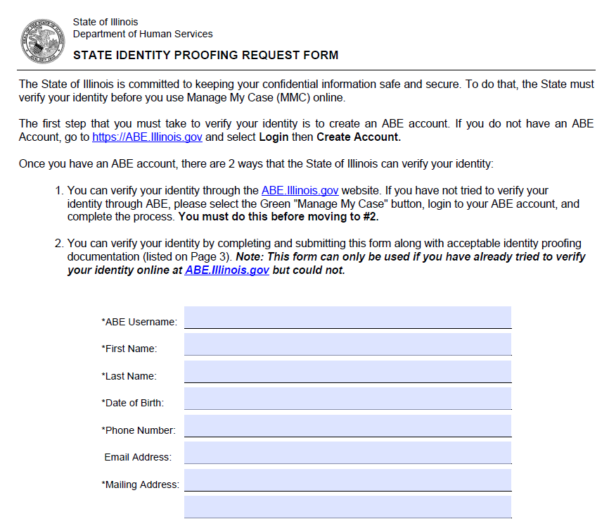
Requesting Manual Identity Proofing
To request State Identity Proofing, fill out, sign, and return the State Identity Proofing Request Form (pdf), or IL444-3610 S FORMULARIO DE SOLICITUD DE PRUEBA DE IDENTIDAD DEL ESTADO (pdf). and proof documents (listed on page 3 of the form).​
If an Approved Representative is completing the form, a signed Approved Representative Form MUST be mailed along with the Request form, and Proof Document, even if one is already on file with the State.​
Return the completed form and proof documents to:​
Illinois Department of Human Services​
Attn.: ID Proofing Unit​
600 E. Ash, Building 500, 5th Fl.​
Springfield, IL 62703​
or Return the form to your local or chosen FCRC​
Allow 6-8 weeks to hear back from the state.​
If there are questions, email: ABE.Questions@illinois.gov

Slide 42
Can I Create an MMC Account for a Customer?
HFS Application Agents/Assisters/MCOs should not create MMC Accounts without the Customer present unless they have been designated as an Approved Representative and have the signed, required paperwork.
Staff can assist the customer in setting up their own MMC Accounts on the customer’s device; staff can be on the phone or online through Zoom, webex, etc. Customer can then complete and submit information while using MMC. The customer must sign any forms submitted through MMC.
Staff should never keep the Customers User ID and password! You can write it down for the customer to keep and emphasize it should be stored securely.
In order to communicate with Caseworkers, if you are an Application Agent assisting with applications or renewals be sure to have customers complete the Application Agent Customer Authorization Form.

Slide 43
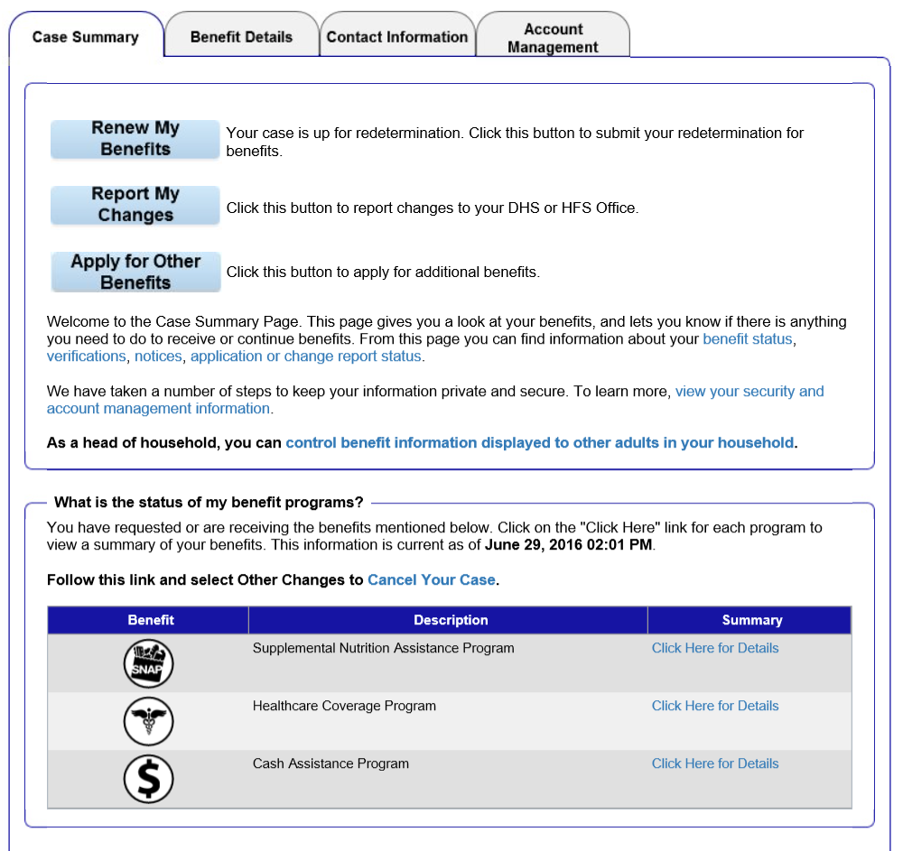
Case Summary - Check
Links to many of the Manage My Case features are available on this page.
​
Important Note: Renew My Benefits will display on the first day of the month 30 days prior to due date.
Customers can get their own benefit details here or from the tab at the top of the page

Slide 44
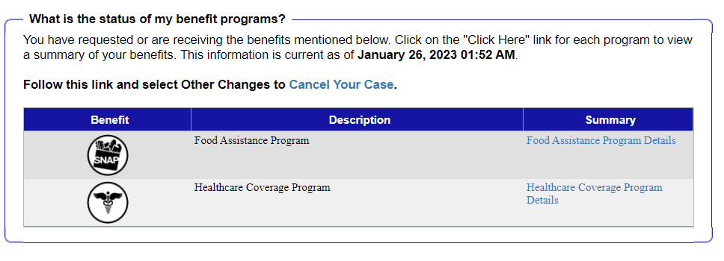
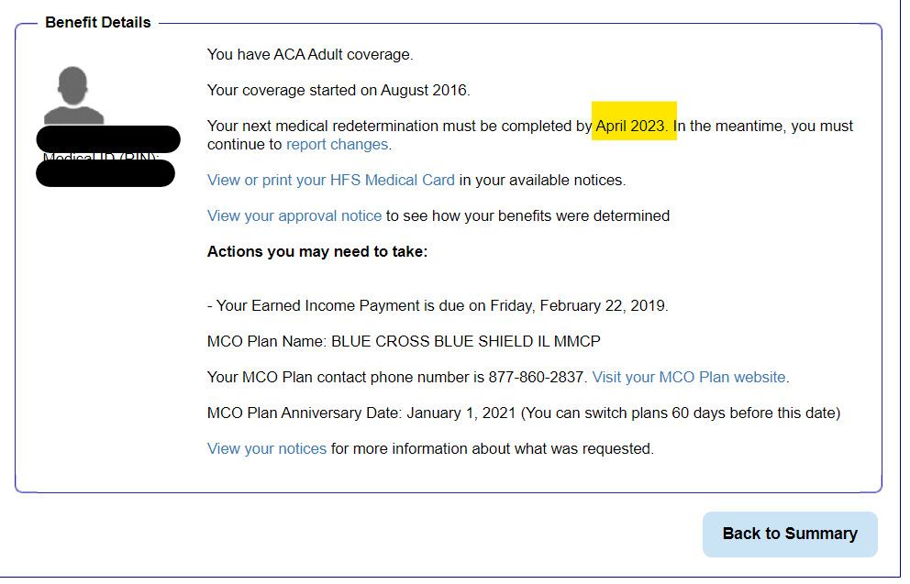
Check Renewal Date: Case Summary or Benefit Details Tabs
View more details about the benefits currently received on the Benefits Details tab.
Remember, due date is always the 1st of the month!
Click the hyperlink under ‘Summary’ to view details about each benefit program received.

Slide 45
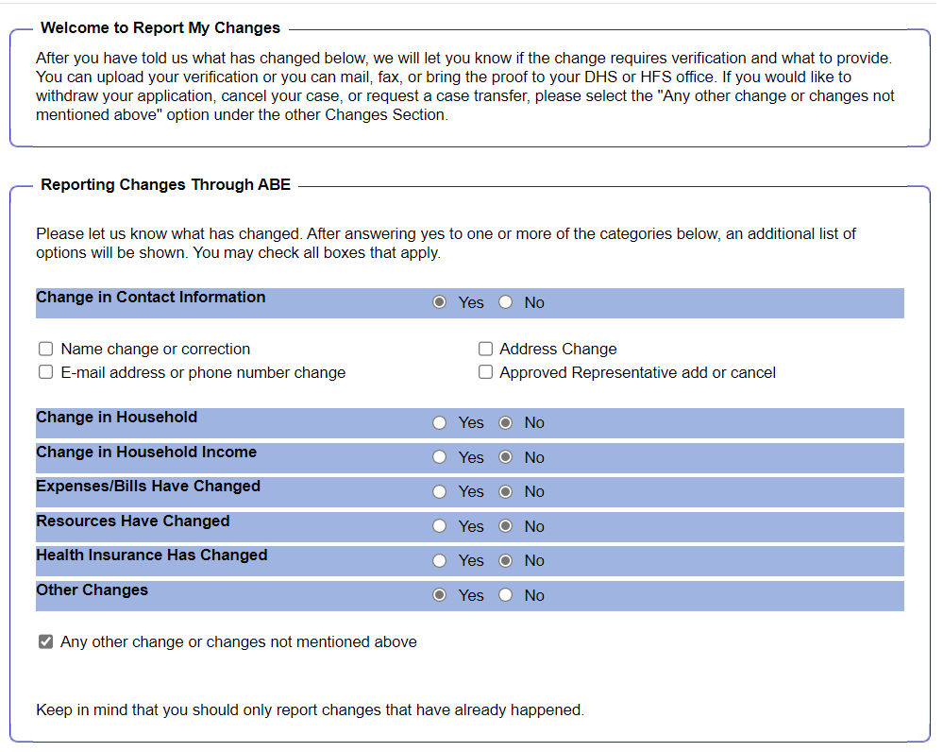

Report Changes
Reporting a change in the household or circumstances:​
1. Customer clicks on the Report My Changes button on the Case Summary page.​
2. Customer chooses the change to be reported and clicks Next. ​
3. Customer completes additional questions ​
4. If the change requires proof, documents can be uploaded through Manage My Case.

Slide 46

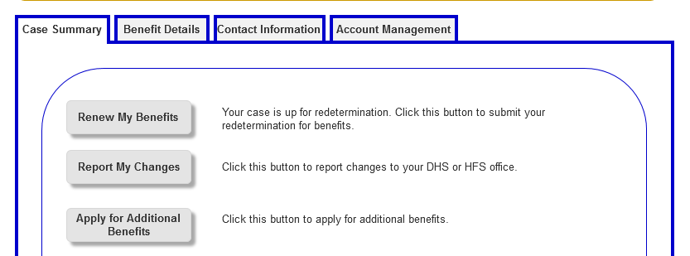
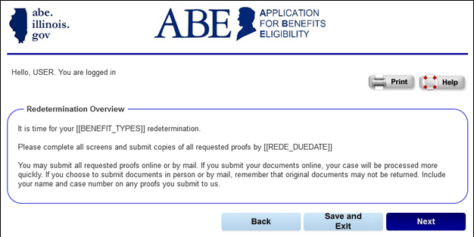
Renew My Benefits – Report any Changes
If it is time to renew customer benefits, a Renew My Benefits button displays on the Case Summary page. This button displays a month before the customers renewal is due.
Click the button. The Redetermination Overview page displays letting the customer know which of their benefits is up for redetermination. Review and click Next.

Slide 47
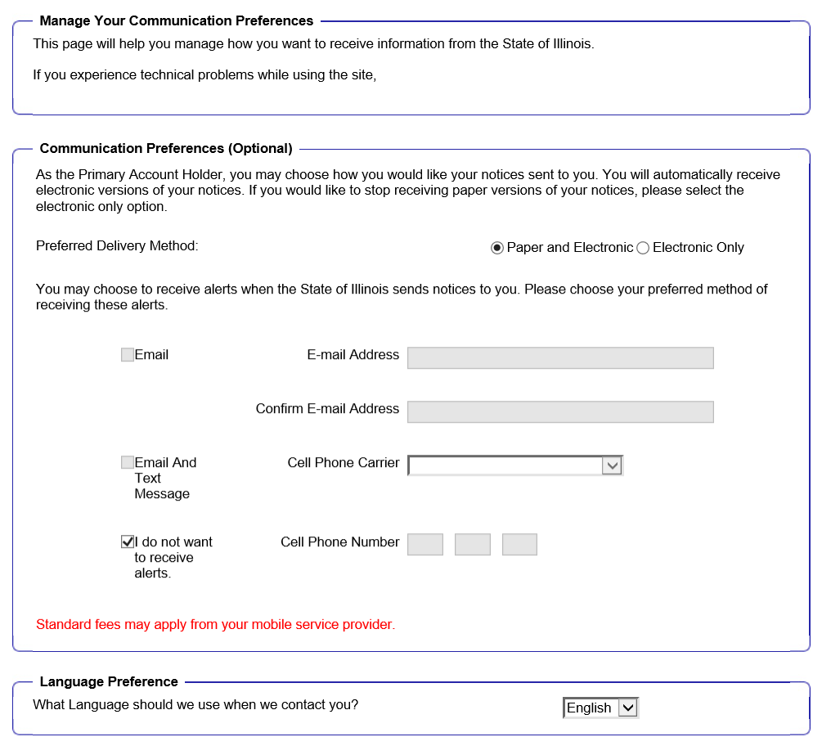
Account Management: Communication Preferences
Customers opt in or out to receive the following:
  Paper and Electronic
  Electronic Only
  Email and text alerts
Note: If an alert e-mail or text bounces back, the State will restart sending paper notices to the last address we have on file for the customer.

Slide 48
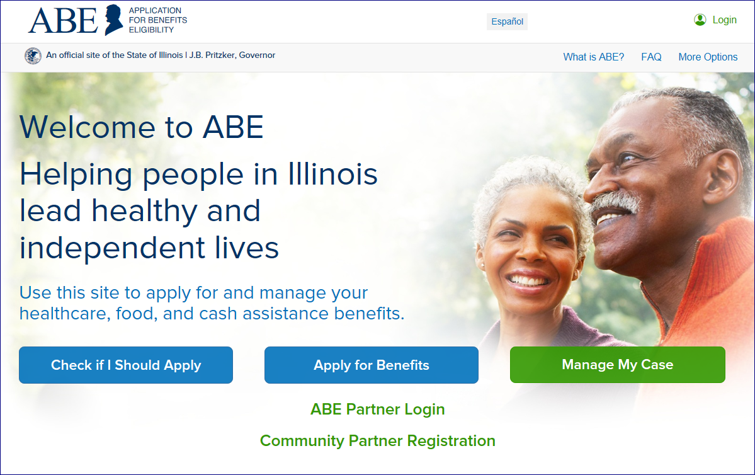
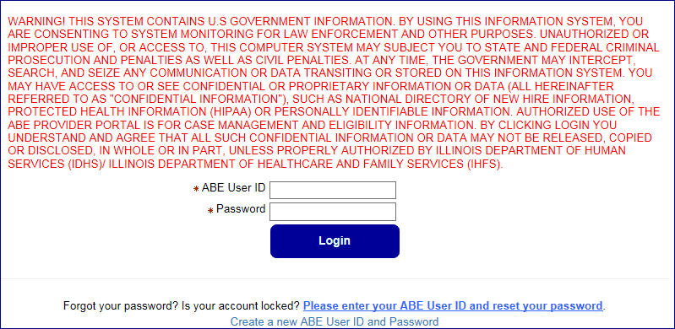
ABE Provider Portal
Use the ABE Partner Portal to upload documents, which can include redetermination paperwork!

Slide 49
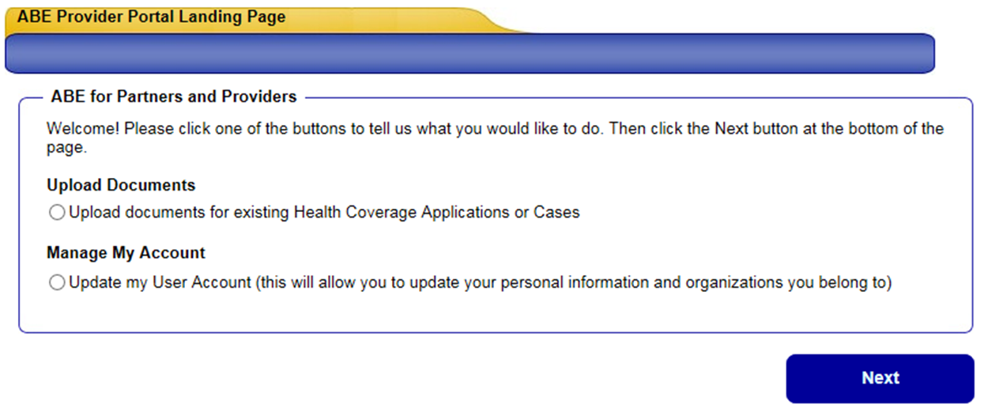
Provider Portal Landing Page
After logging in to the ABE Partner Portal, completing MFA, and choosing your work location (if you have multiple locations) the Partner Portal Landing Page will display.
Select, “Upload document for existing Health Coverage Applications or cases.” Click [Next].
You will choose the “Manage My Account” selection if you need to update your user profile including adding or changing a location, or changing an e-mail.

Slide 50
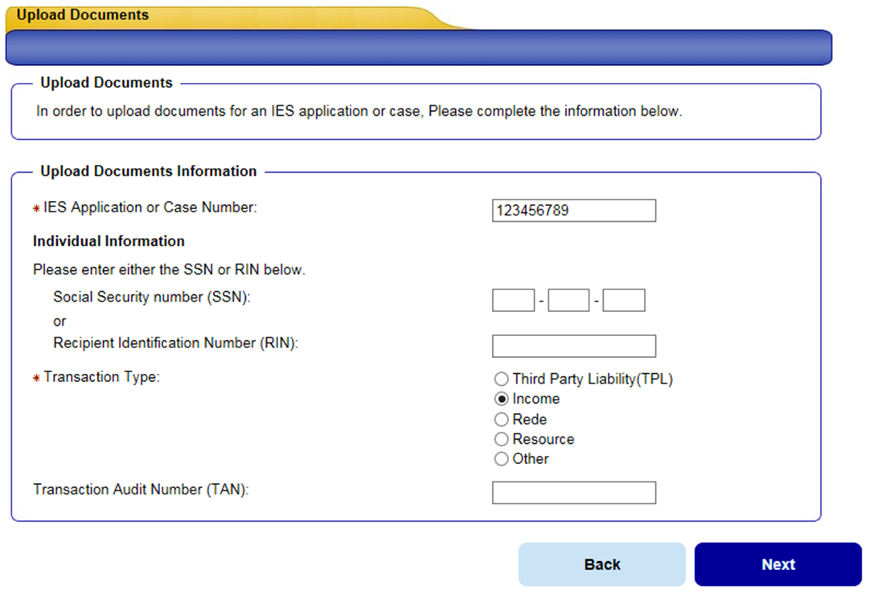
Uploading Documents
Enter the client’s Application or Case Number, Social Security Number or Recipient Identification Number (RIN) and select the Transaction Type that the documents relate. All mandatory questions must be answered to proceed. Click, [Next].
If you choose TPL or Income as your Transaction Type, you will then be asked for the Transaction Audit Number (TAN). When submitting a 3654 document under Other Proof include the admission (TAN) when possible!

Slide 51
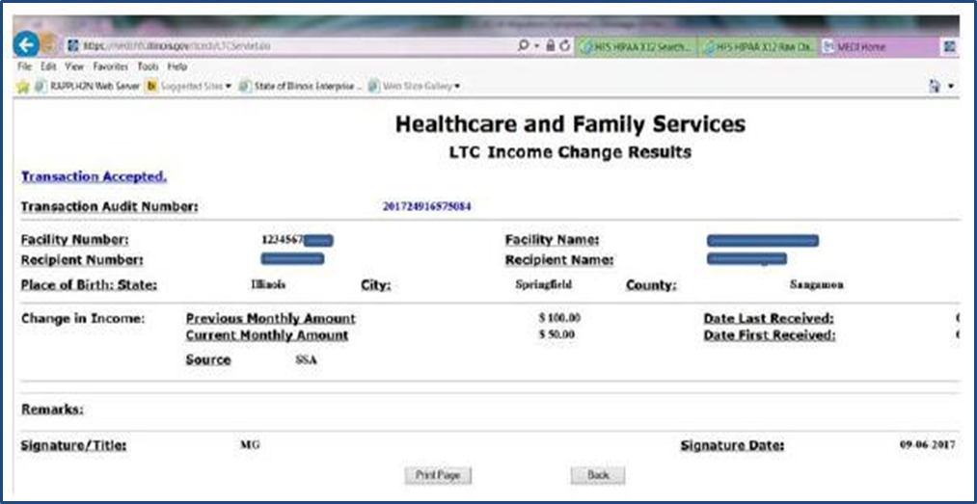
The TAN is an auto generated tracking number assigned to each and every MEDI transaction; you need to submit the changes in MEDI first, in order to get the TAN and upload the documents in the ABE Partner Portal. You can find this number on the Summary Results page to the provider which tells the provider if the submission was accepted successfully.
Finding the TAN

Slide 52
Resources
dhs.abe.questions@illinois.gov – Customer support email
HFS.ABEpartnerportal@Illinois.gov – For Providers needing assistance
Customer Support – Application for Benefits Eligibility ABE Guide, MMC Guide, links to ID Proofing Forms
IDHS: Continuous Coverage Ends 3/31/2023 and Medical Redeterminations Resume (state.il.us)

Slide 53
Scam Alert –
Some States are Already Experiencing Scams
For MCO/Provider Outreach
Please remind customers to beware of scams. Illinois will never ask them for money to renew or apply for Medicaid. Report scams to the fraud report website or the Medicaid fraud hotline at 1-844-453-7283/1-844-ILFRAUD
Direct Customer Outreach – Include on Website/Social Media/other
Beware of scams. Illinois will never ask you for money to renew or apply for Medicaid. Report scams to the fraud report website or the Medicaid fraud hotline at 1-844-453-7283/1-844-ILFRAUD

Slide 54
Questions ?

