Slide 1

Provider Resolution Portal Tutorial February 2021

Slide 2
Providers and MCOs must actively work together to attempt to resolve a dispute in accordance with each MCOs internal dispute process a minimum of 30 calendar days before entering a portal complaint ticket.
This means providers must first follow and exhaust ALL processes provided by MCOs to resolve a dispute.
Communication between a provider and MCO during the initial dispute resolution period is encouraged.

Slide 3
Disputes submitted to the MCO internal dispute process may be submitted in the Portal:
No sooner than 30 calendar days after submitting to the MCO’s internal process; and,
No later than 60 calendar days after submitting to the MCO’s internal process.
MCOs are required to give providers complaint tracking reference numbers for disputes submitted via the MCOs internal dispute process. This complaint tracking reference number is required when a provider enters a ticket into the portal.
Failure to follow these guidelines will result in the immediate closure of the complaint ticket.

Slide 4
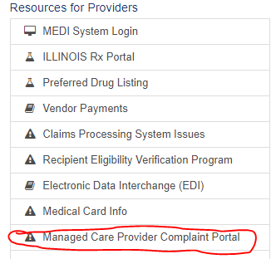
Direct Link: https://www.illinois.gov/hfs/MedicalProviders/cc/Pages/ManagedCareComplaints.aspx
OR
From the HFS home page click on “Medical Providers”
Go to “Resources for Providers” and click on “Managed Care Provider Complaint Portal”

Slide 5
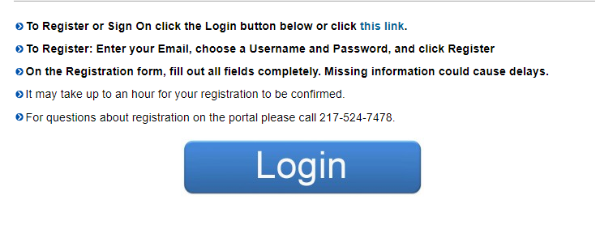
Once on the portal page, a provider or its representative will need to register to submit a complaint ticket.
If a provider or representative is registering for multiple providers or facilities a Tutorial and Multiple Registration Template are provided on the Portal homepage for review.

Slide 6
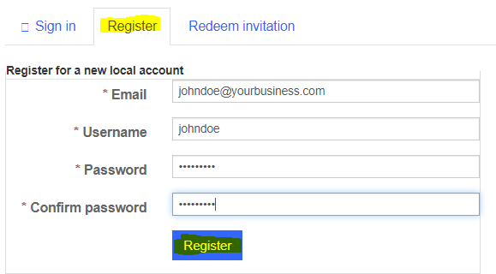
After clicking “Login” the provider will be directed to the “Sign in” tab.
Click on “Sign In” (upper right corner), and the provider will be directed to this screen.
Click on the “Register” tab, complete the fields and click on the “Register” button in blue.

Slide 7
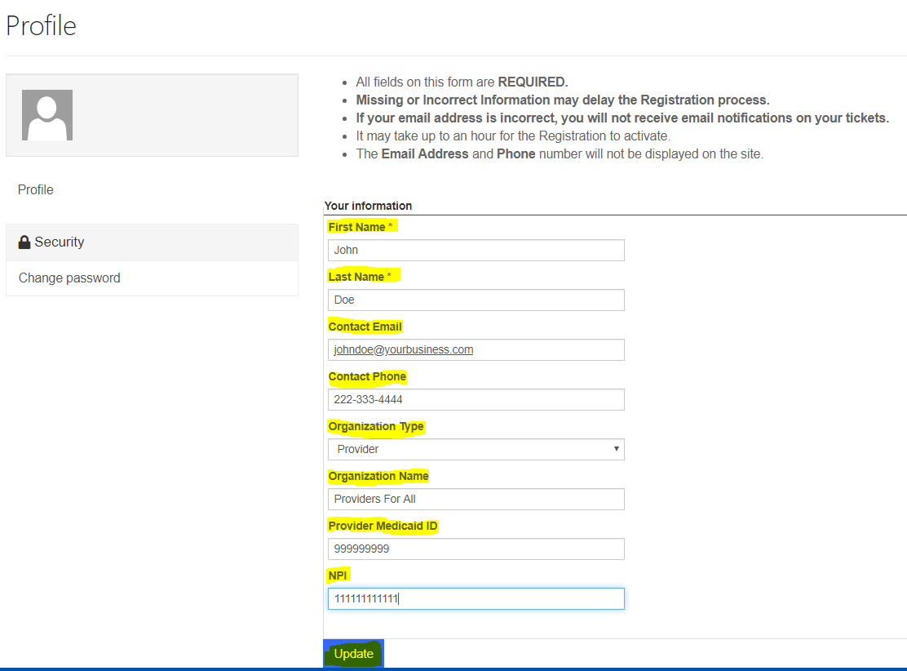
After clicking the “Register” button, a provider will be directed to the “Profile” page. Enter ALL fields and click the “Update” button (in blue). Please note, this is a manual process & ask that you allow time for completion.

Slide 8
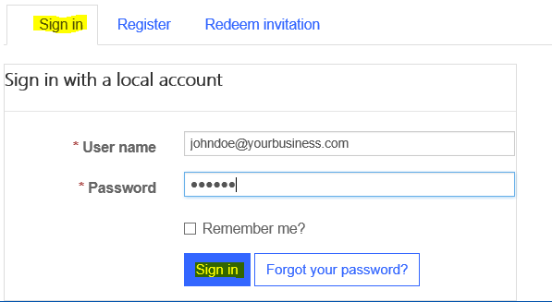
Once registration is completed the provider will receive an email notification stating their ILHFS Partner Portal Registration has been completed successfully.
Providers should allow for a delay between submitting their registration request and receipt of the email registration email. A provider cannot enter a ticket into the Portal until they have received the email registration notification. A provider should check their spam folder if they do not receive an email notification within a few hours of submitting their registration request.
Upon receipt of the email registration notification, follow the instructions provided to access the main Portal page and click “Login”. Then click on the “Sign in” tab; enter your username/password and click on the “Sign in” button (in blue).

Slide 9
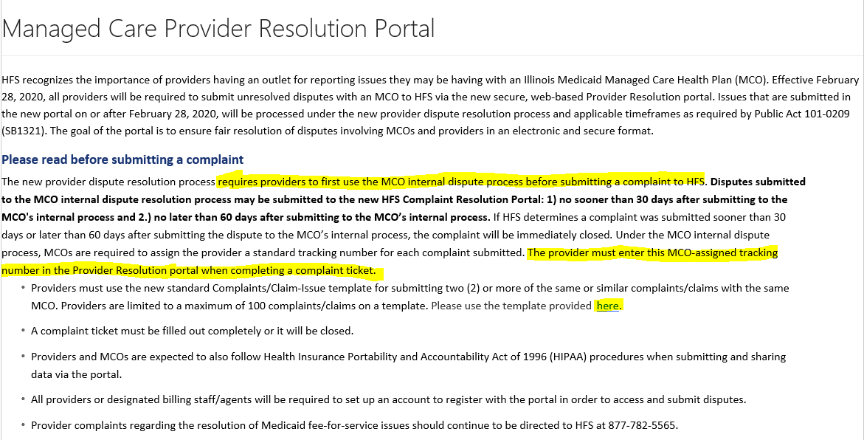
Once logged in, you will be directed to the Portal home page and can begin the process of entering your complaint ticket.
Please make sure to read the information on the home page BEFORE submitting your complaint ticket.

Slide 10
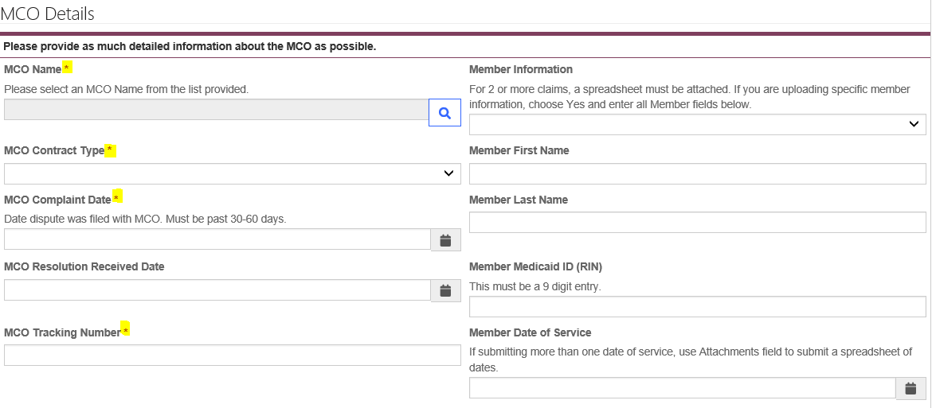
In order to ensure that your ticket is processed timely, all required fields must be completed. Missing information will result in the ticket being delayed or closed.

Slide 11
MCO Name – You can only submit a complaint ticket for one MCO at a time. The Portal does not allow for the submission of one ticket for multiple MCOs.
MCO Contract Type - Select the correct managed care program from the drop down list: HCI (HealthChoice Illinois), MMAI (Medicare-Medicaid Alignment Initiative) or YouthCare (DCFS)
MCO Complaint Date - Enter the date that the dispute was submitted to the MCO internal dispute process. Date must fall within the 30-60 calendar day timely filing guidelines. If the date is outside of these guidelines, the ticket cannot be entered in the portal.
MCO Tracking Number – Enter the dispute reference tracking number provided by the MCO when the dispute was submitted to the MCO internal dispute process. Incomplete or incorrect tracking numbers will cause the ticket to be closed.
When entering 2 or more same or similar issues, you must use the Complaints/Claims Issues Template. The link to the Template is provided on the Portal Home Page. The template shall include the reference tracking number(s) for each claim listed.

Slide 12
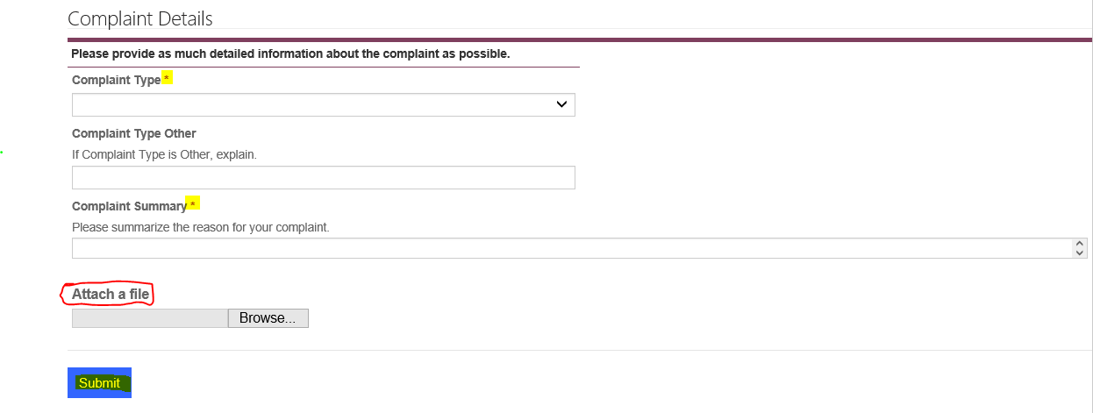

Slide 13
Complaint Details Information:
Complaint Types - Select the appropriate complaint reason code:
Claims/Payment
Communications
Contracting
Coverage/Service Denials
Eligibility
Prior Authorizations
Provider Enrollment
Roster
System Issue
Other - If “Other” is selected as the complaint type, you must provide information to explain the complaint type in the “Complaint Type Other” box.

Slide 14
Complaint Summary – Provide a detailed summary to support the reason for your complaint. Please be thorough in the detail provided.
Attach a File - Documents, spreadsheets or other materials that you want to share as part of the complaint submission must be uploaded in the “Complaint Details” section of the portal.
When you have entered all information and attached any relevant supporting documentation and you are ready to submit the ticket, click the “Submit” button. This action will advance the complaint ticket onto the Portal staff for review.

Slide 15
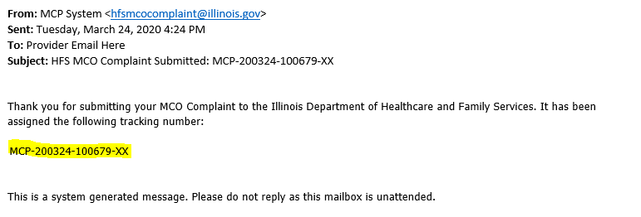
Once you have submitted your ticket, you will receive an automated email notification confirming receipt of the ticket in the portal and the HFS tracking number/ticket number that has been assigned. Below is a sample of an automated email notification. Check your spam folder if you do not receive an automated email notification.

Slide 16
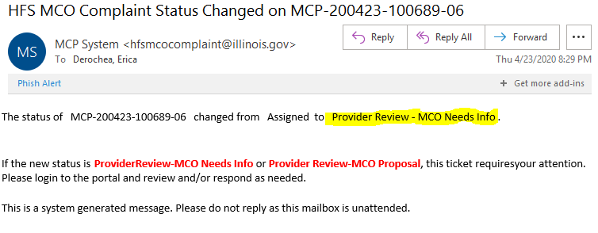
Once the ticket has been submitted in the Portal, the Portal staff have 10 business days to review and advance complete tickets onto the MCO. Incomplete tickets will be closed.
Upon receipt of the ticket, the MCO’s have thirty (30) calendar days to resolve a complaint. In this time, they may need to ask for more information – within five (5) business days of receiving the complaint in the portal. When this happens the ticket status will change and you will receive an automated email notification. This notification will let you know there is an action or request that requires your attention. Below is a sample of an action request email.
Providers have 5 business days to respond to the action request with the additional information or demonstrate (provide evidence) that the requested information has already been submitted to the MCO. The requested information will be submitted in the Portal. If the provider does not respond within the 5 business days, or the information submitted is incomplete, the ticket will be closed. Providers are encouraged to read and respond to Portal email notifications upon receipt in order to not miss the 5 business day timeframe for responding.

Slide 17
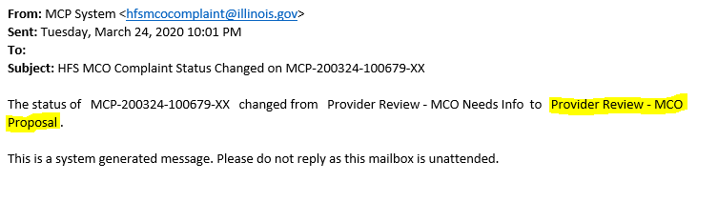
During the 30 calendar day MCO review period, the MCO will enter their response/proposed resolution directly into the Portal. Proposed resolutions will include timeframes for completing resolution actions if applicable, and MCO provider representative contact information.
At this time the ticket status will change and the provider will receive an automated email notification – MCO Proposal has been submitted. A sample notification is provided blow.
The provider must access the Portal and review the MCO response/proposed resolution.
If a provider accepts the response or does not contest the response within 5 business days, the Portal staff will close the ticket.

Slide 18
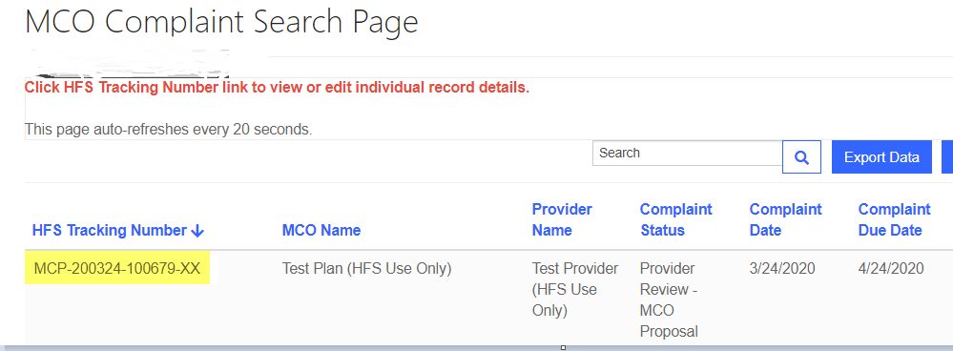
A provider will respond to an MCOs request for additional information or review an MCO response/proposed resolution, or take other actions requested via an automated email notification by signing into the Portal, and clicking on your ticket number listed under “HFS Tracking Number” (All tickets you have submitted will appear here).

Slide 19
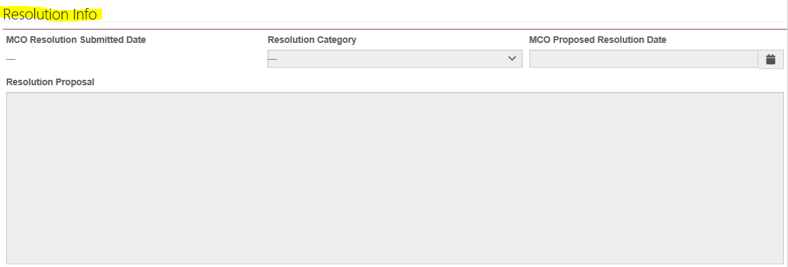
Clicking on your HFS ticket number will direct you to the “MCO Complaint Web Edit” page. On this page you will be able to view your ticket information, interact with the MCO, respond to information requests, and review the MCO response/proposed resolution.
Toward the bottom of this page there is a section called “Resolution Info”. This is where the MCO has provided their response/proposed resolution for your review.

Slide 20
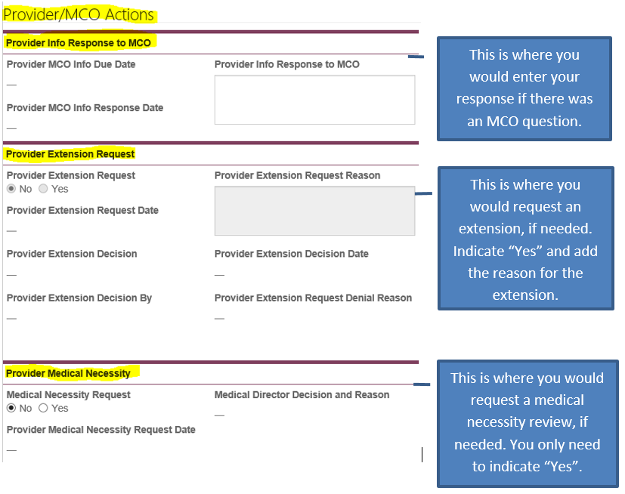
Under the Resolution Info section there is also a section titled “Provider/MCO Actions”. The LEFT side is for providers.

Slide 21
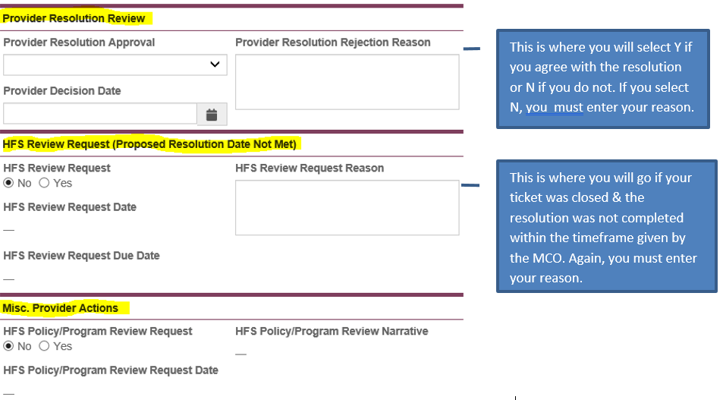
Continuing down the page, you will see more provider “action” options.

Slide 22
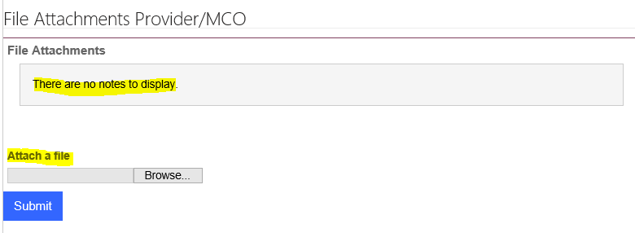
Submitting Attachments/Documents/Forms
At the bottom of the Provider/MCO actions page you will see the section titled “File Attachments Provider/MCO”. This is where providers or MCOs will upload any documents, forms or materials that have been requested, demonstrates prior communications, or that supports a response/proposed resolution.

Slide 23
Questions:
Email HFS.Portalinquiries@Illinois.gov
Portal staff will respond to your inquiry. The Portal staff are working diligently to review and respond as quickly as possible, so please allow time for staff to respond.
When submitting an email, please provided detailed information regarding the questions or issue(s) you are experiencing in the portal; including screenshots of issues as applicable and a good contact phone number and email address.

