Slide 1
Welcome, we will begin shortly.
General Housekeeping:
Please place yourself on mute.
raise your hand to be unmuted.
Change your chat settings to send to “All Panelists and Attendees”

Slide 2
Clinical Collaboration Group
August 2022

Slide 3
Clinical Collaborative Group
What is the Clinical Collaborative Group (CCG)?
The CCG is comprised of a group of stakeholders within the state who are working collaboratively using the Collective Platform to drive measurable progress towards a goal aimed at improving outcomes for patients:
Meets quarterly
Acts as champions within your respective institutions
Forum to share updates and best practices regarding the use of Collective
Uses data to determine appropriate interventions
Measures progress towards the goal at regular intervals

Slide 4
HealthChoice IL ADT Program Overview and Updates
Data Quality Review
Collective Medical Overview
How do different organizations access the data
User Engagement Review
Collaborative Care Insights
Upcoming Events

Slide 5
Illinois’ Comprehensive Medical Programs Quality Strategy includes goals for improving care coordination, using evidence-based interventions to reduce health disparities, deploying technology, and increasing data integration. The ADT system directly supports those critical quality goals and leverages best practices for sharing timely information to enable effective care coordination.
Notes:
Add poll: how are familiar are you with HFS ADT Program?
Have you attended a CCG before?
What part of the care continuum are you a part of?

Slide 6
Placeholder for Data
Collective Medical Footprint – IL
For IL, 189 hospitals and 489 SNFs, as of 1/13/22.
For IL, 189 hospitals and 489 SNFs, as of 1/13/22.

Slide 7
Placeholder for Data
Collective Medical Footprint – IL
For IL, 189 hospitals and 489 SNFs, as of 1/13/22.
For IL, 189 hospitals and 489 SNFs, as of 1/13/22.

Slide 8
Placeholder for Data
Collective Medical Footprint – IL
For IL, 189 hospitals and 489 SNFs, as of 1/13/22.
For IL, 189 hospitals and 489 SNFs, as of 1/13/22.

Slide 9
Collective is a care collaboration solution that gets the right information to the right person at the point of care.
ED and Inpatient Care
A NETWORK
Collective is a network of hospitals, emergency departments, primary care, specialists, behavioral health providers, post-acute care providers, and health plans across the United States, sharing important patient information at the time of care
Primary Care and Specialists
ACO
A PLATFORM
Collective is a platform that intelligently connects each member of a patient’s care team for seamless collaboration at the right time and through the best medium
Behavioral Health/SUD
Community-Based Organizations
Post-Acute Care
Dialysis, Ancillaries
A COMMUNITY
Collective is a community of providers in the care of patients—especially those with complex medical needs—in your communities and across the country.
Government and Payers

Slide 10
Step 1 – Patient Encounter
The patient presents in the emergency department of a hospital with a connection to the Collective network. Basic demographic and triage information about the patient is entered into the hospital’s EHR.

Slide 11
Step 2 – ADT Transmission
Within moments, the hospital’s EHR sends the important information about the encounter to Collective in the form of an ADT message.
ADT Data

Slide 12
Step 3 – Patient Identification
The Collective platform normalizes the new encounter information, identifies the patient’s aggregate profile on the network as well as identifies patient’s aggregate profile existing through Carequality or CommonWell, and merges the new data in.

Slide 13
Step 4 – HIPAA Verification
Collective analyzes its network, and all entities showing a verified HIPAA relationship with the patient are identified, including the facility at which the patient is currently experiencing the triggering encounter.

Slide 14
Step 5 – Criteria Analysis
Each of these entities’ Collective profiles are analyzed to identify which—if any—of the members of the patient’s care team should receive notification of the encounter, and curated specifics about the patient’s needs.

Slide 15
Step 6 – Care Team Notification
Within seconds of the patient’s initial presentation at the triggering facility, real-time notifications are delivered to the members of the patient’s care team identified as being best placed to intervene and impact outcomes.

Slide 16
Step 7 – Provider Action
All members of the patient’s care team are now empowered to take action to influence better outcomes for the patient.
ED providers are empowered to act quickly from a position of knowledge
primary care and specialists can proactively involve themselves when necessary

Slide 17
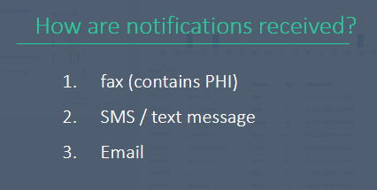
SNF Cohort Criteria & Notifications
Example Criteria & Notifications (ED)
High utilization - 5+ visits in 12 months​
Rising Risk - (Traveling patients) 3 different EDs within 90 days​
History of Security Events (18 months)​
History of Sepsis (12 month look back)​
Patients with Care Insights entered on the network
1. EHR – ED Trackboard
Fax
SMS / Text Message (no PHI)
Email (no PHI)
Collective Medical Web-Based Portal

Slide 18
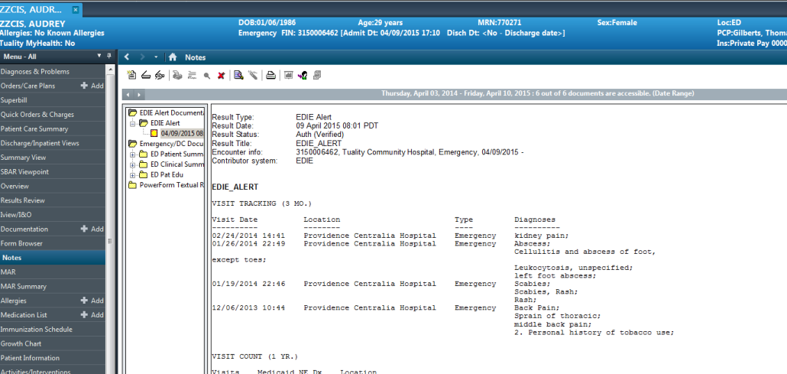
SNF Cohort Criteria & Notifications
ED Trackboard Notification Delivery
EHR ED Track Board

Slide 19
SNF Cohort Criteria & Notifications
Example Criteria & Notifications (Clinic)
High utilization - 5+ visits in 12 months​
Rising Risk - (Traveling patients) 3 different EDs within 90 days​
ED Encounters
ED Discharges
ED Encounters with Behavioral Health Diagnosis
Inpatient Admissions
Inpatient Discharges
Patients with Care Insights entered on the network
1. Fax
SMS / Text Message (no PHI)
Email (no PHI)
Collective Medical Web-Based Portal

Slide 20
SNF Cohort Criteria & Notifications
Example Criteria & Notifications (MCO)
High utilization - 5+ visits in 12 months​
Rising Risk - (Traveling patients) 3 different EDs within 90 days​
Inpatient Encounters
Inpatient 30 Day Readmissions
Diagnosis Based Hospital Encounters
Patients with Care Insights entered on the network
1. Fax
SMS / Text Message (no PHI)
Email (no PHI)
Collective Medical Web-Based Portal

Slide 21
SNF Cohort Criteria & Notifications
Notifications Overtime

Slide 22
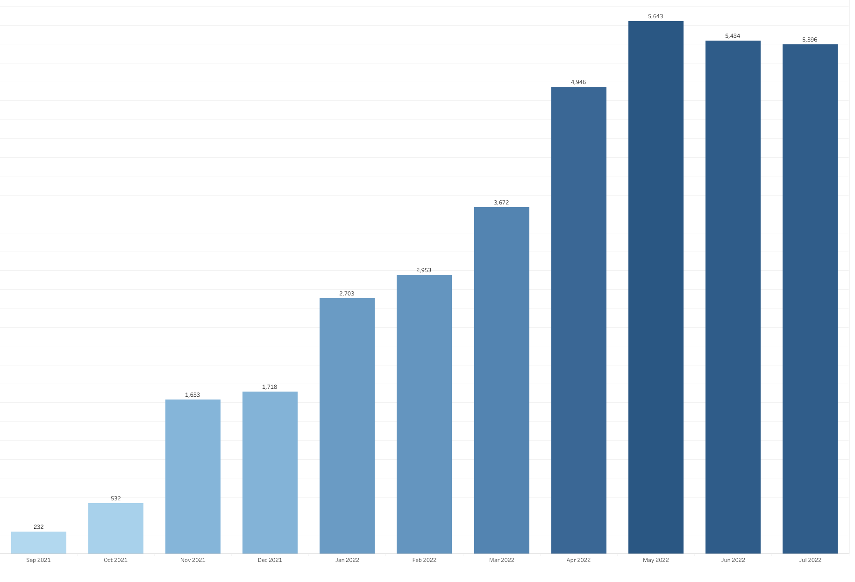
SNF Cohort Criteria & Notifications
Number of Logins

Slide 23
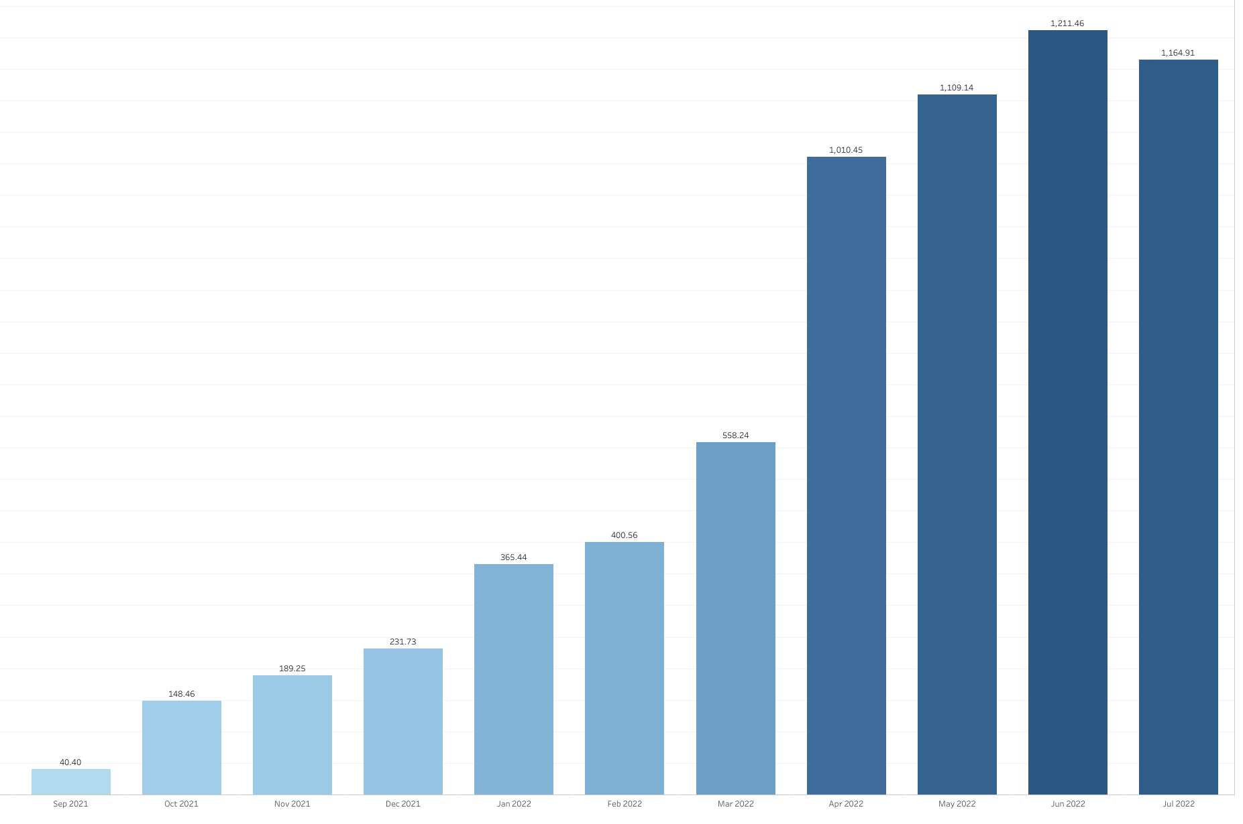
SNF Cohort Criteria & Notifications
Hours Logged In

Slide 24
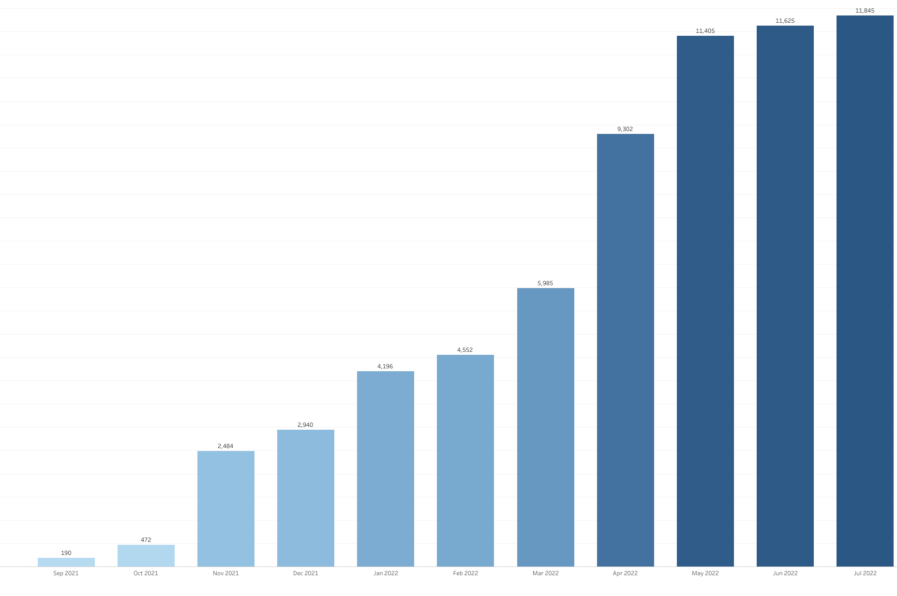
SNF Cohort Criteria & Notifications
Patient Records Viewed

Slide 25
What are Care Insights?
Care Insights are clinical and care coordination information that is applicable across a patient’s care continuum. It is found on the Patient Overview in the Collective Platform page and in the Collective Notification. The purpose is to share a brief synopsis on how to provide the best care for the patient.
Care Insights are written by members of a patients care team such as a provider, RN, case manager, social worker to provide actionable information about the patient at the point of care across the care continuum. These information are typically information that may be buried across multiple patient records.
Writing care insights is a way for you to collaborate with healthcare providers and influence the care a member is getting in different settings.

Slide 26
End Users Authoring Insights
Case Managers, Care Coordinators, Navigators are the most common disciplines to author content based on internal workflows
Accessing Collective Medical through the portal is most efficient for content creation and management of updates
The author is responsible for ensuring the accuracy of information added to the network and that is appropriate for fast consumption by other providers and care coordinators
If an employee leaves an organization, the account manager should be monitoring and delegating the care recommendation updates

Slide 27
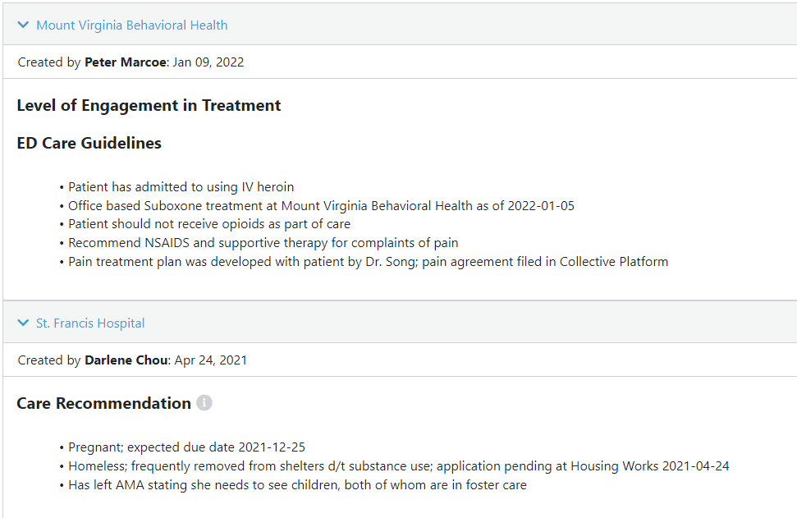
Care Insights – Current State

Slide 28
Collaborative Care Insights
Collaborative Insights consists of multi-facility content. The benefits of using Collaborative Insights includes:
Content is delivered in a single, cohesive patient-centered plan authored between facilities/organizations and providers
Provides relevant information to ensure providers succinctly receive the most accurate info
Increases collaboration across the Collective network, particularly outside of the ED node
Client confusion regarding nomenclature: Care Insights vs. Care Guidelines vs. Care History vs. ED Care Recommendations

Slide 29
Care Insights – Current State

Slide 30
Demo

Slide 31
Adding Insights to patients – mistakes to avoid
Opinions or Judgements About a Patient
Your goal is to provide insight, not pass judgement or taint opinions about the patient
Copy and Pasted Current Medication Lists with Dosing
Medication dosing may change faster than the Care Insight is updated, make sure to include the date of prescription.
Lengthy Chart Notes Directly from the Patient’s Chart Record
Notifications should be easy and fast to consume; including too much information can slow down emergency treatment and cause the important details to get lost, defeating the purpose
Substance Abuse Treatment Program Information If You Are a 42 CFR Provider
It’s the law; make sure you understand all the necessary guidelines or laws surrounding your specialty
Redundant Information that Can Be Found Elsewhere on a Patient Overview Page
Notifications should be easy and fast to consume, and the actionable information should be obvious; duplicating data can cause important information to be missed
Mistakes to Avoid when Adding Insights

Slide 32
Additional Resources – Customer Support
Additional Resources – Customer Support
Available Monday-Friday 7:00am-6:00pm MT
Email: support@collectivemedical.com
Phone: 801-285-0770
Notes:
I start with a high-level intro to Collective Medical and what we’re about
Then I’ll dive into a demo of the Collective Platform to give you an idea of how it can work for you
Next I’ll outline the technical and clinical implementation and review the rough project timeline
And we will wrap up with next steps and action items

Slide 33
Upcoming Events
December 8, 2022 – Fall Clinical Collaborative Group Meeting
Keep a look out for emails regarding future webinars and events.
Stay up to date through the HFS website.

