Slide 1
HealthChoice Illinois ADT Clinical Collaboration Group Increase Efficiency, Improve Patient Outcomes and Implementation Update
December 8, 2022

Slide 2
Agenda
INTRODUCTIONS
Dana Wilson, HFS, Division of Medical Programs, Program & Policy Coordination, Federal Health Information Planning
Nancy Sehy, BSN, RN, CHPCA, Clinical Solutions Lead, PointClickCare/ Collective Medical Technologies
HealthChoice IL ADT Program Overview and Updates
MCO Collaboration
Portal Features & Functions
State Comparison
Portal Demo
Upcoming Events
Notes:
10 - HealthChoice IL ADT Program Overview and Updates
10 - MCO Collaboration
10 - Portal Features & Functions
3 - State Comparison
20 - Portal Demo
7 – Survey, Questions, and Upcoming Events

Slide 3
What type of organization do you represent?
Hospital
Long Term Care
MCO
Ambulatory or Community Provider
Other – please specify
ACO

Slide 4
Does Your Organization:
Both send and receive data, do not have portal
Both send and receive data, have portal but do not use
Only transmit data to the portal
Receive notifications/have portal access
Unsure
In the process of portal integration

Slide 5
Attendee Information
Facility/Organization
Title/Role
Name
Phone Number
Email Address

Slide 6
Project Timeline
Dec 2021
LTC Provider Onboarding Deadline
&
All MCO’s live on Portal
Feb 2022
Begin Ambulatory & Community Provider Onboarding
2022 - 2031
Data Quality
and Analytics Enhancements
2022 - 2031
Initiatives, Incentives, Programs, Increase Efficiency, Improve Patient Outcomes
Feb 2021
CMT Contract Signature
July 2021
Start LTC
Provider Onboarding
May 2021
Start Hospital Onboarding
Sept 2021
Hospital Onboarding Deadline
Jan 2022
1st Clinical Collaborative
Group
Webinars will be held each qtr. going forward for Hospitals, MCO and Skilled Nursing
2022 - 2031
Phase 2:
CCDs, Labs, Imaging, Rx, Scheduling, Physician Notes, Billing Data
Dec 2022
Technical Advisory Committee
Convene

Slide 7
HealthChoice IL ADT Program Overview and Updates

Slide 8
Connected Facilities
HealthChoice Illinois ADT Portal
Collective Medical Technologies
834 Medicaid Facilities Transmitting Data
ED and Inpatient Care
Type | Sending Live Data/ Historical
Hospitals | 189
ICFDD (Intermediate Care Facility/Developmental Disabilities) | 10
SLF (Supportive Living Facilities) | 78
SMHRF (Specialized Mental Health Rehabilitation Facilities) | 18
SNF (Nursing Facilities) | 539
Primary Care and Specialists
ACO
Behavioral Health/SUD
Community-Based Organizations
Post-Acute Care
Dialysis, Ancillaries
Numbers as of November 21, 2022
Government and Payers

Slide 9
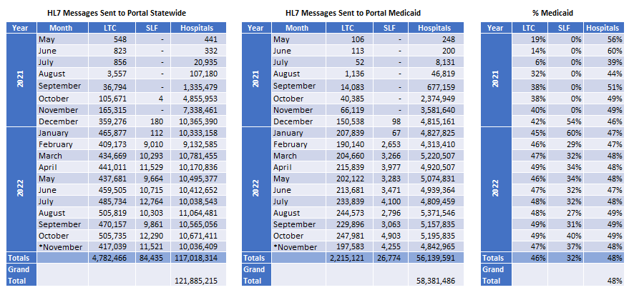
HL7 Messages Sent to Portal
Numbers as of October 30, 2022

Slide 10
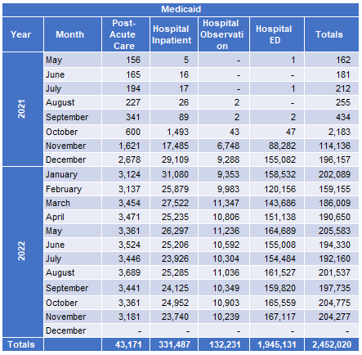
Total Medicaid Encounters
Numbers as of November 30, 2022

Slide 11
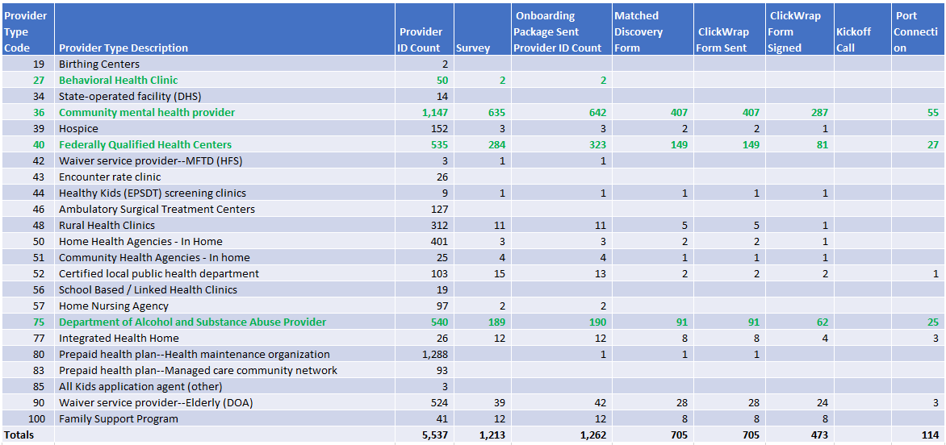
Ambulatory and Community Provider Implementation – by Provider ID

Slide 12
MCO Collaboration

Slide 13
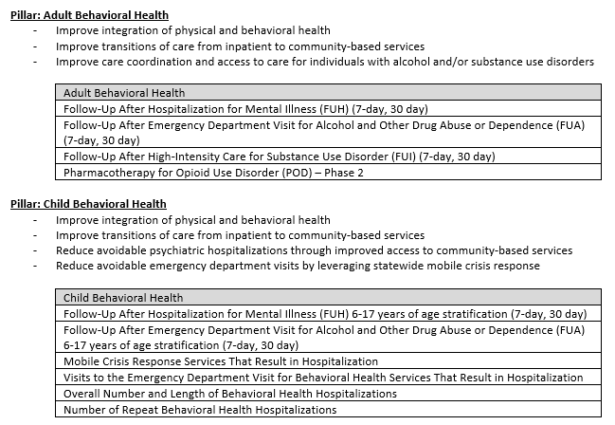
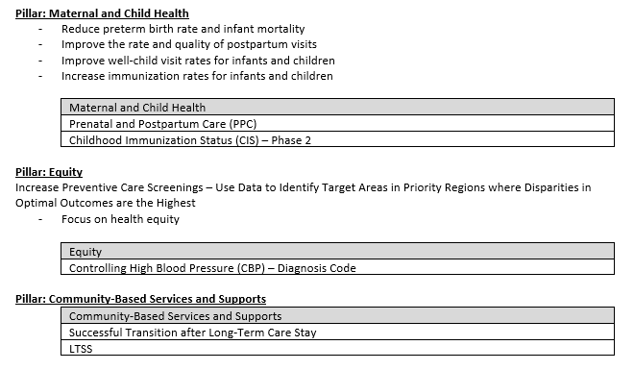
Quality Strategy

Slide 14
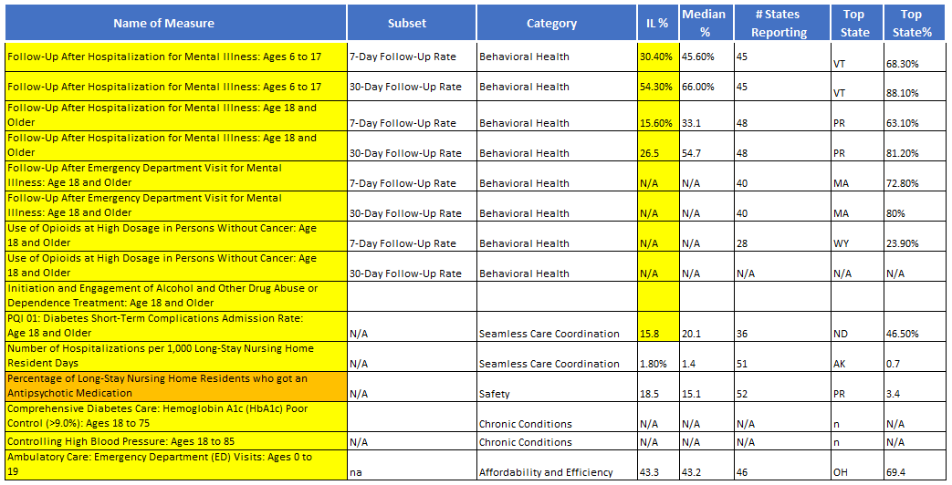
HEDIS Measures

Slide 15
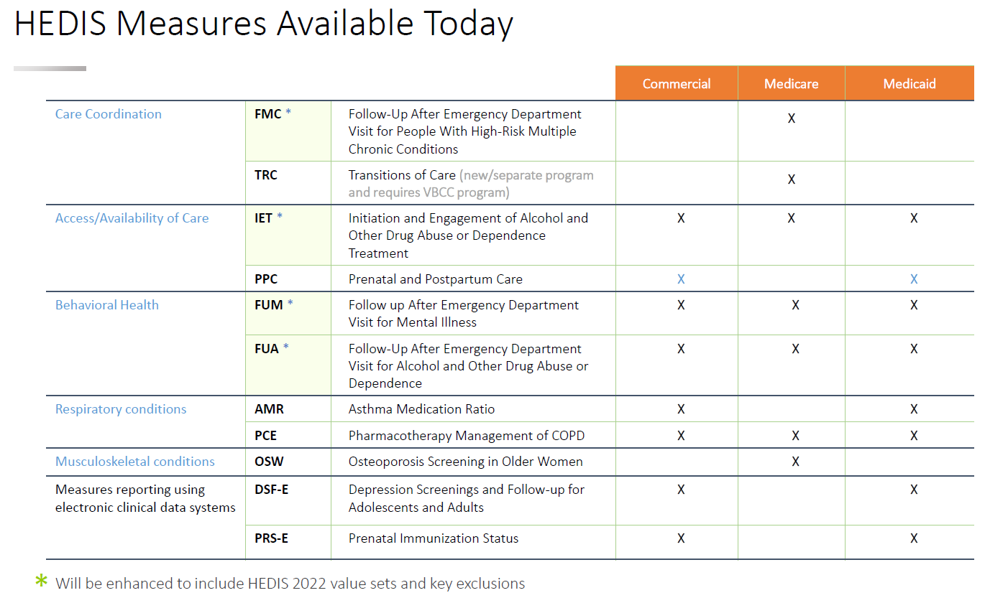
HEDIS Measures

Slide 16
Survey
Are there any other HEDIS Measures that are of high priority to your organization?
Which Quality Strategy Pillar effects your work the most?
What HEDIS Measure effects your facility the most?

Slide 17
The Future of ADT & Solutions for All Points of Care
Other Areas of Interest
Phase 2
Incentive Programs
The Gravity Project (SODH)
Crisis Line Hotline
Sepsis Project
Opioid and Substance Use Disorder Support & Prescription Drug Monitoring
Value-Based Care Optimization
Behavioral Health Integration
Maternal Health
CCDs (Care Team, Vitals, Meds, Physician Notes, Immunizations)
Labs (ORU & ORM)
Imaging (ORU & ORM)
Rx (RDE & Claims)
Scheduling
Physician Notes
Billing Data
Notes:
OTHER AREAS POLL

Slide 18
What other areas of interest would be of most impact to your organization?
Maternal Health
Social determinants of health
Behavioral Health Integration
Incentive programs
Opioid and Substance Use Disorder Support & Prescription Drug Monitoring
Value-Based Care Optimization
Other- Please Specify

Slide 19
What would be the most helpful feature to include next with ADT as part of Phase 2?
Scheduling
Labs & Imaging (ORU & ORM)
CCDs (Care Team, Vitals, Meds, Physician Notes, Immunizations)
Rx (RDE & Claims)
Billing Data

Slide 20
MCO Clinical Leads – Data Quality
Total Messages 2,812,619
Data Fields | Null Values | %
Encounter Chief Complaint | 1,877,703 | 67%
Diagnosis Code | 1,474,734 | 52%
Diagnosis Description | 1,131,865 | 40%
Discharge Disposition | 971,218 | 35%
Discharge Date | 896,188 | 32%
Attending Physician | 326,761 | 12%
Encounter Insurance Name | 615,356 | 22%
Encounter Insurance Plan ID | 724,405 | 26%
Numbers as of November 9, 2022

Slide 21
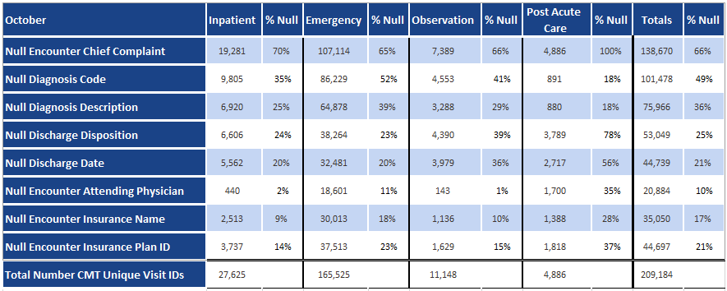
Data Quality by Encounter Type
Numbers as of November 29, 2022
Notes:
DATA QUALITY/INTEGRATION POLL

Slide 22
Which data points would you like to see most improvement on?
Diagnosis Code
Diagnosis Description
Encounter Chief Complaint
Discharge Disposition
Attending Physician
Discharge Date
Encounter Insurance ID

Slide 23
Would it be beneficial if Hospital EMR Integration would be mandatory?
No
Yes

Slide 24
How has the ADT Program Helped?
What part of the Collective Medical platform has been the most beneficial?
What would you like for HFS to focus on in the future that would benefit your facility the most as it relates to the ADT program?
How has the ADT program helped with current workflow?
Please share any stories where the ADT program has made a difference in case management.
Notes:
Dana will provide the answers provided by the MCO’s to give examples for each of the questions provided to the CCG
IL Health Practice Alliance
Member is a chronic user of the ED, frequently going 2 or more times per week. Historically, member has not been compliant with his medications. Member initially was only receiving individual therapy services through provider and attending sporadically. Collective ADT trigger prompted a discussion with the therapeutic team. After discussions with Care Coordinator and also his therapist, member agreed to case management services, receiving a community support individual, being connected with the psychiatrist at provider, and to initiate long-acting injectable medication. A positive effect with this member is that member began to attend his therapeutic appointments regularly and has not utilized the ED since August of 2022.

Slide 25
Portal Features & Functions

Slide 26
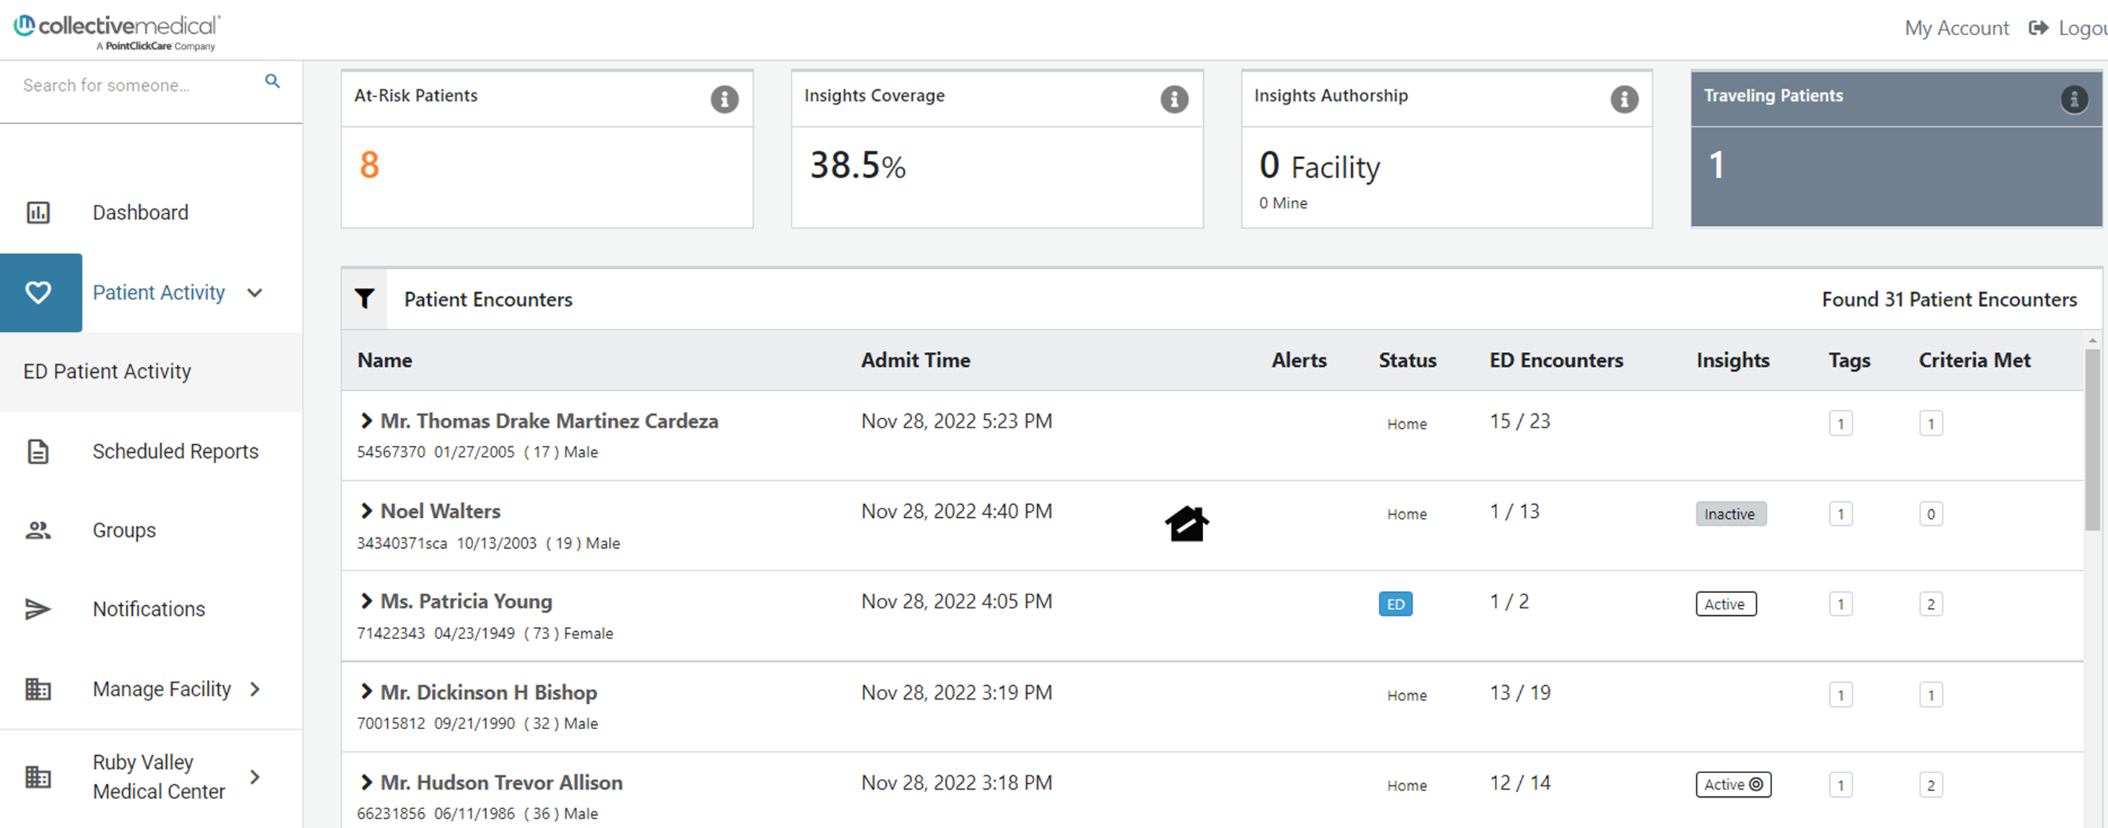
Patient Activity Census Page
Customer Community: ED Patient Activity Overview ED Patient Activity - FAQ
Notes:
Highlight- s At-Risk. Volume/where they've had encounters, etc .
Traveling separates those who, within 24 hrs of leaving your ED, have been at another ED within 24 hrs
Note timeframe selection changes

Slide 27
Notifications
Customer Community: Notifications Overview Notifications FAQ
Notes:
Safety & Security events, Care Insights, Recent Encounters, Care Team

Slide 28
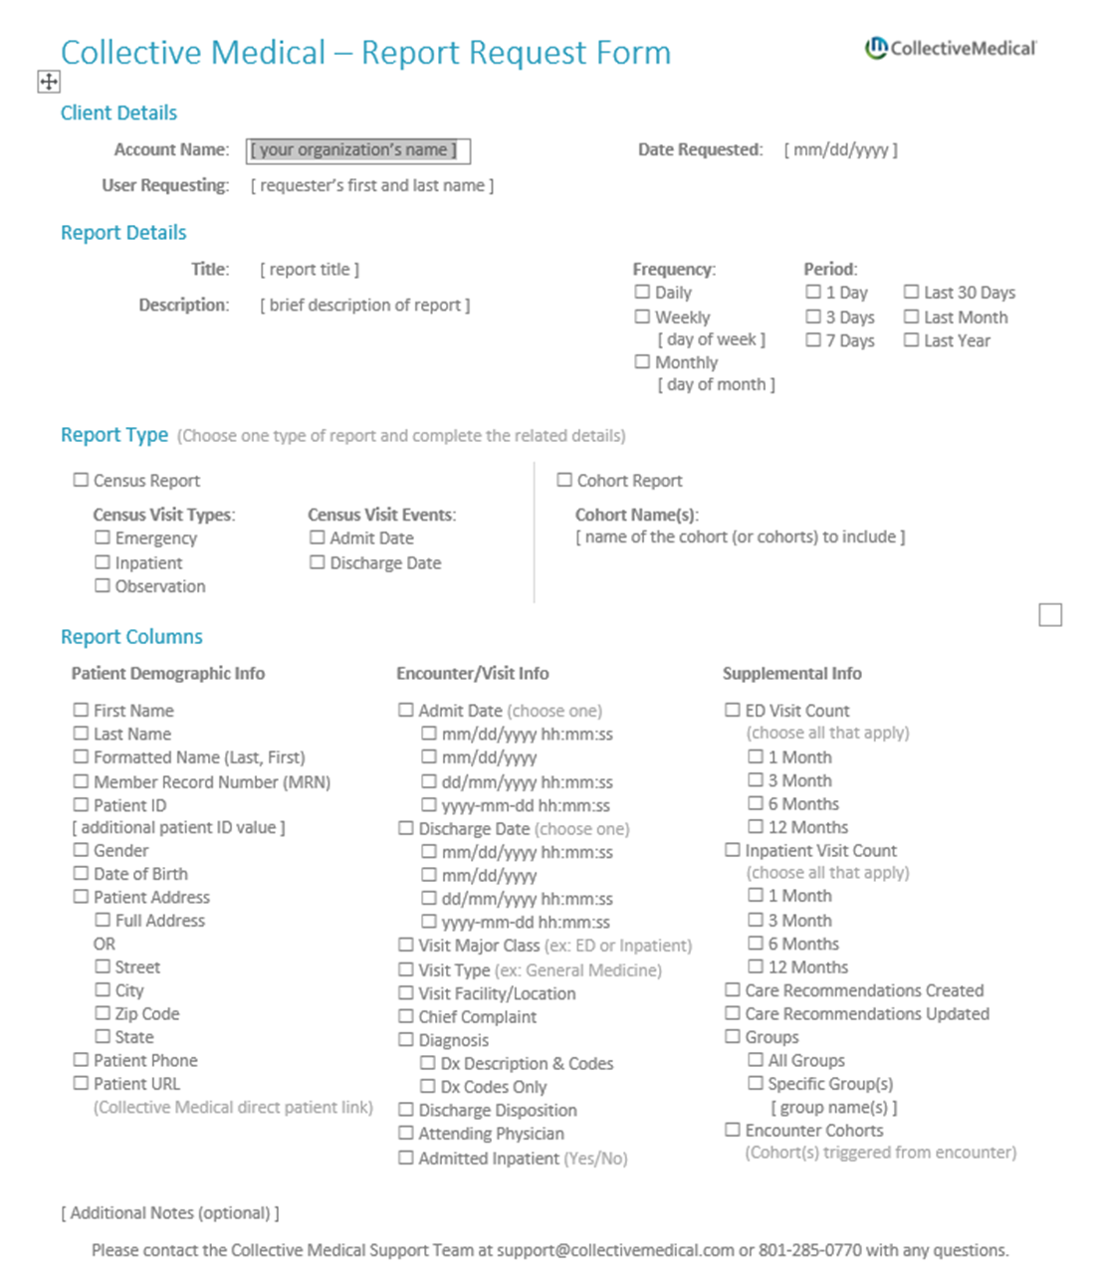
Scheduled Reports
Customer Community:
Scheduled Reports Overview
Scheduled Reports FAQ
To obtain a Report Request Form, contact your Customer Success Manager,
Liz Swetnam
Notes:
Form is obtained from your CSM;
You can have Collective create a deidentified report if you need to share this kind of information outside of your organization
Your organization should regularly review the reports you get from Collective and clean/refresh as needed (don’t get bogged down in unused reports!)
Many organizations use scheduled reports as care coordination worklists (for hospital follow up, etc.)

Slide 29
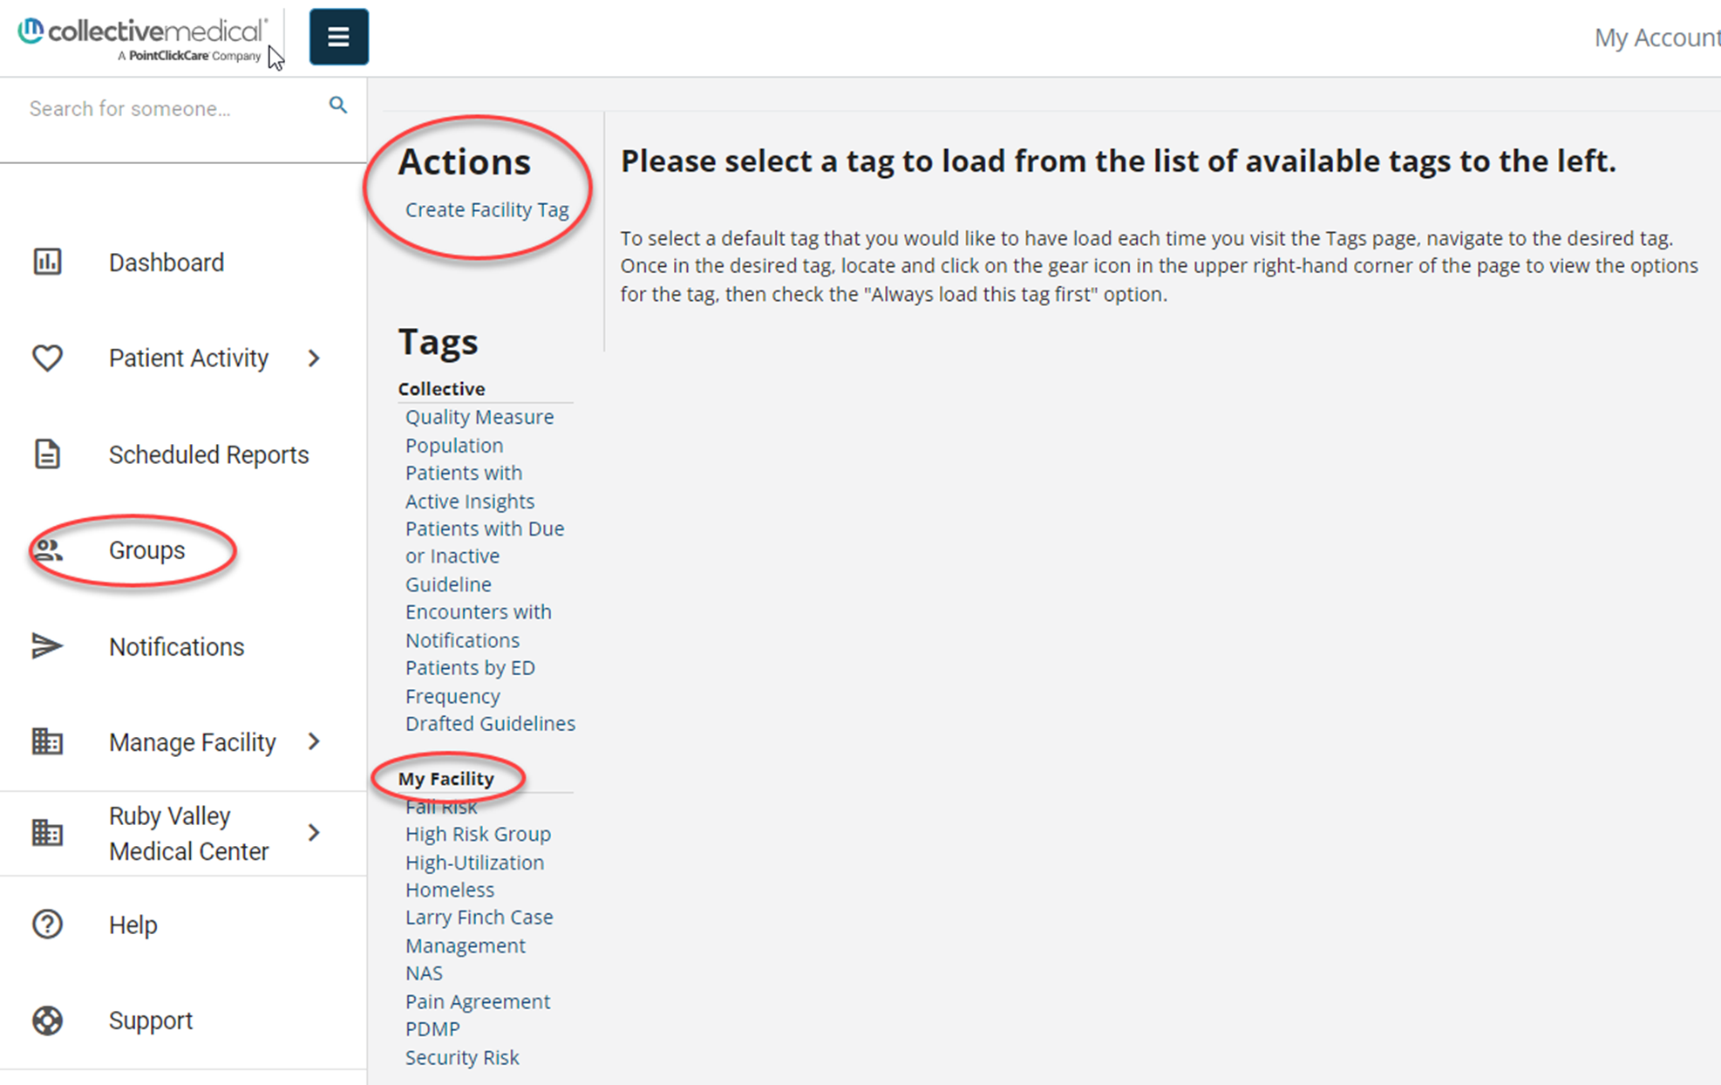
Groups / Tags
Customer Community:
Groups Overview
Groups FAQ
Delete a Tag

Slide 30
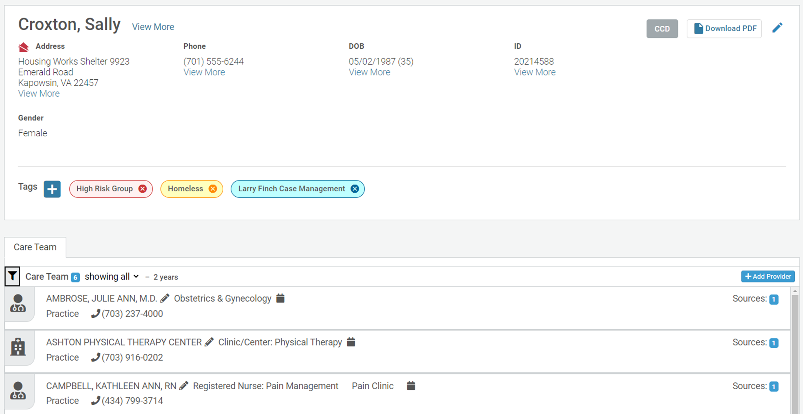
Patient Overview
Customer Community: Patient Overview Page
Notes:
Highlight Phone Number view more, CCD, Tags, Care Team

Slide 31
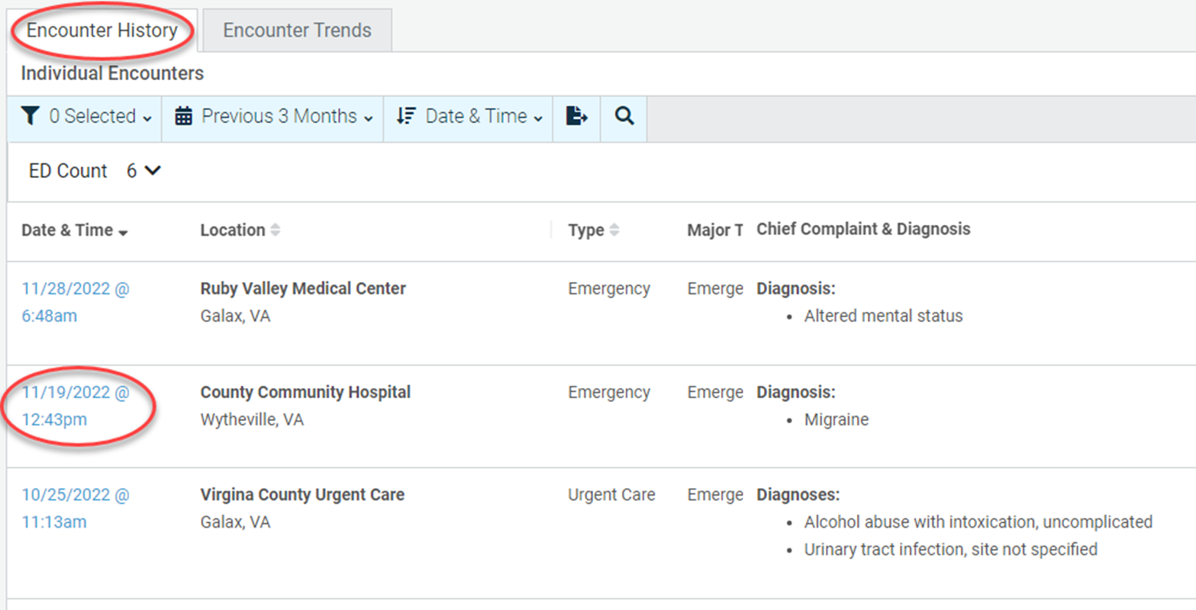
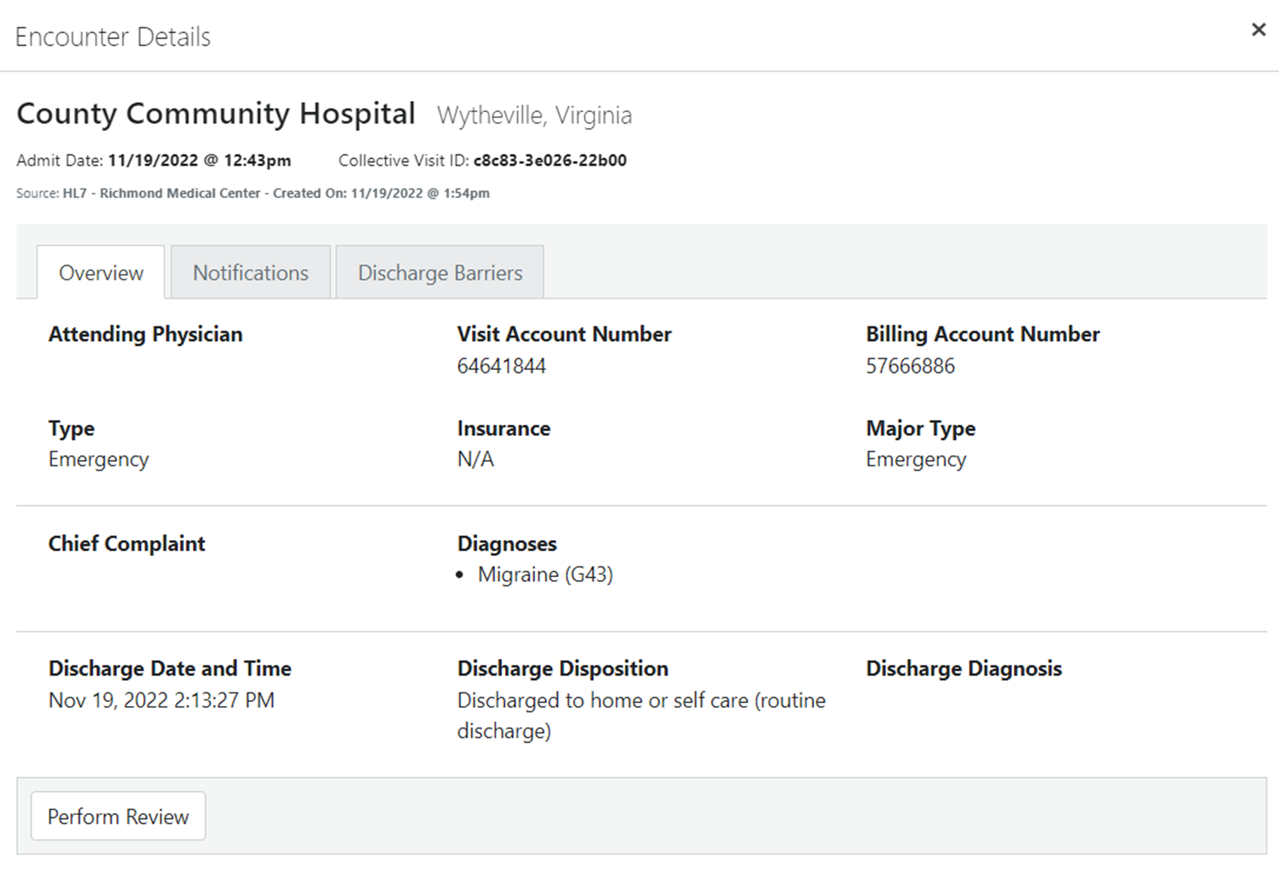
Patient Overview, Continued
Customer Community: Patient Overview Page Encounter Review
Notes:
Highlight hx, ability to change range, includes complaint presenting with as well as diagnosis

Slide 32
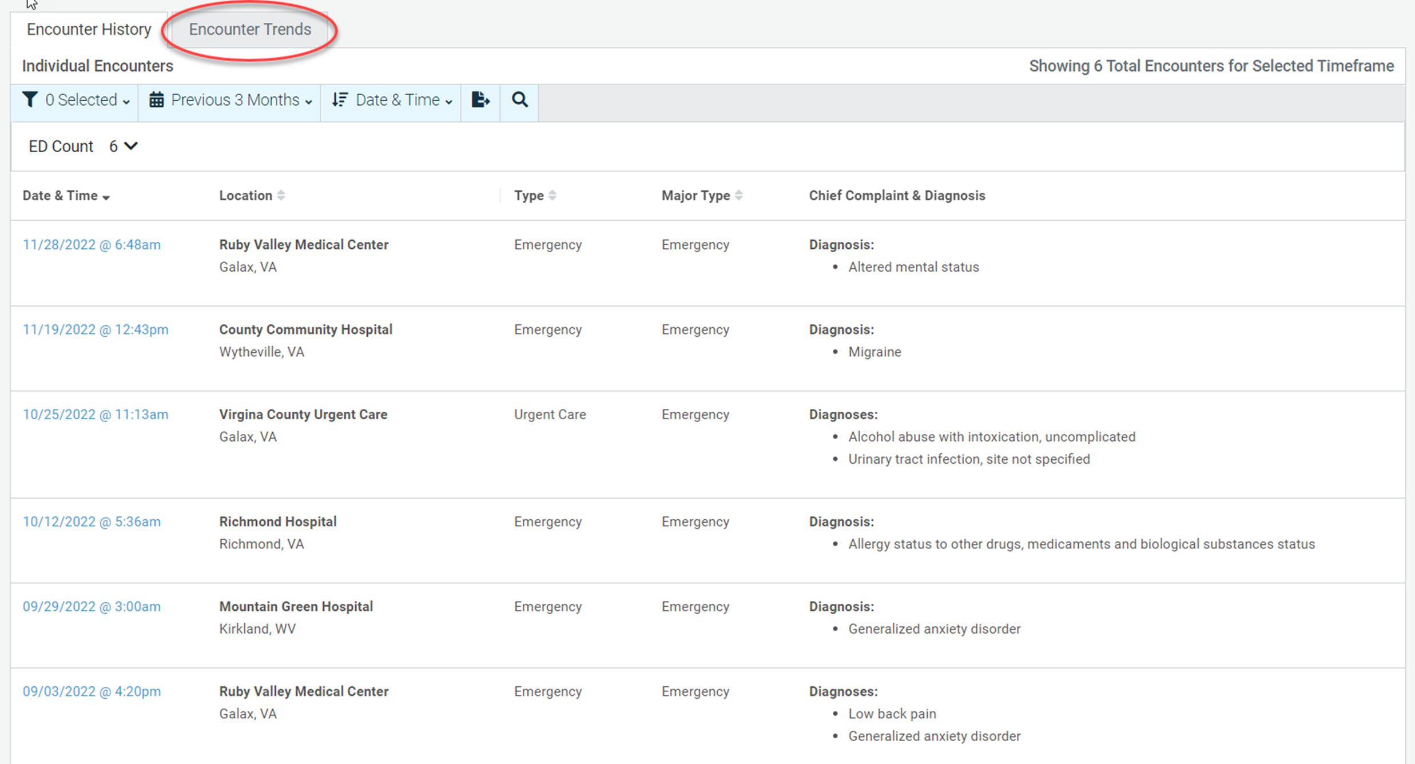
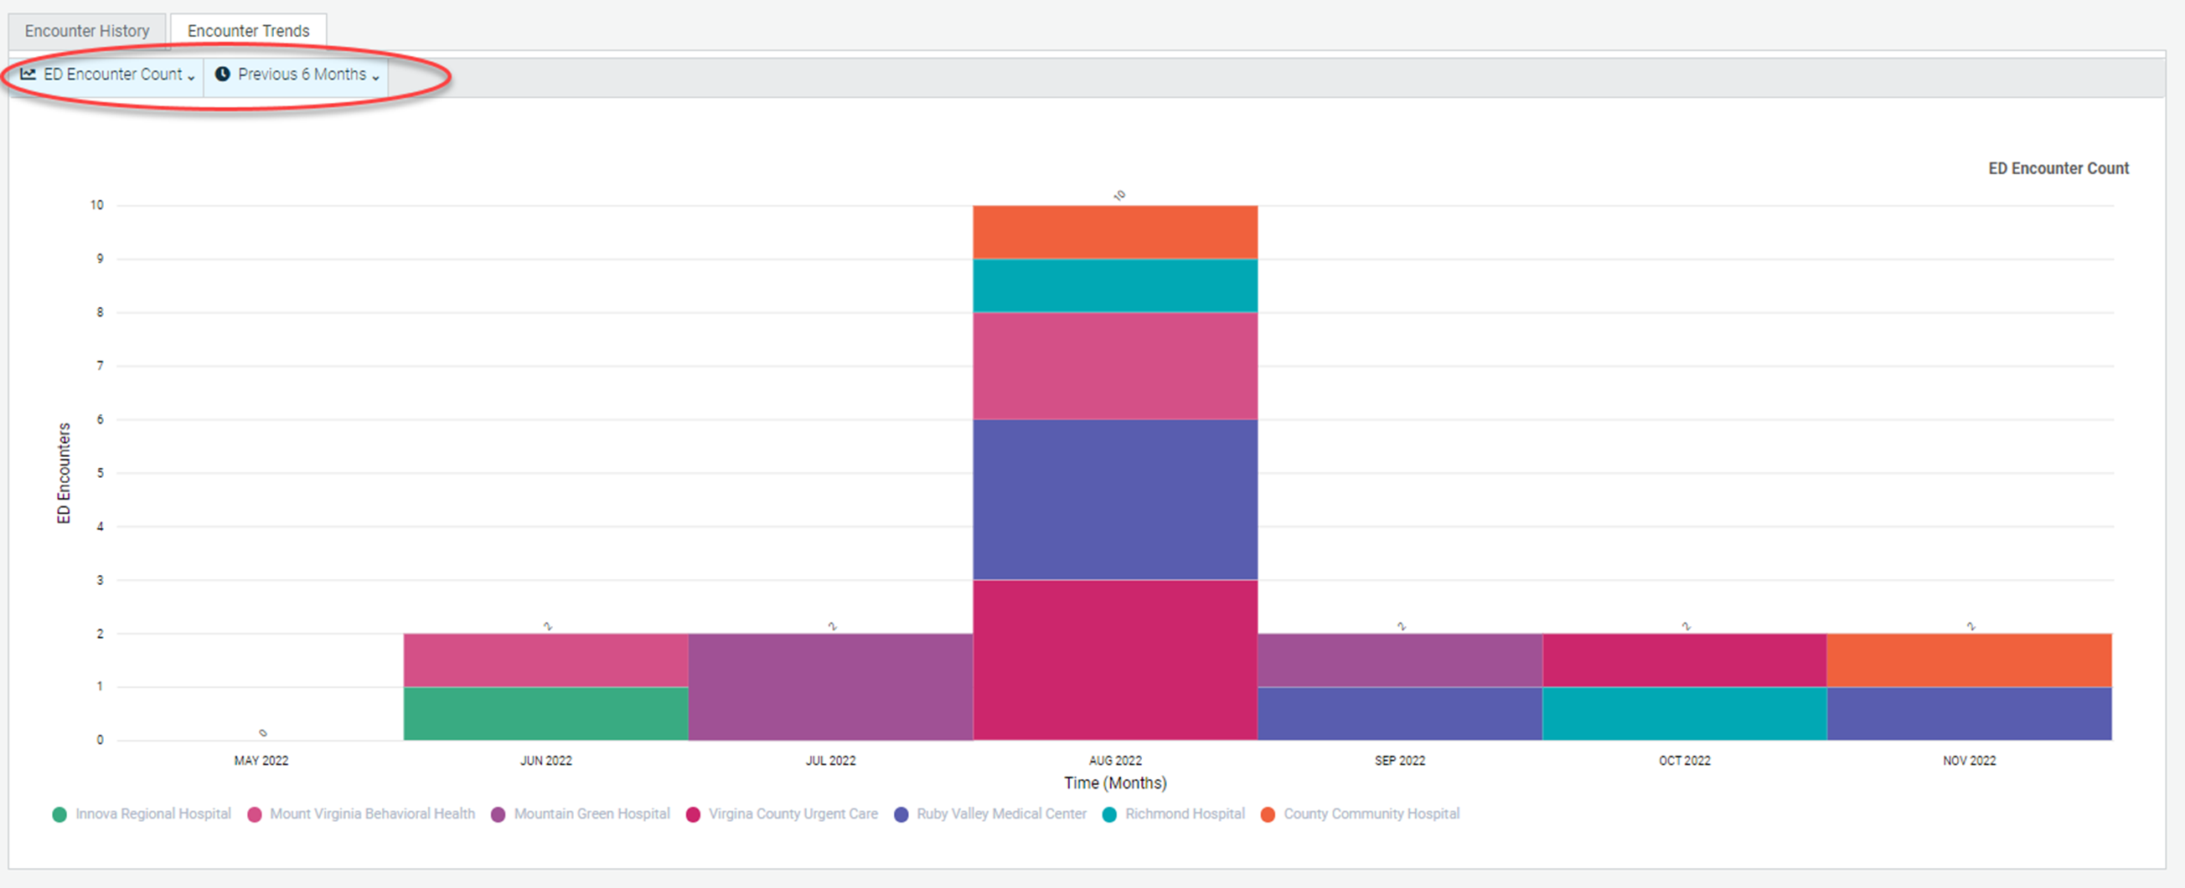
Patient Overview, Continued
Customer Community: Patient Overview Page Encounter Summary Charts
Notes:
Highlight hx, ability to change range, includes complaint presenting with as well as diagnosis

Slide 33
Patient Overview, Continued
Customer Community: Patient Overview Page Security & Safety
Notes:
note specifics, easy to add

Slide 34
Patient Overview, Continued
Customer Community: Patient Overview Page Uploading Attachments
Notes:
Highlight types of attachments, I.e. POLST- ability to share between care settings

Slide 35
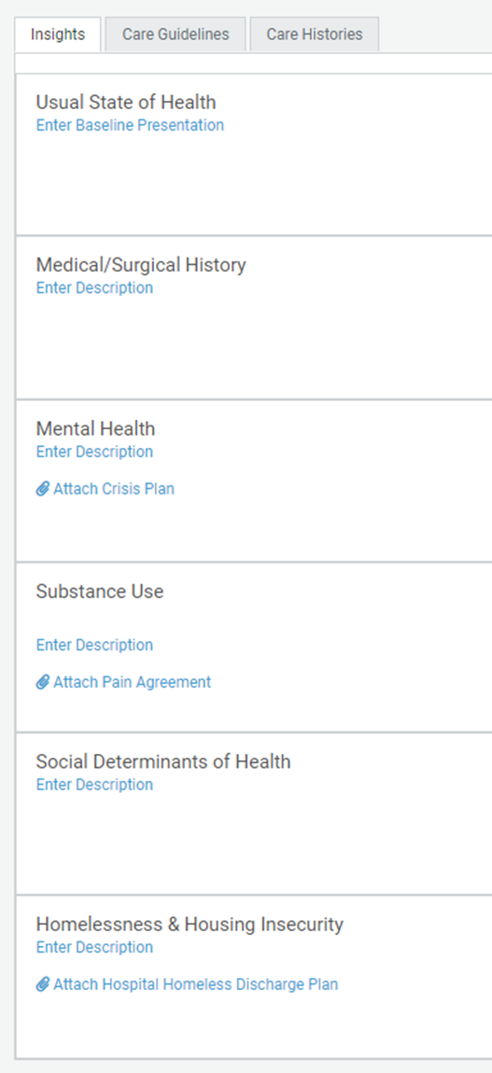
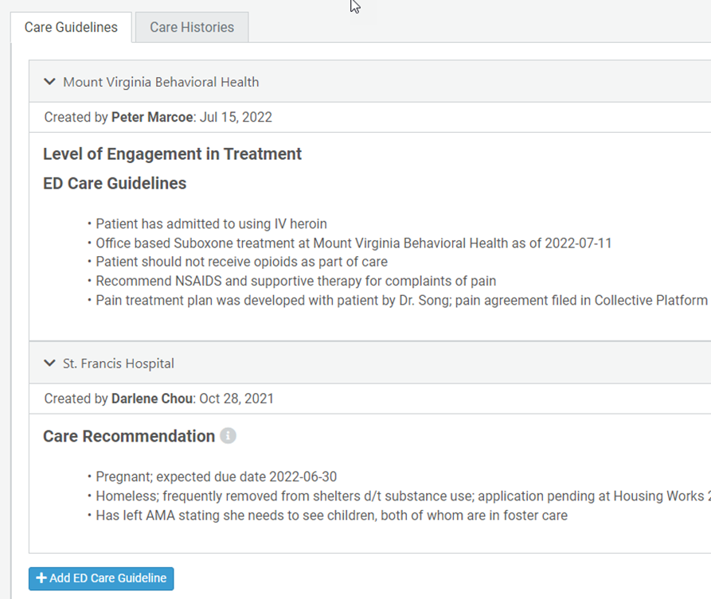
Care Insights
Customer Community: Care Insights Welcome Using Collaborative Insights
New
Old- notes all in one area, broken down by who entered them

Slide 36
State Comparison

Slide 37
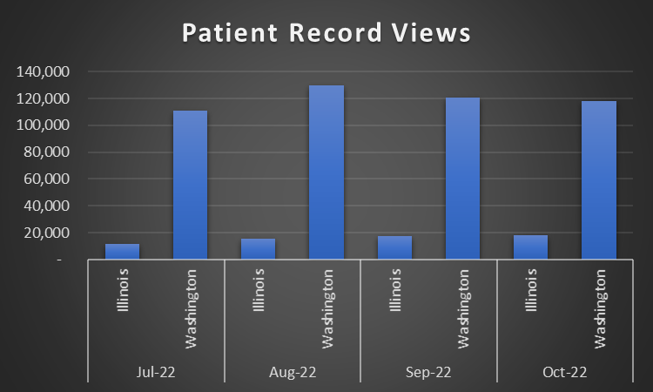
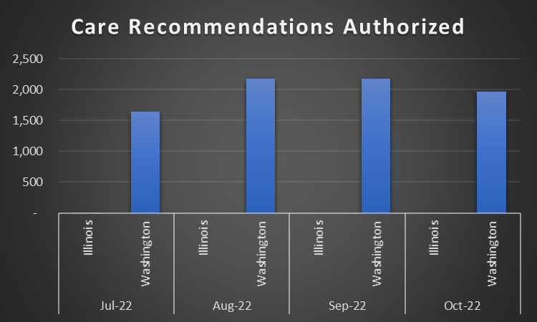
Activity - Illinois vs Washington

Slide 38
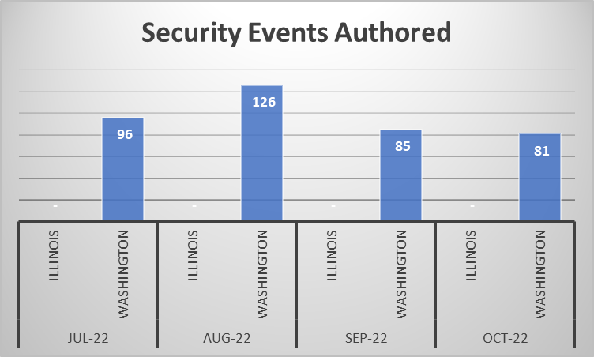
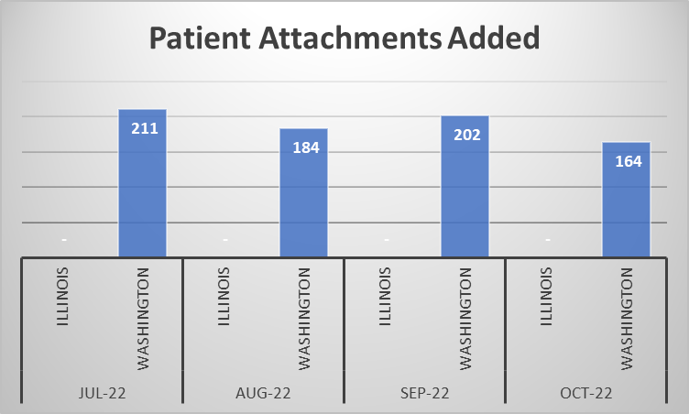
Activity - Illinois vs Washington

Slide 39
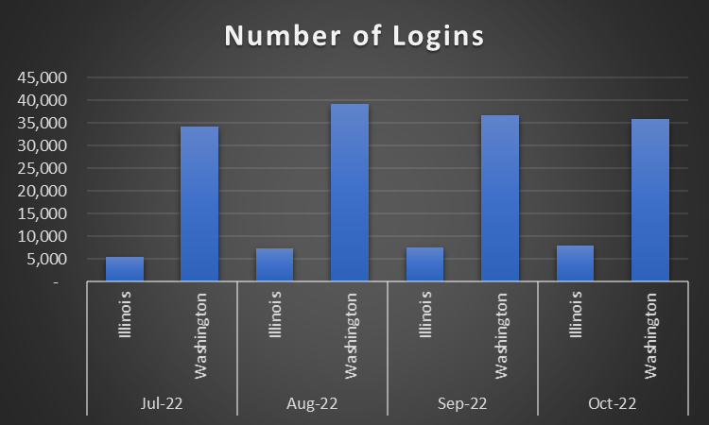
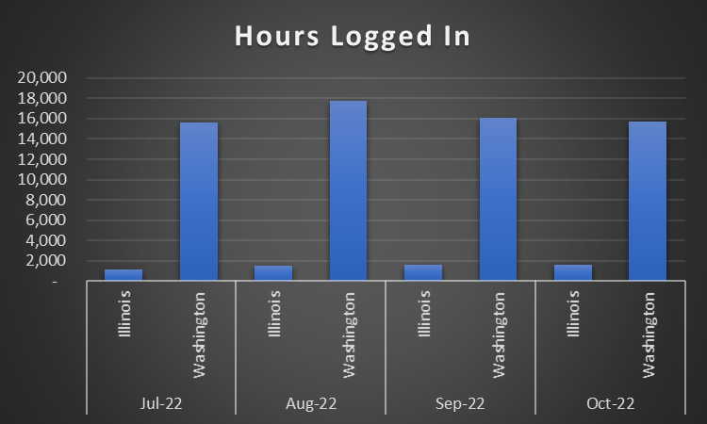
Activity - Illinois vs Washington

Slide 40
Platform Demo Help Demo
Patient Activity Census Page
Notifications
Scheduled Reports / Demand Access
Groups – Tags
Patient Overview:
Care Team
Encounters
Care Insights
Safety Events
Where to find: ​
Platform Training ​
Instructions and Videos
Community Discussions

Slide 41
Training / Future CCG Topics

Slide 42
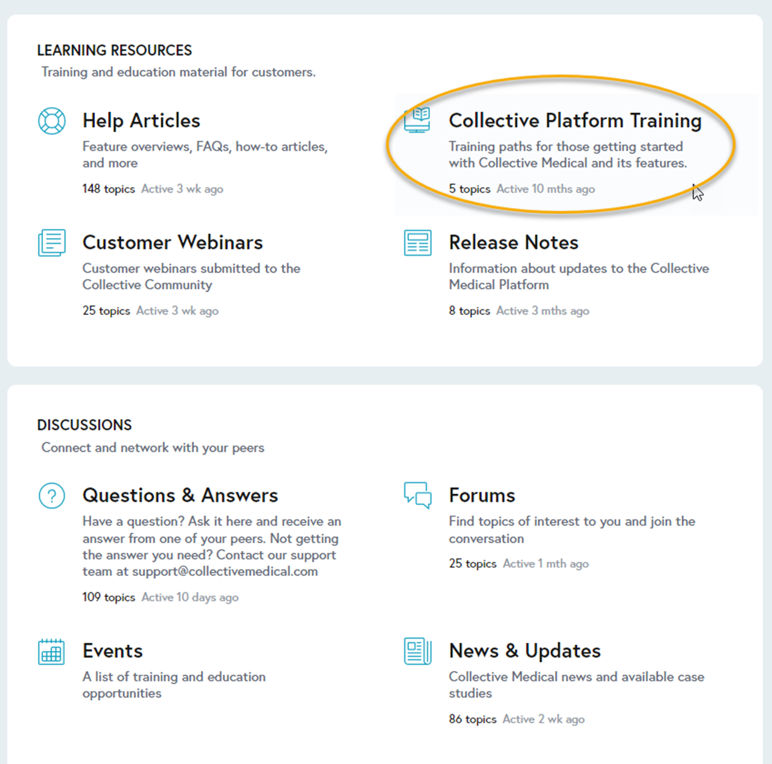
Training access through portal
https://community.collectivemedical.com/
support@collectivemedical.com
Notes:
Demo Tags/Groups, Scheduled Reports, Collective Community access through platform

Slide 43
Survey
What features shown today are something you will use in the future?
Would you like Collective Medical/PointClickCare to contact you for a deeper dive to assist your facility on how to use the platform to meet your needs/initiatives?
Have you used the Customer Community Site?
Please list any topics you would like to see for the next CCG

Slide 44
Survey Link for Polls In This Webinar
https://forms.office.com/g/QG2Vsfrz9A

Slide 45
Questions
State HFS
Website: HealthChoice Illinois ADT
HFS Program Email: HFS.HealthChoiceIllinoisADT@Illinois.gov
Collective Medical/PointClickCare
Customer Community Site: https://community.collectivemedical.com/
Collective Medical Support Email: support@collectivemedicaltech.com

Slide 46
Upcoming Events
Recordings of Past CCGs
Clinical Collaboration Group Webinar (all provider types)
Illinois: Training Webinar
Date: Thursday, March 9, 2022; 12pm – 1:00pm
Link to register: coming soon
Clinical Collaboration Group – Recorded Webinars
Clinical Collaboration Group Training (all provider types) 08/18/2022
Clinical Collaboration Group Hospital Training 04/28/2022
Clinical Collaboration Group Skilled Nursing Training 03/01/2022
Clinical Collaboration Group MCO Training 02/24/2022
Clinical Collaboration Group Hospital Training 02/22/2022
Clinical Collaboration Group (all provider types) 01/20/2022

