Slide 1
HealthChoice Illinois ADT Clinical Collaboration Group Collaborate to Improve Patient Outcomes
November 30, 2023

Slide 2
Agenda
Introductions
Dana Wilson, PMP, Program Manager, HFS, Division of Medical Programs, Program & Policy Coordination, Federal Health Information Planning
Nancy Sehy, BSN, RN, CHPCA, Clinical Solutions Lead, PointClickCare
Ian Bruce, MS, Sr. Clinical Solutions Lead, PointClickCare
Kate Dowd, BSW, MA, Strategic Clinical Solutions Manager, PointClickCare
HealthChoice Illinois ADT Program Updates
New Provider Notice Review
Progress on 2023 CCG Initiative Goals
Privacy Process
Platform Items
Collaboration Examples
Upcoming Events

Slide 3
HealthChoice Illinois ADT Program Updates

Slide 4
HFS HealthChoice Illinois ADT Program Goals
Improve Care Coordination
Provide real-time ADT alerts for immediate action events
Reduce hospital readmissions
Support Managed Care Organizations (MCOs) operations and care coordination
Enhance provider-to-provider communication using HL7 data
Enhance Data Quality
Follow HL7 and USCDI standards for data exchange
Establish state agency HL7 standards for consistency and improved exchange
Achieve a data quality verification rate of 90% or above
Utilize Reporting and Data Analysis
Analyze equity and address disparities in healthcare
Analyze social determinants of health (SDoH)
Improve claims reporting and identify system inefficiencies
Combine HL7 data with existing claims data for insights
Support Interoperability Legislation
Support CMS Conditions of Participation requirements
Assist agencies and providers in meeting federal interoperability requirements
Collaborate with other state agencies to meet public health legislation requirements
Notes:
Improve Care Coordination
One of our primary goals is to improve care coordination. By providing real-time ADT alerts and enabling better communication among healthcare providers, we can enhance follow-up visits, reduce hospital readmissions, and support Managed Care Organizations in their operations and care coordination efforts.
Enhance Data Quality
Ensuring data quality is crucial for effective healthcare delivery. We are committed to following HL7 and USCDI standards for data exchange and establishing our own state agency HL7 standards. By achieving a data quality verification rate of 90% or above, we can enhance the reliability and accuracy of the data we exchange.

Slide 5
Project Timeline
2021
May – Sep Hospital Onboarding
Jul – Dec Long Term Care Onboarding
Dec – All MCO’s connected
Aug 3, 2023
Clinical Collaborative
Group & Technical Advisory Group
Mar 9, 2023
Clinical Collaborative
Group
May 4, 2023
Clinical Collaborative
Group
Aug 2023
Provider Notice
Data Quality
Nov 30, 2023
Clinical Collaborative
Group
2023 - 2031
Data Quality
and Analytics Enhancements
2023 - 2031
Initiatives, Incentives, Programs, Increase Efficiency, Improve Patient Outcomes
Jan 2022
1st Clinical Collaborative
Group (CCG)
Feb 2022
Begin Ambulatory & Community Provider Implementation
Mar 2023
1st Healthcare Transformation Collaborative
May 11, 2023
HFS HealthChoice Illinois ADT Technical Advisory Committee
Convene
Aug 2023 –
Sep 2024
Hospital Data Quality
Remediation
Nov 2023
Provider Notice
FQHCs, CMHCs, BHCs, SUPR
Spring 2024
ADT Data Enterprise Data Warehouse
2023 - 2031
Phase 2:
CCDs, Labs, Imaging, Rx, Scheduling, Physician Notes, Billing Data
CCGs held each qtr. for Hospitals, MCO, LTC, and Ambulatory & Community Providers

Slide 6
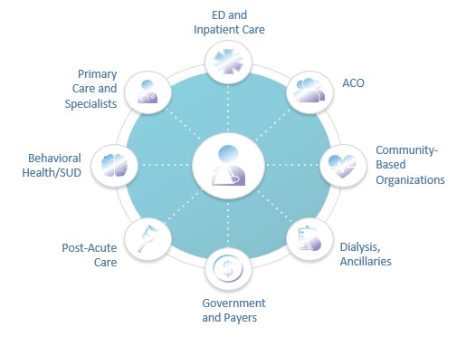
Connected Facilities
553 Medicaid Ambulatory & Community Providers
Type | Subscribing
Certified local public health department | 1
Community Health Agencies - In home | 1
Community Mental Health Provider | 294
Department of Alcohol and Substance Abuse Provider | 69
Family Support Program | 5
Federally Qualified Health Centers | 130
Healthy Kids (EPSDT) screening clinics | 1
Home Health Agencies - In Home | 3
Home Nursing Agency | 1
Hospice | 2
Integrated Health Home | 6
Rural Health Clinics | 4
Waiver service provider--Elderly (DOA) | 36
933 Medicaid Facilities Transmitting Data
Type | Sending Live Data
Hospitals | 194
ICFDD (Intermediate Care Facility/Developmental Disabilities) | 20
SLF (Supportive Living Facilities) | 90
SMHRF (Specialized Mental Health Rehabilitation Facilities) | 18
SNF (Nursing Facilities) | 611
Numbers as of November 22, 2023
https://hfs.illinois.gov/healthchoiceadt/participants.html
Notes:
Show the difference since the last meeting.
Numbers from March 2023 compared to Numbers end of June 2023
42 additional contributing providers - (4 SLF and 38 SNF)
17 new ambulatory and community providers
We currently have an impressive number of Medicaid facilities transmitting data through the HealthChoice Illinois ADT Program. We have 194 hospitals, 12 ICFDD facilities, 90 SLFs, 18 SMHRFs, and 611 SNFs participating in the program. We also have 45 clinics representing almost 411 thousand lives and home health facilities representing 23,650 lives. This extensive network of facilities enhances our ability to exchange vital healthcare information.

Slide 7
New Provider Notice Review

Slide 8
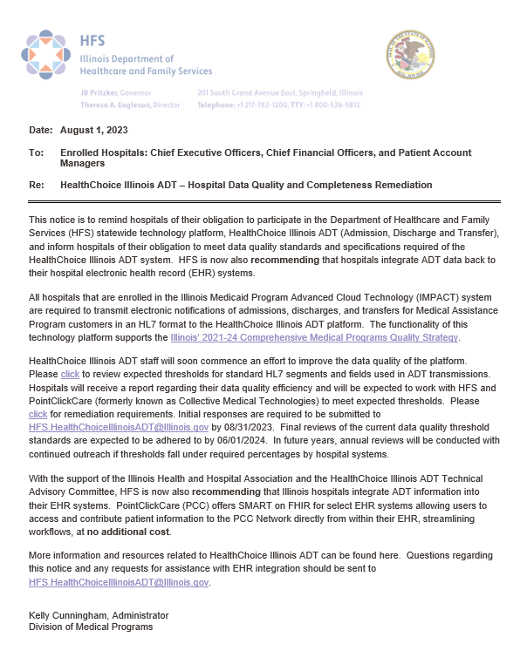
Hospital Provider Notice
Highly Recommending ADT Integration
Working with CMS Financial Management SMEs regarding their suggestion to include connection costs in administrative costs for provider cost reports
Data Quality
Link to HFS HealthChoice Illinois ADT – HL7 ADT Data Quality Standard
Expected percentages and standards
Reports provided to hospitals for current status
Deadlines for Remediation
8/31/23 main contacts, compliance officers, and technical teams to set up initial calls to review current data quality and completeness
Schedule Meetings by 9/30/2023, meet by 12/31/2023
9/30/2023 – 06/01/2024 Review current baselines, identify issues with data quality, correct mappings, testing, and fix data transmission
06/01/2024 Final Review
Annual Reviews

Slide 9
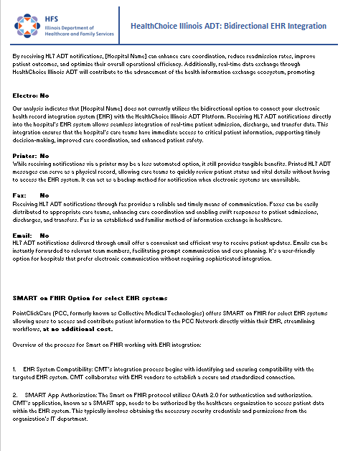
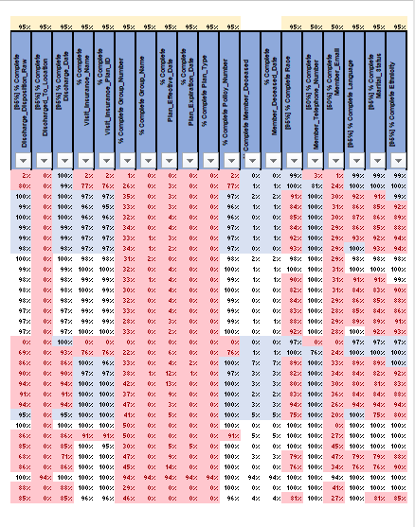
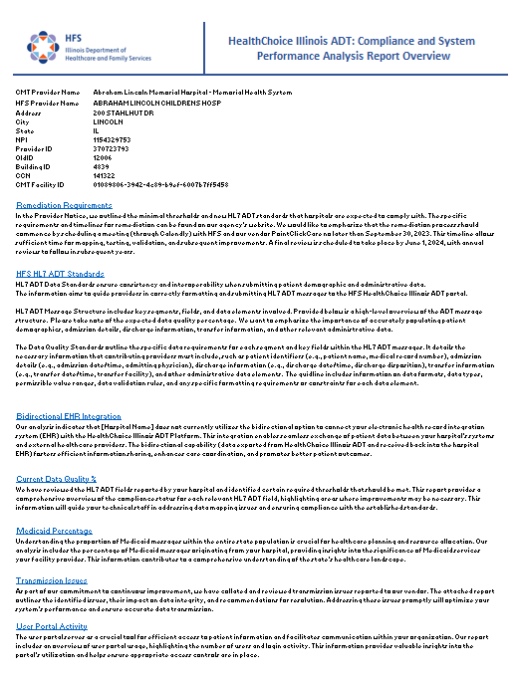
Hospital Compliance and System Performance Analysis Report Overview
Overview
Remediation Requirements
HFS HL7 ADT Standards
Bidirectional EHR Integration
Current Data Quality %
Medicaid Percentage
Transmission Issues
User Portal Activity
Notifications
Claims vs. HL7 Messages

Slide 10
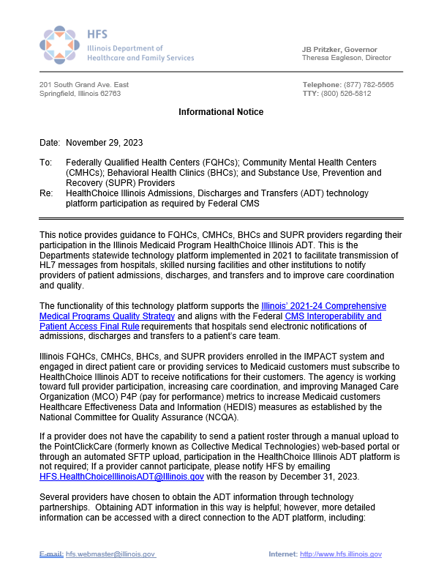
Provider Notice FQHC, CMHC, CHC, SUPR
Shall Subscribe to HealthChoice Illinois ADT
Federally Qualified Health Centers,
Community Mental Health Centers,
Behavioral Health Clinics and Substance Use,
Prevention and Recovery (SUPR) Providers
Technology Platform Supports
Illinois’ 2021-24 Comprehensive Medical Programs Quality Strategy and aligns with the Federal CMS Interoperability and Patient Access Final Rule requirements that hospitals send electronic notifications of admissions, discharges and transfers to a patient’s care team
Goals
Working toward full provider participation
Increasing care coordination
Improving MCO P4P Metrics to raise Illinois HEDIS Measures
Notes:
Federally Qualified Health Centers, Community Mental Health Centers, Behavioral Health Clinics and Substance Use, Prevention and Recovery (SUPR) Providers
We encourage your participation as quickly as possible and ask that you notify HFS.HealthChoiceIllinoisADT@Illinois.gov by December 31, 2023 for the reason your facility cannot participate.
https://www.illinois.gov/hfs/SiteCollectionDocuments/IL20212024ComprehensiveMedicalProgramsQualityStrategyD1.pdf
² https://www.federalregister.gov/documents/2020/05/01/2020-05050/medicare-and-medicaid-programs-patient-protection-and-affordable-care-act-interoperability-and

Slide 11
Benefits of HealthChoice Illinois ADT Program
 | Standard Ambulatory Program
Census | Acute encounters and post-acute encounters
Cohorts | ED Encounters ED Discharges Inpatient Admissions Inpatient Discharges 3+ ED vis its in 3 Months 3+ ED vis its in 12 months BH ED Encounters | Enhanced Additional Criteria for BH Providers: ED Visits – Suicidal Ideation/Attempt or Self-Harm ED Visits – Opioid Overdose Dx ED Visits – Mental Health Dx ED Visits – Substance Use Dx ED Visits – Opioid Use Disorder Dx ED Visits – Alcohol Use Disorder Dx
Notifications | Optional, and can be applied to any cohort above. Standard types: secure email, printer, fax, text (SMS)
Scheduled Reports | Patient census: Daily (prior day), Weekly (prior 7 days),or monthly (previous month). Acute encounters only.
Tags | Cl inics with multiple locations can provide a ‘Location ID’ on the patient roster, which will reflect on the Patient Overvi ew page. Cl ients can manually add tags in the portal.
Flags | Users can view Flags created by other organizations on the Patient Overvi ew Page.
Consent | Included for BH providers
User Accounts | 2-5 initial accounts created for key staff with super user training provided. Super user will create and manage additional accounts. SSO available.
Patient Overview/Care Team/Care Insights | Included
Seamless communication with hospitals, specialists, and community organizations.
Enhanced care transitions and reduced gaps in information exchange.
Efficient sharing of patient data, leading to better decision-making and patient outcomes.
Receiving real-time notifications of patient activity outside of your EHR/clinic.
Benefits of Care Insights - ability to surface patient specific need-to-know
Notes:
Utilize Reporting and Data Analysis
Reporting and data analysis are key to informed decision-making. By analyzing equity and addressing disparities, analyzing social determinants of health, and leveraging HL7 data alongside existing claims data, we can gain valuable insights that help us improve healthcare policies and identify system inefficiencies.
Support Interoperability Legislation
Supporting interoperability legislation is vital to our success. By aligning with CMS Conditions of Participation requirements and assisting agencies and providers in meeting federal interoperability requirements, we can ensure seamless data exchange and collaboration across the healthcare ecosystem.

Slide 12
Notes:
Utilize Reporting and Data Analysis
Reporting and data analysis are key to informed decision-making. By analyzing equity and addressing disparities, analyzing social determinants of health, and leveraging HL7 data alongside existing claims data, we can gain valuable insights that help us improve healthcare policies and identify system inefficiencies.
Support Interoperability Legislation
Supporting interoperability legislation is vital to our success. By aligning with CMS Conditions of Participation requirements and assisting agencies and providers in meeting federal interoperability requirements, we can ensure seamless data exchange and collaboration across the healthcare ecosystem.

Slide 13
2023 CCG Initiative & Goals
Notes:
Before we get started from the PointClickCare side, just a heads up that if any of the content we will be sharing during this webinar is something you’d like more information on, or help using at your organization or facility, we will have the opportunity at the end of this presentation, for you to click a button to request that. I encourage you to please do click that- we are here to help you achieve results.

Slide 14
2023 Clinical Collaboration
Initiative- improve collaboration for care coordination to affect
Adult Behavioral Health- follow-up after ED visit for Mental Illness and
Adult Behavioral Health- follow-up after Hospitalization for Mental Illness
Measures- platform feature use
Care Insights authored
Reports requested/built

Slide 15
2023 Clinical Collaboration Measures- Platform Feature use
Care Insights authored
Start: 3
Goal: 30 more
Currently: 4
Reports requested/built
Start: 104
Goal: 10 more
Currently: 128
Notes:
Insights: This year- Mar- 2, Apr- 3, July 1
Reports: 20 new reports built for IL customers this year- 7 new since last CCG, and many others modified -almost entirely health plans- remind hospitals they can – we would like to see more hospitals benefitting from this- it’s included at no charge for them

Slide 16
PointClickCare Platform Privacy Ian Bruce

Slide 17
“What does HIPAA say specifically about Treatment, Payment, Healthcare Operations (TPO), and public health?”
Use and Disclosure for Treatment
“A covered entity may disclose protected health information for treatment activities of a health care provider”
– 45 CFR 164.506(c)(2)
Use and Disclosure for Payment
“…to obtain premiums or to determine or fulfill its responsibility for coverage and provision of benefits”
– 45 CFR 164.501
Use and Disclosure for Health Care Operations
“…population-based activities relating to improving health or reducing health care costs, protocol development, case management and care coordination”
– 45 CFR 164.506(c)(4); 45 CFR 164.501
Use and Disclosure for Public Health
“A covered entity may use or disclose protected health information for the public health activities and purposes in this paragraph [such as collecting or receiving] information for the purpose of preventing or controlling disease, injury or disability..."
– 45 CFR 164.512(b)

Slide 18
Provisioning User Access Across BH Clinic Sites &
How PCC Identifies Behavioral Health information as Sensitive Data
How are populations with sensitive behavioral health data identified and managed by PCC?
Upstream pre-implementation discovery process allows for identification of types of behavioral health data for each clinic site
SUD treatment programs that are a Part 2 Covered Program under 42 CFR Part 2 will have their own portal configured with SUD consent functionality, separate from programs providing mental health or psychiatric treatment only, which has mental health specific consent functionality configured.
*Programs providing dual diagnosis of both SUD and mental health treatment typically will be treated as a Part 2 covered program.

Slide 19
Consent | Substance Use Disorder 42 CFR Part 2
42 CFR Part 2 is an added level of privacy for patients receiving care at SUD treatment facilities
Key Points:
Added restriction to information sharing for SUD tx facilities
In Addition to HIPAA
Part 2 applies to a setting, not to content: SUD content
coming from an ED does not require consent to be shared;
content coming from an SUD treatment facility
(a Part 2 covered program) does require consent in order to be shared
SUD Treatment facility
HIPAA: Need TPO Relationships
42 CFR Part 2: Need Consent

Slide 20
NO CONSENT
DEFAULT SETTING FOR CONSENT ENABLED PORTAL
All sensitive information from a facility using consent model is housed within a separate consent-enabled portal, making the facility’s relationship to the client invisible by default to the rest of the Network.
Consent
Process
CONSENT
The facility’s relationship to the client, their encounter history at the facility, and any other content generated by this facility on the Platform are shared via the Network to the patient’s other treating providers.
For a facility that utilizes our consent model, the sensitive information from that facility may be disclosed via the Network only if the facility has sent the client’s consent status to PointClickCare.
Notes:
What makes PointClickCare’s consent enabled portals different from our standard portals is that your facility will be onboarded as default invisible to the rest of the Network. That means that any information originating from your facility (such as care team, encounters, or care insights) will not be visible to anyone outside of your facility unless PointClickCare receives a ‘yes’ consent message from your facility, although those from your own organization with portal access will still be able to view this information.
There are two types of consent messages:
No Consent (default)
Consent
Consent allows for the sharing of information with the rest of the care team on the network of all content generated by your facility on the PointClickCare platform, including care team information, encounters at your facility, and care insights. This is indicated with a “Y” in the consent status column in the eligibility file. Consent may be revoked at any time at the patient’s request.
Upstream pre-implementation discovery process allows for identification of types of behavioral health data for each clinic site
SUD treatment programs that are considered a Part 2 Covered Program under 42 CFR Part 2 will have their own portal, separate from programs providing mental health or psychiatric treatment only
*Programs providing dual diagnosis of both SUD and mental health treatment typically will be treated as a Part 2 covered program.

Slide 21
Why Should Clinics Participate?

Slide 22
Network Value for Primary Care
Network Value for Primary Care
Empower patients to stay connected with PCP expedites transitions of care follow up
Share care insights throughout the continuum of care
Coordinate interdisciplinary care conferences through care teams
Share the patients background, voice, and directives in real time
Provide consistent messaging and education around where to access care
Collaborate in real time with health plans, emergency medicine, behavioral health and post acute care to avoid readmissions
Identify trends in utilization by individuals, diagnosis and lines of business
Case manage patients with high utilization patterns at the point of care
Use real time data to improve care outcomes and meet metrics
Enhance communication with health plan by coordinating care off the same data
Reduce no shows and increase acute care follow up visits by connecting directly with your patients next day
Increase over all encounters through education of same day, evening hours and work in appointments in lieu of ED
Patient Centered Care
Reduction in High Utilization
Patient Panel Management

Slide 23
Network Value for Behavioral Health
Collaborate through care team to ensure client follows up on physical or behavioral health at the correct point of care
Establish robust relationships with PCP, Health Plans and community partners
Real time notifications allow clinicians to assist clients in the emergency department and/ or at the time of discharge
Safety & Security alerts in real time help team keep staff and clients protected from harm
Safety plans, effective interventions, and triggers can be shared through insights
Giving clients voice through patient background alleviates the burden from the individual in crisis
Consistent communication from providers across the network endorses the sense of belonging
Same or next day follow up calls or visits assure your client your are there to address their needs
Advocating for individuals living with SPMI
Client and Staff Safety
Enhance Client Connectivity
Reduce ED Utilization

Slide 24
Did you know? Portal features

Slide 25
Parent-Child Portal Configurations
ORGANIZATION NAME
File Column Header | TAG
(TAG Example: Location Assignment, Program)
*parent portal
CSV
LOCATION | Program A *cohorts + notifications + reports
*child portal
LOCATION | Program B
*cohorts + notifications + reports
*child portal
LOCATION | Program C
*cohorts + notifications + reports
Sample File Headers + Rows
Unique Patient ID | Additional Patient ID | First Name | Middle Name | Last Name | Date of Birth | Gender | SSN | Address 1 | Address 2 | City | State | Zip Code | Phone Number | Location Assignment Program
8392758 | M39421-18 | Elizabeth | J | McCarthy | 1939-01-01 | F | XXX-XX-XXXX | 33 Aspen Drive | apt 2 | Lynn | MA | 01905 | 7815993200 | A
9387223 | A0934-11 | Nancy |  | Abelian | 1943-01-01 | F | XXX-XX-XXXX | 16 Main street | apt 3 | Bedford | MA | 01730 | 7812751000 | B
3090992 | H93829-03 | Joyce | p | Harry | 1954-09-01 | M | XXX-XX-XXXX | 142 State Street | unit 4 | Everett | MA | 02149 | 6173816000 | C

Slide 26
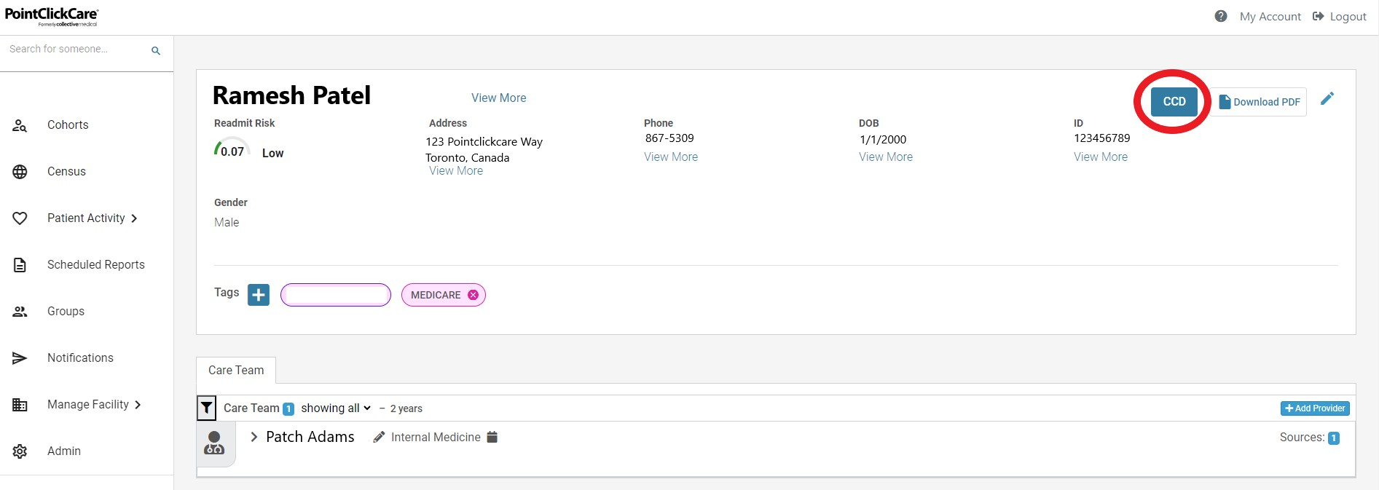
Continuity of Care Documents (CCDs)
Users have access to the 'CCD' button, which allows them to click and see available documents for the patient.
The latest discharge document for the patient will be at the top of the list.
Notes:
CCDs are provided to Hospital, Ambulatory, and Home Care portals
This is nationwide data sourced from patient encounters and curated into the portal.

Slide 27
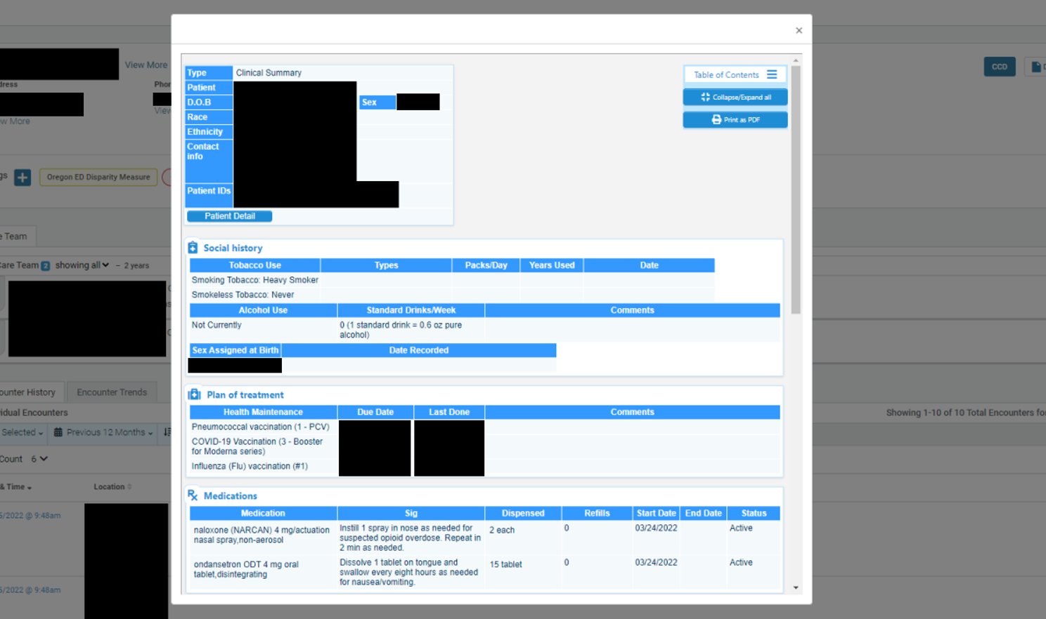
Example CCD
Ccds- source of, what is in there
Notes:
There are options for users to move around elements to customize their views on the way that allows them to best use the information.

Slide 28
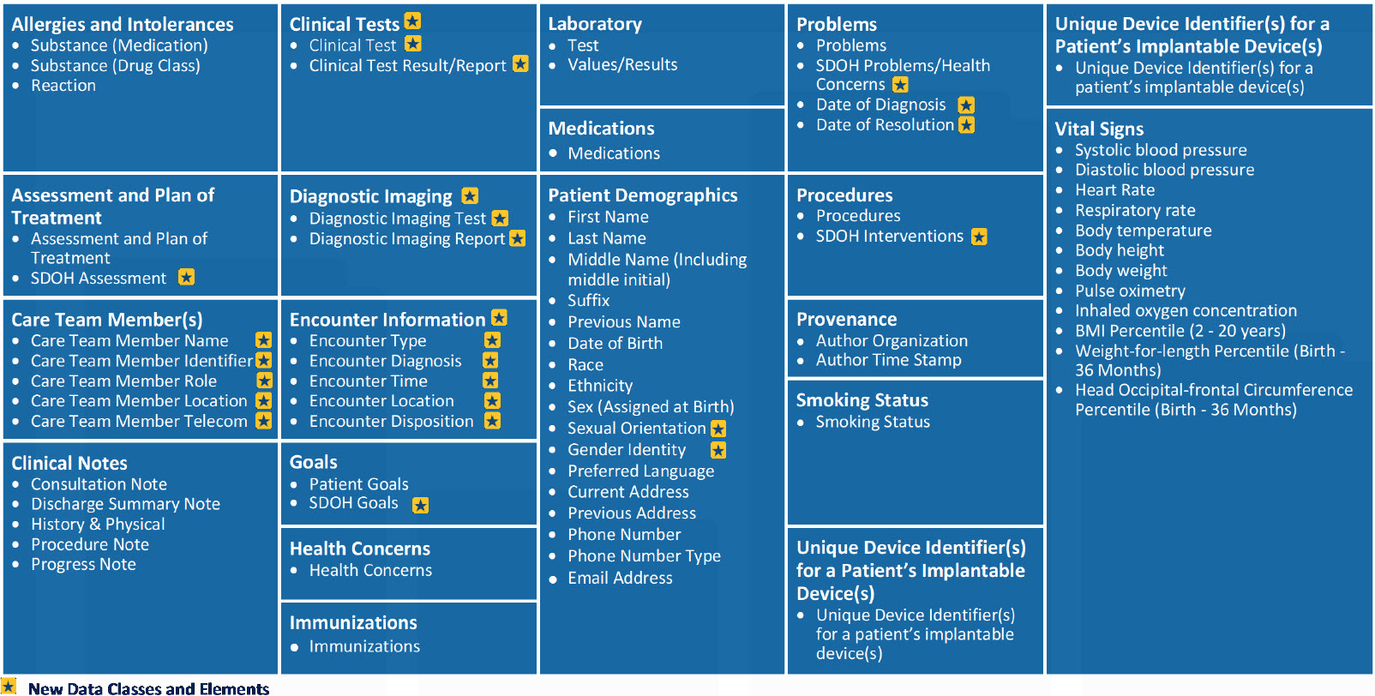
CCD Contents – USCDI Version 2
Notes:
These are examples of elements we can pull into CCDs in the portal for you

Slide 29
Collaboration- What are the Possibilities?

Slide 30
Examples of Regional Care Collaborations- Aspire Health Alliance
“The event notifications are a way to find people and engage them while they’re in the ED. In this acute state—this crisis state—we find a higher rate of engagement. If we send our people to the hospital, we can coordinate with a social worker to say, ‘Look, this is a free service from Mass Health for you. I’m here to help you get what you need; how can I help?”
-Deborah Jean Parsons
Director of Integrated Care, Aspire Health Alliance
With 5% of the state’s most vulnerable patients accounting for 50% of the Massachusetts Medicaid healthcare budget, connecting patients to the BHCP as quickly and effectively as possible is crucial to reducing costs. With the PointClickCare Platform:
50% of patients who are contacted by an Aspire case manager during their hospital stay end up engaging in the BHCP program.
Patient presents at the ED, struggling with behavioral problems and possible other conditions
Hospital stabilizes patient, and releases or admits into inpatient recovery
Behavioral care professional reaches out to patient and begins needed follow-up care.

Slide 31
Examples of Regional Care Collaborations- Aspire Health Alliance
Aspire Health Alliance (Aspire) helps find and connect patients with significant medical, behavioral, mental, and/or social needs to dedicated case managers who will connect them with health and community resources through the Behavioral Health Community Partner (BHCP) program.
Based in Massachusetts, Aspire Health Alliance relies on PointClickCare to help track down the patients in need, when they need it, and connect them to the help they need most. Here’s how it works:
Patient presents at the ED, struggling with behavioral problems and possible other conditions that qualify them for the BHCP program
Hospital admits patient for stabilization and the PCC Platform sends a message directly to Aspire Health Alliance
The patient’s assigned care manager at Aspire is notified, and he or she reaches out to the hospital to request a visit and help establish a patient care plan
Care manager visits, determines best care plan, and connects patient with the BHCP program for ongoing treatment after ED discharge

Slide 32
Examples of Regional Care Collaborations- Mid-Valley Behavioral Care Network
Within the first year of implementation, the percentage of BCN patients receiving follow-up care from therapists or psychiatrists within seven days of hospital discharge increased 10.81%.
Now, 75.81% of patients receive the follow-up care they need within seven days of discharge.
“We’re seeing a really big difference in being able to track using these reports. Collective plays a major role in that. All of this is helping us to see where we’re really at in our coordination efforts and care.”
-Lisa Parks
Case Manager

Slide 33
Examples of Regional Care Collaborations- Mid-Valley Behavioral Care Network
The behavioral health team at Mid-Valley Behavioral Care Network (BCN) saw the inefficiencies facing the behavioral health system—especially when it comes to coordinating patient care with other providers. Tired of calling hospitals and checking emergency department faxes for updates on patients who had been discharged from the ED, these case managers, psychiatrists, and therapists began to advocate for better care collaboration using the PointClickCare Platform.
Patient presents at the ED, struggling with behavioral problems and possible other conditions
Hospital stabilizes patient, and releases or admits into inpatient recovery
Collective sends patient info regarding the event to the patient’s therapist, counselor, or other behavioral care professional
Behavioral care professional reaches out to patient and begins needed follow-up care.

Slide 34
CCG Schedule and Resources

Slide 35
Save The Dates for the 2024 CCG Events!
2024 Clinical Collaboration Group Webinars –
All provider types
Thursday, February 22, 2024; 12pm – 1:00pm
Register Here
Thursday, May 16, 2024; 12pm – 1:00pm
Register Here
Thursday, August 8, 2024; 12pm – 1:00pm
Register Here
Thursday, November 7, 2024; 12pm – 1:00pm
Register Here
Topics including:
Regional Collaborations
Patient level success stories
Workgroup recommendations
New Provider Notices
Platform enhancements
And more!

Slide 36
Would you like to begin a collaboration with another entity? Let’s talk about how we can help!
No thanks
Yes
If you are not on the network already, would you like PointClickCare to contact you to get you set up?
Yes
No- we’re on ☺
Notes:
RUN the poll- bottom

Slide 37
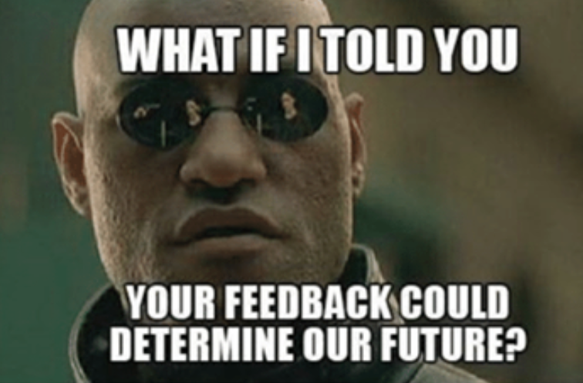
Feedback Please
Help Us Plan The Best 2024 Clinical Collaboration Group Events!
What content have you found the most valuable in the CCG webinars?
What would you like to see/ learn more about in an upcoming CCG?
Notes:
RUN the poll- bottom

Slide 38
Resources
State HFS Website: HealthChoice Illinois ADT HFS Program Email: HFS.HealthChoiceIllinoisADT@Illinois.gov
PointClickCare Customer Community Site: https://community.collectivemedical.com/
PointClickCare Support Email: support@collectivemedicaltech.com
Let’s Get Engaged!
Want an in-person visit from Collective to help your team learn how to best use the platform? A specialized Zoom training?
Click here to schedule a call to discuss your needs!
Click Here

