Slide 1
Behavioral Health
care coordination platform
September 2022

Slide 2
INTRODUCTIONS
Dana Wilson, Medical Programs, HFS
Nancy Sehy, BSN, RN, CHPCA, Clinical Solutions Lead, Collective Medical Technologies
AGENDA
HEALTHCHOICE ILLINOIS ADT OVERVIEW
TECHNOLOGY PLATFORM DISCUSSION
QUESTIONS AND NEXT STEPS

Slide 3
Why HealthChoice Illinois ADT?
Illinois’ Comprehensive Medical Programs Quality Strategy includes goals for improving care coordination, using evidence-based interventions to reduce health disparities, deploying technology, and increasing data integration.
The ADT system directly supports those critical quality goals and leverages best practices for sharing timely information to enable effective care coordination.

Slide 4
Project Timeline
Dec 2021
LTC Provider Onboarding Deadline
&
All MCO’s live on Portal
Feb 2022
Begin Ambulatory & Community Provider Onboarding
2022 - 2031
Initiatives, Incentives, Programs, Increase Efficiency, Improve Patient Outcomes
July 2021
Start LTC
Provider Onboarding
2022 - 2031
Data Quality
and Analytics Enhancements
Feb 2021
CMT Contract Signature
May 2021
Start Hospital Onboarding
Sept 2021
Hospital Onboarding Deadline
Jan 2022
1st Clinical Collaborative
Group
Webinars will be held each qtr. going forward for Hospitals, MCO and Skilled Nursing
Oct 2022
Technical Advisory Committee
Convene
2022 - 2031
Phase 2:
CCDs, Labs, Imaging, Rx, Scheduling, Physician Notes, Billing Data

Slide 5
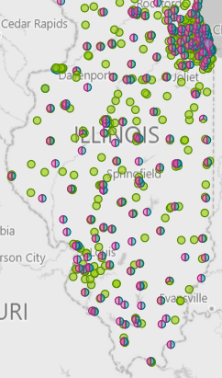
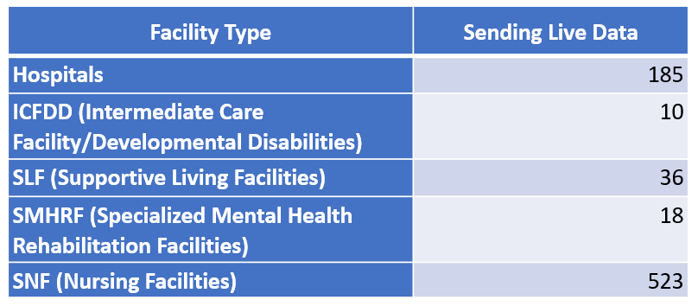
Connected Facilities
Collective Medical Footprint – IL
For IL, 189 hospitals and 489 SNFs, as of 1/13/22.
For IL, 189 hospitals and 489 SNFs, as of 1/13/22.

Slide 6
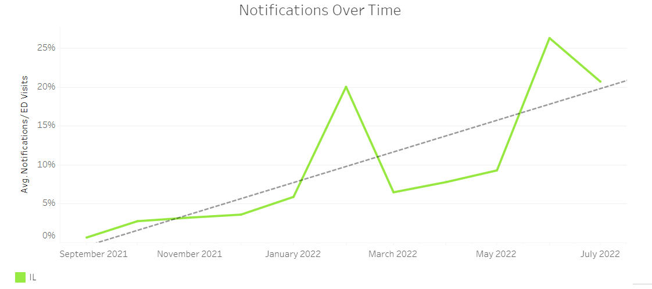
Next Steps
Volume Trending Steadily Upward

Slide 7
Usage Increasing Steadily

Slide 8
Introduction to
Collective Medical

Slide 9
OUR MISSION
Collective improves health outcomes and lowers cost by placing the right insights in front of each stakeholder along a client’s journey to inform and encourage the right action for the patient
Notes:
Sales rep

Slide 10
Collective Medical Technologies
Collective is a care collaboration solution that gets the right information to the right person at the point of care.
ED and Inpatient Care
A NETWORK
Collective is a network of hospitals, emergency departments, primary care, specialists, behavioral health providers, post-acute care providers, and health plans across the United States, sharing important patient information at the time of care
Primary Care and Specialists
ACO
A PLATFORM
Collective is a platform that intelligently connects each member of a patient’s care team for seamless collaboration at the right time and through the best medium
Behavioral Health/SUD
Community-Based Organizations
Post-Acute Care
Dialysis, Ancillaries
A COMMUNITY
Collective is a community of providers in the care of patients—especially those with complex medical needs—in your communities and across the country.
Government and Payers

Slide 11
Care coordination remains a challenge in Behavioral Health
Need for efficiency: Limited time & resources
Challenges faced in knowing the full care team
Difficulty with timely and comprehensive tracking of clients across hospital visits
Getting the care team on the same page: challenges of sharing care plans,
crisis plans; no central tool across orgs for coordinating around shared clients
Challenges of managing consent, information sharing regulations, and sensitive behavioral health information

Slide 12
The Collective approach vs. the standard approach
Standard Approach
Client symptoms are stabilized by hospital staff and client is discharged home
Client is expected to contact FQHC/behavioral health facility on his or her own… …more likely, client returns to the ED the next time the crisis returns
Client with an existing behavioral health provider arrives at hospital during a psychiatric crisis
The Collective Approach
Behavioral health provider is able to coordinate with the ED, help with assessment, and D/C planning
Client is roomed in the ED for stabilization and Collective immediately notifies hospital staff of the client’s Care Plan
Collective also immediately notifies client’s OP behavioral health/FQHC provider
Client is contacted proactively and OP treatment commences upon discharge
Client with an existing behavioral health/FQHC provider arrives at hospital during a crisis

Slide 13
Better Care Coordination through Real-Time Network Collaboration
The Collective platform works in real-time, which means whether you’re in a hospital ED, BH/SUD clinic, or other healthcare facility, you can receive up-to-date Insights into the status of your clients.
Hospital ED
Receive real-time notifications on some of your most complex clients—right in your existing workflows – Do not have to access a different system or dig through medical records for information
Insights help providers identify existing diagnoses and care guidelines and contact the best behavioral health provider for needed follow-up – Decrease LOS, supports efficiency, shared SW/CM have access to same information
ED Intake
ED Discharge

Slide 14
Better Care Coordination through Real-Time Network Collaboration
The Collective platform works in real-time, which means whether you’re in a hospital ED, BH clinic, or other healthcare facility, you can receive up-to-date Insights into the status of your clients.
BH Community Partners
Know when clients are in the hospital—without having to call around or rely on clients to report the incident
Increased visibility into client encounters
Receive real-time notifications of active encounters for faster follow-up
Add care guidelines and crisis plans to guide emergency physicians and mitigate crisis situations—whether a case manager is on-site or not.
ED Intake
ED Discharge

Slide 15
How does the Collective Platform benefit care collaboration?
Risk Identification
Real-time analytics identify high-risk encounters and populations.
Intelligent Notifications
Risk-based alerts, curated into a consumable format and delivered into existing workflow.
Activate the Care Team
Dynamically understand who is on the client’s broader care team that needs to be engaged to support the client.
Share Insights
Connected care team shares unique client specific insights via shared, virtual collaboration environment; insights follow the client going forward.
What risk factors should I be aware of?
How can I quickly learn what I need to know?
How / where can I get the support I need?
Who knows what about this client?

Slide 16
Collective Notifications – Workflow and Process
Step 2 – ADT Transmission
Within moments, the hospital’s EHR sends the important information about the encounter to Collective in the form of an ADT message.
ADT Data

Slide 17
Collective Notifications – Workflow and Process
Step 3 – Patient Identification
The Collective platform normalizes the new encounter information, identifies the patient’s aggregate profile on the network as well as identifies patient’s aggregate profile existing through Carequality or CommonWell, and merges the new data in.

Slide 18
Collective Notifications – Workflow and Process
Step 4 – HIPAA Verification
Collective analyzes its network, and all entities showing a verified HIPAA relationship with the patient are identified, including the facility at which the patient is currently experiencing the triggering encounter.

Slide 19
Collective Notifications – Workflow and Process
Step 5 – Criteria Analysis
Each of these entities’ Collective profiles are analyzed to identify which—if any—of the members of the patient’s care team should receive notification of the encounter, and curated specifics about the patient’s needs.

Slide 20
Collective Notifications – Workflow and Process
Step 6 – Care Team Notification
Within seconds of the patient’s initial presentation at the triggering facility, real-time notifications are delivered to the members of the patient’s care team identified as being best placed to intervene and impact outcomes.

Slide 21
Collective Notifications – Workflow and Process
Step 7 – Provider Action
All members of the patient’s care team are now empowered to take action to influence better outcomes for the patient.
ED providers are empowered to act quickly from a position of knowledge
primary care and specialists can proactively involve themselves when necessary

Slide 22
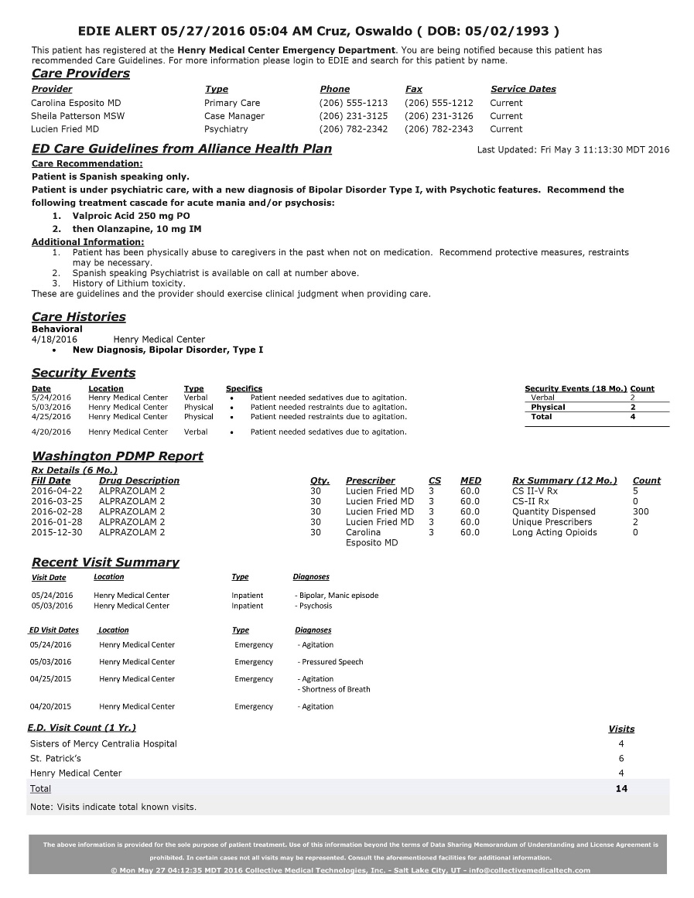
Notifications– When does a BH clinic Receive Notifications?
Standard BH Clinic Notification Criteria
ED Visits
ED Discharges
Inpatient Admissions
Inpatient Discharges
5 or more ED visits within 12 months
3 Different EDs within 90 days
Behavioral Health Related ED Visits

Slide 23
Information from each of these sources can be accessed by care team members in one of two ways:
Real-time Collective notifications, delivered directly to providers at the point of care
Case managers, social workers, and/or community partners receive a notification within workflow (text, email, printer, or EHR)
EMR
Logging into the web-based Collective platform
Login to the portal for patient information, documentation and update care insights
Information shared on network and shared on the notification that is surfaced to the providers at the point of care

Slide 24
Collective Maximizes the Effectiveness of Intensive Case Management
Collective’s real-time alert functionality maximizes the effectiveness of ACT and other BH/SUD intensive case management teams by facilitating coordination that provides valuable BH/SUD clinical collateral information to the Emergency Department.
Help inform decisions on whether a patient requires an admit versus discharge
Avoid unnecessary admissions by deploying well supported discharge plans
Identify at-risk patients who should be admitted
Carry out discharge plans with follow-up appointments, transportation, etc.

Slide 25
Sample Daily Behavioral Health Workflow
Designated Staff Log in Daily to Collective Platform (M-F)
Use Search bar for key client look up
Review Census for recent ED & IP hospital activity
Review Cohorts
Review Client Detail for Utilization Dx, Hx, Care Team and other content
Document hospital visit in client chart/mail ED education letter
After ED visit, call client to schedule appointment
Coordinate Rx refills as needed
Develop care plan for client following Inpatient discharge
Place client on priority list for regular monitoring of hospital utilization
Continue monitoring patients via Collective Platform
Assess care coordination and referral needs for ED high utilizers
Assess transitional care needs for frequent Inpatient admissions/readmissions
Outcome: Clinic develops timely client care plans informed by regular use of Collective Platform

Slide 26
Care Insights: Sharing Care Plans and Care Team Information
EDie Notification 04/28/2018 03:18 PM Nolin, Jack [DOB: 07/15/1939 M]
This patient has registered at Innova Regional Hospital. You are being notified because this patient has active Care Guidelines. For more information, please log into the Collective Platform and search for this patient by name.
Care Team
Provider Abbott, Kathryn RN Advantage Medical Supplies Smith, Barbara RN Besch, George A. MD Bowers, John MD Grayson, Jane MD Access Health LLC Almirante, Cheryl MD Aviso Consulting Abate, Joseph DMD Goodwin House | Phone (801) 354-7000 (434) 455-4335 (804) 354-3784 (804) 278-2091 (757) 261-5910 (703) 504-7900 (800) 381-4923 (757) 446-5908 (209) 754-0452 (540) 982-2463 (703) 578-1000 | Fax (502) 491-5560 No Fax No Fax (703) 780-9077 (757) 466-5834 No Fax (731) 285-6600 (757) 777-3710 (248) 451-9085 No Fax No Fax | Type Case Management DME Care Coordinator Internal Medicine Pulmonologist Radiation Oncology General Practice Endocrinology Behavioral Health Dentist Skilled Nursing | Service Dates Active Active (Start 02/26/16) Active (Start 03/01/17) Active Active Active Active (Start 03/01/17) Active Active Active Active
Let ED, inpatient, post-acute, primary care and other providers/care team members know who else in the community is involved in this client’s care. Also share care plan information to provide critical client context.
These “care insights” automatically follow clients wherever they go on the Collective network and are delivered in real-time to the point of care, directly integrated into existing workflows.
Contains curated, easy to consume, actionable information designed to support more informed-decision making, increased efficiency, and better outcomes.
Care Guidelines from ABC ACO
DNR / DNI
Please check CBG, renal function, and oxygen levels first when presenting with altered mental status.
Anthem Blue Cross Blue Shield care management involved (see Care Team). Feel free to call for further patient background or arrangements with follow-up appointments to PCP.
Daughter, Katherine Woodland, is his main care taker; please contact her if he presents in the ED.
These are guidelines and the provider should exercise clinical judgment when providing care.
Care History
Medical
04/16/2018 Innova Regional Hospital
Past Medical History: Insulin Dependent Diabetes Mellitus, MI, CVA, atrial fibrillation, CHF, adenocarcinoma, COPD, active smoker.
Behavioral
04/16/2018 Innova Regional Hospital
Jack has psychosocial burdens, including depression, post-traumatic stress disorder (PTSD), chronic back pain, and social isolation. Moreover, Jack may also face environmental barriers, such as the distance he needs to walk to get his meals, that worsen his dyspnea.
Security Events
Date 11/05/2017 | Location John Barker | Type Physical | Specifics Patient threatened to assault another patient
Security Events (18 mo.) Verbal | Count 0
Physical | 1
Total | 1
Recent Encounter Summary (6 months)
Admit Date 04/28/2018 04/13/2018 04/16/2018 04/16/2018 03/25/2018 09/27/2017 09/21/2017 09/04/2017 09/01/2017 | Location Alexandria Alexandria Alexandria Alexandria Galax Arlington Galax Alexandria Arlington | Facility Innova Regional Madeline’s Skilled Innova Regional Innova Regional Ruby Valley Virginia Hospital Ruby Valley Madeline’s Skilled Virginia Hospital | Type Emergency SNF Inpatient Emergency Emergency Emergency Emergency SNF Inpatient | Diagnoses - Chest pain - CHF acute exacerbation - CHF acute exacerbation - Shortness of breath - Abnormal glucose - Head injury, unspecified - Abnormal glucose - Acute pyelonephritis - CHF acute exacerbation | Discharge Disposition Emergency Department Home SNF Inpatient Home Home Home Home SNF
E.D. Visit Count (1 yr.) Virginia Hospital Innova Regional Medical Center Ruby Valley Medical Center | Visits 1 2 3
Total Note: Visits indicate total known visits | 6
The above information is provided for the sole purpose of patient treatment. Use of this information beyond the terms of Data Sharing Memorandum of Understanding and License Agreement is prohibited. In certain cases, not all visits may be represented. Consult the aforementioned facilities for additional information. © September 18 03:18:35 MDT 2018 Collective Medical Technologies, Inc. - Salt Lake City, UT - info@collectivemedicaltech.com

Slide 27
The Value of Clinical Insights Across Settings

Slide 28
Care Guidelines: Actionable information for the ED
Client’s baseline status or status when decompensated
Briefly described effective intervention / education when client is in crisis
Diagnosis / Social Determinants / Barriers
Who to contact at the time of crisis when in the ED (family and / or provider)
Notes:
When we talk about authoring “Care Insights” we mean authoring either a “Care Guideline” and/or a “Care History.” Each has their unique purpose, function and value, so let’s start with a brief definition of the characteristics of each. Both care histories and care guidelines are meant to be easily consumed and reviewed by the reader, so not particularly lengthy and certainly not a full care plan or crisis plan (though these may be included as attachment in the patient overview page).
Care guidelines aim to be actionable such that the reader can immediately do something with the information, for example by calling a direct line for further clinical collateral or consultation, whereas care histories are meant to be not necessarily actionable but more complementary essential clinical information that helps the reader gather further needed context on the patient or client.
We’ll look at care histories in the follow slide, but in this slide here we’re seeing an example of some of the elements that are typically found in a care guideline. For example, it can be very helpful for a care team member—new to working with a given client or patient—to understand key baseline information, so a behavioral health an example of this may be that the individual experiences daily auditory hallucinations with mild paranoia. Painting a picture of what decompensation looks like can also be very useful—for that same example, conveying that when decompensated the client’s paranoia typically heightens significantly, agitation is increased, and persecutory delusions dominate their mental content. This can be very helpful in assessing for a specific client what is a true psychiatric emergency versus an individual’s usual state of health or baseline.
Additional examples of what can be helpful in a care guideline would be information that instructs on best ways to deescalate an agitated client or describing triggers to avoid escalating an individual. And of course including any salient contact information of friends or family who can help in a time of crisis or hospital stay.

Slide 29
Care History: Essential Brief Historical Information
Client’s history of psychiatric admissions
Were they helpful or unhelpful for stabilization?
Does the client ever regress on the unit?
History of needing an involuntary hold to be admitted?
History of suicide attempts
How many?
Severity?
When did they occur?
Clarify clearly whether self-harm behavior versus suicide attempt
Additional Information
Housing information
Trauma History
Cognitive/memory issues due to dementia, traumatic brain injuries, or other reasons
Other social determinants of health
Family and social support systems that could facilitate a safe d/c
Notes:
Now here we’re going to look at care histories. Examples of ways the care history section can be used include providing insights regarding an individual’s prior psychiatric admissions. Examples include providing information regarding a client’s prior suicide attempts, self harm, or suicidal ideation. For example, if a patient has a significant history of using self harm as a coping mechanism for their depression, but no known history of suicide attempt or no known prior suicidal ideation this can be very helpful for future clinicians and the rest of the care team. Likewise, if the individual does have a history of suicidal ideation and has made several attempts to end their life, it can be very helpful to document in care history a summary of the specifics on these such as what year the attempts occurred, by what means was the attempt made, assessed severity of the attempt, and other additional context that may benefit the care team in understanding patient’s level of risk in this sphere.
Care history is also a powerful space to convey the non-medical drivers of an individual’s hospital utilization such as any social determinants health information including that related to housing or food insecurity, or transportation or financial barriers. Important cultural information or trauma history affecting the individual’s experience are also very pertinent to convey to the care team through the care history section in order to help drive a trauma informed or culturally appropriate approaches to the individual’s care.

Slide 30
Consent Process
For a facility that utilizes Collective’s consent model, the sensitive information of that facility may be disclosed via the Collective Network only where the facility has indicated, via a consent message, that it has obtained the client’s consent to do so. There are three types of consent messages: No Consent, Partial Consent, and Full Consent.
DEFAULT SETTING FOR CONSENT ENABLED PORTAL
All sensitive information from a facility using Collective’s consent model is housed within a separate consent-enabled portal, making the facility’s relationship to the client invisible by default to the rest of the Collective Network.
PATIENT DATA
PARTIAL CONSENT
Only the facility’s relationship to the client and any encounters at this facility are shared via the Collective Network to the client’s other treating providers.
PATIENT DATA
PATIENT DATA
FULL CONSENT
The facility’s relationship to the client, the client’s encounter history at this facility, and any other content generated by this facility on the Collective Platform are shared via the Collective Network to the client’s other treating providers.

Slide 31
Parent-Child Portal Configurations
ORGANIZATION NAME
File Column Header | TAG
(TAG Example: Location Assignment, Program)
*parent portal
CSV
LOCATION | Program A *cohorts + notifications + reports
*child portal
*child portal
LOCATION | Program B
*cohorts + notifications + reports
*child portal
LOCATION | Program C
*cohorts + notifications + reports
Sample File Headers + Rows
Unique Patient ID | Additional Patient ID | First Name | Middle Name | Last Name | Date of Birth | Gender | SSN | Address 1 | Address 2 | City | State | Zip Code | Phone Number | Location Assignment Program
8392758 | M39421-18 | Elizabeth | J | McCarthy | 1939-01-01 | F | XXX-XX-XXXX | 33 Aspen Drive | apt 2 | Lynn | MA | 01905 | 7815993200 | A
9387223 | A0934-11 | Nancy |  | Abelian | 1943-01-01 | F | XXX-XX-XXXX | 16 Main street | apt 3 | Bedford | MA | 01730 | 7812751000 | B
3090992 | H93829-03 | Joyce | p | Harry | 1954-09-01 | M | XXX-XX-XXXX | 142 State Street | unit 4 | Everett | MA | 02149 | 6173816000 | C

Slide 32
Provisioning User Access Across BH Clinic Sites &
How Collective Identifies Behavioral Health information as Sensitive Data
How are populations with sensitive behavioral health data identified and managed by Collective?
Upstream pre-implementation discovery process allows for identification of types of behavioral health data for each clinic site
SUD treatment programs that are considered a Part 2 Covered Program under 42 CFR Part 2 will have their own portal, separate from programs providing mental health or psychiatric treatment only
*Programs providing dual diagnosis of both SUD and mental health treatment typically will be treated as a Part 2 covered program.

Slide 33
Ambulatory and Community Provider Onboarding
I. HFS Clinic Outreach and Engagement
HFS coordinates a webinar outreach campaign to invite facilities to a webinar/demo
Survey is sent to Clinics to identify engagement and prioritization.
https://www.surveymonkey.com/r/8T87FTX
HFS.HealthChoiceIllinoisADT@Illinois.gov
HFS sends the Collective Onboarding Packet to the facility/organization.
Included in onboarding packet: See IL HFS Onboarding Packet
Electronic Discovery Form Need Completed
Terms and Conditions are completed by the facility/organization.
Engage Collective with clients that completed T&C
II. Collective Implementation Initiation
Collective receives clients with executed T&C, then Collective sends Onboarding Packet.
III. Kick Off/ Onboarding
(Once the client has filled out the discovery form and completed the click wrap agreement, a team member will then be assigned to the implementation and will kick off this stage)
Collective to set up Onboarding Kick Off Call
Set up portal or SFTP Access
Submit File for Validation and processing
Complete and return clinical onboarding forms
Schedule and complete Collective Platform training
Training follow-up and optimization
Submit second file and set to auto process
Client is Live and transition to support is initiated.

Slide 34
Questions?

Slide 35
Next Steps
1. Ambulatory provider customers begin the subscription process by completing a brief HFS survey to receive an HFS onboarding packet
https://www.surveymonkey.com/r/8T87FTX
2. Complete HFS onboarding packet and return to HFS.
HFS.HealthChoiceIllinoisADT@Illinois.gov

Slide 36
Thank You

