Slide 1
HealthChoice Illinois ADT Clinical Collaboration Group Collaborate to Improve Patient Outcomes
August 3, 2023

Slide 2
Agenda
Introductions
Dana Wilson, PMP, Program Manager, HFS, Division of Medical Programs, Program & Policy Coordination, Federal Health Information Planning
Nancy Sehy, BSN, RN, CHPCA, Clinical Solutions Lead, PointClickCare
Kate Dowd, BSW, MA, Strategic Clinical Solutions Manager, PointClickCare
HealthChoice Illinois ADT Program Updates
Technical Advisory Committee Update
New Provider Notice Review
Progress on 2023 CCG Initiative Goals
Platform Notification Success Stories
Platform Updates
Upcoming Events

Slide 3
HealthChoice Illinois ADT Program Updates

Slide 4
HFS HealthChoice Illinois ADT Program Goals
Improve Care Coordination
Provide real-time ADT alerts for immediate action events
Reduce hospital readmissions
Support Managed Care Organizations (MCOs) operations and care coordination
Enhance provider-to-provider communication using HL7 data
Enhance Data Quality
Follow HL7 and USCDI standards for data exchange
Establish state agency HL7 standards for consistency and improved exchange
Achieve a data quality verification rate of 90% or above
Utilize Reporting and Data Analysis
Analyze equity and address disparities in healthcare
Analyze social determinants of health (SDoH)
Improve claims reporting and identify system inefficiencies
Combine HL7 data with existing claims data for insights
Support Interoperability Legislation
Support CMS Conditions of Participation requirements
Assist agencies and providers in meeting federal interoperability requirements
Collaborate with other state agencies to meet public health legislation requirements
Notes:
Improve Care Coordination
One of our primary goals is to improve care coordination. By providing real-time ADT alerts and enabling better communication among healthcare providers, we can enhance follow-up visits, reduce hospital readmissions, and support Managed Care Organizations in their operations and care coordination efforts.
Enhance Data Quality
Ensuring data quality is crucial for effective healthcare delivery. We are committed to following HL7 and USCDI standards for data exchange and establishing our own state agency HL7 standards. By achieving a data quality verification rate of 90% or above, we can enhance the reliability and accuracy of the data we exchange.

Slide 5
Project Timeline
2021
May – Sep Hospital Onboarding
Jul – Dec Long Term Care Onboarding
Dec – All MCO’s connected
Aug 3, 2023
Clinical Collaborative
Group & Technical Advisory Group
Mar 9, 2023
Clinical Collaborative
Group
May 4, 2023
Clinical Collaborative
Group
Aug 2023
Provider Notice
Data Quality
Nov 2, 2023
Clinical Collaborative
Group
2023 - 2031
Data Quality
and Analytics Enhancements
2023 - 2031
Initiatives, Incentives, Programs, Increase Efficiency, Improve Patient Outcomes
Jan 2022
1st Clinical Collaborative
Group (CCG)
Feb 2022
Begin Ambulatory & Community Provider Implementation
Mar 2023
1st Healthcare Transformation Collaborative
May 11, 2023
HFS HealthChoice Illinois ADT Technical Advisory Committee
Convene
Aug 2023 –
Jun 2024
Hospital Data Quality
Remediation
Fall 2023
ADT Data Enterprise Data Warehouse
2023 - 2031
Phase 2:
CCDs, Labs, Imaging, Rx, Scheduling, Physician Notes, Billing Data
CCGs held each qtr. for Hospitals, MCO, LTC, and Ambulatory & Community Providers

Slide 6
Connected Facilities
925 Medicaid Facilities Transmitting Data
HealthChoice Illinois ADT Portal
Collective Medical Technologies
Type | Sending Live Data
Hospitals | 194
ICFDD (Intermediate Care Facility/Developmental Disabilities) | 12
SLF (Supportive Living Facilities) | 90
SMHRF (Specialized Mental Health Rehabilitation Facilities) | 18
SNF (Nursing Facilities) | 611
ED and Inpatient Care
Primary Care and Specialists
ACO
Behavioral Health/SUD
Community-Based Organizations
Numbers as of June 28, 2022
66 Medicaid Ambulatory & Community Providers
Ambulatory Type | Patient Rosters | Patient Population
Clinics | 45 | 410,900
Home Health | 21 | 23,650
Post-Acute Care
Dialysis, Ancillaries
Government and Payers
Numbers as of June 28, 2023
https://hfs.illinois.gov/healthchoiceadt/participants.html
Notes:
Show the difference since the last meeting.
Numbers from March 2023 compared to Numbers end of June 2023
42 additional contributing providers - (4 SLF and 38 SNF)
17 new ambulatory and community providers
We currently have an impressive number of Medicaid facilities transmitting data through the HealthChoice Illinois ADT Program. We have 194 hospitals, 12 ICFDD facilities, 90 SLFs, 18 SMHRFs, and 611 SNFs participating in the program. We also have 45 clinics representing almost 411 thousand lives and home health facilities representing 23,650 lives. This extensive network of facilities enhances our ability to exchange vital healthcare information.

Slide 7
Technical Advisory Committee Update

Slide 8
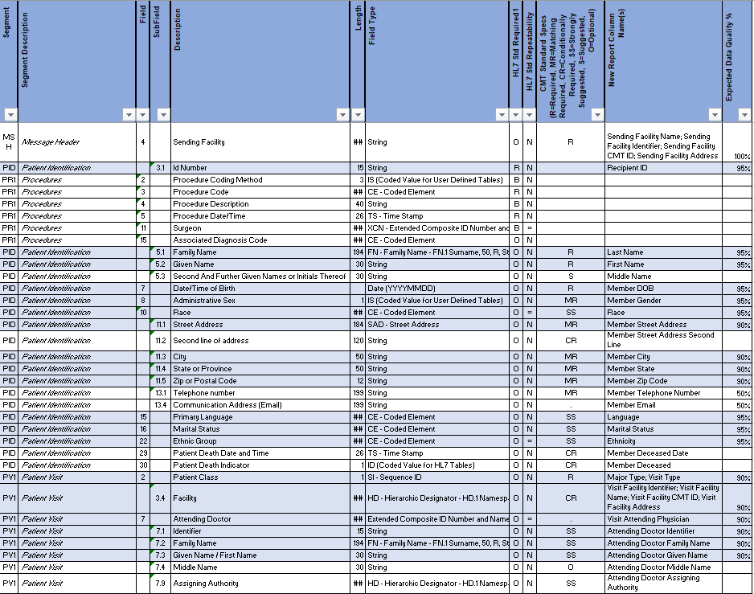
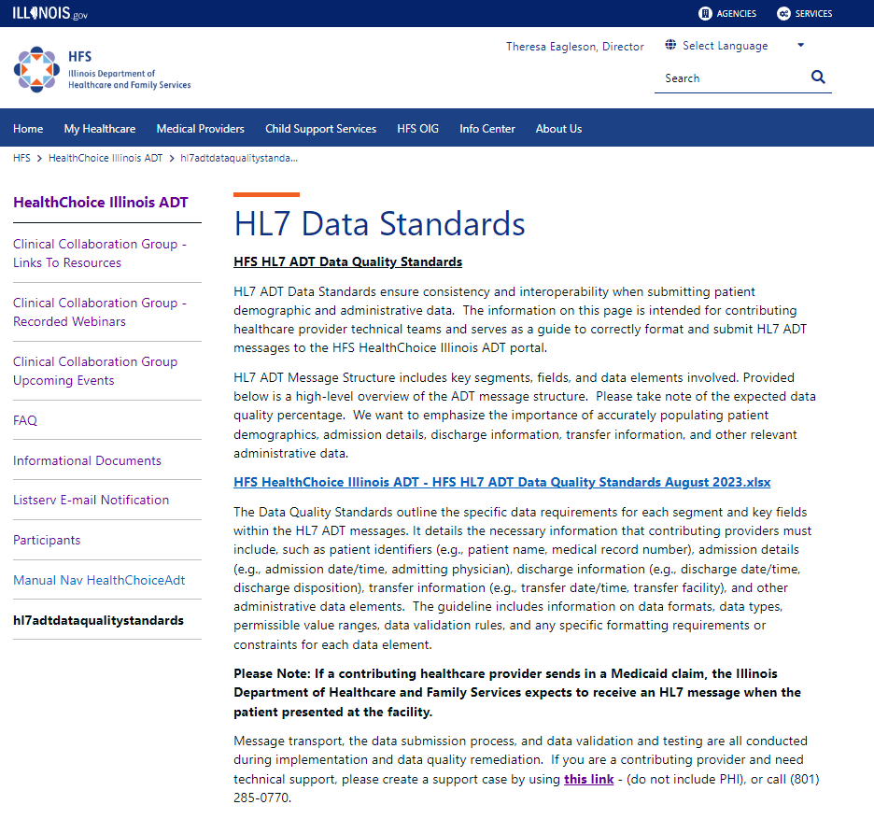
HFS HL7 ADT Data Quality Standards Recommendation by IDPH and the Technical Advisory Committee
HFS HealthChoice Illinois ADT – HFS HL7 ADT Data Quality Standards August 2023.xlsx

Slide 9
New Provider Notice Review

Slide 10
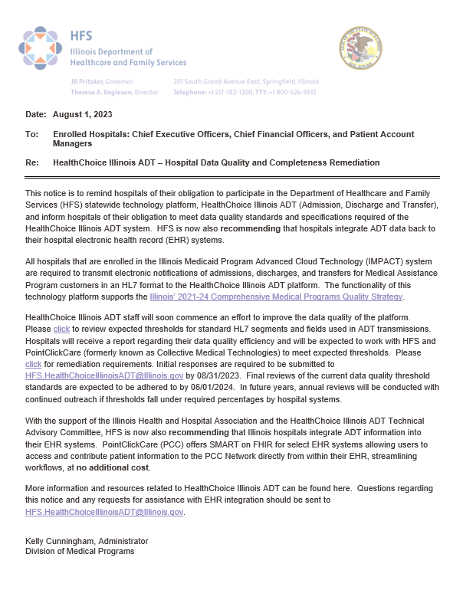
Hospital Provider Notice
Highly Recommending ADT Integration
Working with CMS Financial Management SMEs regarding their suggestion to include connection costs in administrative costs for provider cost reports
Data Quality
Link to HFS HealthChoice Illinois ADT – HL7 ADT Data Quality Standard
Expected percentages and standards
Reports provided to hospitals for current status
Deadlines for Remediation
8/31/23 main contacts, compliance officers, and technical teams to set up initial calls to review current data quality and completeness
Schedule Meetings by 9/30/2023, meet by 12/31/2023
9/30/2023 – 06/01/2024 Review current baselines, identify issues with data quality, correct mappings, testing, and fix data transmission
06/01/2024 Final Review
Annual Reviews

Slide 11
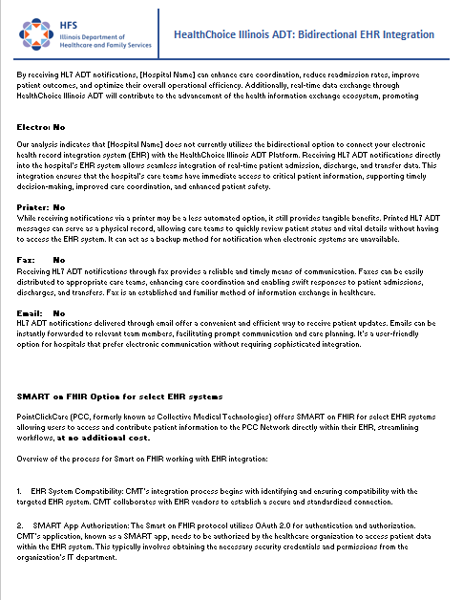
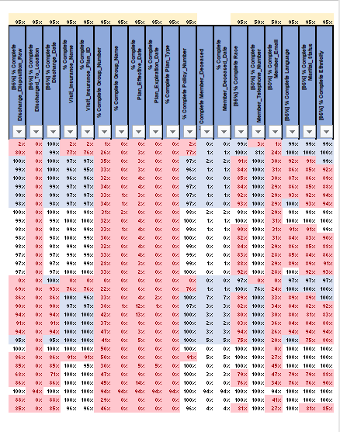
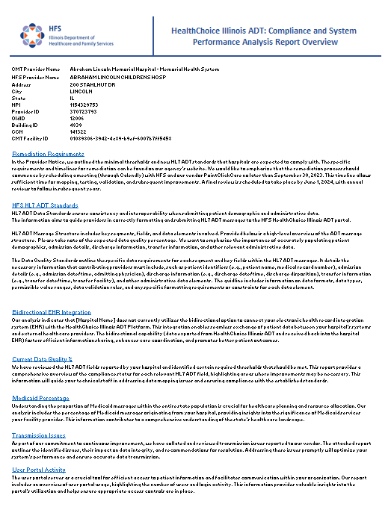
Hospital Compliance and System Performance Analysis Report Overview
Overview
Remediation Requirements
HFS HL7 ADT Standards
Bidirectional EHR Integration
Current Data Quality %
Medicaid Percentage
Transmission Issues
User Portal Activity
Notifications
Claims vs. HL7 Messages

Slide 12
2023 CCG Initiative & Goals
Notes:
Before we get started from the PointClickCare side, just a heads up that if any of the content we will be sharing is something you’d like more information on, or help using at your organization or facility, we will have the opportunity at the end of this presentation, for you to click a button to request that. Please do, we are here to help you achieve results.

Slide 13
2023 Clinical Collaboration
Initiative- improve collaboration for care coordination to affect
Adult Behavioral Health- follow-up after ED visit for Mental Illness and
Adult Behavioral Health- follow-up after Hospitalization for Mental Illness
Measures- platform feature use
Care Insights authored
Reports requested/built

Slide 14
2023 Clinical Collaboration Measures- Platform Feature use
Care Insights authored
Start: 3
Goal: 30 more
Currently: no add’l
Reports requested/built
Start: 104
Goal: 10 more
Currently: 117
Notes:
Insights: None since last CCG Mar- 2, Apr- 3, May-0, Jun- 0 - We will be sharing some success stories showing the powerful impact these can have on lowering avoidable ED visits and readmissions
Reports: 13 new since last CCG – Mar- 2, Apr- 8, May- 4, Jun- 3 almost entirely health plans- remind hospitals they can – we would like to see more hospitals benefitting from this- it’s included at no charge for them

Slide 15
PointClickCare Platform Success Stories Kate Dowd

Slide 16
High Utilization/ Traveling Patient
Health Plan:
Protocol assigned Case Manager to Ron due to multiple notifications
Patient page review demonstrated Ron showed up with traumatic injuries in various locations throughout the state. Case Manager is now concerned for Ron’s safety, but Ron is not responding to outreach.
CM checks whether Ron is attributed to FQHC; FQHC states he has never established care
Care Insight added indicating CM’s concerns around possible abuse, requesting ED to assess for this and report at next ED visit
Hospital:
Ron presents with physical injuries
Health Plan’s Care Insight is read and followed per abuse investigation protocol
“Ron”- 54 yr old male
Lives with Developmental Disabilities with delayed processing and speech
Has Health Care Power of Attorney in place
Criteria Met to Trigger Notifications to ED & MCO:
5+ ED Visits in 12 Months
3+ ED Locations in 90 days
Care Insights

Slide 17
Outcome For Ron
Having reviewed the utilization history and Care Guidelines- ED did confirm injuries were likely caused by assault
Adult Protective Services consulted, and investigation began immediately to ensure Ron’s welfare.
Ron remained in observation as investigation pointed toward his Powers of Attorney (who had transported his to ED every time)
Once safe, Ron reported his POAs HAD been assaulting him then taking him to ED for a long while because they could get pain medications.
Ron currently resides in community based care where he is thriving.
Health Plan Case Manager ensured he got established at FQHC
Powers of Attorneys were revoked
Data from Collective Edie supported the substantiation of abuse (in conjunction with Ron’s self report)
Power of Attorneys were brought up on multiple charges and are serving jail time.

Slide 18
Reduction of Potentially avoidable ED Utilization
Hospital:
Care Insight was added indicating the outpatient IVIG infusion clinic location, and specifying the best IM administration for pain management for Sally
The Neurologist ordering the infusion was added to Care Team.
Care Insight was added indicating Sally’s functional decline and need for supportive services 1-4 days post infusion
Health Plan:
Protocols assigned a Case Manager due to double notification
Care Insights were reviewed, and patient was responsive to outreach
Case Manager coordinated care with Neurologist
“Sally”- 47 yr female
Lives with myasthenia gravis/ receives IVIG routinely at outpatient setting ordered by neurologist
Has not left 10 mile radius of her community hospital in 5 years due to fear of other hospitals not knowing her needs due to different EHRs
Meets High Utilization Criteria deemed potentially avoidable
Criteria Met to Trigger Notifications to ED & MCO:
5+ ED Visits in 12 Months
Care Insights

Slide 19
Outcome For Sally
Sally and Case Manager collaboratively worked with neurology office in effort find treatment alternatives that would reduce her discomfort
Neurologist encouraged non formulary infusion which plan was happy to accommodate to avoid Sally’s suffering and ED encounters
Care Insight was updated with new infusion details and Health Plan’s Case Manager’s information
Sally had a significant decrease is symptoms post infusion with new medications
Participating in the care collaboration with the knowledge that Insights on the PointClickCare Collaboration Network would be seen in EDs outside her community hospital- Sally began reestablishing her social network
After 6 months of improved medical stability, Sally welcomed her foster children back to her home
Sally has increased confidence in healthcare!

Slide 20
Additional Story - Demo

Slide 21
Platform Updates

Slide 22
Rebranding under Parent Company
PointClickCare acquired Collective Medical Technologies, Audacious Inquiry, and Patient Pattern over the last few years, CMT in 2020.
To simplify and highlight the connection of all that data, we are all now under the parent company branding umbrella.

Slide 23
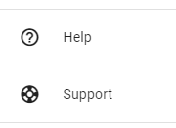
Help and Support are now found under the Resource Hub “?” icon in the upper right of the portal
These two in lower left will be going away soon
New ? icon in upper right
Notes:
Mention branding update/explanation- add slide

Slide 24
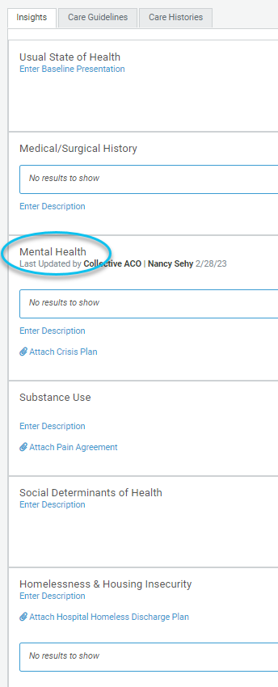
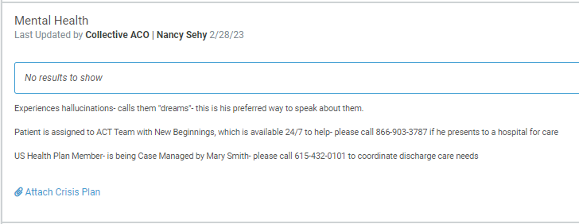
Care Insights
Care Insights Welcome Using Collaborative Insights

Slide 25
Care Insights – Auto-Populating Options
Automated Insights may now be seen under the Insights sections, depending on the facility’s configuration.
If desired, you can see these in the areas of
Medical/Surgical History- High Risk Chronic Conditions (Great for HEDIS measure FMC),
Homelessness & Housing Insecurity,
Mental Health, and
Substance Use
Notes:
Please let us know if you’d like this visibility and we can have it activated for your organization or facility.

Slide 26
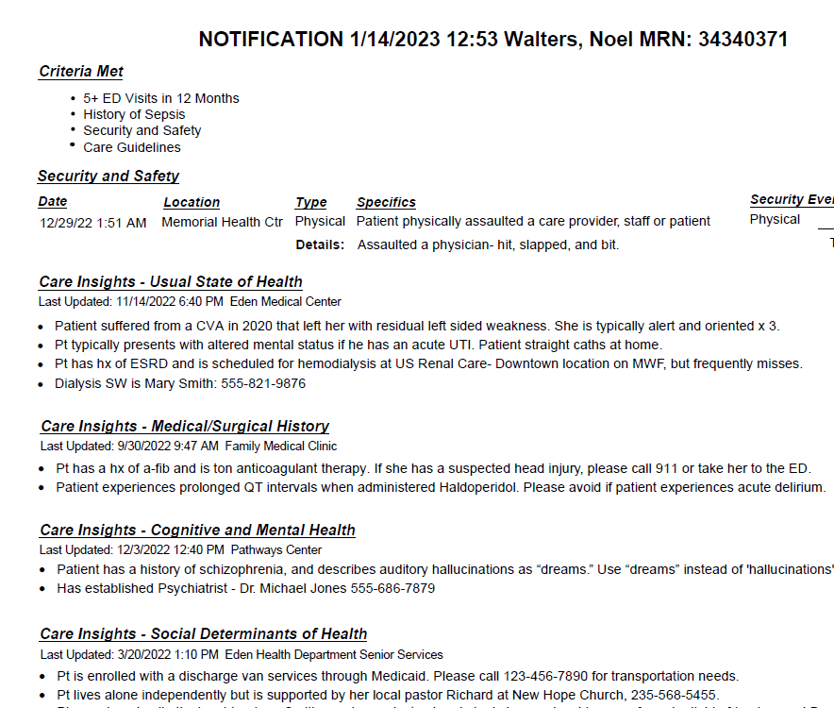
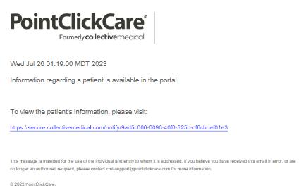
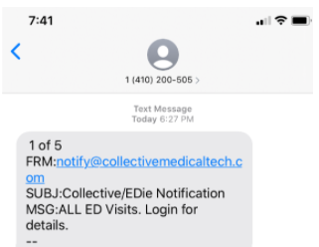
Real-Time Notifications
Available for every program and help improve care collaboration.
Can be sent to users within their existing workflow via ED trackboard, email, text, and/or printer/fax.
Are triggered to be sent to these destinations when a patient meets criteria.
Organizations can choose which Notifications to receive, and which Users receive them.
Notes:
As a side note, I’ve heard that many hospitals aren’t using this capability, which will help your ED become aware of any patients who are high risk, have insights such as special programs or MCO case managers who can assist with caring for the patient, discharge planning, etc. Notifications can also be generated for Flags- things like a history of sepsis, MDRO, or other significant
Also as a reminder, hospitals can have custom reports built to help manage special patient populations or meet your quality initiatives.
Please let us know if you’d like to take advantage of these and we can have them set up for your organization or facility.

Slide 27
CCG Schedule and Resources

Slide 28
Save The Date for the Next Clinical Collaboration Event!
2023 Clinical Collaboration Group Webinars – all provider types
Date: Thursday, November 2, 2023; 12pm – 1:00pm
Register HERE
Topics including:
Monitoring/discussing progress toward initiative goals and making adjustments
Patient level success stories
Workgroup recommendations
New Provider Notices
Platform enhancements

Slide 29
Would you like Collective Medical to contact you to discuss your needs, help with training, etc.?
No thanks
Yes
If you are not on the network already, would you like Collective Medical to contact you to get you set up?
Yes
No- we’re on ☺
Notes:
RUN the poll- bottom

Slide 30
Resources
State HFS Website: HealthChoice Illinois ADT HFS Program Email: HFS.HealthChoiceIllinoisADT@Illinois.gov
Collective Medical/PointClickCare Customer Community Site: https://community.collectivemedical.com/
Collective Medical Support Email: support@collectivemedicaltech.com
Let’s Get Engaged!
Want an in-person visit from Collective to help your team learn how to best use the platform? A specialized Zoom training?
Click here to schedule a call to discuss your needs!
Click Here
Notes:
Nancy: I am hearing more and more interest in collaboration, whether regional, payer based, or a Collaborative of providers-
Please reach out via the Click Here button if you are interested in help forming such a group!

