Slide 1
MAC Community Integration Subcommittee Meeting
February 16, 2023
VIRTUAL WebEx Meeting
2PM – 4PM

Slide 3
Agenda
Call to order
Roll call of Subcommittee members
Introduction of HFS staff
Review and Approval of Past Meeting Minutes
Presentation: Overview of Final Subcommittee Recommendations
Subcommittee Discussion and Vote on Final Recommendations
Public Comment
Additional Business: Old & New
A. Concluding the Subcommittee and Next Steps
B. HFS Announcements
1.Online MAC and Subcommittee Membership
Applications
2. HFS Community Events Participation Request Form
IX. Adjournment
Facilitators: Amber Smock - CI Subcommittee Chair
Gabriela Moroney – Division of Medical Programs
Melishia Bansa, Special Assistant to Director of HFS

Slide 4
I. Call to order II. Roll call of Subcommittee members III. Introduction of HFS staff IV. Review and Approval of Past Meeting Minutes

Slide 5
V. Overview: MAC Community Integration Subcommittee Recommendation Themes and Key Points

Slide 6
Looking Across the Nine 1915(c) HCBS Waivers By Race

Slide 7
 | American Indian/ Alaska Native | Asian | Black | Hawaiian Native/ Other Pacific Islander | White | Hispanic/ Latino | No Answer/ Unknown | Total Medicaid HCBS Participants
Aging | 216 | 13,527 | 33,653 | 30 | 36,566 | 7,711 | 6,115 | 97,818
Brain Injury | 7 | 70 | 1,521 | 1 | 857 | 185 | 157 | 2,798
HIV/AIDS | 2 | 4 | 779 | 0 | 235 | 79 | 39 | 1,138
Physical Disability | 72 | 733 | 13,144 | 11 | 11,087 | 1,971 | 1,968 | 28,986
Supportive Living | 11 | 76 | 2,051 | 4 | 6,084 | 261 | 651 | 9,138
DD Adult | 21 | 450 | 4,627 | 3 | 14,732 | 1,404 | 1,770 | 23,007
DD Childrens Residential | 0 | 3 | 12 | 0 | 54 | 8 | 55 | 132
DD Children’s Support | 0 | 27 | 64 | 1 | 268 | 32 | 437 | 829
MFTD | 7 | 88 | 475 | 0 | 1441 | 281 | 1434 | 2292
Total by race/ethnicity | 336 | 14,978 | 56,326 | 50 | 71,324 | 11,932 | 12,626 | 166,138
Based on raw data provided by the Illinois Department of Health and Family Services, February 9, 2023.

Slide 8
Race Across All Waivers by Percentage
White participants: 42.9%
Black participants: 33.8%
Asian participants: 9%,
Hispanic/Latino participants: 7%
American Indian/Alaska Native participants: 0.2% Hawaiian Native/Pacific Islander participants: 0.03%
7.6% either did not answer the racial/ethnic demographic question, or the data is unknown.
Presenter: Amber Smock, Chair

Slide 9
MAC Community Integration Subcommittee Recommendations

Slide 10
Reaching and Supporting Unserved/Underserved Groups
Re-evaluate HCBS eligibility standards
Improve the effectiveness of the State’s public education about HCBS
Increase mental health services available under all HCBS waivers
Make successful youth transition a priority
Identify opportunities for increased interagency collaboration
Empower providers through investment
Presenter: Amber Smock, Chair

Slide 11
2. Removing Accessibility Barriers in Medicaid HCBS
Initiate a formal interagency assessment of the current state of online and in-person accessibility barriers for applicants/users of HCBS
Build disability accessibility requirements into HCBS contracts with providers; improve language clarity and communication accessibility for those who rely on HCBS
Investigate and resolve disability-related barriers within online benefits accounts
Expand state personnel capacity to assist disabled waiver holders with navigating the system
Presenter: Amber Smock, Chair

Slide 12
3. Improving HCBS Administration and Service Array
Improve any time delays to accessing HCBS
Breaking down waiver service silos that result in undeserving people with multiple needs
Increasing flexibilities to address individual needs/self-determination
Increase dialogue with the Governor’s Office of Management and Budget to support the importance and overall cost savings inherent in good HCBS outcomes
Investigate how to phase in the ending of income- or asset-based service caps, as well as the purpose and structure of service cost maximums
Continue interagency and contractor coordination to accelerate compliance with Ligas, Williams and Colbert
Evaluate the effectiveness of managed care coordination in relation to HCBS
Continue to grow a state agency staff culture of support for community integration
Presenter: Amber Smock, Chair

Slide 13
4. Strengthening the HCBS Workforce
Recruit and onboard new HCBS workers
Stabilize and build resilience within the current HCBS workforce (quality mentoring/supervision, good pay, COLAs, health insurance, nurse training specific to home care, incentives for hard-to-staff areas and hard-to-fill shifts
Support the revamping of HCBS work as a meaningful, important career track profession
Presenter: Amber Smock, Chair

Slide 14
For HCBS Participants, A Healthy HCBS Workforce Economy Looks Like…
Reliable staff available at the hours needed, including on weekends and in the early mornings and evenings
Backup staff available if the regular staff are sick or fail to show
Ease of processing timecards and reliable on-time payments for workers
The right staff for the right situation: there is particularly a shortage of home nurses for those who need higher levels of in-home support
HCBS workers who can not only help someone in the home, but also in the community
Common-sense supports such as helping someone organize their meds
Being able to get support staff a person needs regardless of HCBS participant age
Presenter: Amber Smock, Chair

Slide 15
Addressing the Housing Crisis in HCBS
We recognize that Medicaid is not allowed to directly pay for housing
Yet, we feel there are opportunities for Medicaid to support housing stability for HCBS waiver participants
Given that the stakeholder landscape is split between waiver holders and providers/developers, we created two areas of recommendations to address the separate needs
Presenter: Amber Smock, Chair

Slide 16
Supporting Housing for Medicaid HCBS Participants
Partner with sister state agencies to determine the need for additional housing subsidies
Support public education on how to access and keep housing
Advance efforts to keep the housing process simple and affordable/free for waiver holders
Gain an understanding of housing disparities/discrimination facing waiver participants
Establish housing support as a program service
Fill in gaps for people who cannot currently access housing because their disability diagnosis does not match service eligibility
Increase investment in home modifications
Identify and streamline catch-22 situations in the housing process
Support people in keeping more of their Social Security monthly income in housing situations where services are bundled in
Presenter: Amber Smock, Chair

Slide 17
Supporting Housing Providers and Developers
Create a statewide plan to advance housing for HCBS participants
Revamp the Statewide Referral Network (SRN) and increase innovation with the SRN as a base for outreach
Explore potential flexibilities in housing options
Grow/invest in housing service provider networks
Improve case management where HCBS participants need housing support
Work with Illinois reentry leaders to identify/develop housing opportunities for Medicaid-eligible people with disabilities and seniors returning from incarceration
Pursue a 1115 waiver that would allow the state to pay for housing
Presenter: Amber Smock, Chair

Slide 18
Fostering Employment and Economic Security
Aim for seamless support for HCBS recipients who rely on services from multiple state agencies or divisions
Expand Medicaid waiver-funded employment support/transition programs
Raise Medicaid HCBS income and asset limits, where applicable
Raise or eliminate the $35,000/year income cap for workers who need the Health Benefits for Workers with Disabilities program
Phase out subminimum wage employment statewide
Ensure flexibility of Medicaid HCBS waiver eligibility for participants who are seeing rising wages due to minimum wage increases
Assess Medicaid spenddown impact in terms of economic destabilization for individuals and their families
Presenter: Amber Smock, Chair

Slide 19
Recommendations for the MAC and HFS
Consider establishing a permanent standing subcommittee to address Medicaid HCBS waiver matters;
Alternatively, recommend that the State establish a permanent stand-alone advisory committee on Medicaid HCBS waiver work;
Request that the State commission a survey using “person terms” rather than “provider terms” to gather additional input on ways to strengthen or innovate within Illinois Medicaid HCBS.
Presenter: Amber Smock, Chair

Slide 20
Now, and Going Forward
We find it critical to acknowledge that the State of Illinois is already actively dealing with plans to address at least some of the above-recommended areas.
Our current environment already includes planning efforts such as for a new Money Follows the Person program, as well as efforts to increase funding in areas of needed HCBS investment.
Ultimately, our collective goal should be for Medicaid HCBS to be available and easily accessible for those who need it.
Presenter: Amber Smock, Chair

Slide 21
VI. Subcommittee Discussion and Vote on Final Recommendations

Slide 22
Public Comments

Slide 23
Public Comments
Update:
None Reported
Facilitator: Melishia Bansa, Special Assistant to Director of HFS

Slide 24
Additional Business: Old & New

Slide 25
Concluding The Subcommittee and Next Steps

Slide 26
HFS Announcements

Slide 27
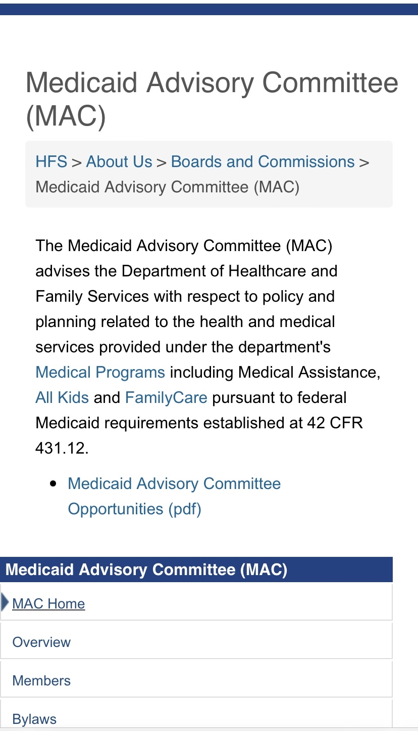
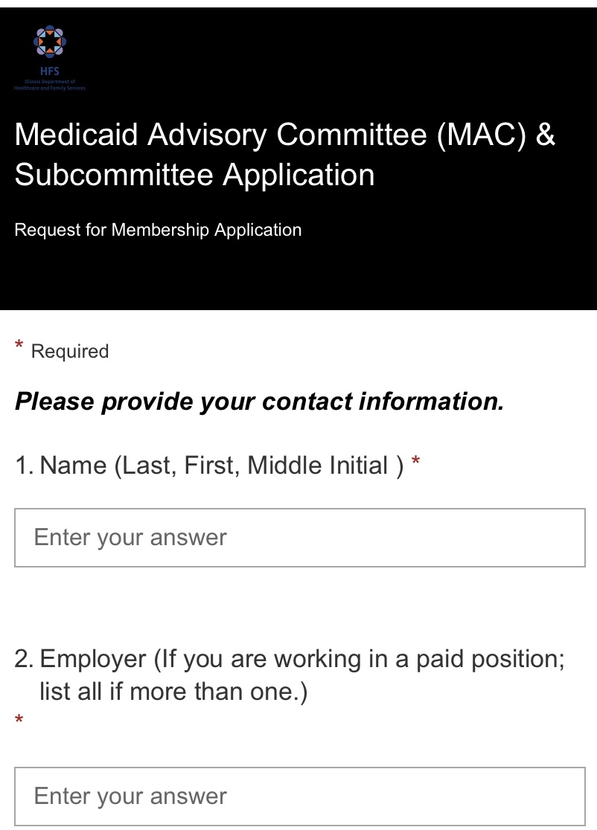
B.1. Online MAC and Subcommittee Membership Applications
Step 1
Step 2
Step 3
Presenter: Melishia Bansa, Special Assistant to Director of HFS

Slide 28
B.1. Resources
To receive MAC email notifications regarding public meeting notices, sign up for our MAC and Subcommittee Listserv:
Medicaid Advisory Committee (MAC) | HFS (illinois.gov)
MAC and Subcommittees E-mail Notification Request | HFS (illinois.gov)
Presenter: Melishia Bansa, Special Assistant to Director of HFS

Slide 29
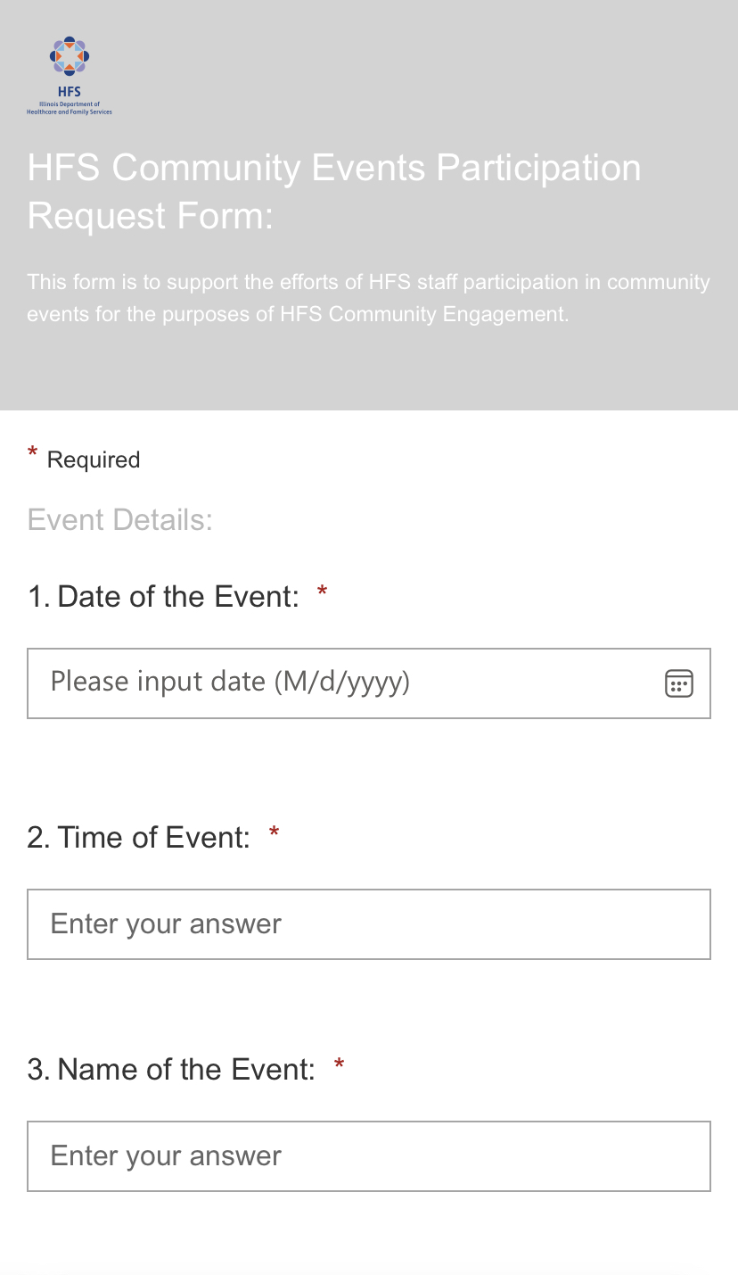
B.2. HFS Community Events Participation Request Form
Speaker’s Bureau: HFS Community Events Participation Request Form
Applicants are able to request HFS to participate in
upcoming community events:
Eligibility, Child Support, HealthChoice IL, etc.
Applicants are able to request trainings:
Medicaid Address Update, PHE Unwinding Toolkit,
Manage My Case, Etc.
Link: HFS Community Events Participation Request Form
Presenter: Melishia Bansa, Special Assistant to Director of HFS

Slide 30
B.2. Resources
The Illinois Department of Healthcare and Family Services (HFS) utilizes a range of social media accounts to better reach our customers and stakeholders. We encourage you to follow us on:
Twitter: https://twitter.com/ILDHFS
Facebook: https://www.facebook.com/ILDHFS
LinkedIn: https://www.linkedin.com/company/ildhfs/
for important news, announcements and alerts. And please spread the
word to your own followers.
Together, let's keep those we serve well informed, educated and
empowered!
Presenter: Melishia Bansa, Special Assistant to Director of HFS

Slide 31
Adjournment THANK YOU

