Slide 1
HealthChoice Illinois ADT Clinical Collaboration Group Collaborate to Improve Patient Outcomes
February 27, 2025

Slide 2
Agenda
Introductions
Mecky Lang, HFS, Division of Medical Programs, Program & Policy Coordination
Nancy Sehy, BSN, RN, CHPCA, Sr. Solution Design Lead, PointClickCare
HealthChoice Illinois ADT Program Updates
Bi-Directional Communication
New Feature included for Hospitals and Health Systems
Network Success Stories
Next Steps / Upcoming CCG Events

Slide 3
Program Updates

Slide 4
HealthChoice Illinois ADT Program Goals
Improve Care Coordination
Real-time ADT Alerts
Reduce Hospital Readmissions
Support MCO Operations
Enhance Provider Communication
Achieve High Data Quality
Utilize Reporting for Insights
Support Interoperability Legislation
Notes:
Our HealthChoice Illinois ADT program is driven by several key goals aimed at improving patient outcomes and healthcare efficiency. These goals include:
Improve Care Coordination: Ensuring seamless coordination of care across providers.
Real-time ADT Alerts: Implementing real-time alerts to keep providers informed.
Reduce Hospital Readmissions: Decreasing readmission rates through better data and care coordination.
Support MCO Operations: Enhancing the operations of Managed Care Organizations with accurate data.
Enhance Provider Communication: Improving communication channels among healthcare providers.
Achieve High Data Quality: Striving for the highest standards in data quality and completeness.
Utilize Reporting for Insights: Leveraging data reporting to gain actionable insights.
Support Interoperability Legislation: Advocating for policies that promote data interoperability.
These goals guide our efforts and ensure that we are continuously improving the quality of care for our HealthChoice beneficiaries.

Slide 5
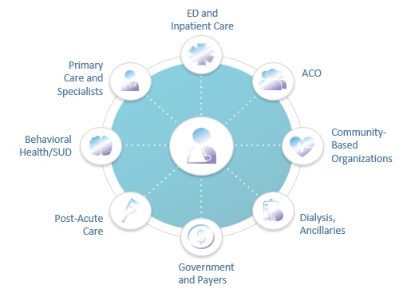
Connected Facilities
673 Medicaid Ambulatory & Community Providers
Type | Subscribing
Certified local public health department | 9
Community Health Agencies - In home | 3
Community Mental Health Provider | 398
Department of Alcohol and Substance Abuse Provider | 97
Family Support Program | 5
Federally Qualified Health Centers | 204
Healthy Kids (EPSDT) screening clinics | 1
Home Health Agencies - In Home | 4
Home Nursing Agency | 1
Hospice | 3
Integrated Health Home | 8
Rural Health Clinics | 4
Waiver service provider--Elderly (DOA) | 40
School Based / Linked Health Clinic | 1
Behavioral Health Clinic | 15
957 Medicaid Facilities Transmitting Data
Type | Sending Live Data
Hospitals | 212
ICFDD (Intermediate Care Facility/Developmental Disabilities) | 31
SLF (Supportive Living Facilities) | 108
SMHRF (Specialized Mental Health Rehabilitation Facilities) | 18
SNF (Nursing Facilities) | 606
Numbers as of 02/12/2025
https://hfs.illinois.gov/healthchoiceadt/participants.html
Notes:
HealthChoice Illinois ADT program now has extensive connectivity across the state.
Currently, we have 1553 Medicaid facilities transmitting data, including:
Hospitals: 212
Intermediate Care Facilities for Developmental Disabilities (ICFDD): 31
Supportive Living Facilities (SLF): 108
Specialized Mental Health Rehabilitation Facilities (SMHRF): 18
Nursing Facilities (SNF): 606
Additionally, we have 792 Medicaid ambulatory and community providers participating, such as:
Community Mental Health Providers: 398
Federally Qualified Health Centers: 204
Department of Alcohol and Substance Abuse Providers: 97
This broad participation ensures that we have comprehensive data coverage across various healthcare settings, enhancing our ability to coordinate care and improve patient outcomes statewide.

Slide 6
Data Quality and Completeness Progress

Slide 7
Data Quality Improvement Project
Focus During Onboarding
Work with Data Senders to establish data quality standards
Emphasis on ADT fields that support Care Collaboration
Ongoing Review and Maintenance
Support teams flag performance changes and perform regular outreach when feeds go down or feed quality dips
Customer Success teams engage with customers regularly to ensure understanding of importance of Data Quality

Slide 8
The Care Collaboration Network Effect

Slide 10
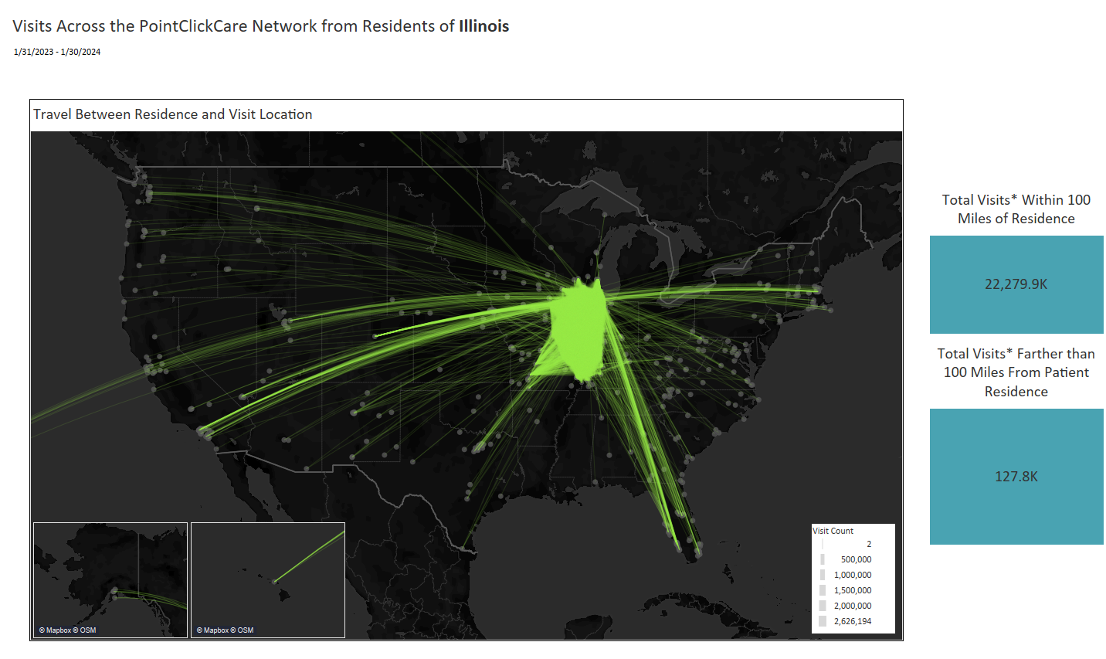
Nationwide Network Impact
Notes:
These next couple of slides were a real eye opener for me, so I wanted to share this information with you to help show the value of the network that HFS is sponsoring for you. This slide here shows how much patient movement there was over the course of a year. So many patients travel away from their primary service area to seek specialized healthcare, for vacation, to visit family and friends, and may experience encounters and problems you are unaware of, because it is not visible in your EMR.
For example, you may not be able to reach a patient and can’t figure out why. Using the Network, you are able to see that they went to the emergency room in Georgia and were admitted to the hospital there. You’d be able to then contact that hospital to coordinate and schedule followup care back home as part of the discharge planning process.

Slide 11
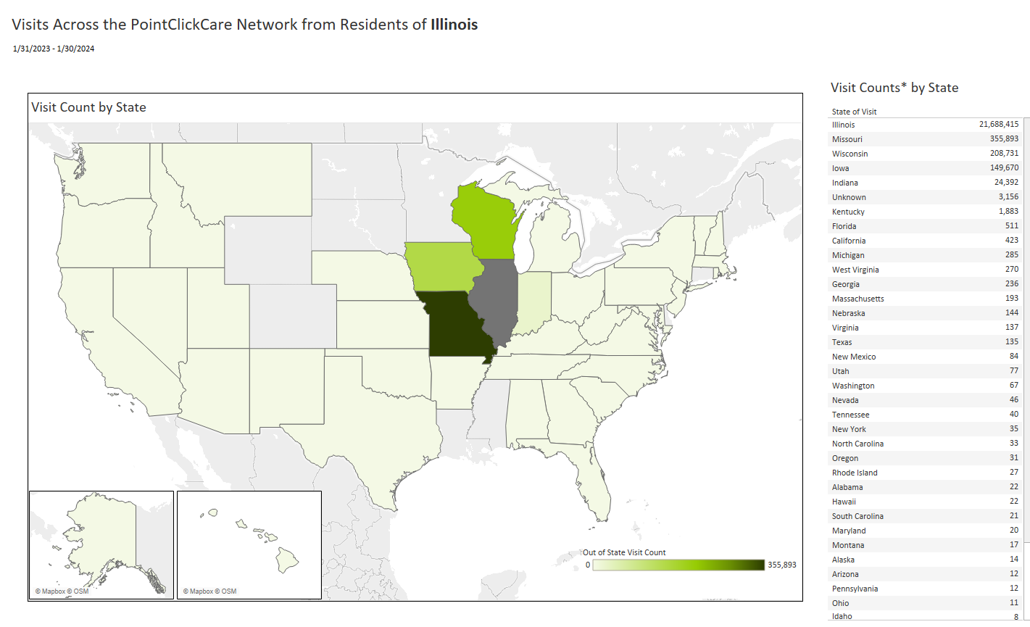
Nationwide Network Effect
Notes:
You can see here all of the healthcare encounters that occurred for residents of Illinois who received care outside of the State. This emphasizes the importance of access to a nationwide network, enabling you to receive not just information from within your EMR, health system, or state-restricted information, giving you fuller picture of your patient, which in turn enhances your ability to collaborate and make care decisions to provide informed care.

Slide 12
Highlighted HFS Sponsored Solution ED Optimization for Hospitals & Health Systems

Slide 14
Workflow Integration in the ED
Patient Presents at Hospital ED
EMR Sends Patient Data to PointClickCare
ED Staff Notified if Visit Meets Criteria
< 1 min
< 2 min
Basic demographic information is entered into the hospital’s EMR at time of triage
Receives and cross-references patient information with our nationwide network
If patient meets pre-defined risk criteria, notification is pushed to the provider workflow, so appropriate action can be taken
Notes:
Now that we’ve covered who we are and what we do and where we can support you – let’s get into HOW this all works.
When a patient walks into your ED, your team registers the patient and enters their demographic information into your EMR. An ADT message (or Admit, Discharge, Transfer) is sent to PCC in real time. Once the ADT is received, PCC’s robust analytics engine kicks in to evaluate the nationwide network and cross references that information with all the patients in our network – this serves as patient matching. Within 2 min PointClickCare can identify that this is a patient of interest or that they have something in their history that requires your team’s attention. A notification is pushed directly to your provider (via Smart on FHIR, a trackboard integration, or if helpful through email, text, or fax.
Within less than a min your ED staff has information they can use to take appropriate action before even seeing the patient.
Example: Upon the identification of a security risk, ED staff can take proper precautions, like removing sharp objects or having a security staff member with them, before seeing the patient. This keeps you, the staff, and the patient safe.

Slide 15
Top Insights Delivered to the ED
Discharge from SNF within 7 Days
Patient admitted to SNF within 60 Days
History of Safety and Security Events
Social Determinants: Housing insecurity within 6 months
Traveling Patients: 3 Different EDs within 90 days
Patients with Individual Care Plans Documented
Patterns of High Utilization: 5 or more ED visits within 12 months
Behavioral Health Events
Substance Use Disorder or Overdose within 12 months, Substance Exposed Infant
Suicidal Ideation / Mental Health Dx within 12 months
History of Sepsis within 12 months
Notes:
We spoke earlier about our ability to curate notification into your ED trackboard to help surface summary level information about the patient population that you have helped to identify. We have highlighted the 3 criteria that we believe would drive the most value to your ED staff. Sending a summary notification directly to your trackboard for patients that have registered in your ED and have either come from a SNF and/or have been discharge from a SNF within 30 days, individuals that have a history of safety or security events, and those that are living with known housing insecurity.
Surfacing this information to your team members as they are getting ready to meet with a patient can help ensure safe and effective interactions with that patient as your team is working to triage their needs. The notification summarize information such as:
The reason(s) this patient triggered a notification
Encounter or utilization history
Care Team Member information
Individualized Care Plan information (documented by others on the network)
For a SNF Summary: Information based on the most recent SNF stay from the PCC EMR including medications, attending physician, and dx
Can you share with us how you see your team benefiting from having access to this information at their fingertips?
Our Solutions expert is going to walk you through a demo of how this would look for your facility and a few more examples of ways this has been used in other emergency departments across the country.
Crawl, walk, run
Summarizing and curating information for you that you otherwise don’t have access to > in a seamless way that aligns with your workflow
Discharge from SNF within 30 Days
History of Safety and Security Events
Social Determinants: Housing insecurity within 6 months
Traveling Patients: 3 Different EDs within 90 days
Patients with Individual Care Plans Documented
Patterns of High Utilization: 5 or more ED visits within 12 months
Acute Readmission Reduction/Avoidance
Behavioral Health Events
Substance Use Disorder: Substance /Opioid / Alcohol Use Disorder or Overdose within 12 months, Substance Exposed Infant
PDMP data (when applicable, by state)
Mental Health: Suicidal Ideation / Mental Health Dx within 12 months
History of Sepsis within 12 months

Slide 16
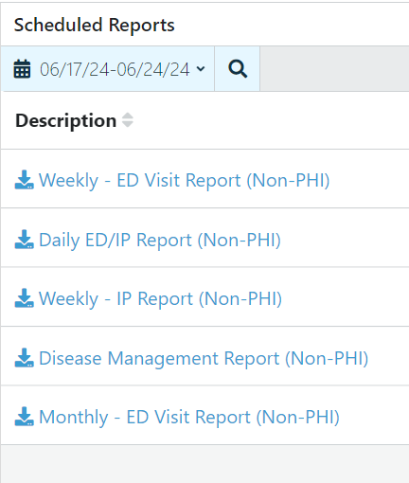
Scheduled Reports
Available Reports
Hospitals :
Custom, built for you with demographic, encounter info, utilization info, diagnosis, and more
Ambulatory :
Acute Encounters of Census (active patients)
Scheduled Reports Overview
Scheduled Reports FAQ
If you’d like to request a Custom Scheduled Report, please email Nancy.Sehy@PointClickCare.com to request a form.
Notes:
Did you know that you can have reports pre-built for you, to access daily, weekly, or monthly?
If you’d like to request a Custom Scheduled Report, please email Nancy.Sehy@PointClickCare.com to request a form.
Mention that Ambulatory includes Home Care such as Home Health, Hospice, Personal Care Services, etc- if a health system has one, they can onboard these as well as clinics; also free-standing

Slide 17
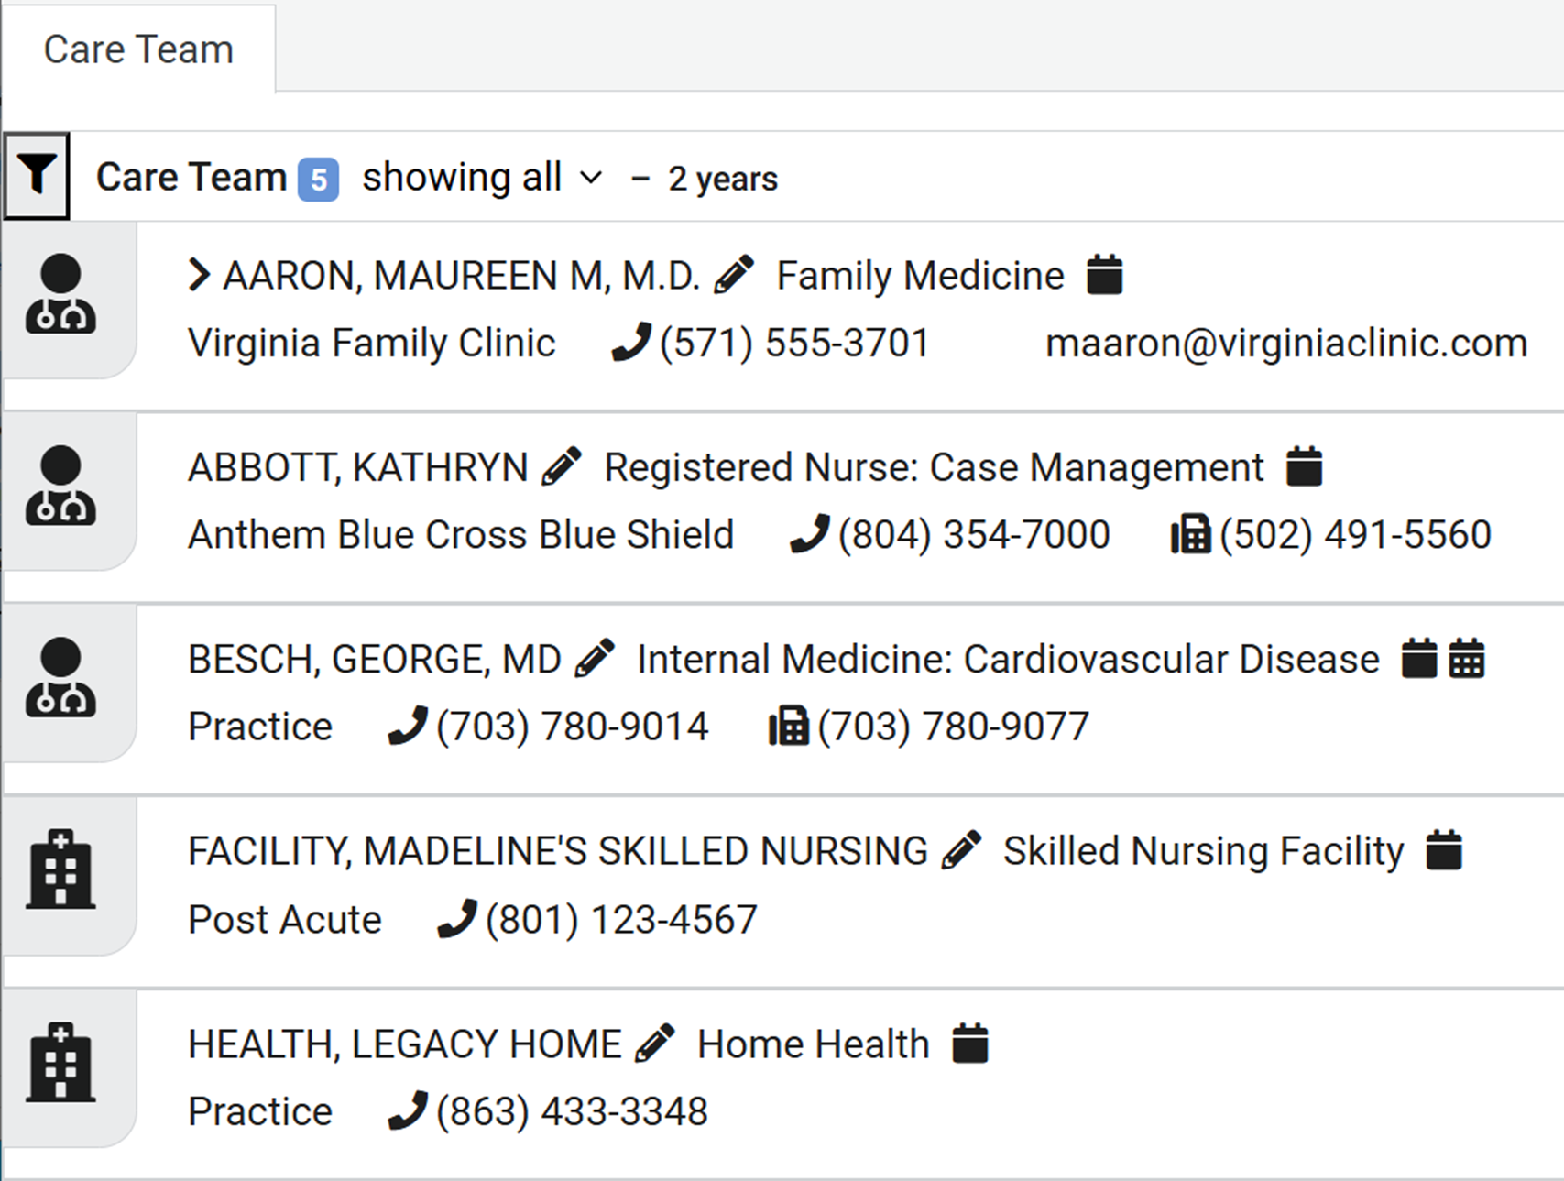
Feature- Care Team
Health System Benefits
Accelerate Throughput
Enable Consulting with Providers who Know the Patient
Streamline Discharge
Ensure Follow-Up with Correct Providers
Prevent Leakage form your System
Notes:
Did you know that you can have reports pre-built for you, to access daily, weekly, or monthly?
If you’d like to request a Custom Scheduled Report, please email Nancy.Sehy@PointClickCare.com to request a form.
Mention that Ambulatory includes Home Care such as Home Health, Hospice, Personal Care Services, etc- if a health system has one, they can onboard these as well as clinics; also free-standing

Slide 18
SSO – Single Sign On
DID YOU KNOW? The PCC Network platform is Single-Sign-On Compatible!
This can streamline your work and help encourage and facilitate your staff’s ease of access.

Slide 19
Integrations Available for Bi-Directional Communication

Slide 20
Notifications and Insights Delivered to Match Your Workflow
FHIR
Embedded via SMART on FHIR
Notifications via ED Trackboard
Notifications via Text, Email, or Printer/Fax

Slide 21
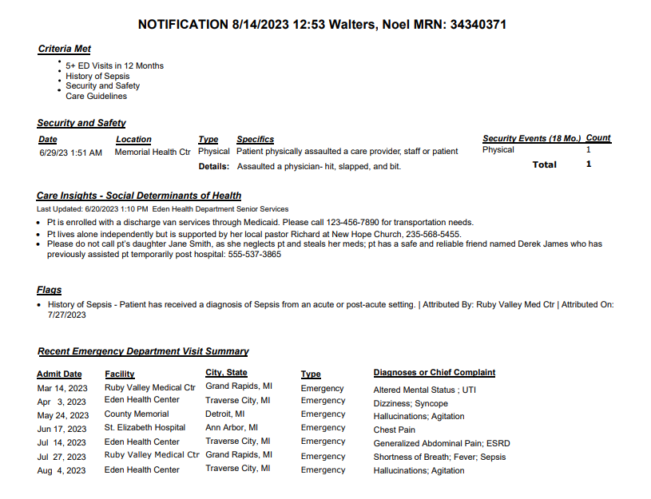
Or through an ED Trackboard Integration
ED Optimization Notification
Notes:
If you aren’t using Epic or Cerner – or don’t have the ability to implement Smart on FHIR now we can help do a direct integration with your ED trackboard.
What you see here is an example of an integration with an ED track board – your ED staff would click on the icon, to open the notification. If you want more information about the patient you can always click on the hyperlink to the portal.
The information within the notification should take no longer than 60 seconds to read.
With this integration, an icon will display in the hospital's ED track board to indicate that there is a Collective notification for that patient. The user clicks on the icon, the Collective notification will display for the user to read, and then the user can close the notification. With this integration, the user will need to log into the Collective portal to edit, add, or delete information.

Slide 22
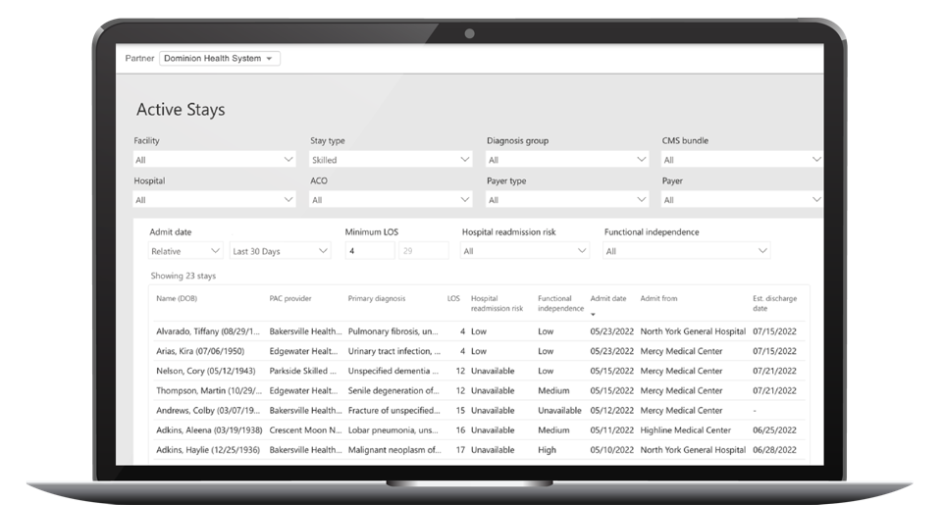
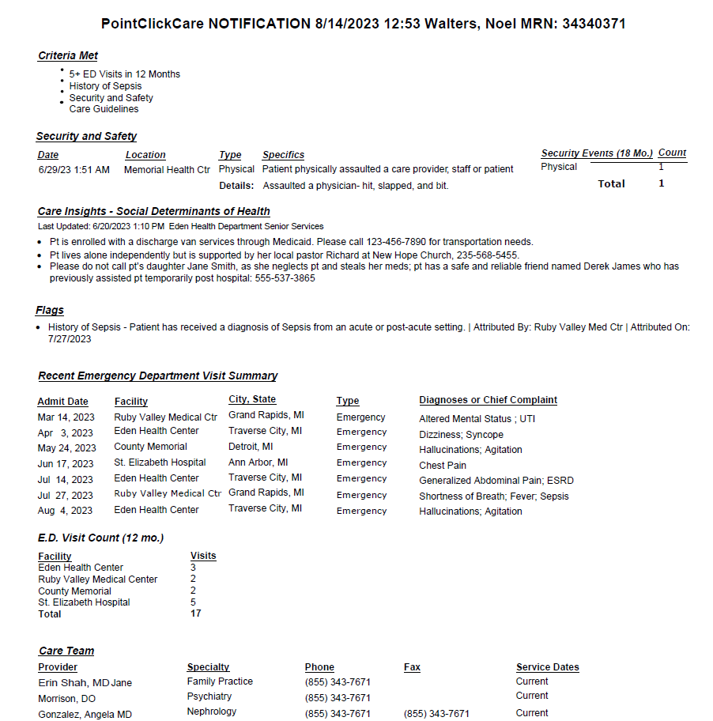
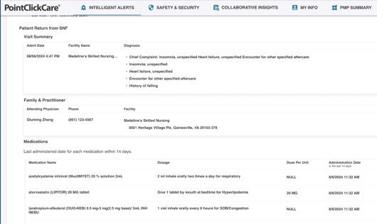
Receive Notifications through SMART on FHIR
Add picture
Notes:
As we just discussed access to the real time notifications being one of our most valuable features – we want to make sure it is clear to you ways we can integrate directly into your workflow.
Smart on FHIR is the best practice and our preferred method for delivering ED optimization. It is available to our customers that use EPIC and Cerner and provides the ability to seamless integrate with the electronic medical record (EMR) making it the premier integration solution we offer.

Slide 23
SMART on FHIR
Accessible within EMR by those health system staff who are outside of the ED, such as Case Managers and Care Coordinators
SMART on FHIR (SoF) App is a way to embed third-party content directly into an Electronic Health Record.
This means that information provided from the PCC Network can be accessed directly from select EHRs, rather than having to access the PCC Platform directly.
The PCC SMART on FHIR app provides intelligent alerts, risk analysis, and other concise actionable information from the PCC network and presents it to the care provider directly within their workflow in their EHR.
The app reduces or eliminates the need for double documentation in care collaboration work streams by saving documented Care Insights simultaneously to Epic or Cerner EHRs as well as to the PCC network of participants.
Available for:
Epic
Cerner
Through the App Orchard/Marketplace

Slide 24
New Feature Available for Hospitals & Health Systems – SNF Stay Summary
Notes:
A very exciting new feature available free of charge, included with your ED Optimization solution-
There will be a poll at the end in which you can indicate that you are interested or would like to discuss further.

Slide 25
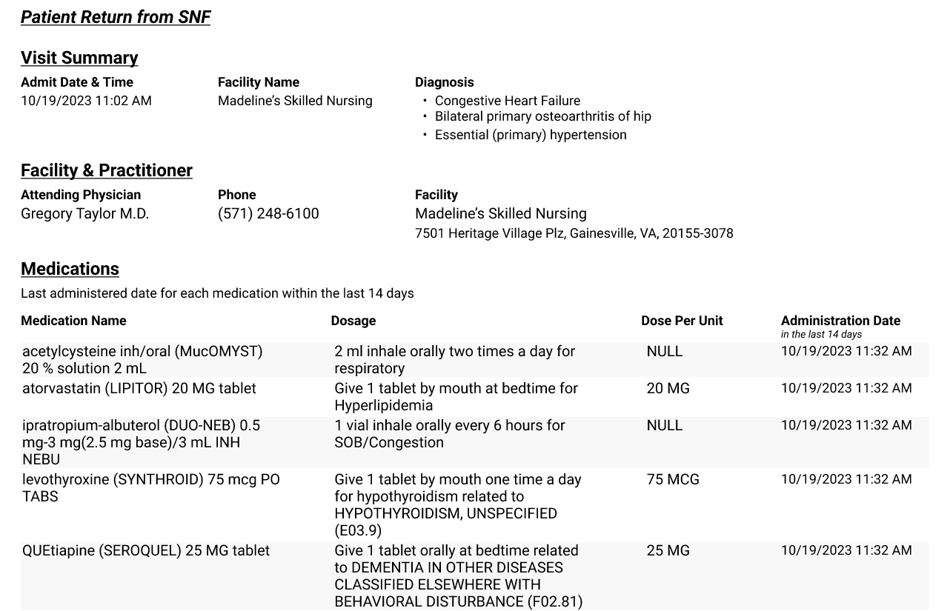
ED SNF Stay Summary Notifications
Triggers when a patient:
Had a SNF discharge in the past 7 days
Had a SNF admission in the last 60 days without a SNF discharge
ED Optimization Notification
A summarized view of their SNF stay includes:
SNF admission date and time
Facility and practitioner name
Diagnoses
Last 14 days of medications, dosages, and administered dates/times
Notes:
One-third of SNF patients face an avoidable ED visit within 30 days of admission.¹ When a patient arrives in the ED from a post-acute provider, their information may not. Without that encounter history, an inpatient admission may be required, and this can leave vulnerable patients at even greater risk and contribute to higher readmission rates. ED Optimization provides real-time visibility into critical information from the leading U.S. SNF network so clinicians can make faster, more informed care decisions and accelerate care delivery.

Slide 26
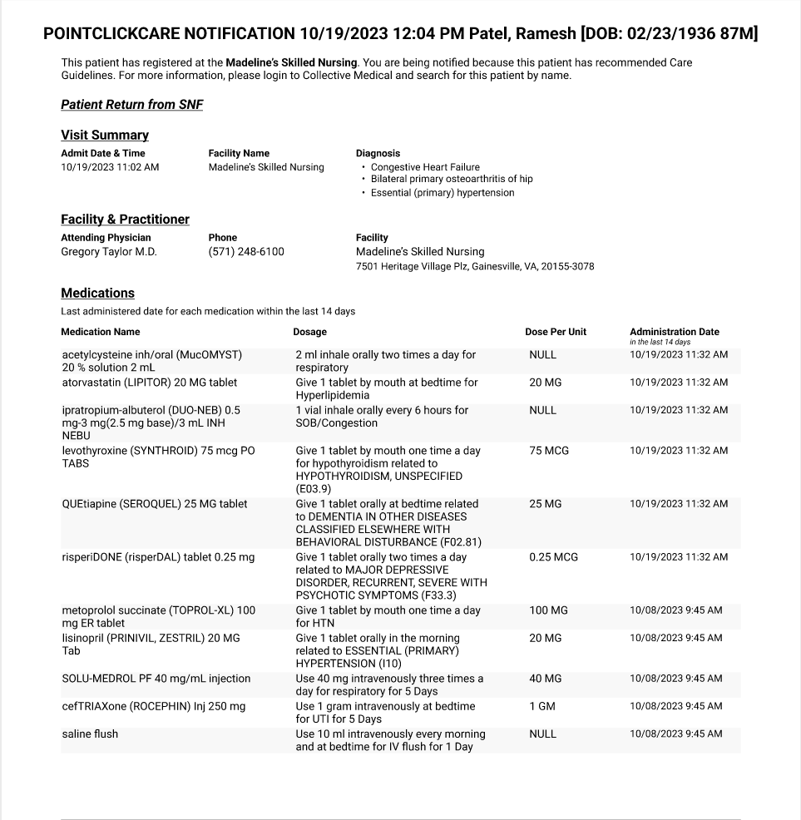
Detailed SNF Summary
The following data from the SNF stay is included when available:
Visit Summary
Admit Date/Time
Facility Name
Diagnosis
Facility & Practitioner
Attending Physician
Physician Phone
Facility Name & Address
Medications
Last 14 days of administered meds
Dosage
Dose Per Unit
Administered Date/Time
Meds are de-duplicated; administered meds that are repeated over 14 days will only show latest administration.

Slide 27
Success Stories and Access to Solutions

Slide 33
Do you have additional questions and would like to discuss? Please indicate here, and we will contact you.
Survey Questions
No thanks
Yes
Would you like to get connected with bi-directional functionality for your ED/ Hospital? (ED TrackBoard, EMR Integration, SNF Summary/Notifications)
YES!
What would you like to see/learn more about in an upcoming CCG? We would love to hear from you.
Indicate

Slide 34
Survey Questions
Do you have additional questions and would like to discuss? Please indicate here, and we will contact you.
No thanks
Yes
Would you like to get connected with bi-directional functionality for your ED/ Hospital? (ED TrackBoard, EMR Integration, SNF Summary/Notifications)
YES!
What would you like to see/learn more about in an upcoming CCG? We would love to hear from you.
Indicate

Slide 35
Upcoming CCG Events and Additional Information

Slide 36
Upcoming CCG Dates for 2025!
2025 Clinical Collaboration Group Webinars –
All provider types
Thursdays, 12pm-1pm
May 8 Register Here
August 7 Register Here
November 6 Register Here
Topics including:
Workgroup recommendations
New Provider Notices
Regional Collaborations
Collaboration success stories
Platform enhancements
And more!
Missed the last CCG? All CCG slide decks and recordings from prior webinars can be found here:
https://hfs.illinois.gov/healthchoiceadt/clinicalcollaborationgrouprecordedwebinars.html

Slide 37
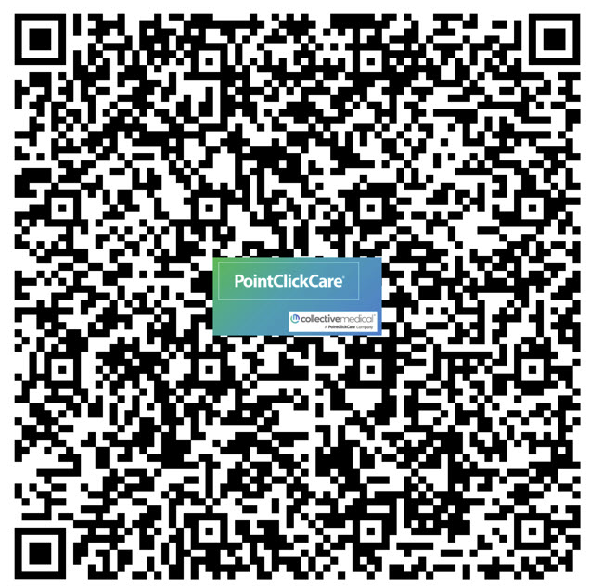
Resources
State HFS Website: HealthChoice Illinois ADT HFS Program Email: HFS.HealthChoiceIllinoisADT@Illinois.gov
Collective Medical/PointClickCare Customer Community Site: https://community.collectivemedical.com/
Collective Medical Support Email: support@collectivemedicaltech.com
Questions? Requests?
Want an in-person visit or virtual meeting with PointClickCare to help your team learn how to best use the platform?
A walk-through of the Network platform and its functions/features?
Click here to schedule a call to discuss your needs and get answers to your questions!

Slide 38
Not on the Network Yet? – Steps to Sign Up
1. Begin the subscription process by completing a brief HFS survey to receive an HFS onboarding packet
https://www.surveymonkey.com/r/8T87FTX
2. Complete HFS onboarding packet and email to HFS:
HFS.HealthChoiceIllinoisADT@Illinois.gov

Slide 39
Thank You!

Slide 40
