Slide 1
House Appropriations Health & Human Services Committee
Department of Healthcare & Family Services
Elizabeth M. Whitehorn, Director
APRIL 16, 2026

Slide 2
HFS’ mission, vision, values

Slide 3
What We Do
Nearly 1 in 3 Illinoisans are served by HFS through health care and child support programs.
HFS provides healthcare to more Illinoisans than any other insurer.
Medicaid
Child Support
3.1 million individuals enrolled
98% of total budget
Serves 330,000 families and nearly 500,000 children
~1% of total budget

Slide 4
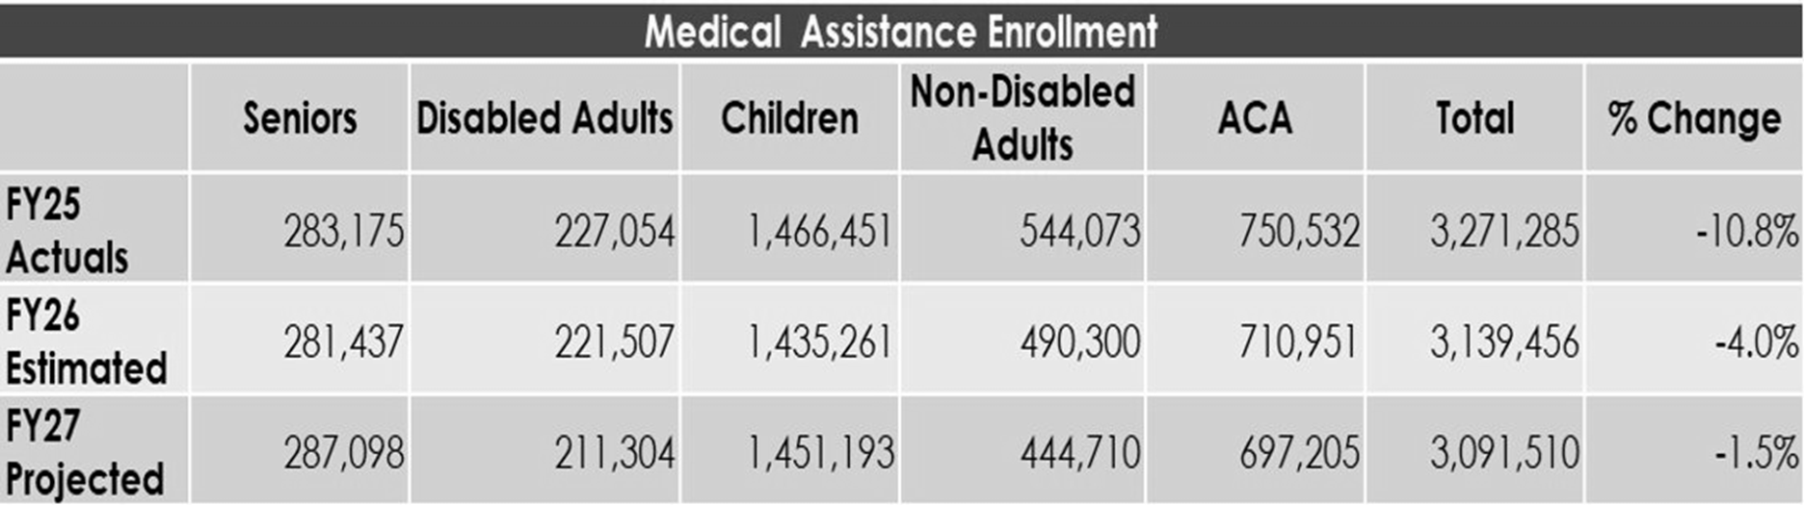
Who Are Our Medical Customers?
*This chart shows HFS' year-over-year Medical Programs enrollment, broken out by population.

Slide 5






Managed Care in Illinois
Managed Care
(78% of Medicaid Population)
Medicaid Managed Care:
Customers choose their health plan among MCOs
Provides care coordination for customers
Incentivizes quality of care
Dual Eligible Special Needs Plan (D-SNP - transition from MMAI)
Health Choice Illinois
HCI -Youth Care
Fee for Service
(22% of Medicaid Population)

Slide 6
FY26 Accomplishments
Rural Health Transformation (RHT) Program: Awarded $193.4 million for CY2026
Medical Debt Relief: Alleviated more than $1.1 billion in medical debt for more than 500,000 beneficiaries
Cell and Gene Therapy (CGT) Access Model: Accepted into the federal CGT Access Model
State Based Marketplace Launch: Allows for more integration between Medicaid and the marketplace
Maternal Health: Continued expansion of new provider types, integrating social and behavioral health services, promoting quality and alternative payment models, federal Transforming Maternal Health Model
HealthChoice Illinois (HCI) procurement: Re-procuring MCOs with the goal of driving transformative growth and expanded access. New contract term begins in Plan Year 2027
Fully Integrated Dual Eligible Special Needs Plan (FIDE-SNP): Began January 1, 2026
Certified Community Behavioral Health Clinic (CCBHCs): Continued implementation to expand access to integrated mental health and substance use treatment services
Hospital Assessment Program: Allows for an additional $2 billion in state-directed payments
Child Support: Achieved highs for parentage establishment and current support collections, while increasing cases with orders or past-due collections. Cut past-due child support case review times by over 92%

Slide 7
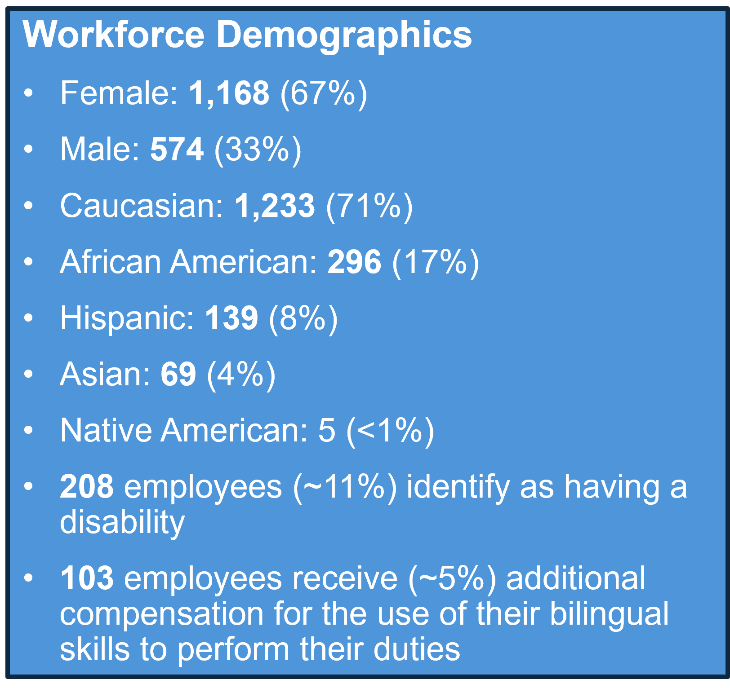
HFS Workforce
Onboard Headcount: 1,742 as of 3/31/26, down from 1,792 on 6/30/25
Allocated headcount for FY26: 2,106​
Budgeted FY27 headcount: 2,144 - 38 additional allocated for new consent decree responsibilities, HR1 implementation, Rural Health Transformation Program, and federal compliance.
HFS has filled 220 positions since 6/1/2025.​
An additional 109 positions are in process to be filled in the next 30-45 days​.
801 staff are aged 50+ (~46%); roughly 261 staff are aged 60+ (~15%)​.
DEIA steering committee helping to drive equitable outcomes in hiring.

Slide 8
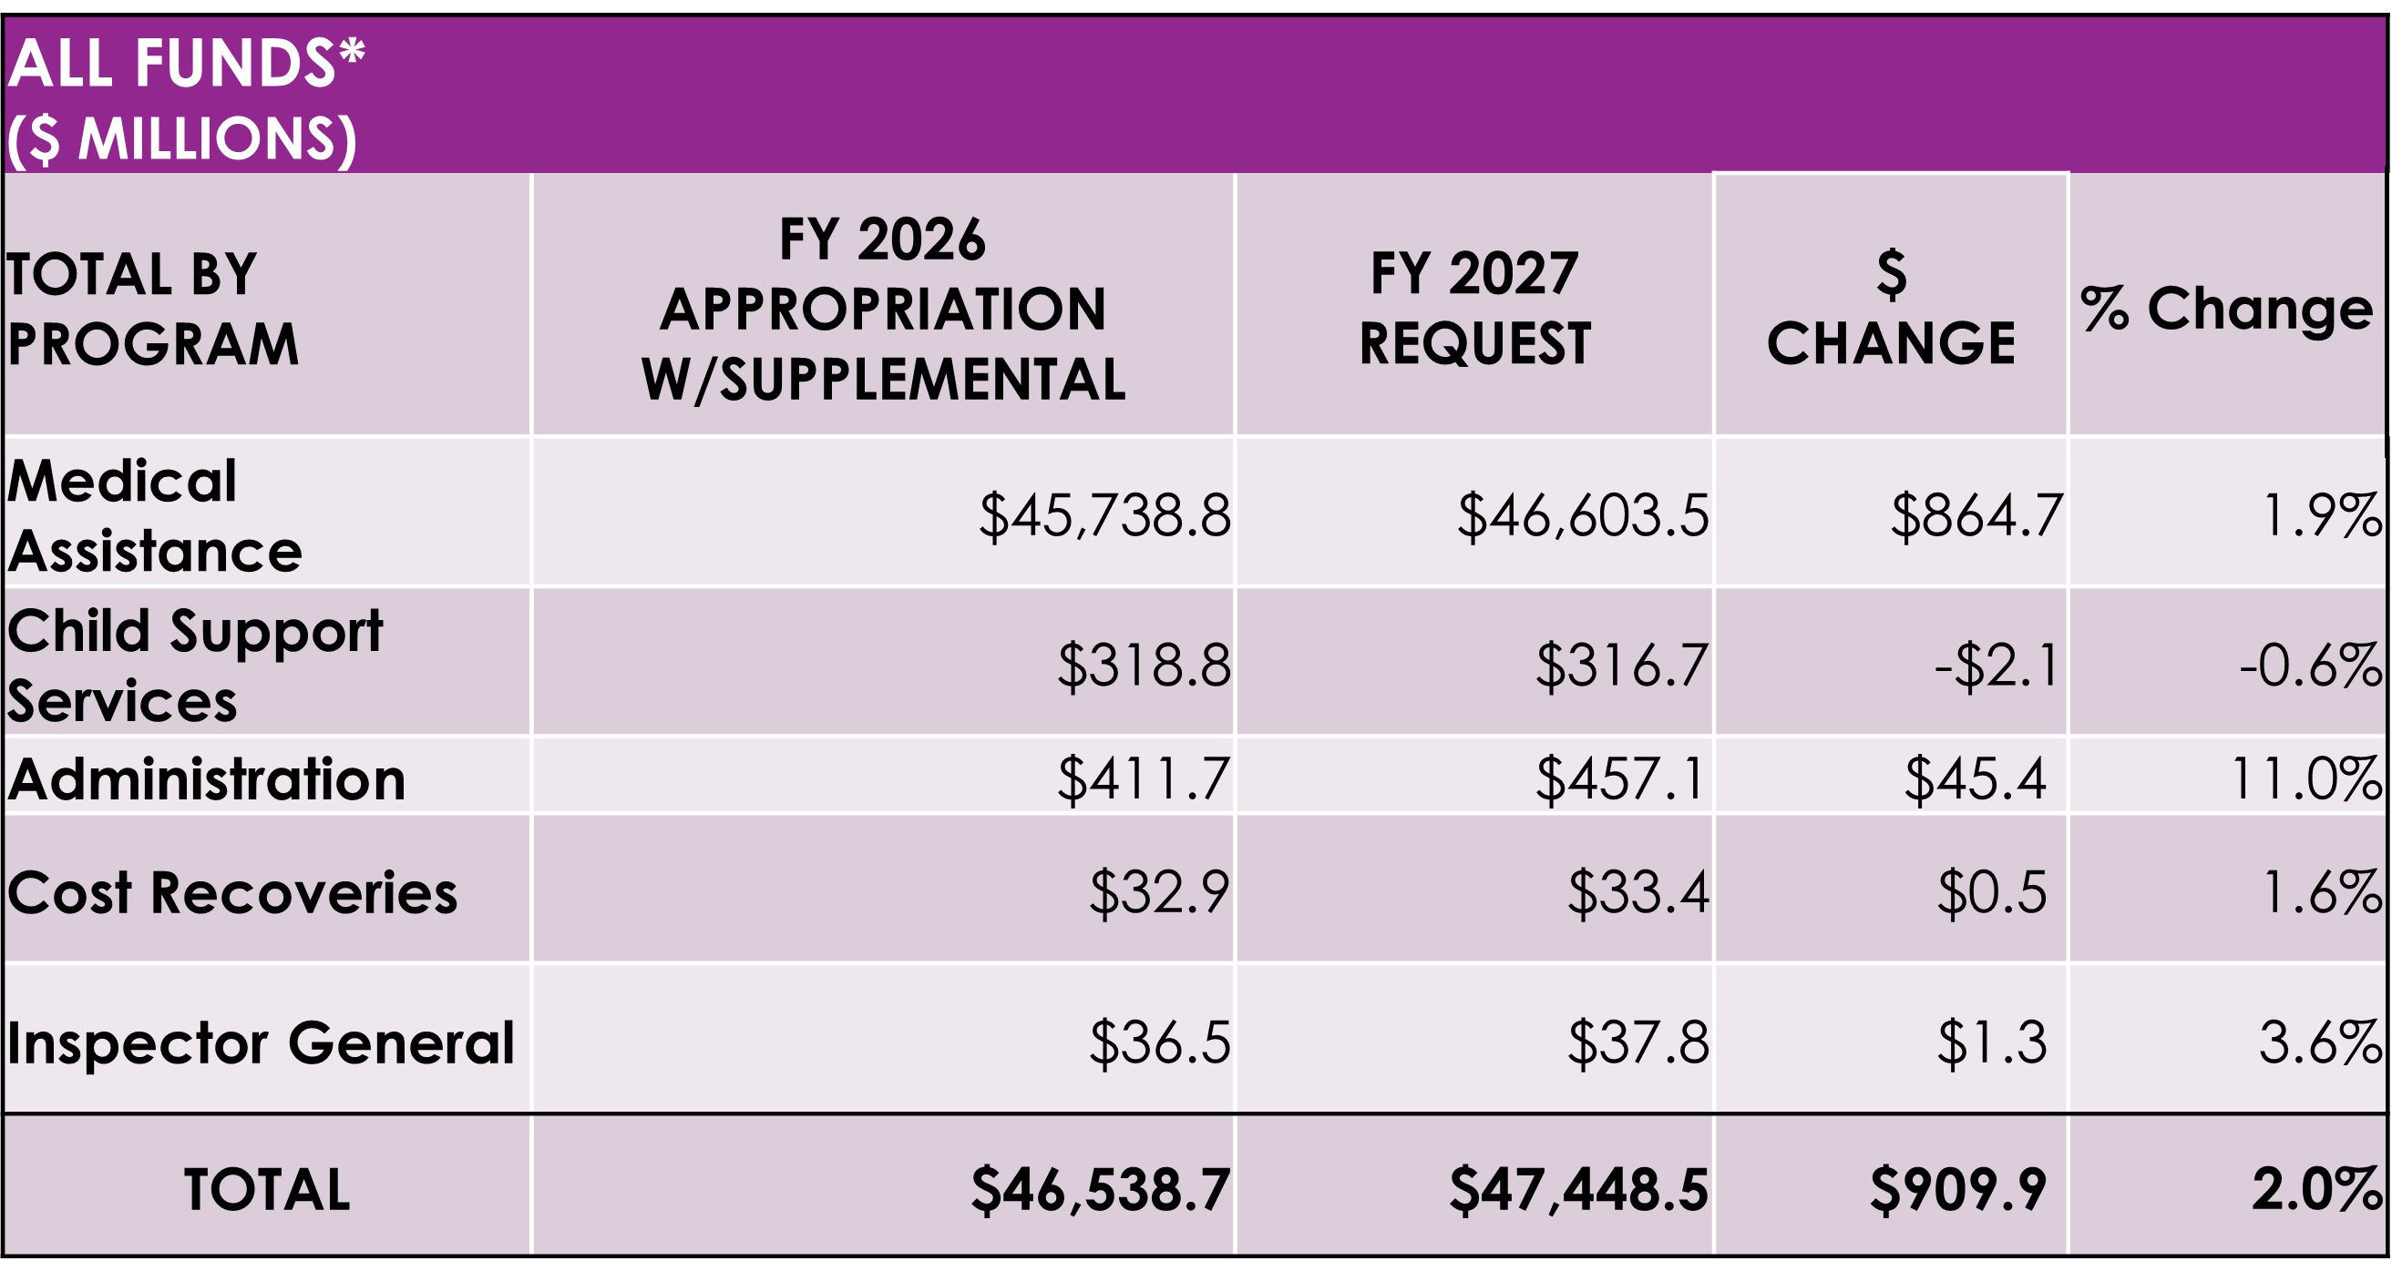
HFS FY27 All Funds Budget

Slide 9
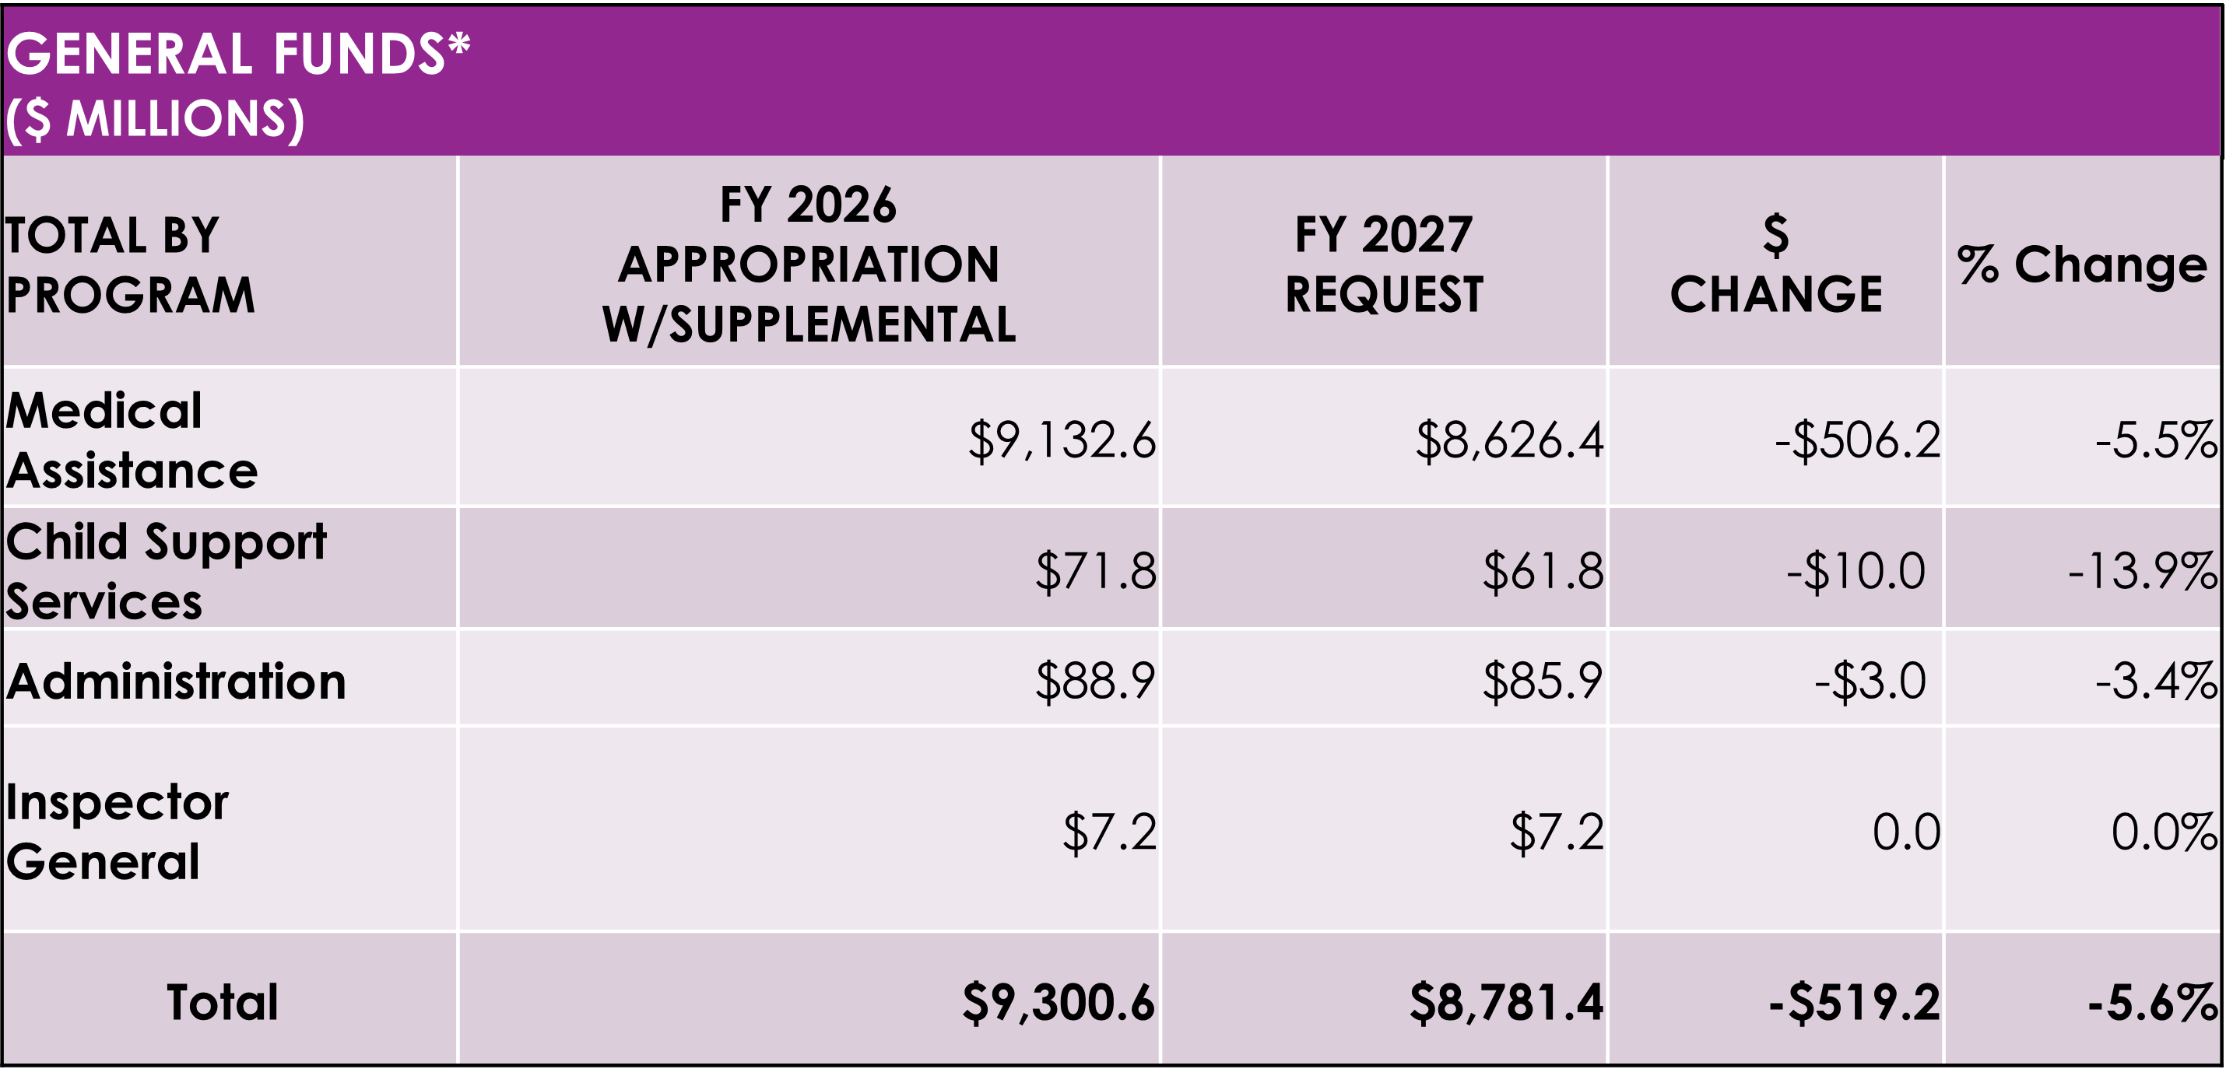
HFS FY27 General Fund Budget

Slide 10
Major Budget Drivers
Upward Pressures:
  $1.4 billion for base rate/utilization cost changes
    $1.3 billion of this total is attributable to Managed Care base rate/utilization cost increases based on actuarial estimates
      $123.6 million of which is attributed to FIDE-SNP (mainly due to timing differences, since FIDE-SNP rates are projected one-year beyond the MMAI baseline)
  $351.5 million for increased Managed Care Assessment Capitations (MAC)
    These payments are made to Medicaid MCOs to achieve actuarially sound rates due to those plans paying the MCO assessment.
  $69.9 million for Medicare Part D clawback payments to the federal government
  $50.0 million for Applied Behavioral Analysis utilization
Downward Pressure:
  FY27 liability is decreased in part by the following:
    $581.3 million due to projected enrollment decreases
      Driven in part by implementation of HR1 policies impacting enrollment (work requirements, 6-month redeterminations for the ACA population, and change in qualified alien definition)

Slide 11
FY27 Budget Highlights
Program Investments
HR1 Infrastructure and Investments - $36.8 million (IT and consumer outreach); $2 million (headcount); and $193.4 million (rural healthcare transformation).
Certified Community Behavioral Health Clinics (CCBHCs) - $110.7 million. Funding including maintenance of 19 CCBHC providers and adding another 9 CCBHC providers by Jan. 1, 2027.
Tailored Care Management Program (TCMP) - $39 million. Effective January 1, 2027, TCMP will replace the DHS Comprehensive Class Member Transition Program and the Community Transition Initiative operated by HFS MCOs.
Health Related Social Needs (HRSN) component of the 1115 waiver - $14.5 million. HFS will implement infrastructure investments and some housing services for Medicaid members.
Community Health Workers (CHWs) - $6.5 million. Includes the implementation of CHWs as Medicaid covered providers.
Gold Card – $6.1 million. Effective January 1, 2027, implementation of a gold card certification for hospital inpatient and outpatient providers exempting them from submitting prior authorization for certain procedures to streamline access to care.

Slide 12
Delayed Program Investments Due to Budget Pressures
Budget Pressures examples
HR1 implementation
Higher acuity customers post Public Health Emergency (PHE)
Increased utilization of Applied Behavior Analysis (ABA) therapy
Implementation of the Fully Integrated Dually Eligible Special Needs Program (FIDE-SNP)
Proposed Delays
72-hour Rule to begin July 1, 2027
Coverage of Music Therapy to begin July 1, 2027
Implementation of 1115 Reentry waiver to begin in FY28
In-state Psychiatric Residential Treatment Facilities (PRTFs) to begin January 1, 2028

Slide 13
FY26 Supplemental Requests
Hospital Provider Fund - $600 million
Due to delayed CMS approval of the new hospital assessment program and increased available resources for hospital claims.
County Provider Trust Fund - $600 million
Increased revenue streams into this fund that garner federal match, facilitated by a higher effective federal match rate, which together enable the Fund to cover additional County Care expenditures.
Rural Healthcare Transformation Fund - $100 million
The supplemental request enables FY26 draw down of federal Rural Health Transformation Program funding awarded under HR1.

Slide 14
Medicaid Program Integrity
HFS protects Medicaid integrity by preventing, detecting, and investigating fraud, overpayments, and billing errors.
HFS OIG oversees all program integrity functions and requires MCOs to report suspected fraud, waste & abuse.
Fraud prevention tools include audits, data analytics, provider screening, exclusion checks, and collaboration with MCO SIUs and Milliman.
Milliman’s award‑winning AI anomaly detection is applied to Illinois Medicaid claims to identify emerging fraud risks.
FY2025 results: over 19,000 audits, $178M in cost avoidance, and multiple sanctions, suspensions, and criminal referrals.

Slide 15
Safety Net Health System Landscape
Current State
32 hospitals paid via safety net designation
Individualized response strategy: diverse array of Medicaid payments specialized for safety net hospitals
  Claims payments, state directed payments, and other add on payments that have been passed by the legislature.
  HFS reimburses SNs average 116% of their costs.
Challenging Factors
  Declines in inpatient volume
  Higher patient acuity
  Declining infrastructure
  Difficult & complex payor mix
  Dramatic federal funding decreases
Planning for the Future
Without coordinated action Illinois risks losing access to care, jobs, and damaging equity
Safety Net Hospitals are private entities and oversee their operational and strategic direction
State’s Role:
  Promote strategic creative approach to challenges.
  Coordination across all stakeholders
  State has limited tools
  The state has limited funding especially in light of coming HR1 related fiscal pressures
  Community listening sessions and fostering critical stakeholder input
  We must work together to protect Medicaid, assess the needs of our Medicaid customers, stabilize the financial and organizational structures of our safety net system, and look for innovative solutions.

Slide 16
HR 1: Federal Medicaid Changes Coming in FY27 and Beyond

Slide 17
HFS’ Guiding Principles in Enacting Federal Changes
Ensure eligible Illinoisans receive and maintain the coverage and benefits for which they qualify.
Ensure the Illinois Medicaid program maintains the ability to cover as many health care services as possible.
Mitigate harm as much as possible.

Slide 18
HR 1 Medicaid eligibility changes
New Federal Requirements for some enrollees
Mandatory Work Requirements (Effective January 1, 2027)
  Medicaid customers aged 19 to 64 without dependents under age 14 must prove they meet certain work, education, and/or community service requirements or claim an exemption in order to be eligible for coverage.
More Frequent Redeterminations (Effective January 1, 2027)
  Currently, states are required to verify Medicaid eligibility annually. HR 1 requires states to verify eligibility for customers in the Affordable Care Act (ACA) expansion population every six months.
Retroactive Coverage Limits (Effective January 1, 2027)
  Reduces medical coverage pre-enrollment from three months to one month for ACA adults and two months for other groups.
Narrowing Non-Citizen Eligibility (Effective October 1, 2026)
  Removes federal matching funds for previously eligible immigrant categories.

Slide 19
HR 1 impact on Medicaid
Internal estimates show that between 165,000 and 300,000 Illinoisans will lose Medicaid coverage due to the new federal work requirements.
States that have imposed work requirements, such as AR and GA, saw tens of thousands of eligible enrollees lose coverage.
More frequent redeterminations for ACA adults will mean an increased administrative burden for caseworkers and customers, and an increased risk that eligible enrollees will lose coverage.
The narrowing of non-citizen eligibility is expected to result in coverage loss for approximately 10,000 full-benefit adult individuals on 10/1/2026 due to the new definition of Qualified Aliens.
Shortened retroactive eligibility period for all populations is expected to bring reduced reimbursement for providers and increased medical debt or forgone care for customers.
Coverage loss due to HR 1 changes will put financial pressure on individuals, providers and the healthcare system broadly. Manatt projects the state will face a roughly $51 billion reduction in Medicaid expenditures in the next decade.

Slide 20
Implementation Timeline for HR1 Eligibility Changes
SNAP
ABAWD implementation
begins
Customer notice outlining upcoming changes sent to ACA population
Open Enrollment PY27 begins
First month where existing ACA customers may lose coverage
Feb 2026
Sept 2026
Nov 2026
March 2027
Nov 2025
June 2026
Oct 2026
Jan 2027
Open Enrollment PY26 began (ACA subsidy changes effective)
CMS guidance
issued (est)
Noncitizen
eligibility
changes begin
WR and 6MR implementation date
WR and 6-month redeterminations go into effect

Slide 21
WR MVP changes
Data & IT | HR 1 implementation: major IES updates
2027 Readiness for HR 1 changes
Other HR1 changes
Data integration
'MVP+' IES changes
Overview
Work requirement-related system changes to ensure smooth implementation & minimize disruption
Other system changes for timely HR 1 compliance & limited audit risk
Population data integration for automated work requirement verification, reducing manual burden
Broader IT initiatives to improve member experience & ease frontline workload
Example components
  Key IES changes, e.g.,:
  Eligibility determination logic
  Caseworker & client portal updates
  Application updates
  Notices & forms
  Key IES changes, e.g.,:
  Noncitizen eligibility changes
  Death Master File (DMF) integration
  6-month REDE implementation
  New data sources, e.g.,:
  Claims data (MMIS)
  Consent-based income verification (1099 via CMS EMMY)
  Education enrollment status (NSC)
Example initiatives:
  No-touch REDEs
  Mobile-friendly ABE
  IVR improvements
  Policy manual/WAG upgrades

Slide 22
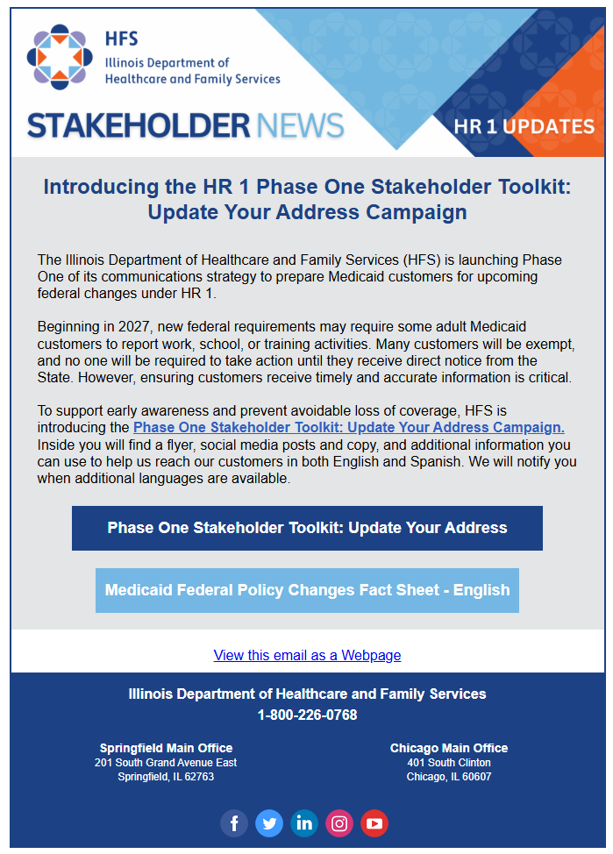
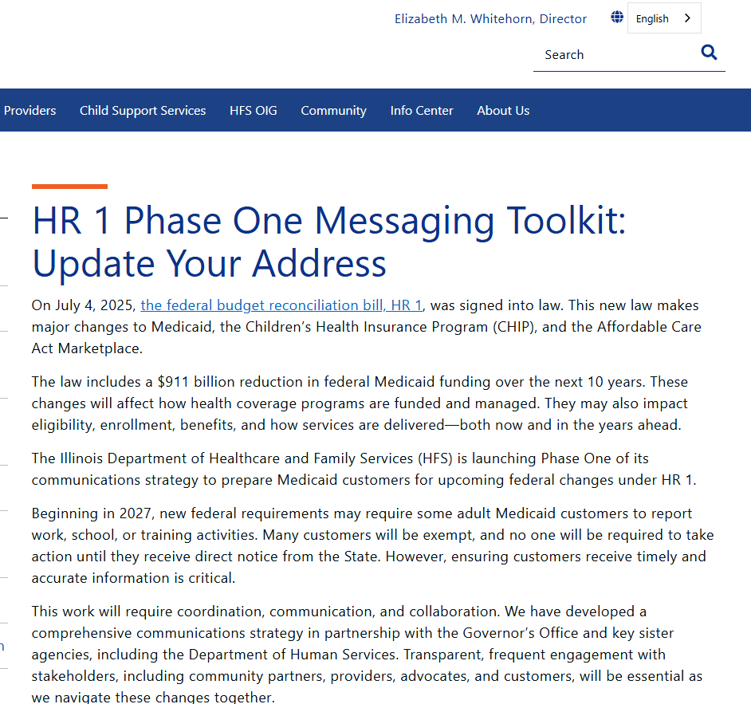
Activating Help from Stakeholders
HFS is planning comprehensive stakeholder engagement and a public awareness & outreach campaign to raise awareness about the HR1 changes
The Phase One Stakeholder Toolkit includes messages & materials to share with Medicaid customers about HR 1 eligibility changes, with more rolling out throughout CY 2026

Slide 23
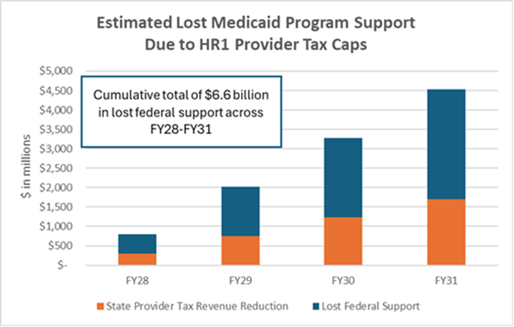
HR 1 changes beyond FY27: Financing
  MCO tax
    July 1, 2027
  Nursing facility tax
    July 1, 2028
Hospital and MCO taxes
    October 1, 2027 through 2032
  State Directed Payments
    Beginning January 1, 2028
  If the state is unable to increase its funding share, after full implementation of the cuts, Medicaid support in Illinois will drop by $4.5 billion annually by 2031, according to GOMB.

Slide 24
HFS FY27 Goals
Implement new federal Medicaid requirements contained in HR 1
Ongoing rollout of the Rural Healthcare Transformation program aimed at improving access to quality care in underserved communities
Re-procure the HealthChoice Illinois MCO contracts serving approximately 2.5 million customers to drive program growth and expand Medicaid access
Work with GO & IDPH on a future-looking safety net healthcare strategy, to monitor hospital health and provide financial assistance to those in crisis
Build on success of the Medical Debt Relief Program
Continuing to advance innovative care programs:
  Certified Community Behavioral Health Clinics (CCBHCs) program
  Expanding maternal health provider types
  1115 waiver programs, including Health-Related Social Needs (HRSN) component, limited housing services
Notes:
Third, we will advance a whole person approach to maternal health that addresses the physical and mental health and social needs during and after pregnancy, including through newly implemented provider type: perinatal doulas and lactation consultants.
customers, pursuing innovative strategies for addressing health related social needs, promoting equity and expanded access and preventing any exploitative practices by contractors such as pharmacy benefit managers. Second, we will ensure Illinoisans have access to quality healthcare they are eligible for by reducing customer barriers to enrollment, increasing customer retention by leveraging flexibilities to make it more seamless for customers to go through the redetrmination process and implement recommendations from the Advisory Council on Financing and Access to Sickle Cell Disease Treatment and Other High Cost Drugs and Treatments, and we will adance a whole person approach to maternal health that addresses the physical and mental health and social needs during and after pregnancy, including through newly implemented provider type: perinatal doulas and lactation consultants.

Slide 25
Q&A

