Slide 1

ILLINOIS PROVIDER ENROLLMENT
Individual / Sole Proprietor

Slide 2
Agenda
Pre-Application Checklist
Introduction to IMPACT and Key Terms
Application Process
Resuming an Application
Starting a New Application
The Business Process Wizard (BPW)
Completing the Application using BPW
Reviewing Submitted Application
Resources
Questions & Answers
Notes:
.

Slide 3
Introduction and Key Terms
IMPACT is a multi-agency effort to replace Illinois’ 30-year-old Medicaid Management Information System (MMIS) with a web-based system that meets federal requirements, is more convenient for providers and increases efficiency by automating and expediting state agency processes.
Key Terms:
  Sole Proprietor: A provider who owns his or her own practice.
  Billing Provider: A provider who submits claims and/or receives payments for an Individual Provider.
  Billing Agent: Submits Medicaid HIPAA compliant Transactions or exchanges EPHI with Medicaid providers or other authorized parties. Also known as Clearing House, Software Vendor or Value Added Network (VAN).
  MCO Plan: Health care plans that provide health care through a provider network. Sister Agencies will also be listed as an MCO. A sister agency is also known as a State Agency or a Waiver provider.
  New Enrollment: A new provider who needs to enroll in the IMPACT system.
  Revalidation: A provider who was previously enrolled in the MMIS system and whose information was transferred to IMPACT.
  Enrollment Timeline:
  Individual Providers will need to enroll or revalidation with IMPACT starting in August 2015.

Slide 4

Application Process
Step 1: Provider Basic Information
Step 2: Add Locations
Step 3: Add Specialties
Step 4: Associate Billing Provider
Step 5: License/Certification
Step 6: Mode of Claim Submission
tep 4: Add Licenses and Certifications
Step 7: Associate Billing Agent
Step 8: Add Ownership Details
Step 9: Add Taxonomy Details
Step 10: Associate MCO Plan
Pressing this button on any screen will bring you back to this menu.
Step 11: 835/ERA Enrollment Form
Pressing any of the buttons below will skip to that step of the presentation
Step 12: Enrollment Checklist
Step 13: Submit Application
Shortcut to Step:
1
2
3
4
5
6
7
8
9
10
11
12
13

Slide 5
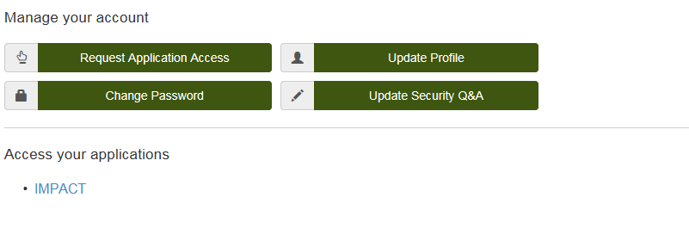
Start New Application
After completing the sign-on, click on IMPACT.
In regards to completing an application, there are two options: New Enrollment or Resuming an application.
Shortcut to Step:
1
2
3
4
5
6
7
8
9
10
11
12
13
Notes:
*****Please turn on pop-up blocker in order to complete the application processes.*****

Slide 6
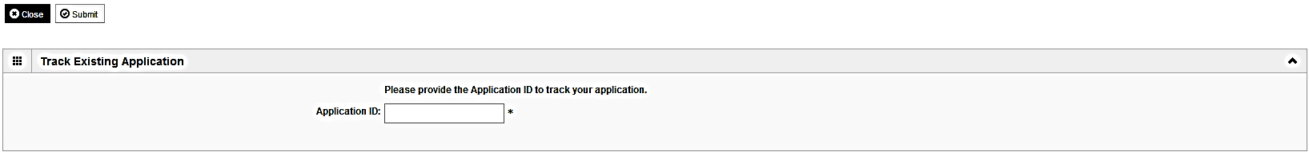
Start New Application
To resume (or revalidate) an application, click on Track Application.
The application number was either mailed out on a yellow card (revalidation) or sent to the listed email address (In-process application).
Enter the Application ID for the application you want to access.
After entering the ID number, click Submit.
This process will then go directly to the Business Process Wizard (BPW).
Shortcut to Step:
1
2
3
4
5
6
7
8
9
10
11
12
13

Slide 7
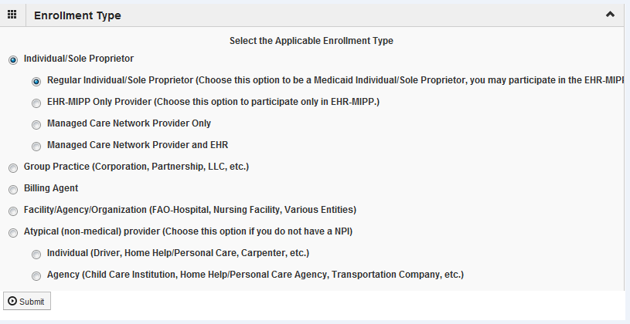
Start New Application
If completing a new application, click on New Enrollment.
Use the radio buttons to select your enrollment type (Typical vs. Atypical), then click on Submit in the lower left corner.
Shortcut to Step:
1
2
3
4
5
6
7
8
9
10
11
12
13

Slide 8
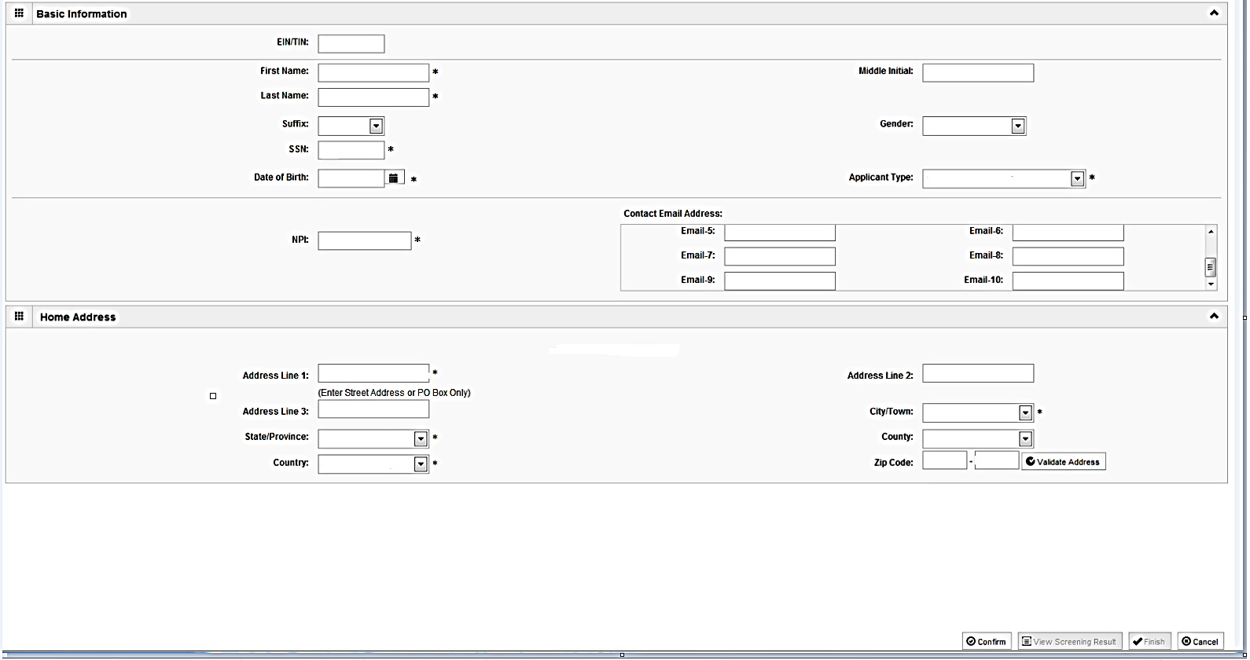
Start New Application
Step 1:(Basic information)
Complete all fields especially required, which are marked with an *.
Applicant Type will need to be selected from the drop down and it drives the rest of the application.
Click Validate Address after street address and zip code have been entered.
After all the information has been entered click Confirm then Finish.
Shortcut to Step:
1
2
3
4
5
6
7
8
9
10
11
12
13
Notes:
****The EIN/TIN entered must be registered with the Illinois Comptroller in order to complete this step.*****

Slide 9
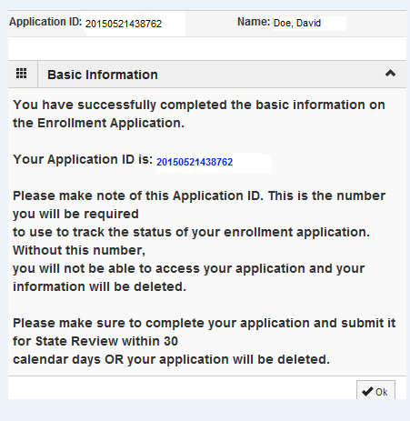
Start new Application
Start New Application
(Step 1: Basic Provider Information)
Start New Application
Step 1: (Basic Provider Information)
Application ID: systematically generated.
Name: should reflect name from Basic Information.
The system will generate an application ID after the successful completion of the Basic Information screen; the application number is a 14-digit number that has the following components:
  The system date in yyyymmdd format
  A 6-digit system generated random number
  Example: 20130514412598
  Application IDs are valid for 30 calendar days; applications must be completed and submitted to the state for review during this 30 day period or the application will be DELETED.
  The application ID will be used to access the application before submission to the state for review and will be used to track the status of your submitted application until it has been marked approved.
  After documenting the ID number, click OK.
Shortcut to Step:
1
2
3
4
5
6
7
8
9
10
11
12
13
Notes:
*****An email containing the Application ID is sent to the email address that was listed on the single sign-on registration process.*****

Slide 10
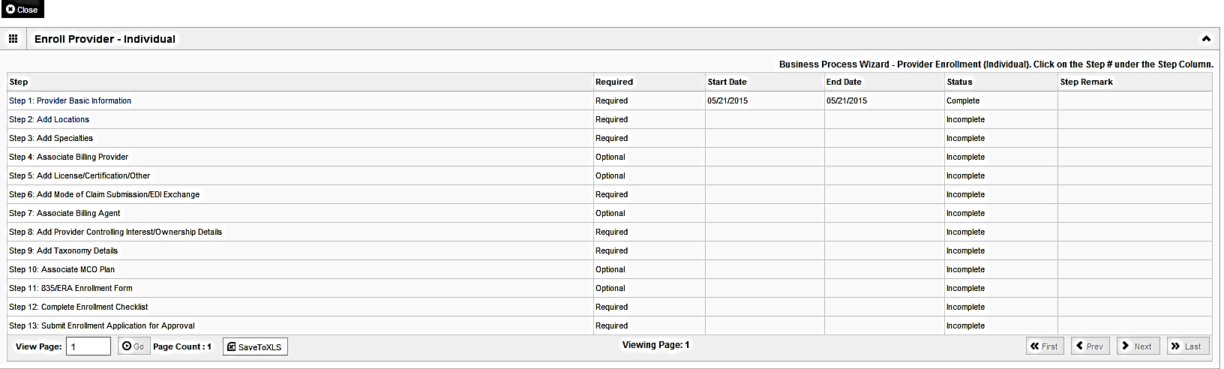
Completing Application using BPW
The BPW serves as the “Control Center” of the application.
  Required: Steps listed as Optional may change to Required based upon previous steps.
  Dates: Entered by the system; Start Date is the date each step is opened, the End Date is the date each step is completed.
  Status: When a step is completed the Status will be updated to Complete; answering some checklist questions may change a prior step’s status back to Incomplete.
  Remarks: Remarks are systematically generated throughout the enrollment process.
Shortcut to Step:
1
2
3
4
5
6
7
8
9
10
11
12
13

Slide 11
Completing the Application Using BPW
Once you have documented your Application ID, you have completed Step 1: Provider Basic Information. The system will place the current date in the End Date field and will place Complete in the corresponding Status field.
Steps 1, 2 and 3 must be completed sequentially before attempting any of the later steps.
Click on Step 2: Add Locations to continue completing your application.
Shortcut to Step:
1
2
3
4
5
6
7
8
9
10
11
12
13

Slide 12
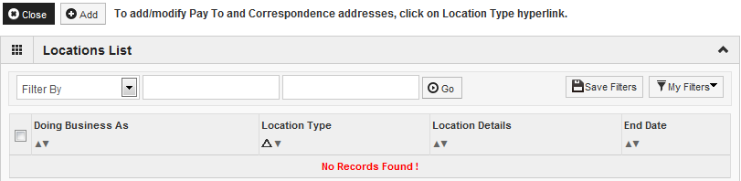
Step 2: Add Locations
Click Add to input the Primary Practice Location address details.
Shortcut to Step:
1
2
3
4
5
6
7
8
9
10
11
12
13

Slide 13
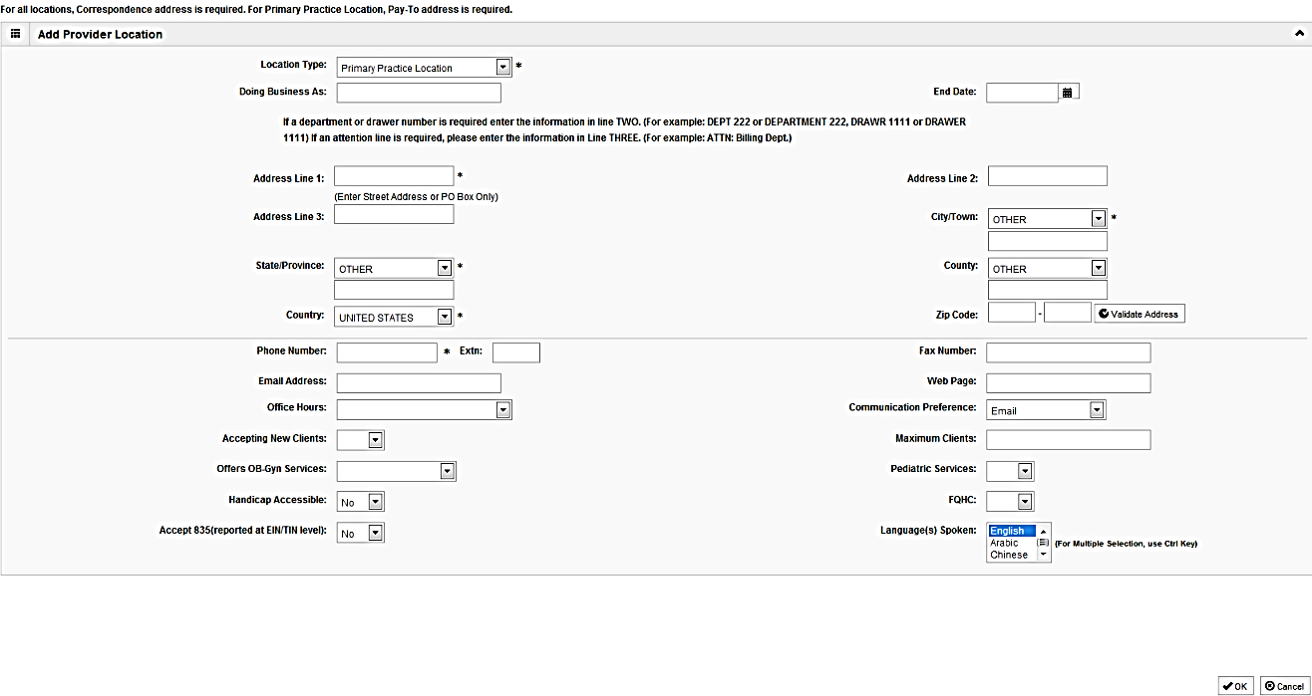
Step 2: Add Locations
Complete all fields especially required, which are marked with an *.
After entering the address and zip code, click on Validate Address.
After all information has been entered, click on OK.
Shortcut to Step:
1
2
3
4
5
6
7
8
9
10
11
12
13

Slide 14
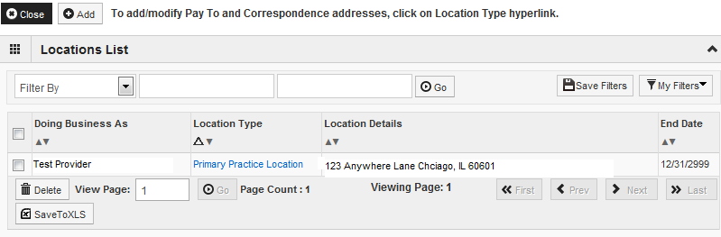
Step 2: Add Locations
Click on the Primary Practice Location hyperlink to add addresses for this location.
The Primary Practice Location requires a Correspondence and a Pay To address be entered.
Shortcut to Step:
1
2
3
4
5
6
7
8
9
10
11
12
13

Slide 15
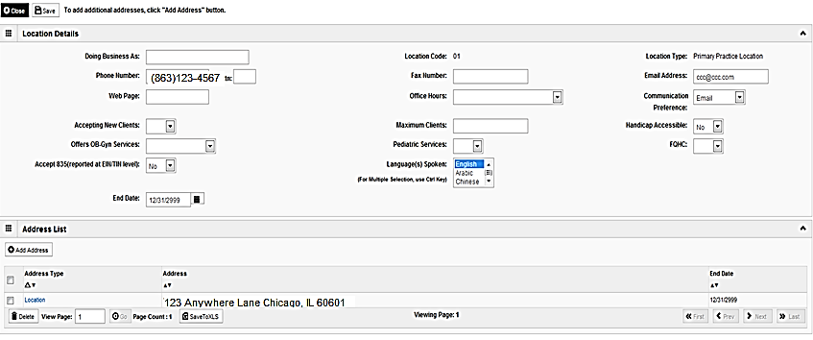
Step 2: Add Locations
Click on Add Address to input the additional address information for the Primary Practice Location.
Shortcut to Step:
1
2
3
4
5
6
7
8
9
10
11
12
13

Slide 16
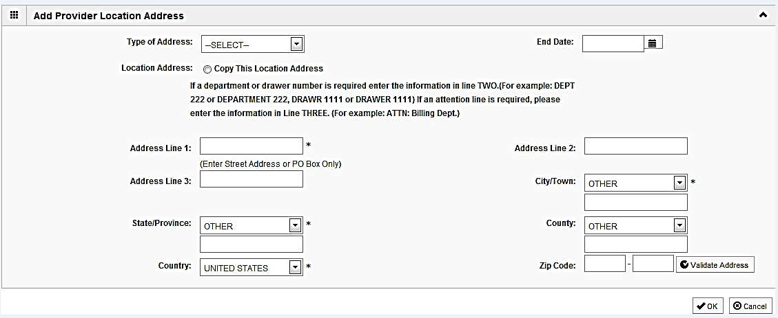
Step 2: Add Locations
Choose type of address (Correspondence or Pay To).
If the address you are entering is the same as the location address, then click the radio icon next to Copy This Location Address.
After entering the address and zip code information, click on Validate Address.
When all required fields and any optional fields are completed, click OK.
Repeat these steps for each additional address type.
Shortcut to Step:
1
2
3
4
5
6
7
8
9
10
11
12
13

Slide 17
Step 2: Add Locations
To list an Other Servicing Location address, click on Add and enter the address information for that location.
For Other Servicing Location, in addition to the location address itself, a Correspondence address is required.
Once all location addresses have been entered, click on Close.
Shortcut to Step:
1
2
3
4
5
6
7
8
9
10
11
12
13

Slide 18
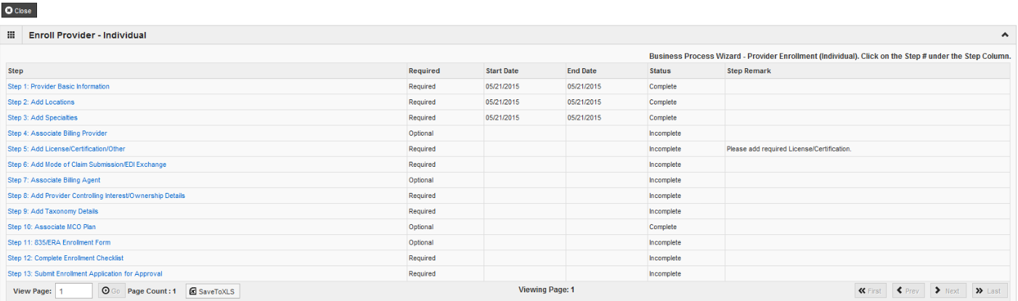
Business Process Wizard
You have completed Step 2: Add Locations. The system will place the current date in the End Date field and will place Complete in the corresponding Status field.
Click on Step 3: Add Specialties to continue your application.
Shortcut to Step:
1
2
3
4
5
6
7
8
9
10
11
12
13

Slide 19
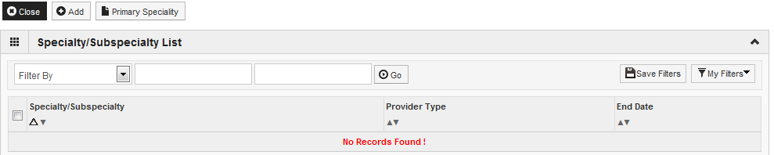
Step 3: Add Specialties
Click on the Add button in the upper left corner.
Shortcut to Step:
1
2
3
4
5
6
7
8
9
10
11
12
13

Slide 20
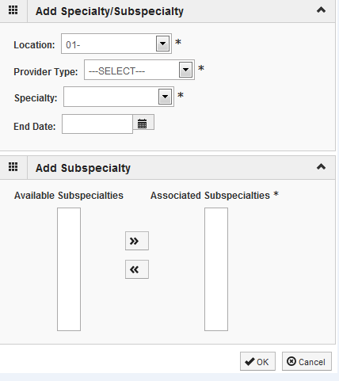
Step 3: Add Specialties
Select your Provider Type from the drop down.
Select your Specialty from the drop down.
Shortcut to Step:
1
2
3
4
5
6
7
8
9
10
11
12
13

Slide 21
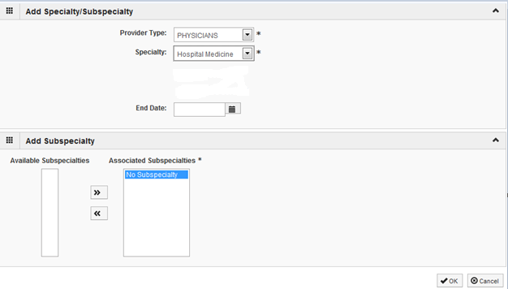
Step 3: Add Specialties
Once the Provider Type and the Specialty are selected, the Subspecialties will populate at the bottom of the screen in the Available Subspecialties box.
The Provider must choose at least one Available Subspecialty (or No Subspecialty) if multiple selections are available.
If only one choice is available, the system will preselect that selection.
Once all desired selections are moved to the Associated Subspecialties box, click OK in the bottom right corner
Click on the Subspecialties then click on the double arrows to move the Subspecialties over to the Associated Subspecialties box.
Shortcut to Step:
1
2
3
4
5
6
7
8
9
10
11
12
13

Slide 22
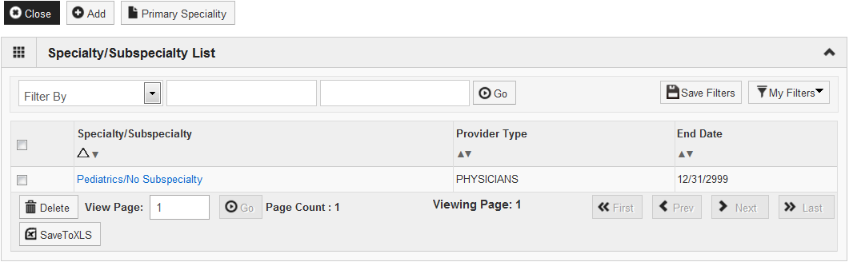
Step 3: Add Specialties
If you have another Specialty/Subspecialty to enter click the Add button in the top left corner and repeat the previous steps.
When all the specialties/subspecialties have been entered, click Primary Specialty to designate one of the listed Specialties as Primary.
Shortcut to Step:
1
2
3
4
5
6
7
8
9
10
11
12
13
Notes:
.

Slide 23
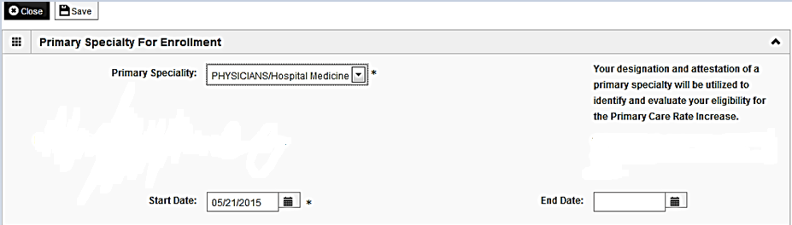
Step 3: Add Specialties
Choose the Primary Specialty for this enrollment from the drop down menu.
Choose the appropriate radio icon to select board certified or not.
Complete the Start Date field. Leave End Date blank.
When all information has been entered, click on Save then Close.
Shortcut to Step:
1
2
3
4
5
6
7
8
9
10
11
12
13

Slide 24
Step 3: Add Specialties
When all the Specialty information has been entered, click on Close to return to the BPW.
Shortcut to Step:
1
2
3
4
5
6
7
8
9
10
11
12
13

Slide 25
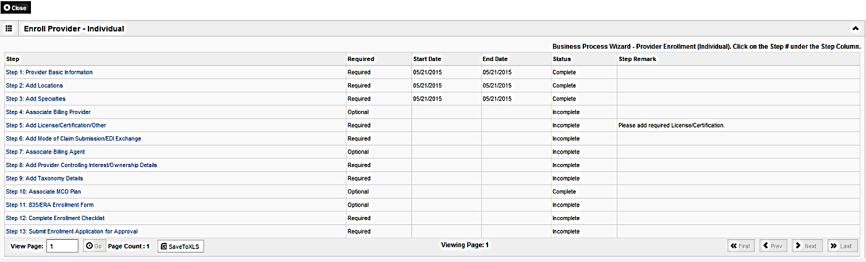
Business Process Wizard
You have completed Step 3: Add Specialties. The system will place the current date in the End Date field and will place Complete in the corresponding Status field.
Click on Step 4: Associate Billing Provider to continue your application.
Shortcut to Step:
1
2
3
4
5
6
7
8
9
10
11
12
13

Slide 26
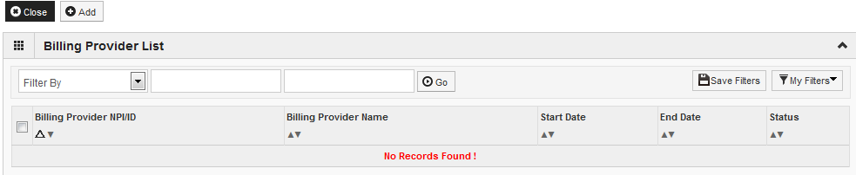
Step 4: Associate Billing Provider
Click Add to associate to a Billing Provider.
Shortcut to Step:
1
2
3
4
5
6
7
8
9
10
11
12
13

Slide 27
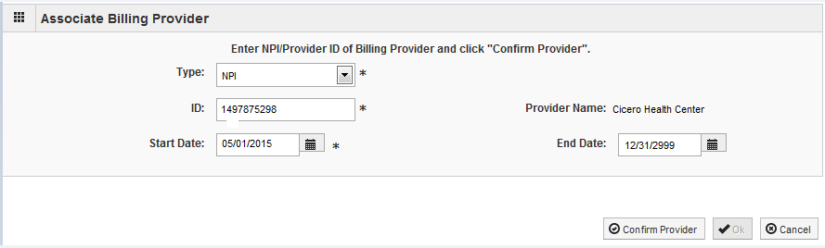
Step 4: Associate Billing Provider
Once all information has been entered, click on Confirm Provider and verify the correct Provider Name is displayed .
Click OK when you are finished.
Shortcut to Step:
1
2
3
4
5
6
7
8
9
10
11
12
13

Slide 28
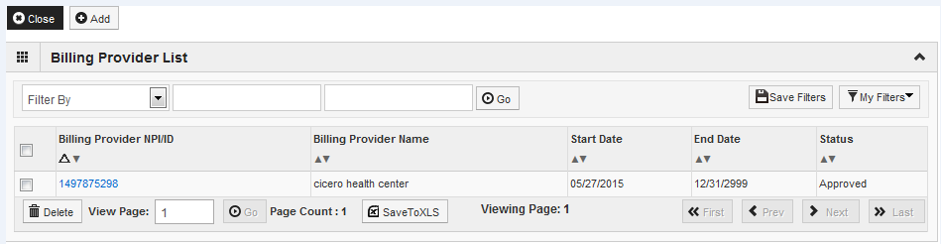
Step 4: Associate Billing Provider
To associate to an additional Billing Provider, click Add and repeat the previous steps.
If there are no other Billing Providers to add, click on Close to return to the BPW.
Shortcut to Step:
1
2
3
4
5
6
7
8
9
10
11
12
13

Slide 29
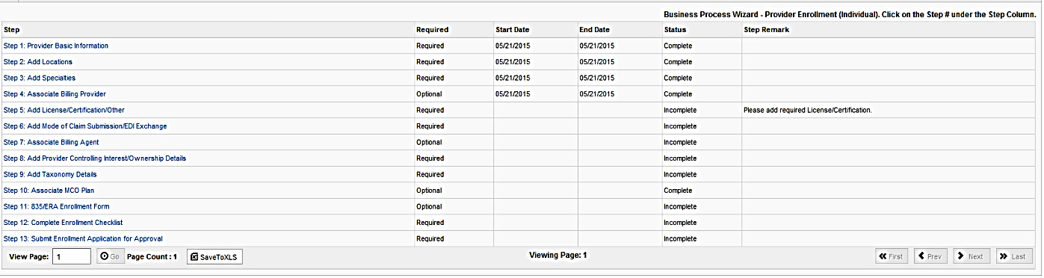
Business Process Wizard
You have completed Step 4: Associate Billing Provider. The system will place the current date in the End Date field and will place Complete in the corresponding Status field.
Click on Step 5: Add Licensing/Certification/Other to continue your application.
Shortcut to Step:
1
2
3
4
5
6
7
8
9
10
11
12
13

Slide 30
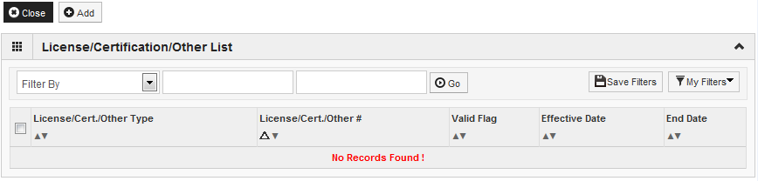
Step 5: Add Licenses/Certifications/Other
Click on the Add button to begin adding Licenses and Certifications.
Shortcut to Step:
1
2
3
4
5
6
7
8
9
10
11
12
13

Slide 31
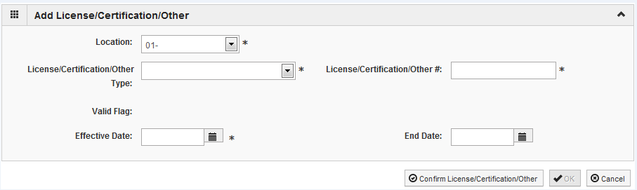
Step 5: Add Licenses/Certifications/Other
Click the drop down menu next to License/Certification Type to select your License/Certification, then enter the License/Certification Number and Effective Date in the appropriate fields. Leave the End Date field blank.
After all information is entered, click on Confirm License/Certification.
Clicking this button will result in the License/Certification being validated and update the Valid Flag to Yes if it is verified to be authentic.
Click Ok.
Shortcut to Step:
1
2
3
4
5
6
7
8
9
10
11
12
13

Slide 32
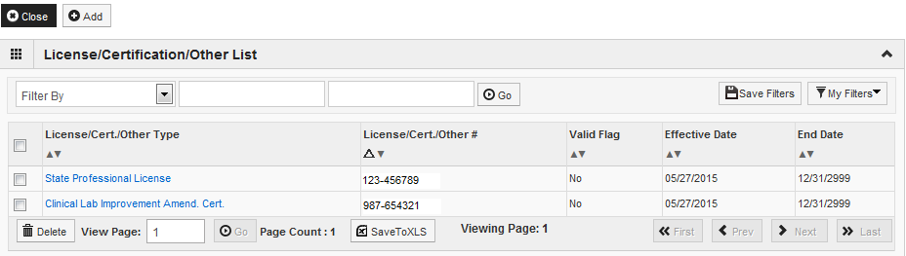
Step 5: Add Licenses/Certifications/Other
If any additional Licenses/Certifications, click on the Add button in the top left corner and repeat the steps.
Click Close once all Licenses/Certifications have been entered to return to the BPW.
Shortcut to Step:
1
2
3
4
5
6
7
8
9
10
11
12
13

Slide 33
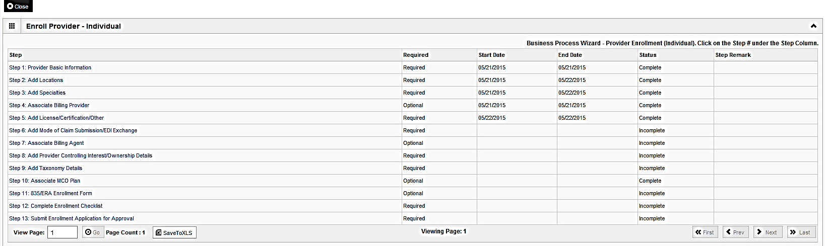
Business Process Wizard
You have completed Step 5: Add Licensing/Certification/Other. The system will place the current date in the End Date field and will place Complete in the corresponding Status field.
Click on Step 6: Add Mode of Claim Submission to continue your application.
Shortcut to Step:
1
2
3
4
5
6
7
8
9
10
11
12
13

Slide 34
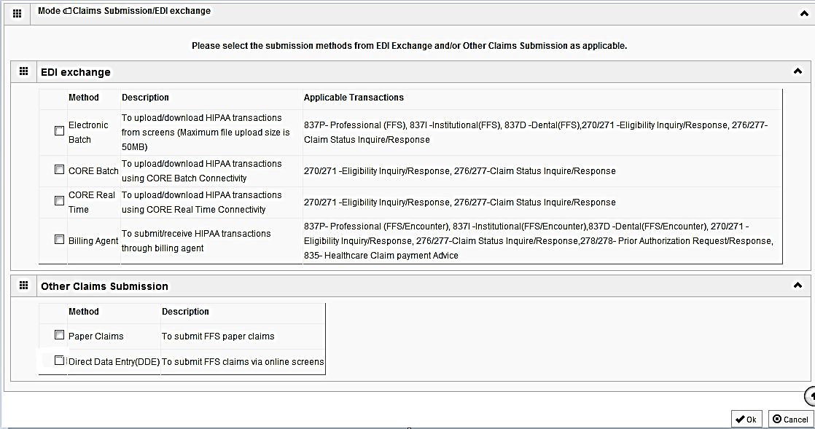
Step 6: Mode of Claim Submission
EDI Exchange
  A New Enrollment will need to complete the necessary external application at http://www.myhfs.illinois.gov/ unless using a Billing Agent or submitting Paper Claims.
P
P
  Select any of the six options to indicate how you wish to process claims.
  Must select at least one option or claims will not be processed.
  After claim submission types have been selected click OK.
Shortcut to Step:
1
2
3
4
5
6
7
8
9
10
11
12
13

Slide 35
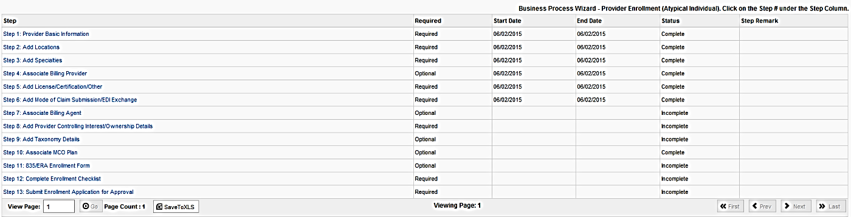
Business Process Wizard
You have completed Step 6: Add Mode of Claim Submission. The system will place the current date in the End Date field and will place Complete in the corresponding Status field.
Click on Step 7: Associate Billing Agent to continue your application.
Shortcut to Step:
1
2
3
4
5
6
7
8
9
10
11
12
13

Slide 36
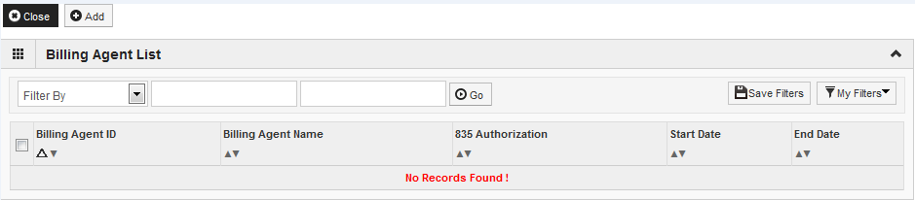
Step 7: Associate Billing Agent
Click Add to input a Billing Agent.
Shortcut to Step:
1
2
3
4
5
6
7
8
9
10
11
12
13

Slide 37
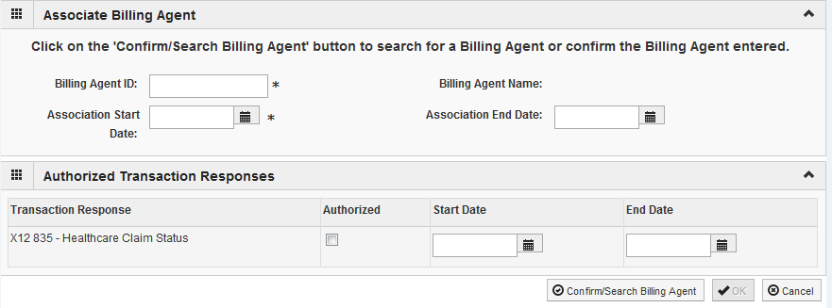
Step 7: Associate Billing Agent
Complete the Billing Agent information then click Confirm/Search Billing Agent and verify that the Billing Agent Name field is auto-populated with the correct agent.
Click OK to return to the billing agent list.
If the Billing Agent info is not known, click on Confirm/Search Billing Agent to locate the desired Billing Agent from the list.
Shortcut to Step:
1
2
3
4
5
6
7
8
9
10
11
12
13

Slide 38
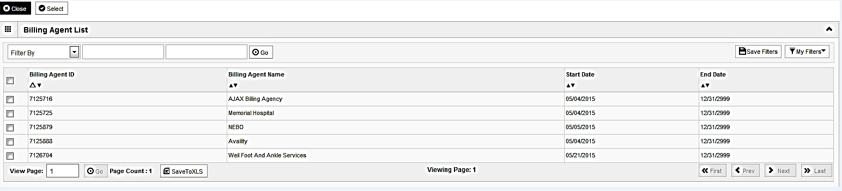
Step 7: Associate Billing Agent
Use the Filter By drop down and enter information to filter the list of the available Billing Agents. (% can be used as a wild card)
After locating the desired Billing Agent, mark the check box next to that line, then click Select.
Shortcut to Step:
1
2
3
4
5
6
7
8
9
10
11
12
13

Slide 39
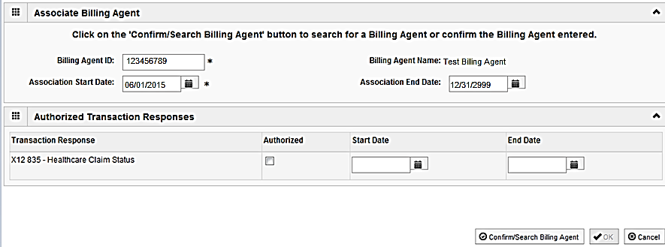
Step 7: Associate Billing Agent
Confirm the Billing Agent information populated correctly.
Click OK to return to the billing agent list.
Shortcut to Step:
1
2
3
4
5
6
7
8
9
10
11
12
13

Slide 40
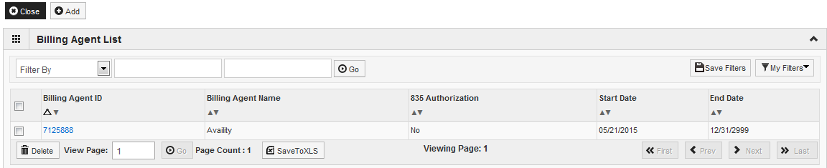
Step 7: Associate Billing Agent
To associate to additional Billing Agents not listed, click Add and repeat the previous steps.
When all billing agents have been entered, click Close to return to the BPW.
Shortcut to Step:
1
2
3
4
5
6
7
8
9
10
11
12
13

Slide 41
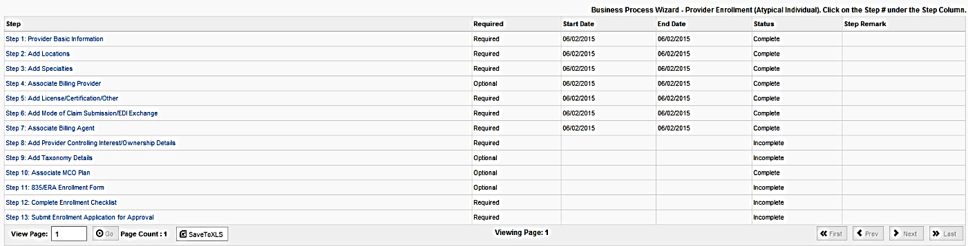
Business Process Wizard
You have completed Step 7: Associate Billing Agent. The system will place the current date in the End Date field and will place Complete in the corresponding Status field.
Click on Step 8: Add Provider Controlling Interest/Ownership Details to continue your application.
Shortcut to Step:
1
2
3
4
5
6
7
8
9
10
11
12
13

Slide 42
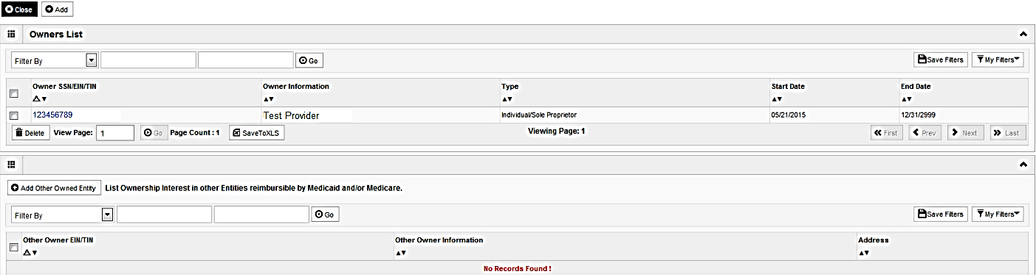
Step 8: Controlling Interest/Ownership
Ownership entries must include at least one Managing Employee and one other Ownership type.
To add Ownership listings, click on Add.
Shortcut to Step:
1
2
3
4
5
6
7
8
9
10
11
12
13
Notes:
*****Additional Ownerships may be required based on prior ownership types that are entered.******

Slide 43
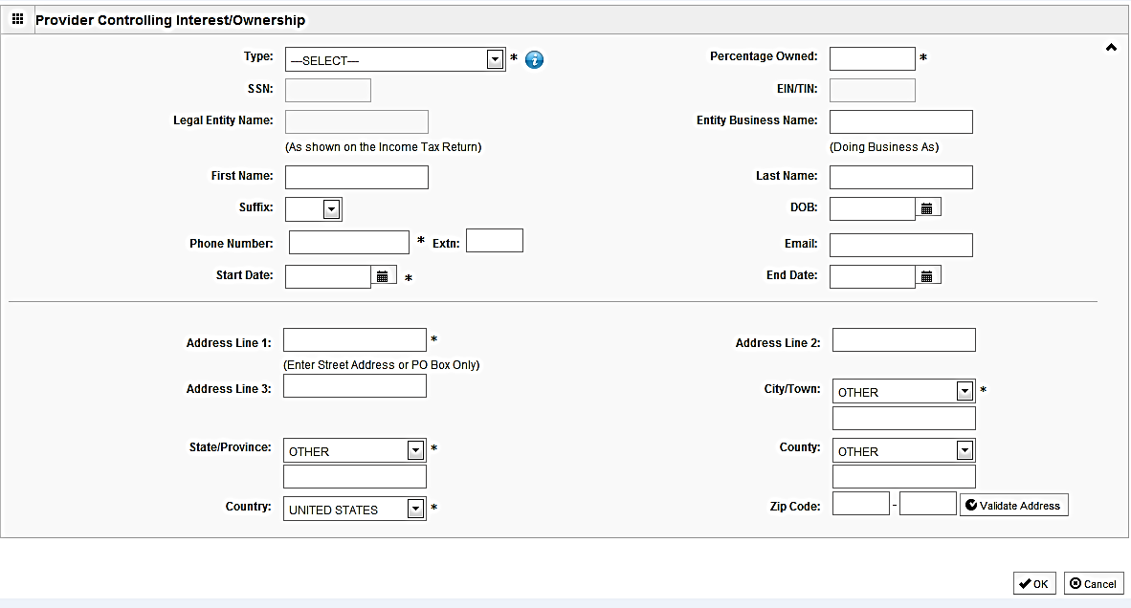
Step 8: Controlling Interest/Ownership
or
Either your SSN or EIN/TIN must be entered.
Enter Percentage Owned as a whole number.
Enter the street address and zip code information, then click Validate Address.
When all details are entered, click OK.
Shortcut to Step:
1
2
3
4
5
6
7
8
9
10
11
12
13

Slide 44
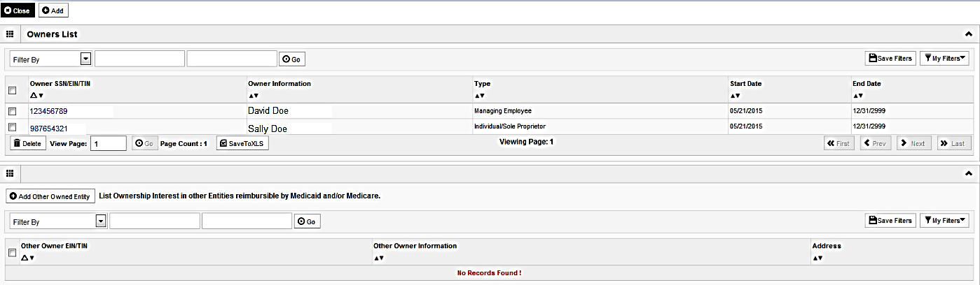
Step 8: Controlling Interest/Ownership
To list additional owners, click Add and repeat the previous steps.
After all ownerships have been listed, click the hyperlink for each Owner listed to specify the relationship between each owner and to complete the Legal Disclosure.
Shortcut to Step:
1
2
3
4
5
6
7
8
9
10
11
12
13

Slide 45
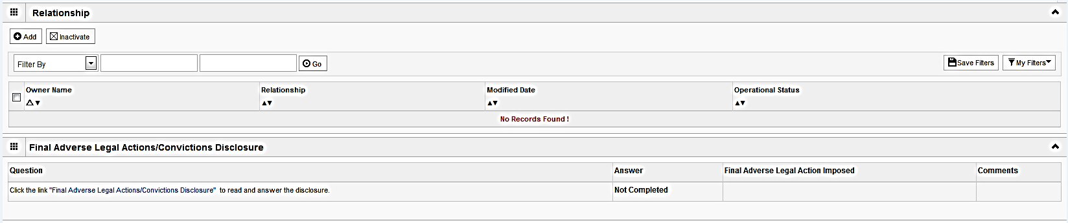
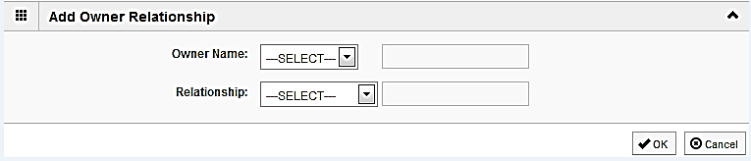
Step 8: Controlling Interest/Ownership
Scroll down the page to the relationship section then, click Add.
From the first drop down list of Owner Name, choose an owner name.
From the second drop down list of Relationships, choose how the chosen owner is related to the listed owner.
Repeat this step until the relationship has been set for each listed owner.
When completed, click OK to return to the ownership listing.
Shortcut to Step:
1
2
3
4
5
6
7
8
9
10
11
12
13

Slide 46
Step 8: Controlling Interest/Ownership
Scroll down to the Final Adverse Legal Action/Conviction History section.
Click on the hyperlink Final Adverse Legal Action/Conviction History.
Shortcut to Step:
1
2
3
4
5
6
7
8
9
10
11
12
13

Slide 47
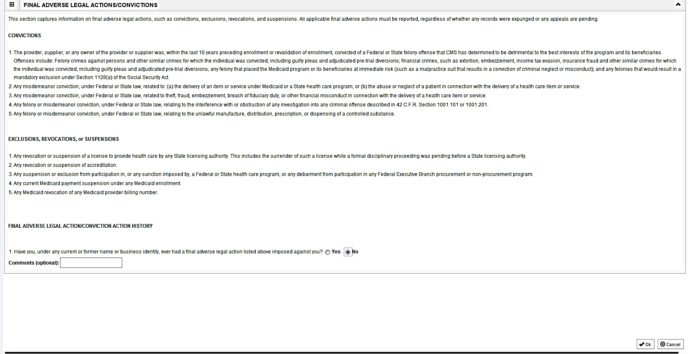
Step 8: Controlling Interest/Ownership
With regards to the chosen ownership, answer the listed question and enter comments if desired.
Click OK when completed.
Repeat for each listed ownership.
Shortcut to Step:
1
2
3
4
5
6
7
8
9
10
11
12
13

Slide 48
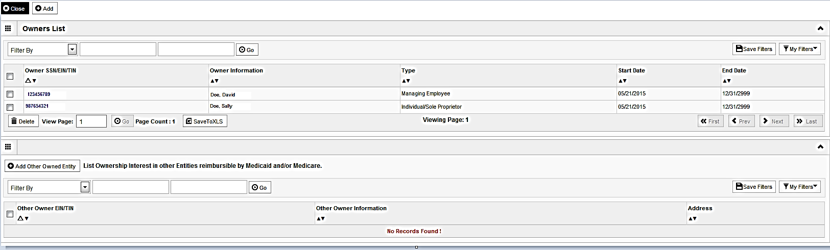
Step 8: Controlling Interest/Ownership
It is required that ownership of 5% or more in any other Medicaid/Medicare entity be entered.
To enter Ownership details in another Medicaid/Medicare Entity, click on Add Other Owned Entity.
Shortcut to Step:
1
2
3
4
5
6
7
8
9
10
11
12
13

Slide 49
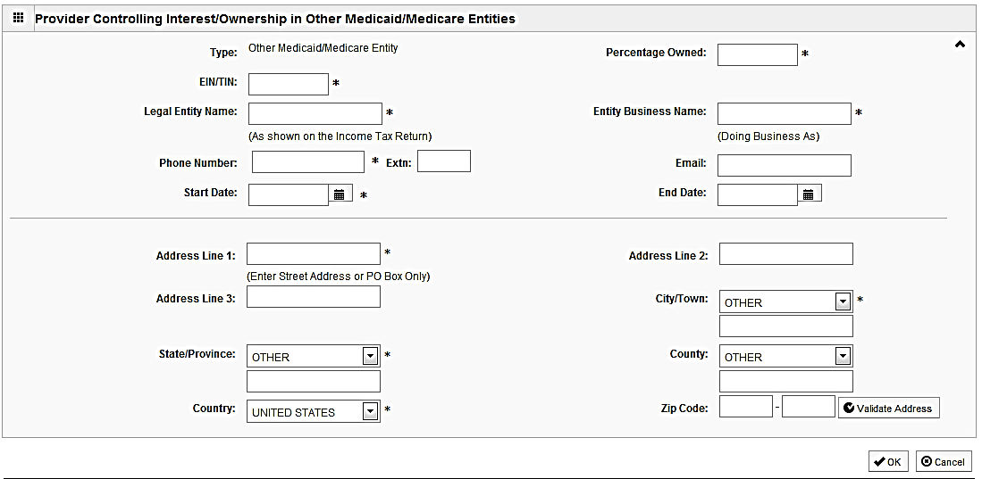
Step 8: Controlling Interest/Ownership
Please complete all fields. At a minimum, all fields with an * are required.
After entering the street address and zip code, click Validate Address.
When all information is complete, click OK.
Repeat these steps to add ownership in another Medicaid/Medicare Entity.
Shortcut to Step:
1
2
3
4
5
6
7
8
9
10
11
12
13

Slide 50
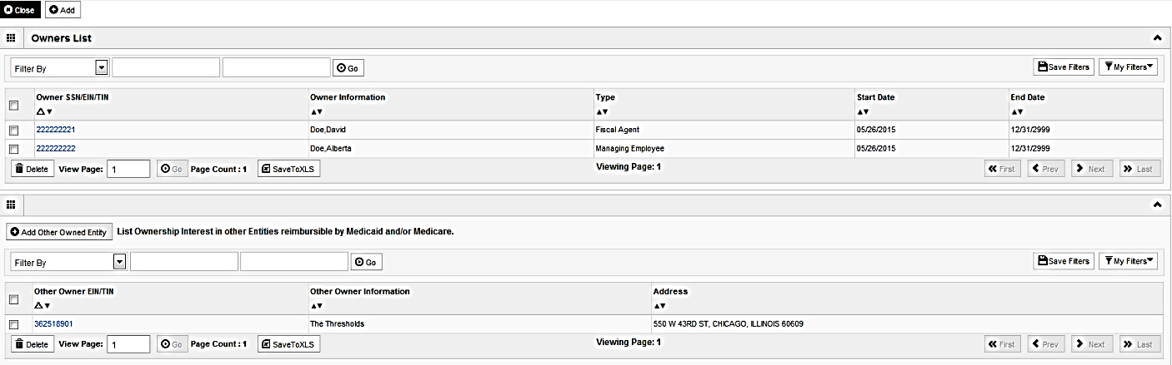
Step 8: Controlling Interest/Ownership
When all ownerships for this location and ownership information in other entities is complete, click Close.
Shortcut to Step:
1
2
3
4
5
6
7
8
9
10
11
12
13

Slide 51
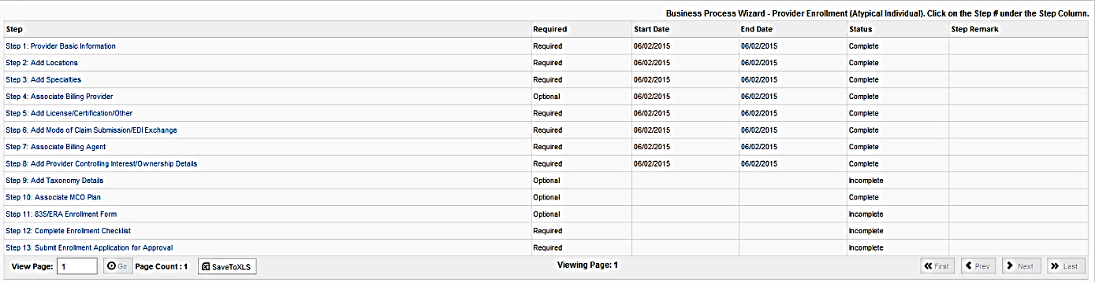
Business Process Wizard
You have completed Step 8: Add Provider Controlling Interest. The system will place the current date in the End Date field and will place Complete in the corresponding Status field.
Click on Step 9: Add Taxonomy Details to continue your application.
Shortcut to Step:
1
2
3
4
5
6
7
8
9
10
11
12
13
Notes:
Provide link to taxonomy code definition

Slide 52
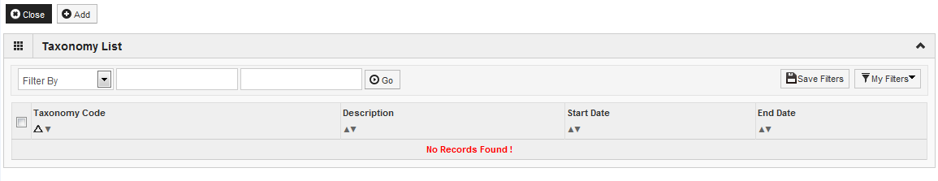
Step 9: Add Taxonomy Details
To enter Taxonomy Details click on Add.
Shortcut to Step:
1
2
3
4
5
6
7
8
9
10
11
12
13

Slide 53
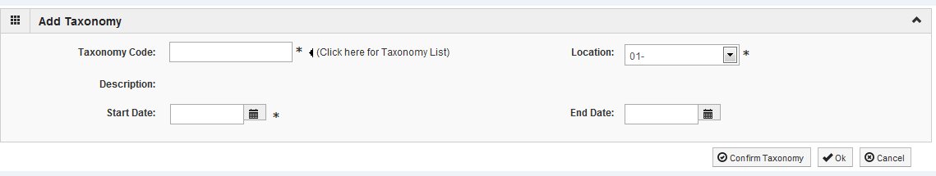
Step 9: Add Taxonomy Details
To add new Taxonomy Details, enter the Taxonomy Code and the Start Date.
Leave the End Date field blank.
Click on Confirm Taxonomy and verify Description is populated correctly.
Click on OK to finalize the submission.
Shortcut to Step:
1
2
3
4
5
6
7
8
9
10
11
12
13

Slide 54
Step 9: Add Taxonomy Details
If code is not known, click on the t to the right of the box to access The National Uniform Claim Committee Taxonomy Code list. This will open a web browser window.
At least one of the Taxonomy Codes entered in IMPACT must be the Taxonomy Code registered with the National Plan and Provider Enumeration System (NPPES).
Shortcut to Step:
1
2
3
4
5
6
7
8
9
10
11
12
13

Slide 55
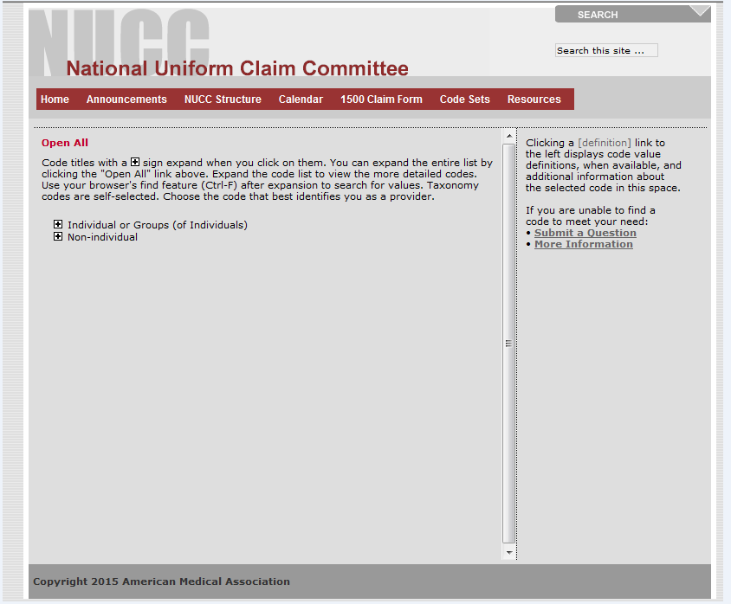
Step 9: Add Taxonomy Details
In the web browser window that opens will be a list of provider types.
Click + next to the appropriate provider type for your enrollment.
Shortcut to Step:
1
2
3
4
5
6
7
8
9
10
11
12
13

Slide 56
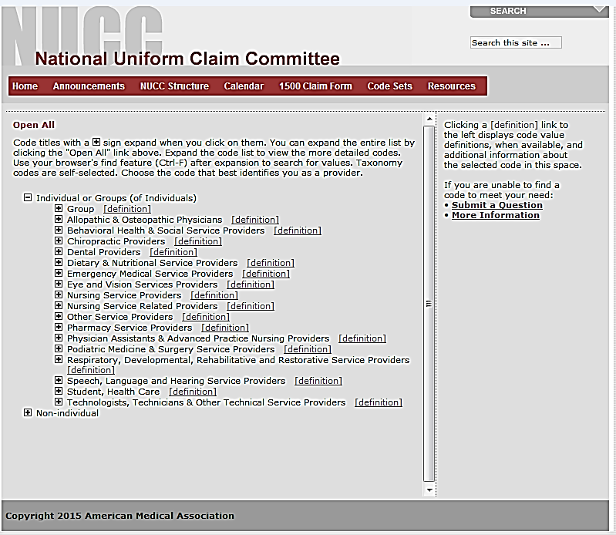
Step 9: Add Taxonomy Details
Click on the + next to the appropriate profession listed under the heading which you previously selected.
Shortcut to Step:
1
2
3
4
5
6
7
8
9
10
11
12
13

Slide 57
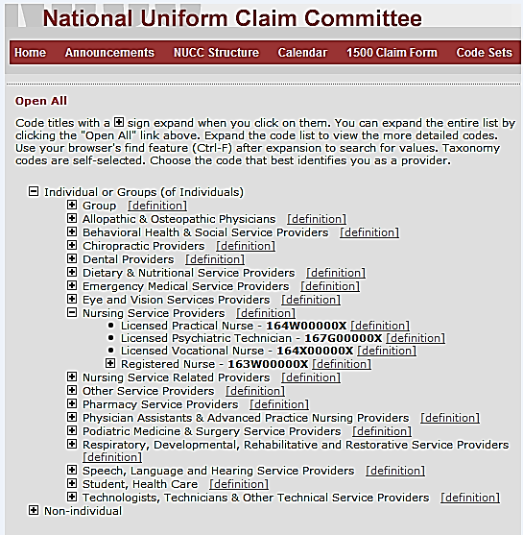
Step 9: Add Taxonomy Details
Click on the + next to the appropriate profession listed under the heading which you previously selected.
Make a note of the Taxonomy Code that is correct for your area of practice.
Click on the X button in the upper right corner to close the National Uniform Claim Committee webpage.
Shortcut to Step:
1
2
3
4
5
6
7
8
9
10
11
12
13

Slide 58
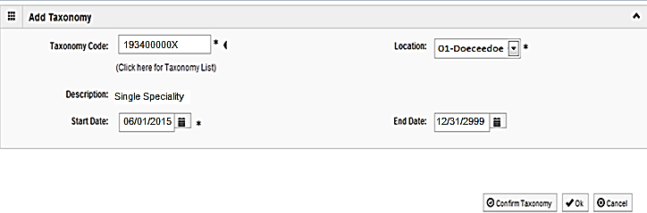
Step 9: Add Taxonomy Details
Enter the Taxonomy Code and the Start Date.
Leave the End Date field blank.
Click on Confirm Taxonomy and verify Description is populated correctly.
Click on OK to finalize the submission.
Shortcut to Step:
1
2
3
4
5
6
7
8
9
10
11
12
13

Slide 59

Step 9: Add Taxonomy Details
Repeat the steps by clicking on the Add button for any additional Taxonomy Codes that need to be entered.
Otherwise, click on the Close button in the upper left corner.
Shortcut to Step:
1
2
3
4
5
6
7
8
9
10
11
12
13

Slide 60

Business Process Wizard
You have completed Step 9: Add Taxonomy Details. The system will place the current date in the End Date field and will place Complete in the corresponding Status field.
Click on Step 10: Associate MCO Plan to continue your application.
Shortcut to Step:
1
2
3
4
5
6
7
8
9
10
11
12
13

Slide 61

Step 10: Associate MCO Plan
Click Add to associate a MCO plan for which there is a current valid contract.
Specific MCO plans can be added only once to the application.
Shortcut to Step:
1
2
3
4
5
6
7
8
9
10
11
12
13

Slide 62

Step 10: Associate MCO Plan
*
*
Enter a Plan ID and Association Start Date.
Leave the End Date field blank.
Click Confirm/Search Plan, verify the Plan Name is correct then, click OK.
If the MCO plan ID is not known, click on Confirm/Search Plan.
Shortcut to Step:
1
2
3
4
5
6
7
8
9
10
11
12
13

Slide 63

Step 10: Associate MCO Plan
Use the Filter By drop down and enter information to filter the list of available MCO plans.
After locating the desired plan, click on the checkbox next to that line.
Click Select to return to the MCO summary screen.
Shortcut to Step:
1
2
3
4
5
6
7
8
9
10
11
12
13

Slide 64

Step 10: Associate MCO Plan
Verify that the MCO plan information populated correctly then click OK.
Shortcut to Step:
1
2
3
4
5
6
7
8
9
10
11
12
13

Slide 65

Step 10: Associate MCO Plan
Click Add to Associate to an additional MCO Plan.
If all MCO Plans have been entered, click Close to return to the BPW.
Shortcut to Step:
1
2
3
4
5
6
7
8
9
10
11
12
13

Slide 66

Business Process Wizard
You have completed Step 10: Associate MCO Plan . The system will place the current date in the End Date field and will place Complete in the corresponding Status field.
Click on Step 11: 835/ERA Enrollment Form to continue your application.
Shortcut to Step:
1
2
3
4
5
6
7
8
9
10
11
12
13

Slide 67

Step 11: Complete 835/ERA
Please complete this section once you have completed the enrollment steps found at http://www.myhfs.illinois.gov/ if you wish to participate in 835/ERA, otherwise close this step.
Scroll down the page and verify/update the listed information and complete any additional fields.
Shortcut to Step:
1
2
3
4
5
6
7
8
9
10
11
12
13

Slide 68

Step 11: Complete 835/ERA
Select your method of retrieval from the drop-down menu.
Shortcut to Step:
1
2
3
4
5
6
7
8
9
10
11
12
13

Slide 69

Step 11: Complete 835/ERA
Check the box next to the agreement statement and the signature portion will be populated.
Once all fields are complete, click Submit, then Close at the top of the page.
Shortcut to Step:
1
2
3
4
5
6
7
8
9
10
11
12
13

Slide 70

Business Process Wizard
You have completed Step 11: 835/ERA Enrollment Form. The system will place the current date in the End Date field and will place Complete in the corresponding Status field.
Click on Step 12: Complete Enrollment Checklist to continue your application.
Shortcut to Step:
1
2
3
4
5
6
7
8
9
10
11
12
13

Slide 71

Step : Associate Billing Agent
Step 12: Complete Enrollment Checklist
All questions must be answered either Yes or No and comments made if directed to do so, if a checklist item does not apply, select No as the answer.
After all of the questions have been answered and comments made, click on the Save button in the upper left corner followed by clicking on the Close button.
Shortcut to Step:
1
2
3
4
5
6
7
8
9
10
11
12
13

Slide 72

Step : Associate Billing Agent
Business Process Wizard
You have completed Step 12: Enrollment Checklist. The system will place the current date in the End Date field and will place Complete in the corresponding Status field.
Click on Step13: Submit Enrollment Application to Submit your application.
Shortcut to Step:
1
2
3
4
5
6
7
8
9
10
11
12
13

Slide 73

Step 13: Submit Enrollment for Approval
Click Next to confirm that all of the information that you have submitted as a part of the application is accurate.
Shortcut to Step:
1
2
3
4
5
6
7
8
9
10
11
12
13
Notes:
Source:

Slide 74

Step 13: Submit Enrollment for Approval
Read through all of the terms and conditions.
Check the box certifying that you agree to the terms and conditions.
Then select Submit Application.
Shortcut to Step:
1
2
3
4
5
6
7
8
9
10
11
12
13
Notes:
Source:

Slide 75

Business Process Wizard
The message above will pop up and advise that the application has been submitted for review. Click on OK.
Shortcut to Step:
1
2
3
4
5
6
7
8
9
10
11
12
13
Notes:
Source:

Slide 76

Business Process Wizard
You have completed Step 13: Submit Enrollment Application for Approval.
Shortcut to Step:
1
2
3
4
5
6
7
8
9
10
11
12
13
Notes:
Source:

Slide 77
Resources
For more information regarding IMPACT, please visit
http://www.illinois.gov/hfs/impact/Pages/AboutIMPACT.aspx
Check out the definitions of common terms at http://www.illinois.gov/hfs/IMPACT/Pages/Glossary.aspx

Slide 78
Questions and Answers
FAQ’s can be found at http://www.illinois.gov/hfs/impact/Pages/faqs.aspx to help resolve common questions and problems when submitting applications.
General questions regarding IMPACT can be addressed to:
  Email: IMPACT.Help@Illinois.gov
  Phone: 1-877-782-5565
    Choose option 1 for IMPACT Help

