Slide 1

ILLINOIS PROVIDER ENROLLMENT
Creating an ILogin Account
for New External IMPACT Users
Notes:
.

Slide 2
Table of Contents
Glossary of Terms 3
Introduction to ILogin 4
Creating a New Account in ILogin 5
Activating the ILogin Account 8
Applying Multifactor Authentication Methods 11
IMPACT Identity Proofing 12
Accessing IMPACT Application 15
Starting IMPACT Enrollment 16
Contact Information 17

Slide 3
Glossary
Glossary of Terms
Chiclet – ILogin term for IMPACT component.
External User – A user whose ILogin User ID does not end with “@illinois.gov”.
HFS – Illinois Department of Healthcare and Family Services.
IMPACT – Illinois Medicaid Program Advanced Cloud Technology is a multi-agency effort to replace Illinois’ 30-year-old Medicaid Management Information System (MMIS).
MFA – Multifactor Authentication. Adds a layer of protection to the sign-in process. Users provide additional identity verification.
New Enrollment – A new provider who needs to enroll in IMPACT.

Slide 4
Introduction to ILogin
IMPACT Single Sign-On Migrates to new ILogin/IMPACT System
The Department of Healthcare and Family Services (HFS) is replacing the authentication and authorization tool used to establish the Single Sign-On account of the Illinois Medicaid Program Advanced Cloud Technology (IMPACT) System with ILogin.
ILogin adds additional layer of security and requires a Multi Factor Authentication (MFA) to access the IMPACT Account.
As a new external user to IMPACT, follow the step-by-step instructions to create a new account in ILogin, set-up Password Recovery options, establish Multifactor Authentication methods, complete IMPACT Identity Proofing and begin a new IMPACT enrollment.

Slide 5
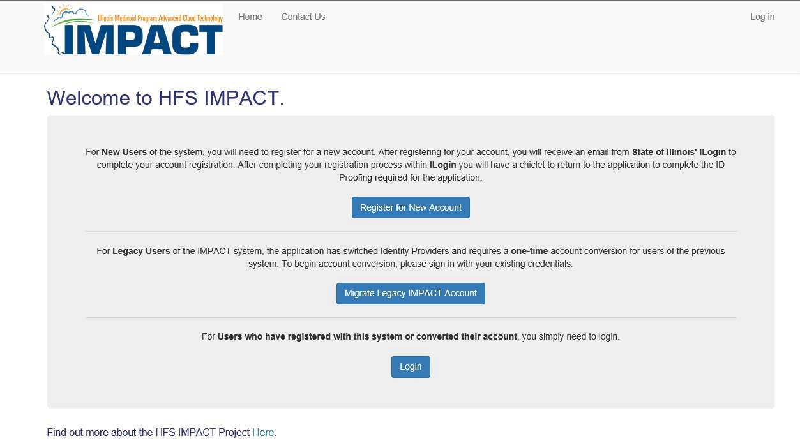
Step 1: Creating A New Account In ILogin
To start creating a new account, go to https://impact.illinois.gov.
Select the “Register for New Account” button.

Slide 6
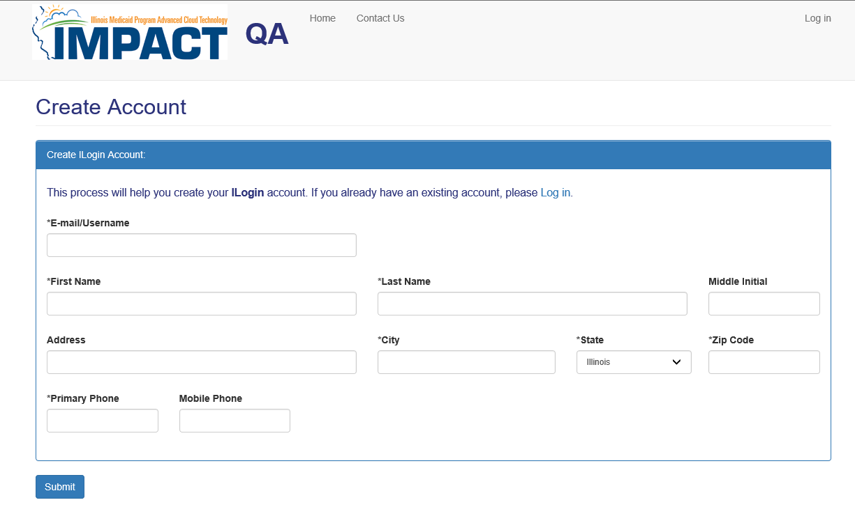

Step 1: Creating A New Account In ILogin
Complete the registration information and click on “Submit”.
The email/username will need to be unique within ILogin.

Slide 7
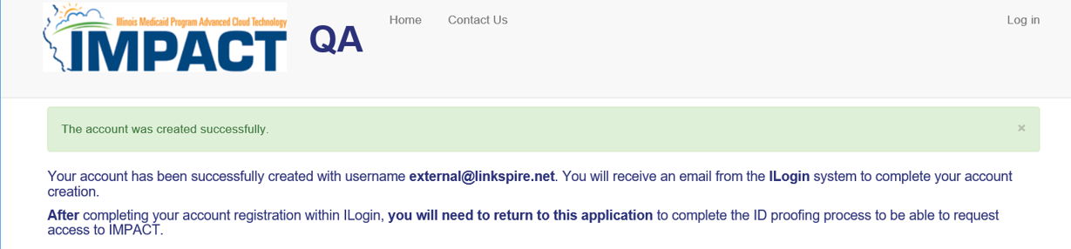
Step 1: Creating A New Account In ILogin
Once you have submitted your registration, you will see the following information indicating “The account was created successfully.”
You will also receive an activation email.

Slide 8
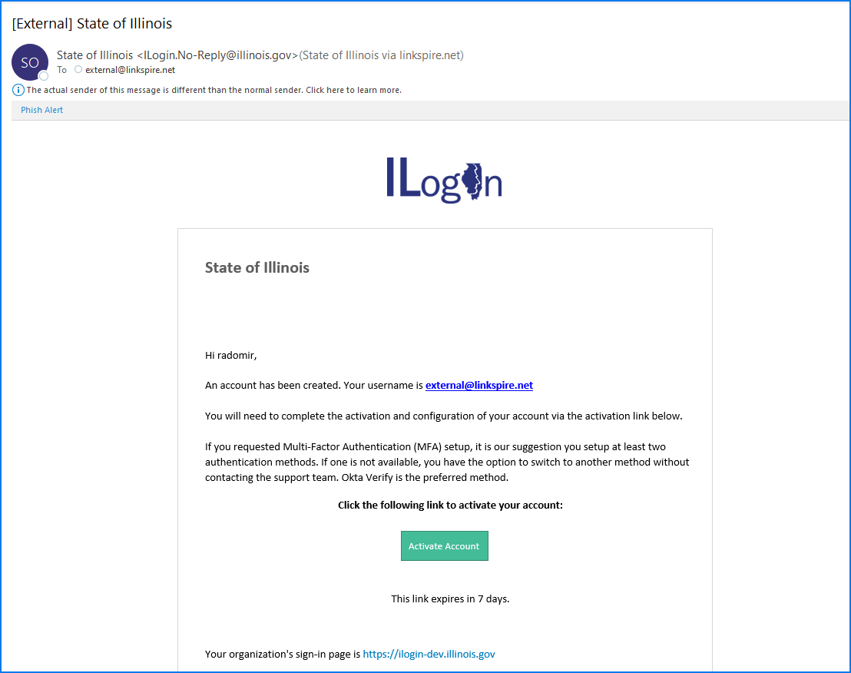
Step 2: Activating the ILogin Account
Once you receive the ILogin activation email, click on the Activate Account button. You will be directed to set up a password, security questions and options for password recovery.
Please Note: This link expires 7 days after you receive the email. Be sure to activate your account as soon as possible.

Slide 9
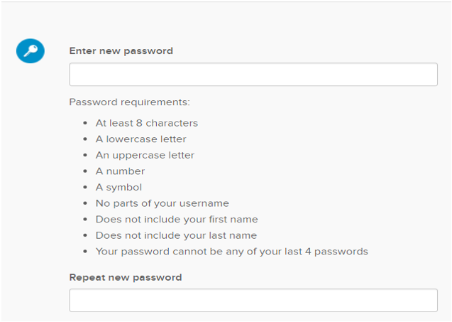
Step 2: Activating the ILogin Account
Create your password. Be sure to follow the password requirements listed below:

Slide 10
Step 2: Activating the ILogin Account
Password Recovery Options
Only presented when logging in to ILogin for the first time.
Complete at least ONE (1) Password Recovery Options.
Click on “Create My Account” to complete account activation.
To make a change to your Password Recovery Options, you can click on the ILogin “Settings” after creating your account.

Slide 11
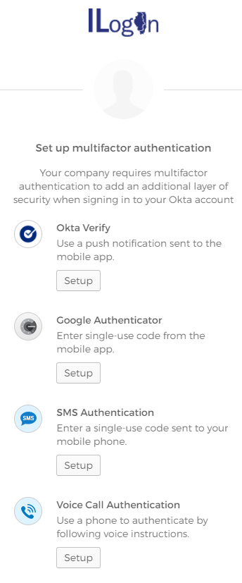
Step 3: Applying Multifactor Authentication Methods
Multifactor Authentication (MFA) Set Up
Only presented when logging in to ILogin for the first time.
You must complete at least ONE (1) Multifactor Authentication Methods.
It is recommended to setup multiple methods, so you have a back-up option if one method is not available to you.
Once MFA Methods is set up, click on the “Finish” button.

Slide 12
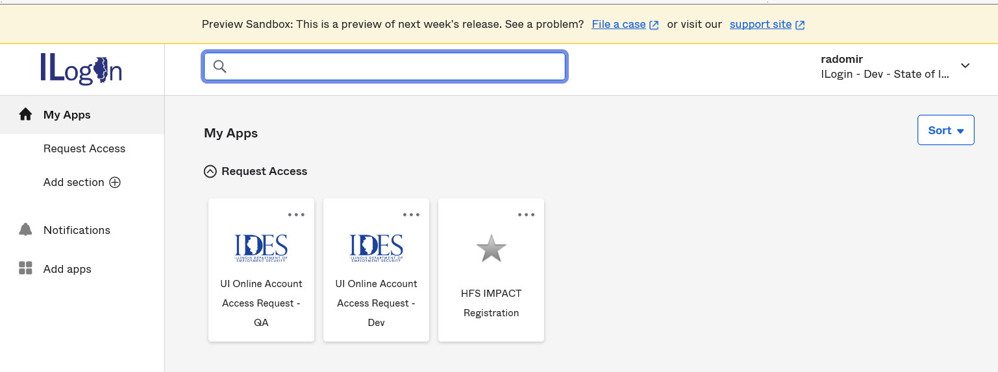

Step 4: IMPACT Identity Proofing
Welcome to the ILogin Dashboard. All the application chiclets that you are authorized to use will appear here. Click on the “HFS IMPACT Registration” chiclet to begin the Identity
Proofing process.

Slide 13
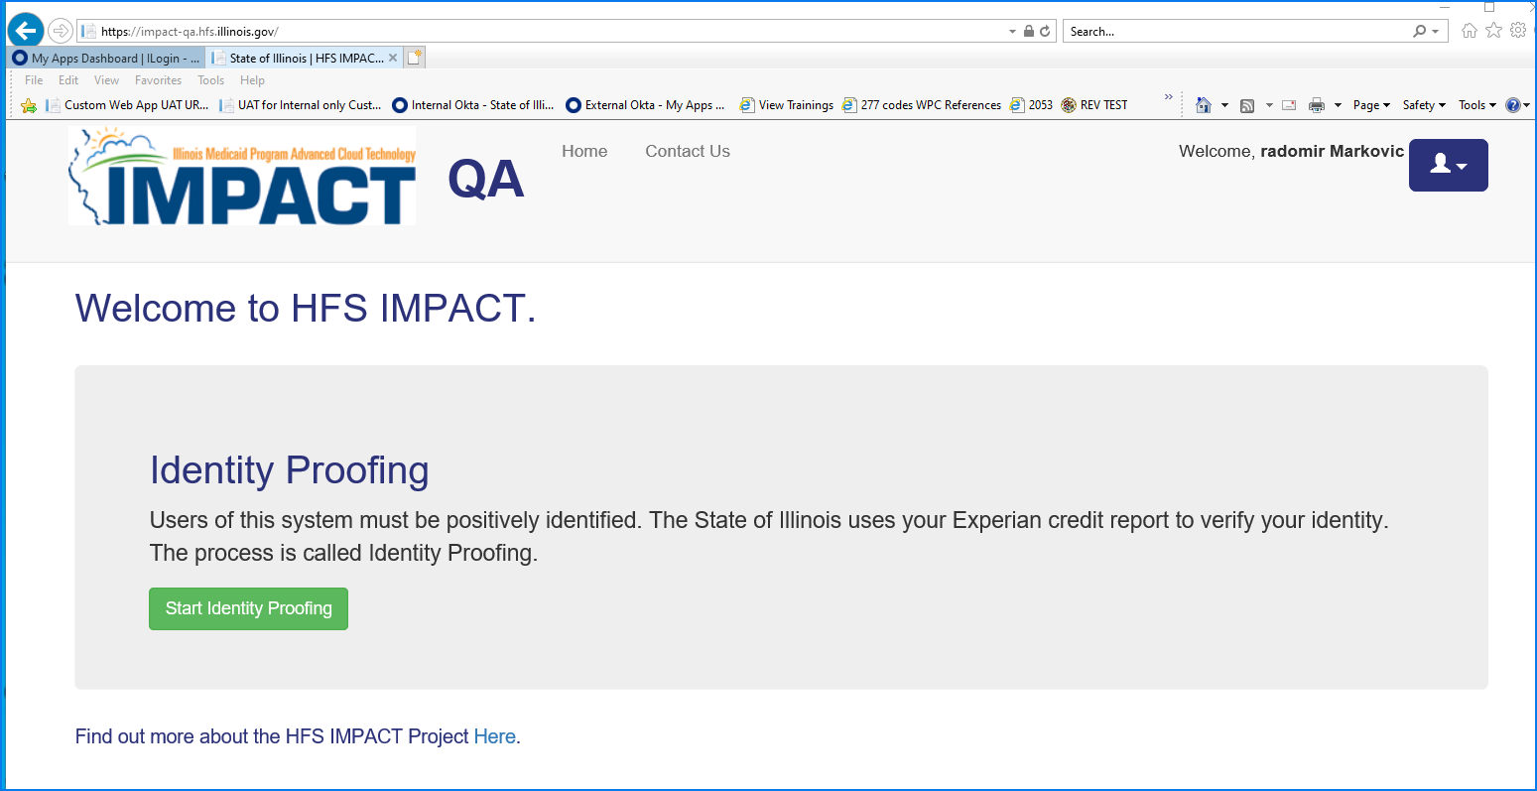
Step 4: IMPACT Identity Proofing
Click on “Start Identity Proofing” button.

Slide 14
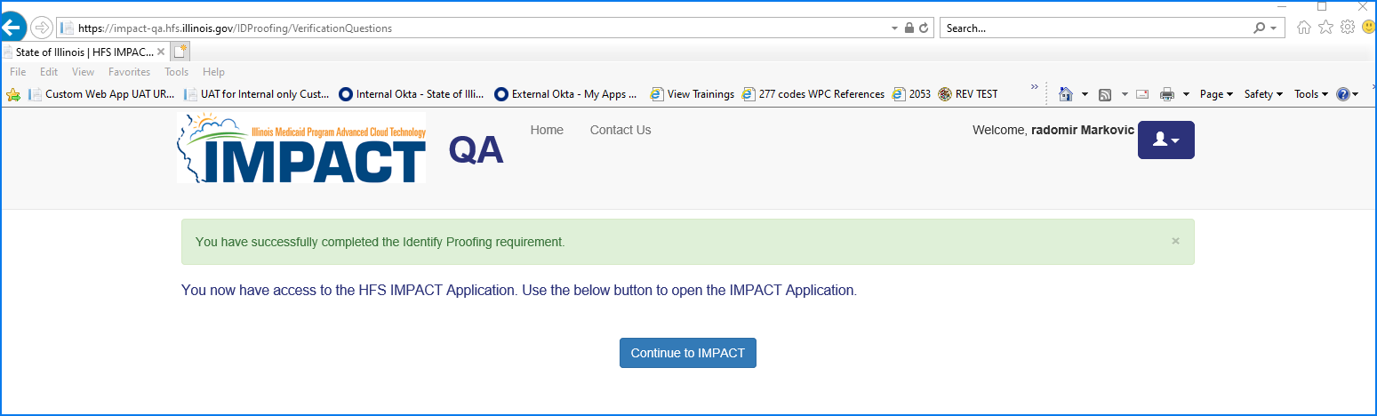
Step 4: IMPACT Identity Proofing
You have successfully completed the IMPACT Identity Proofing step. Click on the “Continue to IMPACT” button.

Slide 15
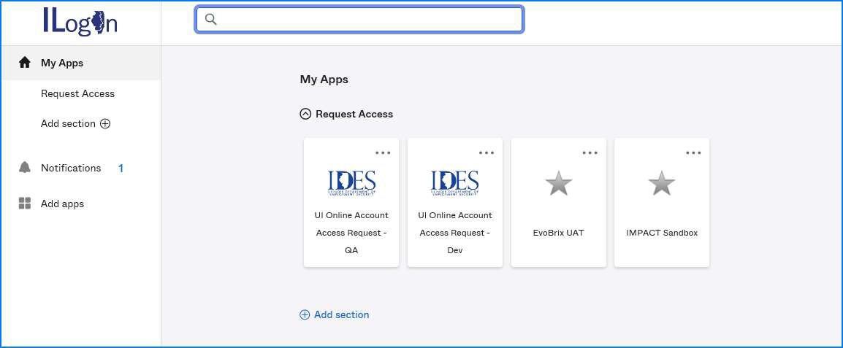

Step 5: Accessing IMPACT Application
Click on the IMPACT chiclet to launch application.

Slide 16
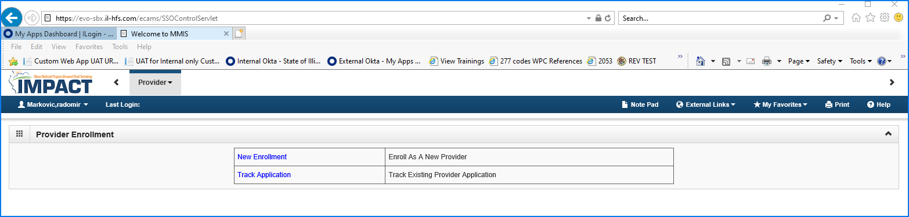
Step 6: Starting IMPACT Enrollment
As a new IMPACT user, you can click on New Enrollment to enroll as a new provider.

Slide 17
Contact Information
Contact Information
Issues with logging in (Locked account or other related issues)
IMPACT Login Helpdesk
1-888-618-8078
IMPACT.Login@Illinois.gov
Issues with ILogin User accounts
DoIT.Okta.Support@illinois.gov
Issues with IMPACT Provider Enrollment – Provider Enrollment Helpdesk
1-877-782-5565
IMPACT.Help@illinois.gov

