Slide 1

ILLINOIS PROVIDER ENROLLMENT
Creating an ILogin Account
for Existing External IMPACT Users
Notes:
.

Slide 2
Table of Contents
Glossary of Terms 3
Introduction to ILogin 4
Converting Existing IMPACT Account 5
Activating the ILogin Account 8
Applying Multifactor Authentication Methods 12
Accessing IMPACT Application 13
Contact Information 16

Slide 3
Glossary
Glossary of Terms
Chiclet – ILogin term for IMPACT component.
Existing External User – A user with an existing IMPACT account whose ILogin User ID does not end with “@illinois.gov”.
HFS – Illinois Department of Healthcare and Family Services.
IMPACT – Illinois Medicaid Program Advanced Cloud Technology is a multi-agency effort to replace Illinois’ 30-year-old Medicaid Management Information System (MMIS).
MFA – Multifactor Authentication. Adds a layer of protection to the sign-in process. Users provide additional identity verification.
New Enrollment – A new provider who needs to enroll in IMPACT.

Slide 4
Introduction to ILogin
IMPACT Single Sign-On Migrates to new ILogin/IMPACT System
The Department of Healthcare and Family Services (HFS) is replacing the authentication and authorization tool used to establish the Single Sign-On account of the Illinois Medicaid Program Advanced Cloud Technology (IMPACT) System with ILogin.
ILogin adds additional layer of security and requires a Multi Factor Authentication (MFA) to access the IMPACT Account.
As an existing external user to IMPACT, you must convert your existing account to an ILogin account. Follow the step-by-step instructions to establish your account in ILogin, set-up Password Recovery options, establish Multifactor Authentication methods and access your IMPACT enrollment.

Slide 5
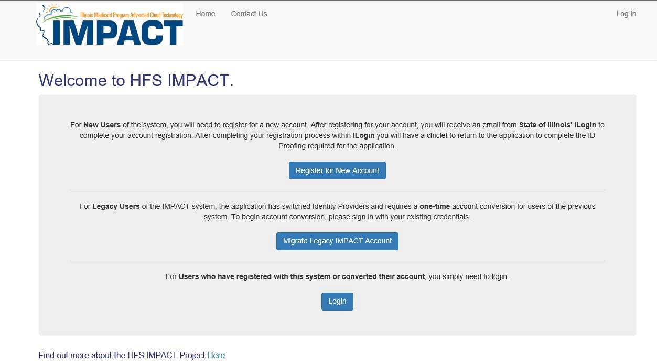
Step 1: Converting Existing IMPACT Account
To convert your existing account, go to https://impact.illinois.gov.
Select the “Migrate Legacy IMPACT Account” button.

Slide 6
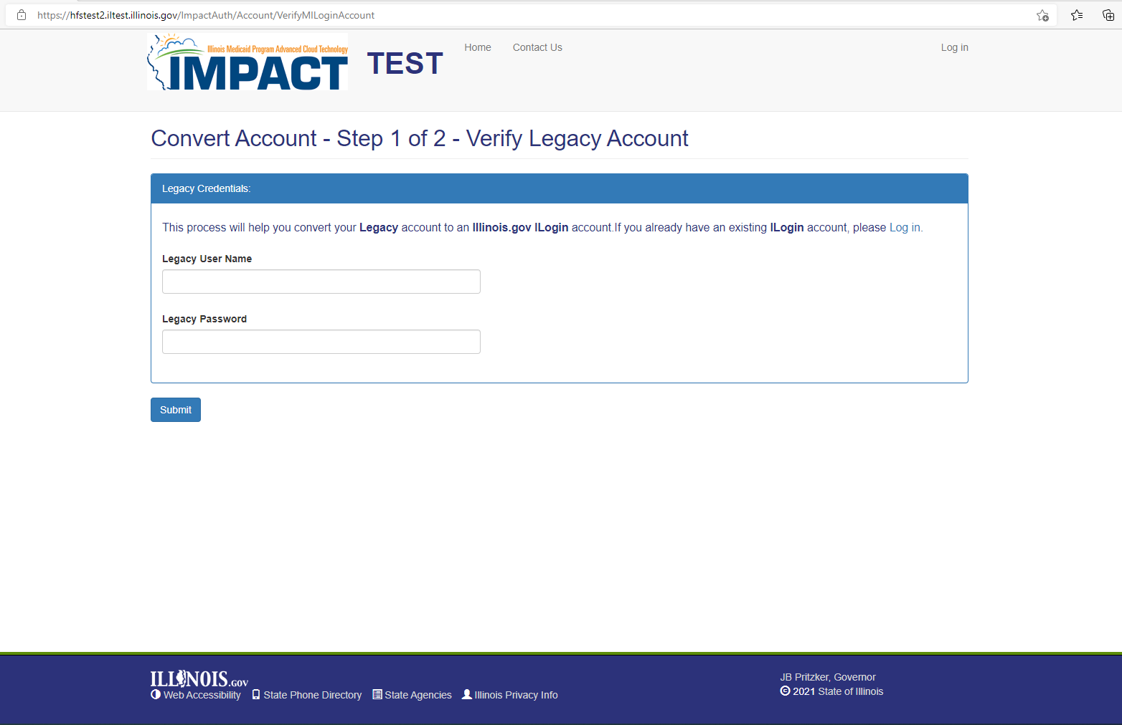

Step 1: Converting Existing IMPACT Account
Enter your existing IMPACT username and password.
Click “Submit.”

Slide 7
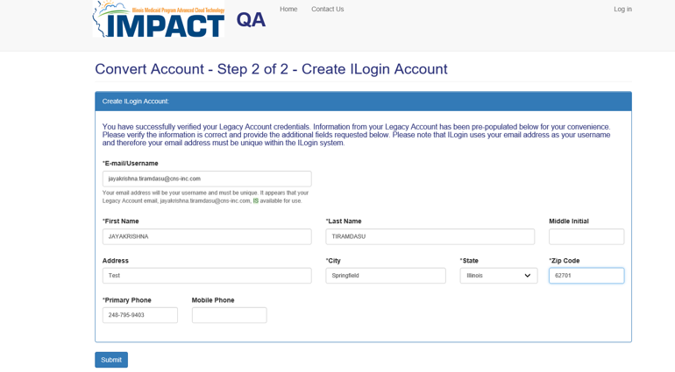
Step 1: Converting Existing IMPACT Account
Your existing IMPACT account information will be pre-populated for review. Verify the information is accurate and make any necessary changes as needed. The email/username will need to be unique within ILogin.
Click “Submit” to create your ILogin account.

Slide 8
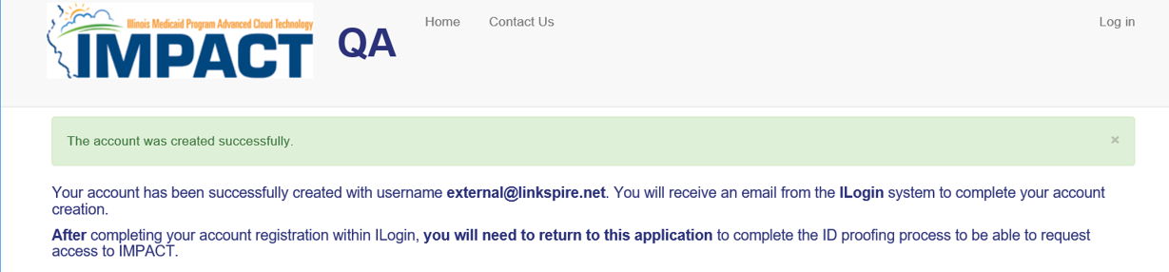
Step 2: Activating the ILogin Account
Once you have submitted your registration, you will see the following information indicating “The account was created successfully.”
You will also receive an activation email.

Slide 9
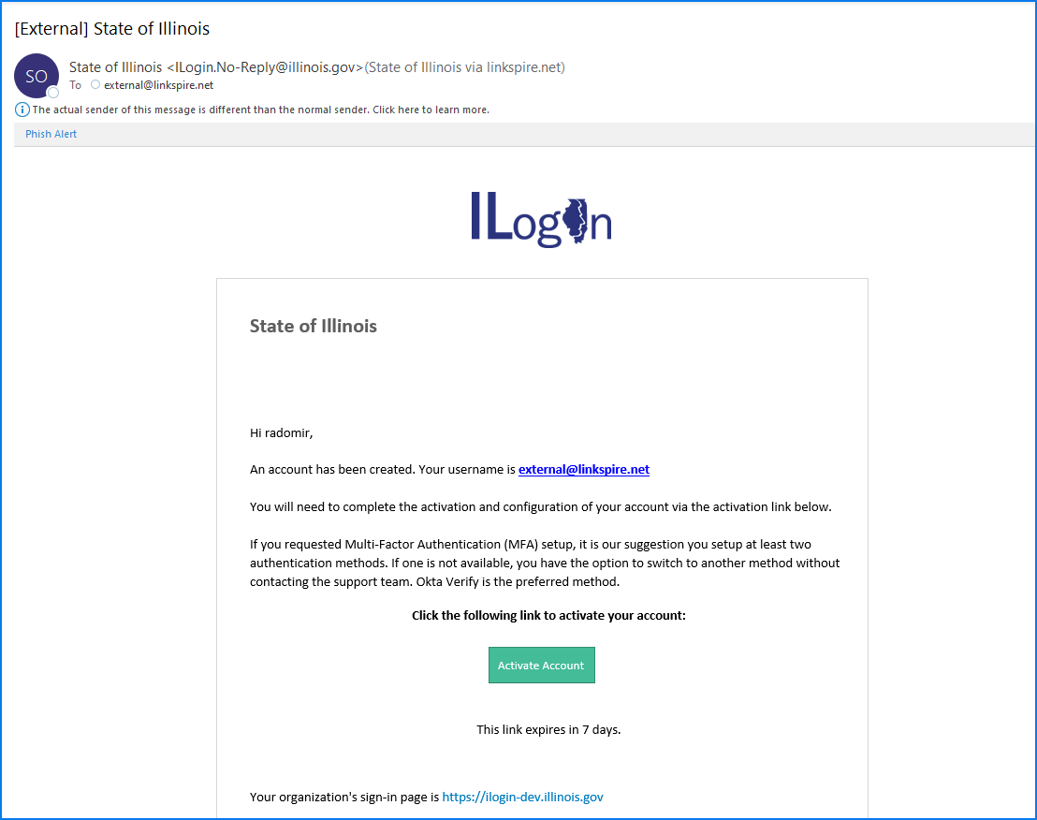
Step 2: Activating the ILogin Account
Click on the Activate Account button of the ILogin activation email. You will be directed to set up a password, security questions and options for password recovery.
Please Note: This link expires 7 days after you receive the email. Be sure to activate your account as soon as possible.

Slide 10
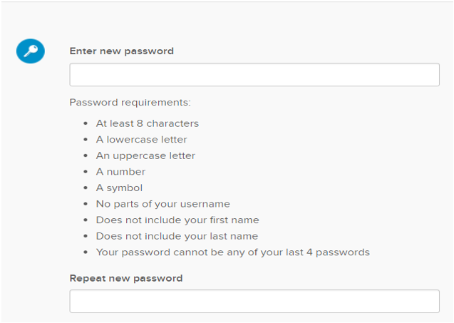
Step 2: Activating the ILogin Account
Create your password. Be sure to follow the password requirements listed below:

Slide 11
Step 2: Activating the ILogin Account
Password Recovery Options
Only presented when logging in to ILogin for the first time.
Complete at least ONE (1) Password Recovery Options.
Click on “Create My Account” to complete account activation.
To make a change to your Password Recovery Options, you can click on the ILogin “Settings” after creating your account.

Slide 12
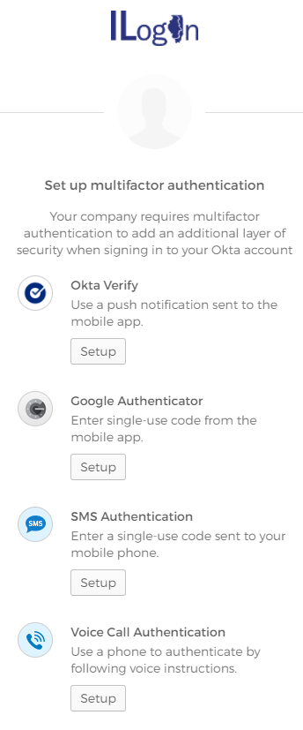
Step 3: Applying Multifactor Authentication Methods
Multifactor Authentication (MFA) Set Up
Only presented when logging in to ILogin for the first time.
You must complete at least ONE (1) Multifactor Authentication Methods.
It is recommended to setup multiple methods, so you have a back-up option if one method is not available to you.
Once MFA Methods is set up, click on the “Finish” button.

Slide 13
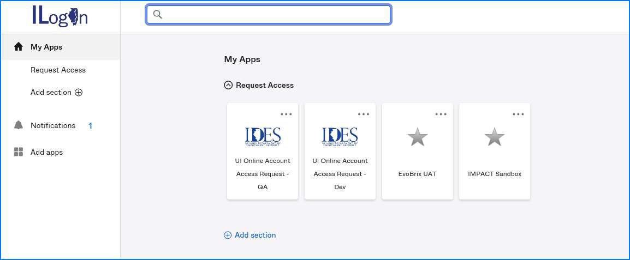



Step 4: Accessing IMPACT Application
Welcome to the ILogin Dashboard. All the application chiclets that you are authorized to use will appear here. Click on the “IMPACT” chiclet.

Slide 14
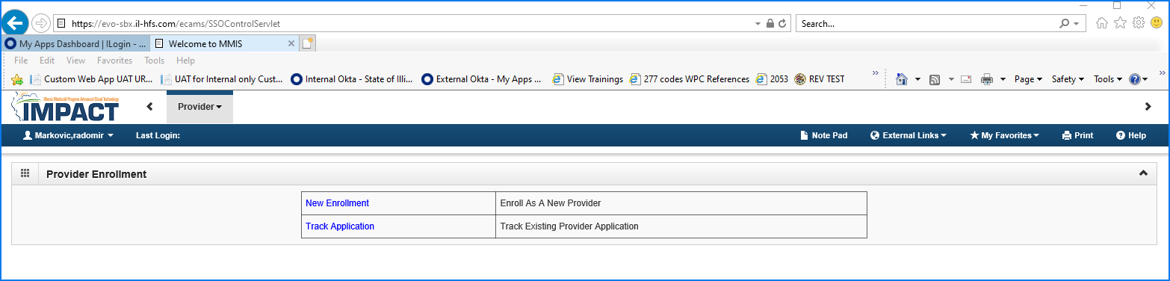
Step 4: Accessing IMPACT Application
If an IMPACT enrollment has not been submitted, you will see the screen below.
Select New Enrollment to enroll as a New Provider.
Select Track Application to track an existing enrollment application.

Slide 15
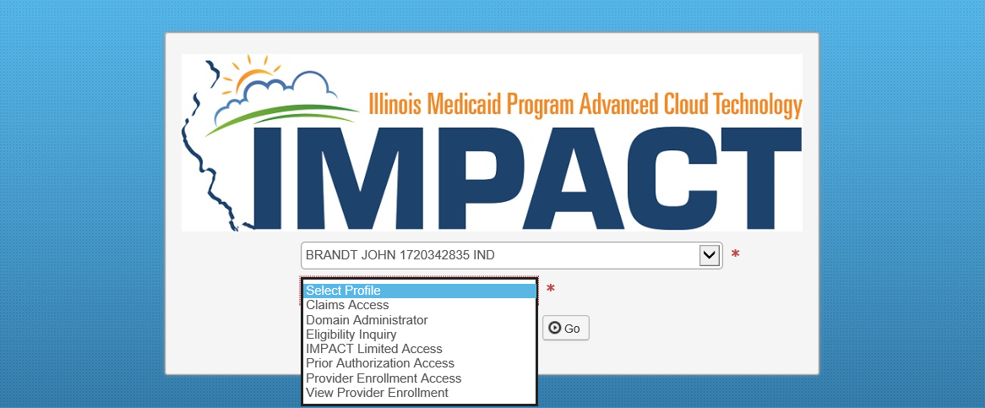
Step 4: Accessing IMPACT Application
If an IMPACT enrollment has been submitted and approved, you will see the screen below.
Select the relevant Profile from the drop-down to access the enrollment.

Slide 16
Contact Information
Contact Information
Issues with logging in (Locked account or other related issues)
IMPACT Login Helpdesk
1-888-618-8078
IMPACT.Login@Illinois.gov
Issues with ILogin User accounts
DoIT.Okta.Support@illinois.gov
Issues with IMPACT Provider Enrollment – Provider Enrollment Helpdesk
1-877-782-5565
IMPACT.Help@illinois.gov

