Slide 1

ILLINOIS PROVIDER ENROLLMENT
Groups

Slide 2
Agenda
Introduction to IMPACT and Key Terms
Application Process
Resuming an Application
Starting a New Application
The Business Process Wizard (BPW)
Completing the Application using BPW
Reviewing Submitted Application
Resources
Questions & Answers
Notes:
.

Slide 3
Introduction and Key Terms
IMPACT is a multi-agency effort to replace Illinois’ 30-year-old Medicaid Management Information System (MMIS) with a web-based system that meets federal requirements, is more convenient for providers and increases efficiency by automating and expediting state agency processes.
Key Terms:
  Group: An organization of individual providers that provide medical or dental services. A type 2 NPI is required and group licensing is not.
  New Enrollment: A Group provider who needs to enroll in the IMPACT system.
  Billing Agent: An agent who submits Medicaid HIPAA compliant transactions or exchanges EPHI with Medicaid providers or other authorized parties. Also known as Clearing House, Software Vendor or Value Added Network (VAN).
  MCO Plan: A health care provider who provides health care through a provider network. In addition, sister agencies will also be listed as an MCO plan. A sister agency is also known as a State Agency or a Waiver Provider.
    NOTE: A Group must be enrolled in IMPACT in order for a provider to associate with them.

Slide 4
Application Process
Step 1: Provider Basic Information
Step 2: Add Locations
Step 3: Add Specialties
Step 4: Add Associate Billing Provider/Other Associations
Step 5: Mode of Claim Submission/EDI Exchange
Step 6: Associate Billing Agent
Step 7: Add Provider Controlling Interest/Ownership Details
Step 8: Add Taxonomy Details
Step 9: Associate MCO Plan
Step 10: 835/ERA Enrollment Form
Pressing this button on any screen will bring you back to this menu.
Step 11: Complete Enrollment Checklist
Step 12: Submit Enrollment Application for Approval
Pressing any of the buttons below will skip to that step of the presentation
Shortcut to Step:
1
2
3
4
5
6
7
8
9
10
11

Slide 5
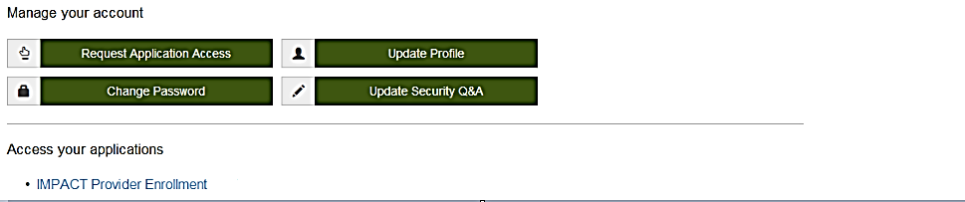
Start New Application
After completing the sign-on, click on IMPACT Provider Enrollment.
In regards to completing an application, there are two options: New Enrollment or Resuming an application.
Shortcut to Step:
1
2
3
4
5
6
7
8
9
10
11
Notes:
******Turn off pop-up blocker in order to access the IMPACT enrollment processes.*****

Slide 6
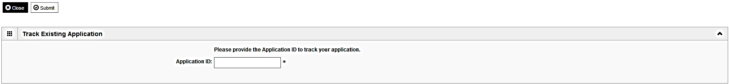
Start New Application
To resume (or revalidate) an application, click on Track Application.
The application number was either mailed out on a yellow card (revalidation) or sent to the listed email address (In-process application).
Enter the Application ID for the application you want to access.
After entering the ID number, click Submit.
This process will then go directly to the Business Process Wizard (BPW).
Shortcut to Step:
1
2
3
4
5
6
7
8
9
10
11

Slide 7
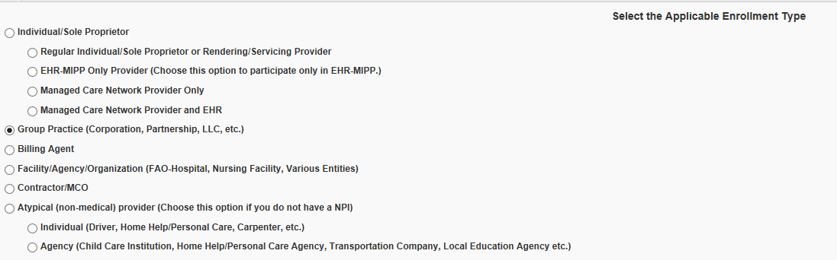
Start New Application
If completing a new application, click on New Enrollment.
Use the radio buttons to select your enrollment type, then click on Submit in the lower left corner.
Shortcut to Step:
1
2
3
4
5
6
7
8
9
10
11

Slide 8
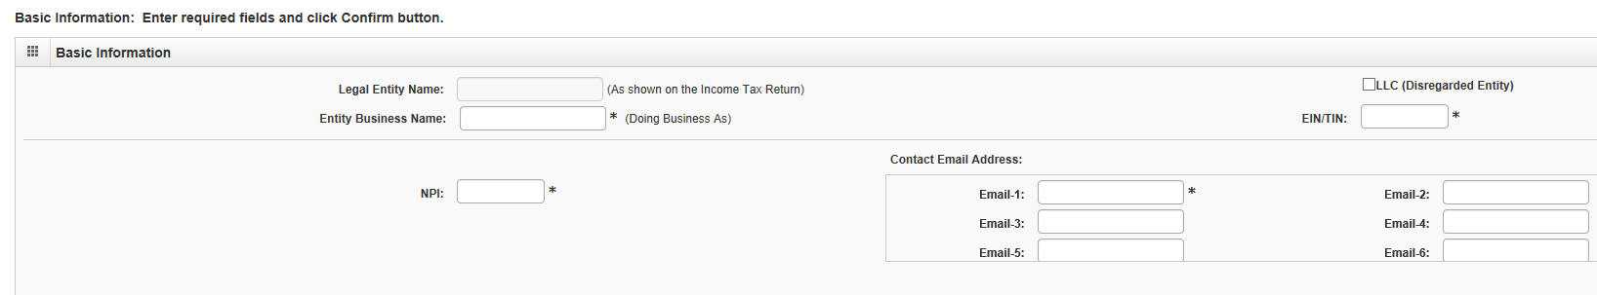
Start New Application
Step 1: Basic Provider Information
Please complete all fields. At a minimum, all fields with an * are required.
After all the information has been entered click Confirm.
Click Finish in the bottom right corner to complete this step.
Shortcut to Step:
1
2
3
4
5
6
7
8
9
10
11
Notes:
******EIN/TIN must be registered with Illinois Comptroller to be able to complete this step.*****

Slide 9
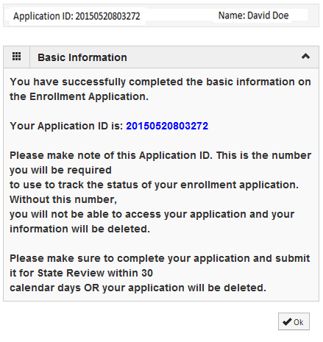
Start New Application
Step 1: Basic Provider Information
Application ID: systematically generated.
Name: should reflect name from the Basic Information screen.
The system will generate an application ID after the successful completion of the Basic Information screen; the application ID is a 14-digit number that has the following components:
    The system date in yyyymmdd format
    A 6-digit system generated random number
    Example: 20150520803272
  Application IDs are valid for 30 calendar days; applications must be completed and submitted to the state for review during this 30 day period or the application will be DELETED.
  The application ID will be used to access the application before submission to the state for review and will be used to track the status of your submitted application until the application has been approved.
  After documenting the application ID, click OK.
Shortcut to Step:
1
2
3
4
5
6
7
8
9
10
11

Slide 10
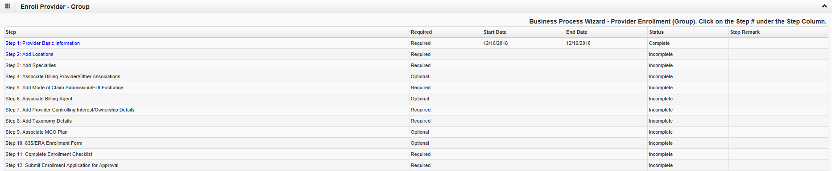
Using the Business Process Wizard (BPW)
The BPW serves as the “Control Center” of the application.
  Required: Steps listed as Optional may change to Required based upon previous steps.
  Dates: Entered by the system; Start Date is the date each step is opened, the End Date is the date each step is completed.
  Status: When a step is completed the Status will be updated to Complete; answering some checklist questions may change a prior step’s status back to Incomplete.
  Remarks: Remarks are systematically generated throughout the enrollment process.
Shortcut to Step:
1
2
3
4
5
6
7
8
9
10
11

Slide 11
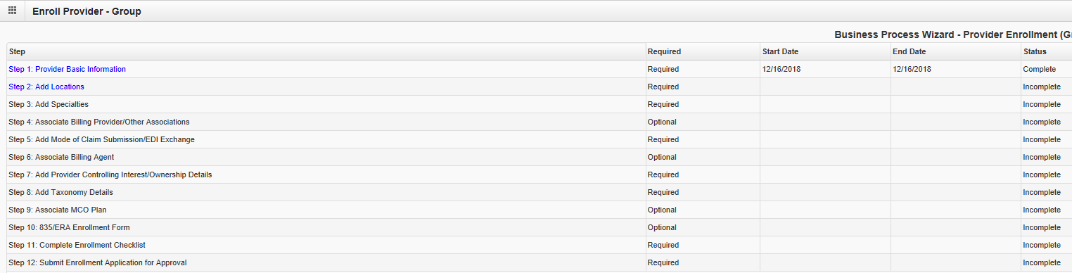
Completing the Application Using BPW
Once you have documented your Application ID, you have completed Step 1: Provider Basic Information. The system will place the current date in the End Date field and will place Complete in the corresponding Status field.
Steps 1, 2 and 3 must be completed in sequential order before attempting any of the later steps.
Click on Step 2: Add Locations to continue completing your application.
Shortcut to Step:
1
2
3
4
5
6
7
8
9
10
11

Slide 12
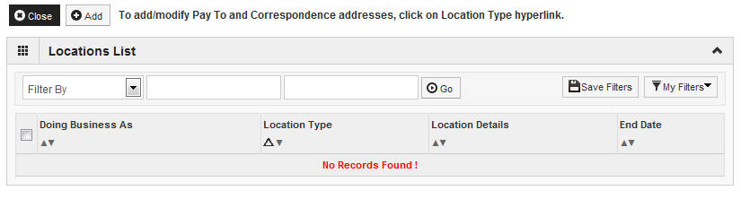
Step 2: Add Locations
Click Add to input the Primary Practice Location address.
Shortcut to Step:
1
2
3
4
5
6
7
8
9
10
11

Slide 13
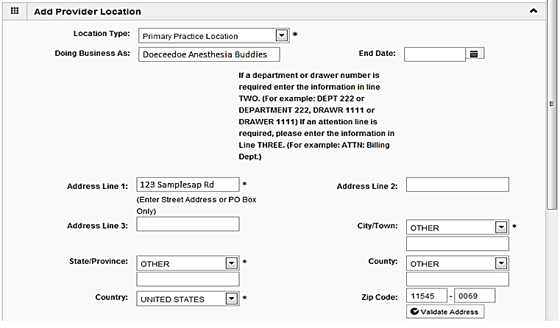
Step 2: Add Locations
Please complete all fields. At a minimum, all fields with an * are required.
Complete all boxes marked with an asterisk *.
Enter the street address and zip code, then click Validate Address.
Scroll down the page to continue.
Shortcut to Step:
1
2
3
4
5
6
7
8
9
10
11

Slide 14
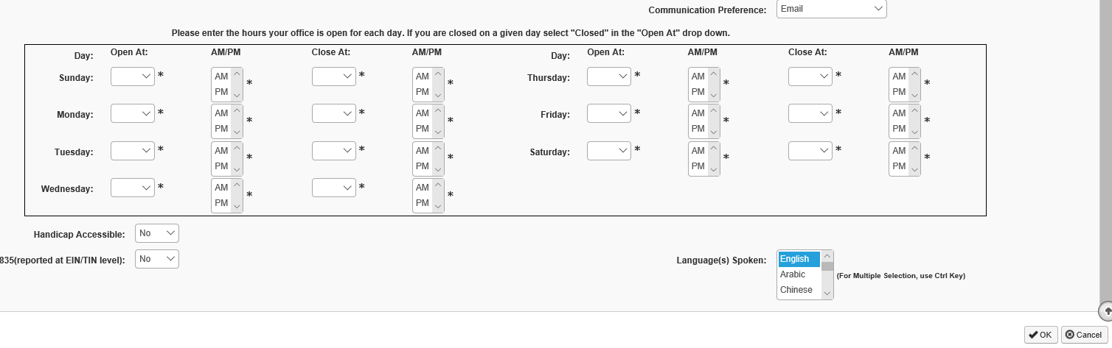
Step 2: Add Locations
When all the information has been entered, scroll down, click OK in the lower right corner.
Note that the office hours section must be filled out completely to proceed.
Shortcut to Step:
1
2
3
4
5
6
7
8
9
10
11

Slide 15
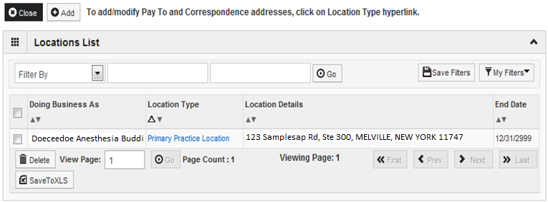
Step 2: Add Locations
Click on Primary Practice Location to add each address for this Location.
For the Primary Practice Location, a Correspondence and a Pay To address are required.
Shortcut to Step:
1
2
3
4
5
6
7
8
9
10
11

Slide 16
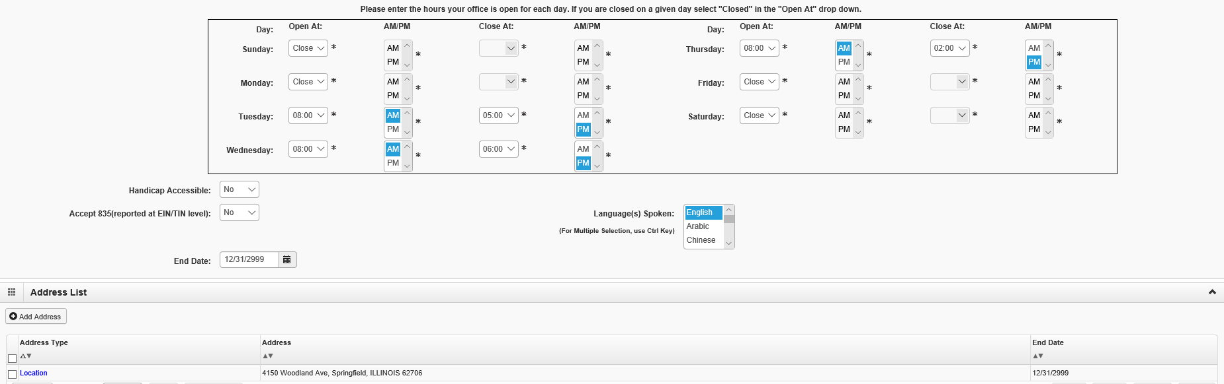
Step 2: Add Locations
Click on Add Address to input the additional address information.
Shortcut to Step:
1
2
3
4
5
6
7
8
9
10
11

Slide 17
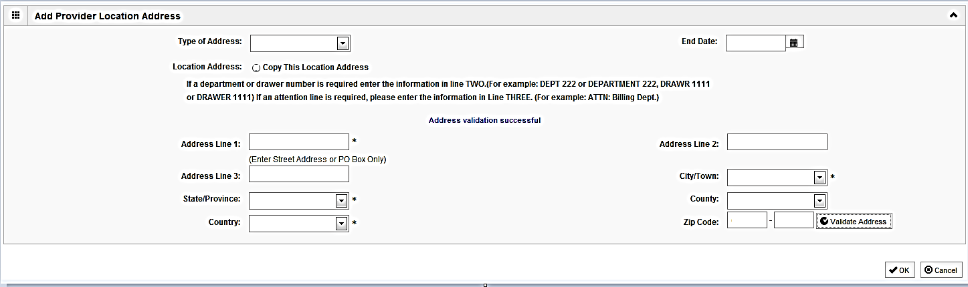
Step 2: Add Locations
Choose type of address from the drop down menu.
If the address you are entering is the same as the Location Address, then click the radio icon next to Copy This Location Address.
If the address is not the same, enter the street address and zip code, then click on Validate address.
When all the information has been entered, click OK.
Repeat these steps for each additional address type.
Shortcut to Step:
1
2
3
4
5
6
7
8
9
10
11

Slide 18
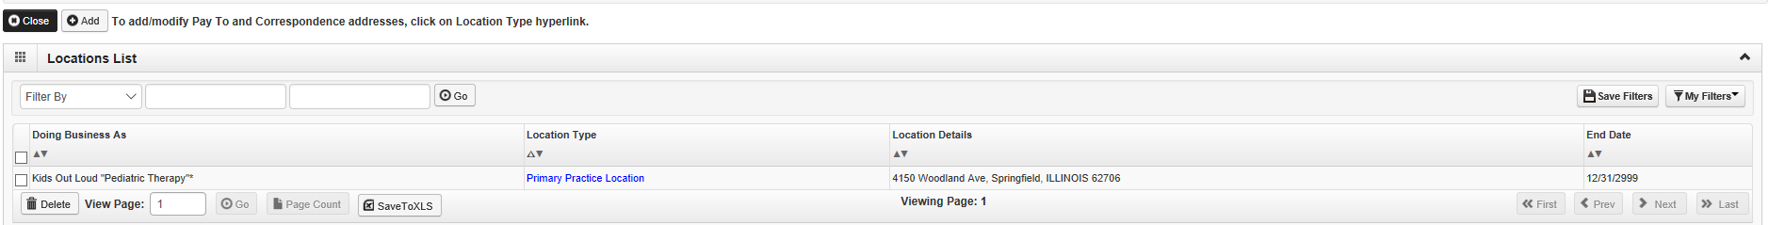
Step 2: Add Locations
When all the addresses have been entered for the Primary Practice Location, click Close.
Shortcut to Step:
1
2
3
4
5
6
7
8
9
10
11

Slide 19
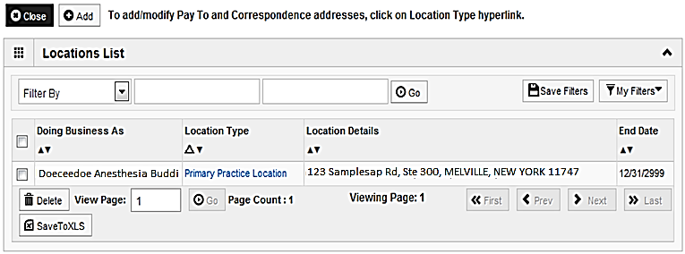
Step 2: Add Locations
To enter an Other Servicing Location, click on Add and repeat the previous steps. A Correspondence address will need to be entered for the Other Servicing Location.
Once all address details have been entered, click on Close.
Shortcut to Step:
1
2
3
4
5
6
7
8
9
10
11

Slide 20
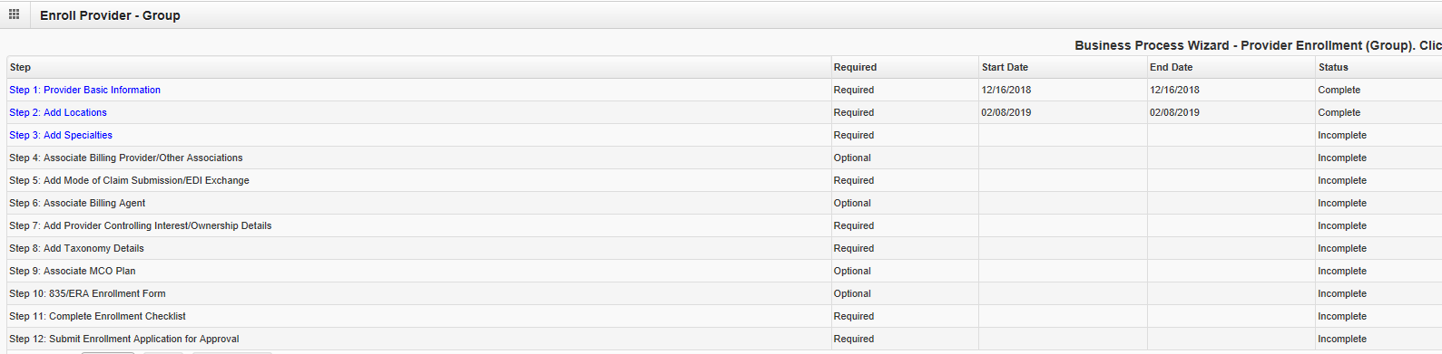
Business Process Wizard
The system will place the current date in the End Date field and will place Complete for Step 2.
Click on Step 3: Add Specialties to continue with the application.
Shortcut to Step:
1
2
3
4
5
6
7
8
9
10
11

Slide 21
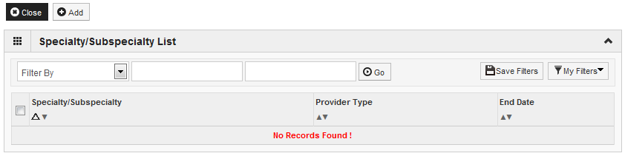
Step 3: Add Specialties
Click the Add button in the upper left corner.
Shortcut to Step:
1
2
3
4
5
6
7
8
9
10
11

Slide 22
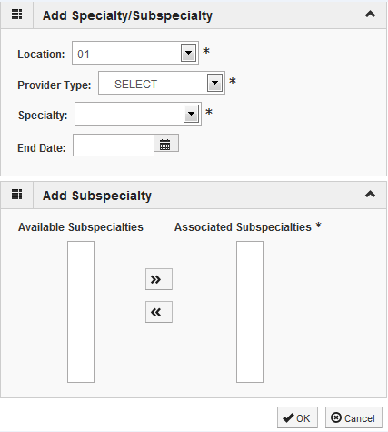
Step 3: Add Specialties
Select your Provider Type from the drop down.
Select your Specialty from the drop down.
Shortcut to Step:
1
2
3
4
5
6
7
8
9
10
11

Slide 23
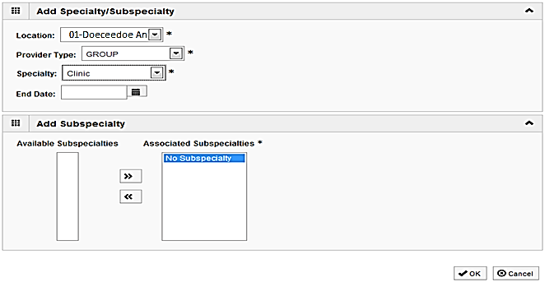
Step 3: Add Specialties
Once the Provider Type and the Specialty are selected, the Subspecialties will populate at the bottom of the screen in the Available Subspecialties box.
The Provider must choose at least one Available Subspecialty (or No Subspecialty) if multiple selections are available.
If only one choice is available, the system will preselect that selection.
Once all desired selections are moved to the Associated Subspecialties box, click OK in the bottom right corner
Click on the Subspecialties then click on the double arrows to move the Subspecialties over to the Associated Subspecialties box.
Shortcut to Step:
1
2
3
4
5
6
7
8
9
10
11

Slide 24
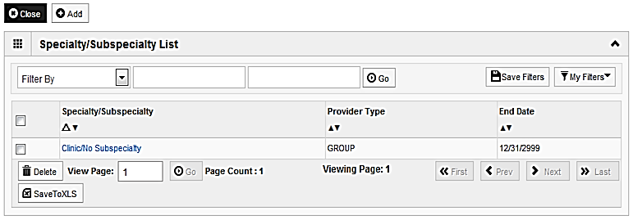
Step 3: Add Specialties
If you have another Specialty and/or subspecialty to enter click the Add button in the top left corner and repeat the steps as needed.
When all the information has been entered, click on Close to return to the BPW.
Shortcut to Step:
1
2
3
4
5
6
7
8
9
10
11
Notes:
.

Slide 25
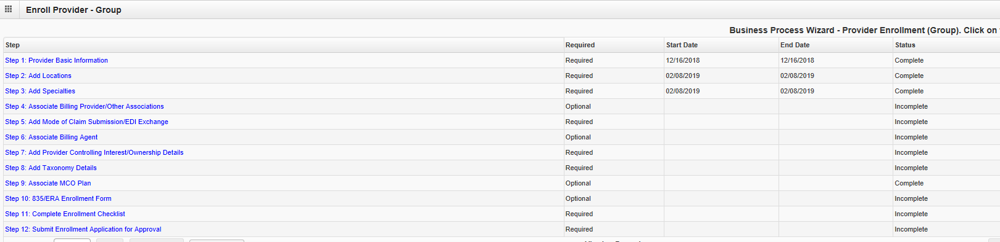
Business Process Wizard
The system will place the current date in the End Date field and will place Complete for Step 3.
Click on Step 4: Associate Billing Provider/Other Associations to continue with the application.
Shortcut to Step:
1
2
3
4
5
6
7
8
9
10
11

Slide 26
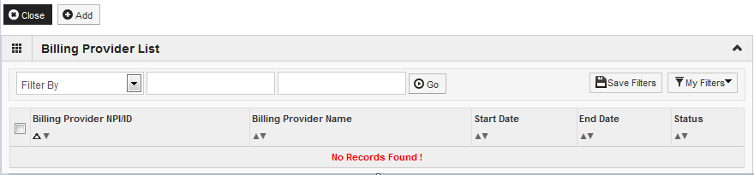
Step 4: Associate Billing Provider/Other Associations
Note: this is an optional step
Click Add to associate to a Billing Provider.
Shortcut to Step:
1
2
3
4
5
6
7
8
9
10
11
12
Notes:
2/6/19 – new section added

Slide 27
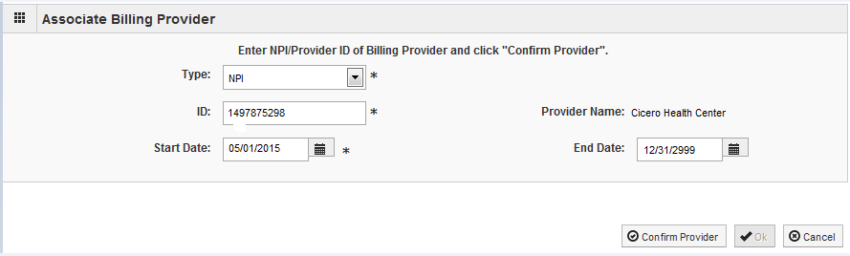
Step 4: Associate Billing Provider/Other Associations
Note: this is an optional step
Once all information has been entered, click on Confirm Provider and verify the correct Provider Name is displayed .
Click OK when you are finished.
Shortcut to Step:
1
2
3
4
5
6
7
8
9

Slide 28
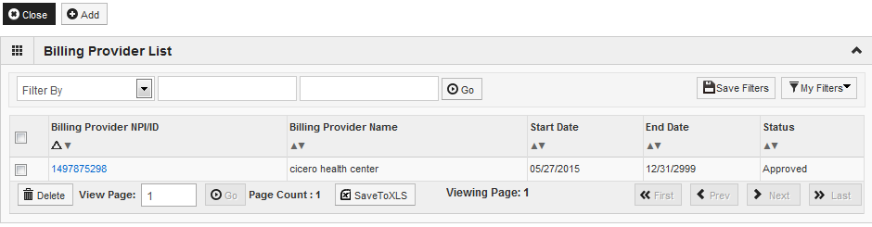
Step 4: Associate Billing Provider/Other Associations
Note: this is an optional step
Click Add and repeat the process as necessary.
If there are no other Billing Providers to add, click on Close to return to the BPW.
Shortcut to Step:
1
2
3
4
5
6
7
8
9

Slide 29
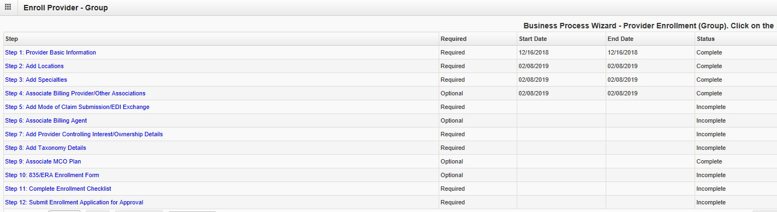
Step 4: Associate Billing Provider/Other Associations
Step 4: Associate Billing Provider/Other Associations
You have completed Step 4: Associate Billing Provider/Other Associations. The system will place the current date in the End Date field and will place Complete in the corresponding Status field.
Click on Step 5: Add Mode of Claim Submission/EDI Exchange to continue your application.

Slide 30
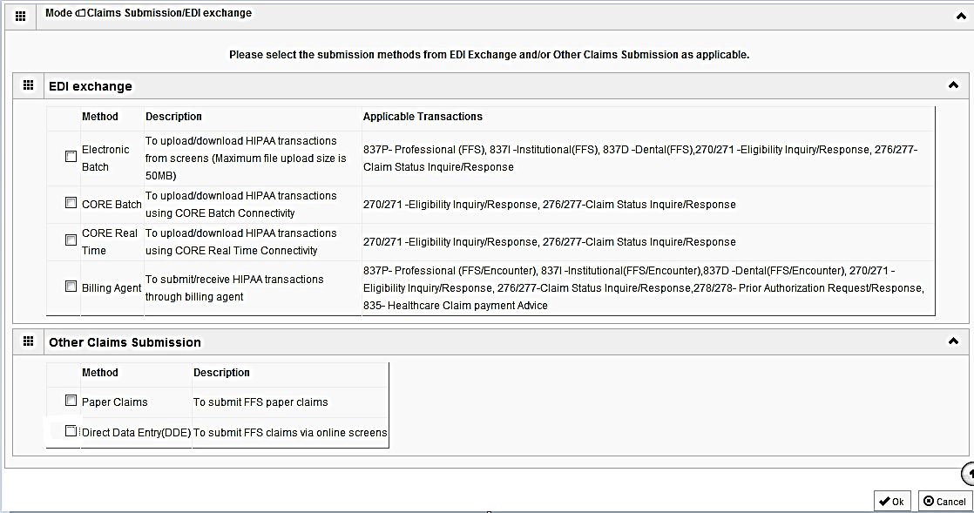
Step 5: Mode of Claim Submission/EDI Exchange
  A New Enrollment will need to complete the necessary external application at http://www.myhfs.illinois.gov/ unless using a Billing Agent or submitting Paper Claims.
P
  Select any of the six options to indicate how you wish to process claims.
  Must select at least one option or claims will not be processed.
  After claim submission types have been selected click OK.
Shortcut to Step:
1
2
3
4
5
6
7
8
9
10
11
Notes:
******The processes chosen here will not affect how claims are processed currently*****

Slide 31
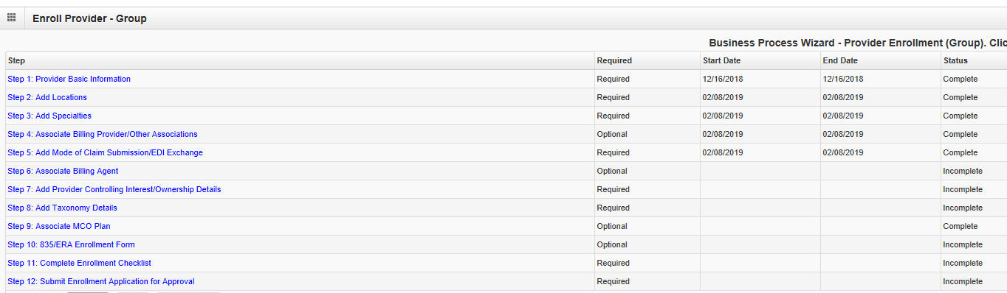
Business Process Wizard
The system will place the current date in the End Date field and will place Complete for Step 5.
Click on Step 6: Associate Billing Agent (if applicable) to continue with the application.
Shortcut to Step:
1
2
3
4
5
6
7
8
9
10
11

Slide 32

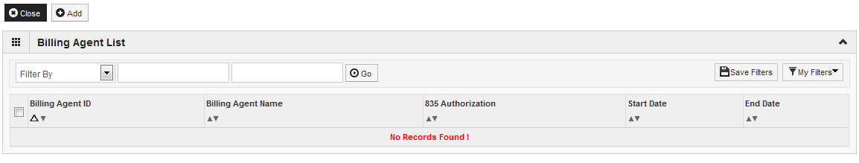
Step 6: Associate Billing Agent
Note: this is an optional step
If applicable, click Add to input a Billing Agent.
Shortcut to Step:
1
2
3
4
5
6
7
8
9
10
11

Slide 33
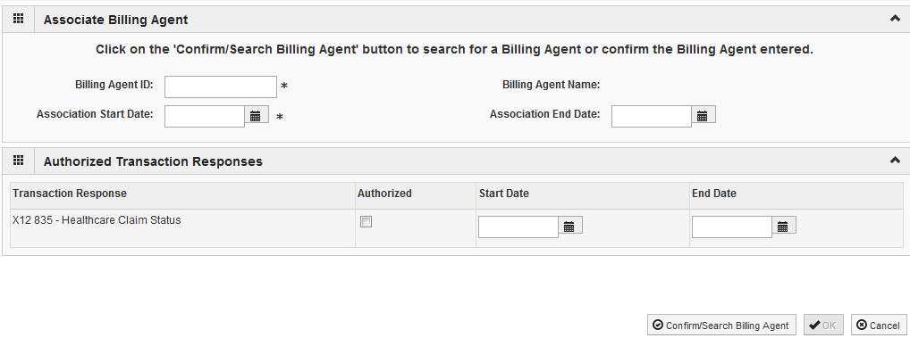
Step 6: Associate Billing Agent
Note: this is an optional step
Complete the Billing Agent information then click Confirm/Search Billing Agent and verify that the Billing Agent Name field is populated with the correct agent.
Click OK to return to the billing agent list.
If the Billing Agent info is not known, click on Confirm/Search Billing Agent to locate the desired Billing Agent from the list.
Shortcut to Step:
1
2
3
4
5
6
7
8
9
10
11

Slide 34
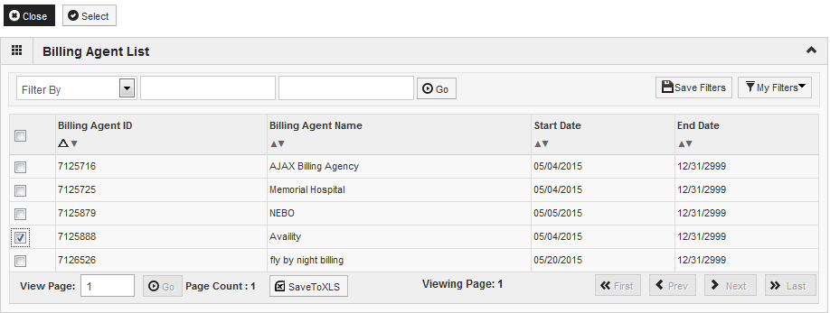
Step 6: Associate Billing Agent
Note: this is an optional step
Use the Filter By drop down to chose an option and enter information to filter the list of available Billing Agents. (% is a wild card function).
After locating the desired billing agent, mark the check box next to that option, then click Select.
Shortcut to Step:
1
2
3
4
5
6
7
8
9
10
11

Slide 35
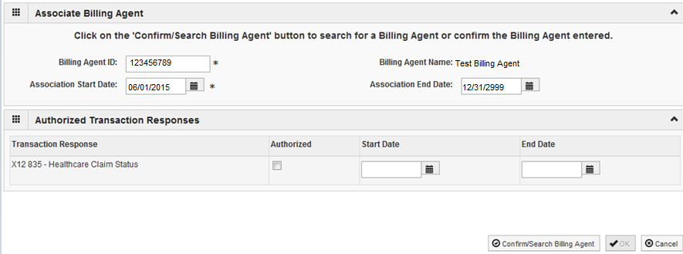
Step 6: Associate Billing Agent
Note: this is an optional step
The selected billing agent information will populate. Verify it is correct, then click OK.
Shortcut to Step:
1
2
3
4
5
6
7
8
9
10
11

Slide 36
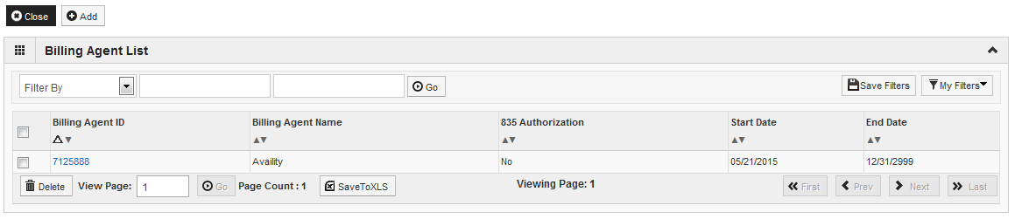
Step 6: Associate Billing Agent
Note: this is an optional step
Click Add to input additional Billing Agents.
When all Billing Agents have been entered, click Close to return to the BPW.
Shortcut to Step:
1
2
3
4
5
6
7
8
9
10
11

Slide 37
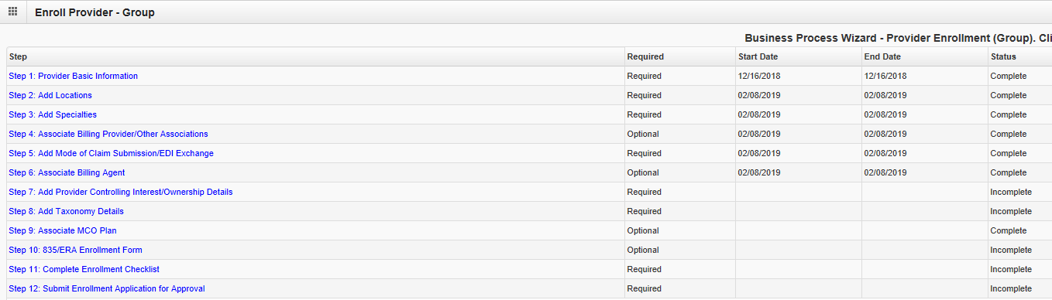
Business Process Wizard
The system will place the current date in the End Date field and will place Complete for Step 6.
Click on Step 7: Add Provider Controlling Interests/Ownership Details to continue with the application.
Shortcut to Step:
1
2
3
4
5
6
7
8
9
10
11

Slide 38
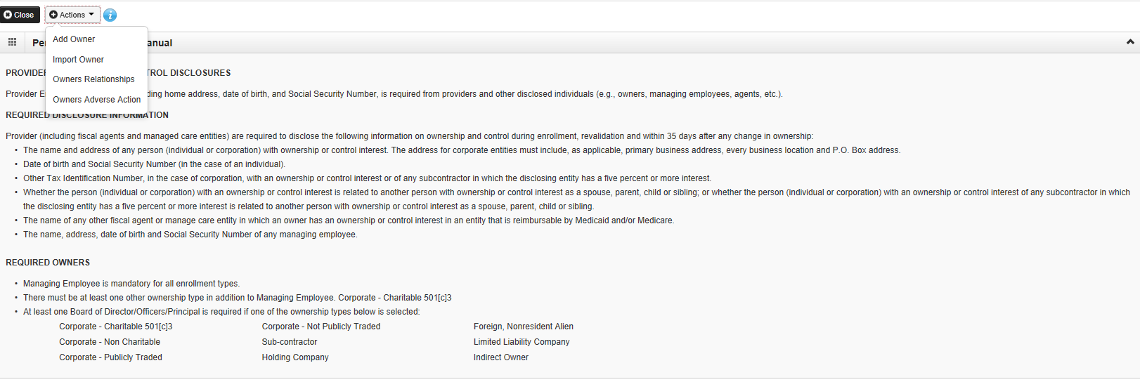
Step 7: Add Provider Controlling Interest/Ownership Details
Ownership entries must include at least one Managing Employee and one other Ownership type.
To add Ownership listings, click on Actions, Add Owner.
Shortcut to Step:
1
2
3
4
5
6
7
8
9
10
11
Notes:
****Additional ownership types may be required based on prior ownerships entered.******

Slide 39
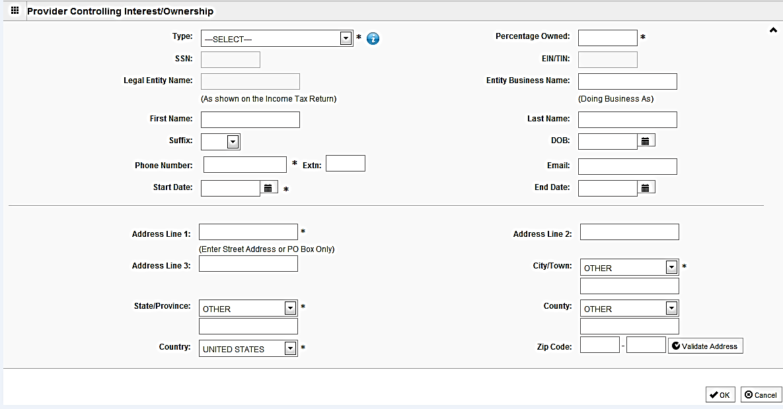
Step 7: Add Provider Controlling
Interest/Ownership Details
Please complete all fields. At a minimum, all fields with an * are required.
or
Either your SSN or EIN/TIN must be entered (as prompted by the system).
Enter Percentage Owned as a whole number.
Enter the street address and zip code information, then click Validate Address.
When all details are entered, click OK.
Shortcut to Step:
1
2
3
4
5
6
7
8
9
10
11

Slide 40
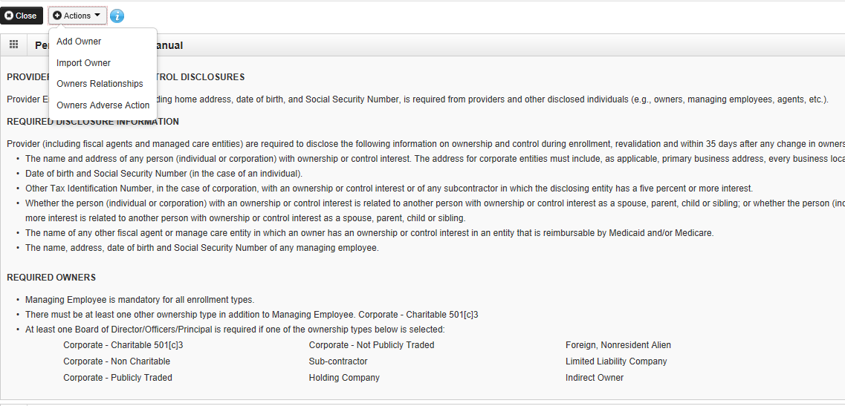
Step 7: Add Provider Controlling Interest/Ownership Details
Click Add and repeat the previous steps to list additional owners
If one of the owners is listed on another enrollment, Import Owner can be selected from the Action box at the top of the page.
This selection will allow the user to import owner information from another enrollment by using the NPI or Provider ID, the Zip Code of the Owner, and the Owner Type.
Shortcut to Step:
1
2
3
4
5
6
7
8
9
10
11

Slide 41
Step 7: Add Provider Controlling Interest/Ownership Details
Now complete the Owners Relationship information by selecting Actions, Owners Relationships.
Shortcut to Step:
1
2
3
4
5
6
7
8
9
10
11

Slide 42
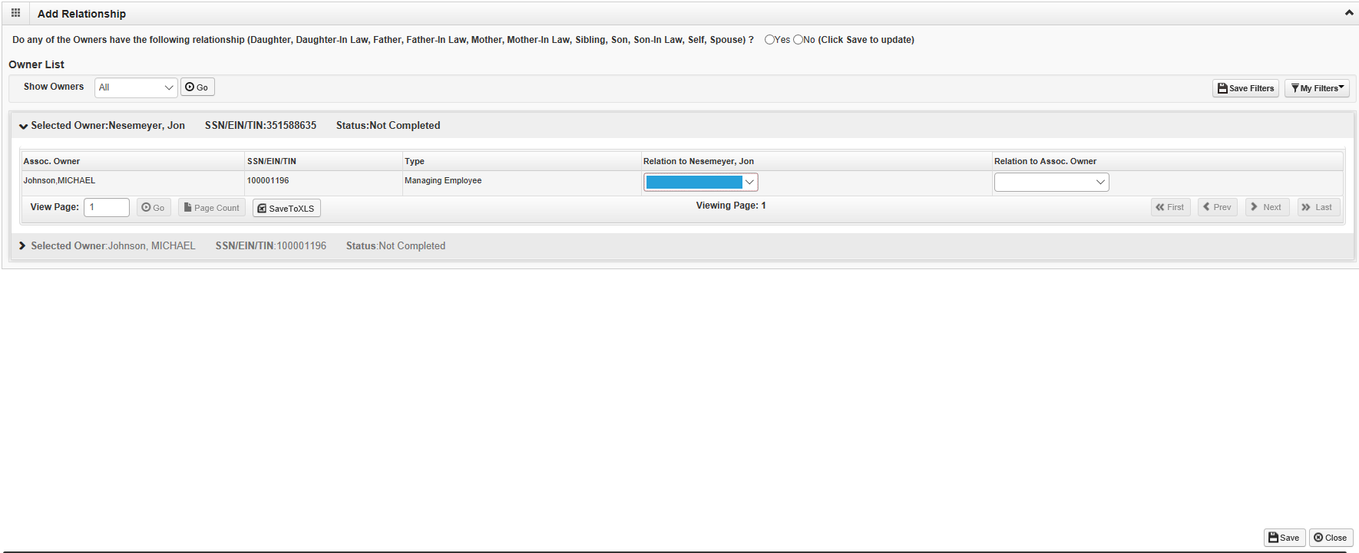
Step 7: Add Provider Controlling Interest/Ownership Details
Select All next to Show Owners, and choose the relationship next to each drop down menu.
Choose Save to complete the screen.
Shortcut to Step:
1
2
3
4
5
6
7
8
9
10
11

Slide 43
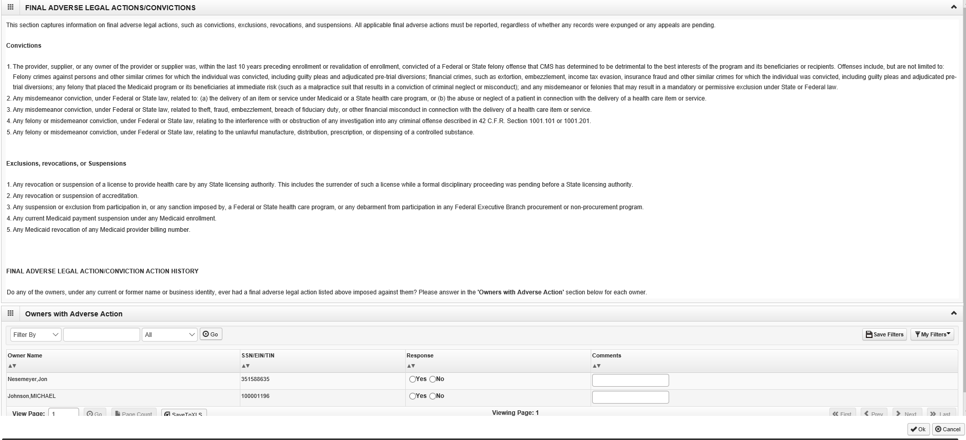
Step 7: Add Provider Controlling Interest/Ownership Details
Read the section on Final Adverse Legal Actions/Convictions.
Complete the Response and Comments (if applicable) section next to each owner.
Select Ok.
Shortcut to Step:
1
2
3
4
5
6
7
8
9
10
11

Slide 44
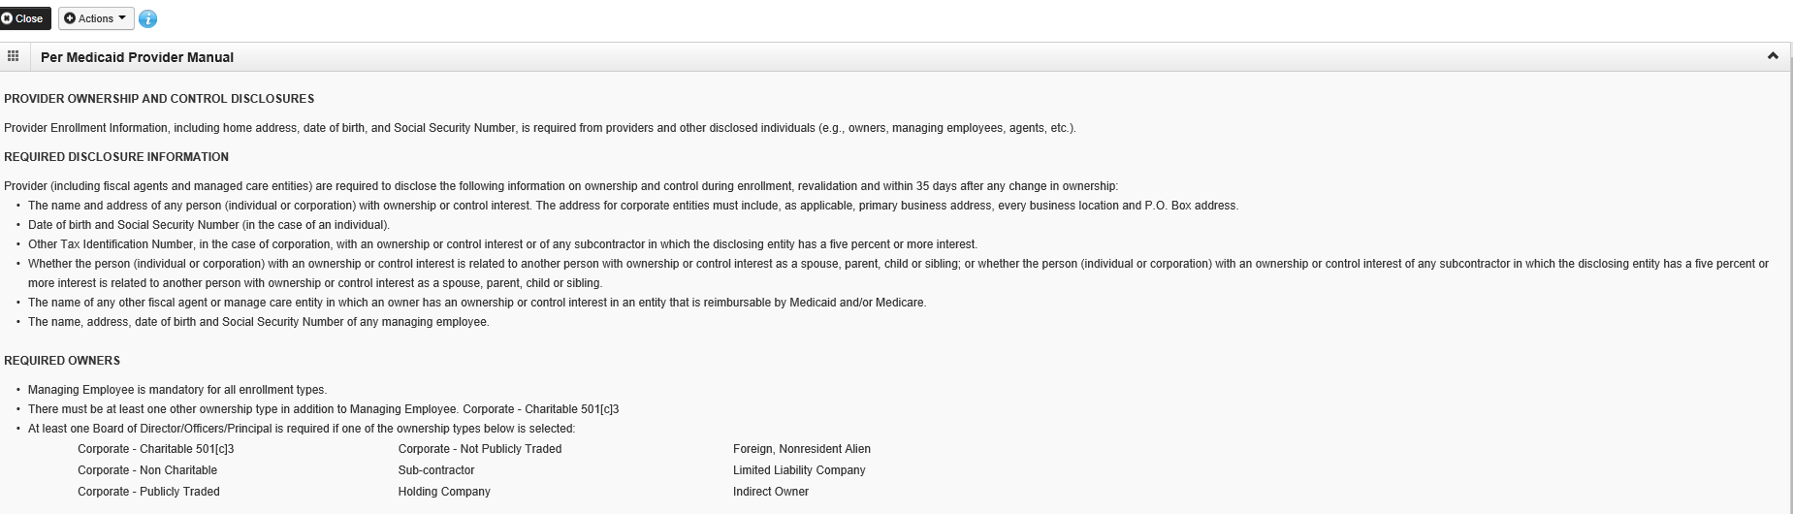
Step 7: Add Provider Controlling Interest/Ownership Details
Select Close.
It is required that ownership of 5% or more in any other Medicaid/Medicare entity be entered.
To enter Ownership details in another Medicaid/Medicare Entity, go to the bottom of the page and click on Add Other Owned Entity.
Shortcut to Step:
1
2
3
4
5
6
7
8
9
10
11

Slide 45
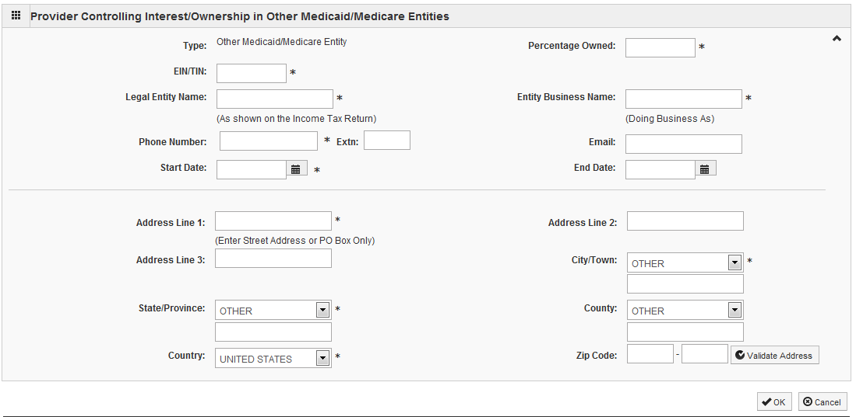
Step 7: Add Provider Controlling Interest/Ownership Details
After entering the street address and zip code, click Validate Address.
When all information is complete, click OK.
Repeat these steps to add ownership in another Medicaid/Medicare Entity.
Shortcut to Step:
1
2
3
4
5
6
7
8
9
10
11
Notes:
Use for Step 3, 4, etc.

Slide 46
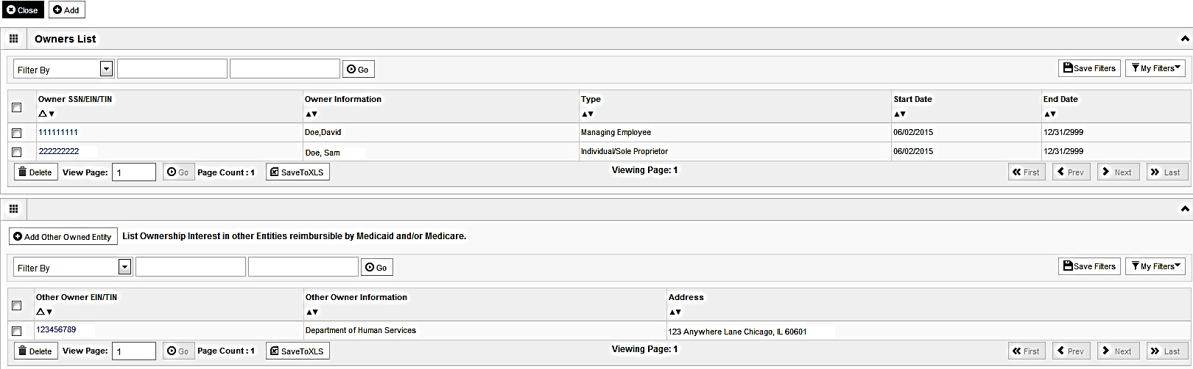
Step 7: Add Provider Controlling Interest/Ownership Details
When all ownerships for this location and ownership information in other entities is complete, click Close.
Shortcut to Step:
1
2
3
4
5
6
7
8
9
10
11

Slide 47
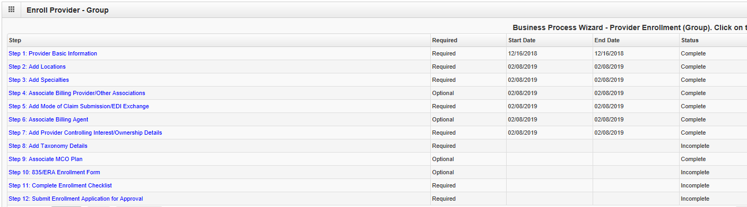
Business Process Wizard
The system will place the current date in the End Date field and will place Complete for Step 7.
Click on Step 8: Add Taxonomy Details to continue with the application.
Shortcut to Step:
1
2
3
4
5
6
7
8
9
10
11

Slide 48
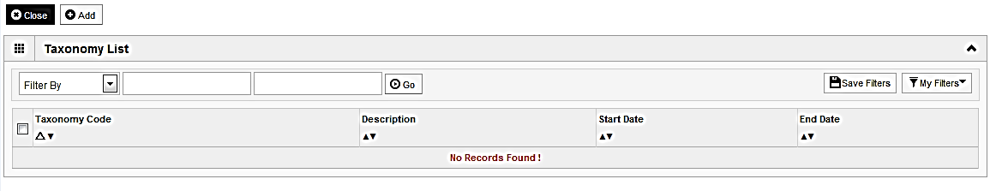
Step 7: Add Taxonomy Details
To enter Taxonomy Details click on Add.
Shortcut to Step:
1
2
3
4
5
6
7
8
9
10
11
Notes:
Provide link to taxonomy code definition

Slide 49
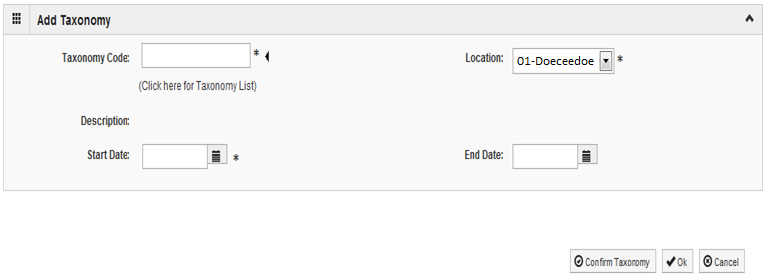
Step 7: Add Taxonomy Details
If the Taxonomy Code is known, enter the Taxonomy Code and the Start Date.
Click on Confirm Taxonomy and verify Description is populated correctly.
Click on OK to finalize the submission.
Shortcut to Step:
1
2
3
4
5
6
7
8
9
10
11

Slide 50
Step 7: Add Taxonomy Details
If code is not known, click on the t to the right of the box to access The National Uniform Claim Committee Taxonomy Code list. This will open a new web browser window.
At least one of the Taxonomy Codes entered in IMPACT must be the Taxonomy Code registered with the National Plan and Provider Enumeration System (NPPES).
Shortcut to Step:
1
2
3
4
5
6
7
8
9
10
11

Slide 51
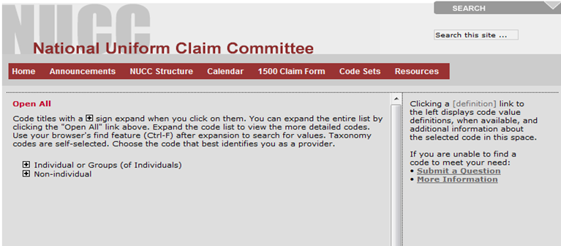
Step 7: Add Taxonomy Details
In the web browser window that opens will be a list of provider types.
Click + next to the appropriate provider type for your enrollment.
Shortcut to Step:
1
2
3
4
5
6
7
8
9
10
11

Slide 52
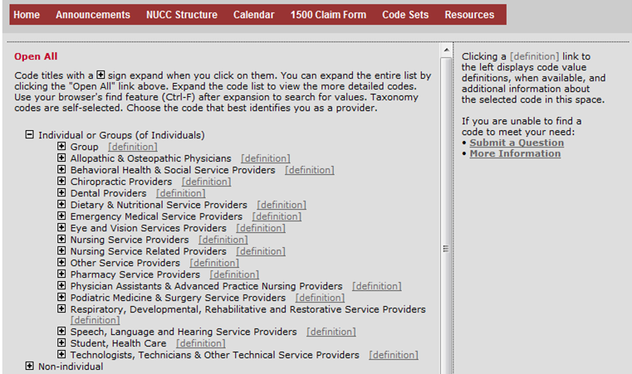
Step 7: Add Taxonomy Details
Click on the + next to the appropriate profession listed under the heading which you previously selected.
Shortcut to Step:
1
2
3
4
5
6
7
8
9
10
11

Slide 53
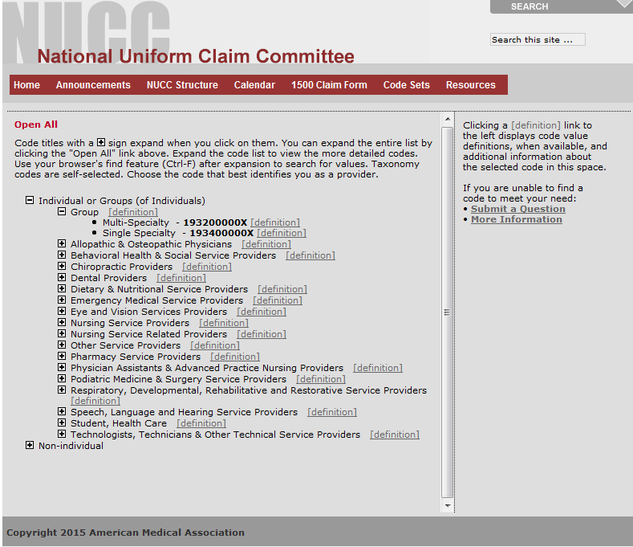
Step 7: Add Taxonomy Details
Make a note of the Taxonomy Code that is correct for your area of practice.
Click on the X button in the upper right corner to close the National Uniform Claim Committee webpage.
Shortcut to Step:
1
2
3
4
5
6
7
8
9
10
11

Slide 54
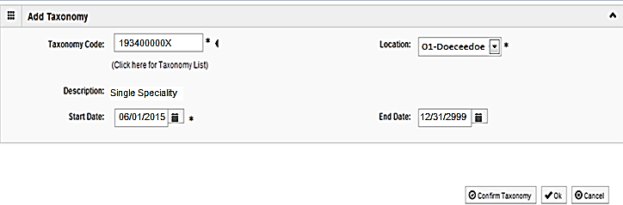
Step 7: Add Taxonomy Details
Enter the Taxonomy Code and the Start Date.
Click on Confirm Taxonomy and verify Description is populated correctly.
Click on OK to finalize the submission.
Shortcut to Step:
1
2
3
4
5
6
7
8
9
10
11

Slide 55
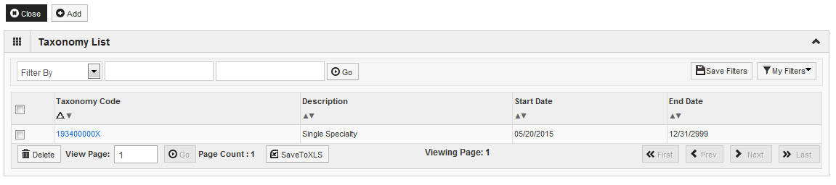
Step 7: Add Taxonomy Details
Repeat the steps by clicking on the Add button for any additional Taxonomy Codes that need to be entered.
Otherwise, click on the Close button in the upper left corner.
Shortcut to Step:
1
2
3
4
5
6
7
8
9
10
11

Slide 56
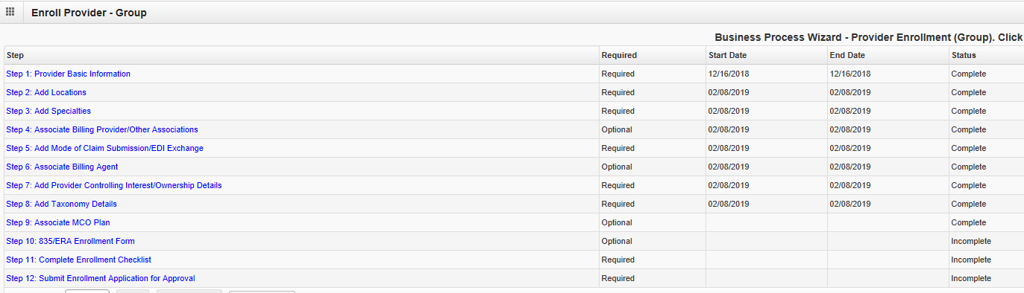
Business Process Wizard
The system will place the current date in the End Date field and will place Complete for Step 8.
Click on Step 9: Associate MCO Plan to continue with the application.
Shortcut to Step:
1
2
3
4
5
6
7
8
9
10
11

Slide 57

Step 9: Associate MCO Plan
Note: this is an optional step
Click Add to associate a MCO plan for which there is a current valid contract.
Specific MCO plans can be added only once to the application.
Sister Agencies will also be listed as an MCO Plan. A sister agency is also known as a State Agency or a Waiver provider.
Shortcut to Step:
1
2
3
4
5
6
7
8
9
10
11

Slide 58

Step 9: Associate MCO Plan
Note: this is an optional step
Enter a Plan ID and Association Start Date (or, the date of the application).
End Date: Leave Blank.
Click Confirm/Search Plan to confirm the plan ID or to search for the plan.
Verify the Plan Name populated correctly, then click OK.
If the MCO is not known, click on Confirm/Search Plan to search for a plan.
Shortcut to Step:
1
2
3
4
5
6
7
8
9
10
11

Slide 59

Step 9: Associate MCO Plan
Note: this is an optional step
Use the Filter By drop down and enter desired information to filter the available MCO plans.
When the desired MCO plan is located, click on the checkbox next to the that line then, click Select.
Shortcut to Step:
1
2
3
4
5
6
7
8
9
10
11

Slide 60

Step 9: Associate MCO Plan
Note: this is an optional step
The chosen MCO plan information will populate.
Verify it is correct then, click OK.
Shortcut to Step:
1
2
3
4
5
6
7
8
9
10
11

Slide 61

Step 9: Associate MCO Plan
Note: this is an optional step
Click Add to Associate to an additional MCO Plan.
If all MCO Plans have been entered, click Close to return to the BPW.
Shortcut to Step:
1
2
3
4
5
6
7
8
9
10
11

Slide 62

Business Process Wizard
The system will place the current date in the End Date field and will place Complete for Step 9.
Click on Step 10: 835/ERA enrollment form to continue with the application.
Shortcut to Step:
1
2
3
4
5
6
7
8
9
10
11

Slide 63

Step 10: 835/ERA Enrollment Form
Note: This step is optional. Please complete this section once you have completed the enrollment steps found at http://www.myhfs.illinois.gov/ if you wish to participate in 835/ERA, otherwise close this step.
Verify the generated information and complete information if needed.
Use the scroll bar to move down the page.
Shortcut to Step:
1
2
3
4
5
6
7
8
9
10
11

Slide 64

Step 10: 835/ERA Enrollment Form
Note: this is an optional step
Select your method of retrieval from the drop-down menu.
Shortcut to Step:
1
2
3
4
5
6
7
8
9
10
11

Slide 65

Step 10: 835/ERA Enrollment Form
Note: this is an optional step
Mark the checkbox to authorize the creation of an 835/ERA account.
The written signature portion should populate.
Once all fields are complete, click Submit and Close at the top of the page.
Shortcut to Step:
1
2
3
4
5
6
7
8
9
10
11

Slide 66

Business Process Wizard
The system will place the current date in the End Date field and will place Complete for Step 10.
Click on Step 11: Complete Enrollment Checklist to continue with the application.
Shortcut to Step:
1
2
3
4
5
6
7
8
9
10
11

Slide 67

Step : Associate Billing Agent
Step 11: Complete Enrollment Checklist
All questions must be answered either Yes or No and comments made if directed to do so. If a checklist item does not apply, select No as the answer.
After all of the questions have been answered and comments made, click on the Save button in the upper left corner followed by clicking on the Close button.
Shortcut to Step:
1
2
3
4
5
6
7
8
9
10
11

Slide 68

Business Process Wizard
The system will place the current date in the End Date field and will place Complete for Step 11.
Click on Step 12: Submit Enrollment Application for Approval to continue with the application.
Shortcut to Step:
1
2
3
4
5
6
7
8
9
10
11

Slide 69

Step 12: Submit Enrollment Application for Approval
Click Next to confirm that all of the information that you have submitted as a part of the application is accurate.
Shortcut to Step:
1
2
3
4
5
6
7
8
9
10
11

Slide 70

Step 12: Submit Enrollment Application for Approval
Read through all of the terms and conditions.
Check the box certifying that you agree to the terms and conditions.
Then select Submit Application.
Shortcut to Step:
1
2
3
4
5
6
7
8
9
10
11
Notes:
Source:

Slide 71

Business Process Wizard
The message below will appear advising that the application has been submitted to the state for review. The application number can be to used to check the status of the application by going through the Track Application option.
Click Close.
Shortcut to Step:
1
2
3
4
5
6
7
8
9
10
11

Slide 72

Business Process Wizard
The system will place the current date in the End Date field and will place Complete for Step 12.
Shortcut to Step:
1
2
3
4
5
6
7
8
9
10
11

Slide 73
Resources
For more information regarding IMPACT, please visit http://www.illinois.gov/hfs/impact/Pages/AboutIMPACT.aspx
Check out the definitions of common terms at http://www.illinois.gov/hfs/impact/Pages/Glossary.aspx
Shortcut to Step:
1
2
3
4
5
6
7
8
9
10
11

Slide 74
Questions and Answers
FAQ’s can be found at http://www.illinois.gov/hfs/impact/Pages/faqs.aspx to help resolve common questions and problems when submitting applications.
General questions regarding IMPACT can be addressed to:
  Email: IMPACT.Help@Illinois.gov
  Phone: 1-877-782-5565
Shortcut to Step:
1
2
3
4
5
6
7
8
9
10
11

