Slide 1

ILLINOIS PROVIDER ENROLLMENT
Facilities, Agencies, Organizations

Slide 2
Agenda
Introduction to IMPACT and Key Terms
Application Process
Resuming an Application
Starting a New Application
The Business Process Wizard (BPW)
Completing the Application using BPW
Reviewing Submitted Application
Resources
Questions & Answers
Notes:
.

Slide 3
Introduction and Key Terms
IMPACT is a multi-agency effort to replace Illinois’ 30-year-old Medicaid Management Information System (MMIS) with a web-based system that meets federal requirements, is more convenient for providers and increases efficiency by automating and expediting state agency processes.
Key Terms:
  Facility, Agency, Organization (FAO): An entity that provides health care services such as, hospitals, nursing facilities and laboratories. A type 2 NPI and licensing is required.
  Revalidation: An FAO provider who was enrolled in the MMIS system and whose information was transferred to IMPACT.
  Billing Agent: Submits Medicaid HIPAA compliant transactions or exchanges EPHI with Medicaid providers or other authorized parties. Also known as Clearing House, Software Vendor or Value Added Network (VAN).
  MCO Plan: Health care plans that provide health care through a provider network. Sister Agencies will also be listed as an MCO. A sister agency is also known as a State Agency or a Waiver provider.
  Enrollment Timeline:
  FAOs will need to enroll in or revalidate with IMPACT starting in August 2015.
  NOTE: In order for a provider to associate to an FAO, the FAO application must be approved in IMPACT.

Slide 4
Application Process
Step 1: Provider Basic Information
Step 2: Add Locations
Step 3: Add Specialties
Step 4: Licenses/Certifications/Other
Step 5: Mode of Claim Submission
Step 6: Associate Billing Agent
tep 4: Add Licenses and Certifications
Step 7: Add Ownership Details
Step 8: Add Taxonomy Details
Step 9: Associate MCO Plan
Pressing this button on any screen will bring you back to this menu.
Step 10: 835/ERA Enrollment Form
Step 11: Enrollment Checklist
Step 12: Submit Application
Pressing any of the buttons below will skip to that step of the presentation
Shortcut to Step:
1
2
3
4
5
6
7
8
9
10
11
12

Slide 5
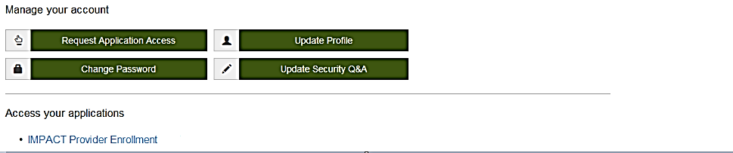
Application Process
After completing the sign-on, click on IMPACT Provider Enrollment.
In regards to completing an application, there are two options: New Enrollment or Resuming an application.
Shortcut to Step:
1
2
3
4
5
6
7
8
9
10
11
12
Notes:
*****Please turn off pop-up blocker in order to access IMPACT application processes.*****

Slide 6
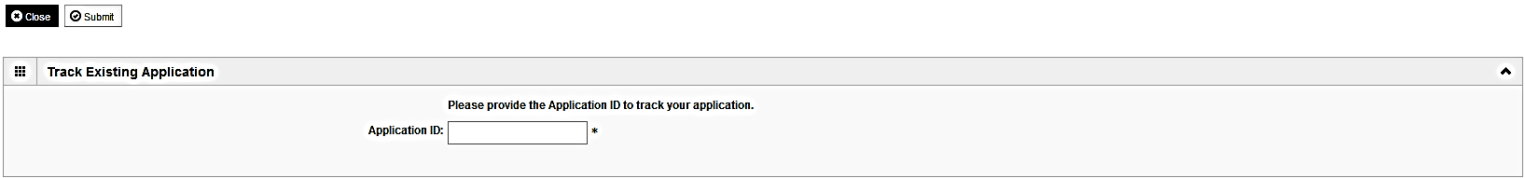
Resume an Application
To resume (or revalidate) an application, click on Track Application.
The application number was either mailed out on a yellow card (revalidation) or sent to the listed email address (In-process application).
Enter the Application ID for the application you want to access.
After entering the ID number, click Submit.
This process will then go directly to the Business Process Wizard (BPW).
Shortcut to Step:
1
2
3
4
5
6
7
8
9
10
11
12

Slide 7
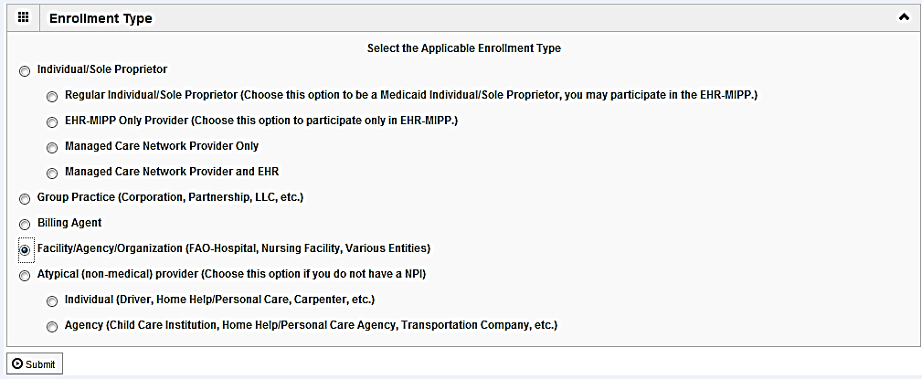
Start New Application
If completing a new application, click on New Enrollment.
Use the radio buttons to select your enrollment type, then click on Submit in the lower left corner.
Shortcut to Step:
1
2
3
4
5
6
7
8
9
10
11
12

Slide 8
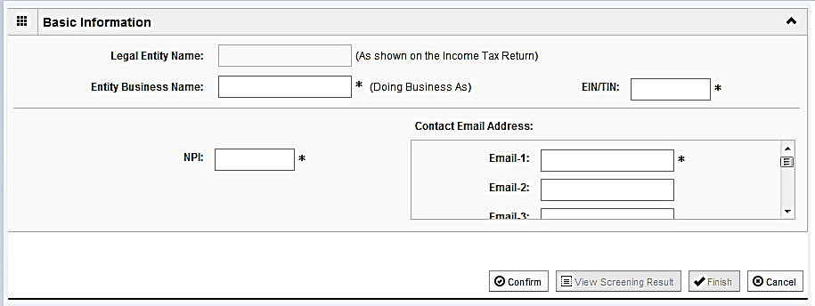
Start New Application
(Step 1: Basic Provider Information)
Please complete all fields. At a minimum, all fields with an * are required.
After all the information has been entered click Confirm.
Click Finish in the bottom right corner to complete this step.
Shortcut to Step:
1
2
3
4
5
6
7
8
9
10
11
12
Notes:
******The EIN/TIN must be registered with the Illinois Comptroller prior to being able to complete the application.******

Slide 9
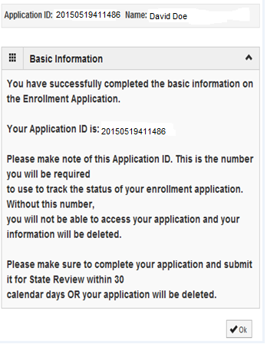
Start New Application
(Step 1: Basic Provider Information)
Application ID: systematically generated.
Name: should reflect name from Basic Information.
The system will generate an application ID after the successful completion of the Basic Information screen; the application number is a 14-digit number that has the following components:
  The system date in yyyymmdd format
  A 6-digit system generated random number
  Example: 20130514412598
  Application IDs are valid for 30 calendar days; applications must be completed and submitted to the state for review during this 30 day period or the application will be DELETED.
  The application ID will be used to access the application before submission to the state for review and will be used to track the status of your submitted application until it is marked approved.
  After documenting the ID number, click OK.
Shortcut to Step:
1
2
3
4
5
6
7
8
9
10
11
12
Notes:
******The application ID number will also be emailed to the email address that was used to create the single-sign on.******

Slide 10
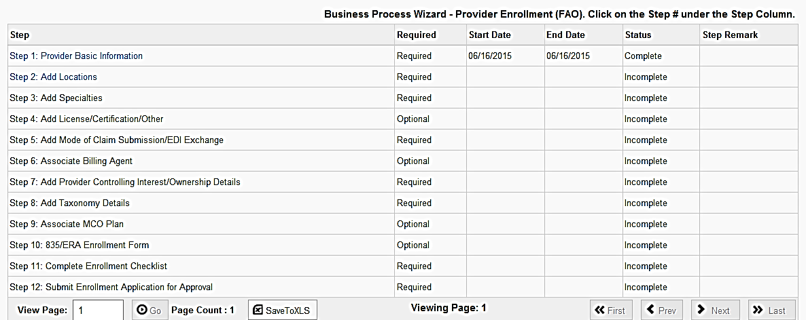
Using the Business Process Wizard (BPW)
The BPW serves as the “Control Center” of the application.
  Required: Steps listed as Optional may change to Required based upon previous steps.
  Dates: Entered by the system; Start Date is the date each step is opened, the End Date is the date each step is completed.
  Status: When a step is completed the Status will be updated to Complete; answering some checklist questions may change a prior step’s status back to Incomplete.
  Remarks: Remarks are systematically generated throughout the enrollment process.
Shortcut to Step:
1
2
3
4
5
6
7
8
9
10
11
12

Slide 11
Completing the Application Using BPW
Once you have documented your Application ID, you have completed Step 1: Provider Basic Information. The system will place the current date in the End Date field and will place Complete in the corresponding Status field.
Steps 1, 2 and 3 must be completed in sequential order before attempting any of the later steps.
Click on Step 2: Add Locations to continue completing your application.
Shortcut to Step:
1
2
3
4
5
6
7
8
9
10
11
12

Slide 12
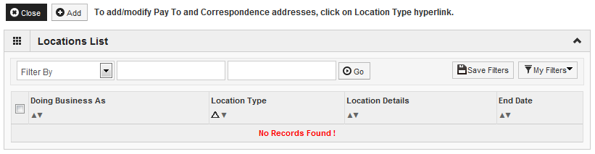
Step 2: Add Locations
Click Add to input the Primary Practice Location address details.
Shortcut to Step:
1
2
3
4
5
6
7
8
9
10
11
12

Slide 13
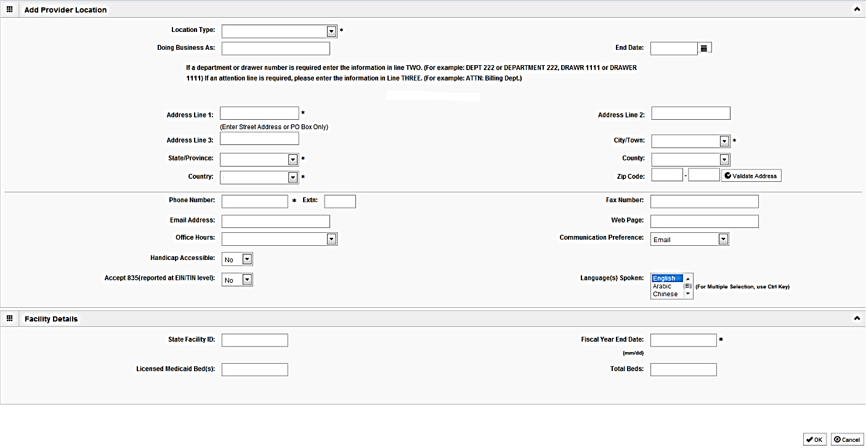
Step 2: Add Locations
Please complete all fields. At a minimum, all fields with an * are required.
Enter the street address and zip code, then click Validate Address.
When all information has been entered, click OK at the lower right corner.
Shortcut to Step:
1
2
3
4
5
6
7
8
9
10
11
12
Notes:
*****If email is listed as the communication preference than an email address must be entered.*****

Slide 14
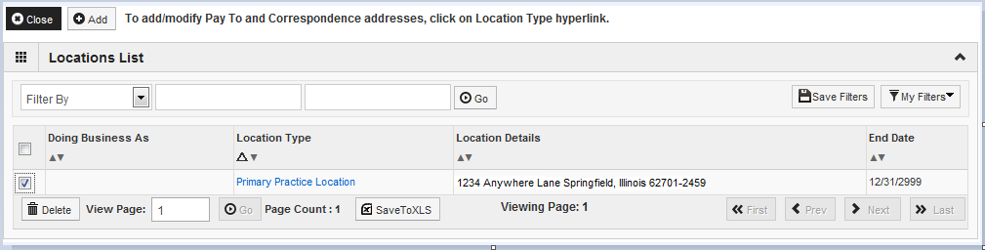
Step 2: Add Locations
Click on the Primary Practice Location hyperlink to add each address for this location.
The Primary Practice Location address requires a Correspondence and a Pay To address.
Shortcut to Step:
1
2
3
4
5
6
7
8
9
10
11
12

Slide 15
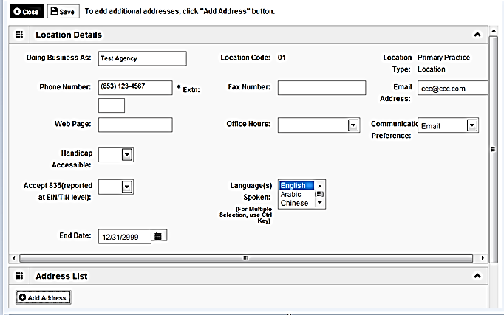
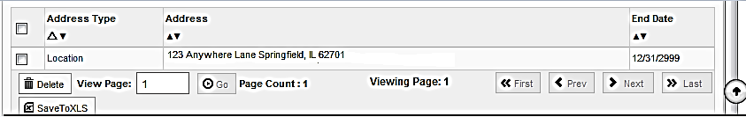
Step 2: Add Locations
Click on Add Address to input the additional addresses for the Primary Practice Location.
Shortcut to Step:
1
2
3
4
5
6
7
8
9
10
11
12

Slide 16
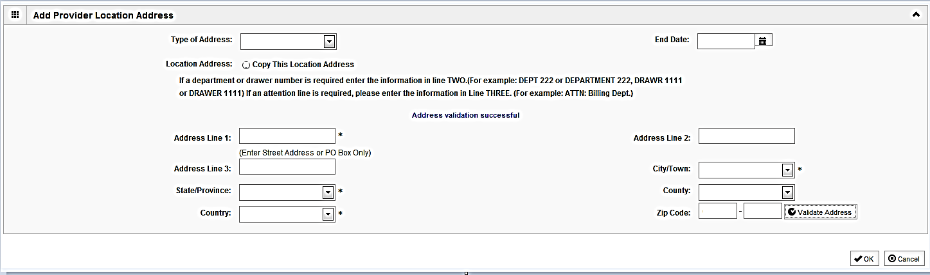
Step 2: Add Locations
Choose type of address from the drop down menu.
If the address you are entering is the same as the Location Address, then click the radio icon next to Copy This Location Address.
If the address is not the same, enter the street address and zip code then click on Validate address.
When all the information has been entered, click OK.
Repeat these steps for each additional address type.
Shortcut to Step:
1
2
3
4
5
6
7
8
9
10
11
12

Slide 17
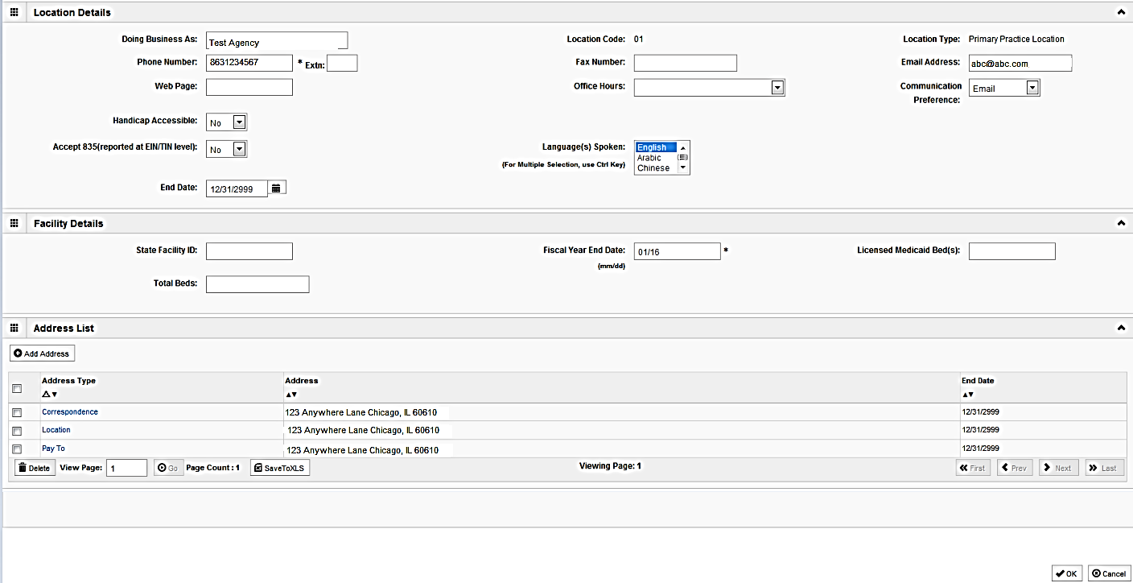
Step 2: Add Locations
After all addresses have been entered click on OK.
Shortcut to Step:
1
2
3
4
5
6
7
8
9
10
11
12

Slide 18
Step 2: Add Locations
To list an Other Servicing Location address, click on Add and enter the address information for that location.
For Other Servicing Location, in addition to the location address itself, a Correspondence address is also required.
Once all location addresses have been entered, click on Close.
Shortcut to Step:
1
2
3
4
5
6
7
8
9
10
11
12

Slide 19
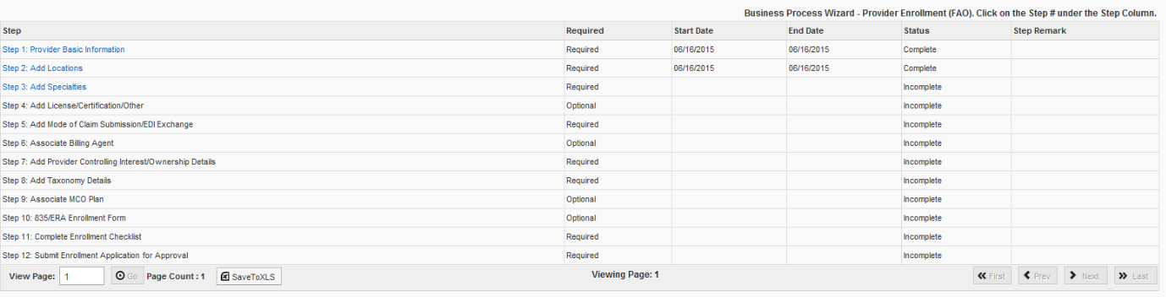
Business Process Wizard (BPW)
You have completed Step 2: Add Locations. The system will place the current date in the End Date field and will place Complete in the corresponding Status field.
Click on Step 3: Add Specialties to continue your application.
Shortcut to Step:
1
2
3
4
5
6
7
8
9
10
11
12

Slide 20
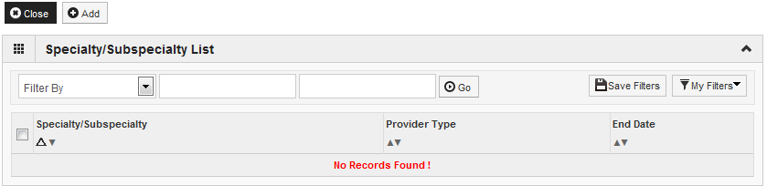
Step 3: Add Specialties
Click on the Add button in the upper left corner.
Shortcut to Step:
1
2
3
4
5
6
7
8
9
10
11
12

Slide 21
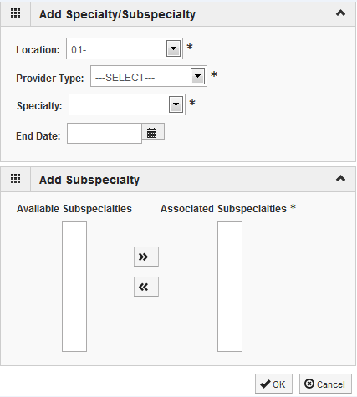
Step 3: Add Specialties
Select your Provider Type from the drop down.
Select your Specialty from the drop down.
Shortcut to Step:
1
2
3
4
5
6
7
8
9
10
11
12

Slide 22
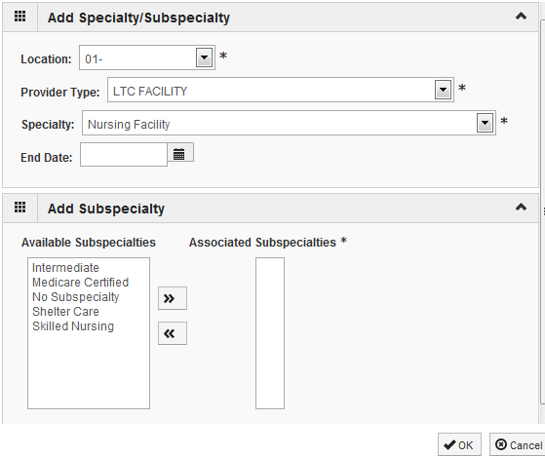
Step 3: Add Specialties
Once the Provider Type and the Specialty are selected, the Subspecialties will populate at the bottom of the screen in the Available Subspecialties box.
The Provider must choose at least one Available Subspecialty (or No Subspecialty) if multiple selections are available.
If only one choice is available, the system will preselect that selection.
Once all desired selections are moved to the Associated Subspecialties box, click OK in the bottom right corner
Click on the Subspecialties then click on the double arrows to move the Subspecialties over to the Associated Subspecialties box.
Shortcut to Step:
1
2
3
4
5
6
7
8
9
10
11
12

Slide 23
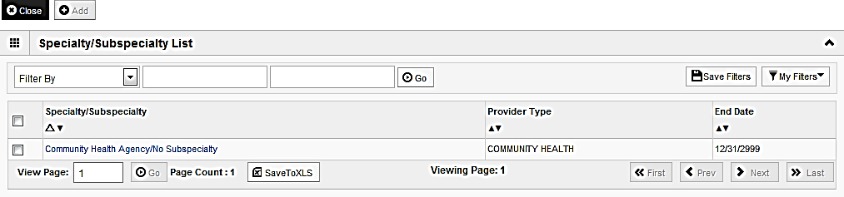
Step 3: Add Specialties
If you have another Specialty to enter click the Add button in the top left corner and repeat the steps as needed.
When all the Specialty information has been entered, click on Close to return to the BPW.
Shortcut to Step:
1
2
3
4
5
6
7
8
9
10
11
12
Notes:
.

Slide 24
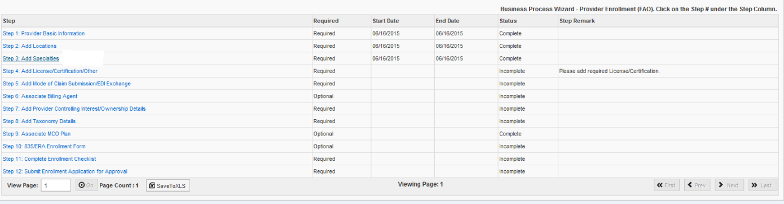
Business Process Wizard (BPW)
You have completed Step 3: Add Specialties. The system will place the current date in the End Date field and will place Complete in the corresponding Status field.
Click on Step 4: Add Licenses/Certifications/Other to continue your application.
Shortcut to Step:
1
2
3
4
5
6
7
8
9
10
11
12

Slide 25
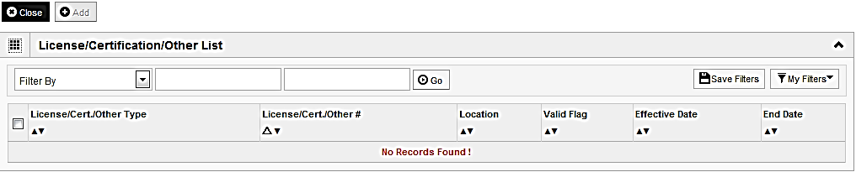
Step 4: Add Licenses/Certifications/Other
Click on the Add button to begin adding Licenses and Certifications.
Shortcut to Step:
1
2
3
4
5
6
7
8
9
10
11
12

Slide 26
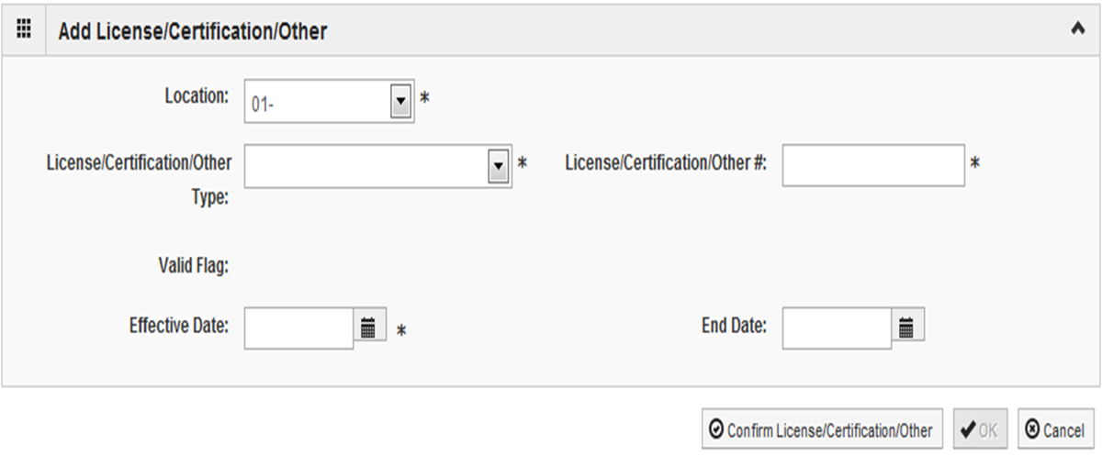
Step 4: Add Licenses/Certifications/Other
Click the drop down menu next to License/Certification Type to select your License/Certification, then enter the License/Certification Number and Effective Date in the appropriate fields. Leave the End Date field blank.
After all information is entered, click on Confirm License/Certification.
Clicking this button will result in the License/Certification being validated and update the Valid Flag to Yes if it is verified to be authentic.
Click Ok.
Shortcut to Step:
1
2
3
4
5
6
7
8
9
10
11
12

Slide 27
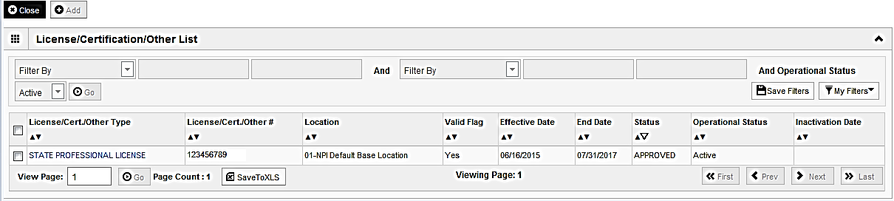
Step 4: Add Licenses/Certifications/Other
If any additional Licenses/Certifications, click on the Add button in the top left corner and repeat the steps.
Click Close once all Licenses/Certifications have been entered to return to the BPW.
Shortcut to Step:
1
2
3
4
5
6
7
8
9
10
11
12

Slide 28
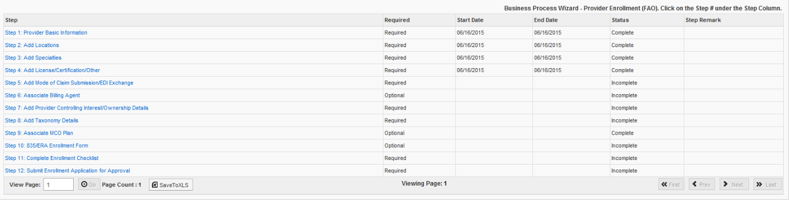
Business Process Wizard (BPW)
You have completed Step 4: Add Licenses/Certifications/Other. The system will place the current date in the End Date field and will place Complete in the corresponding Status field.
Click on Step 5: Add Mode of Claim Submission to continue your application.
Shortcut to Step:
1
2
3
4
5
6
7
8
9
10
11
12

Slide 29
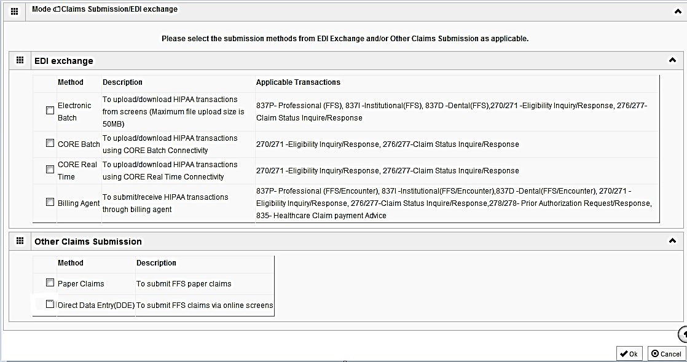
Step 5: Mode of Claim Submission
EDI Exchange
  A New Enrollment will need to complete the necessary external application at http://www.myhfs.illinois.gov/ unless using a Billing Agent or submitting Paper Claims.
P
P
  Select any of the six options to indicate how you wish to process claims.
  Must select at least one option or claims will not be processed.
  After claim submission types have been selected click OK.
Shortcut to Step:
1
2
3
4
5
6
7
8
9
10
11
12
Notes:
*****Choosing Billing Agent will require that a billing agent be associated to the application.*****
****Electronic Batch must be selected prior to being able to select either of the CORE options.****

Slide 30
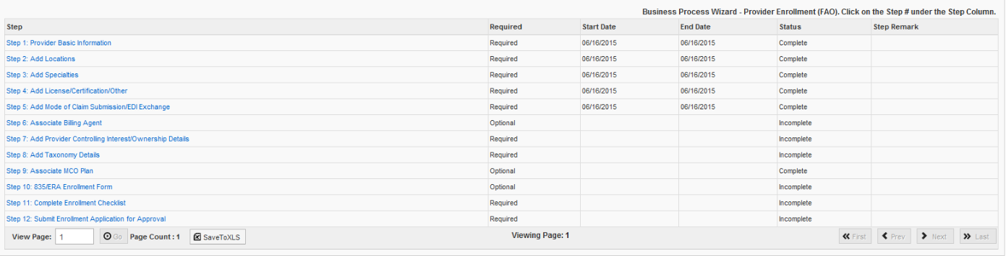
Business Process Wizard (BPW)
You have completed Step 5: Add Mode of Claim Submission The system will place the current date in the End Date field and will place Complete in the corresponding Status field.
Click on Step 6: Associate Billing Agent to continue your application.
Shortcut to Step:
1
2
3
4
5
6
7
8
9
10
11
12

Slide 31

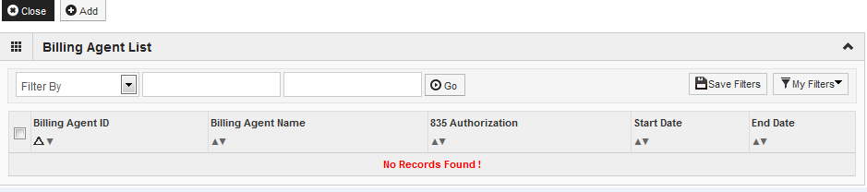
Step 6: Associate Billing Agent
Click Add to input a Billing Agent.
Shortcut to Step:
1
2
3
4
5
6
7
8
9
10
11
12

Slide 32
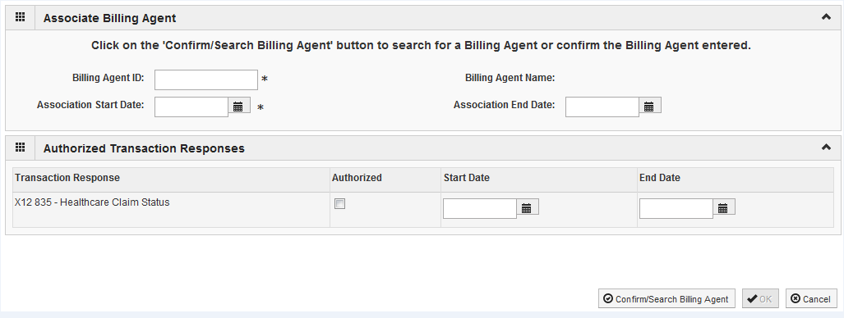
Step 6: Associate Billing Agent
Complete the Billing Agent information then click Confirm/Search Billing Agent and verify that the Billing Agent Name field is auto-populated with the correct agent.
Click OK to return to the billing agent list.
If the Billing Agent info is not known, click on Confirm/Search Billing Agent to locate the desired Billing Agent from the list.
Shortcut to Step:
1
2
3
4
5
6
7
8
9
10
11
12

Slide 33
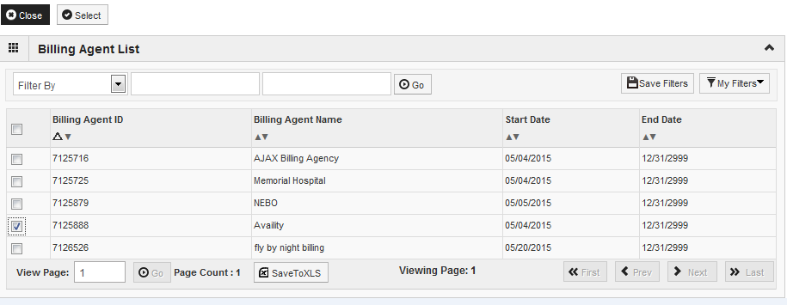
Step 6: Associate Billing Agent
Use the Filter By drop down and choose an option to filter the list of available billing agents. (% is the wild card function)
After the desired Billing Agent is shown on the list, click the check box for that option, then click Select.
Shortcut to Step:
1
2
3
4
5
6
7
8
9
10
11
12

Slide 34
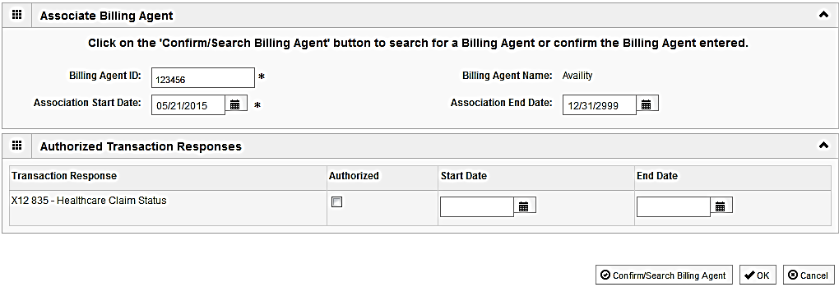
Step 6: Associate Billing Agent
The chosen billing agent information will be populated. Verify that the information is correct then, click OK to return to the Billing Agent list.
Shortcut to Step:
1
2
3
4
5
6
7
8
9
10
11
12

Slide 35
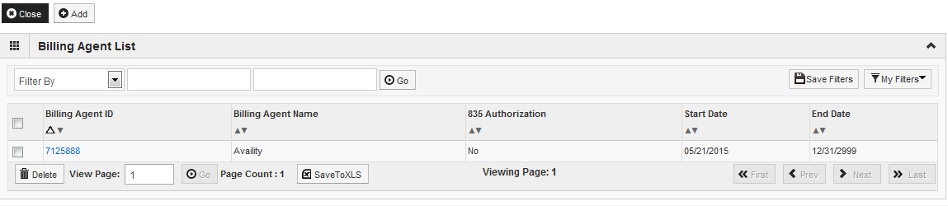
Step 6: Associate Billing Agent
To associate to an additional Billing Agent, click Add and repeat the steps.
When all billing agents have been entered, click Close to return to the BPW.
Shortcut to Step:
1
2
3
4
5
6
7
8
9
10
11
12

Slide 36
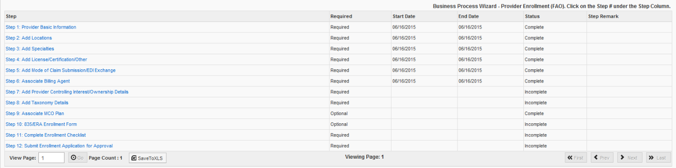
Business Process Wizard (BPW)
You have completed Step 6: Associate Billing Agent The system will place the current date in the End Date field and will place Complete in the corresponding Status field.
Click on Step 7: Add Provider Controlling Interest/Ownership Details to continue your application.
Shortcut to Step:
1
2
3
4
5
6
7
8
9
10
11
12

Slide 37
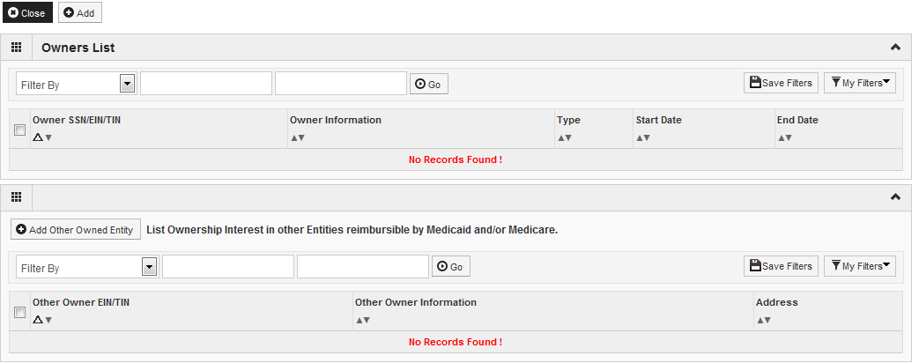
Step 7: Controlling Interest/Ownership
Ownership entries must include at least one Managing Employee and one other Ownership type.
To add Ownership listings, click on Add.
Shortcut to Step:
1
2
3
4
5
6
7
8
9
10
11
12
Notes:
*****Additional ownership types may be required based on previously entered ownership types.*****

Slide 38
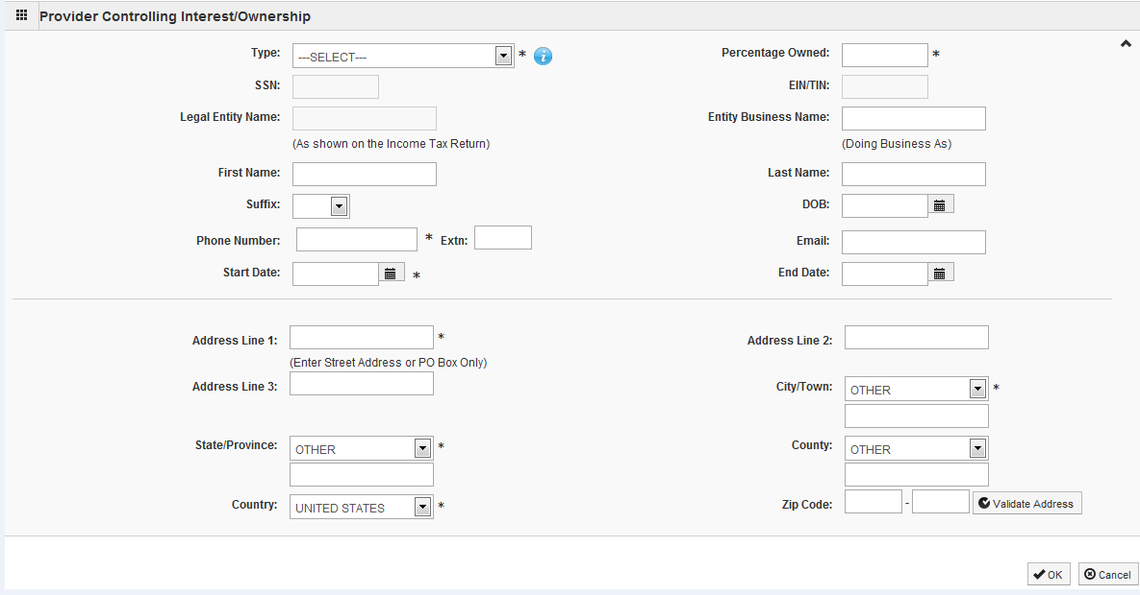
Step 7: Controlling Interest/Ownership
Please complete all fields. At a minimum, all fields with an * are required.
or
Either your SSN or EIN/TIN must be entered.
Enter Percentage Owned as a whole number.
Enter the street address and zip code information, then click Validate Address.
When all details are entered, click OK.
Shortcut to Step:
1
2
3
4
5
6
7
8
9
10
11
12
Notes:
*****The system will prompt as to whether the SSN or EIN/TIN is required.*****

Slide 39
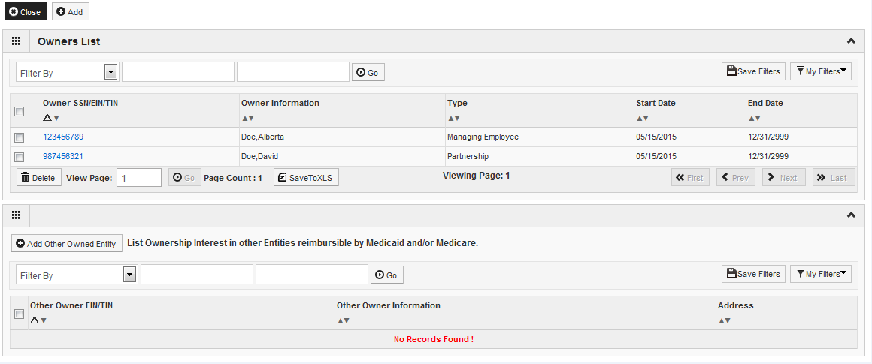
Step 7: Controlling Interest/Ownership
Click Add and repeat the previous steps to list additional owners
After all ownerships have been added, click the hyperlink for the owner listed to complete the relationship and adverse legal disclosure.
This will need to be repeated for each listed owner.
Shortcut to Step:
1
2
3
4
5
6
7
8
9
10
11
12

Slide 40
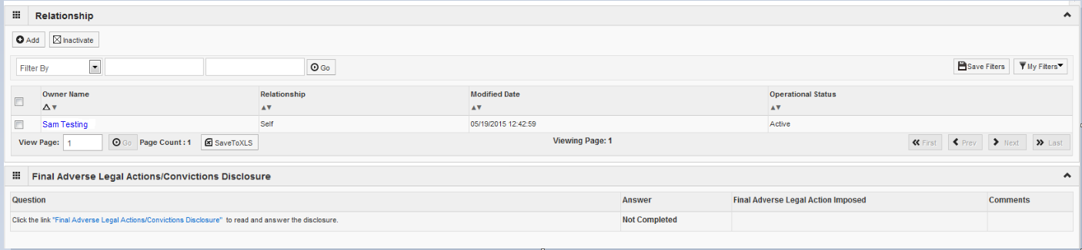
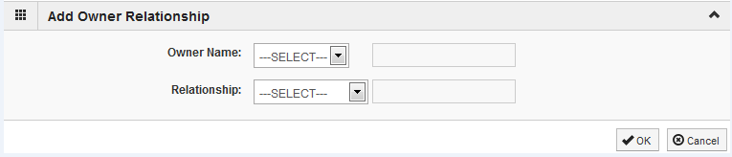
Step 7: Controlling Interest/Ownership
Scroll down to the relationship section then, click Add.
From the first drop down list of Owner Name, choose an owner name.
From the second drop down list of Relationships, choose how the chosen owner is related to the listed owner.
Repeat this step until the relationship is set for each owner.
When completed, click OK to return to the ownership listing.
Shortcut to Step:
1
2
3
4
5
6
7
8
9
10
11
12

Slide 41
Step 7: Controlling Interest/Ownership
Scroll down and click on the Final Adverse Legal Actions/Convictions Disclosure hyperlink.
Shortcut to Step:
1
2
3
4
5
6
7
8
9
10
11
12

Slide 42
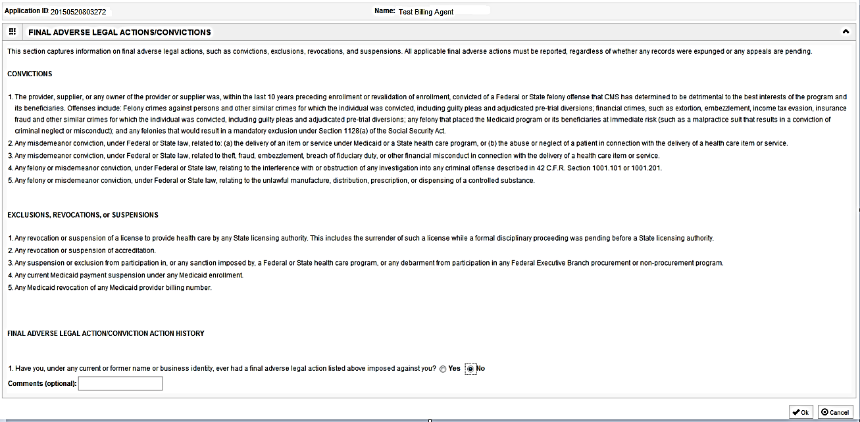
Step 7: Controlling Interest/Ownership
With regards to the chosen Owner, read through the listed information and answer the question and enter comments if desired.
Click OK when completed.
Repeat these steps for each listed Owner.
Shortcut to Step:
1
2
3
4
5
6
7
8
9
10
11
12

Slide 43
Step 7: Controlling Interest/Ownership
It is required that ownership of 5% or more in any other Medicaid/Medicare entity be entered.
To enter Ownership details in another Medicaid/Medicare Entity, click on Add Other Owned Entity.
Shortcut to Step:
1
2
3
4
5
6
7
8
9
10
11
12

Slide 44
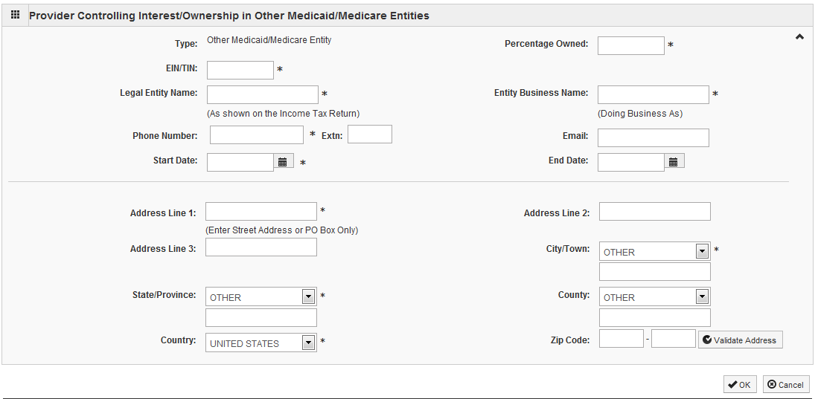
Step 7: Controlling Interest/Ownership
After entering the street address and zip code, click Validate Address.
When all information is complete, click OK.
Repeat these steps to add ownership in another Medicaid/Medicare Entity.
Shortcut to Step:
1
2
3
4
5
6
7
8
9
10
11
12

Slide 45
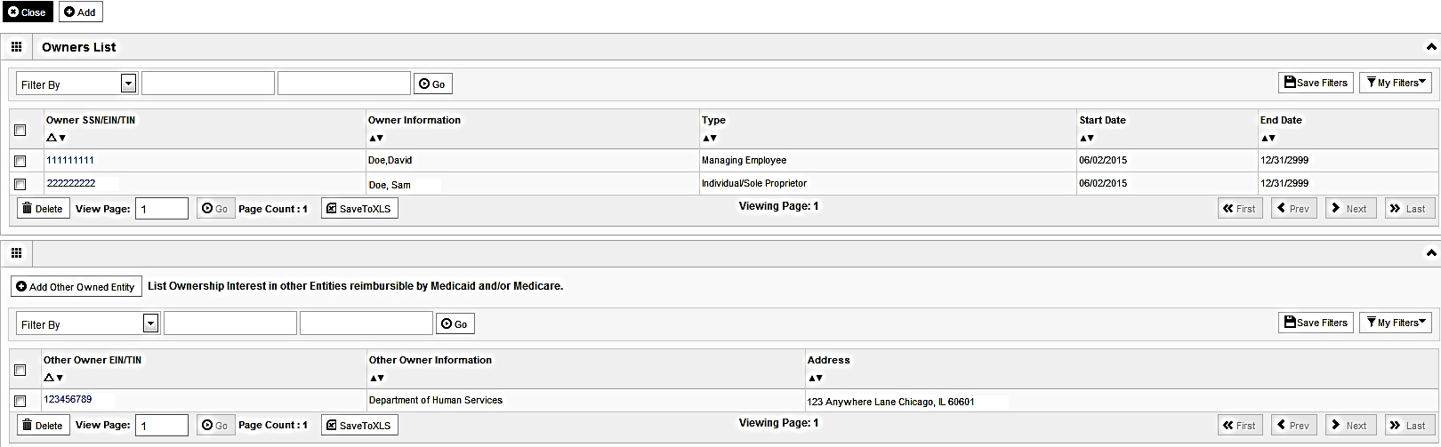
Step 7: Controlling Interest/Ownership
When all ownerships for this location and ownership information in other entities is complete, click Close.
Shortcut to Step:
1
2
3
4
5
6
7
8
9
10
11
12

Slide 46
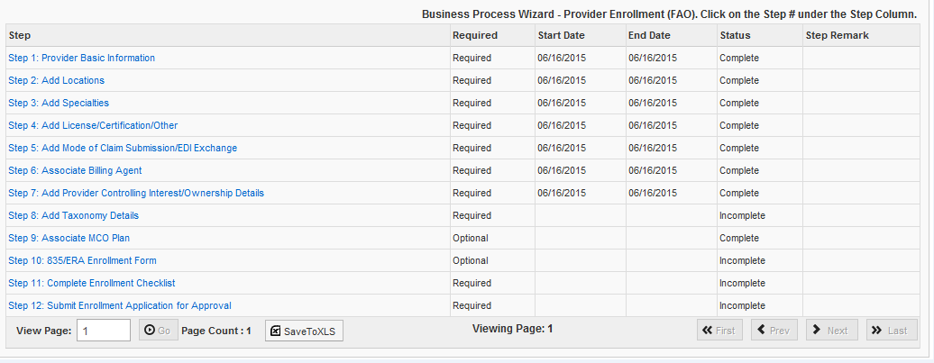
Business Process Wizard (BPW)
You have completed Step 7: Add Provider Controlling Interest/Ownership Details . The system will place the current date in the End Date field and will place Complete in the corresponding Status field.
Click on Step 8: Add Taxonomy Details to continue your application.
Shortcut to Step:
1
2
3
4
5
6
7
8
9
10
11
12

Slide 47
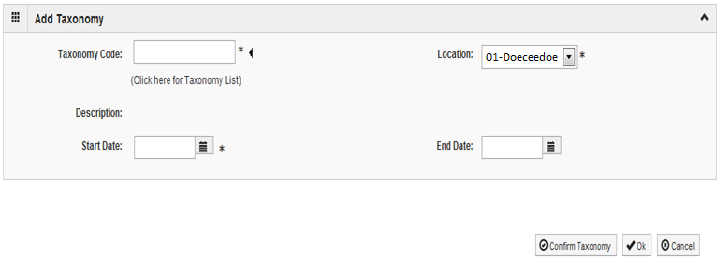
Step 8: Add Taxonomy Details
To add new Taxonomy Details, enter the Taxonomy Code and the Start Date.
Click on Confirm Taxonomy and verify Description is populated correctly.
Click on OK to finalize the submission.
Shortcut to Step:
1
2
3
4
5
6
7
8
9
10
11
12

Slide 48
Step 8: Add Taxonomy Details
If the code is not known, click on the t to the right of the box to access The National Uniform Claim Committee Taxonomy Code list. This will open a web browser window.
At least one of the Taxonomy Codes entered in IMPACT must be the Taxonomy Code registered with the National Plan and Provider Enumeration System (NPPES).
Shortcut to Step:
1
2
3
4
5
6
7
8
9
10
11
12

Slide 49
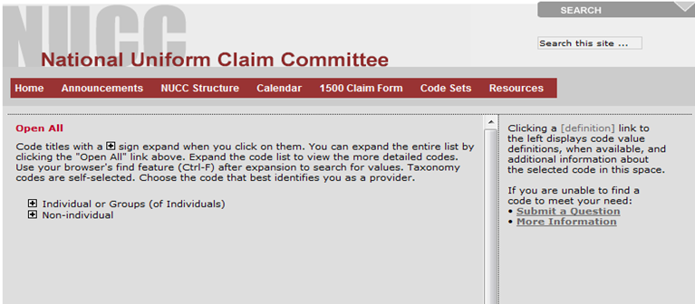
Step 8: Add Taxonomy Details
In the web browser window that opens will be a list of provider types.
Click + next to the appropriate provider type for your enrollment.
Shortcut to Step:
1
2
3
4
5
6
7
8
9
10
11
12

Slide 50
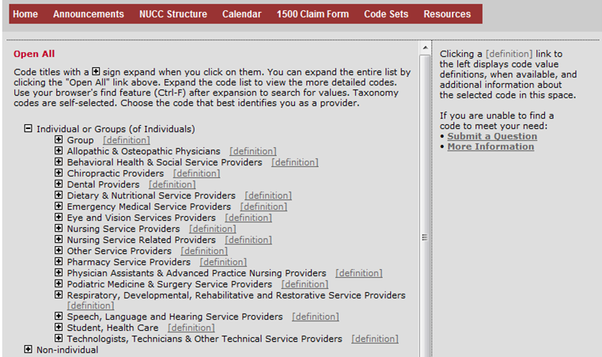
Step 8: Add Taxonomy Details
Click on the + next to the appropriate profession listed under the heading which you previously selected.
Shortcut to Step:
1
2
3
4
5
6
7
8
9
10
11
12

Slide 51
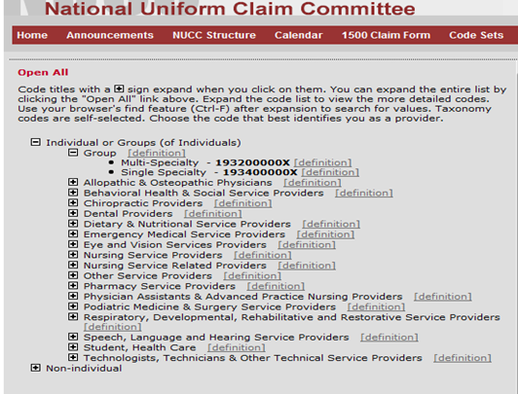
Step 8: Add Taxonomy Details
Choose and write down your Taxonomy Code, then click the X on the top right of the page.
Shortcut to Step:
1
2
3
4
5
6
7
8
9
10
11
12

Slide 52
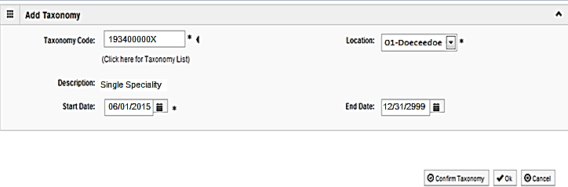
Step 8: Add Taxonomy Details
Enter the Taxonomy Code and the Start Date.
Click on Confirm Taxonomy and verify Description is populated correctly.
Click on OK to finalize the submission.
Shortcut to Step:
1
2
3
4
5
6
7
8
9
10
11
12

Slide 53
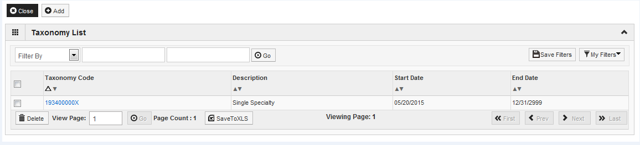
Step 8: Add Taxonomy Details
Repeat the steps by clicking on the Add button for any additional Taxonomy Codes that need to be entered.
Otherwise, click on the Close button in the upper left corner.
Shortcut to Step:
1
2
3
4
5
6
7
8
9
10
11
12

Slide 54
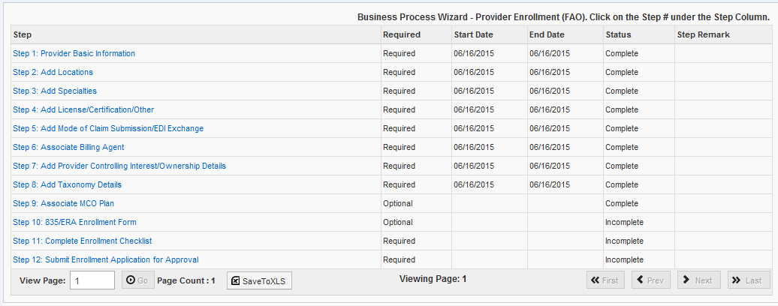
Business Process Wizard (BPW)
You have completed Step 8: Add Taxonomy Details. The system will place the current date in the End Date field and will place Complete in the corresponding Status field.
Click on Step 9: Associate MCO Plan to continue your application.
Shortcut to Step:
1
2
3
4
5
6
7
8
9
10
11
12

Slide 55
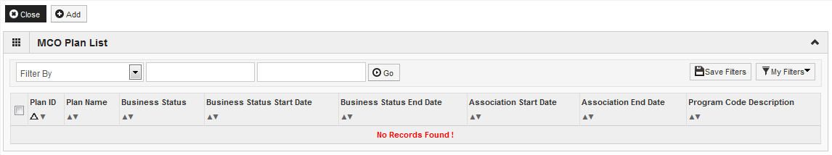
Step 9: Associate MCO Plan
Click Add to associate a MCO plan for which there is a current valid contract.
Specific MCO plans can be added only once to the application.
Shortcut to Step:
1
2
3
4
5
6
7
8
9
10
11
12
Notes:
******If no MCO contract established, need not associate to an MCO plan.*****

Slide 56
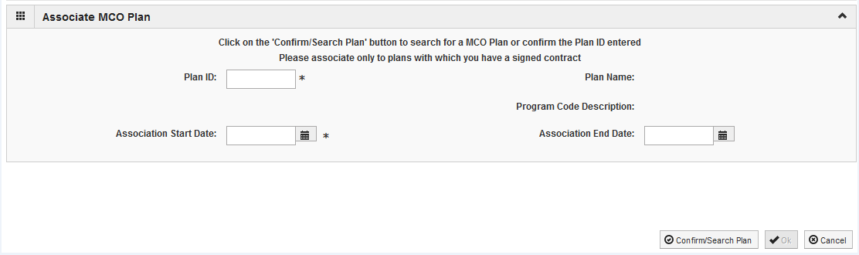
Step 9: Associate MCO Plan
Enter a Plan ID and Association Start Date (or, the date of the application).
End Date: Leave blank.
Click Confirm/Search Plan and verify the Plan Name populated correctly then, click OK.
If the MCO Plan information is not known, click on Confirm/Search Plan.
Shortcut to Step:
1
2
3
4
5
6
7
8
9
10
11
12

Slide 57
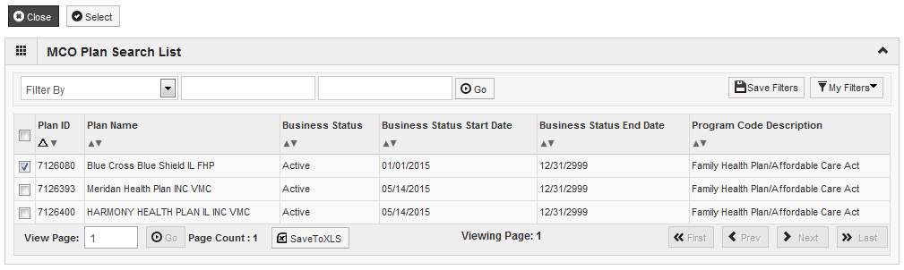
Step 9: Associate MCO Plan
Utilize the Filter By drop down and enter the desired information to filter the list of available MCO plans. (% is a wild card).
Review the entries and click on the checkbox next to the line with the desired MCO information.
Click Select to return to the MCO summary screen.
Shortcut to Step:
1
2
3
4
5
6
7
8
9
10
11
12

Slide 58

Step 9: Associate MCO Plan
The chosen MCO plan information should be populated. Verify it is correct then click OK.

Slide 59

Step 9: Associate MCO Plan
Click Add to Associate to an additional MCO Plan.
When all MCO Plans have been entered, click Close to return to the BPW.
Shortcut to Step:
1
2
3
4
5
6
7
8
9
10
11
12

Slide 60

Business Process Wizard (BPW)
You have completed Step 9: Associate MCO Plan . The system will place the current date in the End Date field and will place Complete in the corresponding Status field.
Click on Step 10: 835/ERA Enrollment Form to continue your application.
Shortcut to Step:
1
2
3
4
5
6
7
8
9
10
11
12

Slide 61

Step 10: Complete 835/ERA
Please complete this section once you have completed the enrollment steps found at http://www.myhfs.illinois.gov/ if you wish to participate in 835/ERA, otherwise close this step.
Verify the generated information and complete information if needed.
Use the scroll bar to move down the page.
Shortcut to Step:
1
2
3
4
5
6
7
8
9
10
11
12

Slide 62

Step 10: Complete 835/ERA
Select your method of retrieval from the drop-down menu.
Scroll down further.
Shortcut to Step:
1
2
3
4
5
6
7
8
9
10
11
12

Slide 63

Step 10: Complete 835/ERA
Checkbox to authorize the creation of an 835/ERA account then the signature portion will be populated.
When complete, click Submit then Close.
Shortcut to Step:
1
2
3
4
5
6
7
8
9
10
11
12

Slide 64

Business Process Wizard (BPW)
You have completed Step 10: 835/ERA Enrollment Form. The system will place the current date in the End Date field and will place Complete in the corresponding Status field.
Click on Step 11: Complete Enrollment Checklist to continue your application.
Shortcut to Step:
1
2
3
4
5
6
7
8
9
10
11
12

Slide 65

Step : Associate Billing Agent
Step 11: Complete Enrollment Checklist
All questions must be answered either Yes or No and comments made if directed to do so, if a checklist item does not apply, select No as the answer.
After all of the questions have been answered and comments made, click on the Save button in the upper left corner followed by clicking on the Close button.
Shortcut to Step:
1
2
3
4
5
6
7
8
9
10
11
12

Slide 66

Business Process Wizard (BPW)
You have completed Step 11: Complete Enrollment Checklist. The system will place the current date in the End Date field and will place Complete in the corresponding Status field.
Click on Step 12: Submit Enrollment Application for Approval to continue your application.
Shortcut to Step:
1
2
3
4
5
6
7
8
9
10
11
12

Slide 67

Step 12: Submit Enrollment for Approval
Click Next to confirm that all of the information that you have submitted as a part of the application is accurate.
Shortcut to Step:
1
2
3
4
5
6
7
8
9
10
11
12

Slide 68

Step 12: Submit Enrollment for Approval
Read through all of the terms and conditions.
Check the box certifying that you agree to the terms and conditions.
Then select Submit Application.
Shortcut to Step:
1
2
3
4
5
6
7
8
9
10
11
12

Slide 69

Business Process Wizard (BPW)
The below message will appear advising that the application has been submitted to the state for review. The application number can to used to check the status of the application by going through the track application option.
Click OK in the message box.
Shortcut to Step:
1
2
3
4
5
6
7
8
9
10
11
12

Slide 70

Business Process Wizard (BPW)
You have completed Step 12: Submit Enrollment Application for Approval. The system will place the current date in the End Date field and will place Complete in the corresponding Status field.
Shortcut to Step:
1
2
3
4
5
6
7
8
9
10
11
12

Slide 71
Resources
For more information regarding IMPACT, please visit http://www.illinois.gov/hfs/impact/Pages/AboutIMPACT.aspx
Check out the definitions of common terms at http://www.illinois.gov/hfs/impact/Pages/Glossary.aspx

Slide 72
Questions and Answers
FAQ’s can be found at http://www.illinois.gov/hfs/impact/Pages/faqs.aspx to help resolve common questions and problems when submitting applications.
General questions regarding IMPACT can be addressed to:
    Email: IMPACT.Help@Illinois.gov
    Phone: 1-877-782-5565
        Choose option 1 for IMPACT Help

