Slide 1

ILLINOIS PROVIDER ENROLLMENT
Provider Domain Administrator:
Granting Access Rights
Changing Access Rights
Removing Access Rights

Slide 2

Domain Administrator
The user who submits an application to the State for approval becomes the Domain Administrator over that enrollment after the application has been approved by the State.

Slide 3
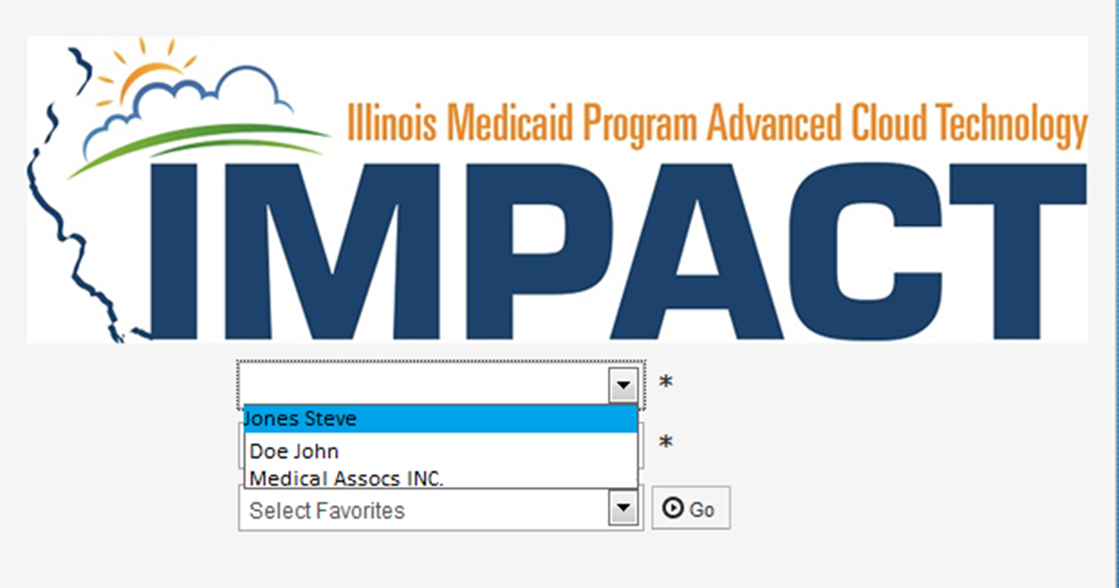
Granting Access Rights
After logging into IMPACT, from the first drop down on the Portal page, select the enrollment for which access rights are being granted.

Slide 4
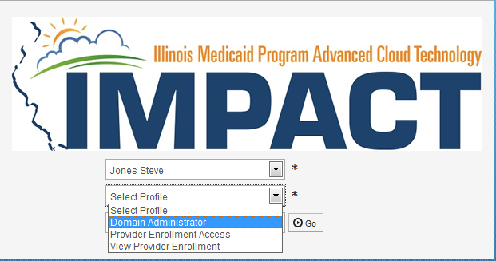
Granting Access Rights
Profiles:
  Domain Administrator: Grants and Removes Rights to an enrollment only.
  Provider Enrollment Access: Completes, modifies and manages enrollment.
  View Provider Enrollment: View only access.

Slide 5
Granting Access Rights
From the second drop down on the portal page, select Domain Administrator.
Click Go.

Slide 6
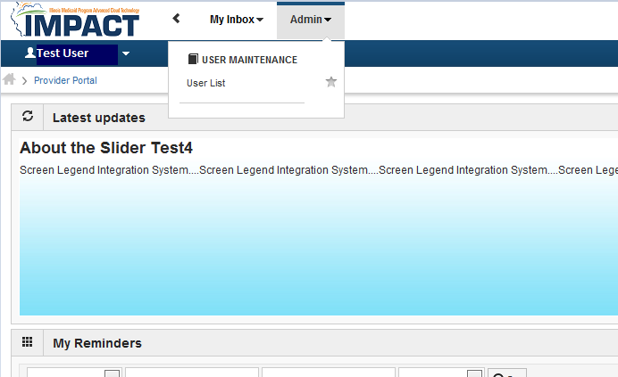
Granting Access Rights
From the IMPACT Home Page, click on the Admin and choose User List from the drop down.

Slide 7
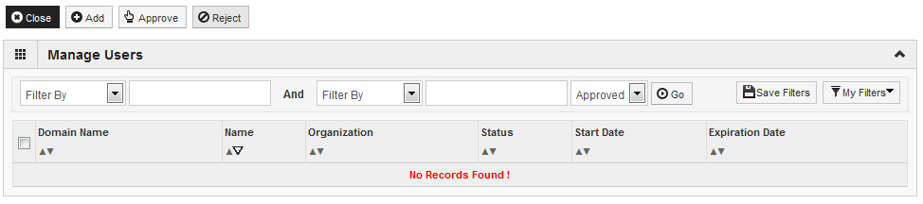
Granting Access Rights
Click Add to grant access to this enrollment.

Slide 8
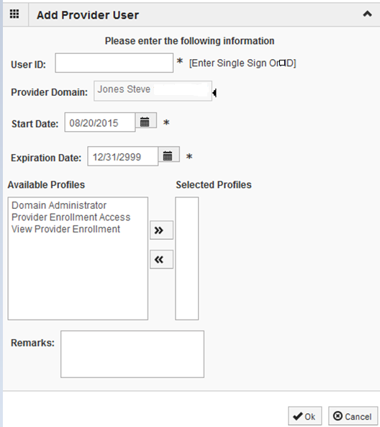
Granting Access Rights
User ID: Enter the User Id (Single Sign-on ID) of the person to whom access is being granted.
Start Date: Enter current or future date.
End Date: Enter a specific date if known or, if rights are ongoing, leave blank and it will default to 12/31/2999.
Choose the desired profile(s) from Available Profiles and use the double arrows to move them to Selected Profiles.
Click Ok when complete.

Slide 9
Granting Access Rights
Even though, No records found is presented, the selected user has been granted access to the enrollment chosen.
Click Close to exit.

Slide 10
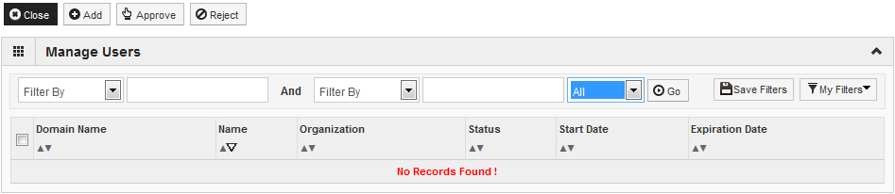

Granting Access Rights
Near the filter by fields is a drop down that defaults to Approved. Choose All from this drop down.
Click Go.

Slide 11
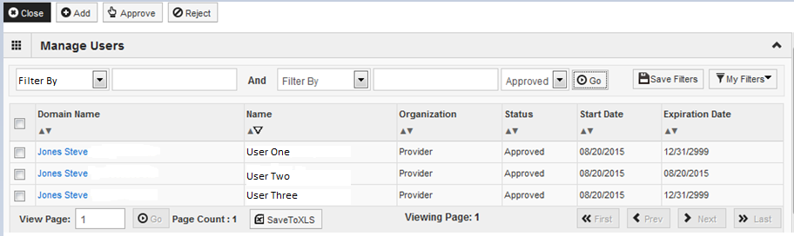
Granting Access Rights
A list of all users who have access to this enrollment will be displayed. To see what access each user has, click on the hyperlinked Domain Name.

Slide 12
This slide was intentionally left blank

Slide 13
Changing Access Rights
After logging into IMPACT, from the first drop down on the Portal page, select the enrollment for which access rights are being changed.

Slide 14
Changing Access Rights
From the second drop down on the portal page, select Domain Administrator.
Click Go.

Slide 15
Changing Access Rights
From the IMPACT Home Page, click on the Admin and choose User List from the drop down.

Slide 16
Changing Access Rights
Near the filter by fields is a drop down that defaults to Approved. Choose All from this drop down.
Click Go.

Slide 17
Changing Access Rights
Locate the user Name for whom access rights are being changed, then click on the respective hyperlinked Domain Name.

Slide 18
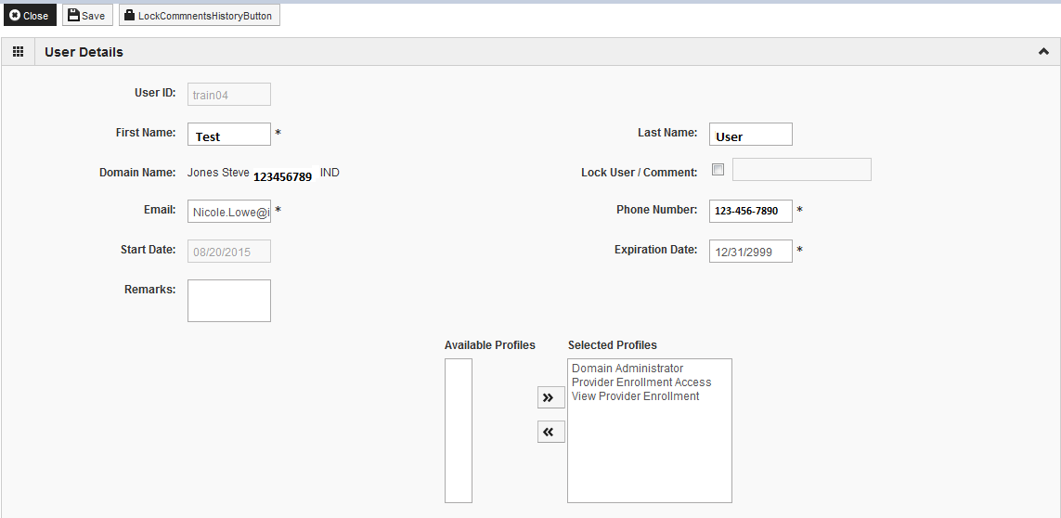
Changing Access Rights
To change the access rights granted, choose the profiles to be removed from the Selected Profiles box and use the double arrows to move them to the Available Profiles box or from Available Profiles to Selected Profiles as needed. There must be at least one profile left under Selected Profiles.
Comments about the change can be made in the Remarks field.
Click Save, then Close.

Slide 19
Changing Access Rights
To change the access rights granted, choose the profiles to be removed from the Selected Profiles box and use the double arrows to move them to the Available Profiles box.
Comments about the change can be made in the Remarks field.
Click Save, then Close.

Slide 20
This page intentionally left blank

Slide 21
Removing Access Rights
After logging into IMPACT, from the first drop down on the Portal page, select the enrollment for which access rights are being removed.

Slide 22
Removing Access Rights
From the second drop down on the portal page, select Domain Administrator.
Click Go.

Slide 23
Removing Access Rights
From the IMPACT Home Page, click on the Admin and choose User List from the drop down.

Slide 24
Removing Access Rights
Near the filter by fields is a drop down that defaults to Approved. Choose All from this drop down.
Click Go.

Slide 25
Changing Access Rights
Locate the user Name for whom access rights are being removed, then click on the respective hyperlinked Domain Name.

Slide 26
Removing Access Rights
To entirely remove a person’s rights to the enrollment (Lock user), place a check in the box next to Lock User/Comment and enter a comment in the comment box.
Enter the date this is to take effect in the Expiration Date field.
Click Save, then Close.

Slide 27
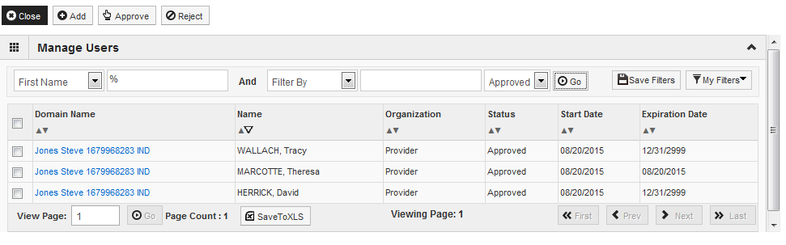
Removing Access Rights
The Expiration Date for that user’s access will be updated on the Manage Users list.
Click Close to exit.

