Slide 1

ILLINOIS PROVIDER ENROLLMENT
Billing Agent
Notes:
.

Slide 2
Agenda
Pre-Application Checklist
Introduction to IMPACT and Key Terms
Application Process
Starting an Application
The Business Process Wizard (BPW)
Completing the Application using the BPW
Reviewing Submitted Application
Resources
Questions & Answers
Notes:
.

Slide 3
Introduction and Key Terms
IMPACT is a multi-agency effort to replace Illinois’ 30-year-old Medicaid Management Information System (MMIS) with a web-based system that meets federal requirements, is more convenient for providers and increases efficiency by automating and expediting state agency processes.
Key Terms:
  Billing Agent: Submits Medicaid HIPAA compliant Transactions or exchanges EPHI with Medicaid providers or other authorized parties. Also known as Clearing House, Software Vendor or Value Added Network (VAN).
  New Enrollment: A billing agent who needs to enroll in the IMPACT system.
  Enrollment Timeline:
  Billing Agents will need to enroll into IMPACT starting in July 2015.
    NOTE: A Billing Agent must be enrolled in IMPACT in order for a provider to associate with that Billing Agent.

Slide 4
Application Process
Step 1: Provider Basic Information
Step 2: Mode of Claim Submission
Step 3: Add Ownership Details
Step 4: Complete Enrollment Checklist
Step 5: Submit Enrollment for Approval
Pressing this button on any screen will bring you back to this menu.
Pressing any of the buttons below will skip to that step of the presentation
Shortcut to Step:
1
2
3
4
5

Slide 5
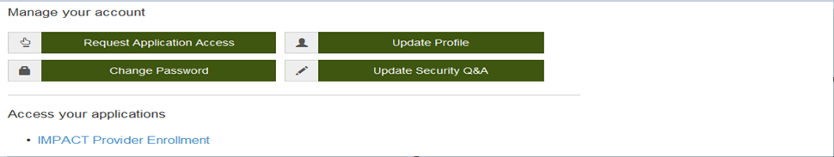
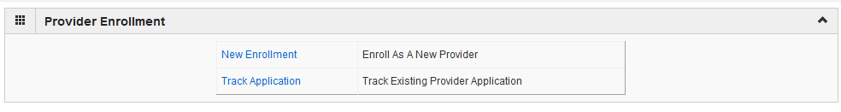
Start Application
After you have completed the single sign-on, click on IMPACT Provider Enrollment.
In regards to completing an application, there are two options:
New Enrollment or Resuming an application.
Shortcut to Step:
1
2
3
4
5
Notes:
Click

Slide 6
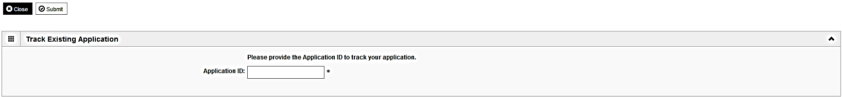
Start Application
To access a previously started application, click on Track Application.
The application ID was sent to the email in the single sign-on account.
Enter the Application ID then, click Submit.
You will be taken directly to the Business Process Wizard.
Shortcut to Step:
1
2
3
4
5
Notes:
Click

Slide 7
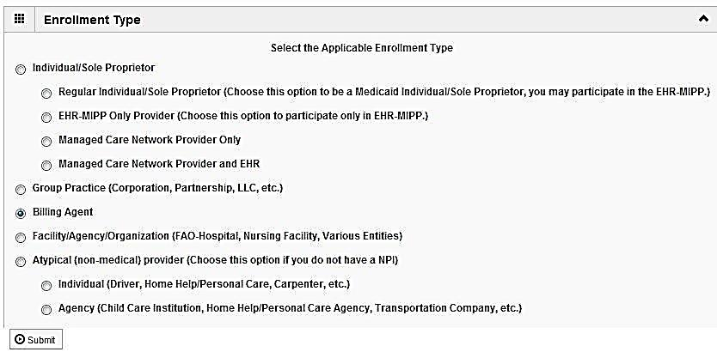
Start Application
To begin a new application, click on New Enrollment.
Use the radio buttons to select your enrollment type (Billing Agent), then click on Submit in the lower left corner.
Shortcut to Step:
1
2
3
4
5
Notes:
Click

Slide 8
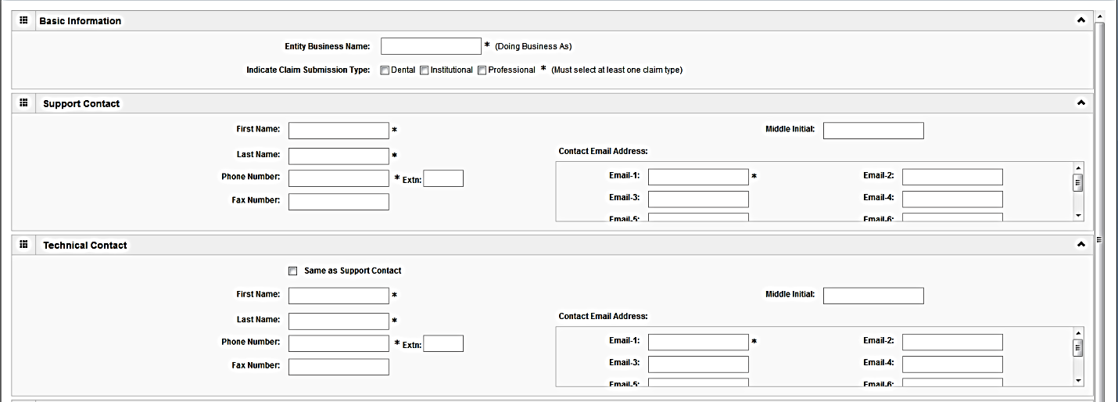
Start Application
(Step 1: Basic Provider Information)
Please complete all fields. At a minimum, all fields with an * are required.
It is necessary to enter a Support Contact and a Technical Contact.
If the Technical Contact is the same as the Support Contact, check the box next to Same as Support Contact.
Use the scroll bar to move down the screen.
Shortcut to Step:
1
2
3
4
5

Slide 9
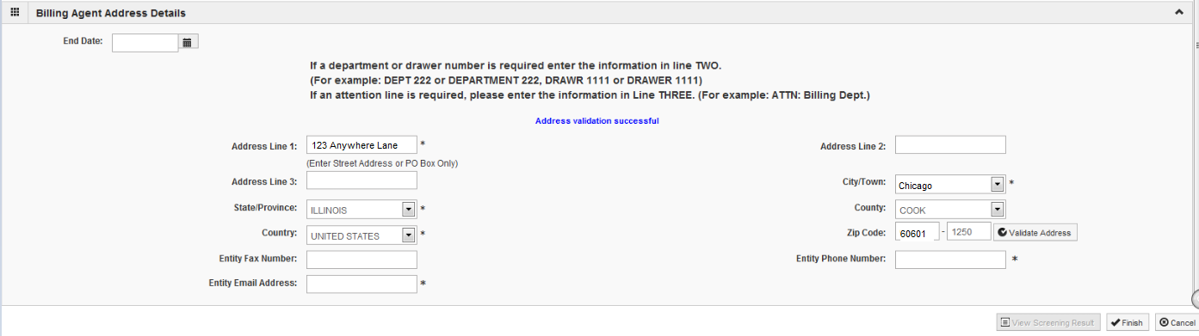
Start Application
(Step 1: Basic Provider Information)
Please complete all fields. At a minimum, all fields with an * are required.
Leave End date blank.
Click Validate Address after the street address and zip code have been entered.
If the address is not validated, check to verify it is correct and update any incorrect information.
When the address has been validated, click Finish.
Shortcut to Step:
1
2
3
4
5

Slide 10
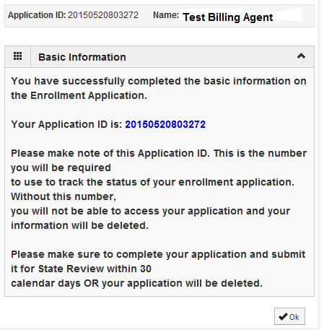
Start Application
(Step 1: Basic Provider Information)
Application ID: systematically generated.
Name: should reflect name from Basic Information.
The system will generate an application ID after the successful completion of the Basic Information screen; the application number is a 14-digit number that has the following components:
  The system date in yyyymmdd format
  A 6-digit system generated random number
  Example: 20130514412598
  Application IDs are valid for 30 calendar days; applications must be completed and submitted to the state for review during this 30 day period or the application will be DELETED.
  The application ID will be used to access the application before submission to the state for review and will be used to track the status of your submitted application until it is marked approved.
  Click OK to continue with your application
Shortcut to Step:
1
2
3
4
5
Notes:
.

Slide 11
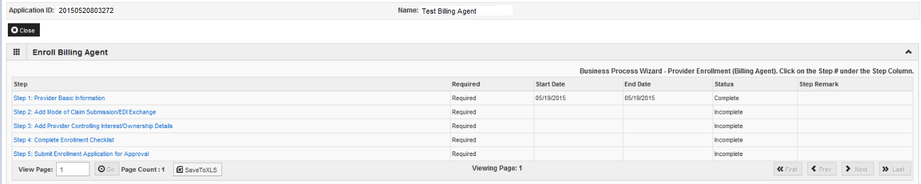
Using the Business Process Wizard (BPW)
The BPW serves as the “Control Center” of the application.
  Required: Steps listed as Optional may change to Required based upon previous steps.
  Dates: Entered by the system; Start Date is the date each step is opened, the End Date is the date each step is completed.
  Status: When a step is completed the Status will be updated to Complete; answering some checklist questions may change a prior step’s status back to Incomplete.
  Step Remark: Remarks are systematically generated throughout the enrollment process.
Shortcut to Step:
1
2
3
4
5

Slide 12
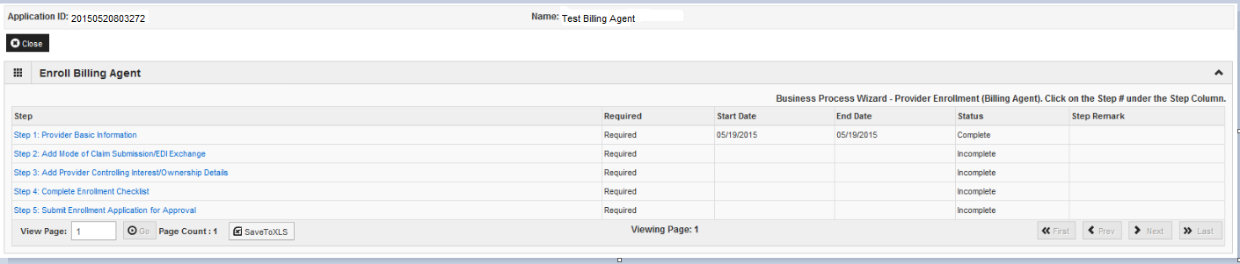
Completing the Application Using BPW
Once you have documented your Application ID, you have completed Step 1: Provider Basic Information. The system will place the current date in the End Date field and will place Complete in the corresponding Status field.
Step 1 must be completed before attempting any of the later steps.
Click on Step 2: Add Mode of Claim Submission/EDI Exchange to continue completing your application.
Shortcut to Step:
1
2
3
4
5

Slide 13
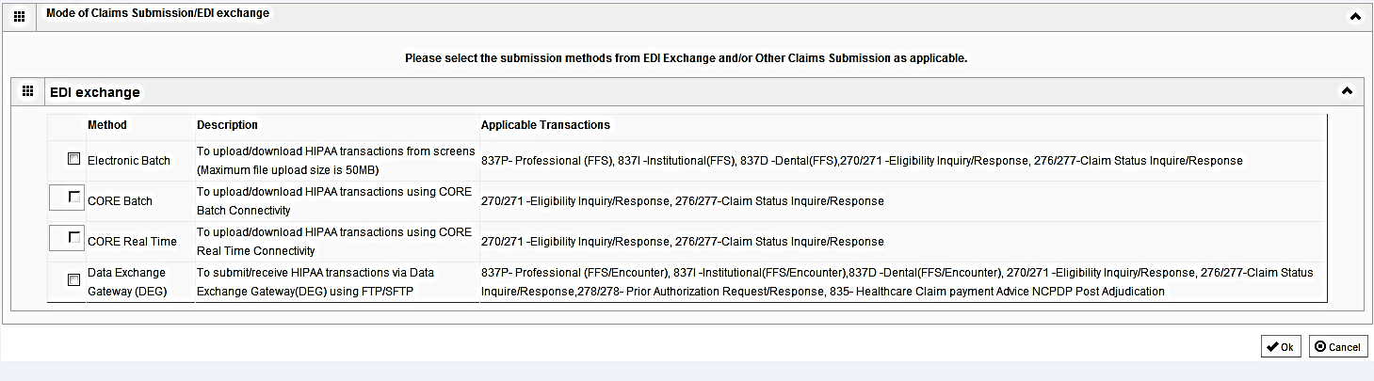
Step 2: Mode of Claim Submission
EDI Exchange
  A New Enrollment will need to complete the necessary external application at http://www.myhfs.illinois.gov/.
P
  Select any of the four options to indicate how you wish to process claims.
  After claim submission types have been selected click OK.
Shortcut to Step:
1
2
3
4
5
Notes:
******Selections made here have no bearing on how claims are currently processed.******

Slide 14
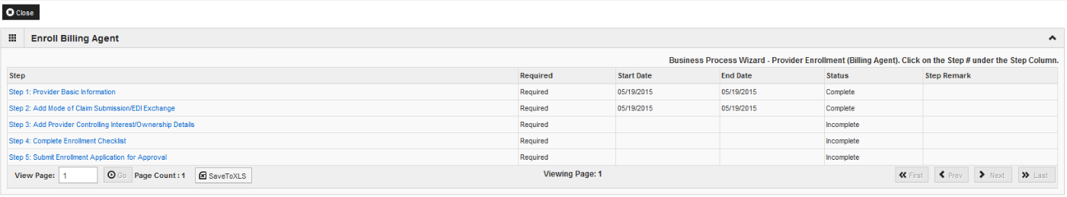
Business Process Wizard (BPW)
You have completed Step 2: Add Mode of Claim Submission/EDI Exchange. The system will place the current date in the End Date field and will place Complete in the corresponding Status field.
Click on Step 3: Add Provider Controlling Interest/Ownership Details to continue your application.
Shortcut to Step:
1
2
3
4
5

Slide 15

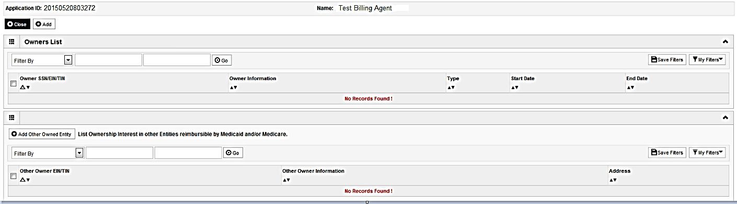
Step 3: Controlling Interest/Ownership
Ownership entries must include at least one Managing Employee and one other Ownership type.
To add Ownership listings, click on Add.
Shortcut to Step:
1
2
3
4
5

Slide 16
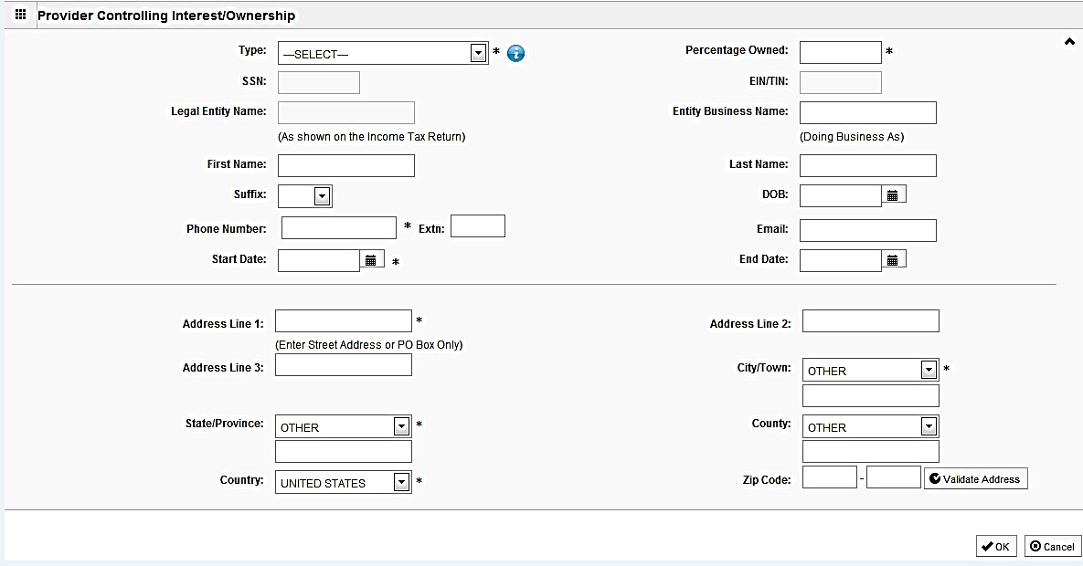
Step 3: Controlling Interest/Ownership
Please complete all fields. At a minimum, all fields with an * are required.
or
Either the SSN or EIN/TIN must be entered (as prompted by the system).
Enter Percentage Owned as a whole number.
Enter the street address and zip code information, then click Validate Address.
When all details are entered, click OK.
Shortcut to Step:
1
2
3
4
5
Notes:
The system will prompt as to whether a SSN or EIN/TIN is needed. This is based on ownership type and enrollment type.

Slide 17
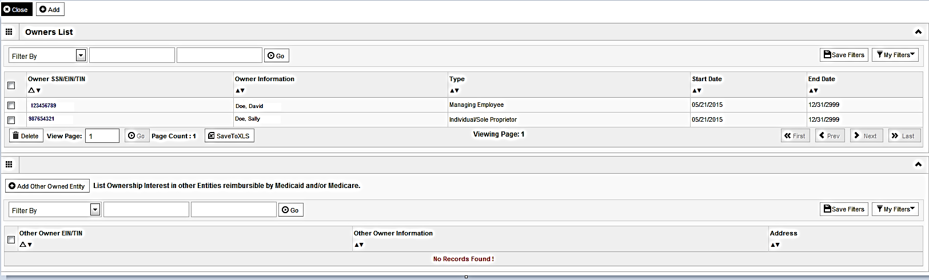
Step 3: Controlling Interest/Ownership
To list additional owners, click Add and repeat the previous steps.
After all ownerships have been listed, click the hyperlink for each Owner listed to specify the relationship between each owner and to complete the Legal Disclosure.
Shortcut to Step:
1
2
3
4
5

Slide 18
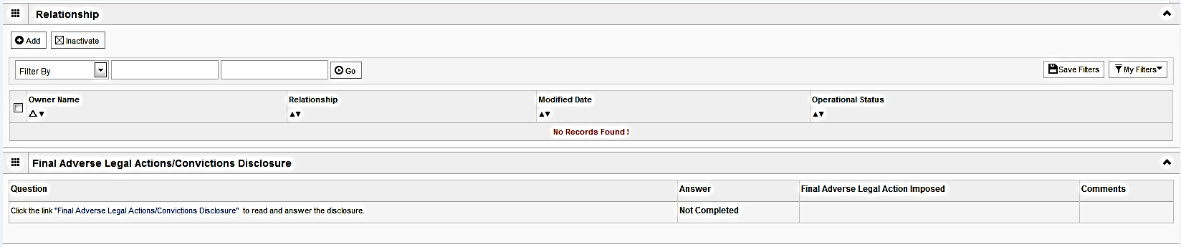
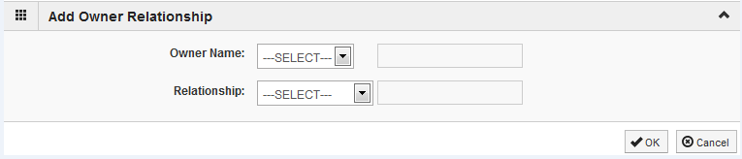
Step 3: Controlling Interest/Ownership
Scroll down the page to the relationship section and click Add.
From the first drop down list of Owner Name, choose an owner name.
From the second drop down list of Relationships, choose how the chosen ownership is related to the listed owner. Repeat these steps until the chosen owner has been related to each person on the list.
When completed, click OK to return to the ownership listing.
Shortcut to Step:
1
2
3
4
5

Slide 19
Step 3: Controlling Interest/Ownership
Scroll down the screen and click on the hyperlink for, Final Adverse Legal Actions/Convictions Disclosure.
Shortcut to Step:
1
2
3
4
5

Slide 20
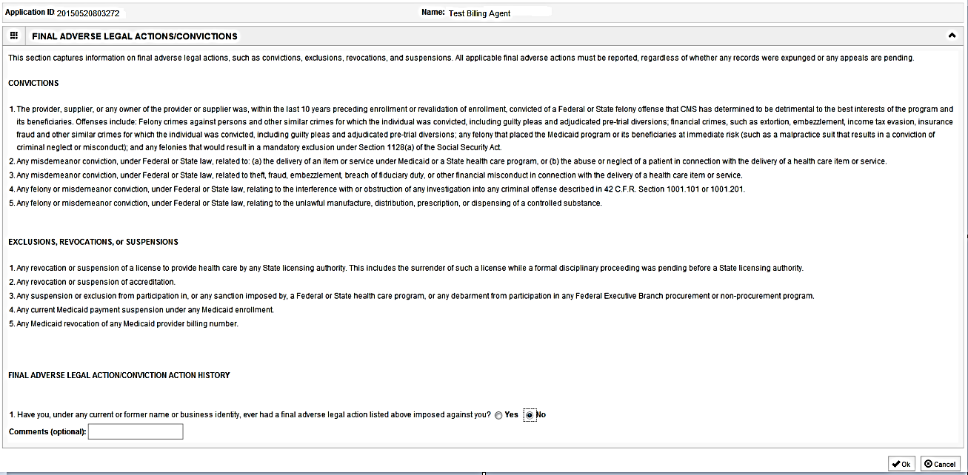
Step 3: Controlling Interest/Ownership
With regards to the chosen Owner, read through the listed information and answer the question and enter comments, if desired.
Click OK when completed.
Repeat these steps for each listed Owner.
Shortcut to Step:
1
2
3
4
5

Slide 21
Step 3: Controlling Interest/Ownership
It is required that ownership of 5% or more in any other Medicaid/Medicare entity be entered.
To enter Ownership details in another Medicaid/Medicare Entity, click on Add Other Owned Entity.
Shortcut to Step:
1
2
3
4
5

Slide 22
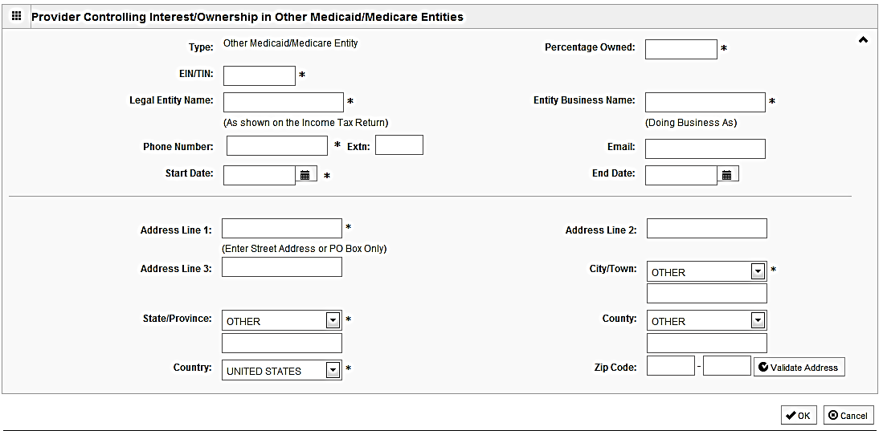
Step 3: Controlling Interest/Ownership
Please complete all fields. At a minimum, all fields with an * are required.
After entering the street address and zip code, click Validate Address.
When all information is complete, click OK.
Repeat these steps to add ownership in another Medicaid/Medicare Entity.
Shortcut to Step:
1
2
3
4
5

Slide 23
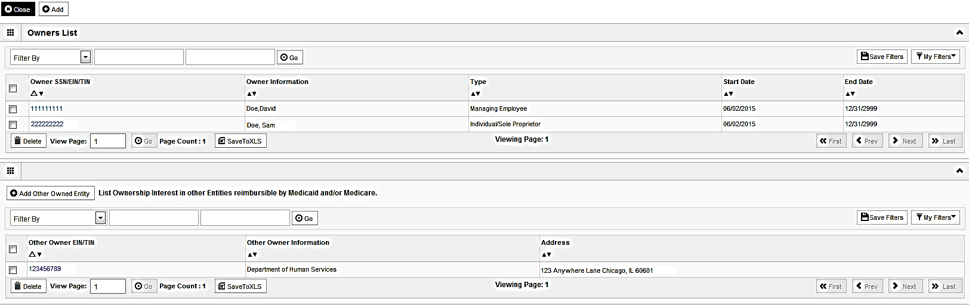
Step 3: Controlling Interest/Ownership
When all ownerships for this location and ownership information in other entities is complete, click Close.
Shortcut to Step:
1
2
3
4
5

Slide 24
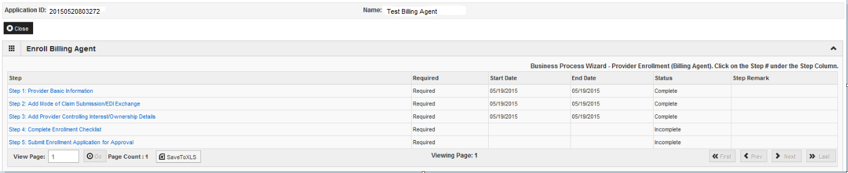
Business Process Wizard (BPW)
You have completed Step 3: Add Provider Controlling Interest/Ownership Details. The system will place the current date in the End Date field and will place Complete in the corresponding Status field.
Click on Step 4: Complete Enrollment Checklist to continue your application.
Shortcut to Step:
1
2
3
4
5

Slide 25
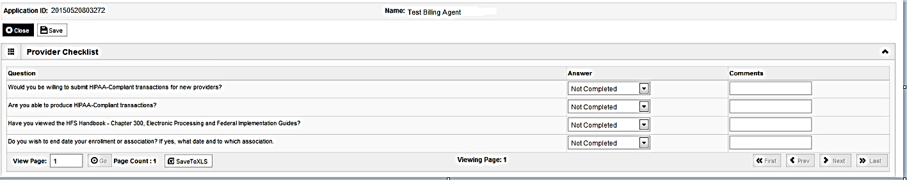
Step 4: Complete Enrollment Checklist
All questions must be answered either Yes or No and comments made if directed to do so, if a checklist item does not apply, select No as the answer.
After all of the questions have been answered and comments made, click the Save button in the upper left corner followed by clicking on the Close button.
Shortcut to Step:
1
2
3
4
5

Slide 26
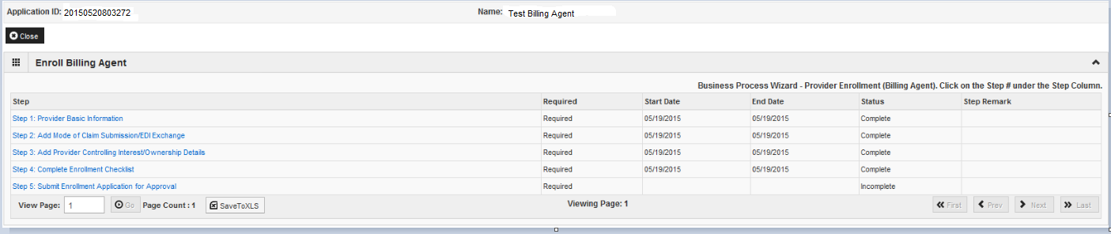
Business Process Wizard (BPW)
You have completed Step 4: Complete Enrollment Checklist. The system will place the current date in the End Date field and will place Complete in the corresponding Status field.
Click on Step 5: Submit Enrollment Application for Approval to continue your application.
Shortcut to Step:
1
2
3
4
5
Notes:
****Before clicking on submit enrollment application for approval, it is necessary to verify all required steps have been marked complete and that the entered information for each step is accurate.********

Slide 27
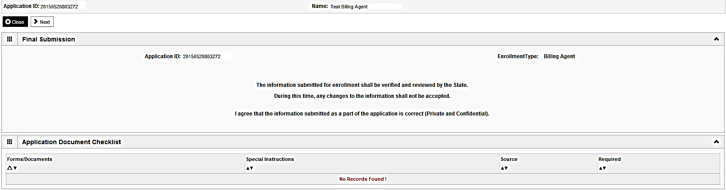
Step 5: Submit Enrollment for Approval
Click Next to confirm that all of the information that you have submitted as a part of the application is accurate.
Shortcut to Step:
1
2
3
4
5

Slide 28
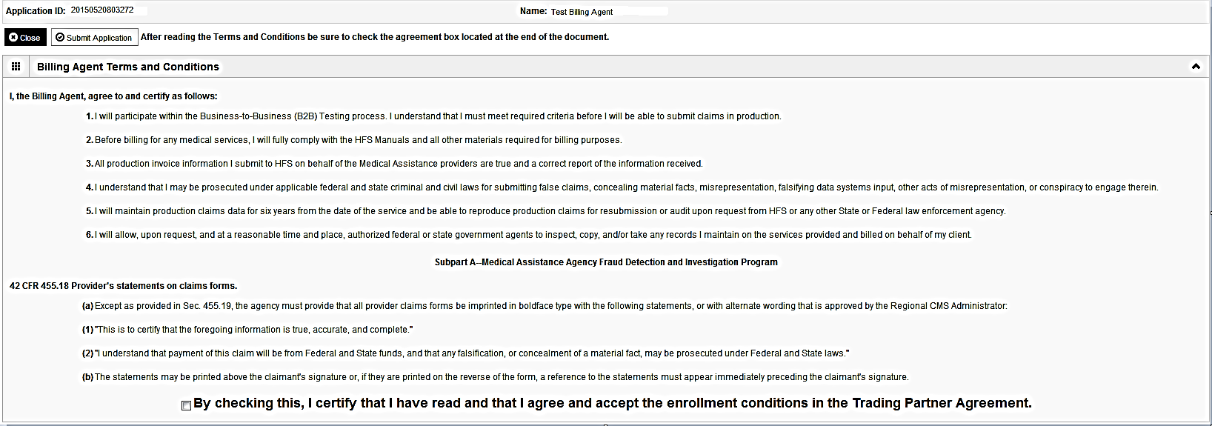
Step 5: Submit Enrollment for Approval
Read through all of the terms and conditions.
Check the box certifying that you agree to the terms and conditions.
Then click Submit Application.
Shortcut to Step:
1
2
3
4
5

Slide 29
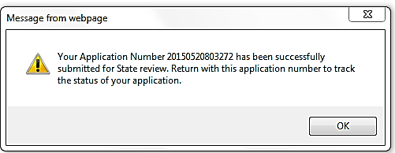
Business Process Wizard (BPW)
The below message will appear advising that the application has been submitted to the state for review. The application number can to used to check the status of the application by going through the track application option.
Click OK in the message box .
Shortcut to Step:
1
2
3
4
5

Slide 30
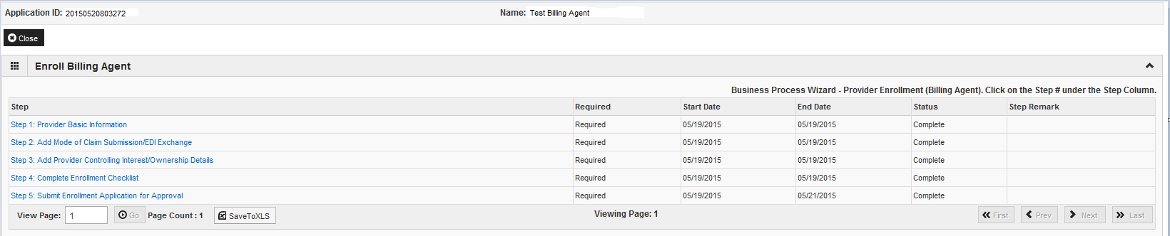
Business Process Wizard (BPW)
You have completed Step 5: Submit Enrollment Application. The system will place the current date in the End Date field and will place Complete in the corresponding Status field.
Shortcut to Step:
1
2
3
4
5

Slide 31
Resources
For more information regarding IMPACT, please visit http://www.illinois.gov/hfs/impact/Pages/AboutIMPACT.aspx
Check out the definitions of common terms at http://www.illinois.gov/hfs/impact/Pages/Glossary.aspx

Slide 32
Questions and Answers
FAQ’s can be found at http://www.illinois.gov/hfs/impact/Pages/faqs.aspx to help resolve common questions and problems when submitting applications.
General questions regarding IMPACT can be addressed to:
  Email: IMPACT.Help@Illinois.gov
  Phone: 1-877-782-5565
    Choose option 1 for IMPACT Help

