Slide 1


Collective Medical Post Acute Care Provider
Training
March 1, 2022

Slide 2
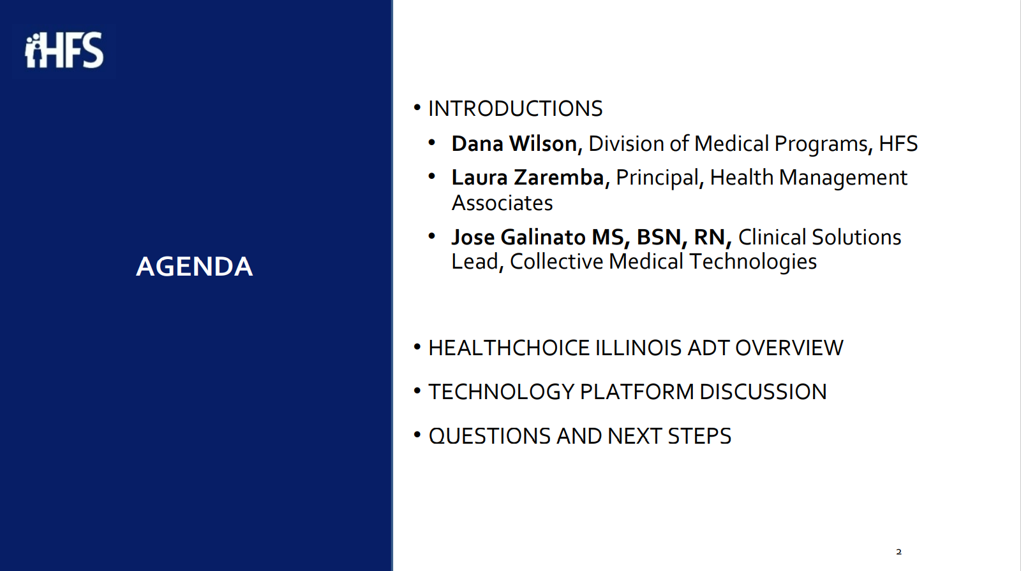
HealthChoice IL ADT Introduction
Collective Medical Introduction
Portal Training
Additional Resources

Slide 3
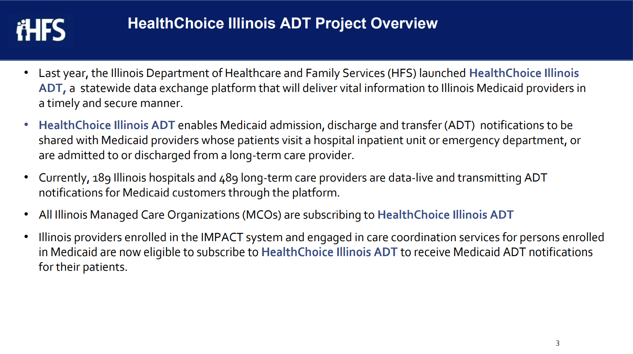


Illinois’ Comprehensive Medical Programs Quality Strategy includes goals for improving care coordination, using evidence-based interventions to reduce health disparities, deploying technology, and increasing data integration. The ADT system directly supports those critical quality goals and leverages best practices for sharing timely information to enable effective care coordination.

Slide 4
Introduction to
Collective Medical

Slide 5
OUR MISSION
Collective improves health outcomes and lowers cost by placing the right insights in front of each stakeholder along a patient’s journey to inform and encourage the right action for the patient
Notes:
Sales rep

Slide 6
Collective Medical Technologies
Collective is a care collaboration solution that gets the right information to the right person at the point of care.
ED and Inpatient Care
A NETWORK
Collective is a network of hospitals, emergency departments, primary care, specialists, behavioral health providers, post-acute care providers, and health plans across the United States, sharing important patient information at the time of care
Primary
Care and Specialists
ACO
A PLATFORM
Collective is a platform that intelligently connects each member of a patient’s care team for seamless collaboration at the right time and through the best medium
Behavioral
Health/SUD
Community-Based
Organizations
Post-Acute
Care
Dialysis,
Ancillaries
A COMMUNITY
Collective is a community of providers in the care of patients—especially those with complex medical needs—in your communities and across the country.
Government
and Payers

Slide 7
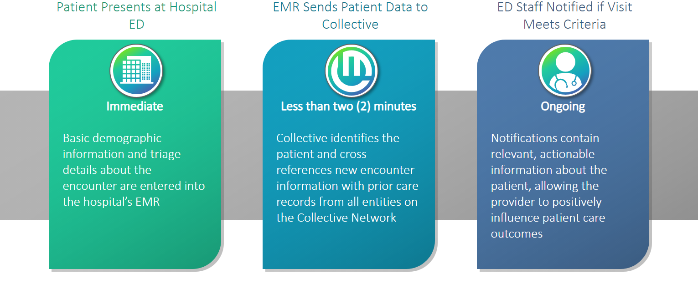
Workflow Integration
Collective Medical Technologies
Patient is admitted to a SNF facility
EMR Sends Patient Data to Collective
SNF Staff Notified if Visit Meets Criteria

Slide 8
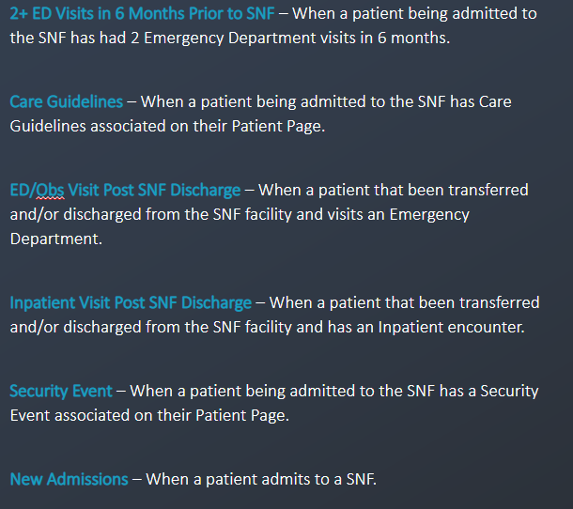
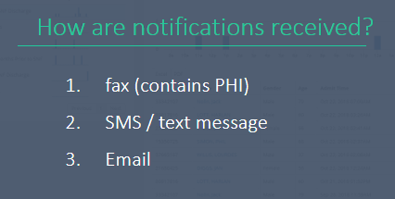
SNF Cohort Criteria & Notifications
SNF Cohort Criteria & Notifications

Slide 9

The Collective Network – Accessing Shared Information
The Collective Network – Accessing Shared Information
Information from each of these sources can be accessed by care team members in one of two ways:
    Real-time Collective notifications, delivered directly to providers at the point of care
    Logging into the Collective platform to view patient information

Slide 10
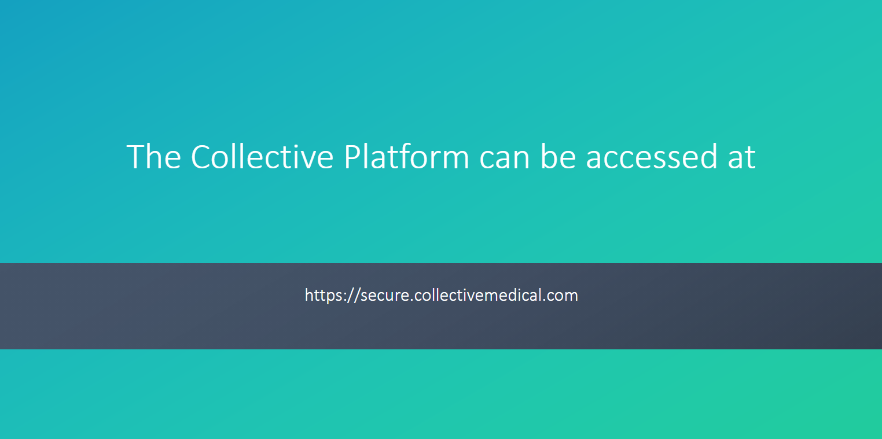

Slide 11
What are Care Guidelines?
Care Guidelines are care considerations and care coordination information that is applicable across a patient’s care continuum. It is part of the Insights section and found on the Patient Overview in the Collective Platform page and in the Collective Notification. The purpose is to share a brief synopsis on how to provide the best care for the patient.
Care Guidelines is a way for you to collaborate with healthcare providers and influence the care a member is getting in different settings.

Slide 12
End Users Authoring Insights
Case Managers, Care Coordinators, Navigators are the most common disciplines to author content based on MCO internal workflows
Accessing Collective Medical through the portal is most efficient for content creation and management of updates
The author is responsible for ensuring the accuracy of information added to the network and that is appropriate for fast consumption by other providers and care coordinators
If an employee leaves an organization, the account manager should be monitoring and delegating the care recommendation updates

Slide 13
Adding Insights to patients – best practices
Include only information that could be relevant in any setting
Present Insights information objectively
Consider what is already presented in the notification (50 in 12 months)
Things to Keep in Mind
Make each patient’s Insights unique
Keep entries short and direct (3 – 5 bullet points)
Make your information actionable and helpful
Avoid using acronyms that are specific to your health system
Keep Insights updated
Creating Useful Care Guidelines

Slide 14
Adding Insights to Patients – Specific Examples of What to Include
Facts about the patient that will influence
care in the emergency department
Pt established with Dr. Smith @ Medford Family Practice (555) 555.1234
Pt has standing order for paracentesis with interventional radiology
Pt now established with GI
Share actions or verbiage the
patient responds well to
Patient describes auditory hallucinations as “dreams.” Please use “dreams” instead of hallucinations when communicating
Baseline Presentation, function,
or symptoms can be helpful
Profound left-side deficits related to past CVA
Identify any narcotic contracts or legal
aspects of the patient’s abilities to make
care decisions for themselves
Chronic Pain Agreement (07/01/2018) – Oxycodone CR, Tizanidine, Gabapentin. Osteoarthritis: chronic lower back pain, right hip pain s/p replacement now with leg length discrepancy, bilateral knee pain
Contact information for pain management
providers or other known specialists
Cherry Lane Mental Health, MH provider: (555) 555-1234
Primary care provider / clinic: Legacy Medical Group NW, Dr. Smith (555) 555-1234

Slide 15
When to add Insights | Care Guidelines
Reason | Example(s)
Support system, discharge | Pt is homeless with very few social / familial supports; please do not call pt’s daughter (Jane Smith), as she neglects pt and steals her meds; pt has a safe and reliable friend named Derek James at xxx-xxx-xxxx who has previously housed pt temporarily post hospital.
Info regarding suicide attempts/holds | 1) Pt has multiple prior self harm acts with no history of suicide attempt or SI; 2) pt is very ill when he decompensates psychiatrically, requiring admission; pt has a hx of requiring an involuntary hold each time.
Hospital resources as secondary gain (food, shelter, etc.) | Consider minimizing secondary gain in the ED, i.e. narcotics/benzos, excessive TV watching/milkshakes/etc and work towards a swift and clear disposition, as presentation allows.
Community case manager involvement/can come to the ED | When pt presents to the ED, please call ICM community tx team 555-123-4567; this team is able to come to the ED to help facilitate a discharge plan and help coordinate care.
Malingering | Pt often presents with various pain complaints, including presenting after having been assaulted and requesting pain medicine for this. This past January, pt conveyed in the ED that he had been hit by a car a month prior, fell down some steps two weeks prior, assaulted a week prior, and then assaulted again 3 days prior to that; pt stated also that he could not walk and that he had been using a wheelchair for a month, but was observed by staff walking around very comfortably in the ED.
Dialysis center contact information and instruction | Pt is a dialysis patient at US Renal Care - Downtown location. Dialysis SW is xxxx xxxx and can be reached at xxx-xxx-xxxx
Security and/or safety events | Patient w/ a documented incident from xx/xx/xxx of pt strangling ED nurse. In order to ensure staff and patient safety, if patient returns to ED/hospital, please ensure nurse/ED doc/MA care team coordinate with security before treating pt/entering room (have security in the room, outside the room, always have 2 staff with pt, etc). Pt with a hx of compulsive swallowing (i.e. pens, spoons, paper clips, etc) please ensure pt’s room in the ED is made safe before rooming pt. Finger foods only (no utensils), etc.

Slide 16
Adding Insights to patients – mistakes to avoid
Opinions or Judgements About a Patient
Your goal is to provide insight, not pass judgement or taint opinions about the patient
Copy and Pasted Current Medication Lists with Dosing
Medication dosing may change faster than the Care Guideline is updated, leading to inaccurate medication administration
Lengthy Chart Notes Directly from the Patient’s Chart Record
Notifications should be easy and fast to consume; including too much information can slow down emergency treatment and cause the important details to get lost, defeating the purpose
Substance Abuse Treatment Program Information If You Are a 42 CFR Provider
It’s the law; make sure you understand all the necessary guidelines or laws surrounding your specialty
Redundant Information that Can Be Found Elsewhere on a Notification
Notifications should be easy and fast to consume, and the actionable information should be obvious; duplicating data can cause important information to be missed
Mistakes to Avoid when Adding Insights

Slide 17
Adding Insights to patients – mistakes to avoid
Patient comes in the hospital after having just been discharged from St. Mary’s Memorial Hospital 4 days ago complaining of chest pain and SOB. Upon arrival, she had elevated VS and was administered SL Nitroglycerin and 6L of O2. Patient has a history of NSTEMI in July 2021. Patient has a history of COPD on home O2 of 3L, but patient has been out of an oxygen tank for 3 weeks. Patient states she can’t remember her oxygen tank provider’s phone number, but the patient may be lying. EKG showed sinus tachycardia. Patient’s PCP is Dr. Michael Chen with phone number 312-222-2222. Social worker consulted and patient established with a DME company for her oxygen tank.
Mistakes to Avoid when Adding Insights

Slide 18
Adding Insights to patients – mistakes to avoid
Patient comes in the hospital after having just been discharged from St. Mary’s Memorial Hospital 4 days ago complaining of chest pain and SOB. Upon arrival, she had elevated VS and was administered SL Nitroglycerin and 6L of O2. Patient has a history of NSTEMI in July 2021. Patient has a history of COPD on home O2 of 3L, but patient has been out of an oxygen tank for 3 weeks. Patient states she can’t remember her oxygen tank provider’s phone number, but the patient may be lying. EKG showed sinus tachycardia. Patient’s PCP is Dr. Michael Chen with phone number 312-222-2222. Social worker consulted and patient established with a DME company for her oxygen tank with HOMES Great Lakes DME phone number 312-233-3333.
Mistakes to Avoid when Adding Insights

Slide 19

Additional Resources – Customer Community
Additional Resources – Customer Community
community.collectivemedical.com
Help Guides
Training Videos
FAQs
Updates
Q&As
Discussions
SNF Cohort Criteria & Notifications
Notes:
I start with a high-level intro to Collective Medical and what we’re about
Then I’ll dive into a demo of the Collective Platform to give you an idea of how it can work for you
Next I’ll outline the technical and clinical implementation and review the rough project timeline
And we will wrap up with next steps and action items

Slide 20
Additional Resources – Customer Support
Additional Resources – Customer Support
Available Monday-Friday 7:00am-6:00pm MT
Email: support@collectivemedical.com
Phone: 801-285-0770
Notes:
I start with a high-level intro to Collective Medical and what we’re about
Then I’ll dive into a demo of the Collective Platform to give you an idea of how it can work for you
Next I’ll outline the technical and clinical implementation and review the rough project timeline
And we will wrap up with next steps and action items

Slide 21
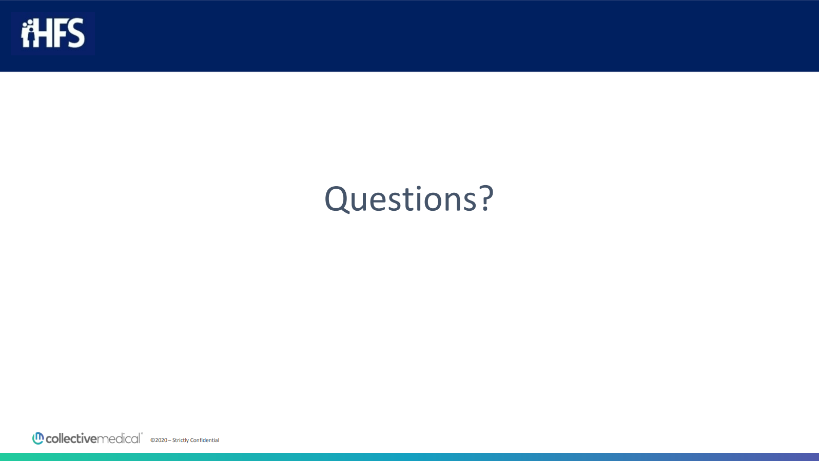

Slide 22


