Slide 1


Collective Medical Hospital Provider
Training
February 22, 2022

Slide 2
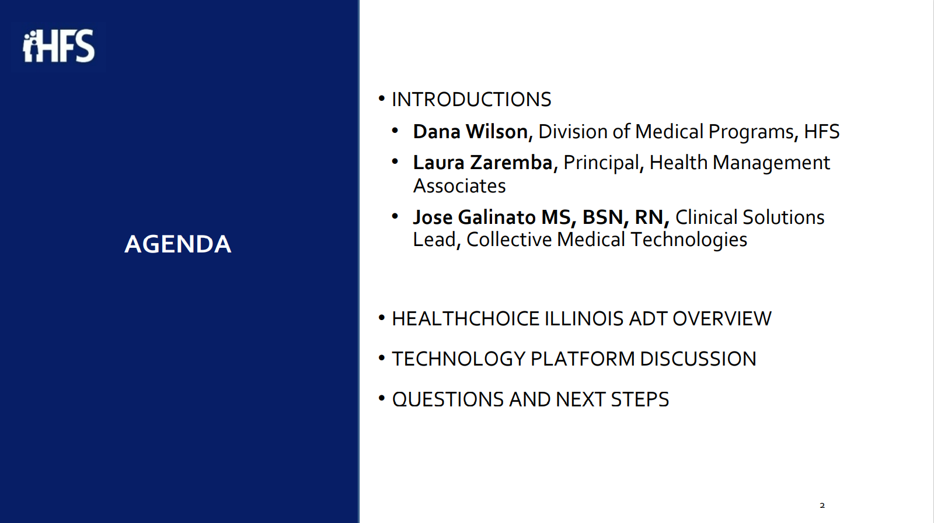
HealthChoice IL ADT Introduction
Collective Medical Introduction
Portal Training
Additional Resources

Slide 3
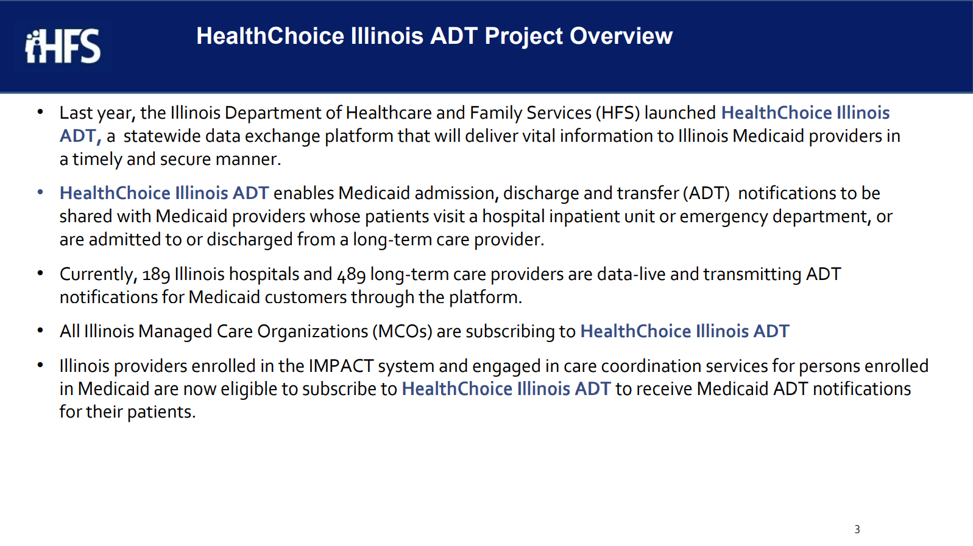


Illinois’ Comprehensive Medical Programs Quality Strategy includes goals for improving care coordination, using evidence-based interventions to reduce health disparities, deploying technology, and increasing data integration. The ADT system directly supports those critical quality goals and leverages best practices for sharing timely information to enable effective care coordination.

Slide 4
Introduction to
Collective Medical

Slide 5
OUR MISSION
Collective improves health outcomes and lowers cost by placing the right insights in front of each stakeholder along a patient’s journey to inform and encourage the right action for the patient
Notes:
Sales rep

Slide 6
Collective Medical Technologies
Collective is a care collaboration solution that gets the right information to the right person at the point of care.
ED and Inpatient Care
A NETWORK
Collective is a network of hospitals, emergency departments, primary care, specialists, behavioral health providers, post-acute care providers, and health plans across the United States, sharing important patient information at the time of care
Primary
Care and Specialists
ACO
A PLATFORM
Collective is a platform that intelligently connects each member of a patient’s care team for seamless collaboration at the right time and through the best medium
Behavioral
Health/SUD
Community-Based
Organizations
Post-Acute
Care
Dialysis,
Ancillaries
A COMMUNITY
Collective is a community of providers in the care of patients—especially those with complex medical needs—in your communities and across the country.
Government
and Payers

Slide 7
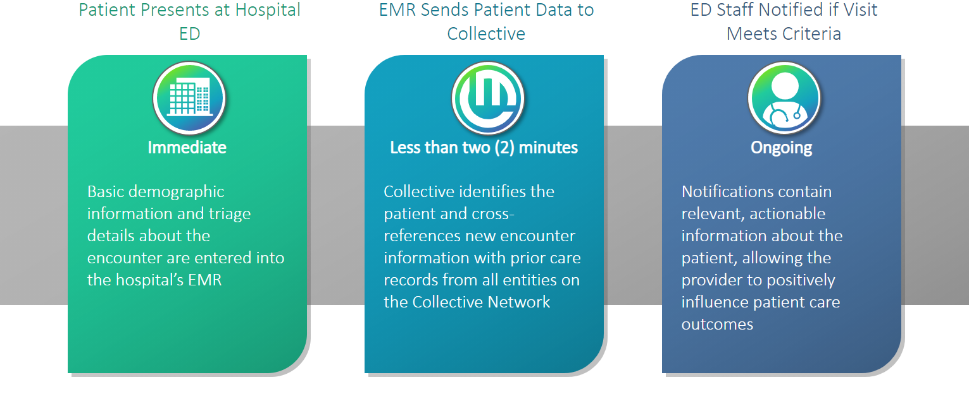
Workflow Integration
Collective Medical Technologies
Patient is admitted to a PAC facility
EMR Sends Patient Data to Collective

Slide 8

The Collective Network – Accessing Shared Information
The Collective Network – Accessing Shared Information
Information from each of these sources can be accessed by care team members in one of two ways:
    Real-time Collective notifications, delivered directly to providers at the point of care
    Logging into the Collective platform to view patient information

Slide 9
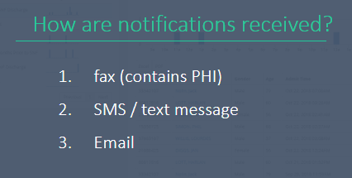
SNF Cohort Criteria & Notifications
ED Criteria & Notifications
High utilization - 5+ visits in 12 months​
Rising Risk - (Traveling patients) 3 different ED’s within 90 days​
Patients with ED Care Guidelines entered on the network
​
History of Security Events (18 months)​
History of Sepsis (12 month look back)​
1. EHR – ED Trackboard
Fax
SMS / Text Message (no PHI)
Email (no PHI)

Slide 10
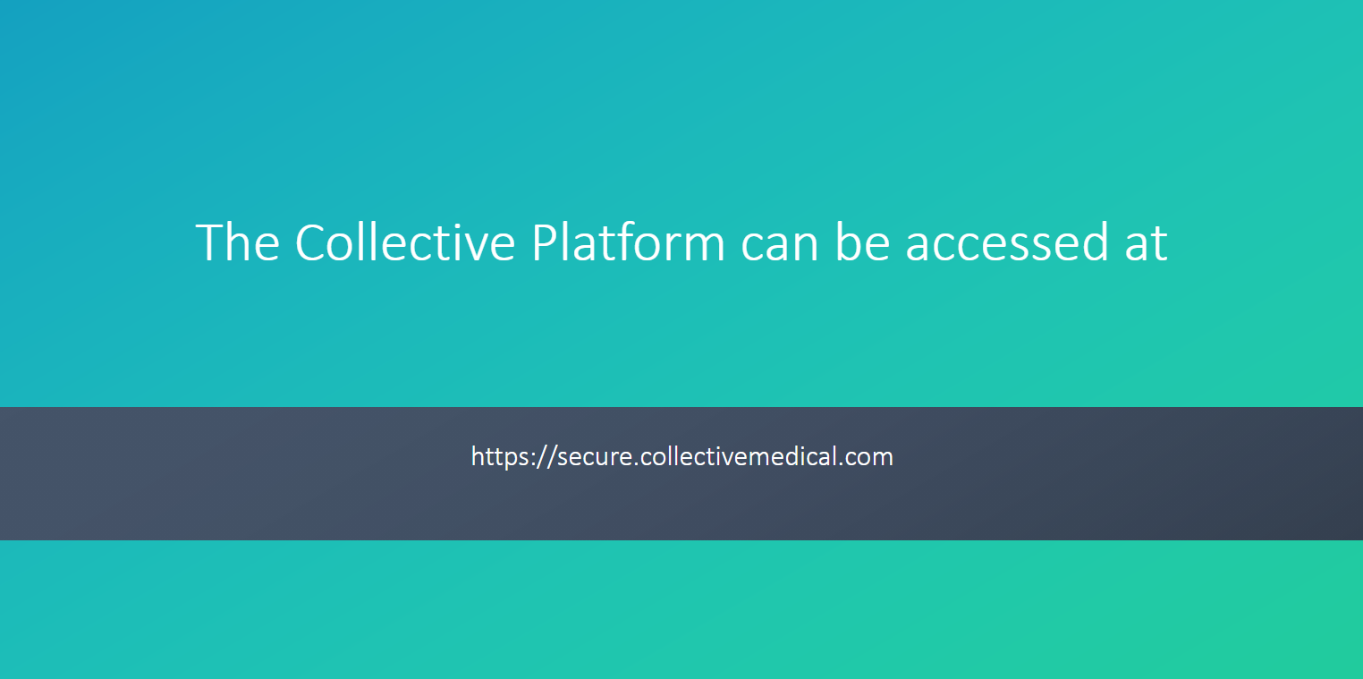

Slide 11
Emergency Departments Authoring Insights
RNs, Case Managers, and Social Workers are the most common disciplines to author content based on each Emergency Departments internal workflows
Accessing Collective Medical through the portal is most efficient for content creation and management of updates
The author is responsible for ensuring the accuracy of information added to the network and that is appropriate for fast consumption by other emergency medicine professionals
If an employee leaves an organization, the account manager should be monitoring and delegating the care recommendation updates

Slide 12
Adding Insights to patients – best practices
Include only information that is relevant in an ED setting, and ensure information is relevant to any ED
Present Insights information objectively
Consider what is already presented in the notification (50 in 12 months)
Things to Keep in Mind
Make each patient’s Insights unique
Keep entries short and direct (3 – 5 bullet points)
Make your information actionable and helpful
Avoid using acronyms that are specific to your health system
Keep Insights updated
Creating Useful Care Guidelines

Slide 13
Adding Insights to Patients – Specific Examples of What to Include
Facts about the patient that will influence
care in the emergency department
Pt established with Dr. Smith @ Medford Family Practice (555) 555.1234
Pt has standing order for paracentesis with interventional radiology
Pt now established with GI
Share actions or verbiage the
patient responds well to
Patient describes auditory hallucinations as “dreams.” Please use “dreams” instead of hallucinations when communicating
Baseline Presentation, function,
or symptoms can be helpful
Profound left-side deficits related to past CVA
Identify any narcotic contracts or legal
aspects of the patient’s abilities to make
care decisions for themselves
Chronic Pain Agreement (07/01/2018) – Oxycodone CR, Tizanidine, Gabapentin. Osteoarthritis: chronic lower back pain, right hip pain s/p replacement now with leg length discrepancy, bilateral knee pain
Contact information for pain management
providers or other known specialists
Cherry Lane Mental Health, MH provider: (555) 555-1234
Primary care provider / clinic: Legacy Medical Group NW, Dr. Smith (555) 555-1234

Slide 14
When to add Insights | Care Guidelines
Reason | Example(s)
Support system, discharge | Pt is homeless with very few social / familial supports; please do not call pt’s daughter (Jane Smith), as she neglects pt and steals her meds; pt has a safe and reliable friend named Derek James at xxx-xxx-xxxx who has previously housed pt temporarily post hospital.
Info regarding suicide attempts/holds | 1) Pt has multiple prior self harm acts with no history of suicide attempt or SI; 2) pt is very ill when he decompensates psychiatrically, requiring admission; pt has a hx of requiring an involuntary hold each time.
Hospital resources as secondary gain (food, shelter, etc.) | Consider minimizing secondary gain in the ED, i.e. narcotics/benzos, excessive TV watching/milkshakes/etc and work towards a swift and clear disposition, as presentation allows.
Community case manager involvement/can come to the ED | When pt presents to the ED, please call ICM community tx team 555-123-4567; this team is able to come to the ED to help facilitate a discharge plan and help coordinate care.
Malingering | Pt often presents with various pain complaints, including presenting after having been assaulted and requesting pain medicine for this. This past January, pt conveyed in the ED that he had been hit by a car a month prior, fell down some steps two weeks prior, assaulted a week prior, and then assaulted again 3 days prior to that; pt stated also that he could not walk and that he had been using a wheelchair for a month, but was observed by staff walking around very comfortably in the ED.
Dialysis center contact information and instruction | Pt is a dialysis patient at US Renal Care - Downtown location. Dialysis SW is xxxx xxxx and can be reached at xxx-xxx-xxxx
Security and/or safety events | Patient w/ a documented incident from xx/xx/xxx of pt strangling ED nurse. In order to ensure staff and patient safety, if patient returns to ED/hospital, please ensure nurse/ED doc/MA care team coordinate with security before treating pt/entering room (have security in the room, outside the room, always have 2 staff with pt, etc). Pt with a hx of compulsive swallowing (i.e. pens, spoons, paper clips, etc) please ensure pt’s room in the ED is made safe before rooming pt. Finger foods only (no utensils), etc.

Slide 15
When to add Insights | Care Histories
Category | Example(s)
Medical Surgical | Hx of lupus Hx of ESRD, on dialysis, gastroparesis / cyclical vomiting syndrome Patient has history of kidney stones
Infection/Chronic | Patient has MRSA and hx of several episodes C. Diff Patient has chronic back pain
Substance Use/Overdose | PDMP report shows over 300 narcotic pills dispensed in the last 60 days (may be redundant) Alcohol dependence for past 25 years, has history of intermittent sobriety, and multiple detox episodes
Behavioral | States she is being seen at Valley Mental Health and has established psychiatrist - Dr. Jones xxx-xxx-xxxx Dx of Depression with hx of psychosis; pt’s SI increases when depressed mood worsens Pt presents often with suicidal ideation, has had over 24 visits for self harm but no hx of suicide attempt
Social | Hx of homelessness, family lives in Alabama, but pt does not have a relationship with them Receives $700 from his SSDI. Has IHSS services in place for 15 hours a week Has been referred to section 8 housing and is on a wait list
Radiation | Has received multiple negative images for abdominal pain (6 in the past 2 years)

Slide 16
Adding Insights to patients – mistakes to avoid
Opinions or Judgements About a Patient
Your goal is to provide insight, not pass judgement or taint opinions about the patient
Copy and Pasted Current Medication Lists with Dosing
Medication dosing may change faster than the Care Guideline is updated, leading to inaccurate medication administration
Lengthy Chart Notes Directly from the Patient’s Chart Record
Notifications should be easy and fast to consume; including too much information can slow down emergency treatment and cause the important details to get lost, defeating the purpose
Substance Abuse Treatment Program Information If You Are a 42 CFR Provider
It’s the law; make sure you understand all the necessary guidelines or laws surrounding your specialty
Redundant Information that Can Be Found Elsewhere on a Notification
Notifications should be easy and fast to consume, and the actionable information should be obvious; duplicating data can cause important information to be missed
Mistakes to Avoid when Adding Insights

Slide 17

Additional Resources – Customer Community
Additional Resources – Customer Community
community.collectivemedical.com
Help Guides
Training Videos
FAQs
Updates
Q&As
Discussions
SNF Cohort Criteria & Notifications
Notes:
I start with a high-level intro to Collective Medical and what we’re about
Then I’ll dive into a demo of the Collective Platform to give you an idea of how it can work for you
Next I’ll outline the technical and clinical implementation and review the rough project timeline
And we will wrap up with next steps and action items

Slide 18
Additional Resources – Customer Support
Additional Resources – Customer Support
Available Monday-Friday 7:00am-6:00pm MT
Email: support@collectivemedical.com
Phone: 801-285-0770
Notes:
I start with a high-level intro to Collective Medical and what we’re about
Then I’ll dive into a demo of the Collective Platform to give you an idea of how it can work for you
Next I’ll outline the technical and clinical implementation and review the rough project timeline
And we will wrap up with next steps and action items

Slide 19
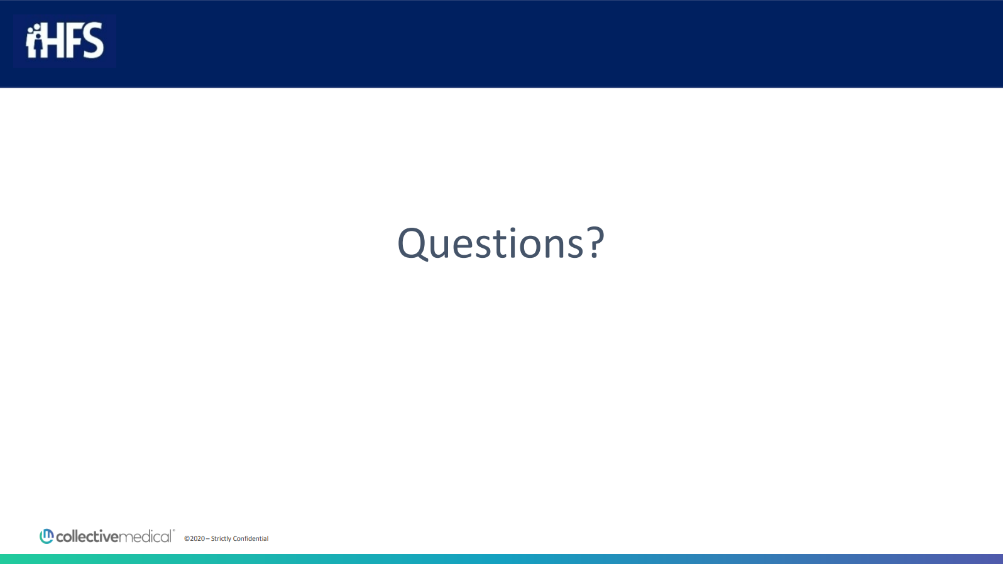

Slide 20


