Slide 1
Welcome, we will begin shortly.
General Housekeeping:
Please place yourself on mute.
raise your hand to be unmuted.
Change your chat settings to send to “All Panelists and Attendees”

Slide 2
Clinical Collaboration Group
April 2022

Slide 3
HealthChoice IL ADT Program Overview and Updates
Collective Medical Overview
Care Insights Authorship
Upcoming Events

Slide 4
Illinois’ Comprehensive Medical Programs Quality Strategy includes goals for improving care coordination, using evidence-based interventions to reduce health disparities, deploying technology, and increasing data integration. The ADT system directly supports those critical quality goals and leverages best practices for sharing timely information to enable effective care coordination.

Slide 5
Network Coverage
Collective Medical Footprint – IL
~34 Supportive Living Facilities
~479 Skilled Nursing Facilities
For IL, 189 hospitals and 489 SNFs, as of 1/13/22.
For IL, 189 hospitals and 489 SNFs, as of 1/13/22.
~185 Hospitals
18 SMRHF (Specialized Mental Health Rehabilitation Facilities)
~6 MCOs
For a complete participant list please visit:
https://www2.illinois.gov/hfs/healthchoiceadt/Pages/Participants.aspx

Slide 7
PlaceHolder for HFS Updates
Next Steps:
Data quality
Reconciliation of TID, NPI

Slide 8
Clinical Collaborative Group
What is the Clinical Collaborative Group (CCG)?
The CCG is comprised of a group of stakeholders within the state who are working collaboratively using the Collective Platform to drive measurable progress towards a goal aimed at improving outcomes for patients:
Meets quarterly
Acts as champions within your respective institutions
Forum to share updates and best practices regarding the use of Collective
Uses data to determine appropriate interventions
Measures progress towards the goal at regular intervals

Slide 9
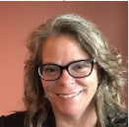
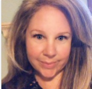
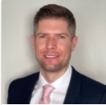
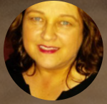
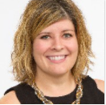
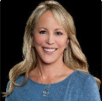
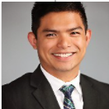
Your Collective Medical Team
Heidi Ferrè
Customer Success
Executive
Sherri Lamont-Miller
Program Manager
Liz Swetnam
Customer Success
Manager
Octavio Aguiar
Customer Success
Manager
Deb Martin
Sr. Account Executive
Nicole Sunder
Director
Health Plan Solutions
Lisa Weatherwax
Clinical Solutions Lead
Jose Galinato
Sr. Clinical Solutions Lead
Jennifer Nebeker
Strategic Initiatives Manager

Slide 10
Collective is a care collaboration solution that gets the right information to the right person at the point of care.
ED and Inpatient Care
A NETWORK
Collective is a network of hospitals, emergency departments, primary care, specialists, behavioral health providers, post-acute care providers, and health plans across the United States, sharing important patient information at the time of care
Primary Care and Specialists
ACO
A PLATFORM
Collective is a platform that intelligently connects each member of a patient’s care team for seamless collaboration at the right time and through the best medium
Behavioral Health/SUD
Community-Based Organizations
Post-Acute Care
Dialysis, Ancillaries
A COMMUNITY
Collective is a community of providers in the care of patients—especially those with complex medical needs—in your communities and across the country.
Government and Payers

Slide 11
Step 1 – Patient Encounter
The patient presents in the emergency department of a hospital with a connection to the Collective network. Basic demographic and triage information about the patient is entered into the hospital’s EHR.
Collective notifications – Workflow and Process

Slide 12
Step 2 – ADT Transmission
Within moments, the hospital’s EHR sends the important information about the encounter to Collective in the form of an ADT message.
ADT Data
Collective notifications – Workflow and Process

Slide 13
Step 3 – Patient Identification
The Collective platform normalizes the new encounter information, identifies the patient’s aggregate profile on the network as well as identifies patient’s aggregate profile existing through Carequality or CommonWell, and merges the new data in.
Collective notifications – Workflow and Process

Slide 14
Step 4 – HIPAA Verification
Collective analyzes its network, and all entities showing a verified HIPAA relationship with the patient are identified, including the facility at which the patient is currently experiencing the triggering encounter.
Collective notifications – Workflow and Process

Slide 15
Step 5 – Criteria Analysis
Each of these entities’ Collective profiles are analyzed to identify which—if any—of the members of the patient’s care team should receive notification of the encounter, and curated specifics about the patient’s needs.
Collective notifications – Workflow and Process

Slide 16
Step 6 – Care Team Notification
Within seconds of the patient’s initial presentation at the triggering facility, real-time notifications are delivered to the members of the patient’s care team identified as being best placed to intervene and impact outcomes.
Collective notifications – Workflow and Process

Slide 17
Step 7 – Provider Action
All members of the patient’s care team are now empowered to take action to influence better outcomes for the patient.
ED providers are empowered to act quickly from a position of knowledge
primary care and specialists can proactively involve themselves when necessary
Collective notifications – Workflow and Process

Slide 18
The Collective Network – Accessing Shared Information
The Collective Network – Accessing Shared Information
Information from each of these sources can be accessed by care team members in one of two ways:
Real-time Collective notifications, delivered directly to providers at the point of care
Logging into the Collective platform to view patient information

Slide 19
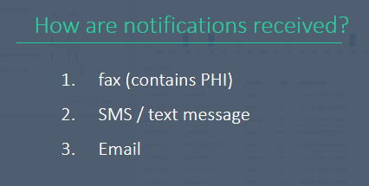
SNF Cohort Criteria & Notifications
Example Criteria & Notifications
High utilization - 5+ visits in 12 months​
Rising Risk - (Traveling patients) 3 different ED’s within 90 days​
​
History of Security Events (18 months)​
History of Sepsis (12 month look back)​
Patients with Care Insights entered on the network
1. EHR – ED Trackboard
Fax
SMS / Text Message (no PHI)
Email (no PHI)
Collective Medical Web-Based Portal

Slide 21
What are Care Insights?
Care Insights are clinical and care coordination information that is applicable across a patient’s care continuum. It is found on the Patient Overview in the Collective Platform page and in the Collective Notification. The purpose is to share a brief synopsis on how to provide the best care for the patient.
Care Insights are written by members of a patients care team such as a provider, RN, case manager, social worker to provide actionable information about the patient at the point of care across the care continuum. These information are typically information that may be buried across multiple patient records.
Writing care insights is a way for you to collaborate with healthcare providers and influence the care a member is getting in different settings.

Slide 22
Sutter Mills-Peninsula ED High Utilizer Program Goal
Reduce ED visit frequency by identifying and supporting patients with high utilization patterns.

Slide 23
Target Population
≥ 35 ED Visits in one year
OR
≥ 5 ED Visits Within 30 days
AND
III. Patient rarely presents to hospital with acute needs, but would benefit from behavioral health or social intervention.

Slide 24
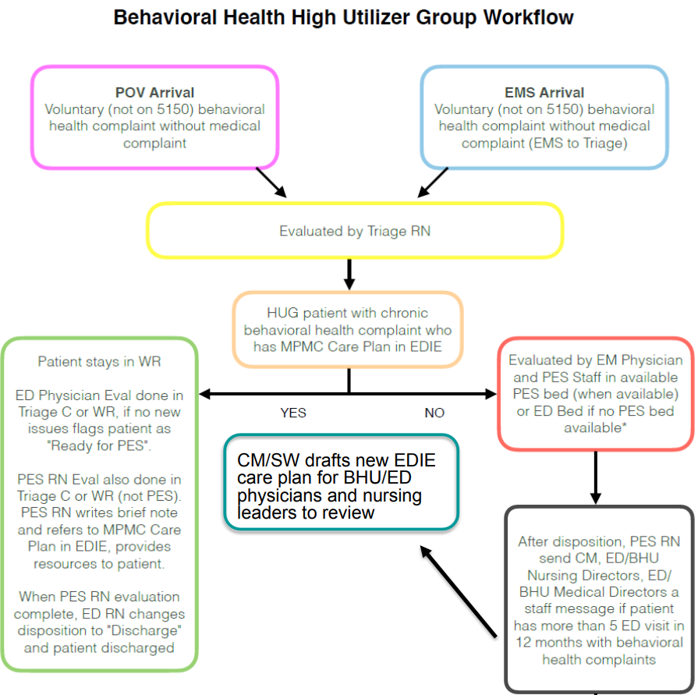
Intervention

Slide 25
Intervention
Care Insight Components
• Patient Summary (anyone)
– Please include patient age, sex and hx
– Please note any other important information the team should know about patient
• Emergency Department & PES Treatment Plan (ED physicians)
– ED physicians to outline guidelines for ED visit. This includes any parameters for clinical care
• Care Recommendations
– ED case managers and social workers to complete
– Please list recommendations for patient’s discharge
including but not limited to: referrals, follow-up contacts and resources

Slide 26
Care Insight Example
Patient Summary:
XX year old male with history of PE (s/p IVC filter), HTN, hyperlipidemia, DMII on insulin, bipolar, and anxiety
Come to ED for various complaints 10-20 times per year
COVID-19 Vaccination Status: Moderna (date xx/xx/xxxx & xx/xx/xxxx)
Endocrinologist: Dr. X
Pain Management: Dr. X
Chronic back pain on Norco 10/325mg 1 tab bid and naproxen
Emergency Department & PES Treatment Plan
If patient is not on a 5150, and does not have a chronic behavioral health complaint follow these steps:
Triage patient and assess for medial complaint
If vitals are stable, patient then directed to wait in ED Waiting Room after Triage - DO NOT PLACE IN ROOM
Physician will assess patient in Triage C. If no new emergent medical or behavioral condition exists, patient will be flagged as "Ready for Discharge"
ED RN to discharge patient (no PES RN evaluation is needed)
Care Recommendations:
Inform patient CM/SW assistance available during normal hours. If patient is willing to accept services:
Connect Pt to Behavioral Health and Recovery Services (BHRS) for referral to therapy and psychiatry outpatient providers by calling 24/7 line at 800-686-0101 or visiting https://www.smchealth.org/bhrs. Consult with PES as needed for referral and assistance in facilitating discharge.
Coordinate with HPSM SW Louis Solano (650-515-1883) to set up safe discharge plan that incorporates community involvement/support. If outside of his normal business hours (9-6pm), email him at Louis.Solano@hpsm.org, requesting outpatient follow up - ensure you can provide cell number for Pt.
Contact the Landmark on call provider and care manager 24/7 at (650) 826-2945 to facilitate a smooth transition to home.
If patient declines the above interventions, please provide SM Mental Health Guide.

Slide 27
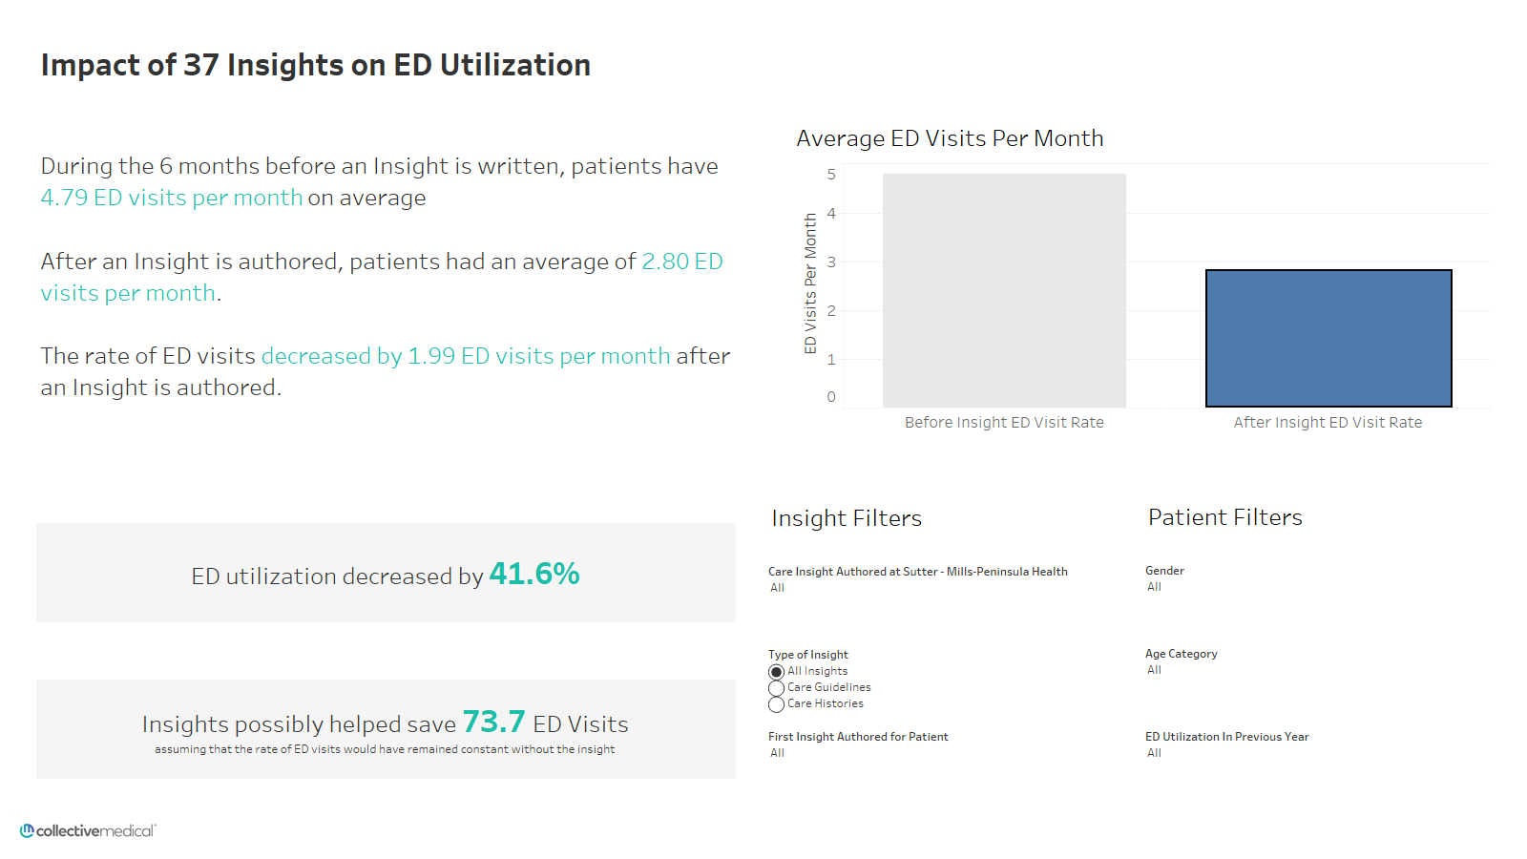
Insights Written By: Sutter-Mills Peninsula
Facilities Considered: All
Patient Group: All Sutter-Peninsula Patients

Slide 28
Insights Written By: Sutter-Mills Peninsula
Facilities Considered: All
Patient Group: All Sutter-Peninsula Patients

Slide 29
Portal Demo

Slide 30
End Users Authoring Insights
Case Managers, Care Coordinators, Navigators are the most common disciplines to author content based on MCO internal workflows
Accessing Collective Medical through the portal is most efficient for content creation and management of updates
The author is responsible for ensuring the accuracy of information added to the network and that is appropriate for fast consumption by other providers and care coordinators
If an employee leaves an organization, the account manager should be monitoring and delegating the care recommendation updates

Slide 31
Adding Insights to patients – best practices
Include only information that could be relevant in any setting
Present Insights information objectively
Consider what is already presented in the notification (50 in 12 months)
Things to Keep in Mind
Make each patient’s Insights unique
Keep entries short and direct (3 – 5 bullet points)
Make your information actionable and helpful
Avoid using acronyms that are specific to your health system
Keep Insights updated
Creating Useful Care Guidelines

Slide 32
Adding Insights to Patients – Specific Examples of What to Include
Facts about the patient that will influence
care different care settings
Pt established with Dr. Smith @ Medford Family Practice (555) 555.1234
Pt has standing order for paracentesis with interventional radiology
Pt now established with GI
Share actions or verbiage the patient responds well to
Patient describes auditory hallucinations as “dreams.” Please use “dreams” instead of hallucinations when communicating
Baseline Presentation, function, or symptoms can be helpful
Profound left-side deficits related to past CVA
A plan for management of chronic conditions, such as use of controlled substances and what alternatives to use
Chronic Pain Agreement (07/01/2018) – Oxycodone CR, Tizanidine, Gabapentin. Osteoarthritis: chronic lower back pain, right hip pain s/p replacement now with leg length discrepancy, bilateral knee pain
Contact information for pain management providers or other known specialists
Cherry Lane Mental Health, MH provider: (555) 555-1234
Primary care provider / clinic: Legacy Medical Group NW, Dr. Smith (555) 555-1234

Slide 33
When to add Insights | Care Guidelines
Reason | Example(s)
Social Determinants of Health | Pt is homeless with very few social / familial supports; please do not call pt’s daughter (Jane Smith), as she neglects pt and steals her meds; pt has a safe and reliable friend named Derek James at xxx-xxx-xxxx who has previously housed pt temporarily post hospital.
Info regarding suicide attempts/holds | 1) Pt has multiple prior self harm acts with no history of suicide attempt or SI; 2) pt is very ill when he decompensates psychiatrically, requiring admission; pt has a hx of requiring an involuntary hold each time.
Hospital resources as secondary gain (food, shelter, etc.) | Consider minimizing secondary gain in the ED, i.e. narcotics/benzos, excessive TV watching/milkshakes/etc and work towards a swift and clear disposition, as presentation allows.
Community case manager involvement | When pt presents to the ED, please call ICM community tx team 555-123-4567; this team is able to come to the ED to help facilitate a discharge plan and help coordinate care.
Malingering | Pt often presents with various pain complaints, including presenting after having been assaulted and requesting pain medicine for this. This past January, pt conveyed in the ED that he had been hit by a car a month prior, fell down some steps two weeks prior, assaulted a week prior, and then assaulted again 3 days prior to that; pt stated also that he could not walk and that he had been using a wheelchair for a month, but was observed by staff walking around very comfortably in the ED.
List of names and contact information for specific services | Pt is a dialysis patient at US Renal Care - Downtown location. Dialysis SW is xxxx xxxx and can be reached at xxx-xxx-xxxx
Security and/or safety events | Patient w/ a documented incident from xx/xx/xxx of pt strangling ED nurse. In order to ensure staff and patient safety, if patient returns to ED/hospital, please ensure nurse/ED doc/MA care team coordinate with security before treating pt/entering room (have security in the room, outside the room, always have 2 staff with pt, etc). Pt with a hx of compulsive swallowing (i.e. pens, spoons, paper clips, etc) please ensure pt’s room in the ED is made safe before rooming pt. Finger foods only (no utensils), etc.

Slide 34
Adding Insights to patients – mistakes to avoid
Opinions or Judgements About a Patient
Your goal is to provide insight, not pass judgement or taint opinions about the patient
Copy and Pasted Current Medication Lists with Dosing
Medication dosing may change faster than the Care Insight is updated, make sure to include when the date of prescription.
Lengthy Chart Notes Directly from the Patient’s Chart Record
Notifications should be easy and fast to consume; including too much information can slow down emergency treatment and cause the important details to get lost, defeating the purpose
Substance Abuse Treatment Program Information If You Are a 42 CFR Provider
It’s the law; make sure you understand all the necessary guidelines or laws surrounding your specialty
Redundant Information that Can Be Found Elsewhere on a Notification
Notifications should be easy and fast to consume, and the actionable information should be obvious; duplicating data can cause important information to be missed
Mistakes to Avoid when Adding Insights

Slide 35
Adding Insights to patients – mistakes to avoid
Patient comes in the hospital after having just been discharged from St. Mary’s Memorial Hospital 4 days ago complaining of chest pain and SOB. Upon arrival, she had elevated VS and was administered SL Nitroglycerin and 6L of O2. Patient has a history of NSTEMI in July 2021. Patient has a history of COPD on home O2 of 3L, but patient has been out of an oxygen tank for 3 weeks. Patient states she can’t remember her oxygen tank provider’s phone number, but the patient may be lying. EKG showed sinus tachycardia. Patient’s PCP is Dr. Michael Chen with phone number 312-222-2222. Social worker consulted and patient established with a DME company for her oxygen tank.
Mistakes to Avoid when Adding Insights

Slide 36
Adding Insights to patients – mistakes to avoid
Patient comes in the hospital after having just been discharged from St. Mary’s Memorial Hospital 4 days ago complaining of chest pain and SOB. Upon arrival, she had elevated VS and was administered SL Nitroglycerin and 6L of O2. Patient has a history of NSTEMI in July 2021. Patient has a history of COPD on home O2 of 3L, but patient has been out of an oxygen tank for 3 weeks. Patient states she can’t remember her oxygen tank provider’s phone number, but the patient may be lying. EKG showed sinus tachycardia. Patient’s PCP is Dr. Michael Chen with phone number 312-222-2222. Social worker consulted and patient established with a DME company for her oxygen tank with HOMES Great Lakes DME phone number 312-233-3333.
Mistakes to Avoid when Adding Insights

Slide 37
Links to Resources
Collective Medical Web Based Portal
HealthChoice Illinois ADT Website
Collective Medical Customer Community Page
Collective Medical Support Team
support@collectivemedicaltech.com

Slide 38
Additional Resources – Customer Support
Additional Resources – Customer Support
Available Monday-Friday 7:00am-6:00pm MT
Email: support@collectivemedical.com
Phone: 801-285-0770
Notes:
I start with a high-level intro to Collective Medical and what we’re about
Then I’ll dive into a demo of the Collective Platform to give you an idea of how it can work for you
Next I’ll outline the technical and clinical implementation and review the rough project timeline
And we will wrap up with next steps and action items

Slide 39
Upcoming Events
August 18, 2022 – Fall Clinical Collaborative Group Meeting
Keep a look out for emails regarding future webinars and events.
Stay up to date through the HFS website.

