Slide 1
HealthChoice Illinois ADT Clinical Collaboration Group Collaborate to Improve Patient Outcomes
May 16, 2024

Slide 2
Agenda
Introductions
Dana Wilson, PMP, Program Manager, HFS, Division of Medical Programs, Program & Policy Coordination, Federal Health Information Planning
Nancy Sehy, BSN, RN, CHPCA, Sr. Clinical Solutions Lead, PointClickCare
TaMyra King-Carter, BSN, RN, Sr. Manager, VBC & Transformation Programs, Complete Care Management Partners
Tiffany Ludlow, Professional Services Manager, PointClickCare
HealthChoice Illinois ADT Program Updates
Platform Items - Demo of User Management, Updated Features
Collaboration Examples - Use of the Network to Improve Patient Care
Upcoming Events /CCGs

Slide 3
Program Updates

Slide 4
Illinois Health Information Exchange Recent History
Brief overview of Illinois HIE attempts
2015 Shift from public to private HIE initiative
2016-2019 Key challenges and transitions
Introduction of HealthChoice Illinois ADT in 2021

Slide 5
HealthChoice Illinois ADT Program Goals
Improve Care Coordination
Real-time ADT Alerts
Reduce Hospital Readmissions
Support MCO Operations
Enhance Provider Communication
Achieve High Data Quality
Utilize Reporting for Insights
Support Interoperability Legislation

Slide 6
Connected Providers
Facilities Transmitting Data
Ambulatory & Community Providers
Type | Sending Live Data
Hospitals | 194
ICF/DD | 54
Supportive Living Facilities | 130
SMHRFs | 19
Nursing Facilities | 684
Total | 1,081
Type | Subscribing
CMHCs | 371
FQHCs | 179
Substance use prevention and recovery providers | 84
Other ambulatory providers | 78
Total | 712
122 added since Feb 2024
126 added since Feb 2024
Numbers as of May 22, 2024
https://hfs.illinois.gov/healthchoiceadt/participants.html

Slide 7
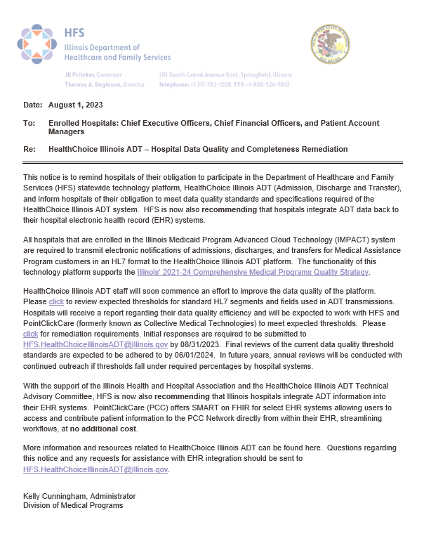
Hospital Provider Notice
Recent Provider Notice: Enhanced Communication & Data Quality
Communication Strategies: Dedicated Email, Listserv Notices
Data Quality Improvements: Key Metrics
Deadlines for Remediation: Upcoming Dates
Remediation Outcome Goals: EMR Integration, Platform Usage

Slide 8
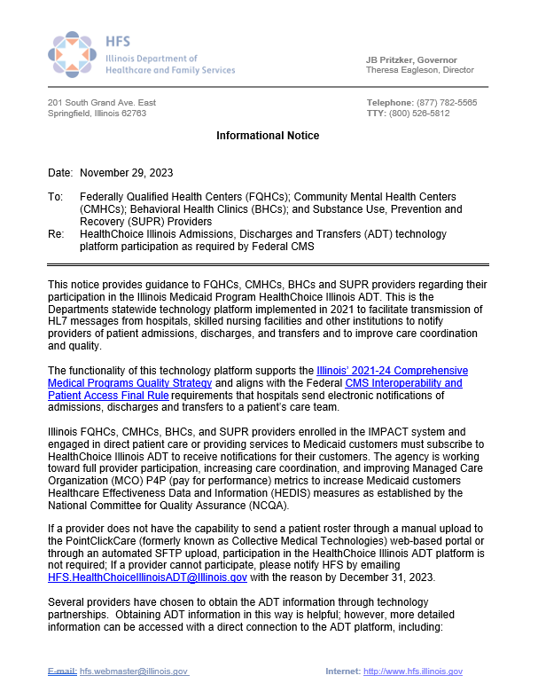
Provider Notice FQHC, CMHC, CHC, SUPR
Overview of recent provider notices to FQHCs, CMHCs, BHCs, and SUPR Providers
Future communication plans and onboarding support
Key goals and supports provided by the technology platform
Key Points:
Subscription requirement for Federally Qualified Health Centers (FQHCs), Community Mental Health Centers (CMHCs), Behavioral Health Clinics, and Substance Use, Prevention, and Recovery (SUPR) Providers
Alignment with Illinois' 2021-24 Comprehensive Medical Programs Quality Strategy and Federal CMS Interoperability and Patient Access Final Rule
Goals: Full provider participation, increased care coordination, improvement of MCO P4P metrics, enhancement of Illinois HEDIS measures

Slide 9
How to Manage Users in the Portal

Slide 10
Types of User Roles
Account Manager
Account Managers can view, modify, and add patient Information, and have facility account management access, allowing them to manage and add user accounts.
IT users have facility account management access and can manage users; however, they do not have permissions to view, modify, or add patient information.
IT
This is a standard user. Patient Access users can view patient information, modify it; they do not have access to facility account management.
Patient Access
Read Only
Read only users can view patient information; they cannot modify or add additional information.
No permissions will allow a user to create an account without any access to patient health information or account creation. This permission set only allows you to access the My Account and Help Information.
No Permissions

Slide 11
Portal Updates

Slide 12
Enhancement- Patient Insurance Information Added

Slide 13
Collaboration- What are the Possibilities?

Slide 14
Care Collaboration - Complete Care Management Partners
Complete Care is a care management company that is dedicated to improving health disparities and health outcomes by providing effective Medicaid and Medicare care management services to our clients.
CCMP is dedicated to reducing fragmentation of care and services, reducing ER utilization, reducing hospitalization rates, increasing options for care, increasing member choice and program flexibility, improving access to care and services, and promoting the member’s overall well-being.
To accomplish this, CCMP utilizes data tools such as assessment, claims, and utilization data to
determine where gaps in care exist and works with both community and health plan partners to address
care gaps and social determinants of health.
Population Health & Analytics
CCMP is improving lives by unlocking insightful data. We are transforming healthcare through population health and analytics using data-driven decisions to inform our teams better and ensure equal access and outcomes for all.

Slide 15
Care Collaboration - Complete Care Management Partners
Engaging the hard to reach high risk patient population – How it works
Customer sends CCMP lists of patients to engage
CCMP Arranges Appointments, Transportation, and other Community Resources
How it’s Done - PCC Care Collaboration Network is Used For:
Real-Time Notification of when a hard to reach patient has presented to the hospital
Field staff deployed to meet the patient while still there, so they can connect and get patient involved in their care management program
View More feature, to see other phone numbers and addresses the patient has used, when unable to contact them
Find out when patients have moved out of state
Get them connected and transferred over to the new State’s Medicaid program
Find out when a patient has recently deceased
Arrange discontinuation of resources

Slide 16
We Want to Participate! What Are the Steps?
Tiffany Ludlow,
Professional Services Manager

Slide 17
Initial Steps to Sign Up
1. Ambulatory provider customers begin the subscription process by completing a brief HFS survey to receive an HFS onboarding packet
https://www.surveymonkey.com/r/8T87FTX
2. Complete HFS onboarding packet and email to HFS:
HFS.HealthChoiceIllinoisADT@Illinois.gov

Slide 18
Implementation Timeline (Ambulatory File Based)
Week 1
Weeks 2-3
Weeks 4-5
Weeks 6-8
Onboarding ​
Kickoff Call
Portal build​
1st submission of eligibility file​
File Validated by ETL​
Client completes and submits user, notifications and report forms to CMT
Second Eligibility File Submitted​
Auto processing set up​
End user training scheduled
User Training on Live Portal​
Hand off to Customer Success or Support​
Close out of Project

Slide 19
File Based
Technical Next Steps
Clinical Next Steps
First File Submission
Connectivity options: SFTP or Portal Upload First File Submission: ______________
File validated by Collective ETL Team
Second file validation upon submission
Auto-processing (data will populate immediately upon upload completion)
Determine your facility’s goals & potential workflows
Complete Onboarding Forms
• User Account Form
• Notifications Form (if applicable)
• Report Builder (if applicable)
User Training on Live Portal
ETL
Second File Submission
Subsequent File Submissions

Slide 20
Direct Integration
Technical Next Steps
Clinical Next Steps
Ensure data sharing agreement is completed
Provide EHR contact to Collective/PM
Collective will establish connectivity & integration directly with your EHR
Determine your facility’s goals & potential workflows
Complete Onboarding Forms
• User Account Form
• Notifications Form (if applicable)
• Report Builder (if applicable)
User Training on Live Portal

Slide 21
Your Project Team
Project Manager
Client Engineering (Integration Based)
Client Engineering (File Based)
Support
Principal point of contact during project.​
​Manages project and plan, resources, communications​
​Handles escalations; manages risks and issues​
Provide status reports
​Integrations Engineer – ADT Feeds and EHR Integrations when applicable​.
​Works with EHR contact to establish connectivity ​
​Works with PM to ensure data is flowing and accurate during project
ETL – Extract, Transform, Load ​​
Reviews the patient file and maps data to correct fields in portal. ​
Works with PM to ensure required data is present and consistent during project
Principal point of contact once the project is closed.​
Supports client when assistance is required.​​
Manages changes to account

Slide 22
CCG Schedule and Resources

Slide 23
Save The Dates for the 2024 CCG Events!
2024 Clinical Collaboration Group Webinars –
All provider types
Thursday, August 8, 2024; 12pm – 1:00pm
Register Here
Thursday, November 7, 2024; 12pm – 1:00pm
Register Here
Topics including:
Workgroup recommendations
New Provider Notices
Regional Collaborations
Collaboration success stories
Platform enhancements
And more!

Slide 24
Do you have additional questions and would like to discuss? Please indicate here, and we will contact you.
No thanks
Yes
What would you like to see/learn more about in an upcoming CCG? We would love to hear from you.
Indicate
Notes:
RUN the poll- bottom

Slide 25
Resources
State HFS Website: HealthChoice Illinois ADT HFS Program Email: HFS.HealthChoiceIllinoisADT@Illinois.gov
Collective Medical/PointClickCare Customer Community Site: https://community.collectivemedical.com/
Collective Medical Support Email: support@collectivemedicaltech.com
Let’s Get Engaged!
Want an in-person visit or virtual meeting with PointClickCare to help your team learn how to best use the platform?
A walk-through of the Network platform and its functions/features?
Click here to schedule a call to discuss your needs and get answers to your questions!
Click Here

