Slide 1
HealthChoice Illinois ADT Clinical Collaboration Group Collaborate to Improve Patient Outcomes
February 22, 2024

Slide 2
Agenda
Introductions
Dana Wilson, PMP, Program Manager, HFS, Division of Medical Programs, Program & Policy Coordination, Federal Health Information Planning
Nancy Sehy, BSN, RN, CHPCA, Clinical Solutions Lead, PointClickCare
Octavio Aguiar, LCPC, CCM, Manager, Customer Success, PointClickCare
Brian Bench, Sr. Solution Engineer, PointClickCare
HealthChoice Illinois ADT Program Updates
Technical Advisory Committee Update
Provider Notice Review
Network Effect
Platform Items- File Submission
Collaboration Examples
Upcoming Events

Slide 3
HealthChoice Illinois ADT Program Updates

Slide 4
HFS HealthChoice Illinois ADT Program Goals
Improve Care Coordination
Provide real-time ADT alerts for immediate action events
Reduce hospital readmissions
Support Managed Care Organizations (MCOs) operations and care coordination
Enhance provider-to-provider communication using HL7 data
Enhance Data Quality
Follow HL7 and USCDI standards for data exchange
Establish state agency HL7 standards for consistency and improved exchange
Achieve a data quality verification rate of 90% or above
Utilize Reporting and Data Analysis
Analyze equity and address disparities in healthcare
Analyze social determinants of health (SDoH)
Improve claims reporting and identify system inefficiencies
Combine HL7 data with existing claims data for insights
Support Interoperability Legislation
Support CMS Conditions of Participation requirements
Assist agencies and providers in meeting federal interoperability requirements
Collaborate with other state agencies to meet public health legislation requirements
Notes:
As we gather here today, we are united by a common vision: to revolutionize care coordination for the 3.7 million individuals under HealthChoice Illinois ADT. Your relentless commitment to this mission has been the cornerstone of our progress. Through the integration of real-time Admission, Transfer, and Discharge (ADT) alerts, we are not just exchanging information — we are paving the way for immediate, life-saving interventions. Each alert you process, each reduction in hospital readmissions, is a testament to your dedication. We are building a stronger, more responsive healthcare system together, where Managed Care Organizations and providers communicate seamlessly, underpinned by the robust HL7 data standards. Our goal to enhance data quality isn't a mere statistic; it's about ensuring that every piece of data has the power to change lives for the better.
But the horizon of our work extends beyond the immediate. By harnessing the power of data analysis and reporting, we are delving into the heart of healthcare equity and addressing disparities that have long been overlooked. Social determinants of health are not just variables in a report; they are the realities of life that shape health outcomes. As we improve claims reporting and identify system inefficiencies, we are not just cutting costs — we are enhancing the quality of care. By meeting and surpassing a 90% data quality verification rate, we ensure that our insights lead to impactful actions.
Yet, we stand at a crossroads where the path forward requires more than just commitment — it demands collaboration. Your role is pivotal. Without your expertise, without your voice, and without your action, our shared vision dims. We are the change agents of healthcare, and together, we are unstoppable. Let us continue to support each other, learn from each other, and inspire each other. As we embrace the challenges ahead, let's remember: we are not just improving a system; we are nurturing the health of millions and the heart of our community.
I invite you all to re-engage with this mission, to reaffirm your commitment, and to take bold steps towards a future where every individual under our care has the opportunity for better health outcomes. Your role is indispensable, your contributions invaluable, and your partnership essential. Together, let's ensure that HealthChoice Illinois ADT remains a beacon of excellence in healthcare coordination and quality. Let's make a difference, not just today, but for generations to come.
Thank you for your service, your passion, and your dedication. Let's move forward, together.

Slide 5
Project Timeline
2021
May – Sep Hospital Onboarding
Jul – Dec Long Term Care Onboarding
Dec – All MCO’s connected
Aug 3, 2023
Clinical Collaborative
Group & Technical Advisory Group
Mar 9, 2023
Clinical Collaborative
Group
May 4, 2023
Clinical Collaborative
Group
Aug 2023
Provider Notice
Data Quality
Nov 2, 2023
Clinical Collaborative
Group
2023 - 2031
Data Quality
and Analytics Enhancements
2023 - 2031
Initiatives, Incentives, Programs, Increase Efficiency, Improve Patient Outcomes
Jan 2022
1st Clinical Collaborative
Group (CCG)
Feb 2022
Begin Ambulatory & Community Provider Implementation
Mar 2023
1st Healthcare Transformation Collaborative
May 11, 2023
HFS HealthChoice Illinois ADT Technical Advisory Committee
Convene
Aug 2023 –
Sep 2024
Hospital Data Quality
Remediation
Fall 2023
ADT Data Enterprise Data Warehouse
2023 - 2031
Phase 2:
CCDs, Labs, Imaging, Rx, Scheduling, Physician Notes, Billing Data
CCGs held each qtr. for Hospitals, MCO, LTC, and Ambulatory & Community Providers

Slide 6
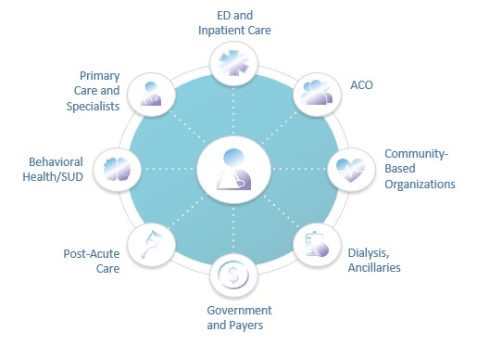
Connected Facilities
586 Medicaid Ambulatory & Community Providers
Type | Subscribing
Certified local public health department | 1
Community Health Agencies - In home | 1
Community Mental Health Provider | 327
Department of Alcohol and Substance Abuse Provider | 71
Family Support Program | 5
Federally Qualified Health Centers | 146
Healthy Kids (EPSDT) screening clinics | 1
Home Health Agencies - In Home (100+ locations) | 3
Home Nursing Agency | 1
Hospice | 3
Integrated Health Home | 6
Rural Health Clinics | 4
Waiver service provider--Elderly (DOA) | 10
Behavioral Health Clinics | 3
Certified Local Public Health Departments | 3
School Based / Liked Health Clinics | 1
959 Medicaid Facilities Transmitting Data
Type | Sending Live Data
Hospitals | 194
ICFDD (Intermediate Care Facility/Developmental Disabilities) | 29
SLF (Supportive Living Facilities) | 108
SMHRF (Specialized Mental Health Rehabilitation Facilities) | 18
SNF (Nursing Facilities) | 610
Numbers as of February 22, 2024
https://hfs.illinois.gov/healthchoiceadt/participants.html
Notes:
Show the difference since the last meeting.
Numbers from March 2023 compared to Numbers end of June 2023
42 additional contributing providers - (4 SLF and 38 SNF)
17 new ambulatory and community providers
We currently have an impressive number of Medicaid facilities transmitting data through the HealthChoice Illinois ADT Program. We have 194 hospitals, 12 ICFDD facilities, 90 SLFs, 18 SMHRFs, and 611 SNFs participating in the program. We also have 45 clinics representing almost 411 thousand lives and home health facilities representing 23,650 lives. This extensive network of facilities enhances our ability to exchange vital healthcare information.

Slide 7
Provider Notice Review

Slide 8
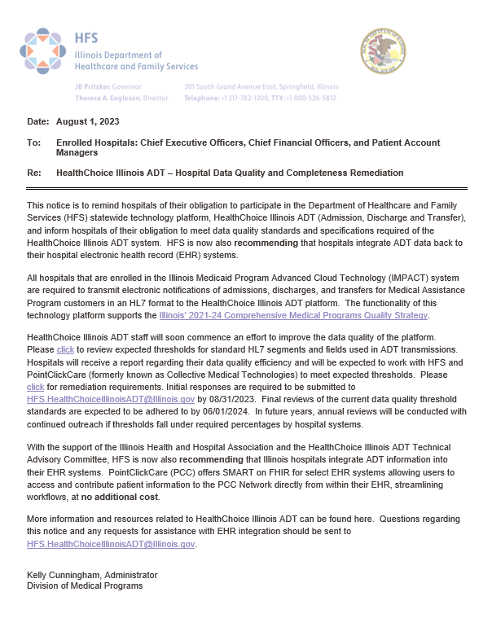
Hospital Provider Notice
Highly Recommending ADT Integration
Working with CMS Financial Management SMEs regarding their suggestion to include connection costs in administrative costs for provider cost reports
Data Quality
Link to HFS HealthChoice Illinois ADT – HL7 ADT Data Quality Standard
Expected percentages and standards
Reports provided to hospitals for current status
Deadlines for Remediation
8/31/23 main contacts, compliance officers, and technical teams to set up initial calls to review current data quality and completeness
Schedule Meetings by 9/30/2023, meet by 12/31/2023
9/30/2023 – 06/01/2024 Review current baselines, identify issues with data quality, correct mappings, testing, and fix data transmission
06/01/2024 Final Review
Annual Reviews

Slide 9
Remediation Outcome Goals
Current Contact Information
Compliance Officer
Technical Staff
Clinical Leads
Main Hospital Contact
Increase Current Encounter Data
Fields align closer with Program HL7 ADT Data Quality Standards
EMR Integration – Bi-Directional
Obtain notifications through EMR, and/or
Email, Fax, Text, Printer
Platform Usage
Train Clinical Leads to use the notifications and portal
Encourage the creation of Care Insights
Annual Reviews
Start process for yearly data quality reviews

Slide 10
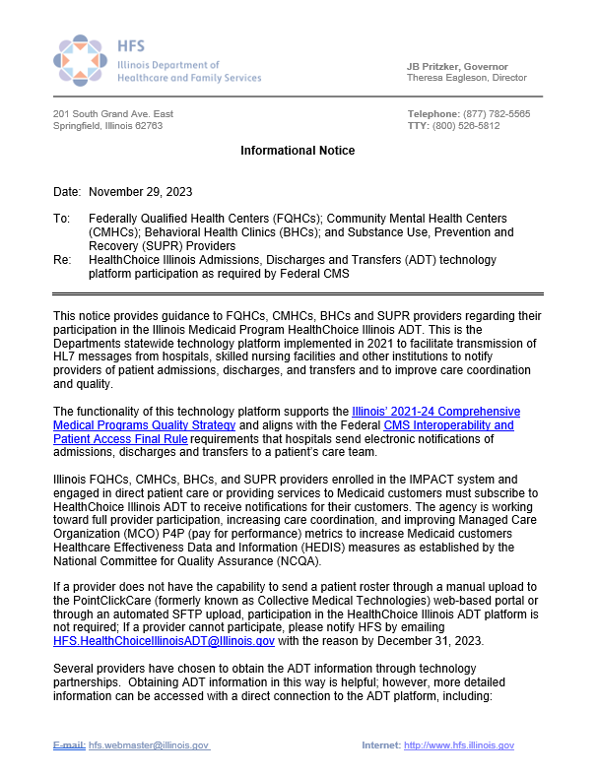
Provider Notice FQHC, CMHC, CHC, SUPR
Shall Subscribe to HealthChoice Illinois ADT
Federally Qualified Health Centers,
Community Mental Health Centers,
Behavioral Health Clinics and Substance Use,
Prevention and Recovery (SUPR) Providers
Technology Platform Supports
Illinois’ 2021-24 Comprehensive Medical Programs Quality Strategy and aligns with the Federal CMS Interoperability and Patient Access Final Rule requirements that hospitals send electronic notifications of admissions, discharges and transfers to a patient’s care team
Goals
Working toward full provider participation
Increasing care coordination
Improving MCO P4P Metrics to raise Illinois HEDIS Measures
Notes:
Federally Qualified Health Centers, Community Mental Health Centers, Behavioral Health Clinics and Substance Use, Prevention and Recovery (SUPR) Providers
We encourage your participation as quickly as possible and ask that you notify HFS.HealthChoiceIllinoisADT@Illinois.gov by December 31, 2023 for the reason your facility cannot participate.
https://www.illinois.gov/hfs/SiteCollectionDocuments/IL20212024ComprehensiveMedicalProgramsQualityStrategyD1.pdf
² https://www.federalregister.gov/documents/2020/05/01/2020-05050/medicare-and-medicaid-programs-patient-protection-and-affordable-care-act-interoperability-and

Slide 11
Ambulatory Provider Notice 11/29/23
Provides real-time notification of ED/Inpatient patient activity, as well as utilization patterns
Access to history of patient encounters and associated diagnoses
CCDs (Continuity of Care Documents
Customer contact information beyond your EMR.
Seamless communication with hospitals, specialists, and community organizations.
Enhanced care transitions and reduced gaps in information exchange.
To view additional consent/privacy/security information- view the previous CCG webinar from 11/30/23 here.
Deadlines
Required listed provider types to notify HFS by 12/31/23 if unable to send their patient roster either manually through the web-based portal or automated SFTP uploads.
Complete the initial onboarding survey by December 31, 2023.
All documentation for participation must be completed by February 28, 2024.
Providers connecting through the portal or through a partnered technology choice should implement by June 31, 2024.
Notes:
Also mention that there are links and information on the last slide, for HFS and PCC- encouraged to contact with all questions about the program, or to request a meeting to discuss further.
And the deck/recording will be on the HFS HealthChoice IL ADT page’s Recorded Webinars section.

Slide 12
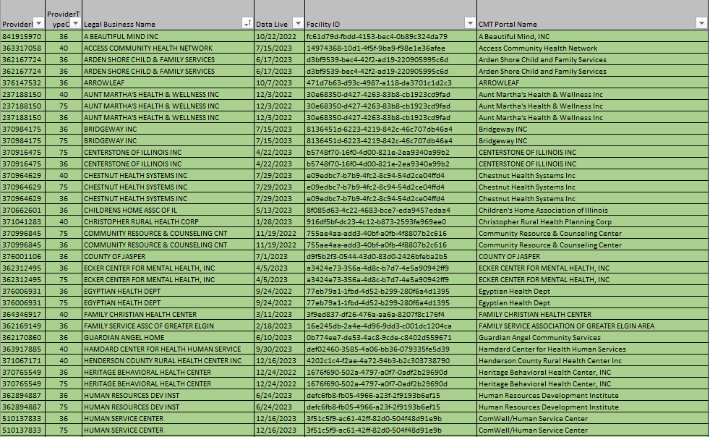
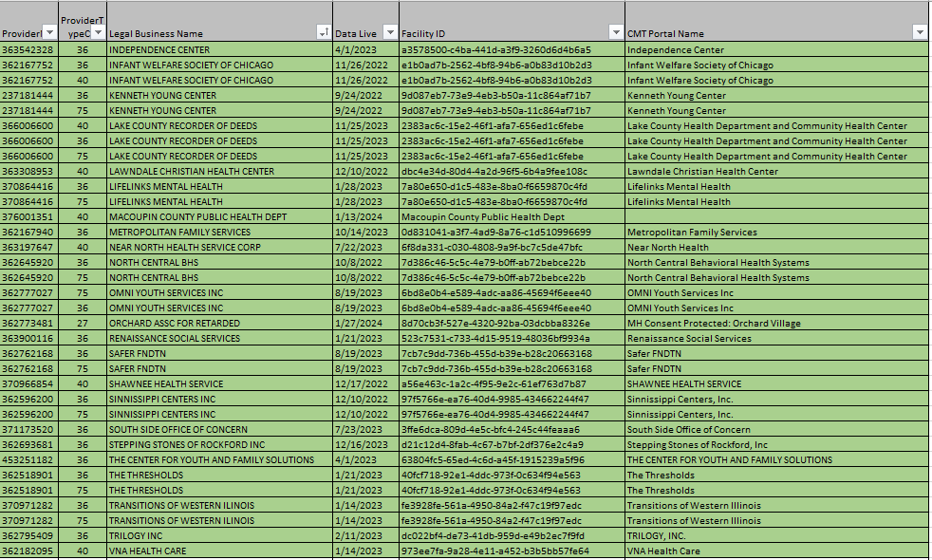
FQHC, CMHC, BHC, SUPR
FQHC = 146, CMHC = 327, BHC = 3, SUPR = 71
Notes:
As of November 1, 2023

Slide 13
Initial Steps to Sign Up
1. Ambulatory provider customers begin the subscription process by completing a brief HFS survey to receive an HFS onboarding packet
https://www.surveymonkey.com/r/8T87FTX
2. Complete HFS onboarding packet and email to HFS:
HFS.HealthChoiceIllinoisADT@Illinois.gov

Slide 14
The Care Collaboration Network Effect

Slide 15
Market-Leading Long-Term Care EHR + the Most Expansive Care Collaboration Network
27,000+ | Long-Term Care facilities
3,100+ | Hospitals and Health Systems
2,200+ | Ambulatory
45% | US Hospitals
75+ | State & Govt. Agencies
2M+ | Patient Records
195M+ | Lives
700M+ | Network Patient Visits
47 | States Connected on the Network
Every | Major US Plan
PointClickCare SNF EHR
Acute Care Connections
CCD Connections
Connections via HIE
Other Integrations
Notes:
97% of US Hospitals discharge to PointClickCare EMR users
PointClickCare is a healthcare technology company
We built the market-leading senior care EHR in North America
We’ve since expanded our data and Network- several years ago Collective Medical joined PointClickCare to create the largest care collaboration network in the U.S., to enable working together to close the communication gaps that undermine patient care.
The network also includes functionality for Value Based Care for Health Systems and Plans like Kaiser, Cleveland Clinic, and other Risk Bearing Entities, as well as the inclusion of provider clinics. This enables entire health systems and freestanding entities to onboard their ambulatory clinics- in Illinois, this is also sponsored by HFS. Now they can collaborate across the care continuum with other customers like the community based care long term supports and services, home care, and others. To do that we’ve built the largest real-time care collaboration network in the US
You can see on this map the large network participation we have thanks to our partnership with HFS’s HealthChoice Illinois ADT, and their sponsorship for you to have this access!

Slide 16
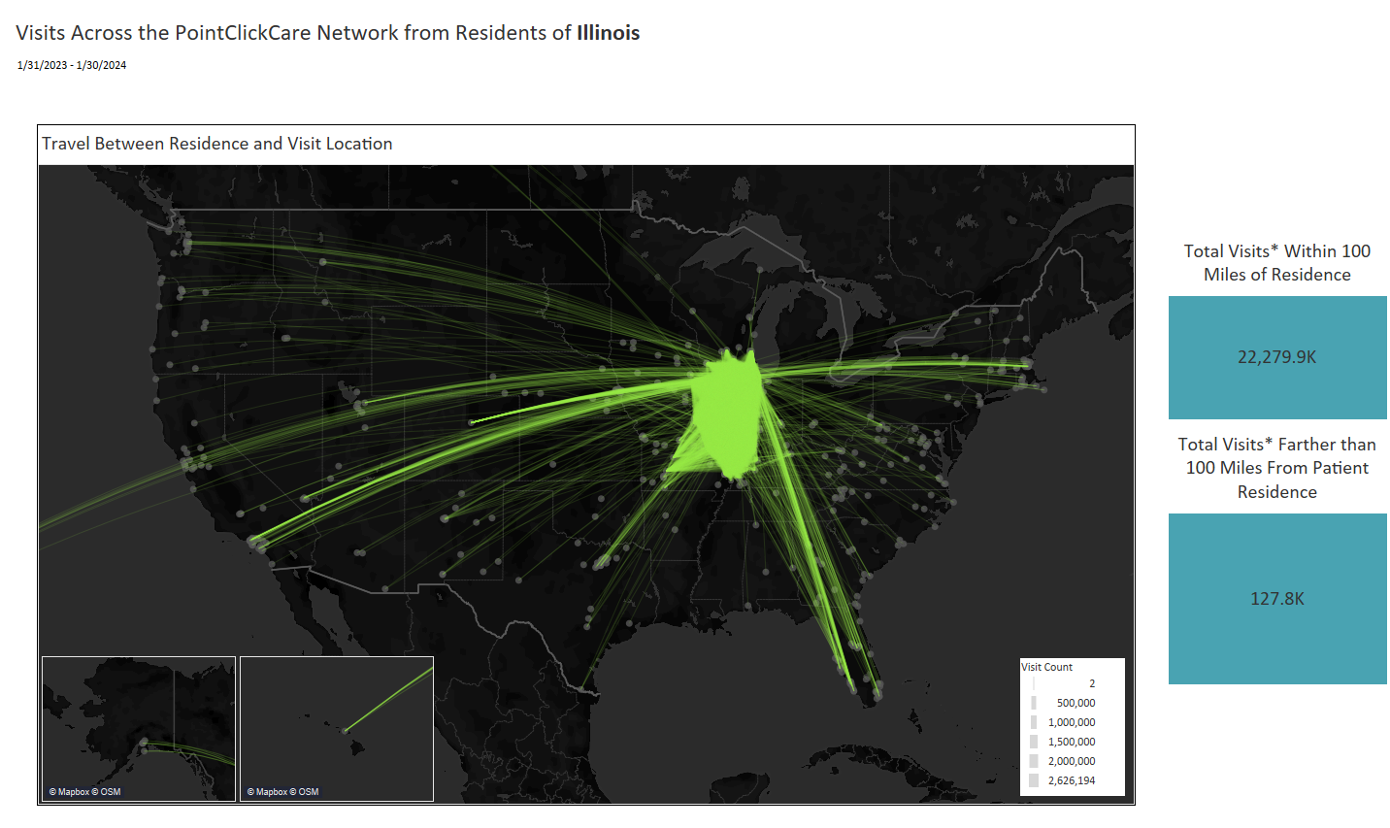
Nationwide Network Impact
Notes:
These next couple of slides were a real eye opener for me, so I wanted to share this information with you to help show the value of the network that HFS is sponsoring for you. This slide here shows how much patient movement there was over the course of a year. So many patients travel away from their primary service area to seek specialized healthcare, for vacation, to visit family and friends, and may experience encounters and problems you are unaware of, because it is not visible in your EMR.
For example, you may not be able to reach a patient and can’t figure out why. Using the Network, you are able to see that they went to the emergency room in Georgia and were admitted to the hospital there. You’d be able to then contact that hospital to coordinate and schedule followup care back home as part of the discharge planning process.

Slide 17
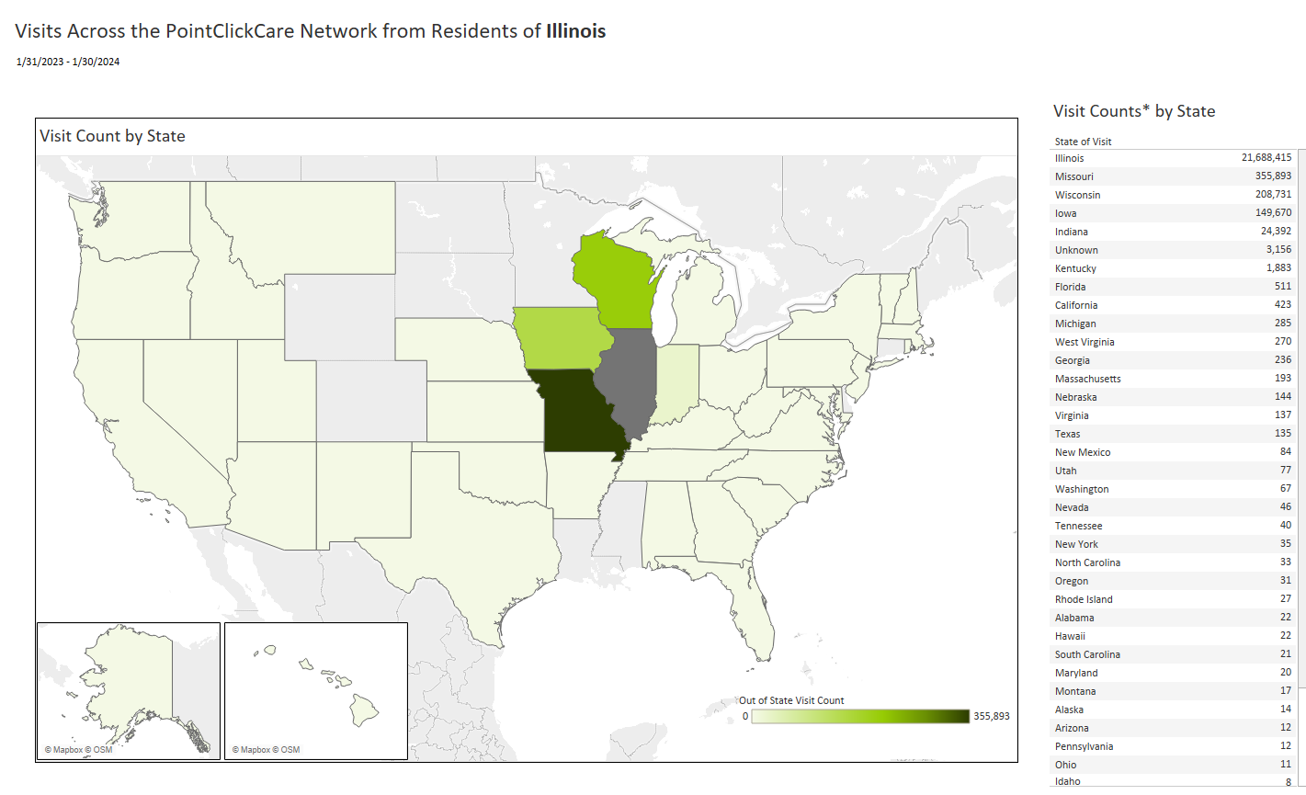
Nationwide Network Effect
Notes:
You can see here all of the healthcare encounters that occurred for residents of Illinois who received care outside of the State. This emphasizes the importance of access to a nationwide network, enabling you to receive not just information from within your EMR, health system, or state-restricted information, giving you fuller picture of your patient, which in turn enhances your ability to collaborate and make care decisions to provide informed care.
HAND OFF TO OCTAVIO

Slide 18
Our platform enables Care Managers to be the patient’s care continuum guide
Discharged to
Skilled Nursing
Coordinators & Community Providers
Risk Bearing Entities
Health Plans
Health Plan
Taken to ED, admitted as IP
Ramesh, 75 years old
Suffers a fall, taken to ED
Discharged from SNF with home health services
Health Plans and other Care Team Members are notified during different points across the care system to engage in care collaboration and treatment planning to support the member/patient.
Post-discharge follow up with PCP
Notes:
Here we see how utilizing CMT's tools gives us the ability to coordinate across the care system.
Collective Medical, a PointClickCare Company, promotes care collaboration and coordination across the care continuum. As you can see in this slide, our solution provides real time notifications to acute care settings such as hospitals, and risk bearing entities such as ACO’s, and Health Plans. The information provided promotes interdisciplinary care team participation which in turn creates better patient outcomes. By doing this, we are empowering providers and risk bearing entities to focus, engage and collaborate with others across the entire continuum of care. It is our goal to help
manage unnecessary length of stays, reduce readmissions, advance population health and manage value-based contracts amongst others.
Review each scenario and the benefits on this slide but focus on HealthPlan.
Give brief examples when possible.

Slide 19
HEDIS Measures MCOs and Health Plans Use
 |  | Commercial | Medicare | Medicaid
STANDARD (Available)
IET | Initiation and Engagement of Alcohol and Other Drug Abuse or Dependence Treatment | X | X | X
FUM | Follow up After Emergency Department Visit for Mental Illness | X | X | X
FUA | Follow-Up After Emergency Department Visit for Alcohol and Other Drug Abuse or Dependence | X | X | X
FUI | Follow-Up After High-Intensity Care for Substance Use Disorder | X | X | X
FUH | Follow-Up After Hospitalization for Mental Illness | X | X | X
COMMON CUSTOM REQUESTS
FMC | Follow-Up After Emergency Department Visit for People With High-Risk Multiple Chronic Conditions |  | X
PPC | Prenatal and Postpartum Care | X |  | X
AMR | Asthma Medication Ratio | X |  | X
PCE | Pharmacotherapy Management of COPD | X | X | X
OSW | Osteoporosis Screening in Older Women |  | X

Slide 20
Driving Collaboration
Share patient care insights and care team information with ED, inpatient, post-acute, and primary care
Push Flags with population indicators and standard care coordination protocols to the broader network
Provides critical patient context to enable informed decision-making regarding treatment

Slide 21
Patient Attribution/Eligibility File Best Practices Brian Bench

Slide 22
Eligibility File Best Practice Overview
Layout
Must be a .csv, .txt (pipe or tab)
File names must remain consistent ex: Point_Click_Care_MMDDYYYY.csv (date at the end can vary)
Column headers, once established must remain consistent, ex: Date of Birth cannot change to DOB or date of birth
Format for all date fields must contain a 4-digit year (2019)
Column formats must remain consistent throughout the entire column, ex: Gender can either be one-character M/F/O or full text Male/Female/Other but not both
All members/patients MUST have a unique ID (MRN) that will remain consistent with that member/patient and will not be duplicated or reassigned to another member/patient
Leave blank values when no information is available, ex: do not use ‘null’ for a middle name or ‘N/A’ for Address 2
Remove any values acting as a ‘placeholder,’ ex: DOB 1/1/1900 or SSN 999999999
Please include only ‘active’ patients the file.

Slide 23
Clinic Eligibility File Standard Columns
Standard Required Column Headers
Unique ID
First Name
Last Name
DOB
Gender
SSN
Address 1
Address 2 (if applicable)
City
State
Zip
Phone Number
***Care Team Column Headers
Provider Name
Provider NPI
Provider Facility Address
Provider City
Provider State
Provider Zip
Provider Phone Number
Provider Taxonomy code
Notes:
Encourage R side items! Need to populate Care Team, let others know this patient is yours, easily see who is involved in the patient’s care to arrange the proper followup. Helps w HEDIS measures

Slide 24
Eligibility File Submission and Maintenance
SFTP – Standard
PointClickCare/Collective Medical prefers to host SFTP
File submission is automated on both sides
Quick turn around for file processing.
Files encrypted at rest when submitted to Collective Medical. Most protected way to submit files
Requires credentials to log in to SFTP and is limited access
Manual – Case by Case
Secure submission
Requires manual upload each time. File automation on customer side is limited.
Anyone with account manager or IT access can see the file can upload and download.
Labor intensive and file frequency can be greatly affected.

Slide 25
Social Security Numbers
SSN Requirement:
SSN is a standard requirement from all customers of PointClickCare/Collective Medical. This includes all hospitals, providers, and plans. SSN is used for matching members and is one of the strongest way to match a member. Collective Medical takes every precaution to protect SSN and will never store the raw value on our database. Collective salt-and-hashes every SSN with a one-way encryption.
PointClickCare/Collective Medical works with a variety of providers and not all providers have SSN for their patients. If SSN is not available, this can potentially affect PCC/Collective’s ability to match patients on our network. When SSN is not available, PCC/Collective employs other data points to aid in matching. If you have questions about SSN please follow up with your implementation specialist or account manager with questions.

Slide 26
Security Reminder

Slide 27
Behavioral Health information as Sensitive Data
How are populations with sensitive behavioral health data identified and managed by PCC?
Upstream pre-implementation discovery process allows for identification of types of behavioral health data for each clinic site
SUD treatment programs that are a Part 2 Covered Program under 42 CFR Part 2 will have their own portal configured with SUD consent functionality, separate from programs providing mental health or psychiatric treatment only, which has mental health specific consent functionality configured.
*Programs providing dual diagnosis of both SUD and mental health treatment typically will be treated as a Part 2 covered program.

Slide 28
Collaboration- What are the Possibilities?
Notes:
Before we get started from the PointClickCare side, just a heads up that if any of the content we will be sharing during this webinar is something you’d like more information on, or help using at your organization or facility, we will have the opportunity at the end of this presentation, for you to click a button to request that. I encourage you to please do click that- we are here to help you achieve results.

Slide 29
Care Collaboration Best Practices
Review Cohorts and Census Each Morning
Why Census?
Quickly review each ED visit/ Inpt stay: dx, visit hx, snapshot of complexity of need
Some visits don’t trigger a Notification or fit into a Cohort depending on dx
If client is not established, there is a lot of valuable info
Notes:
Bullet point 2 – also patient search available, don’t have to wait for Cohort or Notification, or acute activity- will show this in a bit.
Bullet point 3, if pt is accepted to clinic and assigned to provider as their patient, may have visit scheduled for later in the week and this can provide valuable history of care for the pt.

Slide 30
Care Collaboration Best Practices
Some possibilities to consider:
Accurate/timely eligibility file allows you to see clients who are assigned but not necessarily established
Partner with local hospitals to ensure Notifications are enabled on both ends
Regular partner touchbase meetings is highly recommended to ensure workflows are working and maintain engagement
text
Notes:
Be sure to add columns for associating a provider with the patient, so it shows in Care Team to the whole network outside of your clinic or care setting- then the Hospital/MCO knows who to ensure followup with, helps retain your patients and provides them the best care continuity. At the end of this webinar, there will be a spot you can indicate you’d like help with that or further instruction.
Some have asked to know who is on the network, so they can collaborate more closely with them- mention participant link on slide 6 Dana presented

Slide 31
Portal Feature

Slide 32
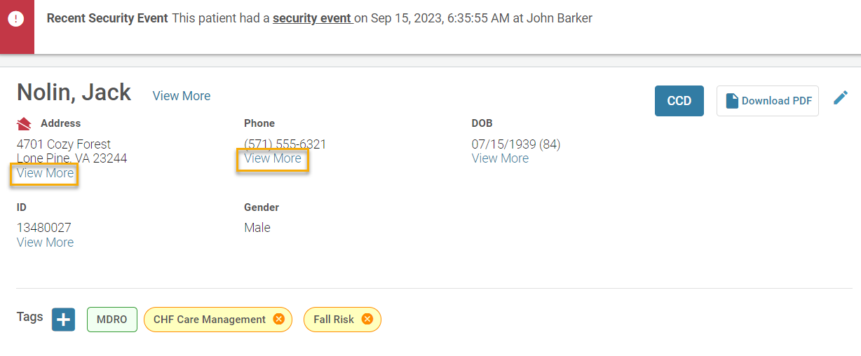
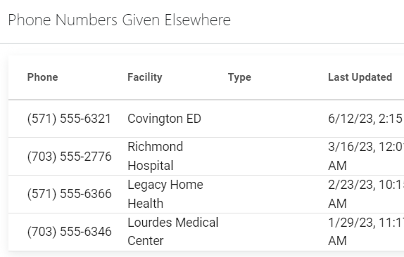
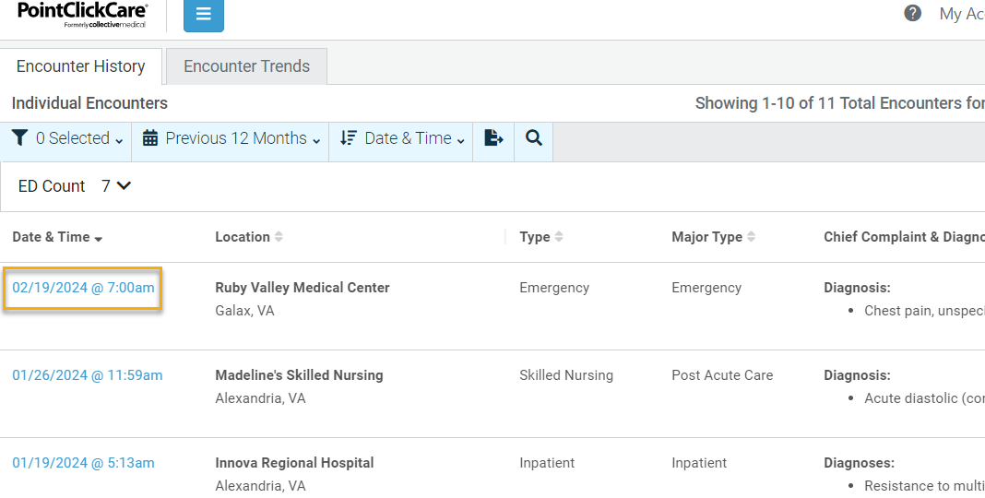
‘View More’ and Other Blue Highlighted Areas
Notes:
One of the MCOs gave this feedback after the last CCG, when asked what they found most helpful!
“Locations and phone numbers - we have found people this way who we were previously unable to reach.“

Slide 33
Patient Search

Slide 34
CCG Schedule and Resources

Slide 35
Save The Dates for the 2024 CCG Events!
2024 Clinical Collaboration Group Webinars –
All provider types
Thursday, May 16, 2024; 12pm – 1:00pm
Register Here
Thursday, August 8, 2024; 12pm – 1:00pm
Register Here
Thursday, November 7, 2024; 12pm – 1:00pm
Register Here
Topics including:
Regional Collaborations
Patient level success stories
Workgroup recommendations
New Provider Notices
Platform enhancements
And more!

Slide 36
Would you like help adding Providers to your File or more info on using SFTP for submitting? Please indicate here , and PCC will contact you.
No thanks
Yes
Do you have questions about the Network and would like to discuss? Please indicate here, and PCC will contact you.
Yes
No Thanks
Notes:
RUN the poll- bottom

Slide 37
Do you have questions about the Provider Notice requirement, and would like to discuss? Please indicate here, and HFS will contact you.
No thanks
Yes
What would you like to see/learn more about in an upcoming CCG? We would love to hear from you.
Indicate
Notes:
RUN the poll- bottom

Slide 38
Resources
State HFS Website: HealthChoice Illinois ADT HFS Program Email: HFS.HealthChoiceIllinoisADT@Illinois.gov
Collective Medical/PointClickCare Customer Community Site: https://community.collectivemedical.com/
Collective Medical Support Email: support@collectivemedicaltech.com
Let’s Get Engaged!
Want an in-person visit or virtual meeting with PointClickCare to help your team learn how to best use the platform?
A walk-through of the Network platform and its functions/features?
Click here to schedule a call to discuss your needs and get answers to your questions!
Click Here
Notes:
Nancy: I am hearing more and more interest in collaboration, whether regional, payer based, or a Collaborative of providers-
Please reach out via the Click Here button if you are interested in help forming such a group!

