Slide 1
HealthChoice Illinois ADT Clinical Collaboration Group Collaborate to Improve Patient Outcomes
November 7, 2024

Slide 2
Agenda
Introductions
Dana Wilson, PMP, Program Manager, HFS, Division of Medical Programs, Program & Policy Coordination, Federal Health Information Planning
Nancy Sehy, BSN, RN, CHPCA, Sr. Clinical Solutions Lead, PointClickCare
Shauntessa Aguon-Clark, ECM and Community Supports Manager,
San Francisco Health Plan
HealthChoice Illinois ADT Program Updates
Innovative Health Plan-Hospital Partnership Initiative in California
Technical Advisory Committee (TAC) Updates
Exploring Additional Data Segment Needs and Solutions
Burden Reduction through Bi-Directional Communication
Future Communication Plans and Onboarding Support
Open Discussion and Q & A
Next Steps / Upcoming CCG Events

Slide 3
Program Updates

Slide 4
HealthChoice Illinois ADT Program Goals
Improve Care Coordination
Real-time ADT Alerts
Reduce Hospital Readmissions
Support MCO Operations
Enhance Provider Communication
Achieve High Data Quality
Utilize Reporting for Insights
Support Interoperability Legislation
Notes:
Our HealthChoice Illinois ADT program is driven by several key goals aimed at improving patient outcomes and healthcare efficiency. These goals include:
Improve Care Coordination: Ensuring seamless coordination of care across providers.
Real-time ADT Alerts: Implementing real-time alerts to keep providers informed.
Reduce Hospital Readmissions: Decreasing readmission rates through better data and care coordination.
Support MCO Operations: Enhancing the operations of Managed Care Organizations with accurate data.
Enhance Provider Communication: Improving communication channels among healthcare providers.
Achieve High Data Quality: Striving for the highest standards in data quality and completeness.
Utilize Reporting for Insights: Leveraging data reporting to gain actionable insights.
Support Interoperability Legislation: Advocating for policies that promote data interoperability.
These goals guide our efforts and ensure that we are continuously improving the quality of care for our HealthChoice beneficiaries.

Slide 5
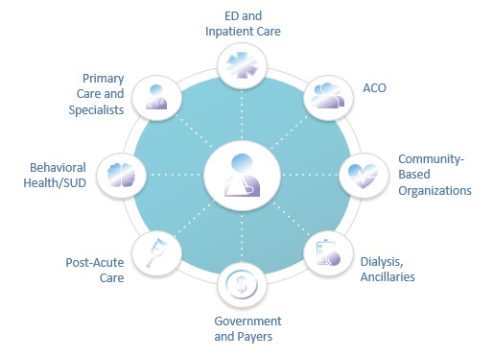
Connected Facilities
701 Medicaid Ambulatory & Community Providers
Type | 10/2024
Behavioral Health Clinic | 7
Certified local public health department | 4
Community Health Agencies - In home | 4
Community Mental Health Provider | 359
Dept of Alcohol and Substance Abuse Provider | 88
Family Support Program | 5
Federally Qualified Health Centers | 179
Healthy Kids (EPSDT) screening clinics | 1
Home Health Agencies - In Home | 3
Home Nursing Agency | 1
Hospice | 3
Integrated Health Home | 7
Rural Health Clinics | 4
Waiver service provider--Elderly (DOA) | 36
961 Medicaid Facilities Transmitting Data
Type | 10/2024
Hospitals | 194
ICFDD (Intermediate Care Facility/Developmental Disabilities) | 31
SLF (Supportive Living Facilities) | 108
SMHRF (Specialized Mental Health Rehabilitation Facilities) | 18
SNF (Nursing Facilities) | 610
Notes:
"As of October 2024, I am proud to share that we have made tremendous progress. Currently, we have over 194 hospitals, 767 long-term care facilities, and 633 behavioral health and community mental health, substance use and FQHCs providers contributing live data. This represents a huge leap from where we began and reflects the hard work of all our partners across the state.
What's truly remarkable is how we did it—working together with MCOs, hospitals, and behavioral health providers, often under limited resources and tight deadlines. This synergy allowed us to identify and correct key data discrepancies, and it’s the combined efforts of all stakeholders that have made this program a success.
Our hospital network is especially critical as they contribute the bulk of ADT data, especially for high-risk patients in emergency care or those frequently admitted. Additionally, the long-term care facilities and behavioral health providers are making strides despite initial challenges, such as privacy concerns and technical readiness. Nancy, feel free to jump in here to expand on the ongoing efforts with behavioral health facilities, and we will go into further detail later in the presentation.
This achievement cannot be overstated. Illinois has previously tried and failed to build a network of this scale, but this time, we did it. We now have a healthy, reliable system, driven by a combination of state and federal policy changes, along with a commitment from all our participants. This level of connectivity strengthens care coordination across settings and is a model for success."

Slide 6
Health Plan – Hospital Partnership Initiative: Enhanced Care Management (ECM)- California Shauntessa Aguon-Clark ECM & Community Supports Manager San Francisco Health Plan
Notes:
Nancy-
Introduction and announce/ensure attendees are aware that many products/states/customers have access to different products, different features, and that theirs may be different from what is shown.
The important point is to share ideas and inspiration about what is being done elsewhere and what is possible

Slide 7
Enhanced Care Management (ECM) - Background
Enhanced Care Management (ECM) is a statewide, 5-year, Medi-Cal benefit effective January 1, 2022.
ECM has been developed from lessons learned, as well as MCP and Provider experience, in the Whole Person Care (WPC) Pilots and Health Homes Program (HHP).
ECM aims to provide a whole-person approach to care that addresses the clinical and non-clinical circumstances of high-need members enrolled in Medi-Cal managed care.
ECM is delivered primarily by community-based entities that hold contracts with managed care plans (MCPs).
Less than half of the eligible members have received ECM Services according to California Department of Health Care Services.
PointClickCare was chosen for this initiative because it has effectively supported organizations with the WPC model and is well-equipped to assist with the ongoing transition to ECM.
Notes:
California launched Enhanced Care Management (ECM) in 2022, a state initiative targeting managed Medicaid plans. ECM evolved from the Whole Person Care model and the Health Homes program, aiming to serve vulnerable patients by linking them with community-based providers for both clinical and non-clinical needs. PointClickCare has a proven track record of aiding organizations in supporting Whole Person Care and we aim to continue to offer robust support during their transition to ECM.
PointClickCare has started aiding the ECM efforts across various sectors including health plans and ambulatory providers, and for the scope of this work, it is designed to support ECM activities in the hospital

Slide 8
ECM Population of Focus
Adults, unaccompanied youth and children, and families experiencing homelessness
Adults, youth, and children who are at risk for avoidable hospital or emergency department care (previously “high utilizers”)
Adults, youth, and children with serious mental health and/or substance use disorder needs
Adults living in the community and at risk for long-term care institutionalization
Adult nursing facility residents transitioning to the community
Children and youth enrolled in California Children’s Services (CCS) or CCS Whole Child Model with additional needs beyond their CCS condition(s)
Children and youth involved in child welfare (foster care)
Adults and youth who are transitioning from incarceration
Pregnant and postpartum individuals; birth equity population of focus (starting in 2024)

Slide 9
Pain Points from the Hospital Perspective
Unnecessary Overutilization of ED: Patients in specific populations present at the ED for care that could have otherwise been provided in an outpatient setting, such as their ECM provider.
High ED volume ties up resources: High utilization patterns and boarding of patients can unnecessarily crowd EDs leaving care teams short of resources. This creates inefficiency, duplication and delays that affect not only that patient but others waiting for treatment.
Action: It is not always apparent which patients in the ED can be eligible for additional support, longitudinal and enhanced care management that could result in better patient care and lower utilization.
ED and Hospital Leaders

Slide 10
Population of Focus in EDO ECM Pilot: PointClickCare Already Surfaces the Most Commonly Referred ECM Population of Focus
High Utilization
Substance Use Disorder/Mental Health
Patients Experiencing Homelessness
5+ ED in the last 6 months
3+ IP admission/SNF encounters in the last 3 months
History of Opioid Use Disorder
History of Substance Use Disorder
History of Alcohol Use Disorder
History of Mental Health Dx
History of Suicidal Ideation or Self-Harm
Housing insecurity diagnosis
Housing insecurity care insight
Suspected Housing insecurity zip code
Can be included in attribution files
Flags from payors can be used to indicate
Notes:
Able to surface the high utilization component in 6 month eligibility criteria
This includes 4 historical ED plus current ED or 2 historical IP encounters with a current ED that resulted in an admission
2. For the SUD/MH – PCC uses 1 or more encounter in the last 12 months – ECM indicates 2 or more encounters
3. (SDOH)Hx of Housing Insecurity
Currently, this criteria is met if the patient presents to the ED and has a recent (6 months) record of confirmed or suspected housing insecurity in the Collective database
Hx of Housing Insecurity (6 months)​
Currently, this criteria is met if the patient presents to the ED and has a recent (6 months) record of confirmed or suspected housing insecurity in the Collective database.
Patients are attributed with a housing insecurity record when:
Housing insecurity diagnosis code provided in ADT message:
Z59.X (series of Z59 codes that align with Housing Insecurity)
Housing Insecurity Insight
Patient has a Housing Insecurity Collaborative Insight documented.
There is a Collaborative Insight Type named "Housing Insecurity".
Currently, only the state of CA as a Housing Insecurity Insight, but when Collaborative Insights are rolled out to each state, the Housing Insecurity Insight will be available nationwide.
The Housing Insecurity Insight will expire after 18 months.
Uploading a Homelessness Discharge Plan to the portal.
This is a requirement in the state of CA and is currently only available in CA. In CA, if a patient presents to the ED with housing insecurity, the patient cannot be discharged without a Homelessness Discharge Plan.
If this is enabled, in the portal there is an option to "Attach Hospital Homeless Discharge Plan" within the Housing Insecurity Collaborative Insight.
By uploading a Homelessness Discharge Plan, the Housing Insecure icon will display for 18 months from the last data we received.
Flat File Indicating Housing Insecurity
Facilities sending eligibility/patient attribution files can indicate Housing Insecurity via this file.
If a facility is interested in pursuing this, you can refer the customer to the ETL team.
The ETL team will work with the customer to provide flat file specs to provide housing insecurity information.
Suspected Housing Insecurity by Zip Code
We can set up a facility configuration to configure a specific zip code that we receive in a hospital's ADT message to indicate Housing Insecurity.
For example, 99999 or 77777 can be configured for an individual facility to always mean housing insecure. However, because this is not as defined as a Dx Code, we call it "suspected Housing insecurity".
The zip code that can be used for this configuration is what the hospital inputs into their system and what is sent via the ADT message. The zip code may be a proxy, for example, the patient states that they don't have a home, but the EMR requires an address, so the registrar uses 77777 when the patient states they do not have a home.
Note: This is not best practice, and we want to make it clear to the recipient of the notification that this is more of a suspicion rather than a clinical diagnosis.
Flags from a Health Plan
When a Health Plan is doing a health risk assessment for a member, the Health Plan can choose to have a Flag associated with that member to indicate the member has SDOH issues.
To implement this, the SDOH Flag will need to be discussed and defined with the Health Plan customer(s).

Slide 11
How PointClickCare Supports ECM Work from the Hospital
Boost Hospital Enrollment of ECM
Optimize Care
Transitions and Outcomes
Promote Collaboration and
Population Health
Identify and enroll eligible patients based on ECM population of focus allowing point-of-care referrals to health plans for services.
Identify already-enrolled members to allow collaboration with ECM providers.
Real-time ADT notification, reports, cohorts can surface population of interest and be integrated in different workflows.
Optimize patient outcomes by being able to refer appropriate patients to health plans for enhanced care management services.
High-risk patients will receive outreach and engagement from ECM providers and longitudinal care thus decreasing inappropriate ED utilization.
Easily collaborate with providers across the healthcare ecosystem in care collaboration by sharing care insights.
Healthcare providers (acute/ED) will have visibility to enrolled members and their care team allowing further collaboration.
Notes:
We're committed to bolstering the ECM initiative at the hospital. Our primary aim is to increase ECM enrollments from the hospital via the portal's tailored features.
This would eventually lead to enhancing care for high-risk patients by linking them with vital outpatient services, reducing unnecessary emergency department visits.
With the ED optimization tools, we'll further foster provider collaboration, now including insights from hospital staff.
Essentially, our strategy aligns with ED optimization goals, customized for this state's initiative and patient demographic.

Slide 12
ECM-Based ED Optimization Features
ECM Criteria-Based Notifications
ECM Cohorts
Reports
Flags
Real-time notifications are delivered to the desired workflow and/or destination(s) when pre-defined criteria is met.
Set of encounter-related criteria to identify populations of focus that are ECM-eligible.
Customizable reports including your population of focus that can be delivered in different cadences.
Standardized contextual patient/member information for the ECM population across the entire PCC Network.
Notes:
Notifications received for these Criteria- can be via ED trackboard or email:
5+ ED Visits in 6 months
3+ IP /SNF in 6 months
Mental Health and SUD encounters
Homelessness
Cohorts and Reports
Surface high risk ECM-eligible patients.
Cohorts group the most common Population of Focus members receiving ECM services in the state.
Reports are customizable to meet different workflows.
Used by care managers who do not work with ED Track board but would like to identify the population for their workflows.
Flags
Are created for Enrolled members.
Provide ECM Provider Contact Information to use for Care Coordination.
Are shared across the entire Collective Medical Network.

Slide 13
UCSF and San Francisco Health Plan ECM Pilot
Step 1
Step 2
Step 3
Step 4
Step 5
PCC sends a weekly report to UCSF and SFHP.
The report for UCSF indicates which patients currently in the hospital and could meet eligibility for ECM services.
UCSF and SFHP meets weekly. Both organizations discuss the patients that could be referred. Report also shows which patients are already assigned to ECM.
UCSF sends a batch referral to SFHP. UCSF also indicates if there is a recommended ECM provider for the needs.
SFHP processes the referral and assigns the patient to the ECM provider, to connect complex patients with longitudinal outpatient services while the are still in the hospital.
The goal is to increase ECM enrollment and decrease future inappropriate utilization though outpatient services.

Slide 14
Early Access Success Metrics
Goals | Metrics | Target
Customer can identify and refer eligible patients at point-of-care (Referral) | Number of ECM Referrals from the ED | 1 to 3 weekly
Customer can enroll eligible patients in ECM Services (Enrollment) | Percent of ECM Referrals that are enrolled | 50%
Enrolled patients receive the necessary services (Services used) | Number of ECM enrolled who received outreach and engagement | 70% of enrolled
Process has resulted in improvement in patient outcomes | IP utilization before and after ECM (if available) | 20% reduction
Customer finds value in the pilot | Case study/Quote/Success Story | Yes/No
Notes:
Matthew to speak on this slide

Slide 15
Technical Advisory Committee Updates

Slide 16
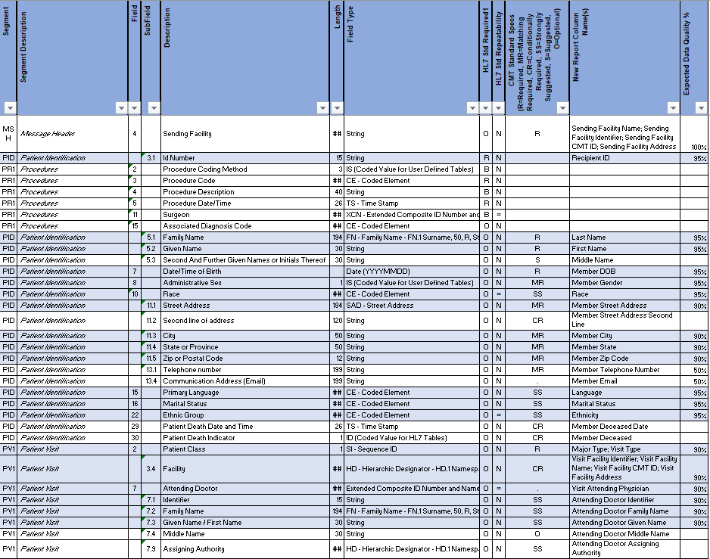
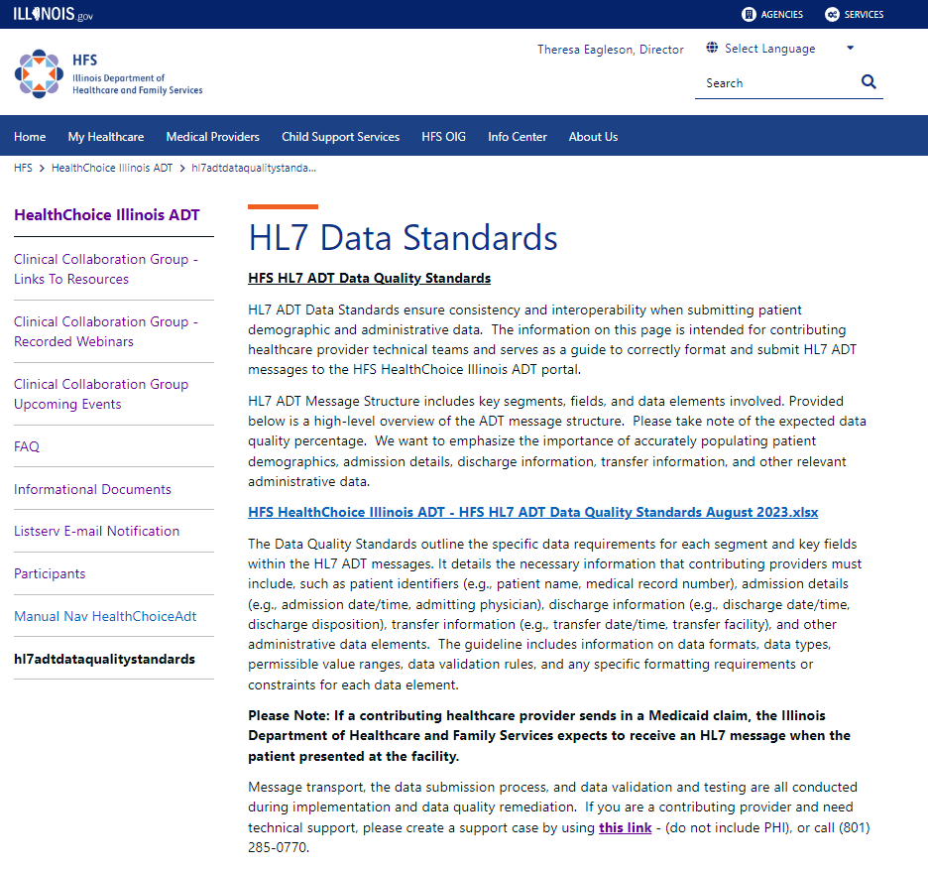
HFS HL7 ADT Data Quality Standards Recommendation by IDPH and the Technical Advisory Committee
HFS HealthChoice Illinois ADT – HFS HL7 ADT Data Quality Standards August 2023.xlsx
Notes:
Let's now focus on the HFS HL7 ADT Data Quality Standards, which are crucial for maintaining high-quality data across all hospital systems in the state.
Background:
Last year, we sent out a provider notice informing all healthcare providers about the initial review of the HL7 ADT Data Quality Standards. This review was essential for setting a baseline for data quality and ensuring that all providers were aware of the expectations and requirements.
Current Status:
As you can see on the slide, we have a detailed list of the current standards. These standards cover a wide range of data elements, from patient identification information to clinical details. Ensuring compliance with these standards is critical for the accuracy and completeness of our healthcare data.
Revisions and Next Steps:
After a thorough review of data from all hospital systems throughout the state, we are considering revisions to these standards to further enhance data quality. The Technical Advisory Committee, in collaboration with the Illinois Department of Public Health (IDPH), will recommend updates based on this review.
A new notification will be published to inform all providers of any revisions to the standards. This notification will include detailed instructions and guidelines to help providers understand and implement the changes.
Annual Review:
It's important to remind all providers that there will be an annual review of data quality standards. If a provider does not meet the revised standards during this review, they will receive specific instructions on how to address any deficiencies and bring their data up to the required quality levels.

Slide 17
Data Quality and Completeness Progress

Slide 18
Data Quality Improvement Project
Focus During Onboarding
Work with Data Senders to establish data quality standards
Emphasis on ADT fields that support Care Collaboration
Ongoing Review and Maintenance
Support teams flag performance changes and perform regular outreach when feeds go down or feed quality dips
Customer Success teams engage with customers regularly to ensure understanding of importance of Data Quality

Slide 19
Data Quality Improvement Project
Areas of Focus
Early Progress + Feedback
Feedback from TAC + MCO partners helped HFS develop list of important ADT fields of focus
Fields included important care coordination elements like chief complaint, diagnoses, and care team
Focused on health systems to begin with
Five groups completed and awaiting claims review
Time consuming process; scheduling and data transfer challenges
Known Issues and Challenges
Reason for Optimism
Hospital Awareness
Resourcing and scheduling
Multiple data hops/areas for failure
Project team has uncovered numerous previously unknown barriers to successful data transmission; already showing vast improvement in many important fields

Slide 20
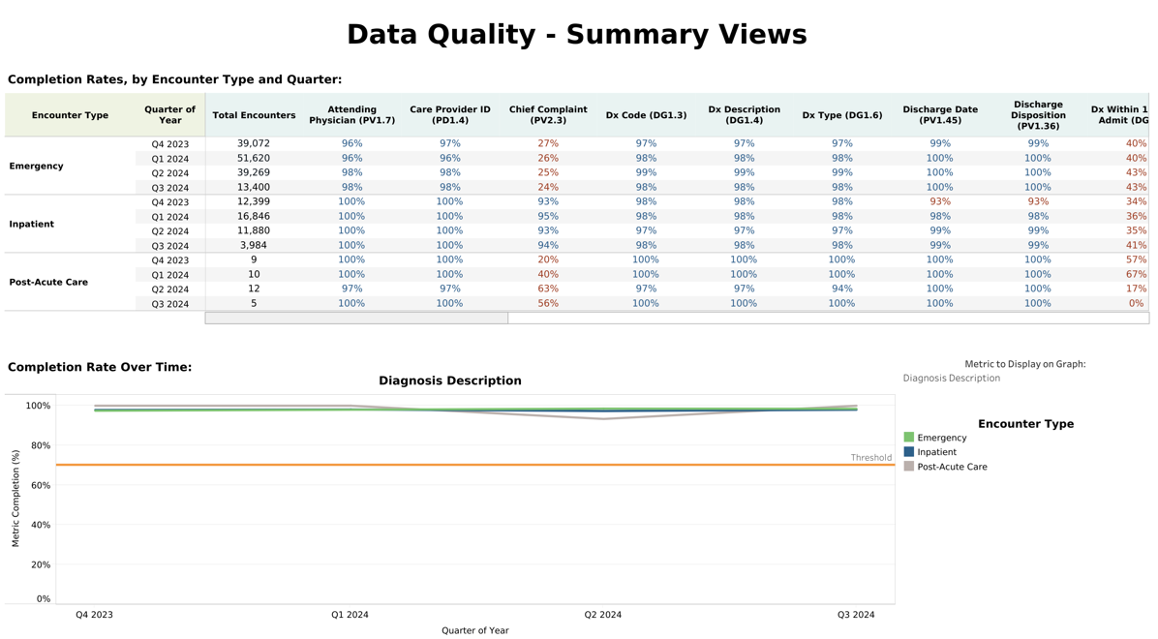
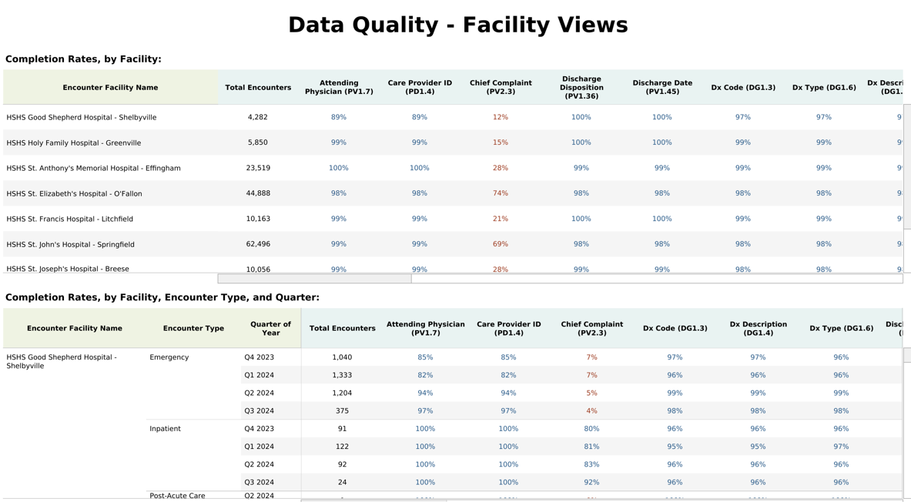
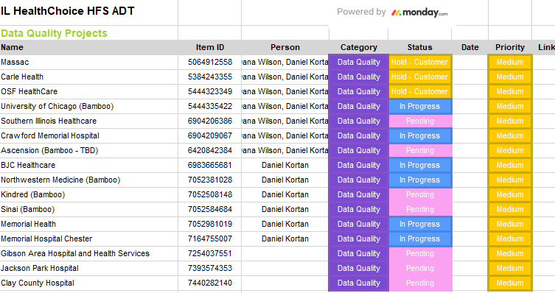
Automation and Reporting Enhancements
Automation process: The automation of these reports will allow us to efficiently track data quality and send alerts to providers, ensuring that issues are identified and resolved quickly.
Reporting enhancements: With the new reports developed by PointClickCare, we will be able to generate monthly data quality dashboards, ADT transmission rates, and care coordination metrics.
Notes:
"Automation has been a crucial element in the scalability of the HealthChoice Illinois ADT Program, ensuring that reports are generated efficiently for both providers and state agencies. One of the key partnerships in this effort has been with PointClickCare/Collective Medical Technologies, who have gone above and beyond to develop reports that communicate our expanded data quality and completeness standards.
Thanks to this collaboration, the remediation process has become much smoother, allowing us to address data discrepancies more quickly and with fewer resources. Moving forward, annual reviews and ongoing data quality checks will be less taxing, thanks to these tailored reporting tools.
It’s partnerships like this that have paved the way for our success. When vendors like PointClickCare prioritize the greater good, and when both the state and our partners can compromise and innovate, it results in a healthy, functioning mini Health Information Exchange (HIE) for Illinois, right in the center of the United States. The progress we’ve made together is impressive, and it’s setting a strong foundation for the future."

Slide 21
Continued Data Quality Improvement
Hospitals Initial Review Complete
Hospitals Still Needing Revisions
Hammond Henry Hospital
Abraham Lincoln Memorial Hospital - Memorial Health System
Advocate Christ Medical Center
Advocate Christ Medical Center
Advocate Condell Medical Center
Advocate Good Samaritan Hospital
Advocate Good Shepherd Hospital
Advocate Illinois Masonic Medical Center
Advocate Lutheran General Hospital
Advocate Sherman Hospital
Advocate South Suburban Hospital
Advocate Trinity Hospital
AMITA Health Adventist Medical Center Bolingbrook
AMITA Health Adventist Medical Center GlenOaks
AMITA Health Adventist Medical Center Hinsdale
AMITA Health Adventist Medical Center La Grange
AMITA Health Alexian Brothers Medical Center
AMITA Health Holy Family Medical Center Des Plaines
AMITA Health Mercy Medical Center
AMITA Health Resurrection Medical Center
AMITA Health Saint Francis Hospital
AMITA Health Saint Joseph Hospital - Chicago
AMITA Health Saint Joseph Hospital - Elgin
AMITA Health Saint Joseph Medical Center
AMITA Health Saints Mary and Elizabeth Medical Center
AMITA Health St. Alexius Medical Center
AMITA Health St. Mary's Hospital
BJC Healthcare - Alton Memorial Hospital
BJC Healthcare - Memorial Hospital Belleville
BJC Healthcare - Memorial Hospital East
Carle BroMenn Medical Center
Carle Eureka Hospital
Carle Foundation Hospital
Carle Hoopeston Regional Health Center
Carle Richland Memorial Hospital
Central DuPage Hospital
CGH MEDICAL CENTER
Clay County Hospital
Crawford Memorial Hospital
Decatur Memorial Hospital - Memorial Health System
Delnor Hospital
Gibson Area Hospital and Health Services
HSHS Good Shepherd Hospital - Shelbyville
HSHS Holy Family Hospital - Greenville
HSHS St. Anthony's Memorial Hospital - Effingham
HSHS St. Elizabeth's Hospital - O'Fallon
HSHS St. Francis Hospital - Litchfield
HSHS St. John's Hospital - Springfield
HSHS St. Joseph's Hospital - Breese
HSHS St. Joseph's Hospital - Highland
HSHS St. Mary's Hospital - Decatur
Jackson Park Hospital
Kindred Chicago - Lakeshore
Kindred Hospital - Sycamore
Kindred Hospital Chicago - Northlake Campus
Kindred Hospital Chicago (North Campus)
Kishwaukee Hospital
Lake Forest Hospital
Lawrence County Memorial Hospital
Marianjoy Rehabilitation Hospital
Massac Memorial Hospital
McDonough District Hospital
Memorial Hospital - Chester
Memorial Medical Center - Memorial Health System
Northwestern Medicine Emergency Center Grayslake
Northwestern Medicine Huntley Hospital
Northwestern Medicine McHenry Hospital
Northwestern Medicine Valley West Hospital
Northwestern Memorial Hospital
OSF - Heart of Mary Medical Center
OSF - Holy Family Medical Cente
OSF - Little Company of Mary Hospital
OSF - Sacred Heart Medical Center
OSF - Saint Anthony Medical Center
OSF - Saint Francis Medical Center
OSF - Saint Francis Medical Center
OSF - Saint Joseph Medical Center
OSF - Saint Paul Medical Center
OSF - St Clares (Perry Memorial) Hospital
OSF - St Elizabeth Medical Center
OSF - St James Hospital
OSF - St Luke Medical Center
OSF - St Mary Medical Center
OSF Saint Anthonys Health Center
Palos Hospital
Passavant Area Hospital - Memorial Health System
RML Specialty Hospital System - Chicago
RML Specialty Hospital System - HINSDALE
Roseland Community Hospital
Rush Copley Medical Center
Rush Oak Park Hospital
Rush University Medical Center
Silver Cross Hospital
So Illinois Health - Herrin Hospital
So Illinois Health - Memorial Hospital Of Carbondale
So Illinois Health - St Joseph Memorial Hospital
Swedish American Hospital - Belvidere
Swedish American Hospital - Rockford
Taylorville Memorial Hospital - Memorial Health System
University of Chicago Medical Center
University of Chicago Medicine Ingalls Memorial
University of Illinois at Chicago
Warner Hospital and Health Services
Woodstock Hospital
La Rabida Childrens Hospital
Albany Care
Anderson Healthcare - Anderson Hospital
Anderson Healthcare - Community Hospital of Staunton
Ann & Robert H Lurie Childrens Hospital of Chicago
Blessing Health System - Blessing Hospital
Blessing Health System - Illini Community Hospital
Carlinville Area Hospital
Chicago Behavioral Health
Edward Hospital
Elmhurst Memorial Hospital
Fairfield Memorial Hospital
Fayette County Hospital
Ferrell Hospital
FHN Memorial Hospital
Franciscan Health - Chicago Heights
Franciscan Health - Olympia Fields
Franklin Hospital District
Galesburg Cottage Hospital
Genesis Medical Center - Aledo
Genesis Medical Center - Silvis
Graham Hospital Association
Hamilton Memorial Hospital District
Hardin County General Hospital
Harrisburg Medical Center
Hillsboro Area Hospital
HOLY CROSS HOSPITAL
Hopedale Medical Complex
Humboldt Park Health
Iroquois Memorial Hospital
Jersey Community Hospital
John H Stroger Hospital - Cook County
Katherine Shaw Bethea Hospital
Kirby Medical Center
Lake Behavioral Hospital
Loretto Hospital
Loyola - Gottlieb Memorial Hospital
Loyola - MacNeal Hospital
Loyola University Medical Center
MARSHALL BROWNING HOSPITAL
Mason District Hospital
Memorial Hospital â€“ Carthage
Mercyhealth - Harvard Hospital
Mercyhealth - Javon Bea Riverside
Mercyhealth - Javon Bea Rockton
Midwest Medical Center
Morris Hospital
MORRISON COMMUNITY HOSPITAL
Mount Sinai Hospital
Mt Vernon - Good Samaritan Regional Health
NorthShore University Health System - Glenbrook Hospital
NorthShore University Health System - Highland Park Hospital
NorthShore University Health System - Swedish Hospital
NorthShore University Health System Evanston Hospital
NorthShore University Health System Skokie Hospital
Northwest Community Hospital
Pana Community Hospital
Paris Community Hospital
Pinckneyville Community Hospital
Pipeline Health - Weiss Memorial Hospital
Pipeline Health - West Suburban Medical Center
Provident Hospital of Cook County
Quorum - Crossroads Community Hospital
Quorum - Gateway Regional Medical Center
Quorum - Heartland Regional Medical Center
Quorum - Red Bud Regional Hospital
Quorum - Union County Hospital
Quorum - Vista Medical Center East
Riverside Medical Center
Rochelle Community Hospital
Saint Anthony Hospital
Salem Township Hospital
Sarah Bush Lincoln Health
Sarah D. Culbertson Memorial Hospital
Schwab Rehabilitation Hospital
Shirley Ryan - Arlington Heights
Shirley Ryan - Burr Ridge
Shirley Ryan - Elk Grove Village OP
Shirley Ryan - Glenview
Shirley Ryan - Homewood
Shirley Ryan - Northshore
Shirley Ryan - Pain Management Center
Shirley Ryan - River Forest
Shirley Ryan - Streeterville DayRehab Center
Shirley Ryan - Vocational Rehab
Shirley Ryan AbilityLab
Shriners Hospital for Children - Chicago
Silver Oaks Behavioral Hospital
South Shore Hospital Corp
Sparta Community Hospital
St. Bernard Hospital
St. Margaret's Health - Peru
St. Margaret's Health - Spring Valley
St. Mary's Hospital - Centralia SSM
The Encompass Health Rehabilitation Institute of Libertyville
The Rehabilitation Institute of Southern Illinois (Encompass)
Thomas H. Boyd Memorial Hospital
Thorek Memorial Hospital
Thorek Memorial Hospital Andersonville
TOUCHETTE REGIONAL HOSPITAL
UHS - Garfield Park Hospital
UHS - Hartgrove Hospital
UHS - Lincoln Prairie Behavioral Health Center
UHS - Riveredge Hospital
UHS - Streamwood Behavioral Health Center
UHS - The Pavilion Foundation Hospital
UnityPoint Health - Methodist
UnityPoint Health - Pekin
UnityPoint Health - Proctor
UnityPoint Health Trinity - Moline (bills with Rock Island)
UnityPoint Health Trinity - Rock Island
Van Matre Encompass Health Rehabilitation
Wabash General Hospital
Washington County Hospital
Notes:
"This slide showcases hospitals that have completed data quality remediation and those still pending. We’ve worked with over 50 hospitals in this phase of the program, and we continue to reach out to those who have not yet fully engaged. Our goal is 100% compliance, and we’re well on our way to achieving this with hospitals completing reviews and improving data transmission."
Next Steps:
"We will continue working with hospitals and long-term care facilities, focusing on critical data fields such as 'Diagnosis Code' and 'Discharge Date' to further improve data quality. We encourage all hospitals that have not yet completed their data quality improvements to engage with us, as this ensures better patient outcomes and compliance with state and federal requirements."

Slide 22
Improved Data Quality
Emergency Room
Inpatient
Segment/Field | % | 2021 | 2022 | 2023 | 2024 | Diff.
Chief Complaint | 95% | 30 | 35 | 34 | 35 | 5%
Diagnosis Code | 90% | 73.5 | 62.75 | 65.25 | 66.5 | 7%
Discharge to Location | 95% | 0 | 6.5 | 12.5 | 17 | 17%
Discharge Date | 95% | 88 | 79.5 | 80 | 80 | 8%
Insurance Name | 95% | 42 | 83 | 93 | 97.5 | 55%
Insurance Plan ID | 95% | 31 | 61.75 | 70.75 | 76.5 | 45%
Group Number | 95% | 17.5 | 29 | 34 | 37 | 19%
Effective Date | 95% | 59 | 53.5 | 61.25 | 70 | 11%
Policy Number | 95% | 40.5 | 78.25 | 85.75 | 90.5 | 50%
Race | 95% | 72 | 73.25 | 76 | 73 | 1%
Telephone Number | 50% | 61.5 | 96 | 96.5 | 98 | 36.5%
Email | 50% | 17 | 30.25 | 31.75 | 36 | 19%
Language | 95% | 72 | 72.25 | 76 | 75.5 | 3.5%
Marital Status | 95% | 71.5 | 72.5 | 74.75 | 71.5 | 0%
Ethnicity | 95% | 67 | 68.5 | 70 | 68 | 1%
Segment/Field | % | 2021 | 2022 | 2023 | 2024 | Diff.
Chief Complaint | 95% | 36 | 28 | 31.25 | 37 | 1%
Diagnosis Code | 90% | 78 | 70.75 | 73.75 | 77 | 1%
Discharge to Location | 95% | 1 | 8.75 | 14.75 | 20.5 | 19.5%
Discharge Date | 95% | 90.5 | 82 | 83.75 | 83 | 7.5%
Insurance Name | 95% | 39.5 | 84.75 | 91.5 | 96 | 56.5%
Insurance Plan ID | 95% | 31.5 | 67 | 74.25 | 80 | 48.5%
Group Number | 95% | 19 | 35 | 39 | 42.5 | 23.5%
Effective Date | 95% | 31.5 | 63.25 | 69 | 76 | 44.5%
Policy Number | 95% | 38 | 80.5 | 84.75 | 89 | 51%
Race | 95% | 62.5 | 74.75 | 77.25 | 75 | 12.5%
Telephone Number | 50% | 69 | 96.25 | 97 | 98.5 | 29.5%
Email | 50% | 17 | 33.25 | 34.75 | 40 | 23%
Language | 95% | 63.5 | 74.25 | 77.5 | 77 | 13.5%
Marital Status | 95% | 62.5 | 70.25 | 72.25 | 71 | 8.5
Ethnicity | 95% | 58.5 | 70.25 | 72.25 | 71 | 12.5%
Notes:
Thank you for following along with the detailed breakdowns of our data improvements. Now, let's take a step back and look at the overall improvements in data quality for both Emergency Room and Inpatient stays.
For the state of Illinois, these improvements mean a more efficient and effective healthcare system. It means that Medicaid beneficiaries receive better care, healthcare providers can operate more efficiently, and the state can ensure compliance with regulations and optimal use of resources. Ultimately, this leads to healthier communities and a more robust public health infrastructure.
These advancements represent significant strides towards our goal of improving patient outcomes and healthcare efficiency across Illinois.

Slide 23
Exploring Additional Data Segment Needs and Solutions

Slide 24
Exploring Additional Data Segment Needs
Key Points for Discussion:
Current Data Ingestion Methods:
Review of current data ingestion methods and their effectiveness.
Potential for CCD and National Network Subscriptions:
Evaluating the benefits and challenges of obtaining data through CCDs and national networks.
Future Data Infrastructure Requirements:
Identifying necessary infrastructure developments to support additional data types (Labs, Imaging, Rx, Scheduling, Physician Notes, Billing Data).
Stakeholder Needs and Preferences:
Gathering feedback on the data needs of various stakeholders and their preferred methods of data ingestion.
Notes:
Thank you for your attention as we reviewed the HFS HL7 ADT Data Quality Standards. This discussion naturally leads us to consider our future needs and the best ways to ingest and utilize additional data segments.
Key Points for Discussion:
Current Data Ingestion Methods:
Let's start by reviewing our current methods for data ingestion. How effective are these methods in meeting our needs? Are there any limitations or challenges you've experienced?
Potential for CCD and National Network Subscriptions:
One proposed solution is to obtain additional data through CCDs (Continuity of Care Documents) and subscriptions to national networks. I'd like to hear your thoughts on this approach. What are the potential benefits and challenges of this method?
Future Data Infrastructure Requirements:
As we look ahead, what infrastructure developments do we need to support the ingestion of additional data types? Are there specific capabilities or systems we should consider implementing?
Stakeholder Needs and Preferences:
Finally, it's crucial that we gather feedback on the data needs of our various stakeholders. What specific data segments are most important to you? What methods of data ingestion do you prefer?

Slide 25
Burden Reduction through Bi-Directional Communication

Slide 26
Open Discussion: Burden Reduction Opportunities
Focus Area – ED Optimization in Hospitals
Bi-Directional Integration or Trackboard
Early adopters proving out value of ED Optimization tool
Now – new interest due to Data Quality Improvement efforts + full Acute Facility connectivity
Key Benefits – Burden Reduction through streamlined inclusion of important care collaboration data into ED workflows
Notes:
Addressing administrative burdens is essential for efficiency and patient care quality. Visual data representation can illuminate paths to reducing these burdens, such as streamlining prior authorization processes or highlighting bed availability through real-time dashboards. These visuals can guide our discussions on policy and process improvements.
Which administrative burden do you feel could be most effectively alleviated through better data visualization, and what would that look like?
This open discussion is a call to action for each of us to consider how we can contribute to the ADT program's evolution. By identifying specific data visualization strategies, we can uncover and address hidden challenges, ultimately reducing burdens and enhancing patient care.
Can you share a scenario where a specific type of data visualization could have significantly reduced a burden or improved a process within your area of expertise?

Slide 27
Open Discussion: Burden Reduction Opportunities
Previous Topics
Prior authorization for LTC stays
Bed availability for SNFs
DCFS state law
Compliance with federal or state reporting mandates, e.g.,
Electronic notification requirement (CMS Interoperability and Patient Access Final Rule)
Medicaid unwinding/redetermination (renewal outreach)
Disease and public health monitoring
Notice of admission (NOA)
Notes:
Addressing administrative burdens is essential for efficiency and patient care quality. Visual data representation can illuminate paths to reducing these burdens, such as streamlining prior authorization processes or highlighting bed availability through real-time dashboards. These visuals can guide our discussions on policy and process improvements.
Which administrative burden do you feel could be most effectively alleviated through better data visualization, and what would that look like?
This open discussion is a call to action for each of us to consider how we can contribute to the ADT program's evolution. By identifying specific data visualization strategies, we can uncover and address hidden challenges, ultimately reducing burdens and enhancing patient care.
Can you share a scenario where a specific type of data visualization could have significantly reduced a burden or improved a process within your area of expertise?

Slide 28
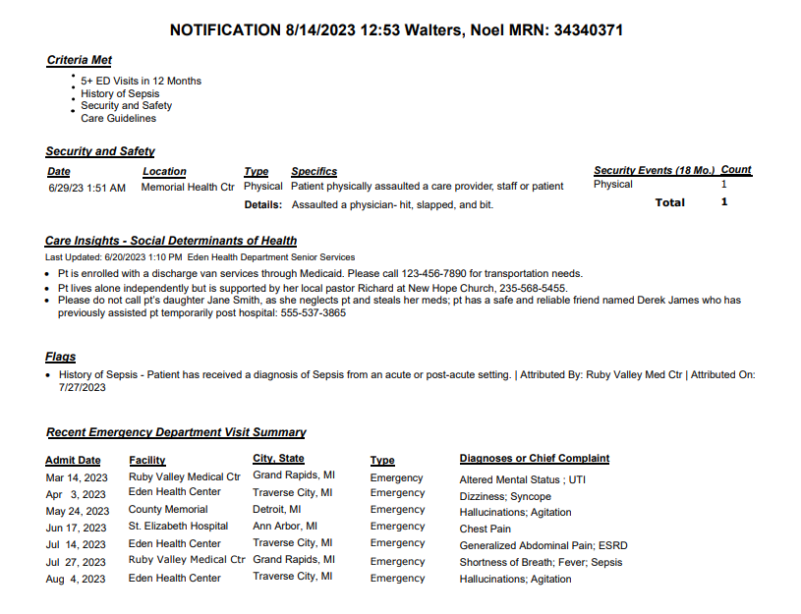
ED Track Board Integration
EDO Notification
Available for:
Epic
Cerner
Meditech (and Sunrise and Expanse)
AthenaHealth
Allscripts
CPSI
T Systems
Others -Any- PCC will work with you
Notes:
With this integration, an icon will display in the hospital's ED track board to indicate that there is a Collective notification for that patient. The user clicks on the icon, the Collective notification will display for the user to read, and then the user can close the notification. With this integration, the user will need to log into the Collective portal to edit, add, or delete information.
The EMRs that ED Optimization can integrate with to include a Collective Notification icon in the EMR's track board are:
Epic
Cerner
Meditech (and Sunrise and Expanse)
AthenaHealth
Allscripts
CPSI
T Systems
Others - CM is proud that we will integrate with any EMR and are vendor agnostic. If the customer is on a different EMR than listed above, you can reach out to the integration or implementation teams. This will require a technical call with our integration or implementation team to determine the best way to integrate with their EMR.

Slide 29
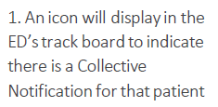
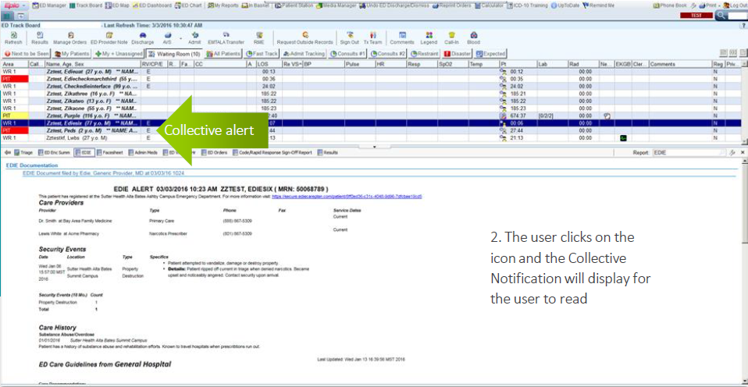
SMART on FHIR Option for select EHR systems
EHR System Compatibility
SMART App Authorization
Launching the SMART App
Contextual Patient Data
Secure Data Exchange
Care Collaboration and
Coordination
Continuity of Care
Notes:
As we advance into the digital age of healthcare, the integration of Electronic Health Records with the HealthChoice Illinois ADT system becomes imperative. This integration not only streamlines patient data sharing but also enhances the quality of care by providing real-time access to patient information.
Recognizing the complexities of EHR systems, our approach has been rooted in collaboration. By working closely with hospitals, clinics, and other healthcare providers, we aim to navigate the technical and administrative hurdles of integration, ensuring a seamless flow of information across the healthcare spectrum.

Slide 30
SMART on FHIR
Accessible within EMR by those health system staff who are outside of the ED, such as Case Managers and Care Coordinators
SMART on FHIR (SoF) App is a way to embed third-party content directly into an Electronic Health Record.
This means that information provided from the PCC Network can be accessed directly from select EHRs, rather than having to access the PCC Platform directly.
The PCC SMART on FHIR app provides intelligent alerts, risk analysis, and other concise actionable information from the PCC network and presents it to the care provider directly within their workflow in their EHR.
The app reduces or eliminates the need for double documentation in care collaboration work streams by saving documented Care Insights simultaneously to Epic or Cerner EHRs as well as to the PCC network of participants.
Available for:
Epic
Cerner
Through the App Orchard/Marketplace

Slide 31
Future Communication Plans and Onboarding Support

Slide 32
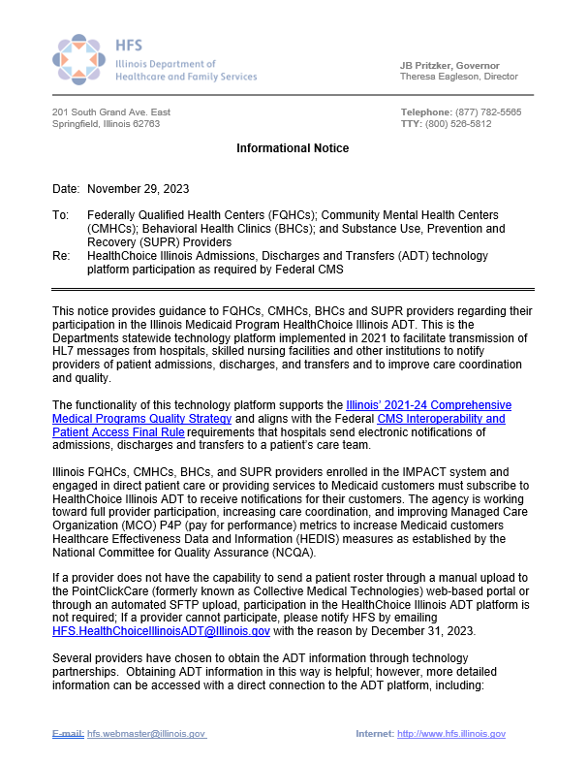
Provider Notice FQHC, CMHC, CHC, SUPR
Overview of provider notices to FQHCs, CMHCs, BHCs, and SUPR Providers
Future communication plans and onboarding support
Key goals and supports provided by the technology platform
Key Points:
Subscription requirement for Federally Qualified Health Centers (FQHCs), Community Mental Health Centers (CMHCs), Behavioral Health Clinics, and Substance Use, Prevention, and Recovery (SUPR) Providers
Alignment with Illinois' 2021-24 Comprehensive Medical Programs Quality Strategy and Federal CMS Interoperability and Patient Access Final Rule
Goals: Full provider participation, increased care coordination, improvement of MCO P4P metrics, enhancement of Illinois HEDIS measures
Notes:
I want to highlight our ongoing efforts with Federally Qualified Health Centers (FQHCs), Community Mental Health Centers (CMHCs), Behavioral Health Clinics (CHCs), and Substance Use Prevention and Recovery (SUPR) Providers in response to our recent provider notices. We have seen an encouraging increase in engagement from these critical healthcare providers.
Key Points:
Subscription Requirement: We are requiring subscription for these provider types unless they communicate some type of burden or hardship by participating. This is to ensure they are well-equipped to receive real-time electronic notifications of patient admissions, discharges, and transfers and be able to complete the 7 day and 30 day follow-up visits.
Alignment with Quality Strategies: Our platform aligns with Illinois' 2021-24 Comprehensive Medical Programs Quality Strategy and the Federal CMS Interoperability and Patient Access Final Rule. This alignment ensures that we meet key healthcare goals and regulatory requirements.
Goals: Our primary goals include achieving full provider participation, increasing care coordination, improving MCO pay-for-performance metrics, and enhancing Illinois HEDIS measures.
I would like to take this moment to thank our MCO partners for their ongoing support and to encourage further collaboration. Specifically, we are looking for ideas and strategies on how MCOs can utilize this provider notice to encourage broader participation and engagement with our program. This collaboration presents a win-win situation where MCOs can help drive the success of the HealthChoice Illinois ADT program while also enhancing their own care coordination efforts.

Slide 33
Portal Updates

Slide 34
None as of now
DID YOU KNOW? The PCC Network platform is Single-Sign-On Compatible! This can streamline your work and help encourage and facilitate your staff’s ease of access.

Slide 35
Open Discussion and Q & A

Slide 36
Do you have additional questions and would like to discuss? Please indicate here, and we will contact you.
Survey Questions
No thanks
Yes
What would you like to see/learn more about in an upcoming CCG? We would love to hear from you.
Indicate
Notes:
RUN the poll- bottom

Slide 37
Save the Date for Upcoming CCG Events

Slide 38
Save The Date for 2025!
2025 Clinical Collaboration Group Webinars –
All provider types
Thursdays, 12pm-1pm
February 27 Register Here
May 8 Register Here
August 7 Register Here
November 6 Register Here
Topics including:
Workgroup recommendations
New Provider Notices
Regional Collaborations
Collaboration success stories
Platform enhancements
And more!
Missed the last CCG? All CCG slide decks and recordings from prior webinars can be found here:
https://hfs.illinois.gov/healthchoiceadt/clinicalcollaborationgrouprecordedwebinars.html

Slide 39
Resources
State HFS Website: HealthChoice Illinois ADT HFS Program Email: HFS.HealthChoiceIllinoisADT@Illinois.gov
Collective Medical/PointClickCare Customer Community Site: https://community.collectivemedical.com/
Collective Medical Support Email: support@collectivemedicaltech.com
Questions? Requests?
Want an in-person visit or virtual meeting with PointClickCare to help your team learn how to best use the platform?
A walk-through of the Network platform and its functions/features?
Click here to schedule a call to discuss your needs and get answers to your questions!
Notes:
Nancy: I am hearing more and more interest in collaboration, whether regional, payer based, or a Collaborative of providers-
Please reach out via the Click Here button if you are interested in help forming such a group!

Slide 40
Initial Steps to Sign Up
1. Ambulatory provider customers begin the subscription process by completing a brief HFS survey to receive an HFS onboarding packet
https://www.surveymonkey.com/r/8T87FTX
2. Complete HFS onboarding packet and email to HFS:
HFS.HealthChoiceIllinoisADT@Illinois.gov

