Slide 1


The Application for Benefits Eligibility
The ABE Partner Portal
An Introduction for Long Term Care Providers
Illinois Department of Healthcare & Family Services (HFS) Illinois Department of Human Services (DHS)
February 2020
Notes:
Hi Everyone, I’m Margaret Dunne with the Illinois Department of Healthcare and Family Services. Today I am going to review the ABE Partner Portal and new functionality available to Hospitals through ABE

Slide 2

Agenda
This Presentation will review:
  The ABE Partner Portal and New Long Term Care Provider function in ABE
  Creating a Partner Portal Account
  Logging in to the Partner Portal and Uploading Documents
  Primary ASA Tasks and Responsibilities

Slide 3
SECTION I
THE ABE PARTNER PORTAL and Long Term Care

Slide 4


The Integrated Eligibility System(IES) and ABE: The Customer, Partner and Worker Facing Portals
ABE
Customer Portal
Partner Portal
IES
Caseworker Portal
Information that customers and Providers
enter in ABE applications and Manage My
Case (MMC), pre-populates the caseworker’s Data Collection pages in IES.
Important customer information like notices and other benefits details are sent from IES
to ABE MMC.
Notes:
Interface with each other and pass information back and forth

Slide 5
ABE and the Partner Portal
ABE, the Application for Benefits Eligibility, is the State of Illinois’ web-based portal for applying for, accessing and managing health coverage, SNAP and cash benefits, and the Medicare Savings Program (MSP). As Approved Representatives and/or Community Partners you have been using ABE to apply for benefits and receive notices through the Customer Portal.
The ABE Partner Portal allows certain Medicaid Providers the ability to complete specific tasks or functions.
Authorized Long Term Care providers through their Partner Portal account can securely submit necessary documentation to the State on changes in income, resources and TPL, as well as redeterminations or other relevant documents through ABE.
Following this training, if you should encounter problems using ABE, please contact your organization’s ABE Agency Security Administrator(ASAs). More about ASAs in a minute!
Notes:
May, or may not be familiar with and have used ABE already
For the purposes of this presentation we will be talking specifically about new functionalities for hospitals
Because of the large number of hospitals and other agencies that currently use and will be using ABE, we’d like to keep one point of contact per agency

Slide 6
Partner Portal Registration Requirements
Your organization/agency/hospital (these terms are used interchangeably and refer to both one facility agencies and organizations that include multiple facilities) must have a Medicaid Provider ID number. You will need this number to register in the Portal. For information on how to register as a Medicaid provider visit hfs.illinois.gov and click on Medical Provider’s – IMPACT Provider Enrollment.
Each Agency must identify one employee who will act as the Primary Agency Security Administrator (ASA) for the purpose of managing agency staff that will use the ABE Partner Portal.
Contractors may not be the Primary ASAs for a Provider however the LTC Provider Primary ASA may designate someone at the contractual agency as a secondary ASA.
Prior to leaving the agency, the Primary ASA must submit a request to have Partner Portal access deactivated and submit registration for a new Primary ASA. Additional ASA Information in Section 4.
Notes:
Who can use the Partner Portal? Agencies that are registered as: Medical Presumptive Eligibility Providers, All Kids Application Providers, or Hospital Providers can use the Partner Portal, however, only entities with a HOSPITAL ID will be able to use the new, Report of Birth functionality!
ASA – Giving and taking away! Point of contact
The ASA is the “Gatekeeper” for the Partner Portal for their Agency

Slide 7




Navigating in ABE
Please review the following tips on navigating through ABE:
Do not use your Internet browser’s back, forward or stop buttons while in the application. Use the buttons provided at the bottom of each page of the application:
Click the [Next] button when you are done with a page and ready for the next questions.
Click the [Back] button if you need to go back to a page and need to change your answers
You will see the [Exit] button after submitting your application. Clicking this button will take you back to the home page.
Click the [Save and Exit] button to save the information already entered and return to the application later.
• You must complete questions with a red star (*) next to them.
• Your ABE session will time-out after 30 minutes of inactivity. You will need to log-in again to continue.

Slide 8
Section 2
Creating an ABE Partner Portal Account

Slide 9
Setting up your ABE Partner Portal Account
From the ABE Homepage (ABE.Illinois.gov), choose the ABE Partner Login link. You will use this link each time you return to ABE. Do NOT use the Login button in the upper right corner of the homepage.
Notes:
Top login is for customers applying for benefits!

Slide 10

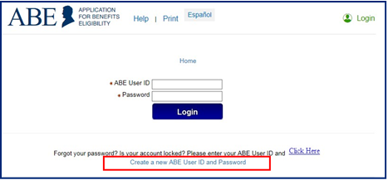
Setting up an Account , cont’d
Click the, [Create a new ABE User ID and Password] link at the bottom of the screen.

Slide 11
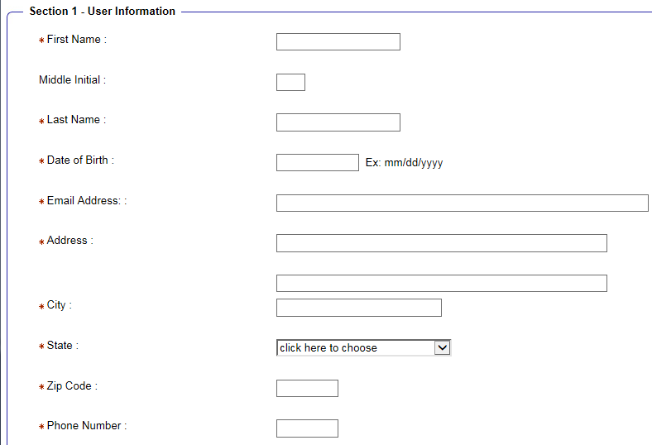
Section 1: User Information
Enter information about yourself and your organization type. Email entered should be your work email! This increases the security of your account and DHS/HFS Data.
Notes:
Responsibility of the ASA to ‘take away’ privileges!
Using work email prevents individuals from accessing the functionality once they have left an organization – 2nd layer of security.

Slide 12
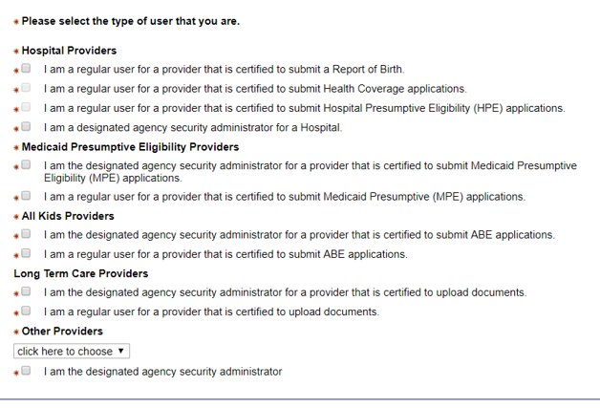
User Information, cont’d
Type of User:
  A regular user for a provider that is certified to upload documents (everyone).
  A designated Agency Security Administrator (ASA) for a Provider that is certified to upload documents.
  The first ASA to register is considered the “Primary ASA” and will be responsible for carrying out the ASA tasks and responsibilities.
Notes:
ALL ASAs must choose both!

Slide 13

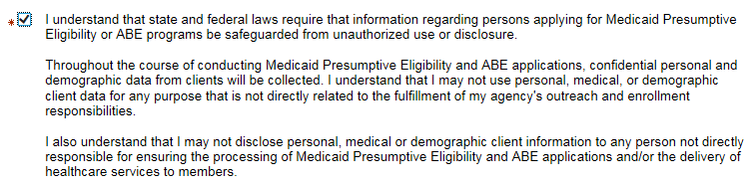
Important Information!
As part of Partner Portal account creation you must check this box. Be careful to read and understand this requirement.
This agreement and language is applicable for Provisional Eligibility Coverage as well!

Slide 14
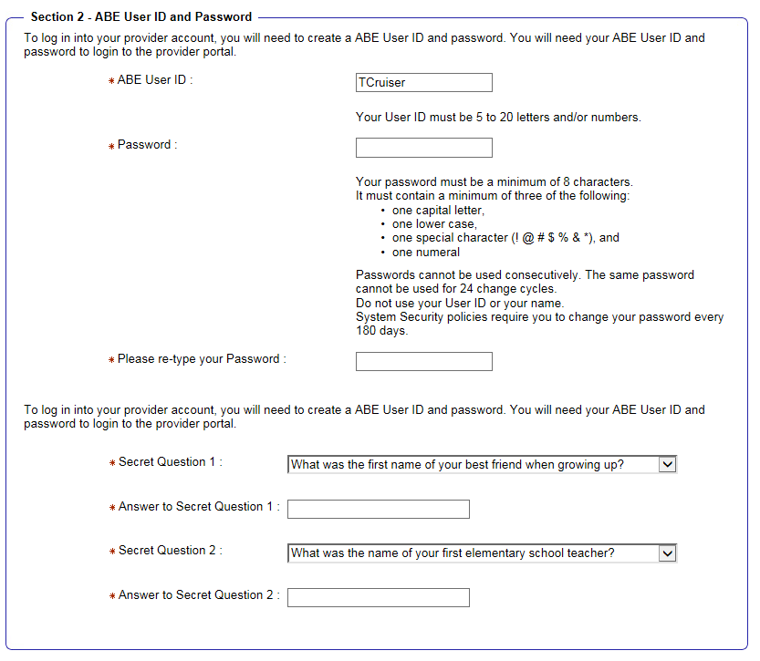
Section 2: Provider User ID and Password
Create a personal ABE User ID and Password that you will use to login to ABE on an ongoing basis. The secret questions and responses you choose will be used as a security check if you need to recover or change your password. User IDs CANNOT be recovered.
You will be prompted to change your ABE password every 6 months.
It is important to write down the answers to your security questions and store them in a secure location. Passwords cannot be reset without correct answers. If you are not able to reset your password, you will need to go through the Account creation process again. Accounts are “locked” after 3 unsuccessful password attempts. This lock last for 60 minutes.
Notes:
User IDs cannot be recovered if forgotten!
Passwords can only be reset if you know the answers to your secret questions! HFS cannot reset accounts or tell you what your password or ID is!

Slide 15
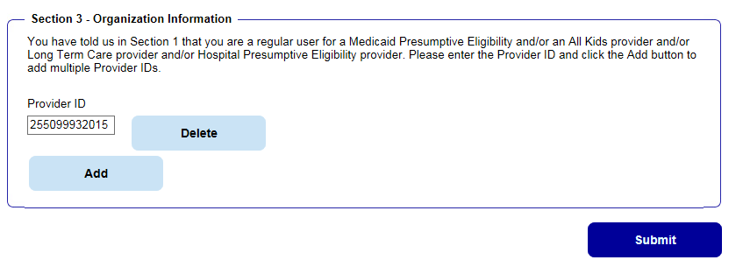
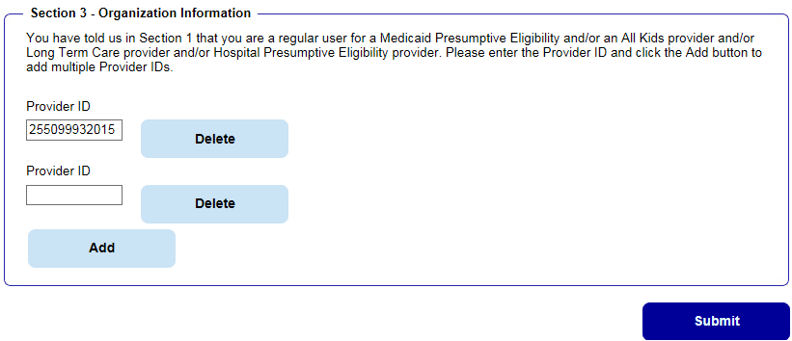
Section 3: Organization Information
Once you enter your ABE user type and create a User ID and Password, Section 3 will display.
Enter your Organization’s State of Illinois Medicaid Provider ID Number. If you will upload documents for multiple facilities, click [Add] and an additional Provider ID box will display. You may do this as many times as needed to add all locations.
Click [Submit] when you have added all numbers. If you do not know your HFS Provider ID, contact your office administrator or billing office.
Tip: If you need to add multiple Provider IDs because you work at more than one location, add them before entering your password and security questions. As a security measure, ABE wipes out these responses when the page is refreshed.
Notes:
ASA – only put number in first box!
You may add more boxes if you are working at multiple hospitals Click add to display more Provider ID fields
Simply hit delete if you mistakenly added a box

Slide 16

Account Confirmation
Once all required fields are complete, click [Submit].
If you are the Primary Agency Security Administrator, after creating your account you must go to ABE ASA Request SharePoint and enter your ABE account information as well as your organization’s information. Your ASA request will be reviewed by the HFS business and security offices before approval. You must be approved and granted access before you can approve others in your organization to use the portal.
All other users should submit the ABE Registration Form 1706P to the organization’s Primary ASA for review and record keeping. The 1706P can be found under the Medical Providers tab on the Medical Forms page under Providers, labeled Application for Benefits Eligibility (ABE) (pdf) on the HFS Website.
After review, the Primary ASA will approve and grant Partner Portal access to the remaining users.
Once granted access users are ready to begin using the Partner Portal.
Notes:
These are working links, however you can also find on the Forms page

Slide 17
Knowledge Check:
What does ABE stand for?
  Abraham Lincoln Benefits Exchange
  All Benefits Eligibility
  Application for Benefits Eligibility
Can any Provider use the ABE Partner Portal?
Can all documents be submitted in the Partner Portal?
If I forget my User ID or password can the state reset my account?
Notes:
A User account will “lock” after several incorrect password attempts. This lock out lasts for 60 minutes – HFS cannot “unlock” your account!

Slide 18
Section 3
Logging in to the Partner Portal and Uploading Documents

Slide 19
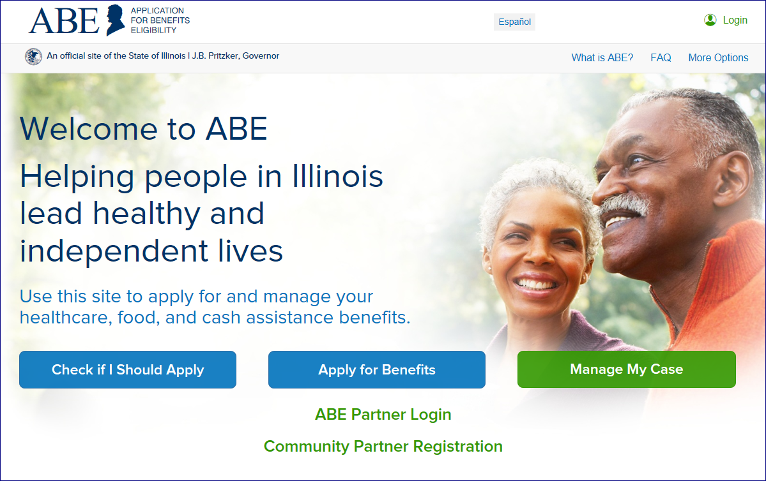
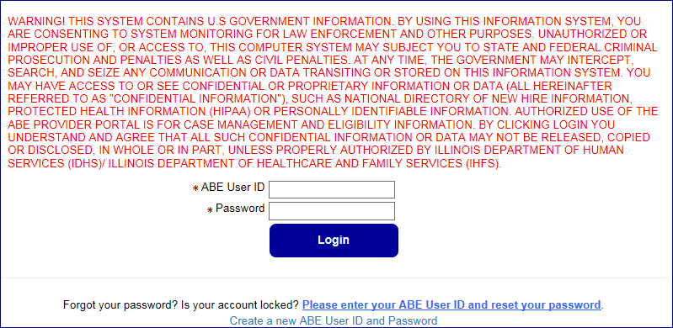
Logging In and Multi-Factor Authentication
You will use the ABE Partner Login in the middle of the page to arrive at the correct Partner Login screen.

Slide 20
Multifactor Authentication (MFA) Process
For security purposes, we are required to validate a user’s identity each time they log-in to the ABE Partner Portal. ABE does this through a process called multi-factor or two factor authentication.
E-mail Activation
The first time you log into the ABE Partner Portal, you will be asked to register your e-mail address. You must enter the e-mail address you used when setting up your ABE User Partner Portal Account and one you can access when working in the Partner Portal. Because of this additional security measure, the email used should be your work email. Click [Register].
Notes:
Multi-factor authentication is a process in which a code must be entered to log into a system. Only the registered email can get the code
adds a layer of security – required by federal regulations
First time only e-mail activation.
Email used when setting up your account

Slide 21
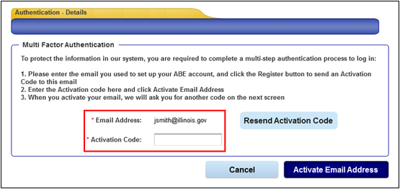
Email Activation
  An Activation Code will be sent to the e-mail address. Enter the code in the space provided and click [Activate Email Address].
If you do not receive the Activation Code, check your Junk or Spam folder. If the Activation Code is not received after 10 minutes (it usually arrive within a minute), click [Resend Activation Code] to generate a new code.
You will only need to activate your e-mail address once (unless your email changes).
If you no longer use or have access to the e-mail address associated with your ABE User Profile, you will need to contact your Agency Security Administrator to have your profile updated with your new e-mail address or you must set up a new ABE User Account with a valid e-mail address.
Notes:
In my experience the code is sent pretty quickly, however, there are days when the system is slower

Slide 22
Access Authentication
Once your e-mail is activated, an Access Code will be sent to that e-mail address. Enter this code in the space provided. Click [Next] and the Provider Portal Landing page displays.
ABE will send an Access Code to the registered, activated e-mail each time you log into the ABE Partner Portal. The code must be entered on the Authentication Access Code page to reach the Partner Portal Landing page.
Notes:
Access Authentication every time!

Slide 23
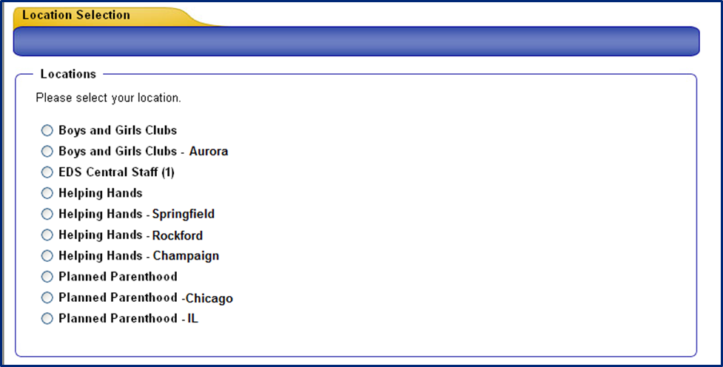
Location Selection
After completing Multifactor Authentication, if you entered multiple Provider IDs in your user profile, the Location Selection page displays. If you are associated with only one location, you will be taken directly to the ABE Partner Portal Landing Page.
On the Location Selection page, indicate the location where you are working for this ABE session.

Slide 24
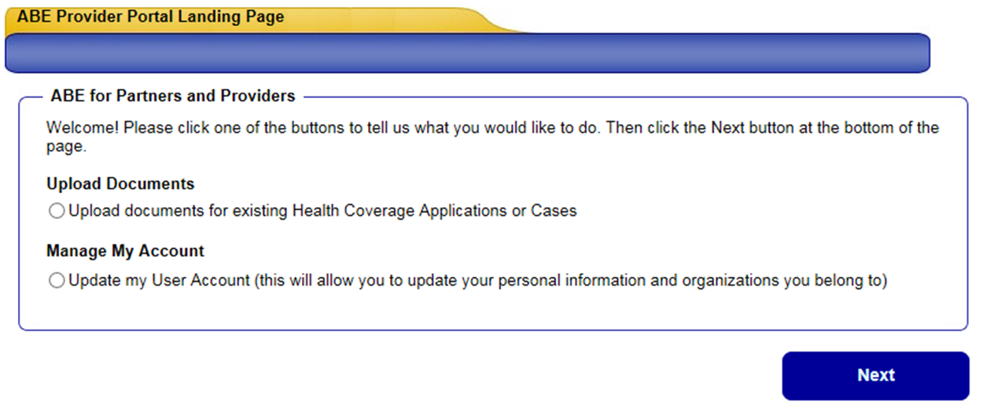
Provider Portal Landing Page
After logging in to the ABE Partner Portal, completing MFA, and choosing your work location (if you have multiple locations) the Partner Portal Landing Page will display.
Select, “Upload document for existing Health Coverage Applications or cases.” Click [Next].
You will choose the “Manage My Account” selection if you need to update your user profile including adding or changing a location, or changing an e-mail.
Notes:
This screen may look different depending on your hospitals functionality in the portal in the future

Slide 25
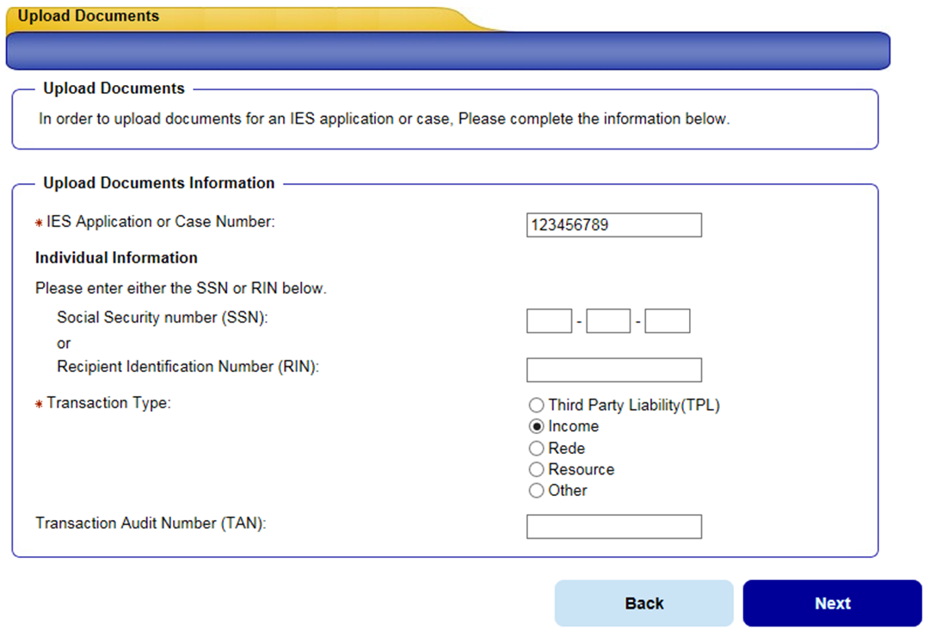
Uploading Documents
Enter the client’s Application or Case Number, Social Security Number or Recipient Identification Number (RIN) and select the Transaction Type that the documents relate. All mandatory questions must be answered to proceed. Click, [Next].
If you choose TPL or Income as your Transaction Type, you will then be asked for the Transaction Audit Number (TAN). When submitting a 3654 document under Other Proof include the admission (TAN) when possible!

Slide 26
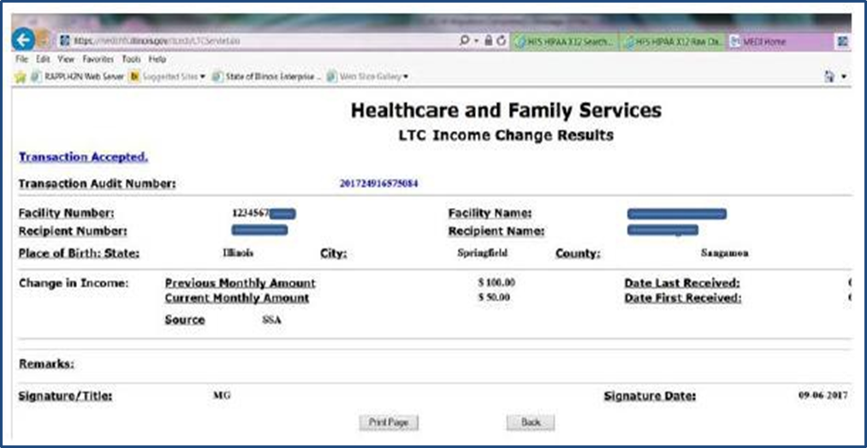
Finding the TAN
The TAN is an auto generated tracking number assigned to each and every MEDI transaction; you need to submit the changes in MEDI first, in order to get the TAN and upload the documents in the ABE Partner Portal. You can find this number on the Summary Results page to the provider which tells the provider if the submission was accepted successfully.

Slide 27
Proof Categories
Review the various Proof Categories listed and examples for each category. Click [Next]. The Submit Your Documents page will display; select the category(s) of proof document you would like to submit. Click [Next]. Proof Categories include:
      Proof of SSN Application
      Proof of Aged, Blind and Disability Assistance
      Proof of Disability
      Proof of Medicare
      Proof of Liquid Assets
      Proof of Other Assets
      Proof of Employment
      Proof of Self Employment
      Proof of Rental Payments
      Proof of Support Expenses
      Proof of Other Expenses
      Other Proof (this category would include Additional Financial Information for LTC, HFS 3654 and Other Related Verification Documents not categorized elsewhere).
Remember - When submitting a 3654 document under Other Proof include the admission TAN when possible!

Slide 28
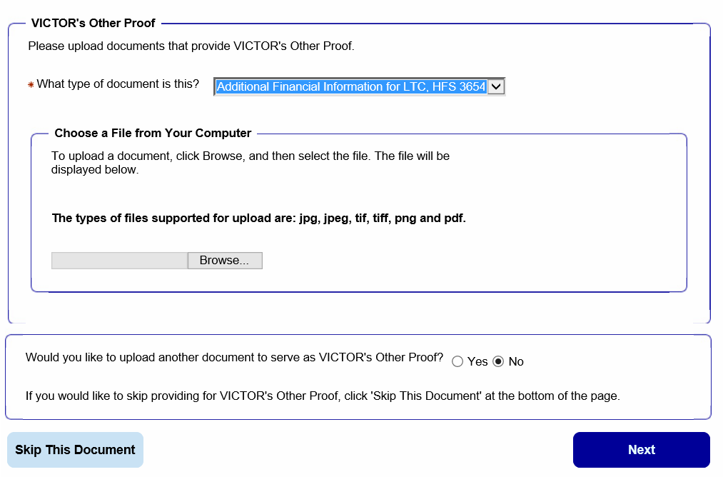
Document Type
Indicate the document type you are submitting from the drop down. (In this example the category selected is Other Proof and the document is an Additional Financial Information for LTC, HFS 3654).
REMEMBER! It is very important to separate proof documents by category and type. Do not upload all documents together. There are separate verification ‘queues’ the documents drop into depending on how the document was identified when you uploaded them. If you upload files together, it could appear that required documents are missing and some of the documents could be missed!
Click the browse button to locate the desired document file
Click Yes to upload more documents from this category.
You will have the opportunity to add Proof documents for another category on the next page. If you change your mind and do not have a Proof Document to submit in this category, select Skip This Document. Click [Next].

Slide 29
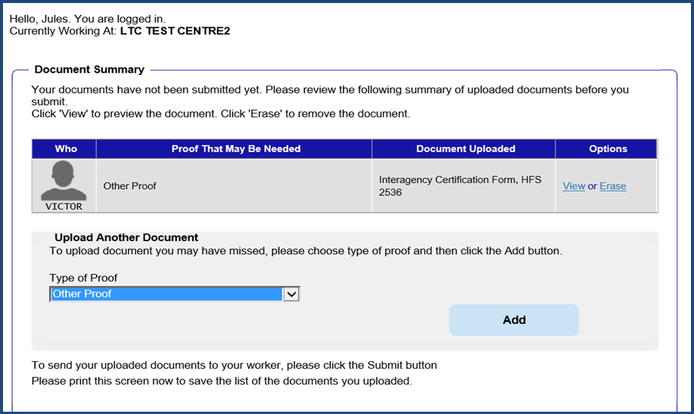
Document Summary
On the Document Summary page, review the Proof Category and the Document Type. You can view the document selected to verify that it is correct – and erase it if it is not the right document.
If you have documents in other Proof Categories, use the Type of Proof drop down under Upload Another Document to select the next document you would like to add. Click [Add]. You can add up to 10 documents at a time. If you have more than 10 documents, submit the first 10 and then begin the process again.
**On RARE occasion, you will see more than one individual listed on the case. For example, this could occur for a short term rehabilitation stay. In these instances you will need to choose the individual you wish to upload docs for.

Slide 30
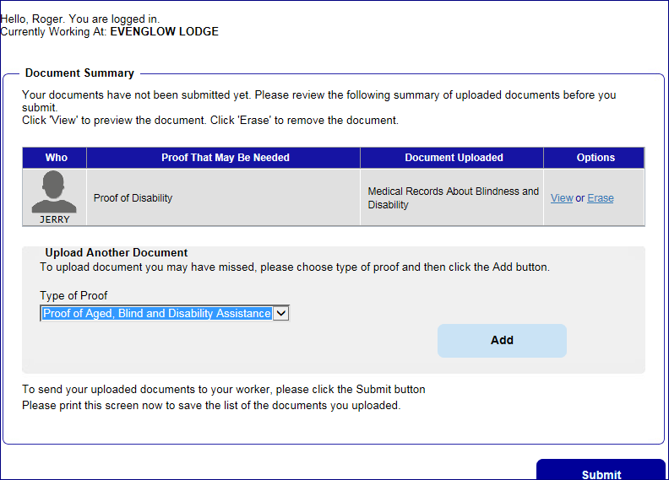
Print and Submit
Once all documents have been uploaded and BEFORE submitting, PRINT out a copy of the Summary page to keep as your receipt . The Summary will list all documents that were successfully uploaded. Click [Submit]. The documents will be transferred to the client’s case record for a LTC worker to process.

Slide 31
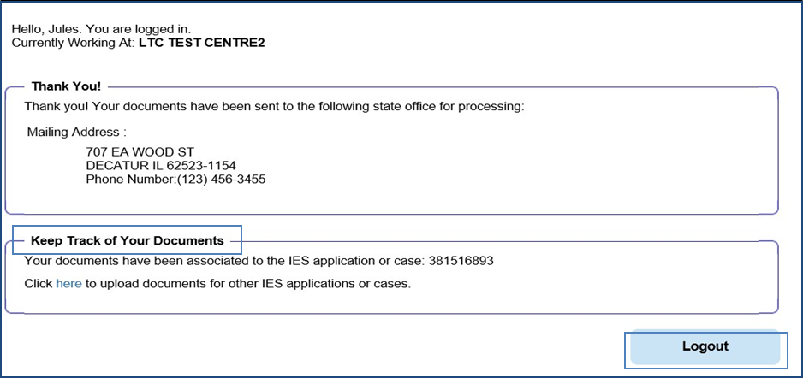
Confirmation and Location
The confirmation page is your ‘proof’ that the documents were transmitted successfully and gives the address of the office that received them based on where the case is assigned. PRINT out this page and attach to the Document Summary page for your records. Use the Click here link to upload additional documents or Logout of ABE.

Slide 32
Thank you!
Thank you for taking the time to view this Introduction for Long Term Care Providers and learn more about ABE - the Application for Benefits Eligibility. We hope you found this presentation useful. A LTC Guide and specific Job Aids are also available on the Long Term Services and Support (LTSS) page for your assistance.
If you have any questions about using ABE, please e-mail them to HFS.ABEPartnerportal@Illinois.gov

Slide 33
Additional ABE Partner Portal Resources
ABE Partner Portal Problems and Questions HFS.ABEpartnerportal@Illinois.gov
To be approved as the ASA for your facility go to: ABE ASA Request SharePoint
Additional training materials are available on the Long Term Services and Support (LTSS) page.
The 1706P Form (must be completed and stored at your facility for all system users!) can be found on the HFS Medical Forms page under Providers, labeled Application for Benefits Eligibility (ABE) (pdf)
How do I know if my facility has already assigned a Primary ASA? Check with your administration/billing office or send the question to HFS.ABEPartnerPortal@illinois.gov

Slide 34
Section 4
Primary ASA Tasks and Responsibilities

Slide 35
ASA Responsibilities
Each Partner organization that will use the Application for Benefits Eligibility (ABE) Partner Portal must select a senior staff member to serve as the organization’s Primary ABE Agency Security Administrator (ASA). The Primary ASA serves as the HFS point of contact regarding the organization’s ABE participation, and will be responsible for administering the ABE security protocols at their agency. The Primary ASA:
    Will enter their ABE Partner Portal account information as well as agency/hospital information on the ABE ASA Request SharePoint site.
    Is responsible for designating another staff member for this position should they leave the agency (before leaving)!
    Will submit a deactivation request and direct the new Primary ASA to submit their ABE Partner Portal account and hospital/agency information on the ABE ASA Request SharePoint site.

Slide 36
Responsibilities, continued
  May designate four additional agency staff as ASAs
  Approves Partner Portal ‘Regular Users’ from the agency
  Maintains Picture ID and 1706P records for all Partner Portal Users at the agency
  Terminates ABE Partner Portal access when staff leave the agency or are otherwise determined to no longer need access
  All ASAs are also able to perform the same functions in the Portal as a ‘Regular User’ for their User Type

Slide 37
ASA Registration Overview
The Primary ASA should be the first person from the organization or location to register in ABE (refer to the Creating an ABE Partner Portal Account Job Aid for assistance). When completing the registration screen, indicate that you are the designated security administrator in the Type of User section.
After Registration, the Primary ASA will then go to: ABE ASA Request SharePoint site. and enter individual and agency/hospital information.
The HFS Business Unit will approve the account and the HFS Global Security Administrator (GSA) will grant access to the Portal. The Primary ASA will get an auto-notification e-mail indicating that their registration has been approved
The ASA should then invite the organization’s remaining users to set up their own ABE Partner Portal Accounts.

Slide 38
Registration Overview, continued
ASAs should verify the identity of each ABE Partner Portal user by reviewing a valid picture ID.
Valid forms of identification include:
  Current and valid US driver’s license or state identity card
  US passport
  US military identification
  Certificate of citizenship or naturalization, and various immigration forms for non-US citizens.
It is critical that all users remember their username and password as well as the answers to their security questions. Users will not be able to change their password or make other changes to their account if they do not have that information.

Slide 39
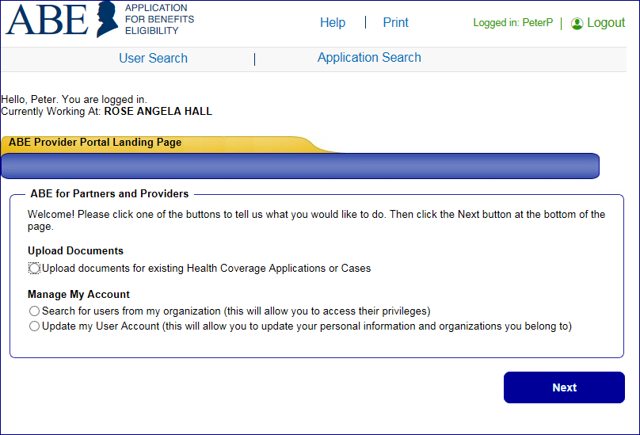
Approving Facility Users
The ASA will use the Manage My Account feature in ABE to approve each ABE user. As an ASA you will see this option that ‘regular users’ do not see in this section. Under Manage My Account select Search for users from my organization. Click [Next]. The Search Criteria page displays.

Slide 40
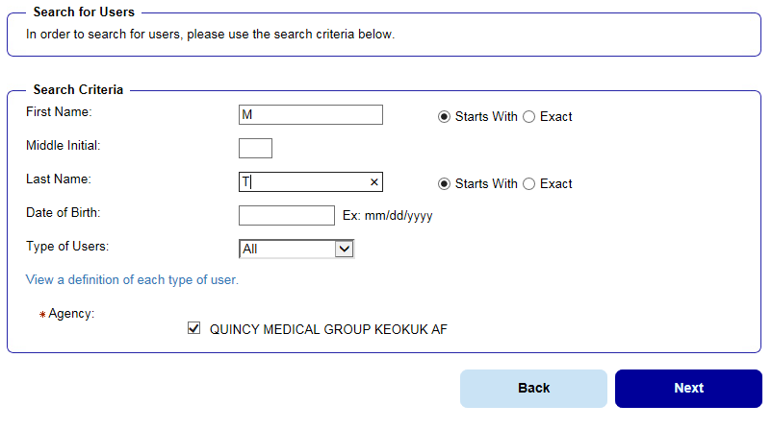
User Search
Search for Users. Enter information for the user. Click [Next]. You do not need to enter full name and birthdate, but the more information entered the fewer user names will display and the quicker your Search Results will come up.

Slide 41
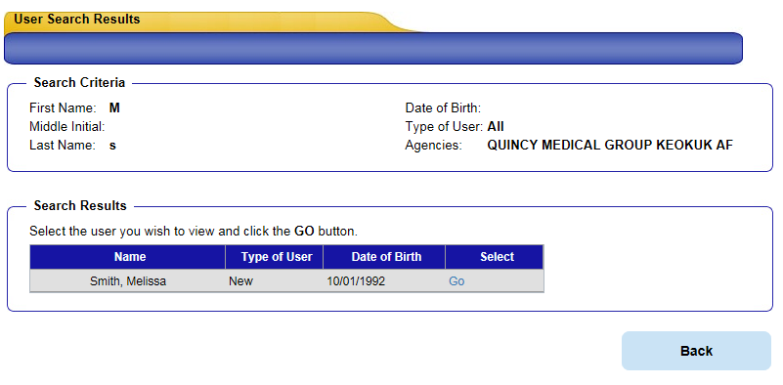
Search Results
Search Results Display. Names that meet the search criteria entered will display. All new staff will display as “New” under Type of User. Click the [Go] button next to the user’s name in the list to change Type of User.

Slide 42
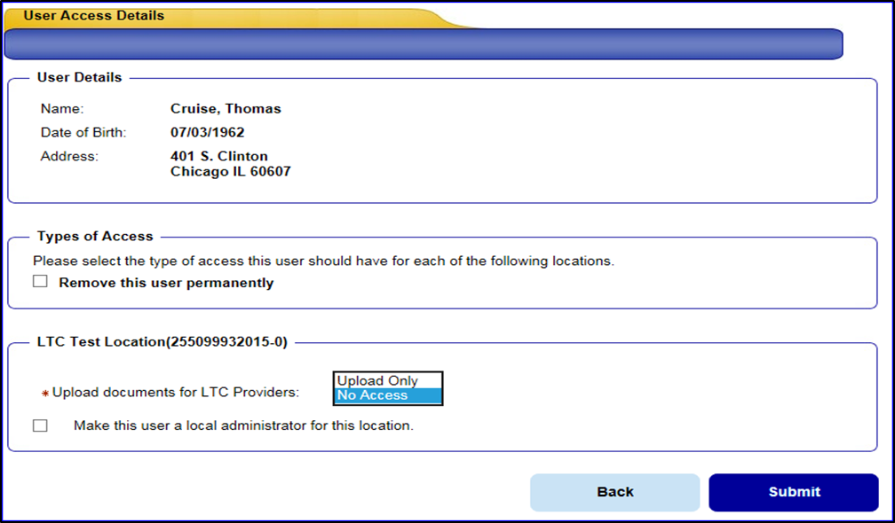
User Access Details
The User Access Detail screen displays. When the User Access Details page displays, the default of [No Access] will display for a new user. Select the Upload Only option in the bottom box. You may also choose to make this person an Administrator by checking the box on the bottom left.
Click [Submit]. [If the staff member leaves the organization, be sure to revisit this section and change the user’s profile to Remove this user permanently.

Slide 43
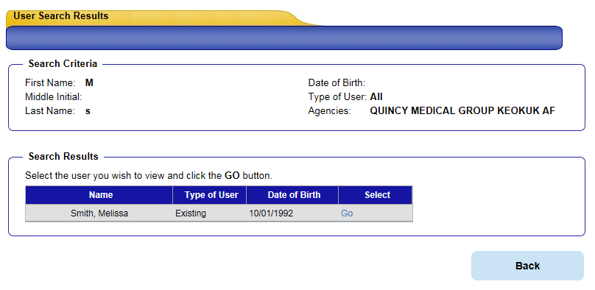
Updated User Type
Updated User Type is Displayed. You will not get a confirmation message, but the User will now display as an existing user on their User Access Details screen. Any time you need to change the Users access you will select the [Go] button for the chosen User.

Slide 44
Thank You!
The staff member is now able to login and use ABE to submit applications/enrollments/birth reports or documents depending on their user type.
Make sure that a ABE Partner Portal Registration Form 1706P has been submitted to the ASA for every ABE user at your agency/facility/organization.
It is the responsibility of the Primary ASA to maintain an accurate user list and keep copies of each user’s Registration Form and Identity Verification (picture ID) on file at your agency.
If you have any questions about using ABE, please e-mail them to HFS.ABEPartnerPortal@Illinois.gov
**Remember to keep HFS informed of any Primary ASA changes at your organization!

