Slide 1

The Application for Benefits Eligibility
The ABE Partner Portal
An Introduction for Hospitals Illinois Department of Healthcare & Family Services (HFS) Illinois Department of Human Services (DHS)
November 2019
Notes:
Hi Everyone, I’m Margaret Dunne with the Illinois Department of Healthcare and Family Services. Today I am going to review the ABE Partner Portal and new functionality available to Hospitals through ABE

Slide 2

Agenda
This Presentation will review:
  Introductory review of ABE, the ABE Partner Portal and the new Report of Birth (ROB) Hospital function in ABE(Phase I)
  ROB Phase II functions (coming soon!)

Slide 3
SECTION I
THE ABE PARTNER PORTAL and REPORT of BIRTH PHASE I

Slide 4


The Integrated Eligibility System(IES) encompasses both the customer facing and worker facing portals
ABE
Customer Portal
Partner Portal
IES
Caseworker Portal
Information that customers and Providers
enter in ABE applications and Manage My
Case (MMC), pre-populates the caseworker’s Data Collection pages in IES.
Important customer information like notices and other benefits details are sent from IES
to ABE MMC.
Notes:
Interface with each other and pass information back and forth

Slide 5
ABE and the Partner Portal
ABE, the Application for Benefits Eligibility, is the State of Illinois’ web-based portal for applying for, accessing and managing health coverage, SNAP and cash benefits, and the Medicare Savings Program (MSP).
The Partner Portal within ABE allows certain Medicaid Providers the ability to complete specific tasks or functions
Hospitals enrolled in IMPACT, (coded as Provider Type 030 – Hospital), can now use the ABE Partner Portal to submit a Report of Birth for babies born to mothers on IL Medicaid or “Deemed Newborns”.
Following this training, if you should encounter problems using ABE, please contact your organization’s ABE Agency Security Administrator(ASAs). More about ASAs in a minute!
Notes:
May, or may not be familiar with and have used ABE already
For the purposes of this presentation we will be talking specifically about new functionalities for hospitals
Because of the large number of hospitals and other agencies that currently use and will be using ABE, we’d like to keep one point of contact per agency

Slide 6
Partner Portal Registration Requirements
Your organization/agency/hospital (these terms are used interchangeably and refer to both one facility agencies and organizations that include multiple facilities) must have a Medicaid Provider ID number. You will need this number to register in the Portal. This number, also listed as “Provider Key”, can be found in the upper left hand corner of your HFS Provider Information Sheet.
For information on how to register as a Medicaid provider visit hfs.illinois.gov and click on Medical Provider s – IMPACT Provider Enrollment.
Each Agency must identify one employee who will act as the Primary Agency Security Administrator (ASA) for the purpose of managing agency staff that will use the ABE Partner Portal.
Contractors may not be the Primary ASAs for a hospital, however the hospital Primary ASA may designate someone at the contractual agency as a secondary ASA.
Prior to leaving an agency/hospital, the Primary ASA must submit a request to have Partner Portal access deactivated and submit registration for a new Primary ASA.
Notes:
Who can use the Partner Portal? Agencies that are registered as: Medical Presumptive Eligibility Providers, All Kids Application Providers, or Hopsital Providers can use the Partner Portal, however, only entities with a HOSPITAL ID will be able to use the new, Report of Birth functionality!
ASA – Giving and taking away! Point of contact
The ASA is the “Gatekeeper” for the Partner Portal for their Agency

Slide 7
Primary ASA Tasks and Responsibilities
The Primary ASA:
  Acts as the HFS point of contact for ABE Partner Portal participation
  Is responsible for giving and taking away ABE Partner Portal access for all agency staff
  Must keep an accurate record of all Partner Portal users
  Maintains 1706Ps and documents confirming a user’s identity for all ABE Partner Portal users
  Attests that they are approved by their organization to serve as the ASA
  May designate up to four additional individuals to serve as secondary ASAs.
If you wish to be approved as the Primary ASA for multiple hospitals you must complete one registration for each hospital
After the designated Primary ASA submits their registration, the submitted information will be reviewed by HFS Business Office Personnel and once approved, passed to the HFS Global Security Administrator to grant system access to the ABE Partner Portal.

Slide 8
Babies by the Numbers!
Reviewing the scope of the work in Illinois:
  In 2017 (most recent stats) there were 149,390 births in Illinois*
  In the same year 44% of births in Illinois were financed by Medicaid**
  Breaking this down, we can approximate that there were 65,730 Medicaid births in 2017 for a monthly rounded up average of 5500.
  In 2019/2020 we can expect comparable numbers as Medicaid enrollment and birthrates have remained fairly static over the past few years in IL
  Reviewing October data, we captured 1988 births for an approximate 36 % of Medicaid eligible newborns through the hospital Report of Birth function in ABE.
  We can do better!
  *Kaiser Family Foundation, Illinois Department of Public Health
  ** Kaiser Family Foundation

Slide 9
Important Points to Remember:
More submissions do not equal more coverage!
  Newborns can only be added to ACTIVE cases. The hospital must check MEDI before using ROB!
  Newborns cannot be added to an MPE case – this is a temporary case.
  ROB cannot be used for DOC and DCFS cases or for mothers living in a facility
  Until search function is Live in Phase II, hospital co-workers need to check to make sure they are not duplicating reports! If two reports are submitted this could cause both reports to exception out.
  If the case is certified, the newborn is added to any active benefits/EDGs on Mom’s case. If Mom is getting TANF and Medicaid at the time of the birth, the baby will be added. If Mom will newly qualify for SNAP or TANF, she must complete an application through the FCRC or apply for the benefit through the Manage My Case (MMC)function in ABE.
  ‘Case unknown’ accounts for 60-80% of exceptions on any given day. This represents those cases where the mother of the baby is either not recognized by our system, or is eligible and certified for a program now, but wasn’t eligible or certified for a program when the baby was born.

Slide 10
Setting up your ABE Partner Portal Account
From the ABE Homepage (ABE.Illinois.gov), choose the ABE Partner Login link. You will use this link each time you return to ABE. Do NOT use the Login button in the upper right corner of the homepage.
Notes:
Top login is for customers applying for benefits!

Slide 11

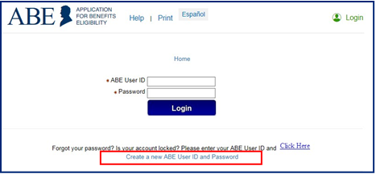
Setting up an Account , cont’d
Click the, [Create a new ABE User ID and Password] link at the bottom of the screen.

Slide 12
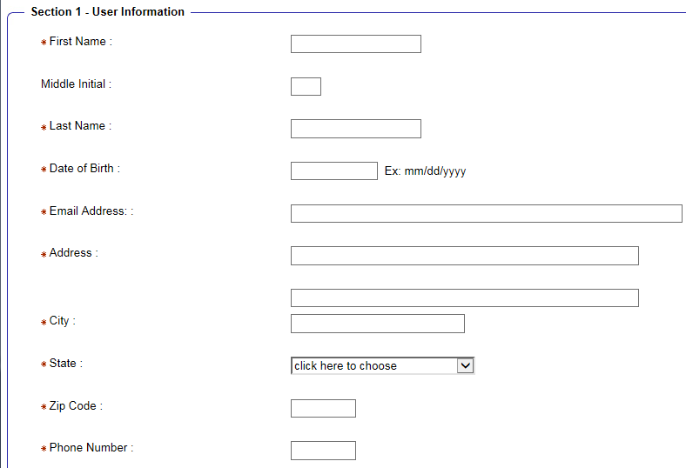
Section 1: User Information
Enter information about yourself and your organization type. Email entered should be your work email! This increases the security of your account and DHS/HFS Data.
Notes:
Responsibility of the ASA to ‘take away’ privileges!
Using work email prevents individuals from accessing the functionality once they have left an organization – 2nd layer of security.

Slide 13
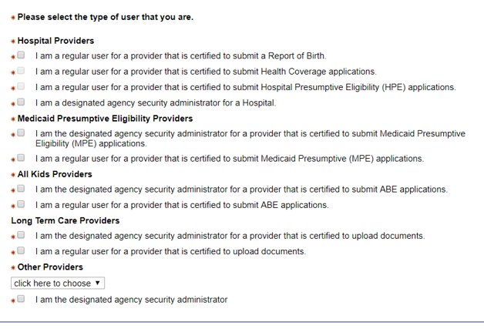
User Information, cont’d
Type of User:
  A regular user for a provider certified to submit a Report of Birth (everyone).
  A designated Agency Security Administrator (ASA) –ASAs must select BOTH categories. The first ASA to register is considered the “Primary ASA” and will be responsible for carrying out the ASA tasks and responsibilities.
Notes:
ALL ASAs must choose both!

Slide 14

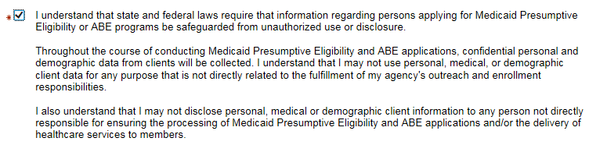
Important Information!
As part of Partner Portal account creation you must check this box. Be careful to read and understand this requirement.

Slide 15
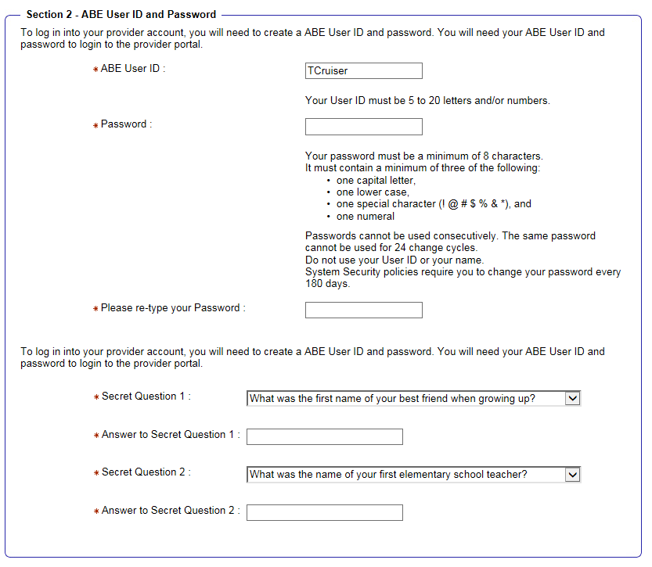
Section 2: Provider User ID and Password
Create a personal ABE User ID and Password that you will use to login to ABE on an ongoing basis. The secret questions and responses you choose will be used as a security check if you need to recover or change your password. User IDs CANNOT be recovered.
You will be prompted to change your ABE password every 6 months.
It is important to write down the answers to your security questions and store them in a secure location. Passwords cannot be reset without correct answers. If you are not able to reset your password, you will need to go through the Account creation process again. Accounts are “locked” after 3 unsuccessful password attempts. This lock last for 60 minutes.
Notes:
User IDs cannot be recovered if forgotten!
Passwords can only be reset if you know the answers to your secret questions! HFS cannot reset accounts or tell you what your password or ID is!

Slide 16
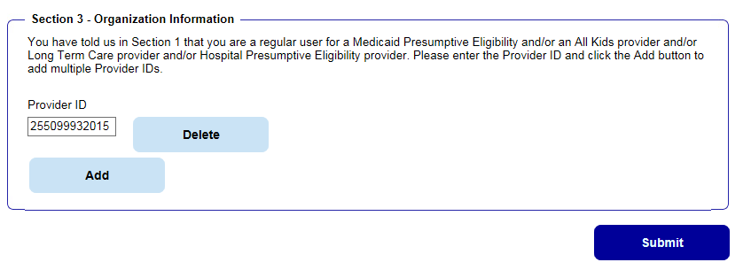
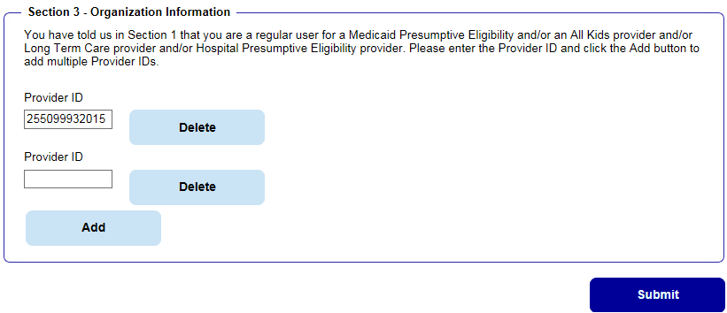
Section 3: Organization Information
Once you enter your ABE user type and create a User ID and Password, Section 3 will display.
Enter your Organization’s State of Illinois Medicaid Provider ID Number. Click [Submit]. If you do not know your HFS Provider ID, contact your office administrator or billing office. If you have checked regular user and ASA, two boxes will display – enter Provider Number in FIRST box only before clicking [Submit]
Tip: If you need to add multiple Provider IDs because you work at more than one hospital location, add them before entering your password and security questions. As a security measure, ABE wipes out these responses when the page is refreshed.
Notes:
ASA – only put number in first box!
You may add more boxes if you are working at multiple hospitals Click add to display more Provider ID fields
Simply hit delete if you mistakenly added a box

Slide 17

Account Confirmation
Once all required fields are complete, click [Submit].
If you are the Primary Agency Security Administrator, after creating your account you must go to ABE ASA Request SharePoint and enter your ABE account information as well as your organization’s information. Your ASA request will be reviewed by the HFS business and security offices before approval. You must be approved and granted access before you can approve others in your organization to use the portal.
All other users should submit the ABE Registration Form 1706P to the organization’s Primary ASA for review and record keeping. The 1706P can be found under the Medical Providers tab on the Medical Forms page under Providers, labeled Application for Benefits Eligibility (ABE) (pdf) on the HFS Website.
After review, the Primary ASA will approve and grant Partner Portal access to the remaining users.
Once granted access users are ready to begin using the Partner Portal.
Notes:
These are working links, however you can also find on the Forms page

Slide 18
Knowledge Check:
What does ABE stand for?
  Abraham Lincoln Benefits Exchange
  All Benefits Eligibility
  Application for Benefits Eligibility
Can any Provider use the ABE Partner Portal?
Can all Medicaid births be reported in the Partner Portal?
If I forget my User ID or password can the state reset my account?
Notes:
A User account will “lock” after several incorrect password attempts. This lock out lasts for 60 minutes – HFS cannot “unlock” your account!

Slide 19
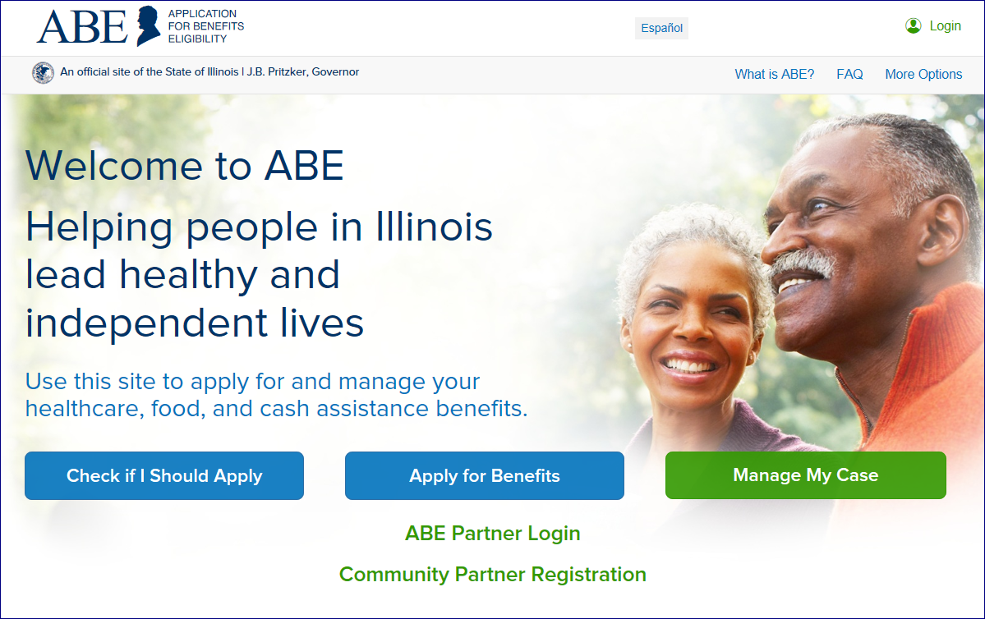
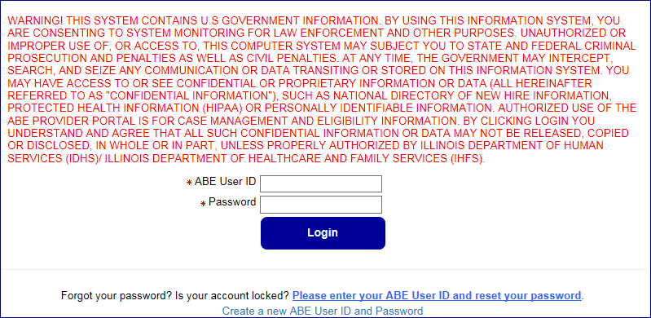
Using the Partner Portal to Report Births

Slide 20
Multifactor Authentication (MFA) Process
For security purposes, we are required to validate a user’s identity each time they log-in to the ABE Partner Portal. ABE does this through a process called multi-factor or two factor authentication.
E-mail Activation
The first time you log into the ABE Partner Portal, you will be asked to register your e-mail address. You must enter the e-mail address you used when setting up your ABE User Profile and one you can access when working in the Partner Portal. Because of this additional security measure, the email used should be your work email. Click [Register].
Notes:
Multi-factor authentication is a process in which a code must be entered to log into a system. Only the registered email can get the code
adds a layer of security – required by federal regulations
First time only e-mail activation.
Email used when setting up your account

Slide 21
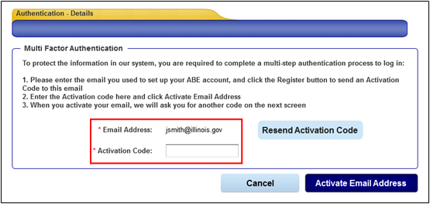
Email Activation
  An Activation Code will be sent to the e-mail address. Enter the code in the space provided and click [Activate Email Address].
If you do not receive the Activation Code, check your Junk or Spam folder. If the Activation Code is not received after 10 minutes (it usually arrive within a minute), click [Resend Activation Code] to generate a new code.
You will only need to activate your e-mail address once (unless your email changes).
If you no longer use or have access to the e-mail address associated with your ABE User Profile, you will need to contact your Agency Security Administrator to have your profile updated with your new e-mail address or you must set up a new ABE User Account with a valid e-mail address.
Notes:
In my experience the code is sent pretty quickly, however, there are days when the system is slower

Slide 22
Access Authentication
Once your e-mail is activated, an Access Code will be sent to that e-mail address. Enter this code in the space provided. Click [Next] and the Provider Portal Landing page displays.
ABE will send an Access Code to the registered, activated e-mail each time you log into the ABE Partner Portal. The code must be entered on the Authentication Access Code page to reach the Partner Portal Landing page.
Notes:
Access Authentication every time!

Slide 23
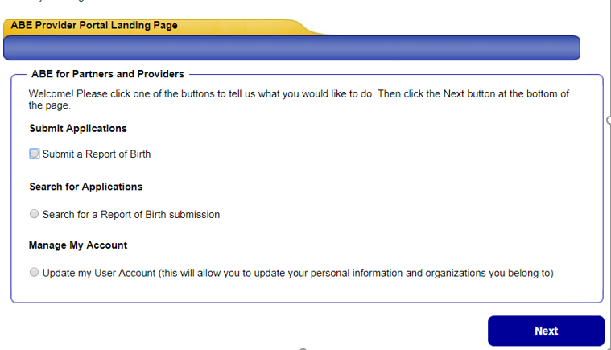
Provider Portal Landing Page
After logging in to the ABE Partner Portal, completing MFA, and choosing your work location (if you have multiple locations) the Partner Portal Landing Page will display.
Select, “Submit a Report of Birth” [Next].
You will choose the “Manage My Account” selection if you need to update your user profile including adding or changing a location, or changing an e-mail.
Notes:
This screen may look different depending on your hospitals functionality in the portal in the future

Slide 24
CHECK MEDI FIRST!
Before using the Report of Birth function in ABE, check MEDI or whatever eligibility application/website you access to make sure the Mother has active coverage!
    For more information on MEDI go to the MEDI Getting Started page
If Mother does not show active for medical coverage in MEDI, do not submit a Report of Birth, instead help Mother apply for benefits with the newborn through ABE.Illinois.gov
Notes:
MEDI (HFS Medical Electronic Data Interchange) or whatever application/site you use to check eligibility. Eligible medical coverage includes; Moms and Babies, All Kids Assist, FamilyCare, Widow(er), AABD Medical, AABD Spenddown, ACA Adult, Former Foster Care

Slide 25
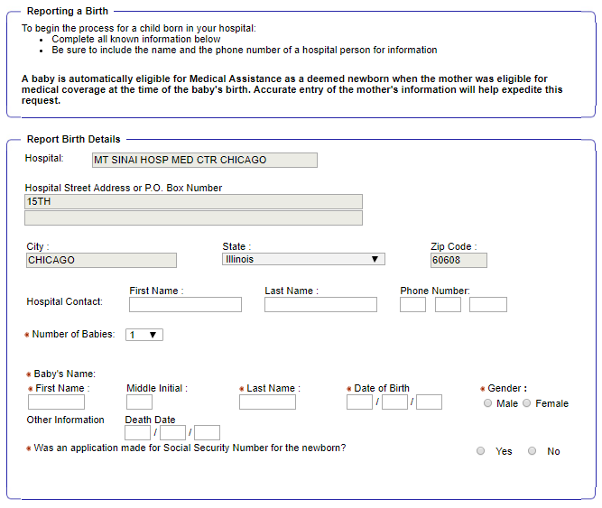
Report of Birth Screen
Hospital Name and Address will be prefilled based on your Account information. Complete babies information next. All fields with a red * must be filled. Don’t forget to add contact information for the hospital representative completing this report.
Notes:
Hospital information is prefilled matching your Provider ID information – why it is important to chose location correctly!
Babies information first

Slide 26
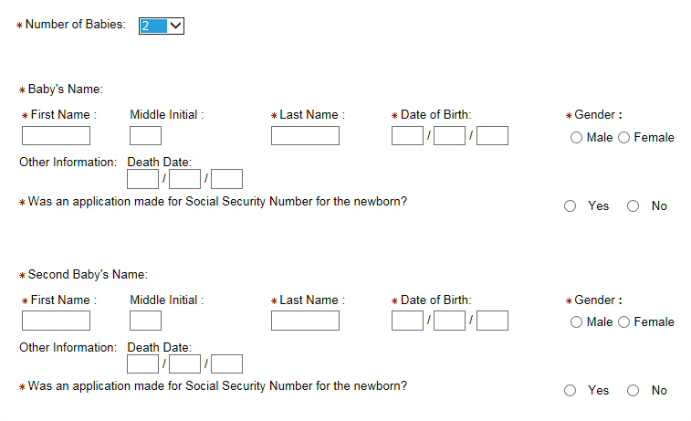
Multiple Births
If you choose a number greater than 1 in the Number of Babies field, a corresponding number of entries for baby’s information will display.
Important! DO NOT enter suffixes (for example Jr.) in the last name field! This will prevent a match and the Newborn will not be added nor assigned a RIN. Instead the request is sent to a Queue in the local office for a worker to process. This, in turn, means the addition of the newborn to the Mothers medical coverage will be delayed. We will be adding an extra field in the ABE Report of Birth screen as soon as possible to address this problem.
Notes:
Can now have up to 5 births!

Slide 27
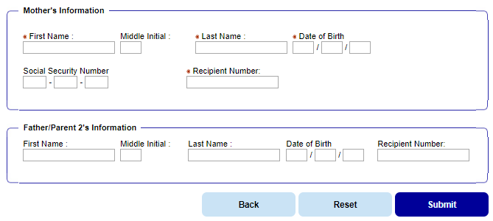
Report of Birth – Parent (s)
Mother’s Information is mandatory since baby is added to mother’s case; you must also know the Recipient Number for the Mother. The Father’s information is optional although helpful if known. Click, [Submit]. It is CRITICAL that you enter information correctly(NO SUFFIX)! Check and recheck before submitting this information. DO NOT resubmit if you discover you have submitted incorrect information, instead, send an email to: DHS.NBU@Illinois.gov with Mothers Name, DOB and RIN, correct information for the newborn, and a contact name in case there are questions.

Slide 28

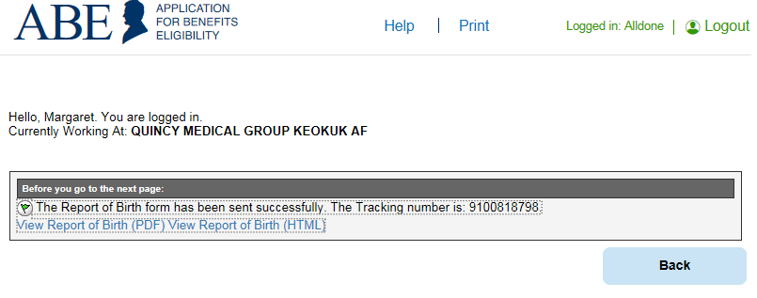
Confirmation Page
The confirmation page is your proof that the Report of Birth was transmitted successfully. You can use the [Print] key to save for your/your patients records. Click [View Report of Birth(PDF)] or [View Report of Birth (HTML)]. A summary of the information and date submitted will display in a printable format. Save both items for your records.

Slide 29
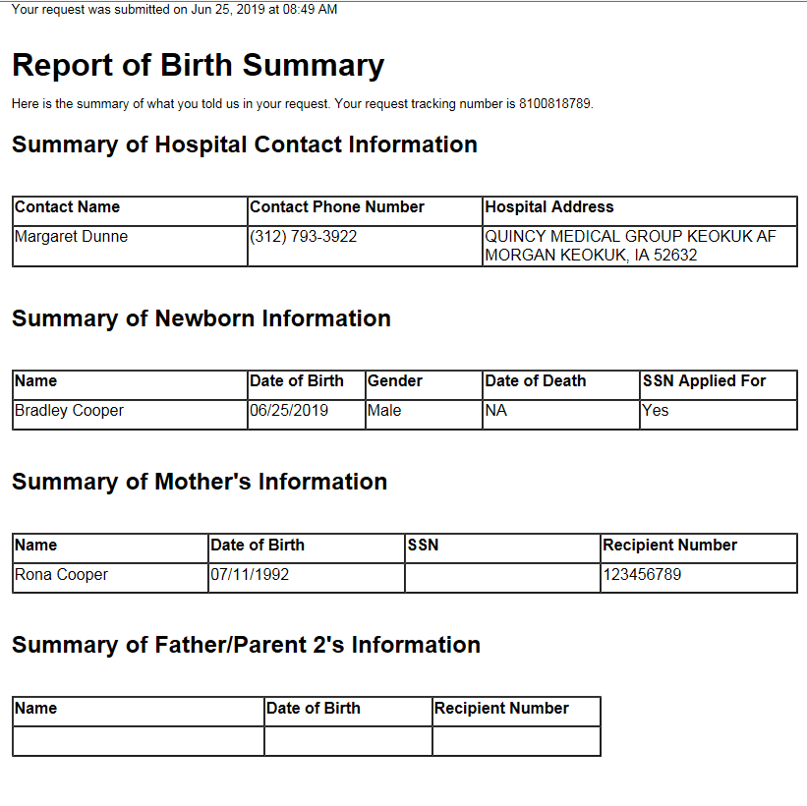
We cannot emphasis enough the importance of entering information correctly and NOT creating multiple submissions for the same newborn. This will cause many problems for HFS . If we find that a Hospital does this repeatedly, the Hospital may not be allowed to use the Report of Birth functionality.
Notes:
Potentially creating multiple IDs for same individual – billing issues, etc…

Slide 30
Frequently Asked Questions
If a baby transfers to another hospital without being reported/added to Moms case, can the new hospital complete and submit the Report of Birth?
  If a Report of Birth has not been submitted, the non-birth hospital can complete and submit the Report of Birth.
What is the age cutoff for using the Report of Birth? For example, if we see an eligible 6-month-old at our hospital without coverage, can we complete the Report of Birth?
  A Report of Birth can be submitted by a hospital provider for a baby up to 13 months of age, counting by whole months. For example, if a baby is born in July, they can be reported using this functionality until the end of the following July.
How quickly will the state add newborns to moms' case?
  If the baby is matched to Mother’s case successfully, the case addition and RIN generation will be immediate. However, it will take 48 (business) hours for the RIN and coverage to migrate to MMIS.
Will this work if the mother has QMB/Dual Medicaid?
  The Report of Birth function can be used for QMB/Dual Medicaid recipients.

Slide 31
FAQs - Continued
How will I know whether the baby has been successfully added to the case?
  Currently, in Phase I of Report of Birth, there is no way to determine if the baby was successfully added to the case. You can check MEDI/MMIS in 48 (business) hours to see if a RIN has been generated. If the auto-certification was not successful, the Report of Birth is sent to a worker queue for eligibility review and processing. The family will need to follow up with the FCRC.
Is the process the same if mother has an MCO such as Meridian, Illinicare, etc.?
  Yes
If a Partner Portal user has an existing account (AKAA, MPE, Community Worker) can they add their hospital’s provider ID to their existing account or must they set up a new hospital account?
  If you have an existing MPE account, you cannot add a Hospital Provider ID and functionality to that account. To use Hospital functions in ABE (currently only Report of Birth) you will have to set up a new, separate account with your Hospital Provider ID. For new ABE Portal users, if you are a hospital completing MPE Applications you will need to create two separate MPE and Hospital accounts.

Slide 32
More FAQs
Can the same person be the Primary Agency Security Administrator for multiple Hospitals?
  If each Hospital Provider approves you, you can be Primary ASA for multiple hospitals.
Can I submit a single 1706P for multiple hospitals or do I need to submit one for each hospital?
  Please submit one form per hospital.
If a hospital has a vendor doing Applications, will they be able to complete these Birth Reports as well?
  Hospital vendors/sub-contractors may use the Report of Birth function with the hospital’s permission, using each Hospital’s Provider ID and not the vendor’s Medicaid provider number. The worker will create one account with multiple Provider ID numbers listed, one for each hospital. When the Vendor logs in to ABE they will choose the location where they are working that day, so the child is tied to the hospital in which they are born.
Will other types of facilities/Partner Portal users be able to use the Report of Birth function in the future?
  At this point in time there are no plans to expand usage of the Report of Birth functionality to other Prover types

Slide 33
Knowledge Check
Can you report a birth if you do not know the Mother’s RIN or birth date?
Can I add “Junior” or “Third” to a baby or parent’s name?
If you make a mistake you should resubmit a report of birth with correct information?
  Yes
  No
Can you use your personal email when creating your Partner Portal account?

Slide 34
Report of Birth/Hospital Resources
ABE Partner Portal and Report of Birth Problems and Questions HFS.ABEpartnerportal@Illinois.gov
To be approved as the ASA for your hospital go to: ABE ASA Request SharePoint
Slide Deck, Q&A and all other materials will be available on the HFS Hospitals and Institutional Providers page.
The 1706P Form can be found on the HFS Medical Forms page under Providers, labeled Application for Benefits Eligibility (ABE) (pdf)
How do I know if my Hospital has already assigned a Primary ASA? Check with your hospital administration/billing office or send the question to HFS.ABEPartnerPortal@illinois.gov

Slide 35
SECTION II
REPORT OF BIRTH PHASE II

Slide 36
Phase II Report of Birth
In ROB Phase II, expected to Go-Live late in 2019, the following additional functionality will be added:
  If a Report of Birth is successfully certified, a Recipient Identification Number (RIN) will be returned to the hospital Partner Portal user immediately in ABE. The RIN is considered PHI.
  The hospital user will be able to view the status of their submissions (Submitted, In Progress, Completed or Invalid)
  The hospital user will be able to search to see if a Report of Birth has already been submitted for a newborn by other hospital staff (can only see reports from their hospital).
  The ASA will be able to view all submissions by users from their hospital.
  The case RPY will be able to use the same Report of Birth function in Manage My Case (MMC) and the baby will be auto-certified for any benefit the Mother is receiving at the time of birth(same rules apply as those for hospitals!). A RIN will be generated immediately if the case is certified. Remember, Mom must have an active medical case for this functionality to work. For staff working with mothers, if you have access to MEDI check coverage first!
  New functionality in Phase II includes both PII (search function) and PHI!

Slide 37
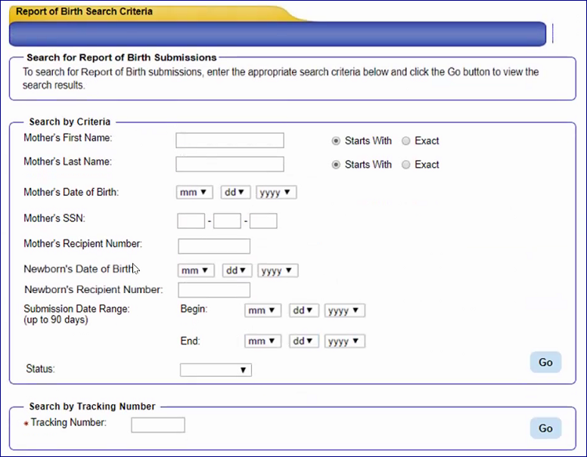
ROB Phase II Search Screen
Notes:
Since you will be able to search for ALL submissions from your hospital and not only those you submitted and information will be displayed in the summary – this represents information you did not previously have, including SSNs, this represents PHI and PII .

Slide 38
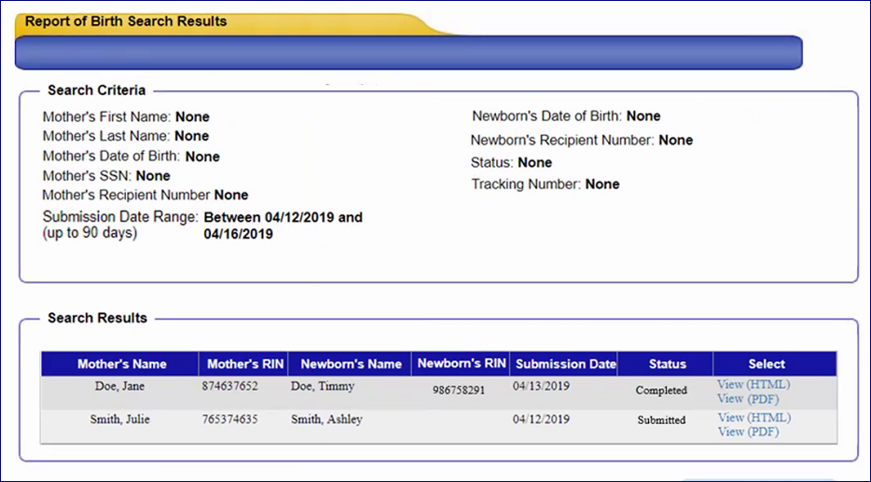
Search Results Screen
A User can enter very broad search queries for comprehensive organization data or specific information when looking for a single individual. If the status shows as completed, a RIN will be displayed.
Notes:
Can view same summary that is available when you submit the report

Slide 39
Status Syncing Examples
Scenario | Status Displayed in Provider Portal | Newborn’s RIN Displayed
User submits Report of Birth/Newborn Add and the submission has not been successfully processed in IES. This includes: If the submission encounters an exception and does not make it to IES. If the job encounters a technical exception and does not process the submission. | Submitted | No
Submission is processed successfully and the newborn is added to data collection. At least one valid newborn on the submission has not been certified yet. | In Progress | No
The newborn has been successfully added and all valid newborns on the submission have been certified either by batch or online after the case appeared on the MUE100 report. | Completed | Yes
Record has a business exception and creates a Newborn Exception task. The task has not been completed yet. At least one valid newborn on the submission has not been certified yet. | In Progress | No
The Newborn Exception task has been processed and closed and, if resolution was ‘Manual Addition’ or ‘Death’, all valid newborns have been manually added by the case worker and certified. | Completed | Yes
The Newborn Exception task has been processed and closed. The submission was invalid, and the newborn was not able to be added. | Invalid | No
Notes:
Some examples on what happens in the system with the data and the results seen in the Partner Portal

Slide 40
Users questions or requests for assistance can be sent to HFS.ABEPartnerPortal@Illinois.gov

